Slide 1
Dual Link Manipulator
Joint Control

Slide 2
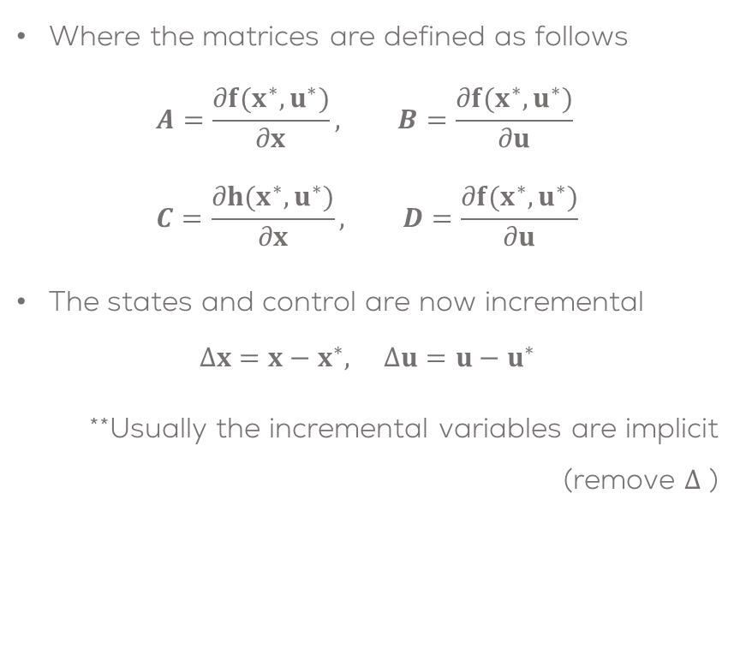
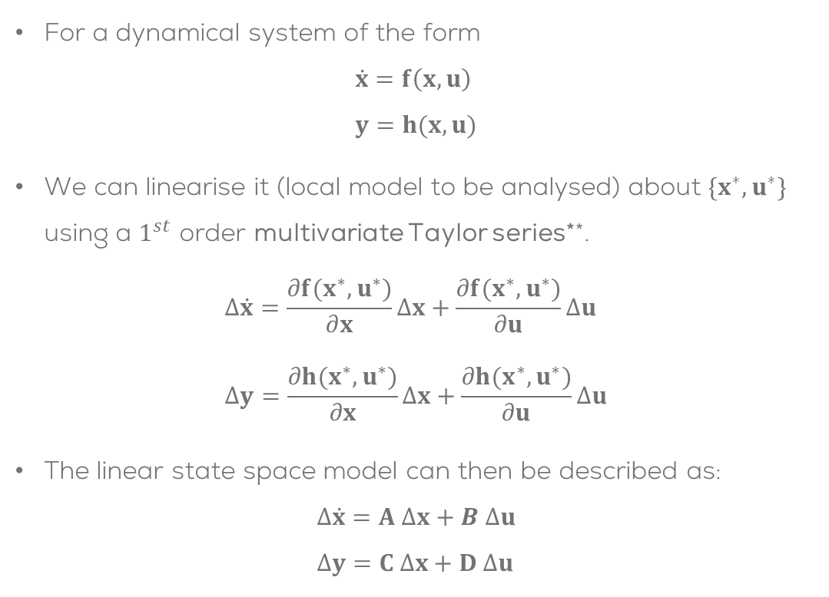
Linearisation of a State Space System
For a dynamical system of the form
$$\dot{x}=f\left(x,u\right) \\ y=h(x,u)$$
We can linearise it (local model to be analysed) about $\{x^{∗},u^{∗}\}$ using a $1^{st}$ order multivariate Taylor series**.
$$Δ\dot{x}=\frac{∂f(x^{∗},u^{∗})}{∂x}Δx+\frac{∂f(x^{∗},u^{∗})}{∂u}Δu \\ Δy=\frac{∂h(x^{∗},u^{∗})}{∂x}Δx+\frac{∂h(x^{∗},u^{∗})}{∂u}Δu$$
The linear state space model can then be described as:
$$Δ\dot{x}=A Δx+B Δu \\ Δy=C Δx+D Δu$$
Where the matrices are defined as follows
$$A=\frac{∂f(x^{∗},u^{∗})}{∂x}, B=\frac{∂f(x^{∗},u^{∗})}{∂u} \\ C=\frac{∂h(x^{∗},u^{∗})}{∂x}, D=\frac{∂f(x^{∗},u^{∗})}{∂u}$$
The states and control are now incremental
$$Δx=x−x^{∗}, Δu=u−u^{∗}$$
**Usually the incremental variables are implicit (remove $Δ$ )
** Named after the mathematician Brook Taylor (1685-1731). This is not related to Taylor Swift nor a TV series about Taylor Swift.

Slide 3

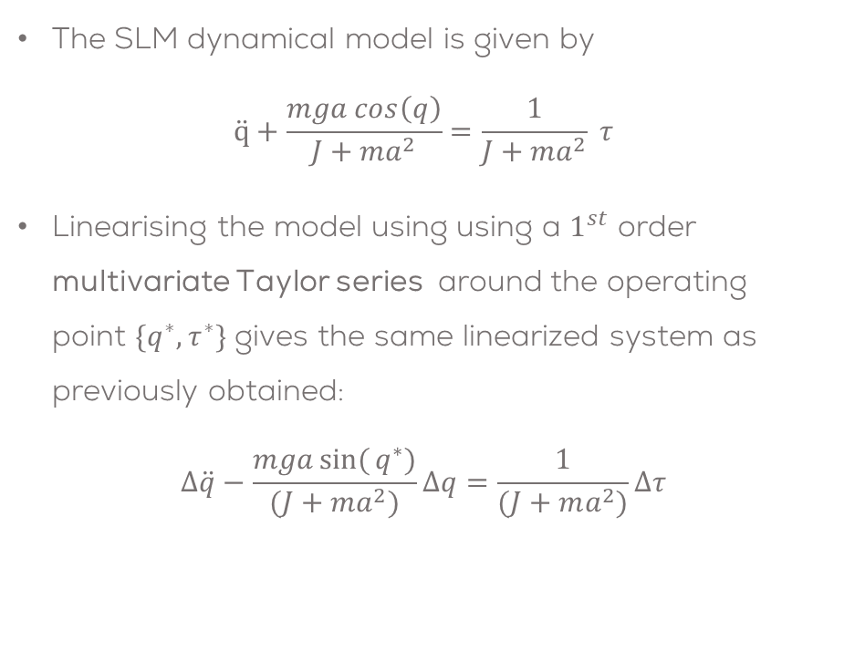
SLM Linearisation Example
The SLM dynamical model is given by
$$\ddot{q}+\frac{mga cos\left(q\right)}{J+ma^{2}}=\frac{1}{J+ma^{2}} τ$$
Linearising the model using using a $1^{st}$ order multivariate Taylor series around the operating point $\{q^{∗},τ^{∗}\}$ gives the same linearized system as previously obtained:
$$Δ\ddot{q}−\frac{mga\sin{(}q^{∗})}{(J+ma^{2})}Δq=\frac{1}{(J+ma^{2})}Δτ$$
This can be expressed in state space form as
$\left[\begin{matrix}Δ\dot{q} \\ Δ\ddot{q}\end{matrix}\right]=\left[\begin{matrix}0 & 1 \\ \frac{mga\sin{(}q∗)}{J+ma^{2}} & 0\end{matrix}\right]\left[\begin{matrix}Δq \\ Δ\dot{q}\end{matrix}\right]+\left[\begin{matrix}0 \\ \frac{1}{J+ma^{2}}\end{matrix}\right]Δτ$

Slide 4
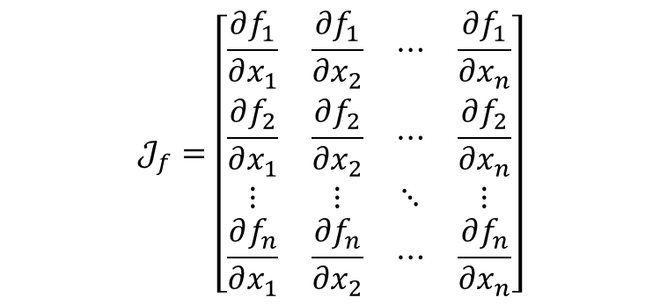

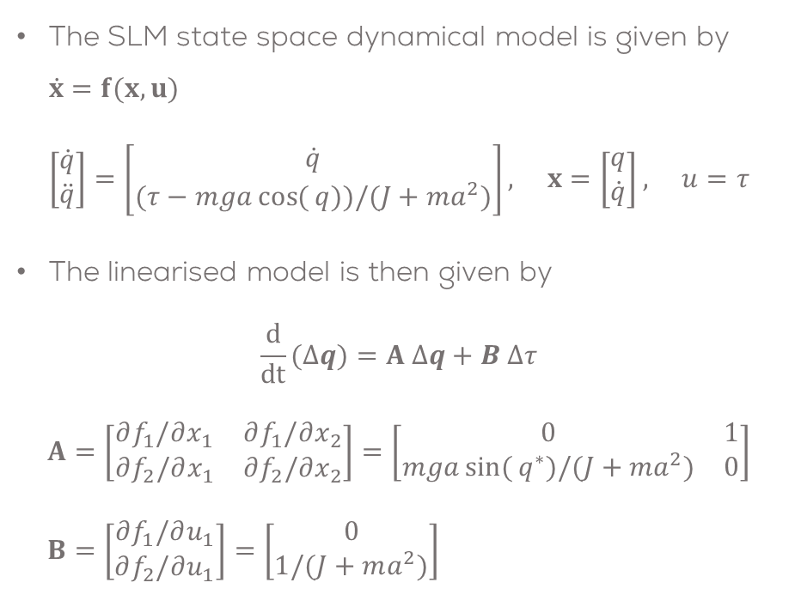
SLM Linearisation Example
The SLM state space dynamical model is given by $\dot{x}=f(x,u)$ $\left[\begin{matrix}\dot{q} \\ \ddot{q}\end{matrix}\right]=\left[\begin{matrix}\dot{q} \\ (τ−mga\cos{(}q))/(J+ma^{2})\end{matrix}\right], x=\left[\begin{matrix}q \\ \dot{q}\end{matrix}\right], u=τ$
The linearised model is then given by $\frac{d}{dt}(Δq)=A Δq+B Δτ$
$$A=\left[\begin{matrix}∂f_{1}/∂x_{1} & ∂f_{1}/∂x_{2} \\ ∂f_{2}/∂x_{1} & ∂f_{2}/∂x_{2}\end{matrix}\right]=\left[\begin{matrix}0 & 1 \\ mga\sin{(}q^{∗})/(J+ma^{2}) & 0\end{matrix}\right] \\ B=\left[\begin{matrix}∂f_{1}/∂u_{1} \\ ∂f_{2}/∂u_{1}\end{matrix}\right]=\left[\begin{matrix}0 \\ 1/(J+ma^{2})\end{matrix}\right]$$
The same equation is obtained using this method.
This is called Jacobian.
Definition (Jacobian): Given a vectorial function $f:ℝ^{n}→ℝ^{n}$, then the Jacobian matrix $𝒥_{f}∈ℝ^{n×n}$ is defined by:

Slide 5
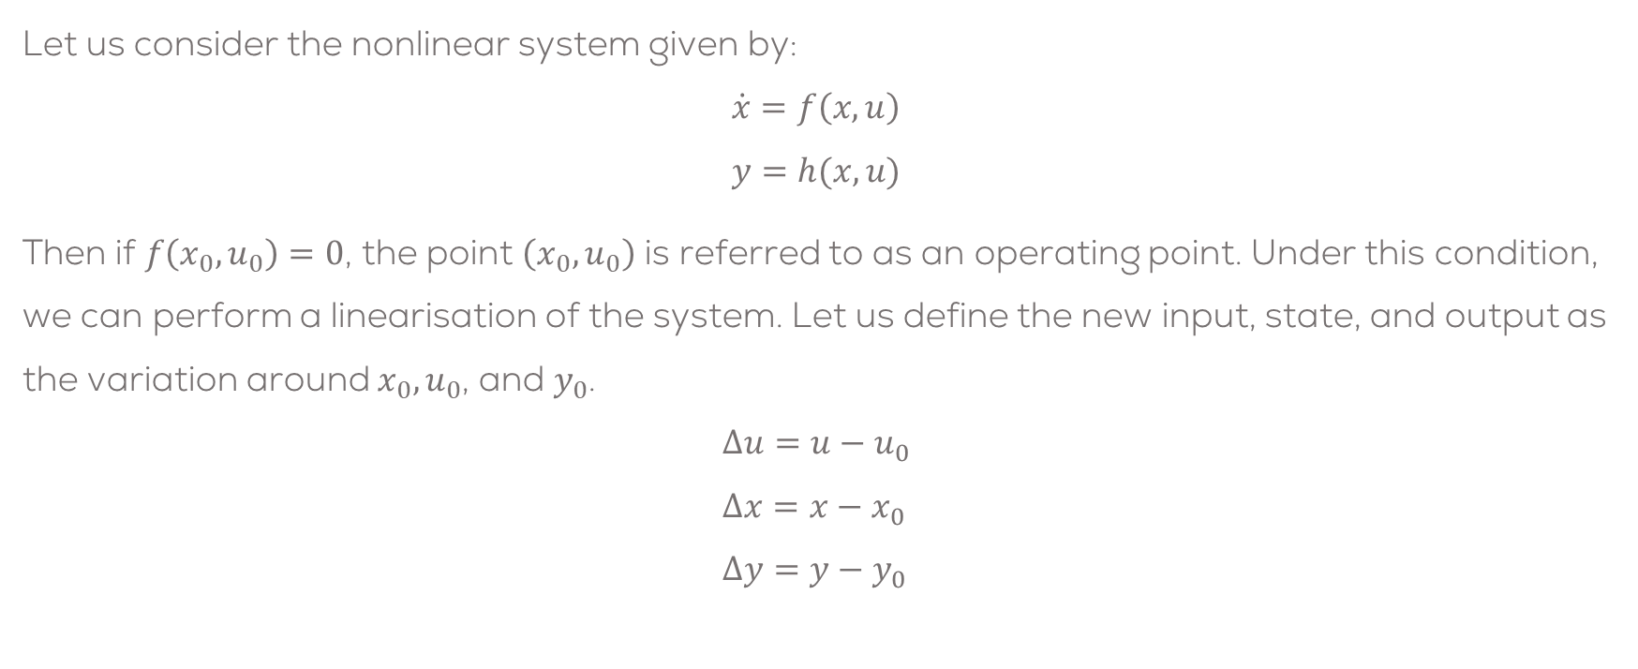
Linearisation around an operating point (generalisation)
Let us consider the nonlinear system given by:
$$\dot{x}=f\left(x,u\right) \\ y=h(x,u)$$
Then if $f\left(x_{0},u_{0}\right)=0$, the point $\left(x_{0},u_{0}\right)$ is referred to as an operating point. Under this condition, we can perform a linearisation of the system. Let us define the new input, state, and output as the variation around $x_{0},u_{0}$, and $y_{0}$.
$$Δu=u−u_{0} \\ Δx=x−x_{0} \\ Δy=y−y_{0}$$

Slide 6

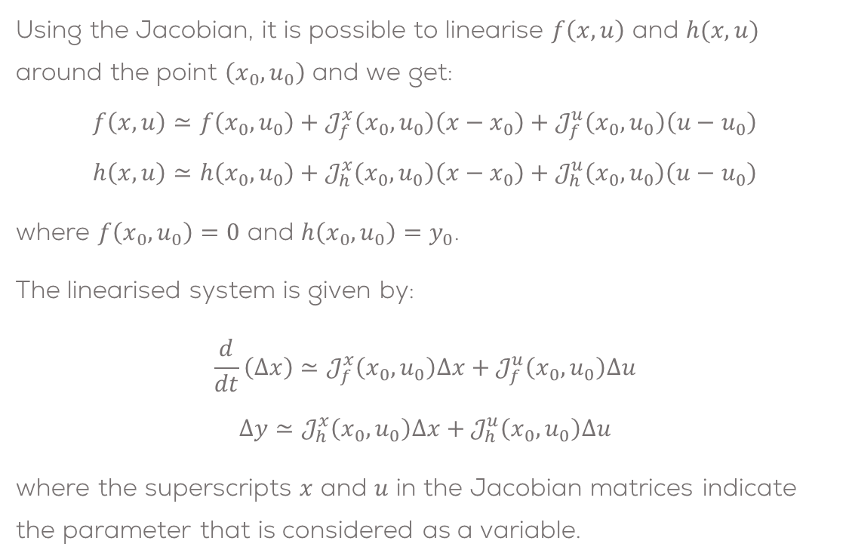
Linearisation around an operating point (generalisation)
Using the Jacobian, it is possible to linearise $f\left(x,u\right)$ and $h(x,u)$ around the point $\left(x_{0},u_{0}\right)$ and we get:
$$f\left(x,u\right)≃f\left(x_{0},u_{0}\right)+𝒥_{f}^{x}\left(x_{0},u_{0}\right)\left(x−x_{0}\right)+𝒥_{f}^{u}\left(x_{0},u_{0}\right)\left(u−u_{0}\right)$$
$$h\left(x,u\right)≃h\left(x_{0},u_{0}\right)+𝒥_{h}^{x}\left(x_{0},u_{0}\right)\left(x−x_{0}\right)+𝒥_{h}^{u}\left(x_{0},u_{0}\right)\left(u−u_{0}\right)$$
where $f\left(x_{0},u_{0}\right)=0$ and $h\left(x_{0},u_{0}\right)=y_{0}$.
The linearised system is given by:
$$\frac{d}{dt}\left(Δx\right)≃𝒥_{f}^{x}\left(x_{0},u_{0}\right)Δx+𝒥_{f}^{u}\left(x_{0},u_{0}\right)Δu$$
$$Δy≃𝒥_{h}^{x}\left(x_{0},u_{0}\right)Δx+𝒥_{h}^{u}\left(x_{0},u_{0}\right)Δu$$
where the superscripts $x$ and $u$ in the Jacobian matrices indicate the parameter that is considered as a variable.
In other words
$$\frac{d}{dt}\left(Δx\right)=A Δx+B Δu \\ y=C Δx+D Δu$$
where
$$A=𝒥_{f}^{x}\left(x_{0},u_{0}\right), B=𝒥_{f}^{u}\left(x_{0},u_{0}\right) \\ C=𝒥_{h}^{x}\left(x_{0},u_{0}\right), D=𝒥_{h}^{u}\left(x_{0},u_{0}\right)$$

Slide 7
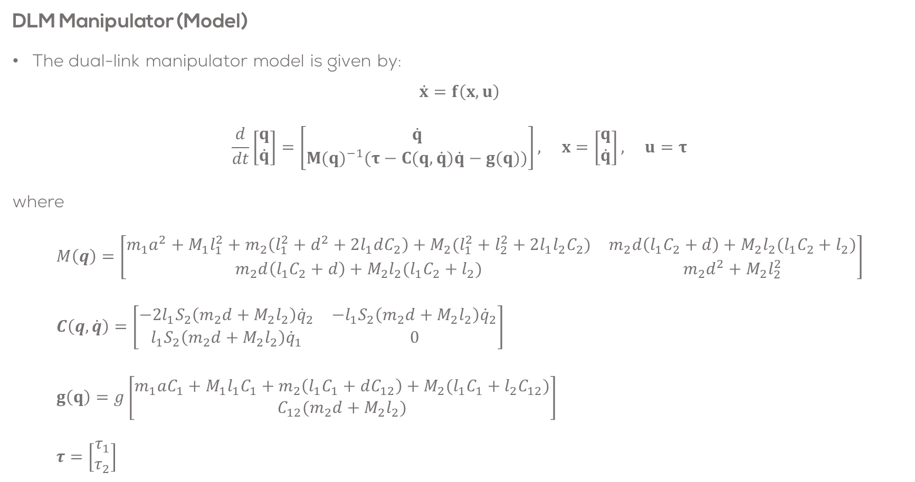
Dual Link Manipulator Model
DLM Manipulator (Model)
The dual-link manipulator model is given by:
$$\dot{x}=f\left(x,u\right)$$
$$\frac{d}{dt}\left[\begin{matrix}q \\ \dot{q}\end{matrix}\right]=\left[\begin{matrix}\dot{q} \\ M(q)^{−1}(τ−C(q,\dot{q})\dot{q}−g(q))\end{matrix}\right], x=\left[\begin{matrix}q \\ \dot{q}\end{matrix}\right], u=τ$$
where
$$M\left(q\right)=\left[\begin{matrix}m_{1}a^{2}+M_{1}l_{1}^{2}+m_{2}\left(l_{1}^{2}+d^{2}+2l_{1}dC_{2}\right)+M_{2}(l_{1}^{2}+l_{2}^{2}+2l_{1}l_{2}C_{2}) & m_{2}d\left(l_{1}C_{2}+d\right)+M_{2}l_{2}(l_{1}C_{2}+l_{2}) \\ m_{2}d\left(l_{1}C_{2}+d\right)+M_{2}l_{2}(l_{1}C_{2}+l_{2}) & m_{2}d^{2}+M_{2}l_{2}^{2}\end{matrix}\right] \\ C\left(q,\dot{q}\right)=\left[\begin{matrix}−2l_{1}S_{2}\left(m_{2}d+M_{2}l_{2}\right){\dot{q}}_{2} & −l_{1}S_{2}\left(m_{2}d+M_{2}l_{2}\right){\dot{q}}_{2} \\ l_{1}S_{2}\left(m_{2}d+M_{2}l_{2}\right){\dot{q}}_{1} & 0\end{matrix}\right] \\ g\left(q\right)=g\left[\begin{matrix}m_{1}aC_{1}+M_{1}l_{1}C_{1}+m_{2}\left(l_{1}C_{1}+dC_{12}\right)+M_{2}(l_{1}C_{1}+l_{2}C_{12}) \\ C_{12}(m_{2}d+M_{2}l_{2})\end{matrix}\right] \\ τ=\left[\begin{matrix}τ_{1} \\ τ_{2}\end{matrix}\right]$$

Slide 8
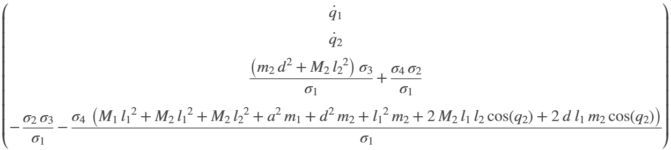


Dual Link Manipulator Model
DLM Manipulator (Model)
Expanding the model in MATLAB:
$\frac{d}{dt}\left[\begin{matrix}q \\ \dot{q}\end{matrix}\right]=$
where

Slide 9
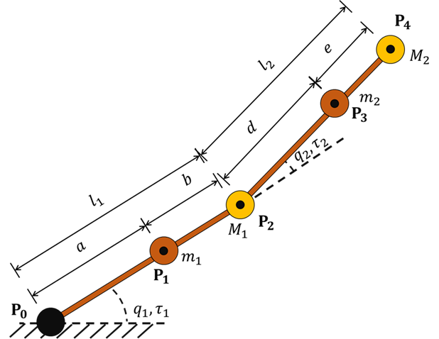

DLM Linearisation Example
Let the parameters of the DLM to be:
$m1=3 kg$
$m2=3 kg$
$M1=1.5 kg$
$M2=1 kg$
$a=0.2 m$
$b=0.2 m$
$d=0.2 m$
$e=0.2 m$
$g=9.8 ms^{−2}$

Slide 10
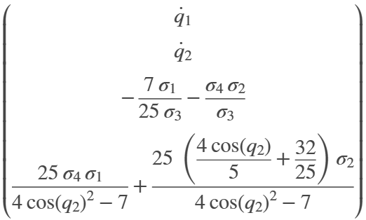




DLM Nonlinear Model
Substituting the values in the model using MATLAB:
$$\frac{d}{dt}\left[\begin{matrix}q_{1} \\ q_{2} \\ {\dot{q}}_{1} \\ {\dot{q}}_{2}\end{matrix}\right]=$$
While the non-linear, state space equations appear complex there are a few observations to make:
The denominator is the determinant of the mass-inertia matrix, always positive and always invertible
where

Slide 11

DLM Linearisation Example
Having obtained the DLM Nonlinear model, it is time now to linearise it around an operating point.
This can be done using the concept of the Jacobian.
In this case, we will use MATLAB symbolic toolbox to make the linearisation easier.

Slide 12
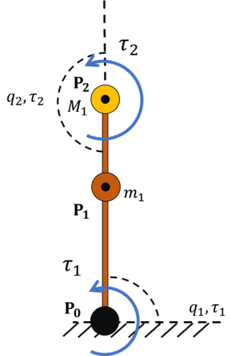
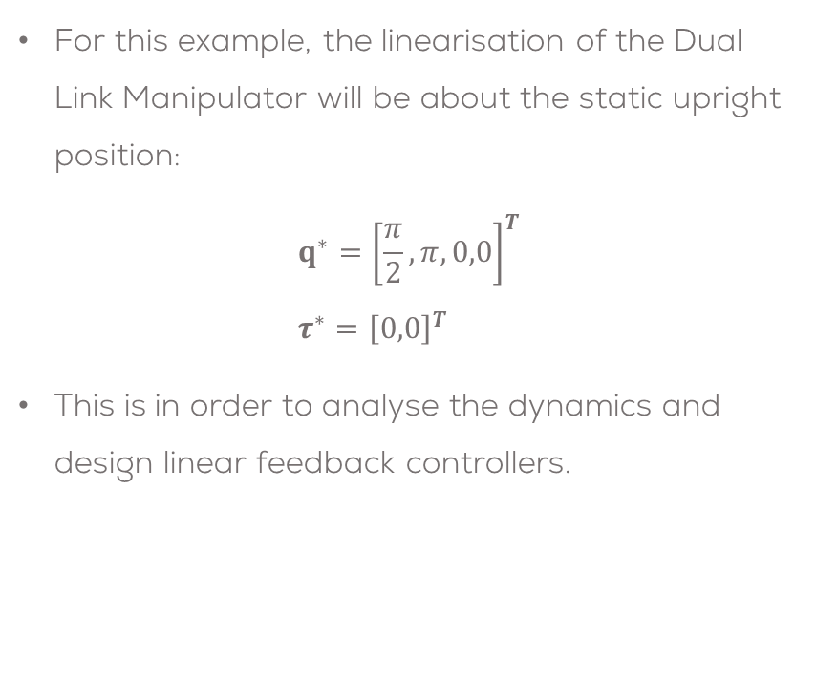
DLM Linearisation Example
For this example, the linearisation of the Dual Link Manipulator will be about the static upright position:
$$q^{∗}={\left[\frac{π}{2},π,0,0\right]}^{T} \\ τ^{∗}={\left[0,0\right]}^{T}$$
This is in order to analyse the dynamics and design linear feedback controllers.

Slide 13

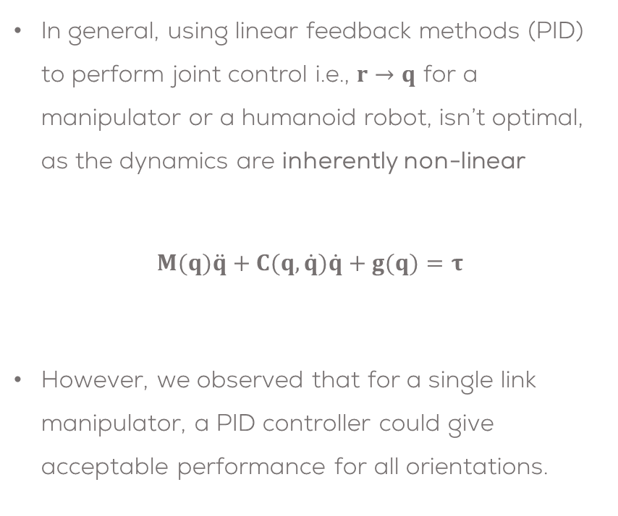
DLM Linearisation Example
In general, using linear feedback methods (PID) to perform joint control i.e., $r→q$ for a manipulator or a humanoid robot, isn’t optimal, as the dynamics are inherently non-linear
$$M(q)\ddot{q}+C(q,\dot{q})\dot{q}+g(q)=τ$$
However, we observed that for a single link manipulator, a PID controller could give acceptable performance for all orientations.

Slide 14
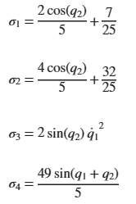
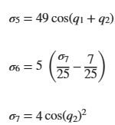


DLM Linearisation Example
The linear system of a DLM will have the following form
$$Δ\dot{q}=A Δq+B Δτ \\ Δy=C Δq+D Δτ$$
Using the Jacobian, to linearise the system and substituting the values we obtain the $A$ Matrix:
$$A(q^{∗},{\dot{q}}^{∗},τ^{∗})=$$
where
Verifying the odd entry is possible
Computer algebra was the right choice …
This is just for two links …

Slide 15
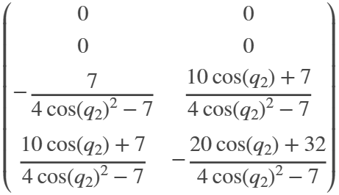


DLM Linearisation Example
The $B$ Matrix is obtained using MATLAB as follows
Only depends on the relative joint angle $q_{2}$, as the lower submatrix is simply the inverse of the mass–inertia matrix
The torque signals enter the state space equations multiplied by the inverse mass/inertia matrix.
The original non-linear dynamics are affine:$\dot{x}=f(x)+g(x)u$
The output of the system is $q_{1}$ and $q_{2}$, therefore the matrix $C$ can be defined as follows
$$C=\left[\begin{matrix}1 & 0 & 0 & 0 \\ 0 & 1 & 0 & 0 \\ 0 & 0 & 0 & 0 \\ 0 & 0 & 0 & 0\end{matrix}\right]$$
$$B(q^{∗})=$$

Slide 16


DLM Linearisation Example
Linearising around the previously defined operating point:
$$q^{∗}={\left[\frac{π}{2},π,0,0\right]}^{T} \\ τ^{∗}={\left[0,0\right]}^{T}$$
The model then becomes (MIMO):
$$Δ\dot{q}=A Δq+B Δτ \\ Δy=C Δq+D Δτ$$
where
$$A=\left[\begin{matrix}0 & 0 & 1 & 0 \\ 0 & 0 & 0 & 1 \\ \frac{784}{25} & −\frac{98}{3} & 0 & 0 \\ −\frac{539}{25} & −49 & 0 & 0\end{matrix}\right]$$
$$B=\left[\begin{matrix}0 & 0 \\ 0 & 0 \\ \frac{7}{3} & 1 \\ 1 & 4\end{matrix}\right], C=\left[\begin{matrix}1 & 0 & 0 & 0 \\ 0 & 1 & 0 & 0 \\ 0 & 0 & 0 & 0 \\ 0 & 0 & 0 & 0\end{matrix}\right], D=\left[\begin{matrix}0 & 0 \\ 0 & 0 \\ 0 & 0 \\ 0 & 0\end{matrix}\right]$$

Slide 17
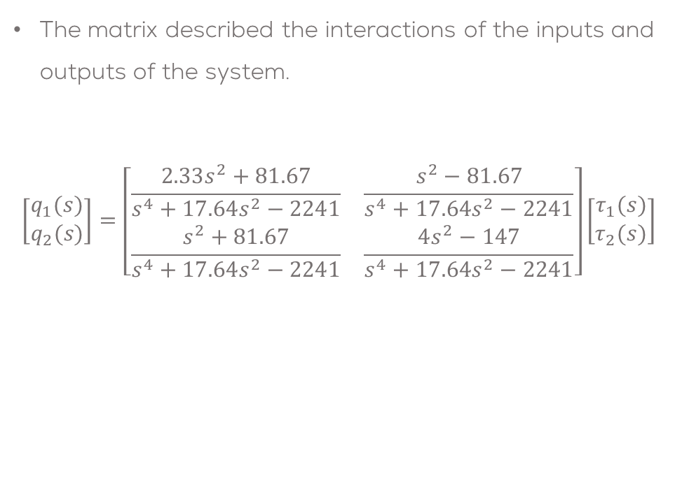

Linearised MIMO system
Converting from SS to TF using MATLAB it is possible to obtain the MIMO model of the system.
$$G_{1}=\frac{2.33s^{2}+81.67}{s^{4}+17.64s^{2}−2241}$$
$$G_{2}=\frac{s^{2}+81.67}{s^{4}+17.64s^{2}−2241}$$
$$G_{3}=\frac{s^{2}−81.67}{s^{4}+17.64s^{2}−2241}$$
$$G_{4}=\frac{4s^{2}−147}{s^{4}+17.64s^{2}−2241}$$
The matrix described the interactions of the inputs and outputs of the system.
$$\left[\begin{matrix}q_{1}(s) \\ q_{2}(s)\end{matrix}\right]=\left[\begin{matrix}\frac{2.33s^{2}+81.67}{s^{4}+17.64s^{2}−2241} & \frac{s^{2}−81.67}{s^{4}+17.64s^{2}−2241} \\ \frac{s^{2}+81.67}{s^{4}+17.64s^{2}−2241} & \frac{4s^{2}−147}{s^{4}+17.64s^{2}−2241}\end{matrix}\right]\left[\begin{matrix}τ_{1}(s) \\ τ_{2}(s)\end{matrix}\right]$$

Slide 18

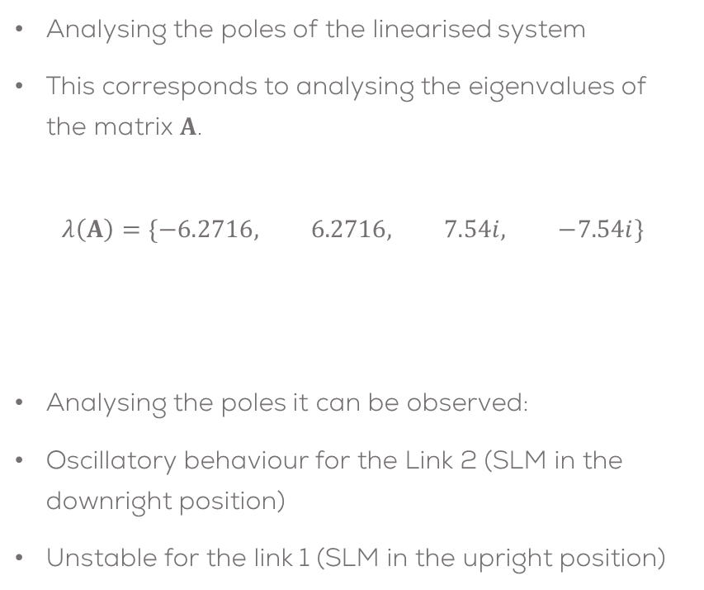

DLM Linearisation Example
Analysing the poles of the linearised system
This corresponds to analysing the eigenvalues of the matrix $A$.
$$λ\left(A\right)=\{−6.2716, 6.2716, 7.54i, −7.54i\}$$
Analysing the poles it can be observed:
Oscillatory behaviour for the Link 2 (SLM in the downright position)
Unstable for the link 1 (SLM in the upright position)
Link 1
Link 2
$$τ=0.15 , ω=7.55$$

Slide 19
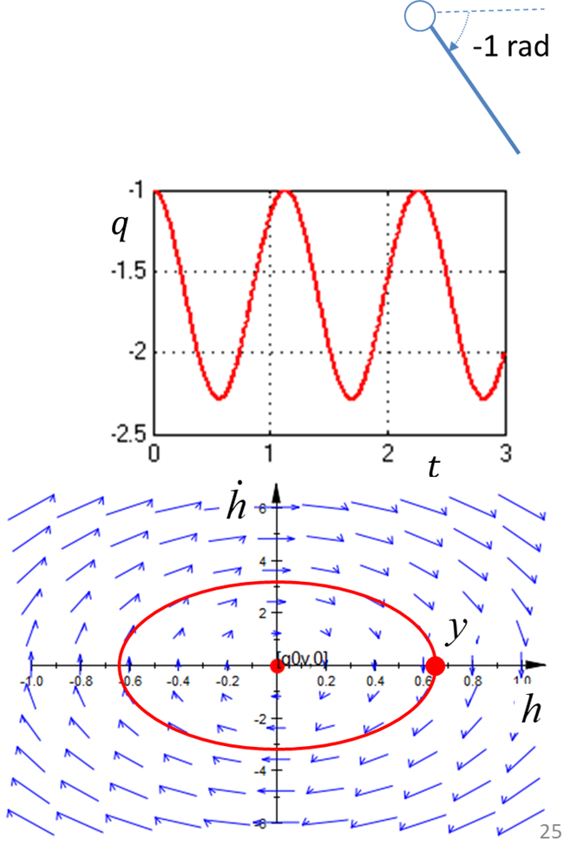
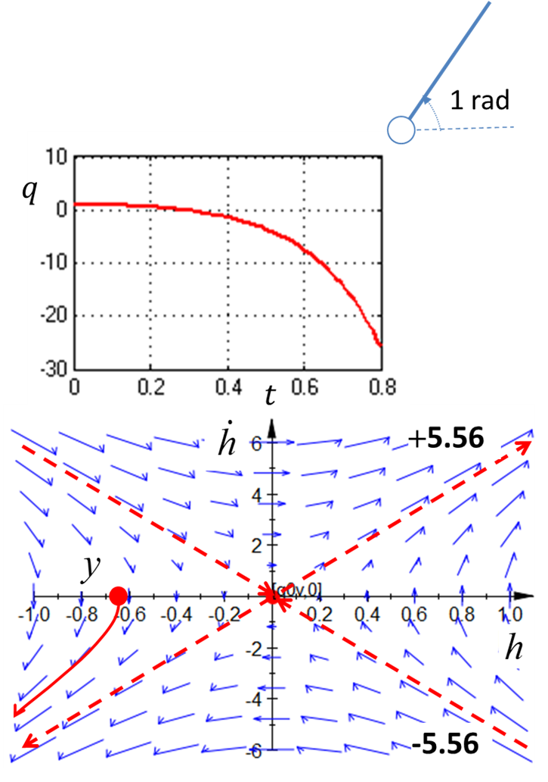
DLM Linearisation Example

Slide 20
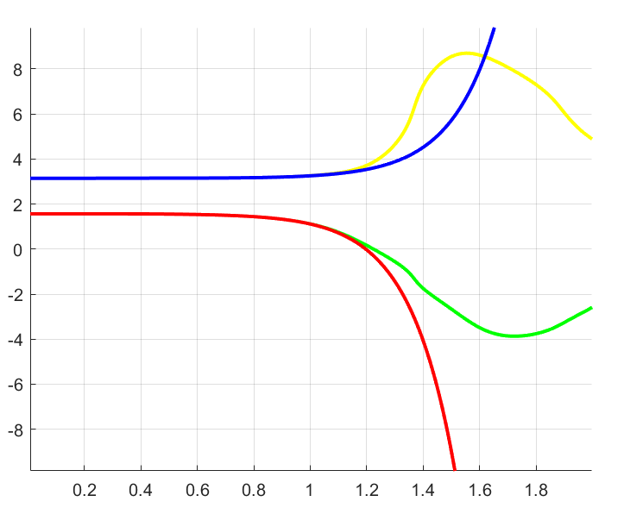

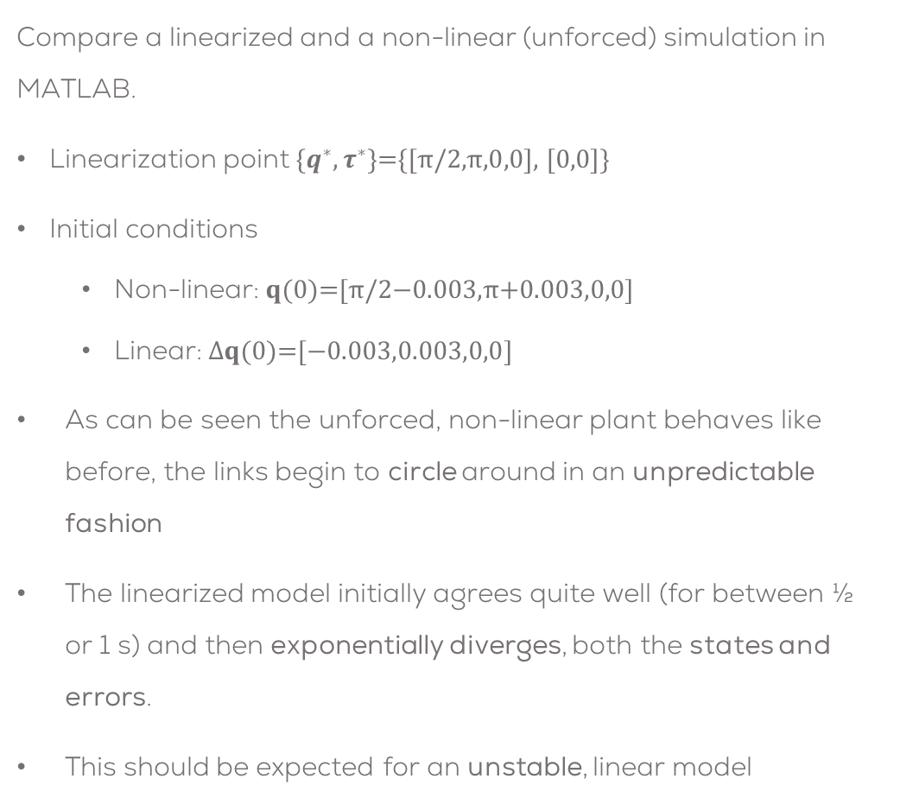



Linearized v Non-linear Comparison Simulation
Compare a linearized and a non-linear (unforced) simulation in MATLAB.
Linearization point $\{q^{∗},τ^{∗}\}\text{=\{[}π\text{/2,}π\text{,0,0}\text{], [0,0]\}}$
Initial conditions
Non-linear: $q(0)\text{=[}π\text{/2}\text{−0.003}\text{,}π\text{+0.003}\text{,0,0}\text{]}$
Linear: $∆q(0)\text{=[}\text{−0.}\text{003}\text{,0.}\text{003}\text{,0,0}\text{]}$
As can be seen the unforced, non-linear plant behaves like before, the links begin to circle around in an unpredictable fashion
The linearized model initially agrees quite well (for between ½ or 1 s) and then exponentially diverges, both the states and errors.
This should be expected for an unstable, linear model
The evolution of the linear and nonlinear joint angles and the corresponding errors are shown below
$$q_{2}^{non−linear}$$
$$q_{2}^{linear}$$
$$q_{1}^{non−linear}$$
$$q_{1}^{linear}$$
Joint Angle Evolution

Slide 21
Conclusions
The linearized model is a good approximation to the non-linear model for the DLM and can be used for linear, feedback control (PID) design
One key insight is that the eigenvalues consist of an stable/unstable pair (Link 1) and an oscillatory pair (Link 2).
In subsequent section, design a linear (PID) joint controller for each joint.

Slide 22

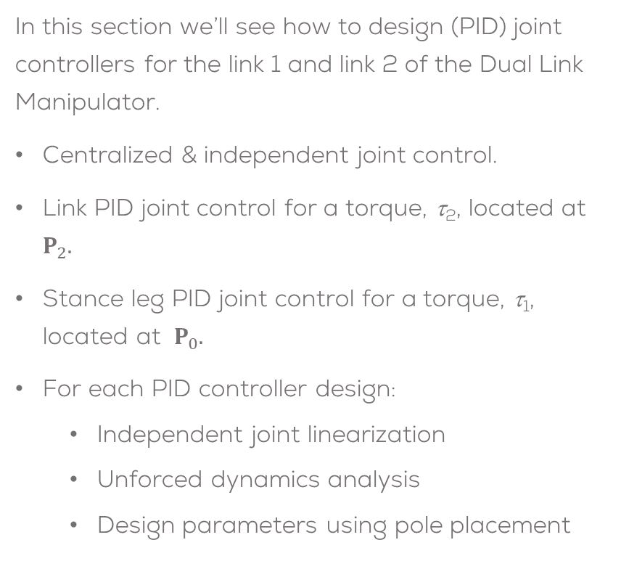
PID Joint Control
In this section we’ll see how to design (PID) joint controllers for the link 1 and link 2 of the Dual Link Manipulator.
Centralized & independent joint control.
Link PID joint control for a torque, τ₂, located at $P_{2}.$
Stance leg PID joint control for a torque, τ₁, located at $P_{0}.$
For each PID controller design:
Independent joint linearization
Unforced dynamics analysis
Design parameters using pole placement

Slide 23
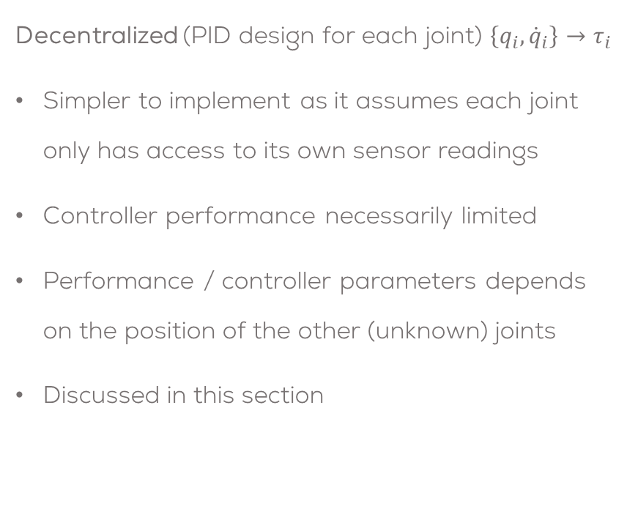
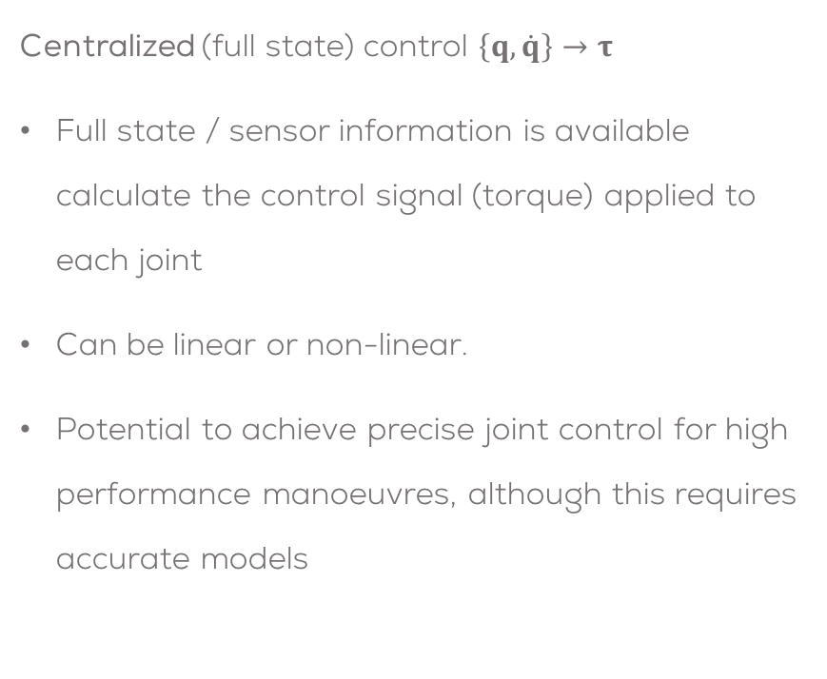
Linear Centralized & Decentralized Control
Centralized (full state) control $\left\{q,\dot{q}\right\}→τ$
Full state / sensor information is available calculate the control signal (torque) applied to each joint
Can be linear or non-linear.
Potential to achieve precise joint control for high performance manoeuvres, although this requires accurate models
Decentralized (PID design for each joint) $\left\{q_{i}, {\dot{q}}_{i}\right\}→τ_{i}$
Simpler to implement as it assumes each joint only has access to its own sensor readings
Controller performance necessarily limited
Performance / controller parameters depends on the position of the other (unknown) joints
Discussed in this section

Slide 24

PID Joint Control of the Link 2
Consider developing a position (set-point or tracking) controller for the link 2 about $P_{2}$ (without motor dynamics) when the link 1 is vertical & stationary $P_{0}≜P_{2}$, $q≜q_{2}$, with two masses single mass $m$ at $p_{3}$:

