Slide 1
Jetson User Guide

Slide 2

1
Overview
2
Installation
3
Remote Access
Table of Contents
4
Camera Interface
5
Teleoperation
6
F.A.Q

Slide 3
Overview
This guide will help get you started with using the Jetson board on the Puzzlebot
In order to understand the ROS commands used, please refer to the basic ROS tutorials provided to you
If you are facing any challenges and need some assistance, please reach out on our Discord server and/or visit us during our dedicated office hours

Slide 4
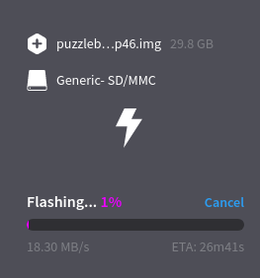
Installation
The OS for the Jetson is stored on an SD card
An image must be flashed to the SD card, download it from here
This is flashed from an image using the Balena Etcher tool
To flash the SD card:
Insert the SD into your PC
Launch the etcher software
Select the image downloaded from the link above in the “Flash from file” section
Select the SD card in the “Select target” section
Click “Flash”, and wait.
Notes:
We have created an image with various pieces of software (including ROS) preinstalled such that you don’t need to install them yourself.

Slide 5
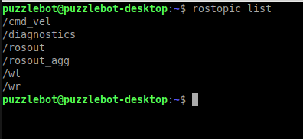
Preinstalled Software
ROS
TensorFlow
OpenCV
nvidia Camera nodes
Hackerboard Communication Routines
The Hacker Board communication starts each time the Jetson is booted up
To test the communication, use rostopic list. You should see list of topics as shown, although this will depend which control mode the Hacker Board is using.
If the communication fails, the protocol can be restarted with the command: sudo systemctl restart puzzlebot.service

Slide 6
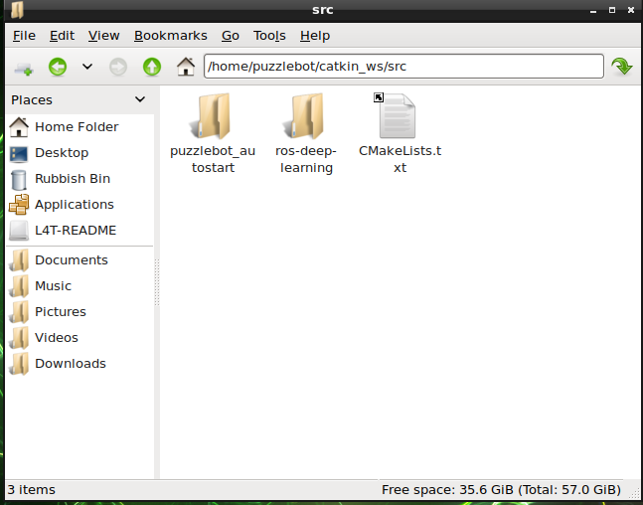
Preinstalled Software
There is a pre-setup catkin workspace on the Jetson
These two packages are necessary for the PuzzleBot and camera communication, and should not be changed in any way

Slide 7
Remote Access
It can be useful to control the Jetson from a remote PC, as the robot cannot be in motion and also hooked up to a monitor
To do this, SSH is used. It uses Wi-Fi to give your computer access to the Jetson.
The Jetson generates its own Wi-Fi network for communication with an external device:
Default Network Name: PuzzlebotJetson
Default Network Password: Puzzlebot72
Before attempting remote access, change the Network Name to something unique
The WiFi details can be changed on the Jetson by selecting:
Networks->Edit Connections->Hotspot
As with the Hacker Board, there will be conflict issues if many Jetsons are in the same room and share the same network name

Slide 8
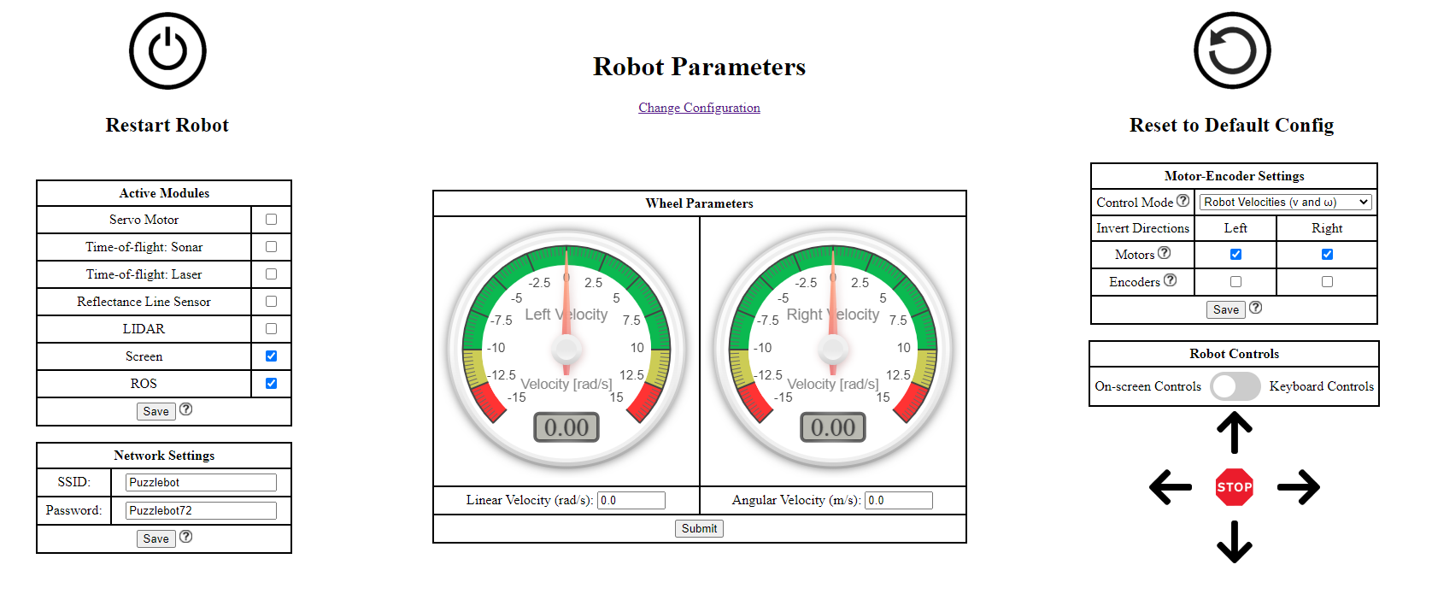
Remote Access
Make sure that ROS enabled from the hacker board’s configuration webpage
Make sure ROS is checked

Slide 9
Remote Access
On the external PC, open a cmd window and type:
ssh puzzlebot@10.42.0.1
Password: Puzzlebot72
If prompted, type yes and then press enter.
This command window is now equivalent to one running on the Jetson.
Any command can be run from this window, and it is equivalent to running one on the Jetson.
Once any control code is written on the Jetson, it can be tested and debugged remotely via SSH, enabling the PuzzleBot to move around

Slide 10
Testing
Test the ROS communication with rostopic echo
Echo the topics /wr and /wl, and rotate the wheels
The speed of the wheels should be displayed
Publish to the command topics, the wheels should turn
If control mode 1 is used, publish to /cmd_vel
If control mode 2 is used, publish to /cmd_wR and /cmd_wL
If control mode 3 is used, publish to /cmd_pwmR and /cmd_pwmL
The control mode is changed on the Hacker Board webpage

Slide 11
Raspberry Pi Camera
NVIDIA provides a package for interfacing with a CSI camera
This Package is pre-installed on the PuzzleBot image
Several launch files are available. Only 2 are of interest to us:
ros_deep_learning video_viewer.ros1.launch
ros_deep_learning video_source.ros1.launch
On your Jetson, run the command:
roslaunch ros_deep_learning video_viewer.ros1.launch
The camera view should be displayed on the screen.
Notes:
These resources are available from this repository, featuring full installation instructions, however the necessary packages are pre-installed on the Puzzzlebot-002 image
Mini-task – preview the camera – The camera feed should appear on their screen

Slide 12
Multi-device Communication
Each device has its own ROS_IP and ROS_ MASTER_URI variables
The ROS_IP is always the local IP of the device
The ROS_MASTER_URI informs the devices where in the network the ROS master is
By default, both IP and URI are local to each device
External PC
Jetson
ROS IP – local IP with reference to Jetson Network
ROS Master URI – Points to master on the Jetson
ROS IP – local IP with reference to Jetson Network
ROS Master URI – Points to local master
Notes:
With Puzzlebot, the ROS Master runs on the puzzlebot, so the external PC must be directed to that master.
This enables remote control of the puzzlebot and debugging of the Jetson code, without needing to connect the jetson to a monitor/keyboard
Mention ROS_Hostname – with more devices, referring to each by IP can be confusing, so ROS hostname provides a way to give each device a name

Slide 13
Teleoperation
Install the ROS teleop twist keyboard package on an external PC
sudo apt install ros-melodic-teleop-twist-keyboard
Remotely connect to the PuzzleBot from the external device
Use ifconfig to get local IP. It will be of the form 10.42.0.XXX
export ROS_MASTER_URI=http://10.42.0.1:11311
export ROS_IP=<your_local_ip>
Once connected, use rostopic list to check if the connection has been successful
The topics /cmd_vel, /wr, and /wl should be displayed, along with a few others
Notes:
For the Mexico course, the PuzzleBot will already be setup. Suggested to guide them through the setup process anyway as this will not always be the case. Click on the link, show them the etcher software
The teleoperation package enables basic keyboard control by publishing messages to the rostopic package
NOTE: if multiple Jetsons are to be run in the same area, they will need to have unique Network names. Suggest demonstrating how to do this.
Puzzlebot72 is also the default password for the Jetson itself, so if sudo is required, that is the password

Slide 14
Teleoperation
Once your ROS_IP and ROS_MASTER_URI are set, your remote device has access to all the ROS topics, services, etc that the Jetson has.
It is not a remote access into the Jetson like SSH, we cannot start nodes or run other commands
However, it can be more useful, as we cannot easily display visualisations via SSH.
Use the external device to remotely operate the puzzlebot
rosrun teleop_twist_keyboard teleop_twist_keyboard.py
Follow the instructions displayed in the command window
Use SSH to start a source camera node
roslaunch ros_deep_learning video_source.ros1.launch
Use rqt to view the image from the camera on your machine
rosrun rqt_image_view rqt_image_view, and select the image_raw topic
Notes:
Troubleshooting:
If we can see the master on the external PC but not the right topics (usually just 2 or 3 topics including /rosout), there is a problem with the hackerboard communication
The communication can be restarted with sudo systemctl restart puzzlebot.service through ssh
The status of the communication can be checked with sudo systemctl status puzzlebot.service
Ask students to observe the slow framerate of the image – this is the limitation with remote operation, ROS can only handle so much data over wifi. It would be impractical to operate a ROS node on the image sent to the laptop, so we run our image processing on the Jetson itself and then observe the results from the laptop

Slide 15
Troubleshooting
The Hacker Board communication will only work correctly if the Jetson is connected to its own WiFi network
Go to Network -> Create new WiFi network, and select “Hotspot” from the dropdown.
If the network is configured incorrectly, you will likely see the message “unable to communicate with master”
If the ROS master is available, but the topics /wr and /wl are not available, check the connection to the hacker board, and restart it. Then, restart the communication with
sudo systemctl restart puzzlebot.service
Sometimes the Jetson WiFi Network takes a couple of minutes to appear on other devices after a reboot. If it does not, make sure no other connections are saved. It is only guaranteed to connect to PuzzlebotJetson on boot if there are no other connections saved
Always consider checking the hacker board if these don’t work: is ROS turned on?

