Slide 1
PuzzleThon
2023 – First edition

Slide 2
What is PuzzleThon?
It is a joint initiative of Manchester Robotics Ltd., The University of Manchester and NVIDIA to facilitate the students to access the latest technologies and approaches in Robotics and AI.
It is an initiative to prepare the students for the multi-trillion market in robotics and AI by reducing the skills gap in trained roboticists now and in the future.

Slide 3
Market Sector | % of companies adopting robotics (2020)
Mining & Metals | 90%
Advanced Manufacturing | 85%
Manufacturing | 79%
Oil & Gas | 79%
Transportation & Storage | 69%
Automotive | 60%
Agriculture, Food & Bev | 54%
With the increasing advances and adoption of AI, robotics and automation the skills gap will be an issue for industry.

Slide 4
£5.2 Trillion
Skills Gap
2021-2030
12.1
Million
Empty Positions

Slide 5
How PuzzleThon addresses this problem?
By proposing a set of challenges inspired from real life and solve them using the latest technology in the field from NVIDIA.

Slide 6
PuzzleThon – First edition is a warm-up edition
PuzzleThon – Next editions will propose a mixed approach, i.e., working with the physical twin and the digital twin in NVIDIA Omniverse.

Slide 7
PuzzleThon – First edition
The challenge:
Autonomous driving, make your own ‘mini-Tesla’.

Slide 8
What we give you?
HARDWARE:
1. One PuzzleBot per team.
PuzzleBot is an affordable robotic platform developed at the Department of Electrical and Electronic Engineering and used for teaching undergraduate, and post-graduate, as well as for research.
2. Traffic signs and traffic lights
3. A track sample
Digital Twin

Slide 9
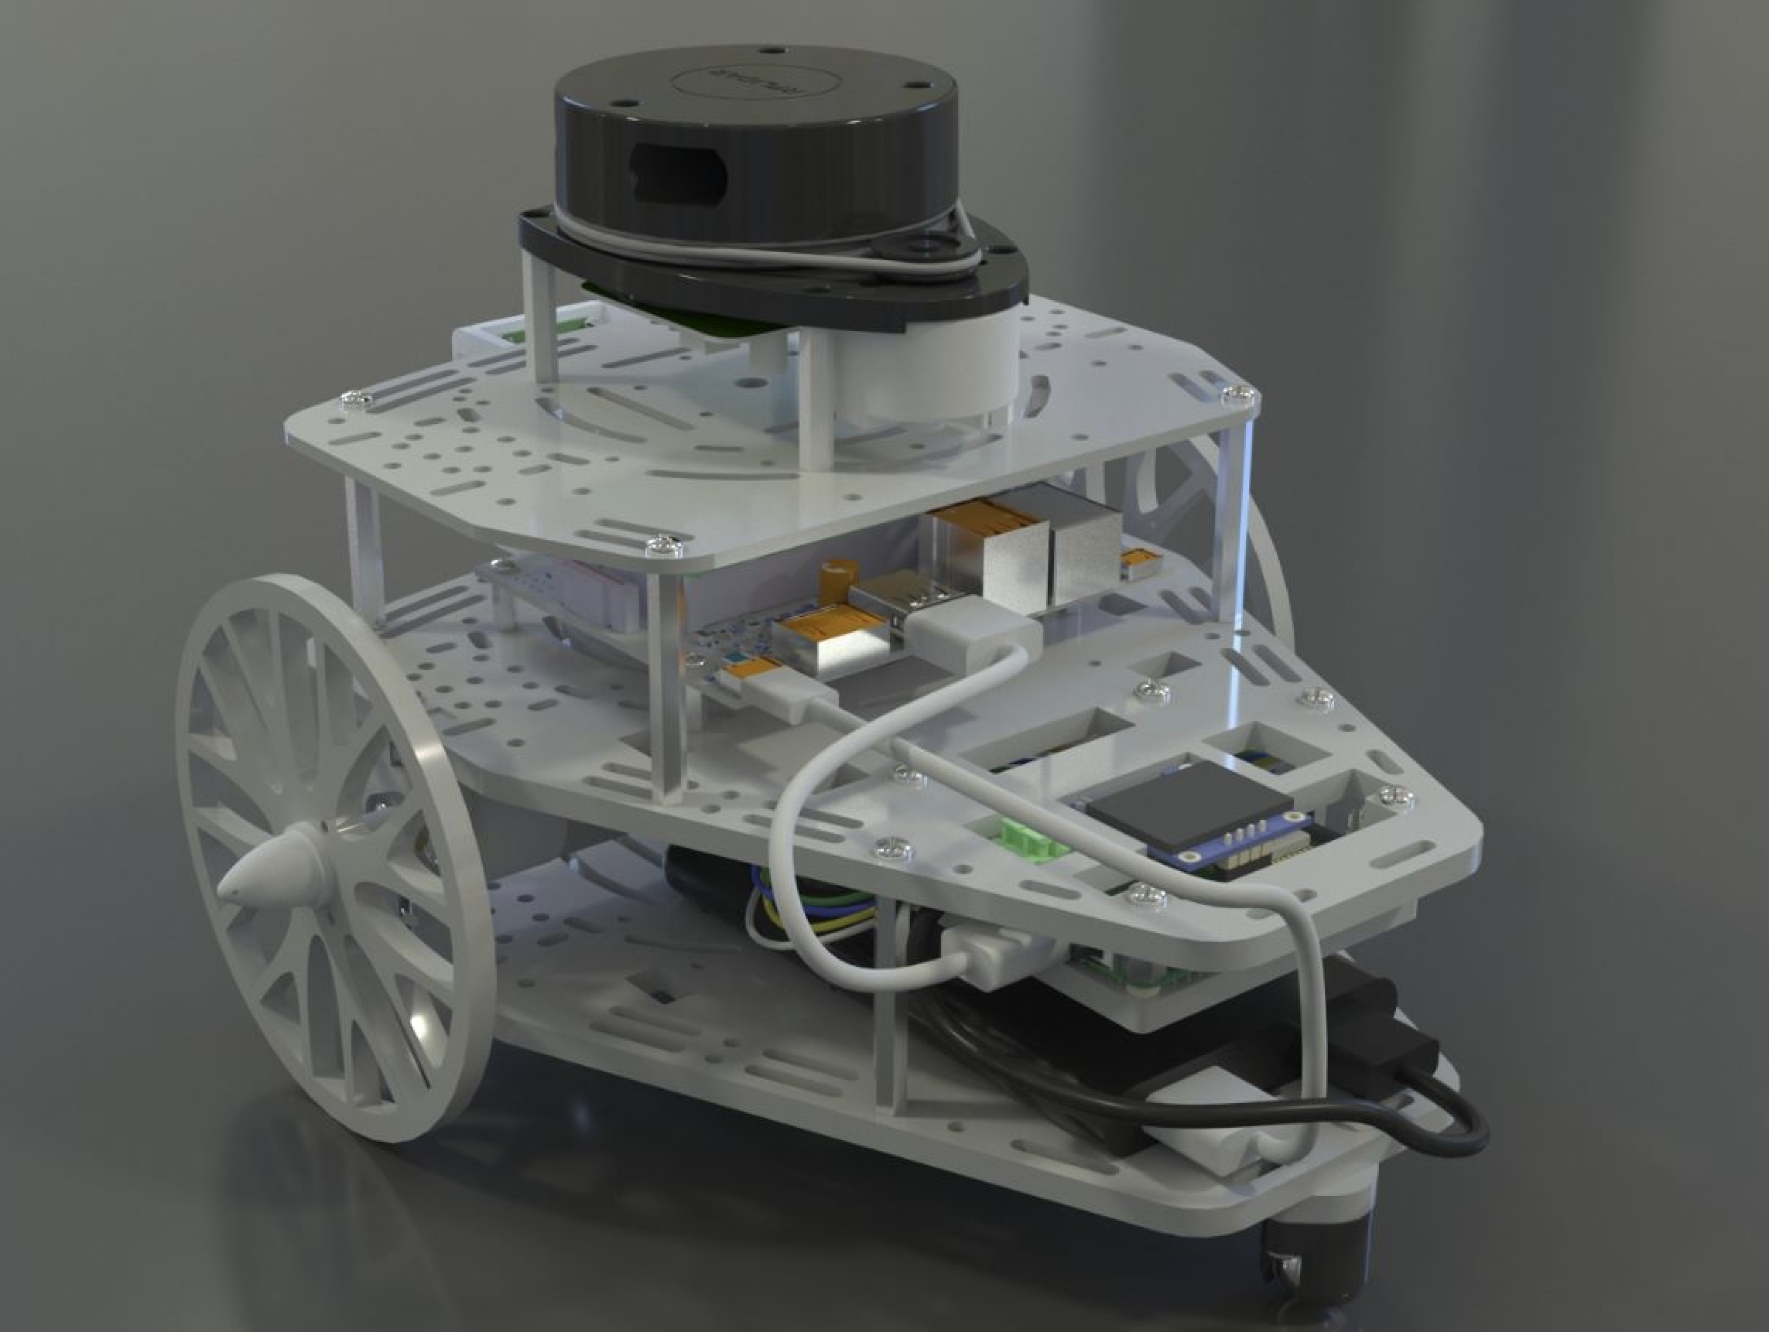

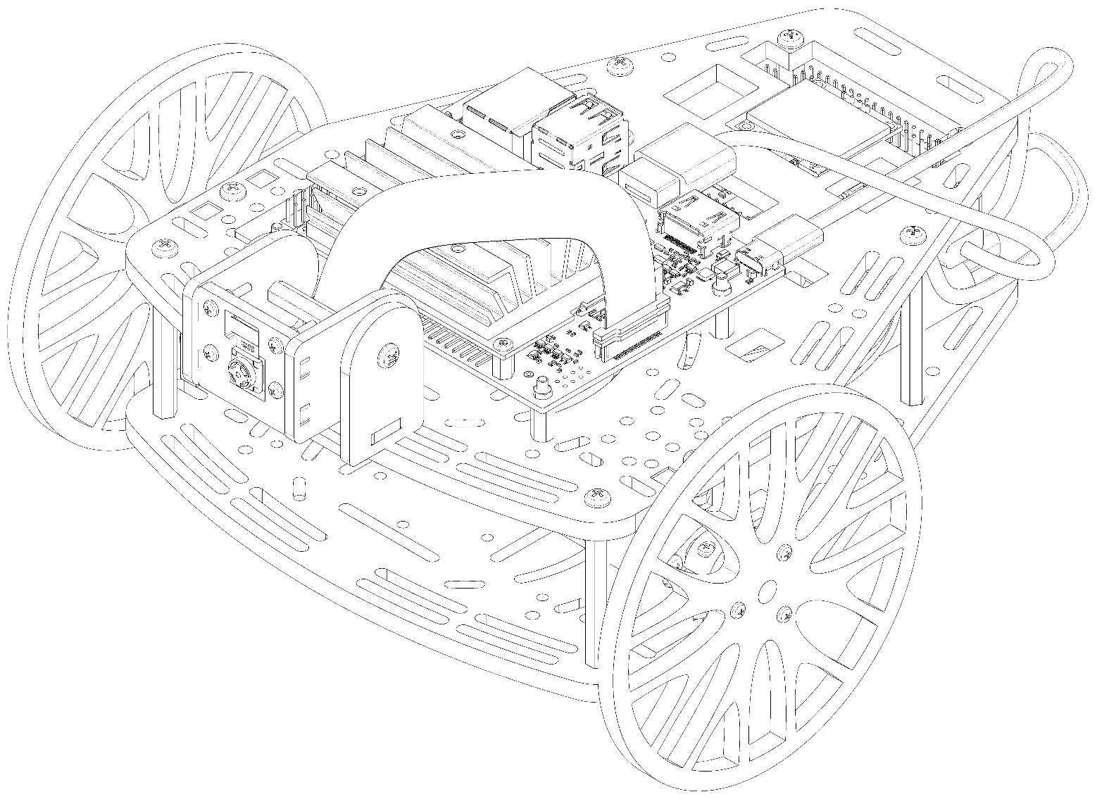
®
Digital Twin
Digital Twin

Slide 10
SUPPORT:
Access to a GitHub repository where you can find self-explanatory materials to guide you through the Challenge.

Slide 11
Digital Twin
What we ask you to do?
Work as a team of three in your own time:
1. Assemble the robot,
2. Implement a navigation strategy based on line detection, traffic sign recognition and traffic light detection using PuzzleBot equipped with camera and NVIDIA Jetson Nano.

Slide 12
The challenge (Autonomous navigation on an unseen track):
On the challenge day, we'll build a track, we’ll place traffic sings and traffic lights around and we expect your robot to autonomously navigate around.
Digital Twin

Slide 13
The prizes:
First prize:
Nintendo switch Oled
Second prize:
PuzzleBot Jetson Edition (a mobile robot equipped with camera, NVIDIA Jetson Nano, and memory card 64GB)
Third prize:
NVIDIA Jetson Nano
Digital Twin

Slide 14
Example:
https://youtu.be/-39Pbqh56pw
Digital Twin

Slide 15
The plan for the PuzzleThon:
Monday, the 6th of March you start the work in Simulation (ROS, Gazebo)
Monday, the 13th of March you’ll start the work with the real robot. (only if you decide to continue)
On Friday, the 17th of March we will announce the date and the venue for the final competition.
Digital Twin

