Slide 1
Challenges
Mini challenge AI

Slide 2
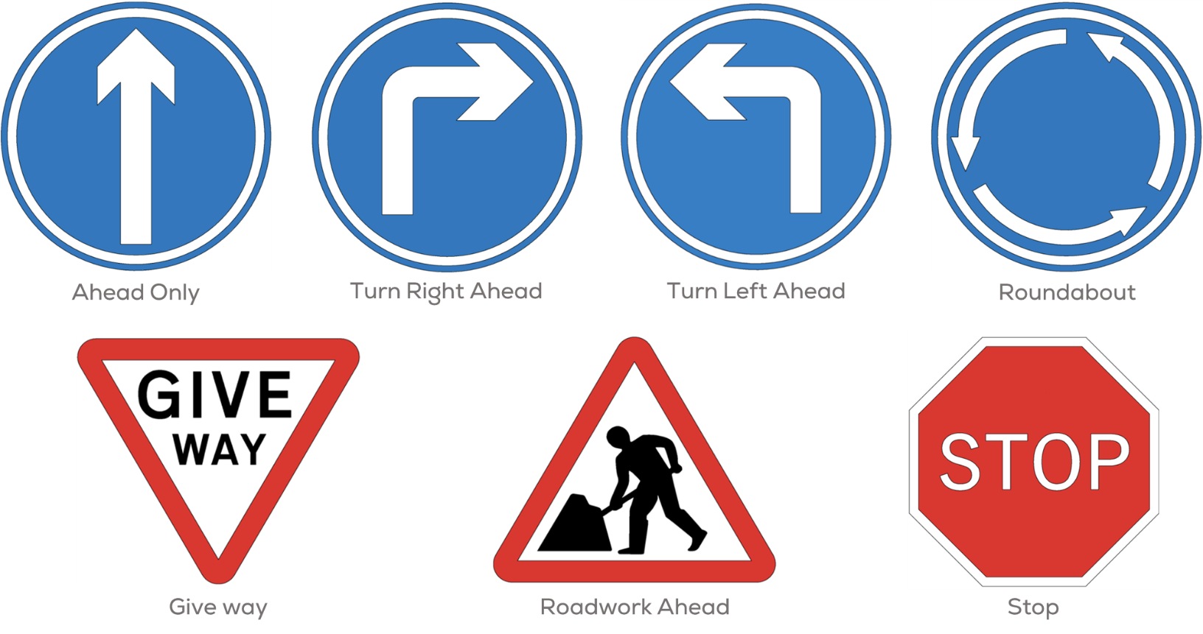
Mini challenge AI
Traffic Signs
Develop a neural network to automatically detect the traffic signs.

Slide 3
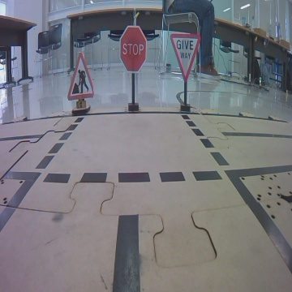
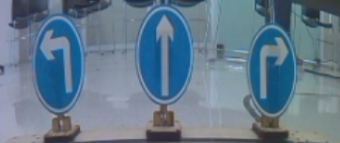
Mini challenge AI
Dataset generation and preprocessing
Briefly explain your methodology for data acquisition.
Preform and explain the data preprocessing.
Use data augmentation techniques to enlarge your data set. Explain the used techniques with the class

Slide 4
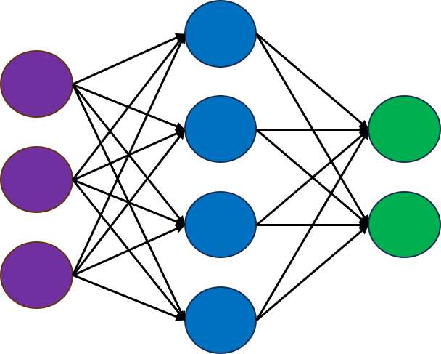
Mini challenge AI
Neural Network Architecture
Briefly explain your neural network architecture (layers) and their purpose in your solution.
For the input and output layers explain the reasoning of the activation functions you use.
For the convolutional layers explain the reasoning of the kernels you use.

Slide 5
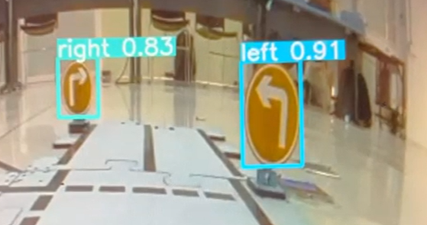
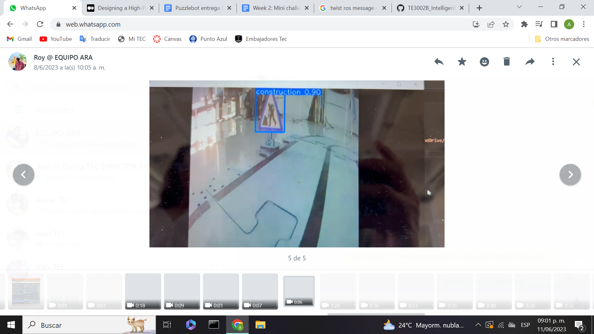
Mini challenge AI
Neural Network Performance
Use accuracy, precision, recall, the confusion matrix and two other relevant performance metrics to assess your neural network.
Identify strengths and areas for improvement.
Explain how would you improve the network performance.
YOU MUST DEMOSTRATE THAT YOU CAN DETECT THE TRAFFIC SIGNS (VIDEO)

Slide 6
Rules
This is challenge not a class. The students are encouraged to research, improve tune explain their algorithms by themselves.
MCR2(Manchester Robotics) Reserves the right to answer a question if it is determined that the questions contains partially or totally an answer.
The students are welcomed to ask only about the theoretical aspect of the classed.
No remote control or any other form of human interaction with the simulator or ROS is allowed (except at the start when launching the files).
It is forbidden to use any other internet libraires with the exception of standard libraires or NumPy.
If in doubt about libraires please ask any teaching assistant.
Improvements to the algorithms are encouraged and may be used as long as the students provide the reasons and a detailed explanation on the improvements.
All the students must be respectful towards each other and abide by the previously defined rules.
Manchester robotics reserves the right to provide any form of grading. Grading and grading methodology are done by the professor in charge of the unit.

