Slide 1
Map Based Localisation
Worked Example

Slide 2
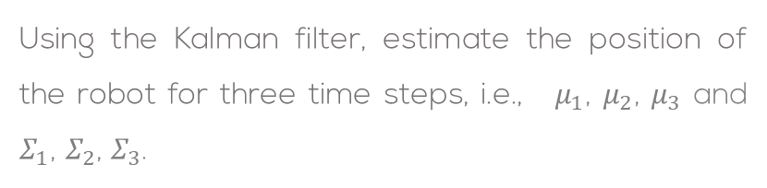
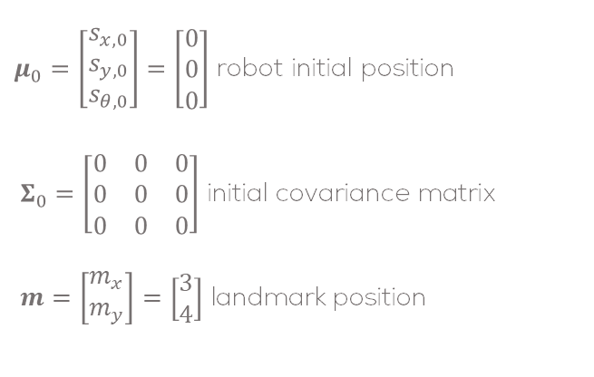
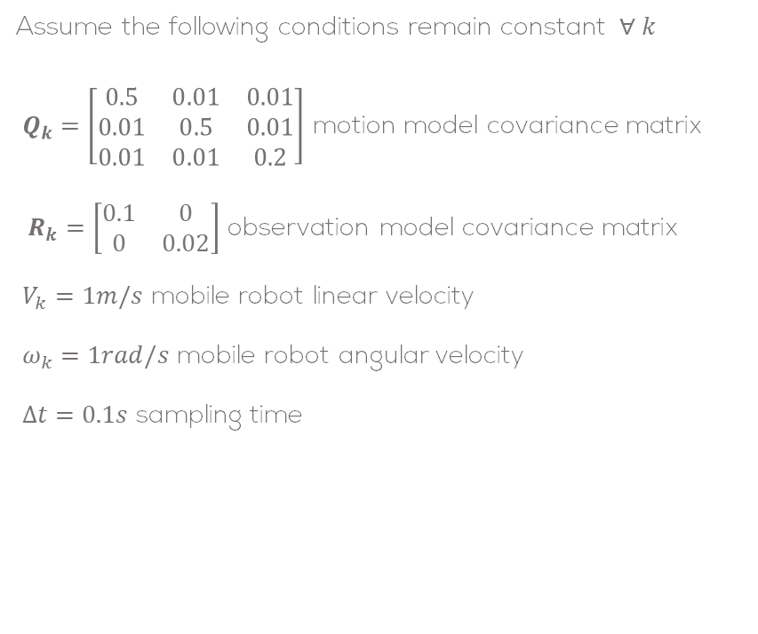
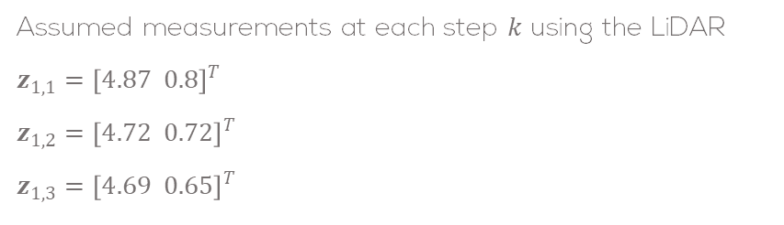
Problem Statement
Using the Kalman filter, estimate the position of the robot for three time steps, i.e., $μ_{1}$, $μ_{2}$, $μ_{3}$ and $Σ_{1}$, $Σ_{2}$, $Σ_{3}$.
Assume the following conditions remain constant $∀ k$
$Q_{k}=\left[\begin{matrix}0.5 & 0.01 & 0.01 \\ 0.01 & 0.5 & 0.01 \\ 0.01 & 0.01 & 0.2\end{matrix}\right]$ motion model covariance matrix
$R_{k}=\left[\begin{matrix}0.1 & 0 \\ 0 & 0.02\end{matrix}\right]$ observation model covariance matrix
$V_{k}=1m/s$ mobile robot linear velocity
$ω_{k}=1rad/s$ mobile robot angular velocity
$Δt=0.1s$ sampling time
$μ_{0}=\left[\begin{aligned}s_{x,0} \\ s_{y,0} \\ s_{θ,0}\end{aligned}\right]=\left[\begin{aligned}0 \\ 0 \\ 0\end{aligned}\right]$ robot initial position
$Σ_{0}=\left[\begin{matrix}0 & 0 & 0 \\ 0 & 0 & 0 \\ 0 & 0 & 0\end{matrix}\right]$ initial covariance matrix
$m=\left[\begin{matrix}m_{x} \\ m_{y}\end{matrix}\right]=\left[\begin{matrix}3 \\ 4\end{matrix}\right]$ landmark position
Assumed measurements at each step $k$ using the LiDAR
$$z_{1,1}={\left[4.87 0.8\right]}^{T}$$
$$z_{1,2}={\left[4.72 0.72\right]}^{T}$$
$$z_{1,3}={\left[4.69 0.65\right]}^{T}$$

Slide 3
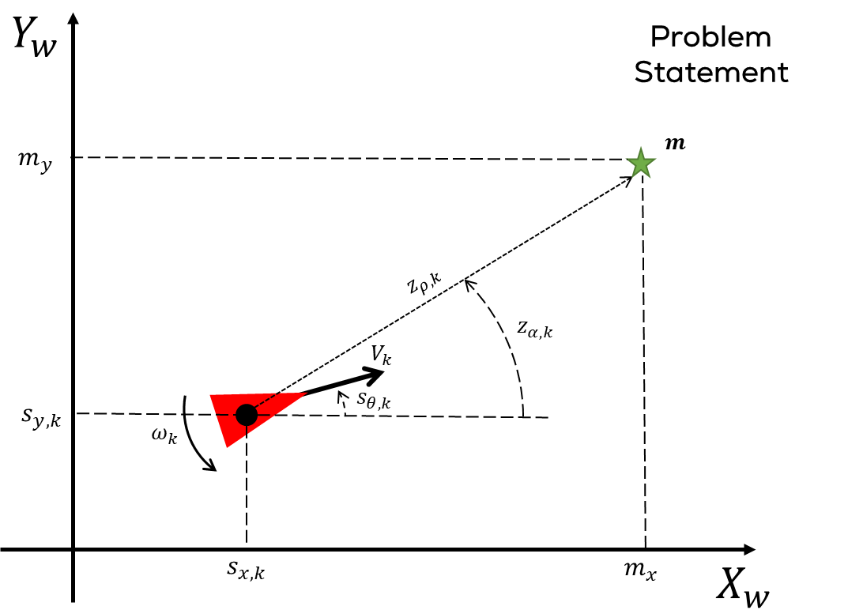
Problem Statement

Slide 4
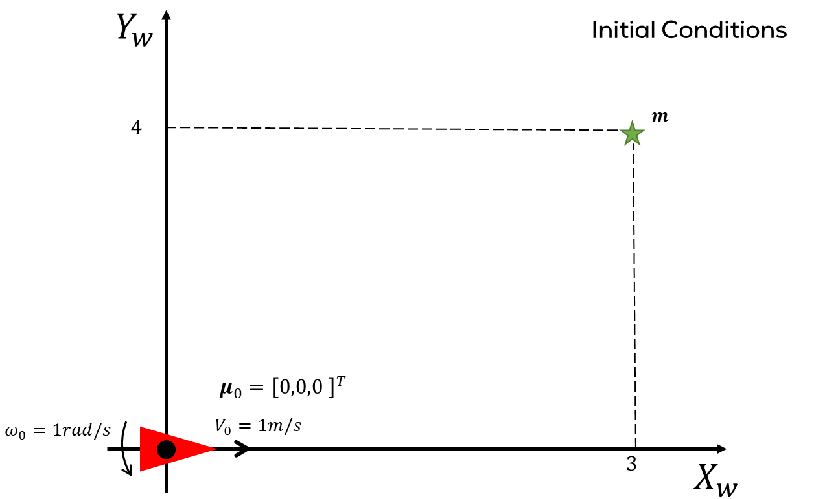
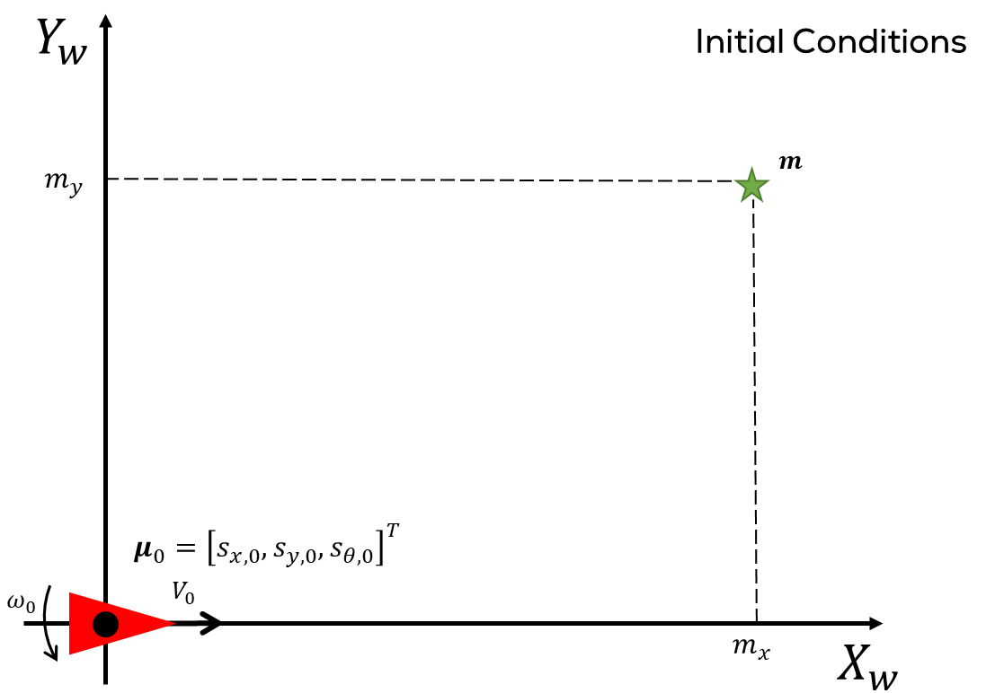
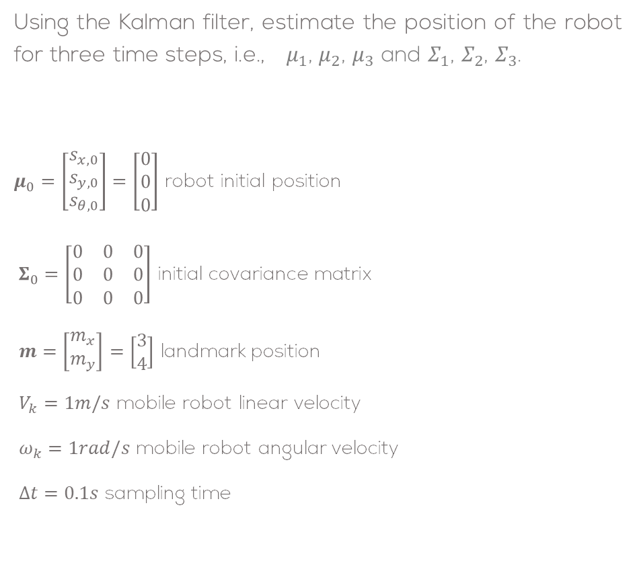
Solution: Initial Conditions
Using the Kalman filter, estimate the position of the robot for three time steps, i.e., $μ_{1}$, $μ_{2}$, $μ_{3}$ and $Σ_{1}$, $Σ_{2}$, $Σ_{3}$.
$μ_{0}=\left[\begin{aligned}s_{x,0} \\ s_{y,0} \\ s_{θ,0}\end{aligned}\right]=\left[\begin{aligned}0 \\ 0 \\ 0\end{aligned}\right]$ robot initial position
$Σ_{0}=\left[\begin{matrix}0 & 0 & 0 \\ 0 & 0 & 0 \\ 0 & 0 & 0\end{matrix}\right]$ initial covariance matrix
$m=\left[\begin{matrix}m_{x} \\ m_{y}\end{matrix}\right]=\left[\begin{matrix}3 \\ 4\end{matrix}\right]$ landmark position
$V_{k}=1m/s$ mobile robot linear velocity
$ω_{k}=1rad/s$ mobile robot angular velocity
$Δt=0.1s$ sampling time

Slide 5
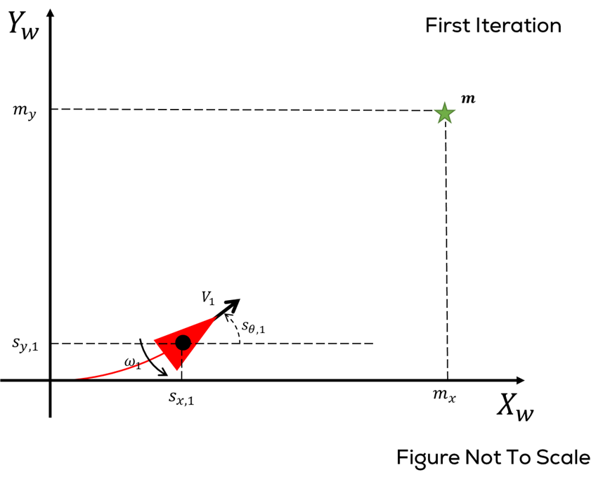
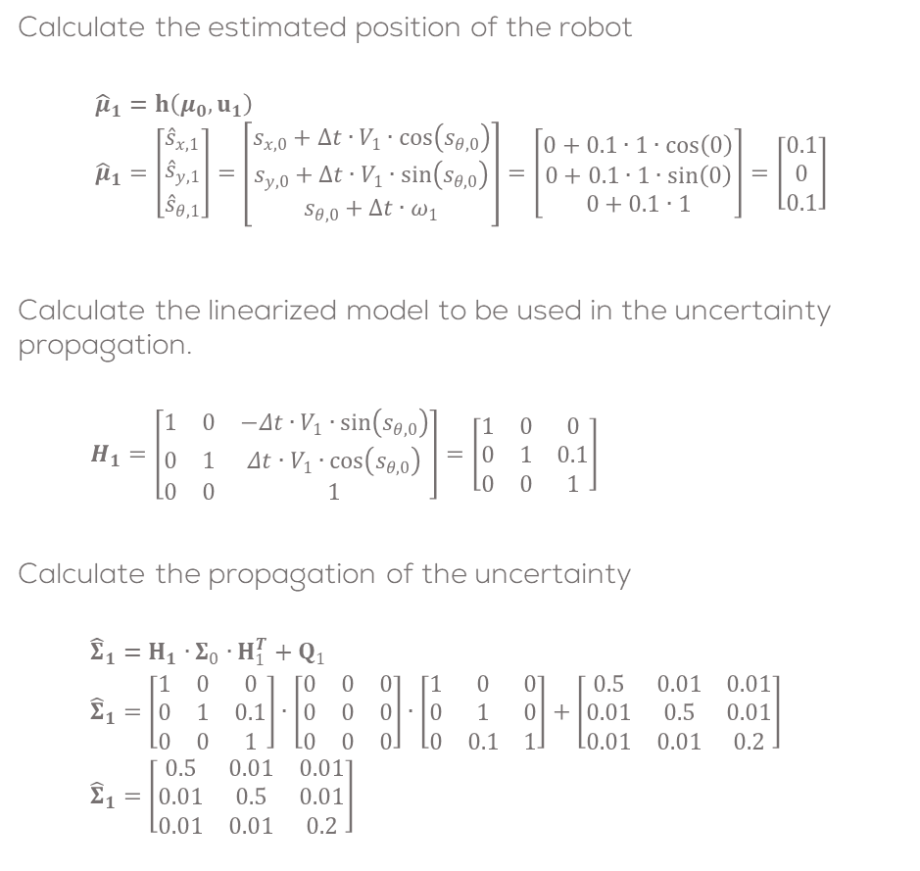
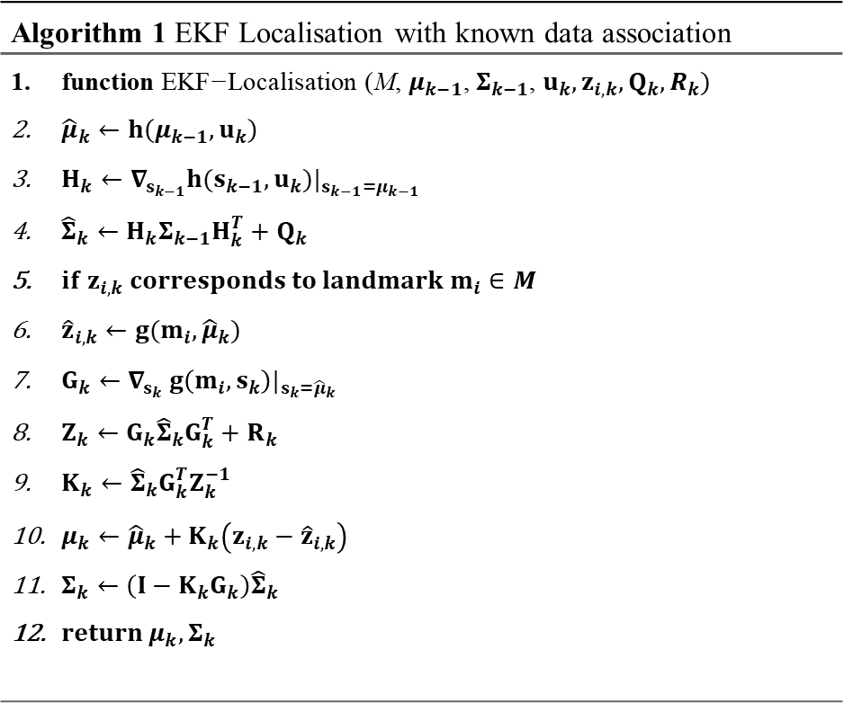
Solution: Iteration 1
Calculate the estimated position of the robot
$${\hat{μ}}_{1}=h\left(μ_{0},u_{1}\right) \\ {\hat{μ}}_{1}=\left[\begin{aligned}{\hat{s}}_{x,1} \\ {\hat{s}}_{y,1} \\ {\hat{s}}_{θ,1}\end{aligned}\right]=\left[\begin{aligned}s_{x,0}+Δt∙V_{1}∙\cos\left(s_{θ,0}\right) \\ s_{y,0}+Δt∙V_{1}∙\sin\left(s_{θ,0}\right) \\ s_{θ,0}+Δt∙ω_{1}\end{aligned}\right]=\left[\begin{aligned}0+0.1∙1∙\cos\left(0\right) \\ 0+0.1∙1∙\sin\left(0\right) \\ 0+0.1∙1\end{aligned}\right]=\left[\begin{aligned}0.1 \\ 0 \\ 0.1\end{aligned}\right]$$
Calculate the linearized model to be used in the uncertainty propagation.
$$H_{1}=\left[\begin{matrix}1 & 0 & −Δt∙V_{1}∙\sin\left(s_{θ,0}\right) \\ 0 & 1 & Δt∙V_{1}∙\cos\left(s_{θ,0}\right) \\ 0 & 0 & 1\end{matrix}\right]=\left[\begin{matrix}1 & 0 & 0 \\ 0 & 1 & 0.1 \\ 0 & 0 & 1\end{matrix}\right]$$
Calculate the propagation of the uncertainty
$${\hat{Σ}}_{1}=H_{1}∙Σ_{0}∙H_{1}^{T}+Q_{1}$$
$${\hat{Σ}}_{1}=\left[\begin{matrix}1 & 0 & 0 \\ 0 & 1 & 0.1 \\ 0 & 0 & 1\end{matrix}\right]∙\left[\begin{matrix}0 & 0 & 0 \\ 0 & 0 & 0 \\ 0 & 0 & 0\end{matrix}\right]∙\left[\begin{matrix}1 & 0 & 0 \\ 0 & 1 & 0 \\ 0 & 0.1 & 1\end{matrix}\right]+\left[\begin{matrix}0.5 & 0.01 & 0.01 \\ 0.01 & 0.5 & 0.01 \\ 0.01 & 0.01 & 0.2\end{matrix}\right]$$
$${\hat{Σ}}_{1}=\left[\begin{matrix}0.5 & 0.01 & 0.01 \\ 0.01 & 0.5 & 0.01 \\ 0.01 & 0.01 & 0.2\end{matrix}\right]$$
Algorithm 1 EKF Localisation with known data association
$\text{function} \text{EKF}\text{−}\text{Localisation}\text{ (}\text{M}\text{, }μ_{k−1}\text{, }Σ_{k−1}\text{, }u_{k}, z_{i,k}, Q_{k},R_{k})$ ${\hat{μ}}_{k}←h\left(μ_{k−1},u_{k}\right)$ $H_{k}←∇_{s_{k−1}}h(s_{k−1}, u_{k})|_{s_{k−1}=μ_{k−1}}$ ${\hat{Σ}}_{k}←H_{k}Σ_{k−1}H_{k}^{T}+Q_{k}$ $if z_{i,k} corresponds to landmark m_{i}∈M$ ${\hat{z}}_{i,k}←g(m_{i},{\hat{μ}}_{k})$ $G_{k}←∇_{s_{k}} g\left(m_{i},s_{k}\right)|_{s_{k}={\hat{μ}}_{k}}$ $Z_{k}←G_{k}{\hat{Σ}}_{k}G_{k}^{T}+R_{k}$ $K_{k}←{\hat{Σ}}_{k}G_{k}^{T}Z_{k}^{−1}$ $μ_{k}←{\hat{μ}}_{k}+K_{k}\left(z_{i,k}−{\hat{z}}_{i,k}\right)$ $Σ_{k}←\left(I−K_{k}G_{k}\right){\hat{Σ}}_{k}$ $return μ_{k},Σ_{k}$

Slide 6
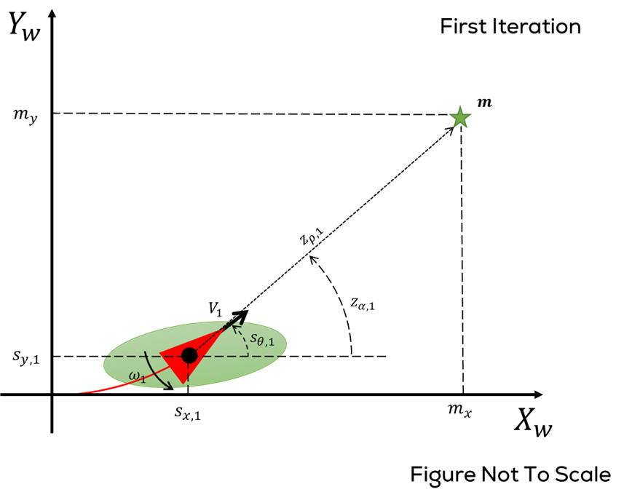
Solution: Iteration 1
Observation Model

Slide 7
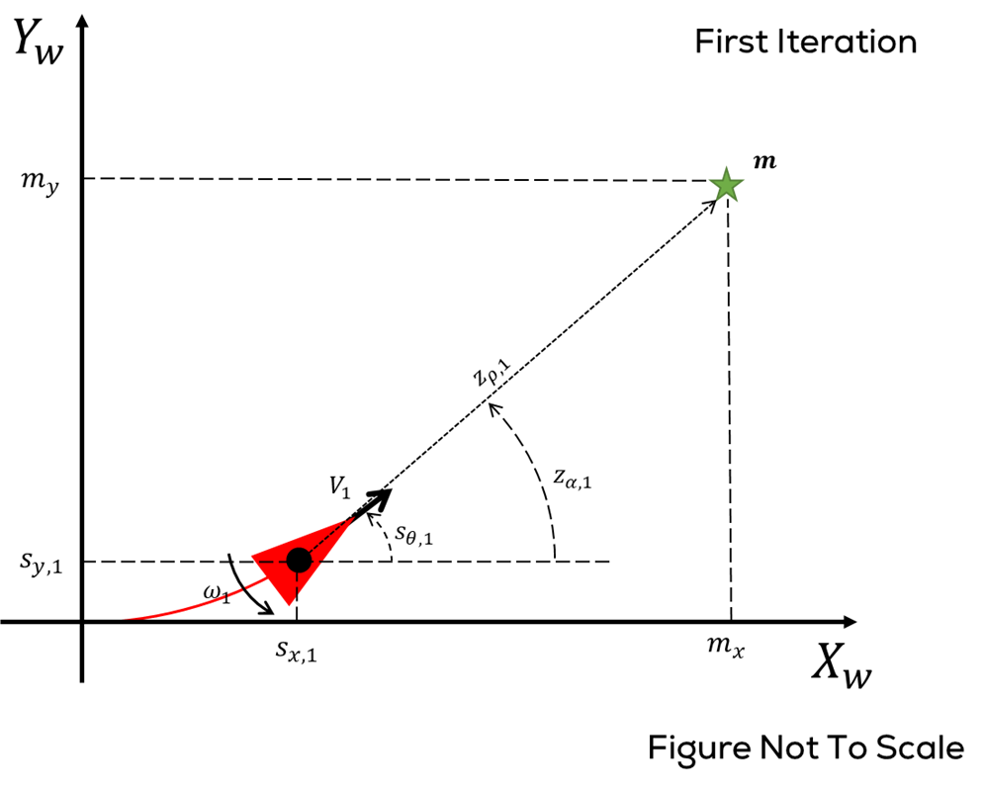
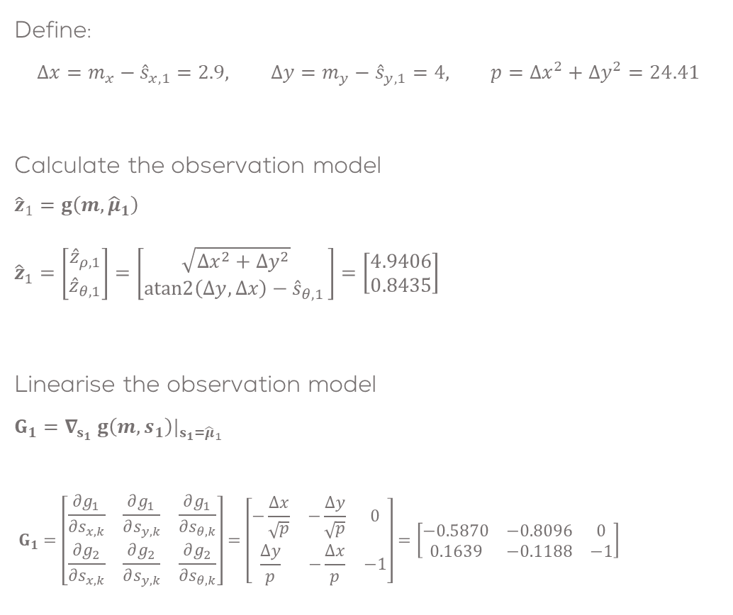

Solution: Iteration 1
Define:
$$Δx=m_{x}−{\hat{s}}_{x,1}=2.9, Δy=m_{y}−{\hat{s}}_{y,1}=4, p=Δx^{2}+Δy^{2}=24.41$$
Calculate the observation model
$${\hat{z}}_{1}=g\left(m,{\hat{μ}}_{1}\right) \\ {\hat{z}}_{1}=\left[\begin{matrix}{\hat{z}}_{ρ,1} \\ {\hat{z}}_{θ,1}\end{matrix}\right]=\left[\begin{matrix}\sqrt{Δx^{2}+Δy^{2}} \\ atan2\left(Δy,Δx\right)−{\hat{s}}_{θ,1 }\end{matrix}\right]=\left[\begin{matrix}4.9406 \\ 0.8435\end{matrix}\right]$$
Linearise the observation model
$$G_{1}=∇_{s_{1}} g\left(m,s_{1}\right)|_{s_{1}={\hat{μ}}_{1}} \\ G_{1}=\left[\begin{matrix}\frac{∂g_{1}}{∂s_{x,k}} & \frac{∂g_{1}}{∂s_{y,k}} & \frac{∂g_{1}}{∂s_{θ,k}} \\ \frac{∂g_{2}}{∂s_{x,k}} & \frac{∂g_{2}}{∂s_{y,k}} & \frac{∂g_{2}}{∂s_{θ,k}}\end{matrix}\right]=\left[\begin{matrix}−\frac{Δx}{\sqrt{p}} & −\frac{Δy}{\sqrt{p}} & 0 \\ \frac{Δy}{p} & −\frac{Δx}{p} & −1\end{matrix}\right]=\left[\begin{matrix}−0.5870 & −0.8096 & 0 \\ 0.1639 & −0.1188 & −1\end{matrix}\right]$$
Algorithm 1 EKF Localisation with known data association
$\text{function} \text{EKF}\text{−}\text{Localisation}\text{ (}\text{M}\text{, }μ_{k−1}\text{, }Σ_{k−1}\text{, }u_{k}, z_{i,k}, Q_{k},R_{k})$ ${\hat{μ}}_{k}←h\left(μ_{k−1},u_{k}\right)$ $H_{k}←∇_{s_{k−1}}h(s_{k−1}, u_{k})|_{s_{k−1}=μ_{k−1}}$ ${\hat{Σ}}_{k}←H_{k}Σ_{k−1}H_{k}^{T}+Q_{k}$ $if z_{i,k} corresponds to landmark m_{i}∈M$ ${\hat{z}}_{i,k}←g(m_{i},{\hat{μ}}_{k})$ $G_{k}←∇_{s_{k}} g\left(m_{i},s_{k}\right)|_{s_{k}={\hat{μ}}_{k}}$ $Z_{k}←G_{k}{\hat{Σ}}_{k}G_{k}^{T}+R_{k}$ $K_{k}←{\hat{Σ}}_{k}G_{k}^{T}Z_{k}^{−1}$ $μ_{k}←{\hat{μ}}_{k}+K_{k}\left(z_{i,k}−{\hat{z}}_{i,k}\right)$ $Σ_{k}←\left(I−K_{k}G_{k}\right){\hat{Σ}}_{k}$ $return μ_{k},Σ_{k}$

Slide 8

Solution: Iteration 1
Using the linearised model compute the measurement uncertainty propagation
$$Z_{1}=G_{1}∙{\hat{Σ}}_{1}∙G_{1}^{T}+R_{1}$$
$$Z_{1}=\left[\begin{matrix}−0.5870 & −0.8096 & 0 \\ 0.1639 & −0.1188 & −1\end{matrix}\right]∙\left[\begin{matrix}0.5 & 0.01 & 0.01 \\ 0.01 & 0.5 & 0.01 \\ 0.01 & 0.01 & 0.2\end{matrix}\right]∙\left[\begin{matrix}−0.5870 & 0.1639 \\ −0.8096 & −0.1188 \\ 0 & −1\end{matrix}\right]+\left[\begin{matrix}0.1 & 0 \\ 0 & 0.02\end{matrix}\right]$$
$$Z_{1}=\left[\begin{matrix}0.6095 & 0.0133 \\ 0.0133 & 0.2392\end{matrix}\right]$$
Calculate Kalaman Gain
$$K_{1}={\hat{Σ}}_{1}{∙G}_{1}^{T}{∙Z}_{1}^{−1}$$
$$K_{1}= \left[\begin{matrix}0.5 & 0.01 & 0.01 \\ 0.01 & 0.5 & 0.01 \\ 0.01 & 0.01 & 0.2\end{matrix}\right]∙\left[\begin{matrix}−0.5870 & 0.1639 \\ −0.8096 & −0.1188 \\ 0 & −1\end{matrix}\right]∙\left[\begin{matrix}1.6427 & −0.0916 \\ −0.0916 & 4.1858\end{matrix}\right]$$
$$K_{1}=\left[\begin{matrix}−0.5019 & 0.3238 \\ −0.6684 & −0.2460 \\ −0.0047 & −0.8340\end{matrix}\right]$$
Algorithm 1 EKF Localisation with known data association
$\text{function} \text{EKF}\text{−}\text{Localisation}\text{ (}\text{M}\text{, }μ_{k−1}\text{, }Σ_{k−1}\text{, }u_{k}, z_{i,k}, Q_{k},R_{k})$ ${\hat{μ}}_{k}←h\left(μ_{k−1},u_{k}\right)$ $H_{k}←∇_{s_{k−1}}h(s_{k−1}, u_{k})|_{s_{k−1}=μ_{k−1}}$ ${\hat{Σ}}_{k}←H_{k}Σ_{k−1}H_{k}^{T}+Q_{k}$ $if z_{i,k} corresponds to landmark m_{i}∈M$ ${\hat{z}}_{i,k}←g(m_{i},{\hat{μ}}_{k})$ $G_{k}←∇_{s_{k}} g\left(m_{i},s_{k}\right)|_{s_{k}={\hat{μ}}_{k}}$ $Z_{k}←G_{k}{\hat{Σ}}_{k}G_{k}^{T}+R_{k}$ $K_{k}←{\hat{Σ}}_{k}G_{k}^{T}Z_{k}^{−1}$ $μ_{k}←{\hat{μ}}_{k}+K_{k}\left(z_{i,k}−{\hat{z}}_{i,k}\right)$ $Σ_{k}←\left(I−K_{k}G_{k}\right){\hat{Σ}}_{k}$ $return μ_{k},Σ_{k}$

Slide 9
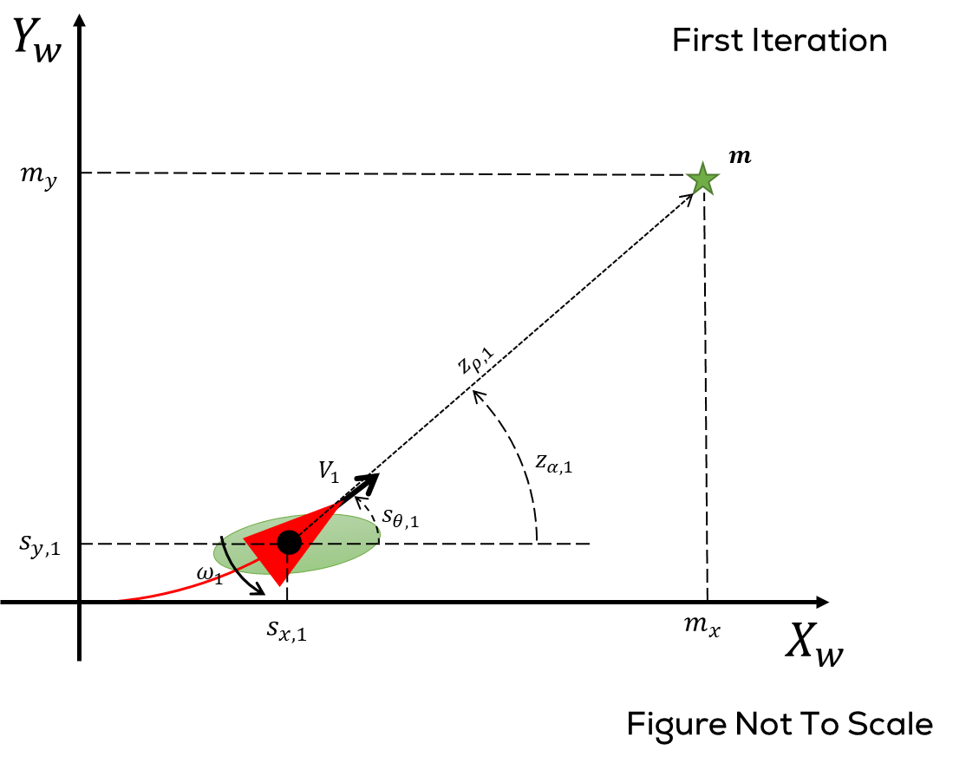
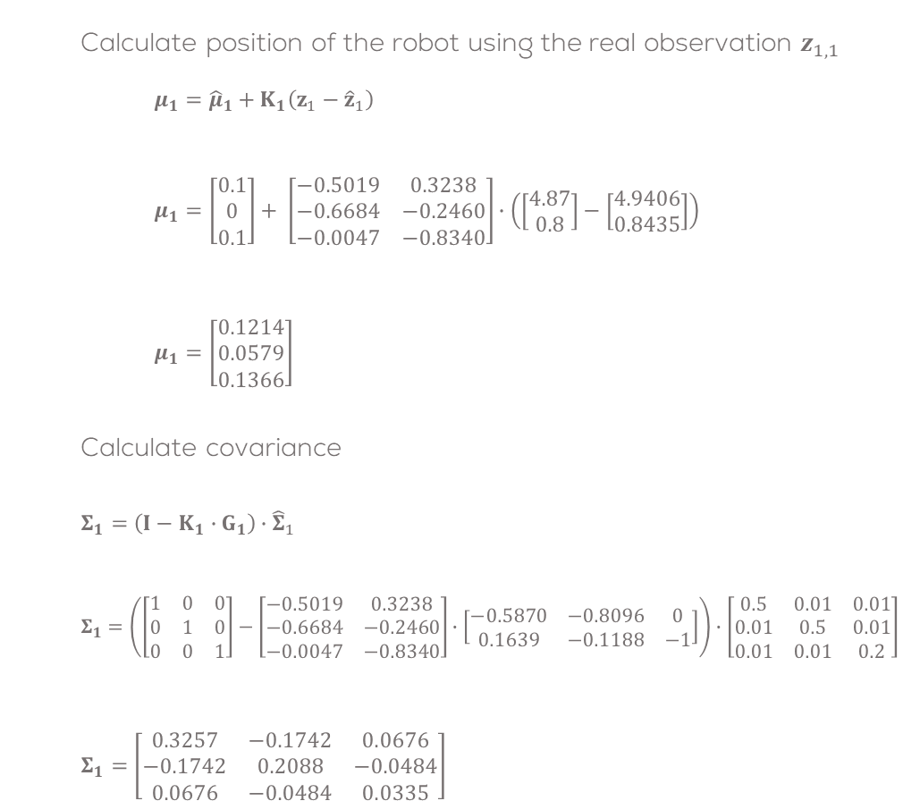
Solution: Iteration 1
Calculate position of the robot using the real observation $z_{1,1}$
$$μ_{1}={\hat{μ}}_{1}+K_{1}\left(z_{1}−{\hat{z}}_{1}\right) \\ μ_{1}=\left[\begin{aligned}0.1 \\ 0 \\ 0.1\end{aligned}\right]+ \left[\begin{matrix}−0.5019 & 0.3238 \\ −0.6684 & −0.2460 \\ −0.0047 & −0.8340\end{matrix}\right]∙\left(\left[\begin{matrix}4.87 \\ 0.8\end{matrix}\right]−\left[\begin{matrix}4.9406 \\ 0.8435\end{matrix}\right]\right) \\ μ_{1}=\left[\begin{aligned}0.1214 \\ 0.0579 \\ 0.1366\end{aligned}\right]$$
Calculate covariance
$$Σ_{1}=\left(I−K_{1}∙G_{1}\right){∙\hat{Σ}}_{1} \\ Σ_{1}=\left(\left[\begin{matrix}1 & 0 & 0 \\ 0 & 1 & 0 \\ 0 & 0 & 1\end{matrix}\right]−\left[\begin{matrix}−0.5019 & 0.3238 \\ −0.6684 & −0.2460 \\ −0.0047 & −0.8340\end{matrix}\right]∙\left[\begin{matrix}−0.5870 & −0.8096 & 0 \\ 0.1639 & −0.1188 & −1\end{matrix}\right]\right)∙\left[\begin{matrix}0.5 & 0.01 & 0.01 \\ 0.01 & 0.5 & 0.01 \\ 0.01 & 0.01 & 0.2\end{matrix}\right] \\ Σ_{1}=\left[\begin{matrix}0.3257 & −0.1742 & 0.0676 \\ −0.1742 & 0.2088 & −0.0484 \\ 0.0676 & −0.0484 & 0.0335\end{matrix}\right]$$
Algorithm 1 EKF Localisation with known data association
$\text{function} \text{EKF}\text{−}\text{Localisation}\text{ (}\text{M}\text{, }μ_{k−1}\text{, }Σ_{k−1}\text{, }u_{k}, z_{i,k}, Q_{k},R_{k})$ ${\hat{μ}}_{k}←h\left(μ_{k−1},u_{k}\right)$ $H_{k}←∇_{s_{k−1}}h(s_{k−1}, u_{k})|_{s_{k−1}=μ_{k−1}}$ ${\hat{Σ}}_{k}←H_{k}Σ_{k−1}H_{k}^{T}+Q_{k}$ $if z_{i,k} corresponds to landmark m_{i}∈M$ ${\hat{z}}_{i,k}←g(m_{i},{\hat{μ}}_{k})$ $G_{k}←∇_{s_{k}} g\left(m_{i},s_{k}\right)|_{s_{k}={\hat{μ}}_{k}}$ $Z_{k}←G_{k}{\hat{Σ}}_{k}G_{k}^{T}+R_{k}$ $K_{k}←{\hat{Σ}}_{k}G_{k}^{T}Z_{k}^{−1}$ $μ_{k}←{\hat{μ}}_{k}+K_{k}\left(z_{i,k}−{\hat{z}}_{i,k}\right)$ $Σ_{k}←\left(I−K_{k}G_{k}\right){\hat{Σ}}_{k}$ $return μ_{k},Σ_{k}$

Slide 10
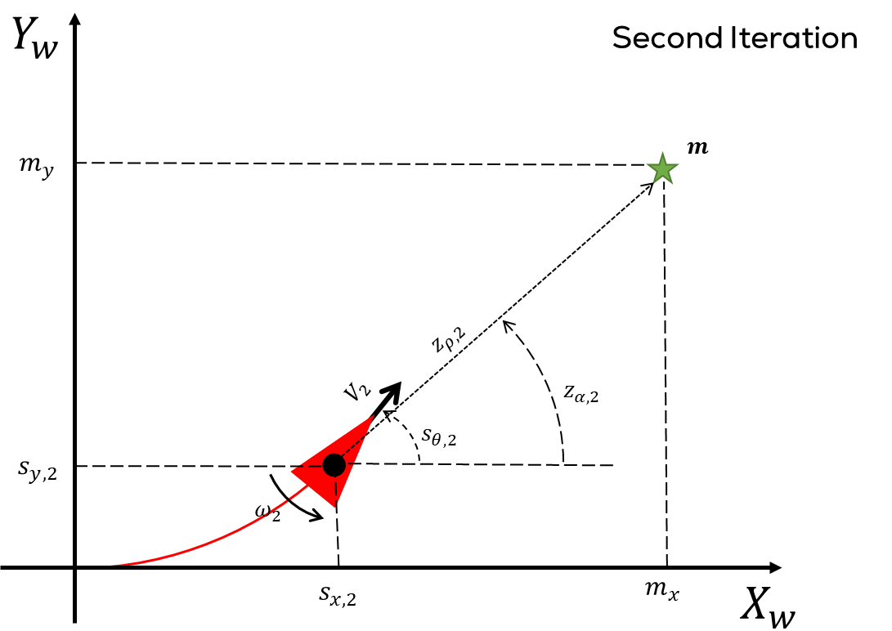

Solution: Iteration 2

Slide 11
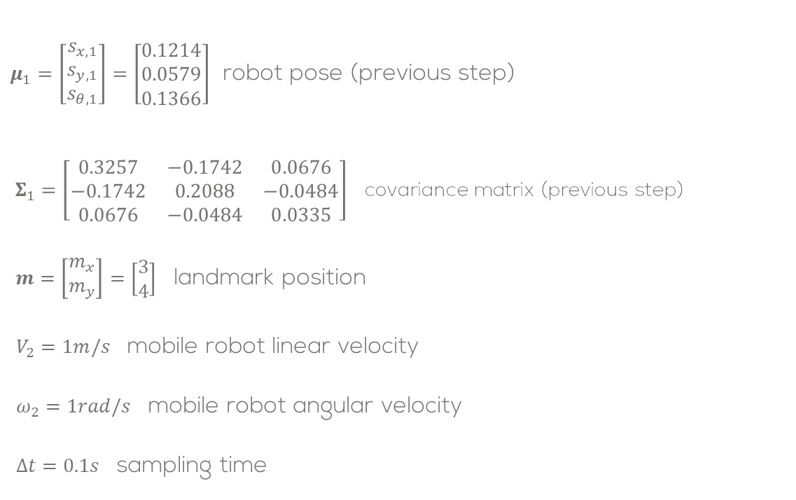
Solution: Iteration 2
$μ_{1}=\left[\begin{aligned}s_{x,1} \\ s_{y,1} \\ s_{θ,1}\end{aligned}\right]=\left[\begin{aligned}0.1214 \\ 0.0579 \\ 0.1366\end{aligned}\right]$ robot pose (previous step)
$Σ_{1}=\left[\begin{matrix}0.3257 & −0.1742 & 0.0676 \\ −0.1742 & 0.2088 & −0.0484 \\ 0.0676 & −0.0484 & 0.0335\end{matrix}\right]$ covariance matrix (previous step)
$m=\left[\begin{matrix}m_{x} \\ m_{y}\end{matrix}\right]=\left[\begin{matrix}3 \\ 4\end{matrix}\right]$ landmark position
$V_{2}=1m/s$ mobile robot linear velocity
$ω_{2}=1rad/s$ mobile robot angular velocity
$Δt=0.1s$ sampling time

Slide 12
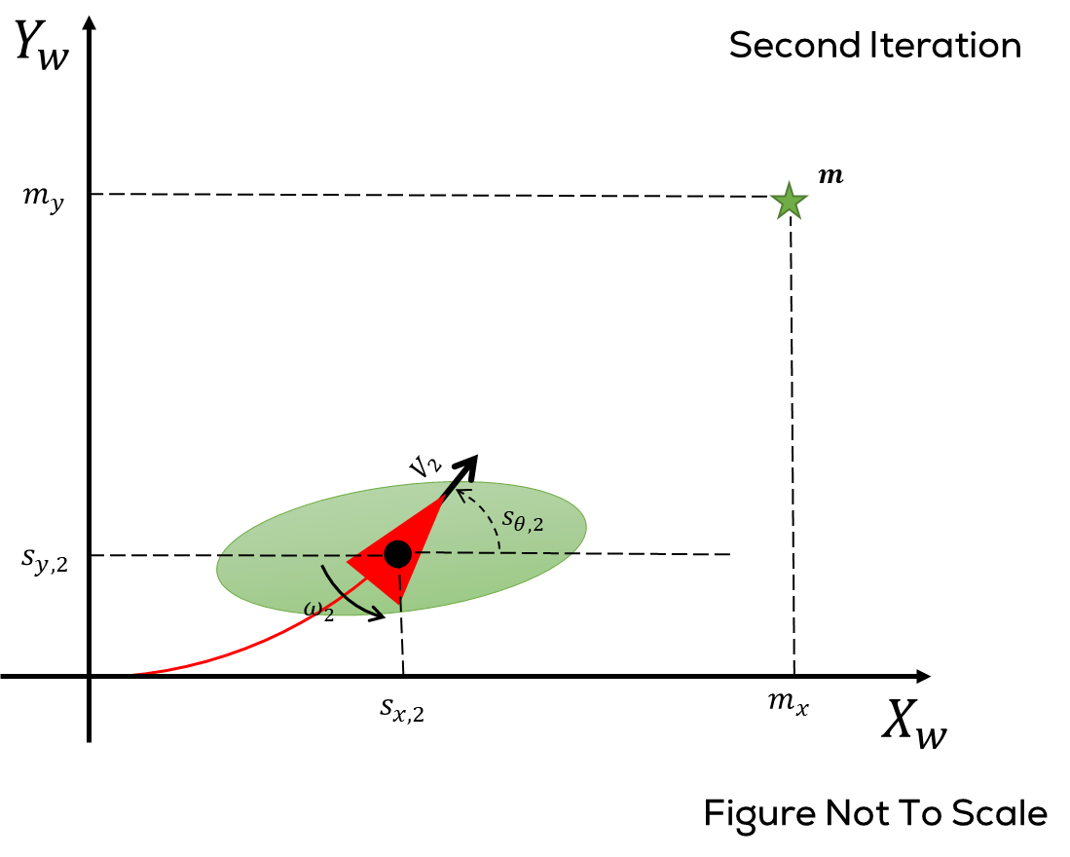
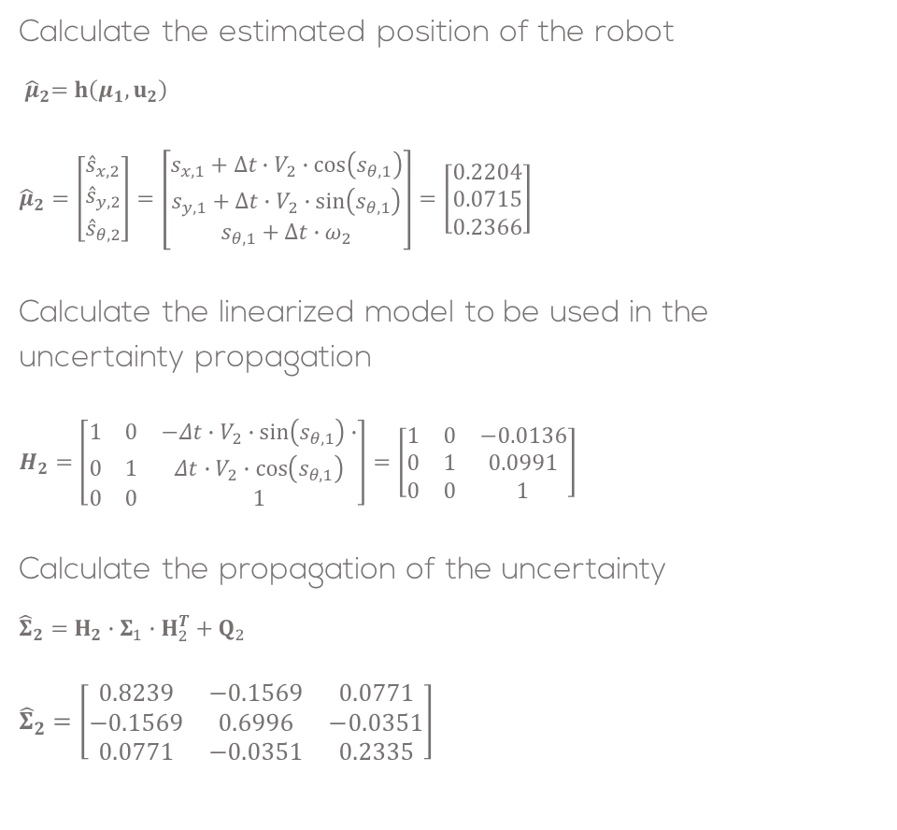
Solution: Iteration 2
Calculate the estimated position of the robot
$${ \hat{μ}}_{2}=h\left(μ_{1},u_{2}\right)$$
$${\hat{μ}}_{2}=\left[\begin{aligned}{\hat{s}}_{x,2} \\ {\hat{s}}_{y,2} \\ {\hat{s}}_{θ,2}\end{aligned}\right]=\left[\begin{aligned}s_{x,1}+Δt∙V_{2}∙\cos\left(s_{θ,1}\right) \\ s_{y,1}+Δt∙V_{2}∙\sin\left(s_{θ,1}\right) \\ s_{θ,1}+Δt∙ω_{2}\end{aligned}\right]=\left[\begin{aligned}0.2204 \\ 0.0715 \\ 0.2366\end{aligned}\right]$$
Calculate the linearized model to be used in the uncertainty propagation
$$H_{2}=\left[\begin{matrix}1 & 0 & −Δt∙V_{2}∙\sin\left(s_{θ,1}\right)∙ \\ 0 & 1 & Δt∙V_{2}∙\cos\left(s_{θ,1}\right) \\ 0 & 0 & 1\end{matrix}\right]=\left[\begin{matrix}1 & 0 & −0.0136 \\ 0 & 1 & 0.0991 \\ 0 & 0 & 1\end{matrix}\right]$$
Calculate the propagation of the uncertainty
$${\hat{Σ}}_{2}=H_{2}∙Σ_{1}∙H_{2}^{T}+Q_{2}$$
$${\hat{Σ}}_{2}=\left[\begin{matrix}0.8239 & −0.1569 & 0.0771 \\ −0.1569 & 0.6996 & −0.0351 \\ 0.0771 & −0.0351 & 0.2335\end{matrix}\right]$$

Slide 13
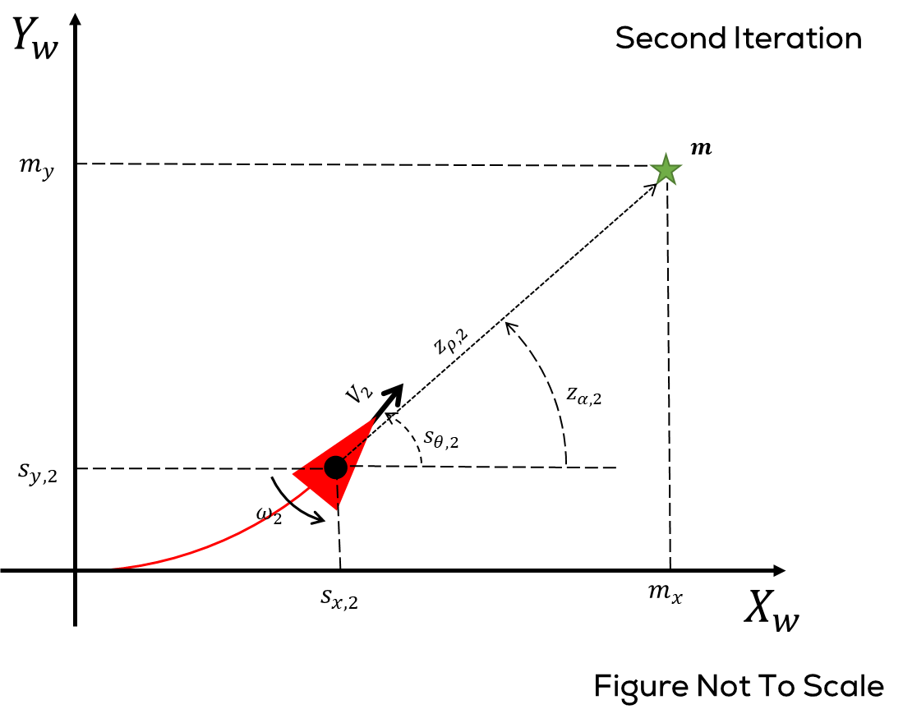
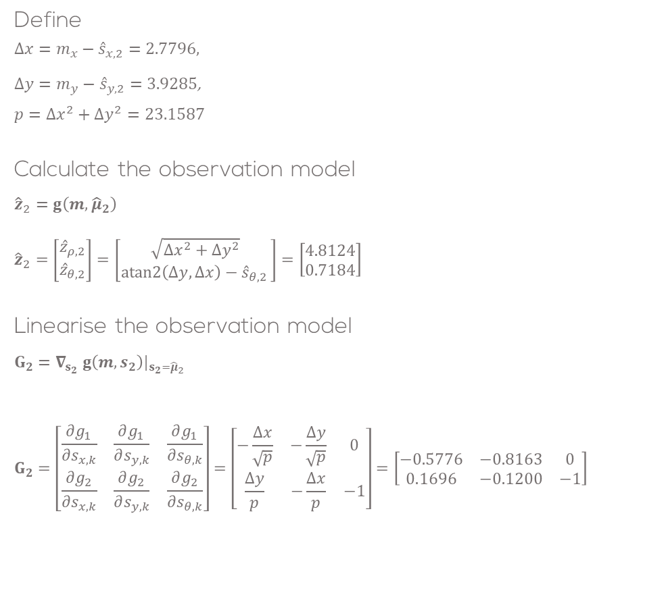
Solution: Iteration 2
Define
$Δx=m_{x}−{\hat{s}}_{x,2}=2.7796$,
$Δy=m_{y}−{\hat{s}}_{y,2}=3.9285$,
$$p=Δx^{2}+Δy^{2}=23.1587$$
Calculate the observation model
$${\hat{z}}_{2}=g\left(m,{\hat{μ}}_{2}\right)$$
$${\hat{z}}_{2}=\left[\begin{matrix}{\hat{z}}_{ρ,2} \\ {\hat{z}}_{θ,2}\end{matrix}\right]=\left[\begin{matrix}\sqrt{Δx^{2}+Δy^{2}} \\ atan2\left(Δy,Δx\right)−{\hat{s}}_{θ,2 }\end{matrix}\right]=\left[\begin{matrix}4.8124 \\ 0.7184\end{matrix}\right]$$
Linearise the observation model
$$G_{2}=∇_{s_{2}} g\left(m,s_{2}\right)|_{s_{2}={\hat{μ}}_{2}}$$
$$G_{2}=\left[\begin{matrix}\frac{∂g_{1}}{∂s_{x,k}} & \frac{∂g_{1}}{∂s_{y,k}} & \frac{∂g_{1}}{∂s_{θ,k}} \\ \frac{∂g_{2}}{∂s_{x,k}} & \frac{∂g_{2}}{∂s_{y,k}} & \frac{∂g_{2}}{∂s_{θ,k}}\end{matrix}\right]=\left[\begin{matrix}−\frac{Δx}{\sqrt{p}} & −\frac{Δy}{\sqrt{p}} & 0 \\ \frac{Δy}{p} & −\frac{Δx}{p} & −1\end{matrix}\right]=\left[\begin{matrix}−0.5776 & −0.8163 & 0 \\ 0.1696 & −0.1200 & −1\end{matrix}\right]$$

Slide 14

Solution: Iteration 2
Using the linearised model compute the measurement uncertainty propagation
$$Z_{2}=G_{2}∙{\hat{Σ}}_{2}∙G_{2}^{T}+R_{2} \\ Z_{2}=\left[\begin{matrix}0.6931 & 0.0146 \\ 0.0146 & 0.2591\end{matrix}\right]$$
Calculate Kalaman Gain
$$K_{2}={\hat{Σ}}_{2}{∙G}_{2}^{T}{∙Z}_{2}^{−1}$$
$$K_{2}=\left[\begin{matrix}−0.5090 & 0.3430 \\ −0.6879 & −0.2526 \\ −0.0054 & −0.8342\end{matrix}\right]$$

Slide 15
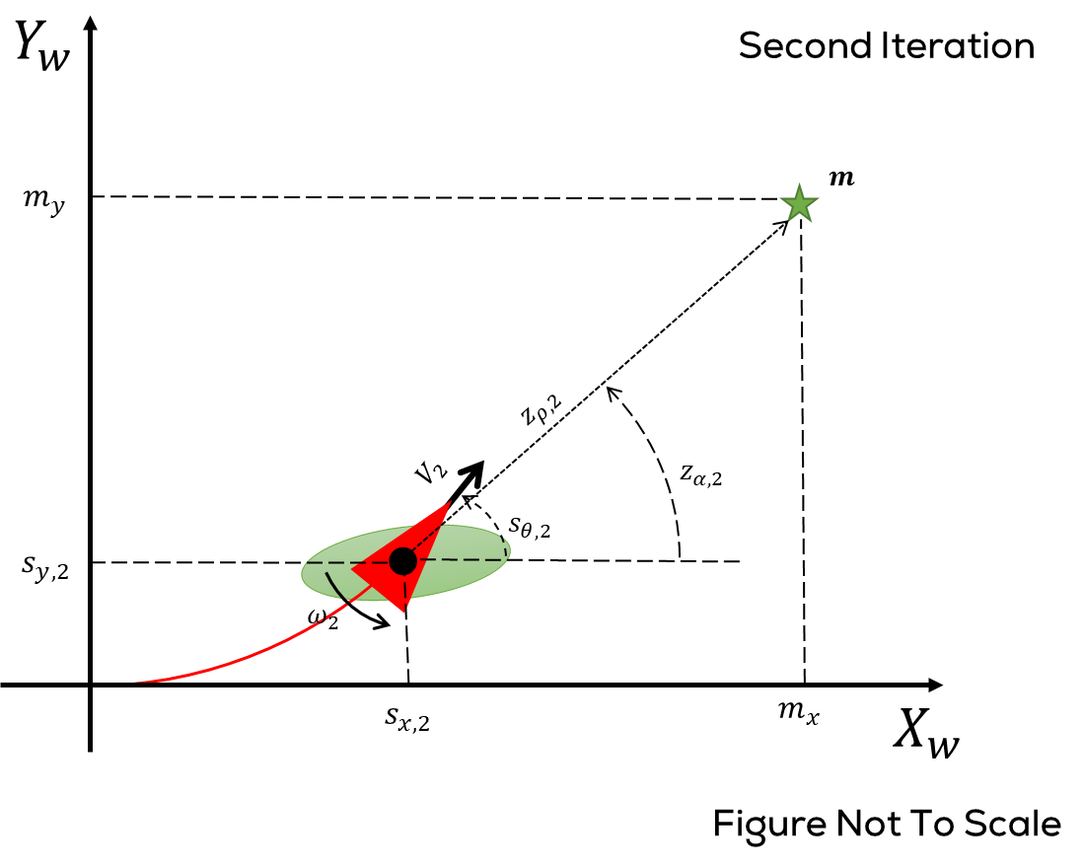
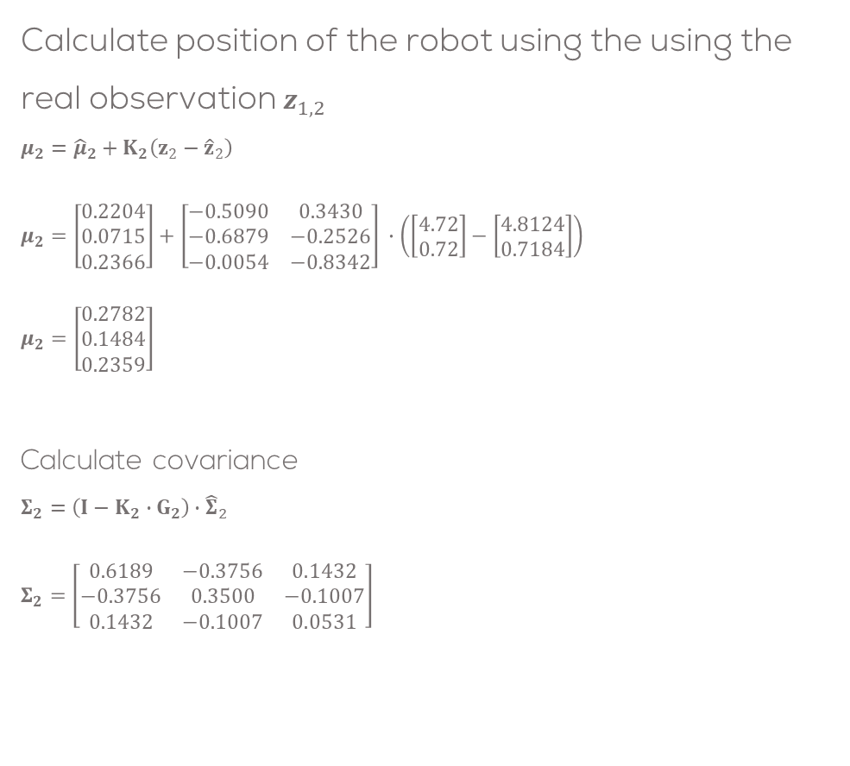
Solution: Iteration 2
Calculate position of the robot using the using the real observation $z_{1,2}$
$$μ_{2}={\hat{μ}}_{2}+K_{2}\left(z_{2}−{\hat{z}}_{2}\right)$$
$$μ_{2}=\left[\begin{aligned}0.2204 \\ 0.0715 \\ 0.2366\end{aligned}\right]+\left[\begin{matrix}−0.5090 & 0.3430 \\ −0.6879 & −0.2526 \\ −0.0054 & −0.8342\end{matrix}\right] ∙\left(\left[\begin{matrix}4.72 \\ 0.72\end{matrix}\right]−\left[\begin{matrix}4.8124 \\ 0.7184\end{matrix}\right]\right) \\ μ_{2}=\left[\begin{aligned}0.2782 \\ 0.1484 \\ 0.2359\end{aligned}\right]$$
Calculate covariance
$$Σ_{2}=\left(I−K_{2}∙G_{2}\right){∙\hat{Σ}}_{2}$$
$$Σ_{2}=\left[\begin{matrix}0.6189 & −0.3756 & 0.1432 \\ −0.3756 & 0.3500 & −0.1007 \\ 0.1432 & −0.1007 & 0.0531\end{matrix}\right]$$

Slide 16
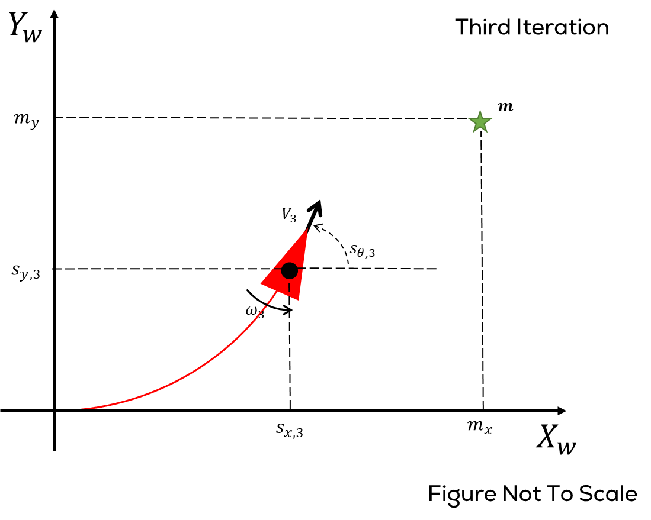
Solution: Iteration 3

Slide 17
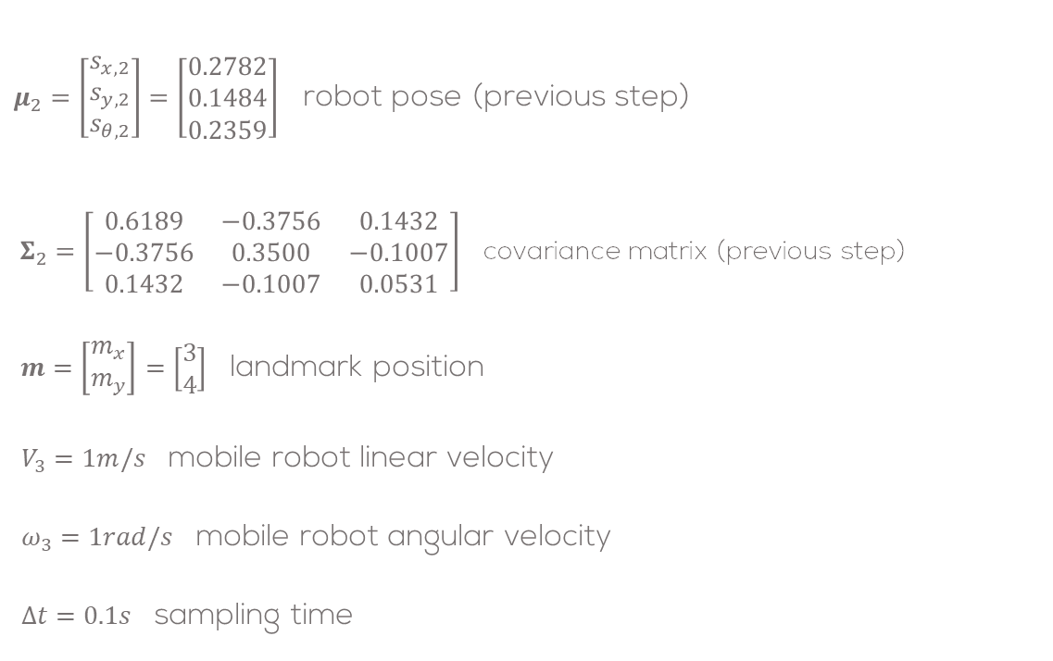
Solution: Iteration 3
$μ_{2}=\left[\begin{aligned}s_{x,2} \\ s_{y,2} \\ s_{θ,2}\end{aligned}\right]=\left[\begin{aligned}0.2782 \\ 0.1484 \\ 0.2359\end{aligned}\right]$ robot pose (previous step)
$Σ_{2}=\left[\begin{matrix}0.6189 & −0.3756 & 0.1432 \\ −0.3756 & 0.3500 & −0.1007 \\ 0.1432 & −0.1007 & 0.0531\end{matrix}\right]$ covariance matrix (previous step)
$m=\left[\begin{matrix}m_{x} \\ m_{y}\end{matrix}\right]=\left[\begin{matrix}3 \\ 4\end{matrix}\right]$ landmark position
$V_{3}=1m/s$ mobile robot linear velocity
$ω_{3}=1rad/s$ mobile robot angular velocity
$Δt=0.1s$ sampling time

Slide 18
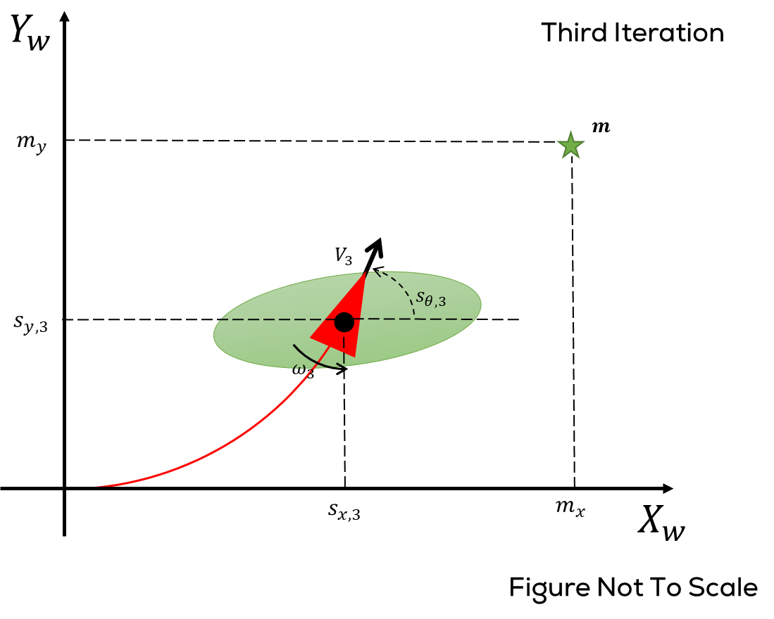
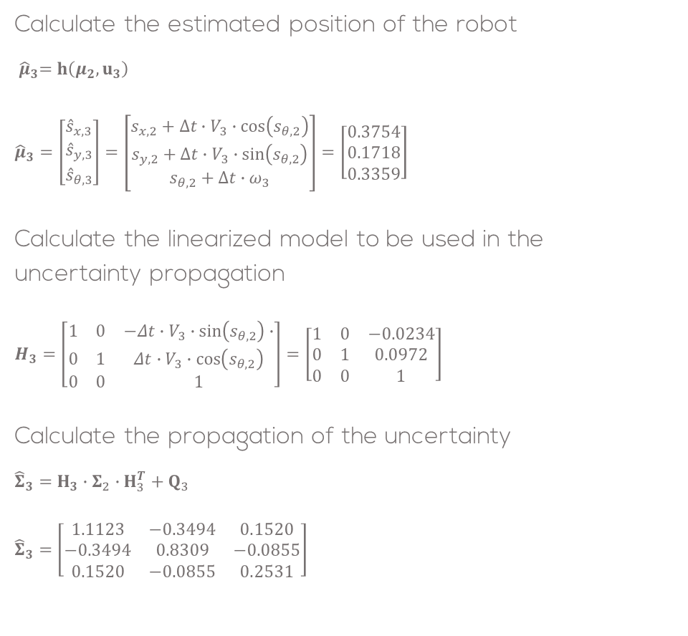
Solution: Iteration 3
Calculate the estimated position of the robot
$${ \hat{μ}}_{3}=h\left(μ_{2},u_{3}\right)$$
$${\hat{μ}}_{3}=\left[\begin{aligned}{\hat{s}}_{x,3} \\ {\hat{s}}_{y,3} \\ {\hat{s}}_{θ,3}\end{aligned}\right]=\left[\begin{aligned}s_{x,2}+Δt∙V_{3}∙\cos\left(s_{θ,2}\right) \\ s_{y,2}+Δt∙V_{3}∙\sin\left(s_{θ,2}\right) \\ s_{θ,2}+Δt∙ω_{3}\end{aligned}\right]=\left[\begin{aligned}0.3754 \\ 0.1718 \\ 0.3359\end{aligned}\right]$$
Calculate the linearized model to be used in the uncertainty propagation
$$H_{3}=\left[\begin{matrix}1 & 0 & −Δt∙V_{3}∙\sin\left(s_{θ,2}\right)∙ \\ 0 & 1 & Δt∙V_{3}∙\cos\left(s_{θ,2}\right) \\ 0 & 0 & 1\end{matrix}\right]=\left[\begin{matrix}1 & 0 & −0.0234 \\ 0 & 1 & 0.0972 \\ 0 & 0 & 1\end{matrix}\right]$$
Calculate the propagation of the uncertainty
$${\hat{Σ}}_{3}=H_{3}∙Σ_{2}∙H_{3}^{T}+Q_{3}$$
$${\hat{Σ}}_{3}=\left[\begin{matrix}1.1123 & −0.3494 & 0.1520 \\ −0.3494 & 0.8309 & −0.0855 \\ 0.1520 & −0.0855 & 0.2531\end{matrix}\right]$$

Slide 19

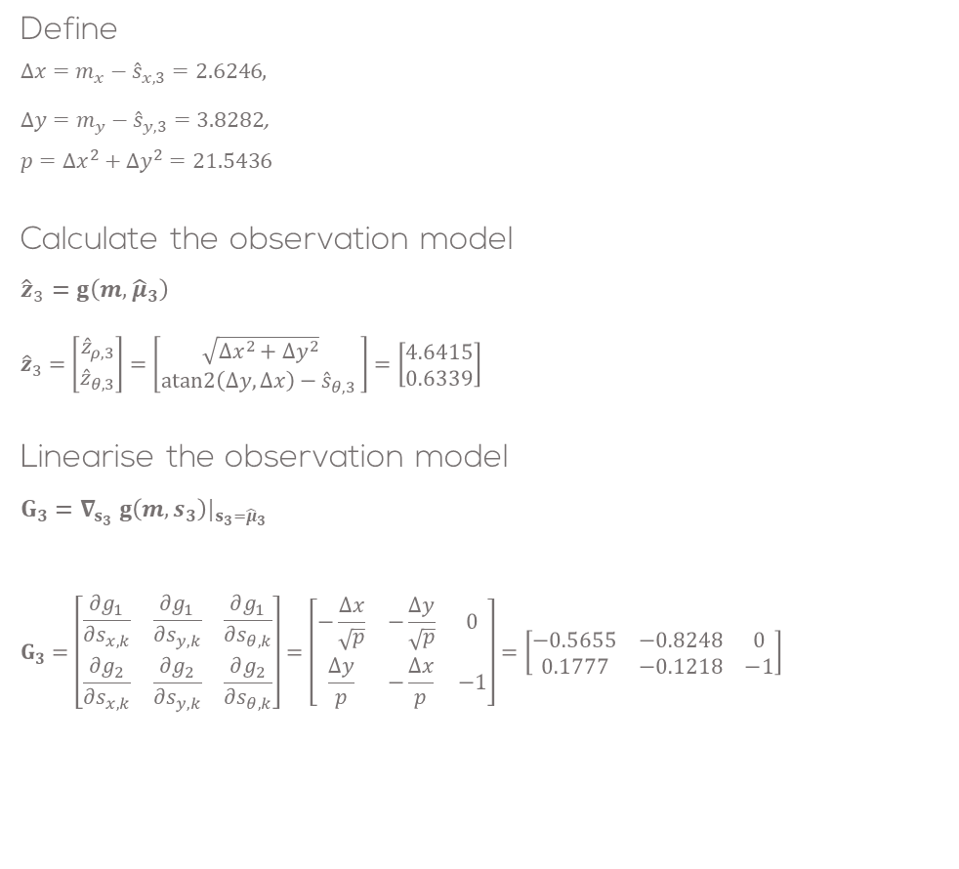
Solution: Iteration 2
Define
$Δx=m_{x}−{\hat{s}}_{x,3}=2.6246$,
$Δy=m_{y}−{\hat{s}}_{y,3}=3.8282$,
$$p=Δx^{2}+Δy^{2}=21.5436$$
Calculate the observation model
$${\hat{z}}_{3}=g\left(m,{\hat{μ}}_{3}\right)$$
$${\hat{z}}_{3}=\left[\begin{matrix}{\hat{z}}_{ρ,3} \\ {\hat{z}}_{θ,3}\end{matrix}\right]=\left[\begin{matrix}\sqrt{Δx^{2}+Δy^{2}} \\ atan2\left(Δy,Δx\right)−{\hat{s}}_{θ,3 }\end{matrix}\right]=\left[\begin{matrix}4.6415 \\ 0.6339\end{matrix}\right]$$
Linearise the observation model
$$G_{3}=∇_{s_{3}} g\left(m,s_{3}\right)|_{s_{3}={\hat{μ}}_{3}}$$
$$G_{3}=\left[\begin{matrix}\frac{∂g_{1}}{∂s_{x,k}} & \frac{∂g_{1}}{∂s_{y,k}} & \frac{∂g_{1}}{∂s_{θ,k}} \\ \frac{∂g_{2}}{∂s_{x,k}} & \frac{∂g_{2}}{∂s_{y,k}} & \frac{∂g_{2}}{∂s_{θ,k}}\end{matrix}\right]=\left[\begin{matrix}−\frac{Δx}{\sqrt{p}} & −\frac{Δy}{\sqrt{p}} & 0 \\ \frac{Δy}{p} & −\frac{Δx}{p} & −1\end{matrix}\right]=\left[\begin{matrix}−0.5655 & −0.8248 & 0 \\ 0.1777 & −0.1218 & −1\end{matrix}\right]$$

Slide 20

Solution: Iteration 2
Using the linearised model compute the measurement uncertainty propagation
$$Z_{3}=G_{3}∙{\hat{Σ}}_{3}∙G_{3}^{T}+R_{3} \\ Z_{3}=\left[\begin{matrix}0.6950 & 0.0143 \\ 0.0143 & 0.2608\end{matrix}\right]$$
Calculate Kalaman Gain
$$K_{3}={\hat{Σ}}_{3}{∙G}_{3}^{T}{∙Z}_{3}^{−1}$$
$$K_{3}=\left[\begin{matrix}−0.4978 & 0.3656 \\ −0.6965 & −0.2602 \\ −0.0052 & −0.8266\end{matrix}\right]$$

Slide 21
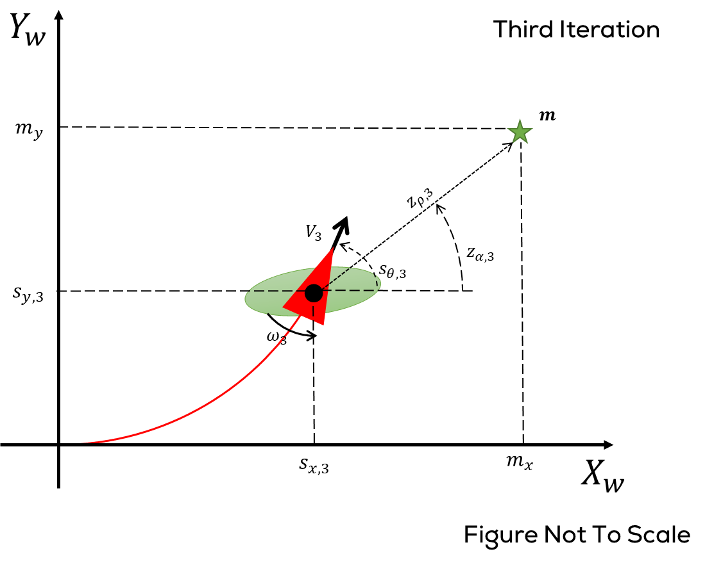
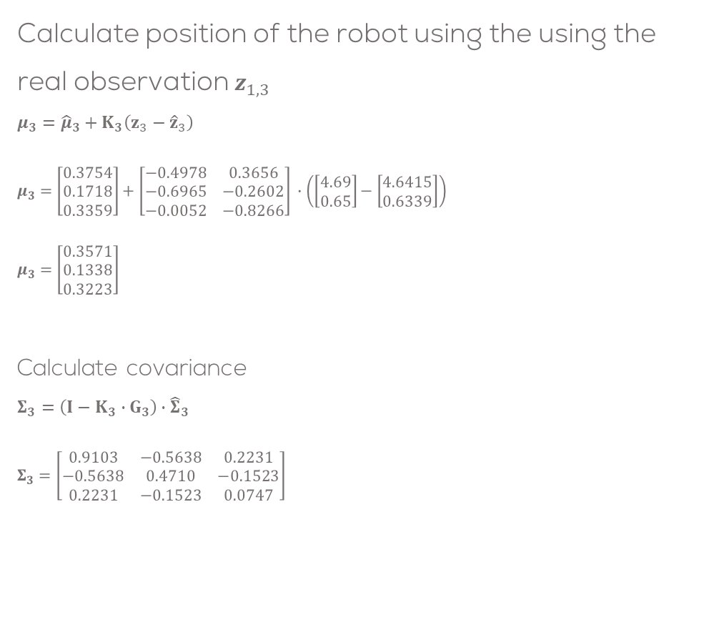
Solution: Iteration 2
Calculate position of the robot using the using the real observation $z_{1,3}$
$$μ_{3}={\hat{μ}}_{3}+K_{3}\left(z_{3}−{\hat{z}}_{3}\right)$$
$$μ_{3}=\left[\begin{aligned}0.3754 \\ 0.1718 \\ 0.3359\end{aligned}\right]+\left[\begin{matrix}−0.4978 & 0.3656 \\ −0.6965 & −0.2602 \\ −0.0052 & −0.8266\end{matrix}\right] ∙\left(\left[\begin{matrix}4.69 \\ 0.65\end{matrix}\right]−\left[\begin{matrix}4.6415 \\ 0.6339\end{matrix}\right]\right) \\ μ_{3}=\left[\begin{aligned}0.3571 \\ 0.1338 \\ 0.3223\end{aligned}\right]$$
Calculate covariance
$$Σ_{3}=\left(I−K_{3}∙G_{3}\right){∙\hat{Σ}}_{3}$$
$$Σ_{3}=\left[\begin{matrix}0.9103 & −0.5638 & 0.2231 \\ −0.5638 & 0.4710 & −0.1523 \\ 0.2231 & −0.1523 & 0.0747\end{matrix}\right]$$

