Slide 1
Robot Modelling
Mini challenge 1

Slide 2
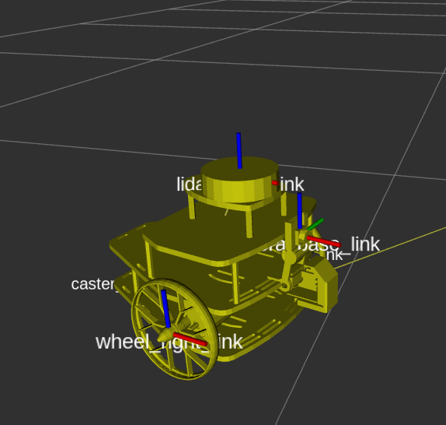
Introduction
Introduction
This mini challenge is intended for the student to review the concepts introduced in the previous sessions.
The activity consists of modelling a differential drive robot in RVIZ.
The robot must be modelled using ROS markers or URDF format.
The robot must use the tf2 library of ROS.

Slide 3
Robot modelling
Make a new package called “puzzlebot_sim”, with the following packages
std_msgs, sensor_msgs, geometry_msgs, ros2launch, tf2_ros_py, python3-numpy, python3-transforms3d, rclpy, robot_state_publisher, joint_state_publisher_gui
Use transformations and different markers (with meshes) or a URDF description file to build a simple mobile robot (differential drive).
The robot must contain a chassis, two wheels and a caster ball.
The student can use some basic shapes to test the robot and then replace them with the provided .stl files.
Front View
Back View

Slide 4
Robot modelling
map
The expected transformations are represented on the right diagram.
map: fixed frame
base_footprint: robot pose representation in the 2D (x,y plane).
base_link: base link representing the robot’s centre.
wheel_r, wheel_l: wheel link
caster: caster ball link.
static tf
odom
dynamic tf / joint
base_footprint
static tf
dynamic tf / joint
base_link
static tf / joint
dynamic tf
wheel_r
wheel_l
caster

Slide 5
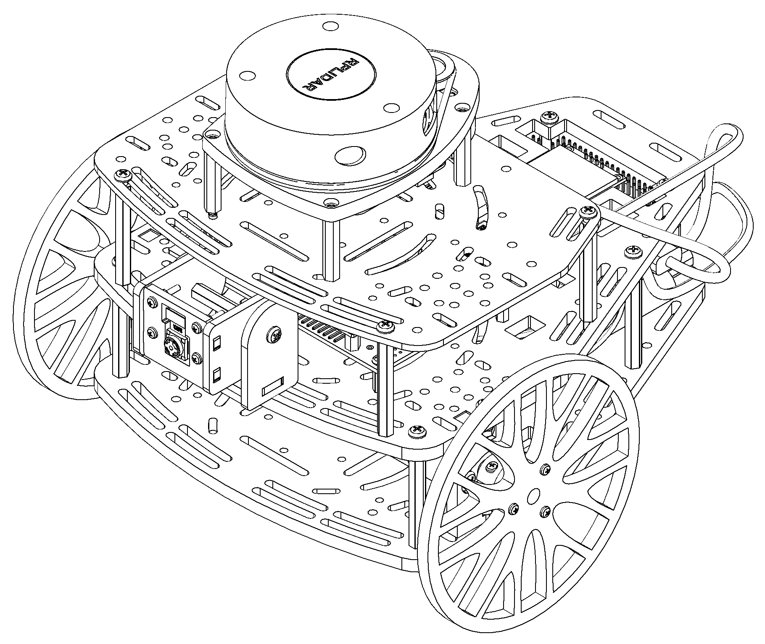
Robot modelling
Robot
base_laser
wheel_r
caster
chassis
base_link
wheel_l
base_footprint
odom
map

Slide 6
Robot Modelling
Joint / TF | Parent Link | Child Link | Translation | Rotation
base_link_joint | base_footprint | base_link | x= 0.0 y = 0.0 z = 0.05 | r = 0.0 p = 0.0 y = 0.0
wheel_r_joint | base_link | wheel_r_link | x= 0.052 y = -0.095 z = -0.0025 | r = 0.0 p = 0.0 y = 0.0
wheel_l_joint | base_link | wheel_l_link | x= 0.052 y = 0.095 z = -0.0025 | r = 0.0 p = 0.0 y = 0.0
caster_joint | base_link | caster_link | x= -0.095 y = 0.0 z = -0.03 | r = 0.0 p = 0.0 y = 0.0

Slide 7
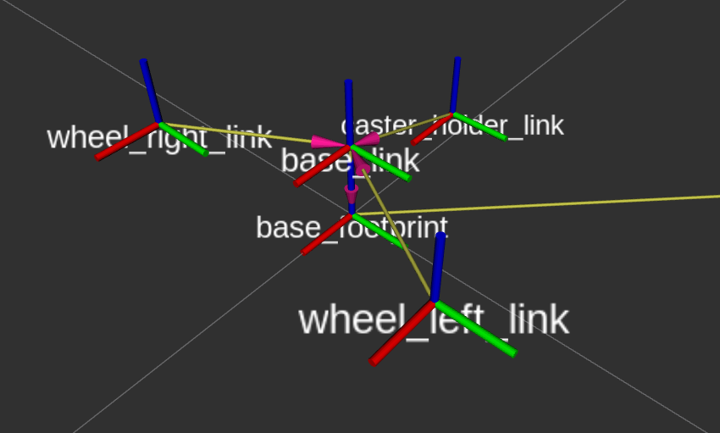
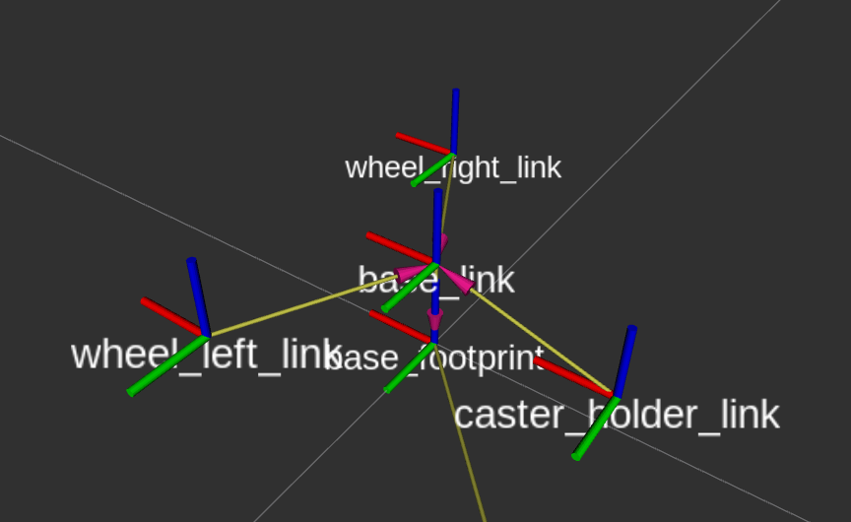
Robot Modelling
Front View
Back View

Slide 8
Robot modelling
Use the .stl files provided to make the robot look like the Puzzlebot.
MCR2_puzzlebot_jetson_lidar_base.stl
MCR2_wheel.stl
MCR2_caster_wheel.stl
The .stl files are off-centre and some rotated, use the following measurements to centre them to each defined link. Alternatively, you can use any CAD software to verify the distances to the centre of the figure.
Please be aware that these measurements are when the links are defined by default.
Link/Frame | .stl file | Translation to centre | Rotation to centre
base_link | MCR2_puzzlebot_jetson_lidar_base.stl | x= 0.05 y = 0.0 z = 0.097 | r = 1.57 p = 0.0 y = 3.1416
wheel_l_link | MCR2_wheel.stl | x= 0.055 y = 0.005 z = 0 | r = -1.57 p =0 y =0
wheel_r_link | MCR2_wheel.stl | x= 0.055 y = -0.005 z = 0 | r = 1.57 p =0 y =0
caster_link | MCR2_caster_wheel.stl | x= 0 y = 0 z = -0.015 | r = 0 p =0 y =0

Slide 9
Robot modelling

Slide 10
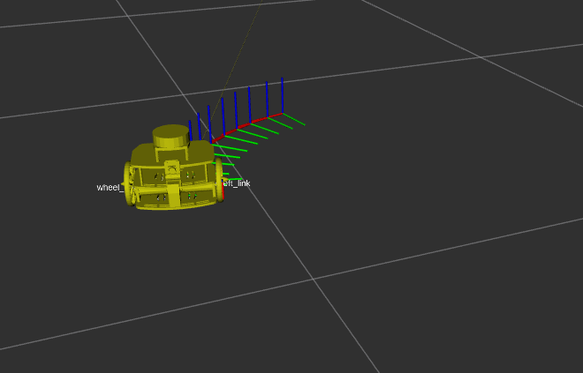
Expected results
The robot should spawn in the RVIZ world.
The robot should be able to move around a central position.
If possible, move the wheels!.

