Slide 1
Challenges
Mini challenge 3

Slide 2
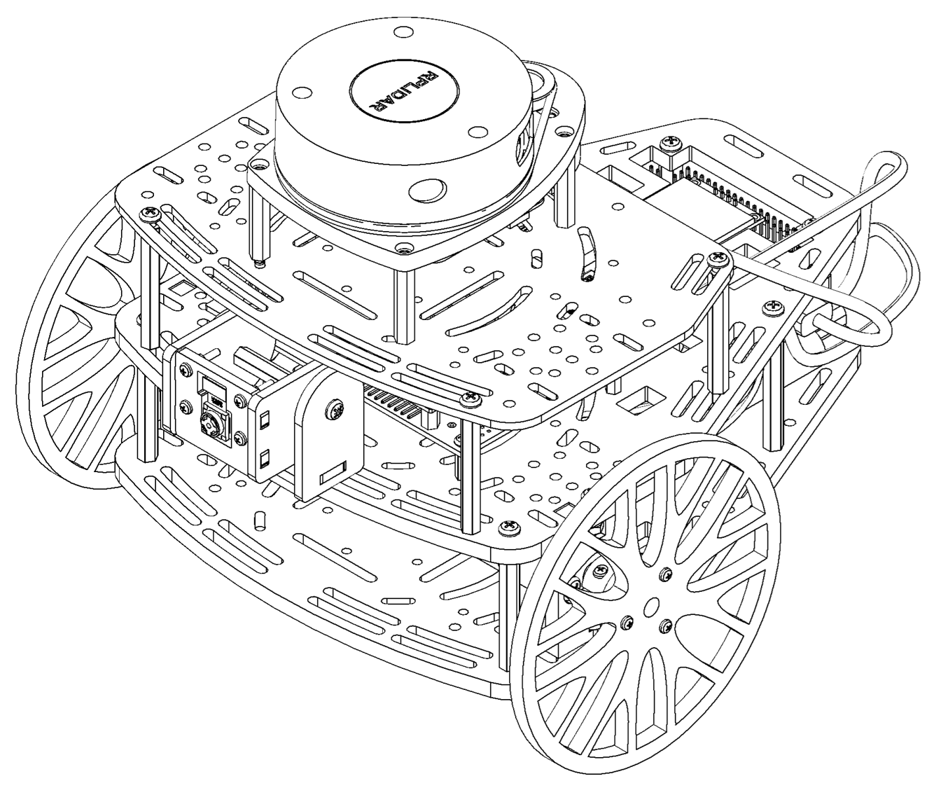
Mini challenge 3
This challenge consists of the simulation and control of multiple robots.
The student must use the previous puzzlebot kinematic simulator and use the knowledge of parameters, namespaces and Transforms in ROS2 to define a multi Puzzlebot simulator.

Slide 3
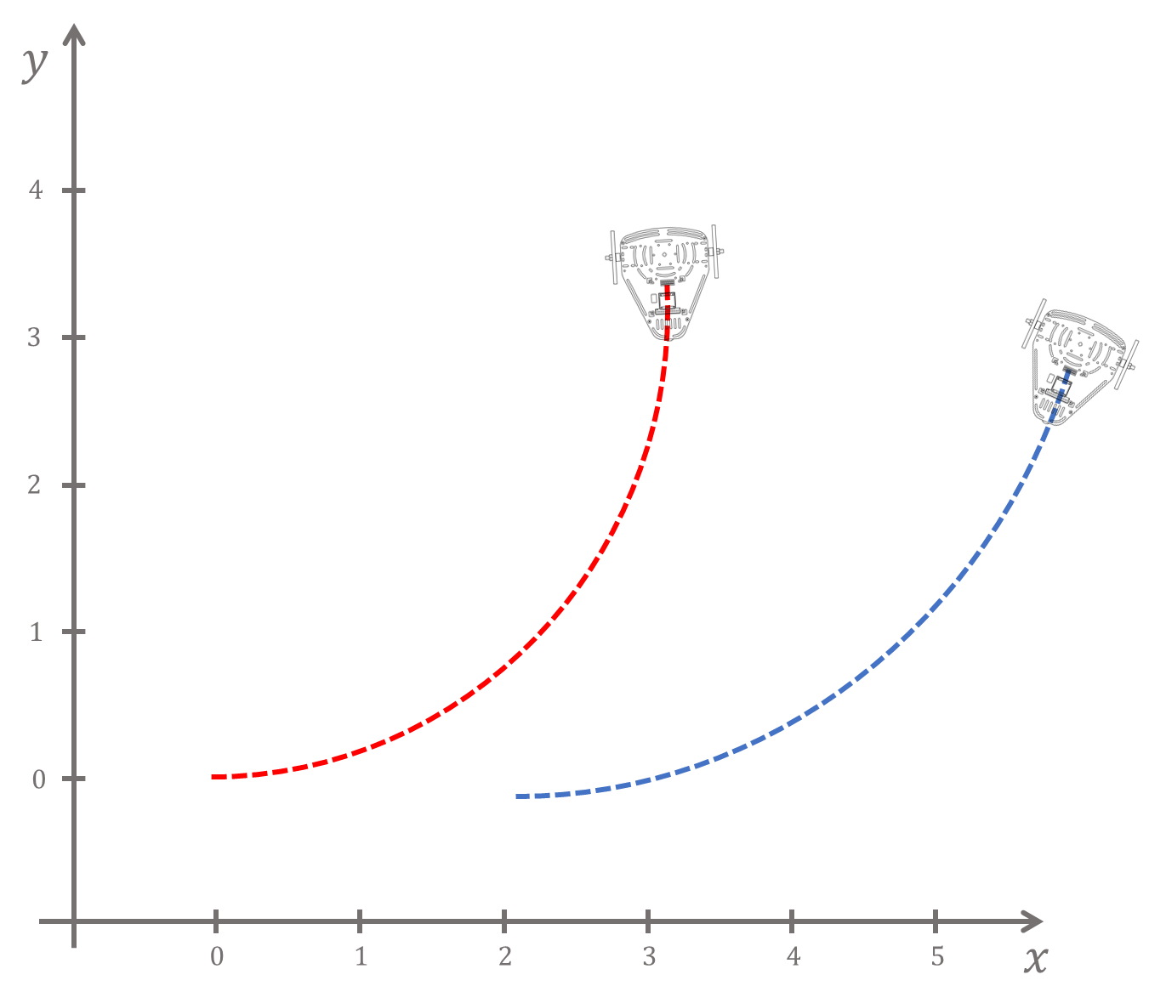
Mini challenge 3
As stated before, this activity consists of creating multiple groups of nodes to simulate and control multiple robots.
Simulate multiple nonholonomic robot (e.g., Puzzlebot) using ROS2.
Every robot must contain its own joint state publisher, kinematic simulation, controller and localisation node.
Each robot must be independently controlled.

Slide 4
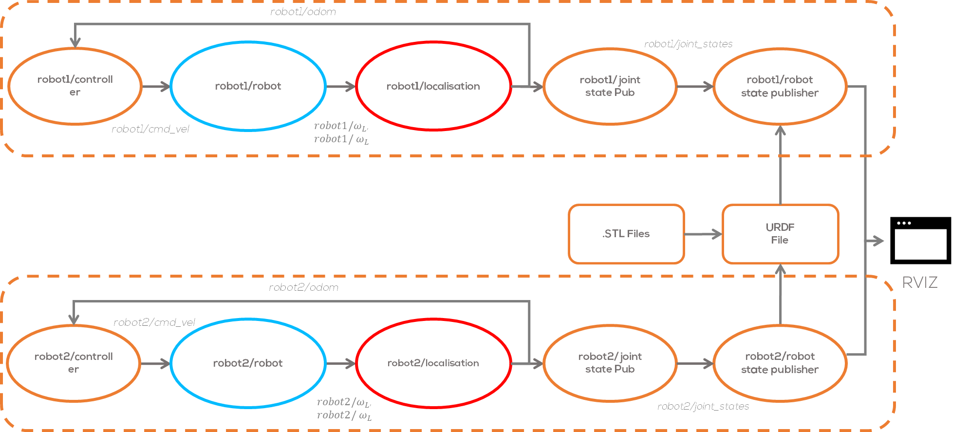

Slide 5
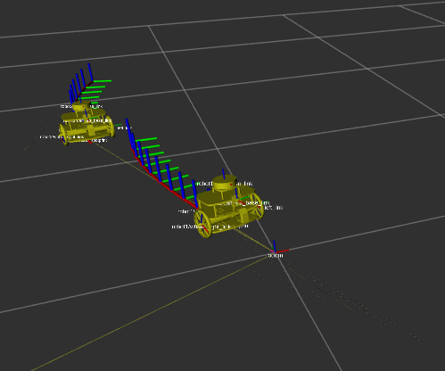
Mini challenge 3
The student must define two groups using namespaces “robot1” and “robot2” respectively.
The student must use namespaces and parameters to avoid naming conflicts for transforms and topics.
The student must define different initial positions for each robots and different set points to control them.

Slide 6
Mini challenge 3: Extra (optional)
Use substitutions and arguments to define a single reusable launch file and use it for two robots.
More information about substitutions can be found here.

Slide 7
Rules
This is challenge not a class. The students are encouraged to research, improve tune explain their algorithms by themselves.
MCR2(Manchester Robotics) Reserves the right to answer a question if it is determined that the questions contains partially or totally an answer.
The students are welcomed to ask only about the theoretical aspect of the classed.
No remote control or any other form of human interaction with the simulator or ROS is allowed (except at the start when launching the files).
It is forbidden to use any other internet libraires with the exception of standard libraires or NumPy.
If in doubt about libraires please ask any teaching assistant.
Improvements to the algorithms are encouraged and may be used as long as the students provide the reasons and a detailed explanation on the improvements.
All the students must be respectful towards each other and abide by the previously defined rules.
Manchester robotics reserves the right to provide any form of grading. Grading and grading methodology are done by the professor in charge of the unit.

