Slide 1
Challenges
Mini challenge 2

Slide 2
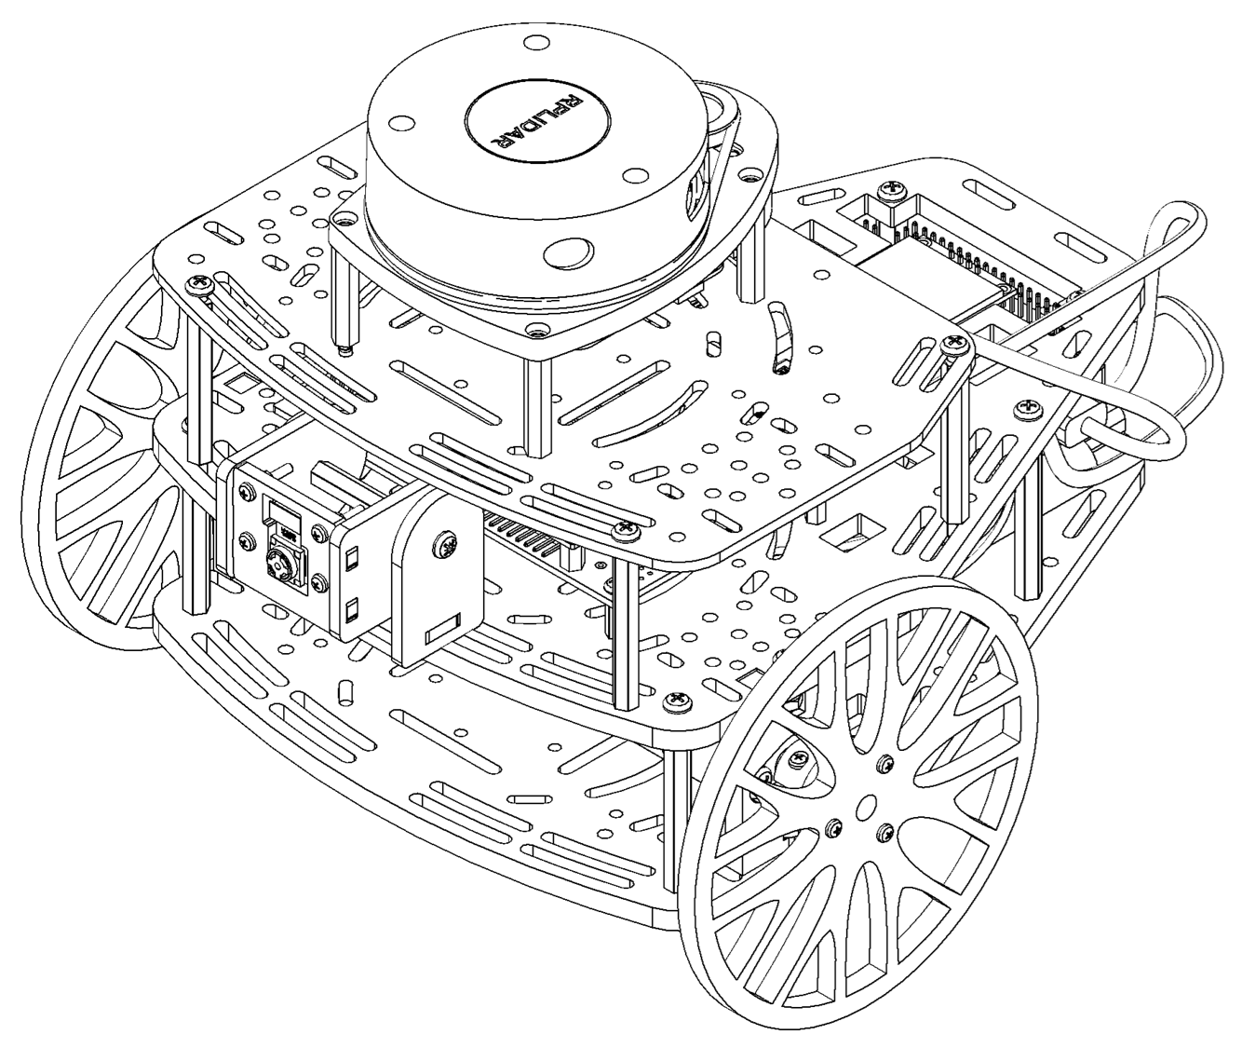
Mini challenge 2
This challenge is intended for the student to review the concepts introduced in this week. The challenge is divided into three parts:
Part 1:
Development of a kinematic simulator for the Puzzlebot robotic platform using the kinematic model of a nonholonomic robot.
Part 2:
Develop a dead reckoning localisation node for the Puzzlebot. The results of the simulation must be visualised in RVIZ.
The visualisation must be a 3D robot on RVIZ.
Part 3:
Develop a node for controlling the position of the Puzzlebot (point stabilisation).

Slide 3
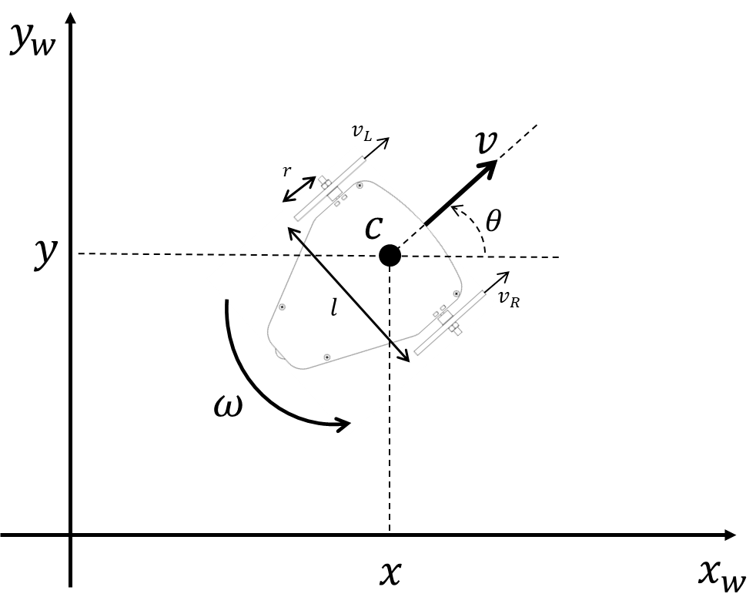
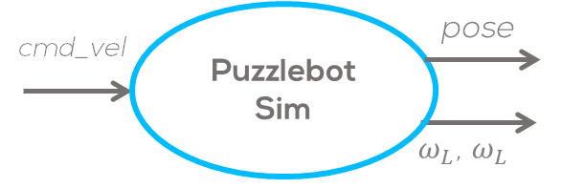
Mini challenge 2: Part 1
This part of the activity consists of creating a node that simulates a dynamical system.
Simulate a nonholonomic robot (e.g., Puzzlebot) using ROS.

Slide 4
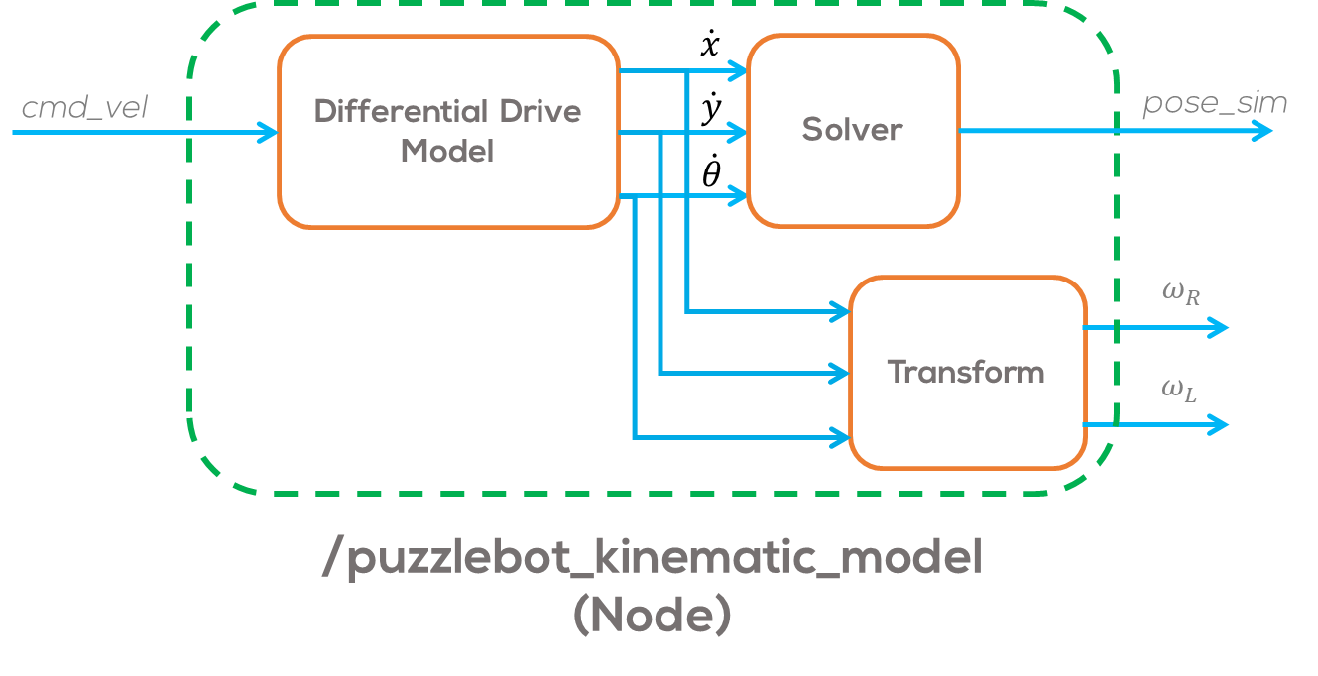
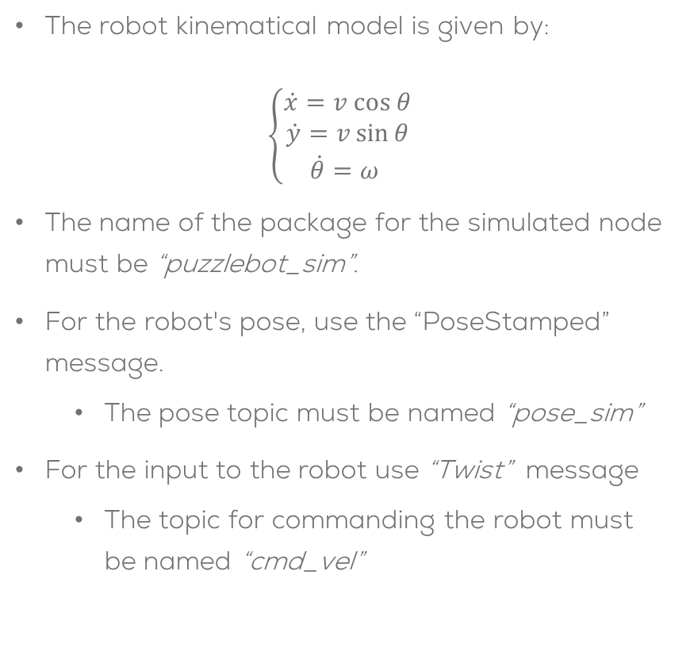
Mini challenge 2: Part 1
The robot kinematical model is given by:
$$\left\{\begin{aligned}\dot{x}=v cos θ \\ \dot{y}=v\sin{θ} \\ \dot{θ}=ω \end{aligned}\right.$$
The name of the package for the simulated node must be “puzzlebot_sim”.
For the robot's pose, use the “PoseStamped” message.
The pose topic must be named “pose_sim”
For the input to the robot use “Twist” message
The topic for commanding the robot must be named “cmd_vel”

Slide 5
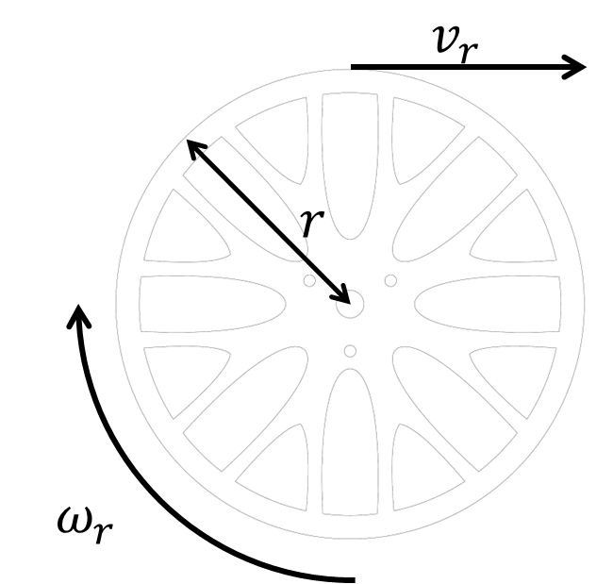
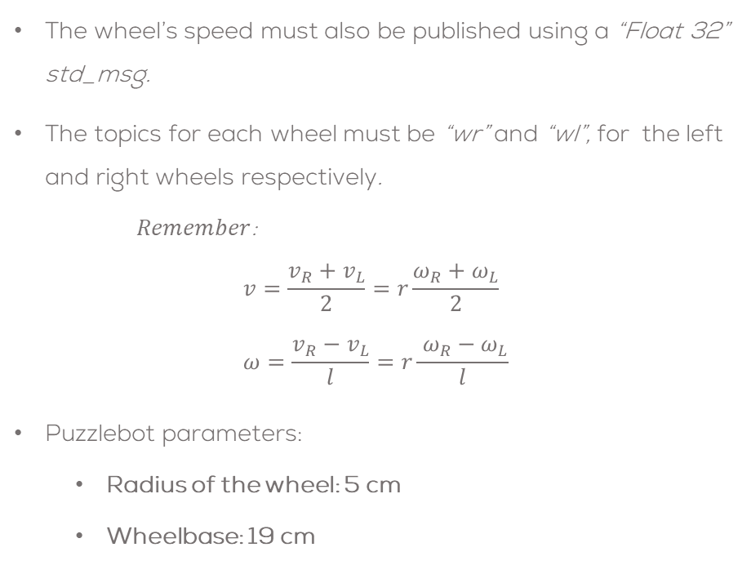
Mini challenge 2: Part 1
The wheel’s speed must also be published using a “Float 32” std_msg.
The topics for each wheel must be “wr” and “wl”, for the left and right wheels respectively.
$Remember$:
$$v=\frac{v_{R}+v_{L}}{2}=r\frac{ω_{R}+ω_{L}}{2} \\ ω=\frac{v_{R}−v_{L}}{l}=r\frac{ ω_{R}−ω_{L}}{l}$$
Puzzlebot parameters:
Radius of the wheel: 5 cm
Wheelbase: 19 cm

Slide 6
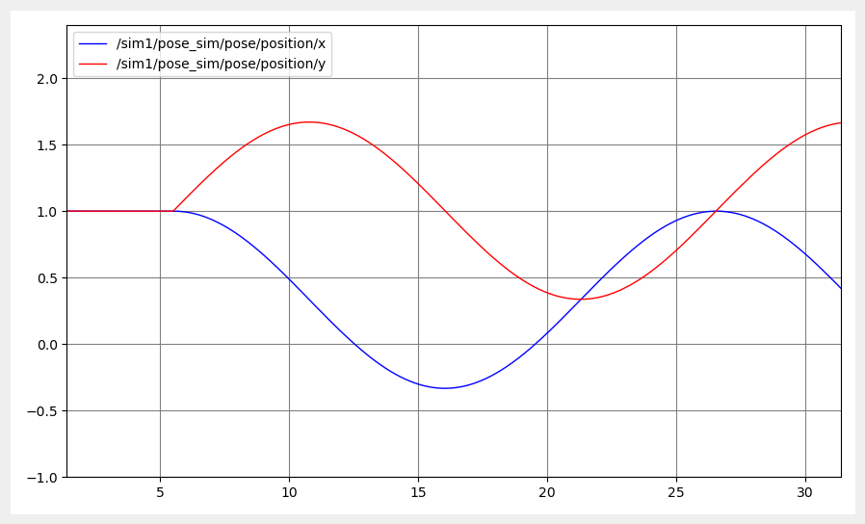
Mini challenge 2: Part 1
Test your simulation by inputing some commands into the “cmd_vel” topic.
Test the linear speed and position
Test angular speed and angle.
Use the “rqt_plot” to verify your results.
Plot the position and wheel speeds.
Verify if the results are correct.
You can use the “teleop_twist_keyboard” node to test your results

Slide 7
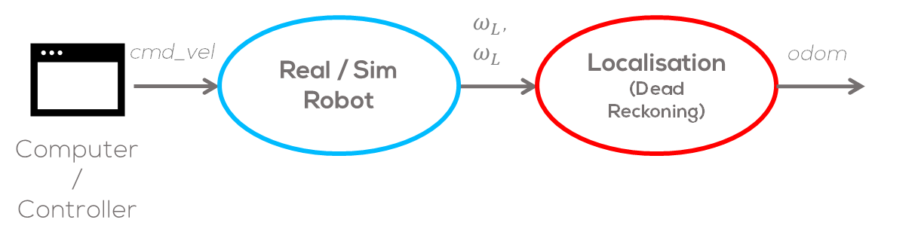
Mini challenge 2: Part 2
Make a simple node called “localisation” that subscribes to the “wr” and “wl” topics of the simulated robot.
Use this information to create an Odometry Message and publish the message in an odom topic.
For this activity, it is not required to fill in the covariance part of the odometry message.
Verify that the results are correct using the “rqt_plot” or the “rqt_multiplot”

Slide 8
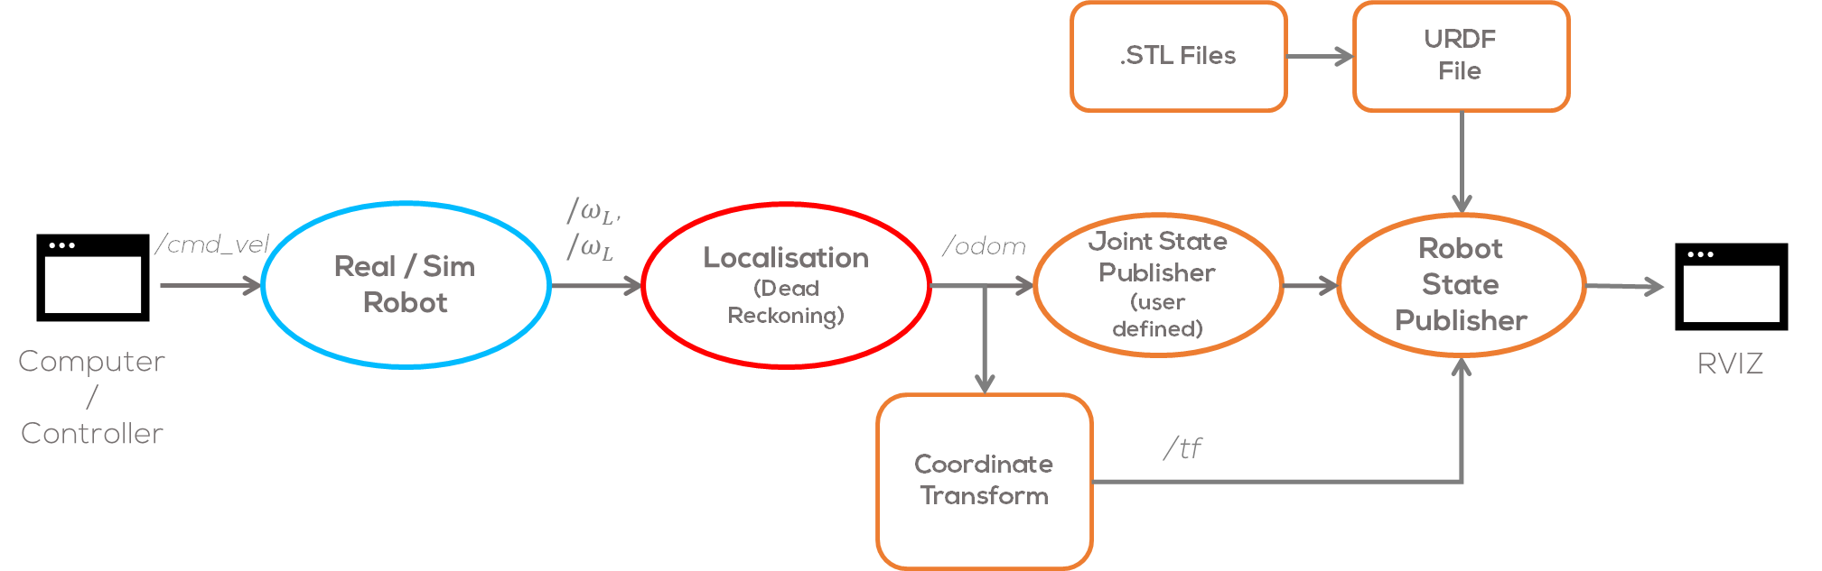
Mini challenge 2: Part 2
Modify the custom joint publisher for the Puzzlebot of the previous challenge to read the odometry message and publish the joint information, to the simulated robot.
Establish the inertial frame to be called “odom” (the frame can be set up in the launch file)
Make a transform between the “odom” frame and the “base_link” or “base_footprint” frame. The transformation can be set up in the Joint State publisher node or a separate node.
Use the teleoperation node or a command to test your simulation.

Slide 9
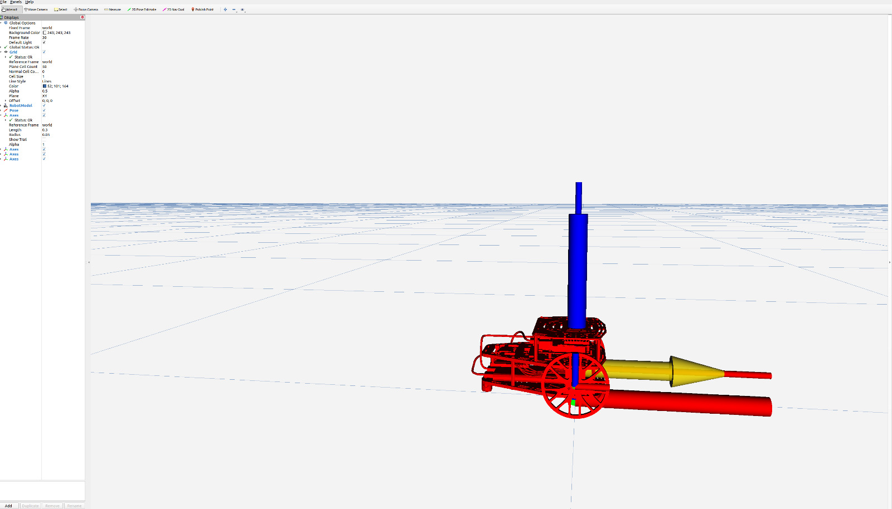
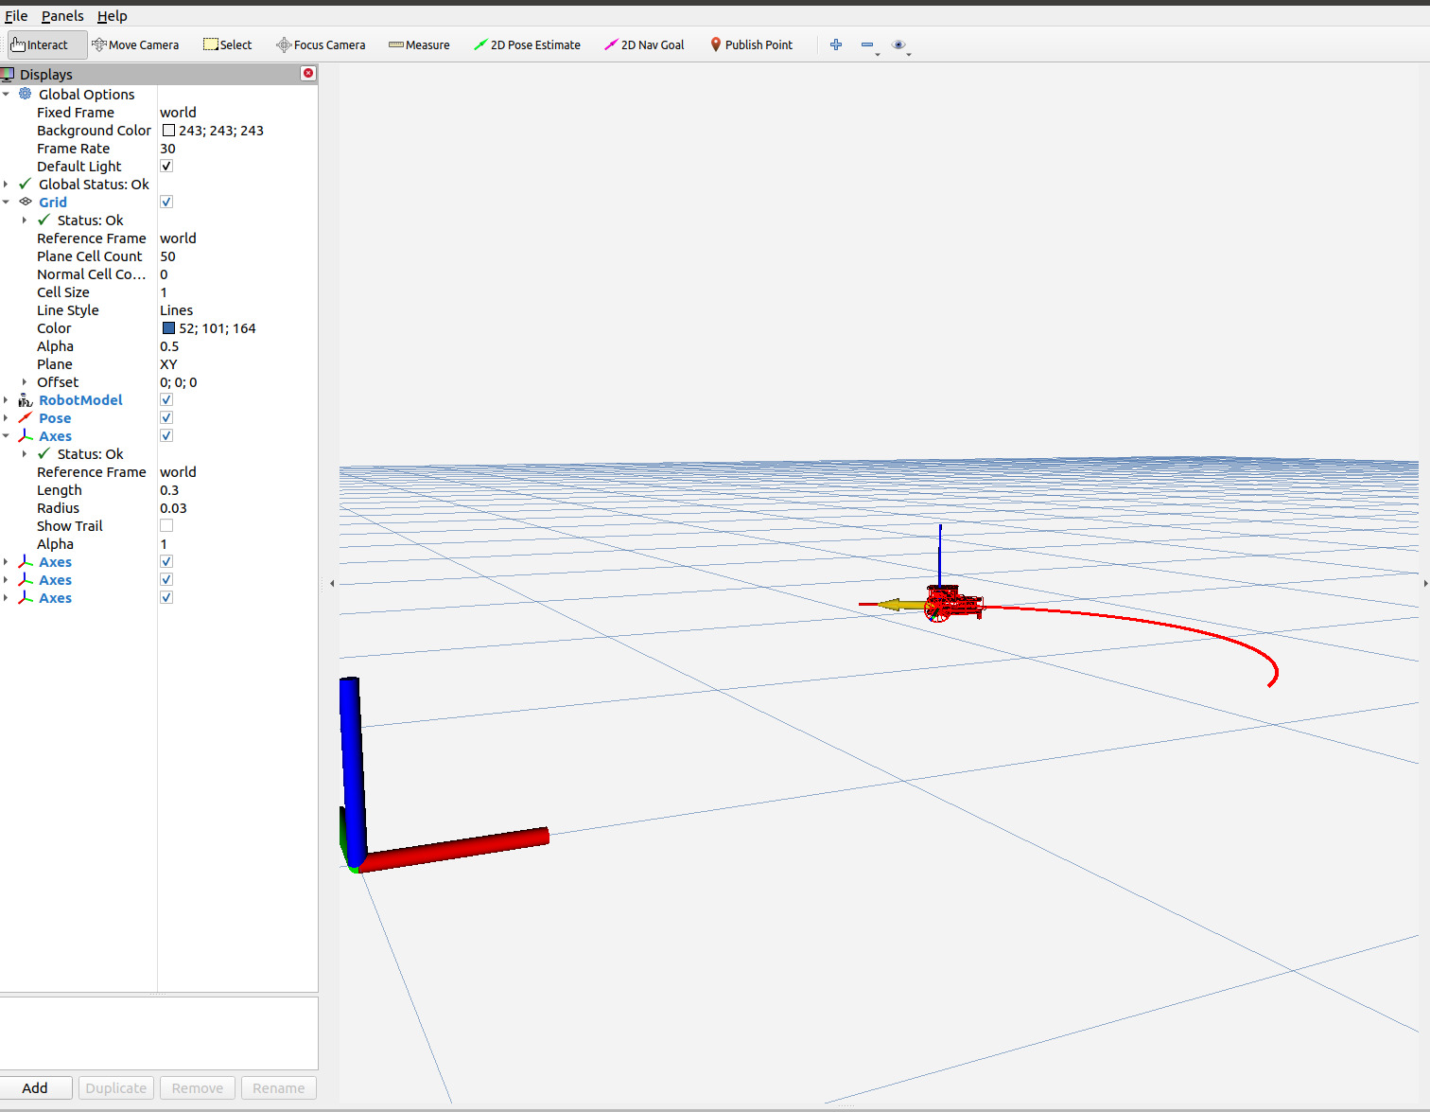
Mini challenge 2: Part 2
The student is allowed to use “tf” coordinate transforms or “URDF “ files for the simulation, or a combination of both.
The student must define the coordinate frames and transformations to be used.
The students must define the required launch files for this activity.
The simulation must be tested under different conditions, i.e., different speeds.
The students must define a correct sampling time for the simulation .
The students must solve the differential equations using numerical methods.
The usage of any library is strictly forbidden.
Expected results:

Slide 10
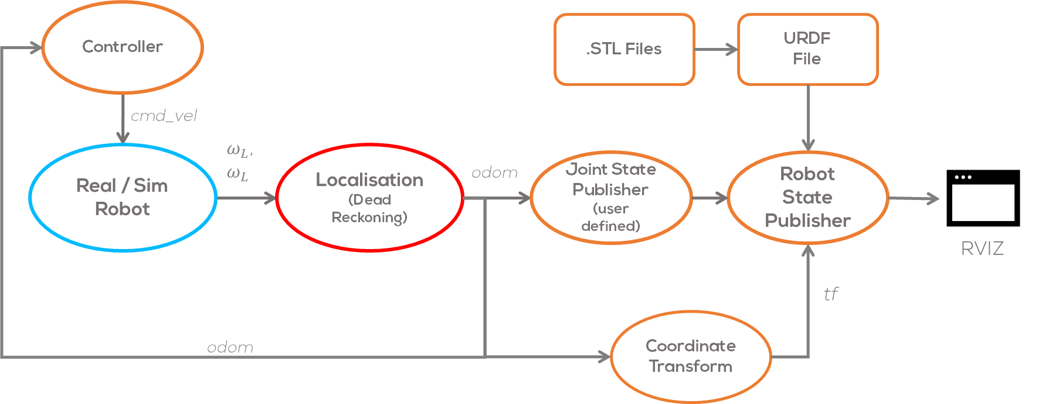
Mini challenge 2: Part 3
Make a simple node called “control” that subscribes to the “odom” topic of the simulated robot.
Set Points can be stablished as parameters.
Use this information to send commands to the robot.
Verify that the results are correct using “rviz”
The user is encouraged to set a trajectory (square, pentagon, etc.) to test the controller algorithm.

Slide 11
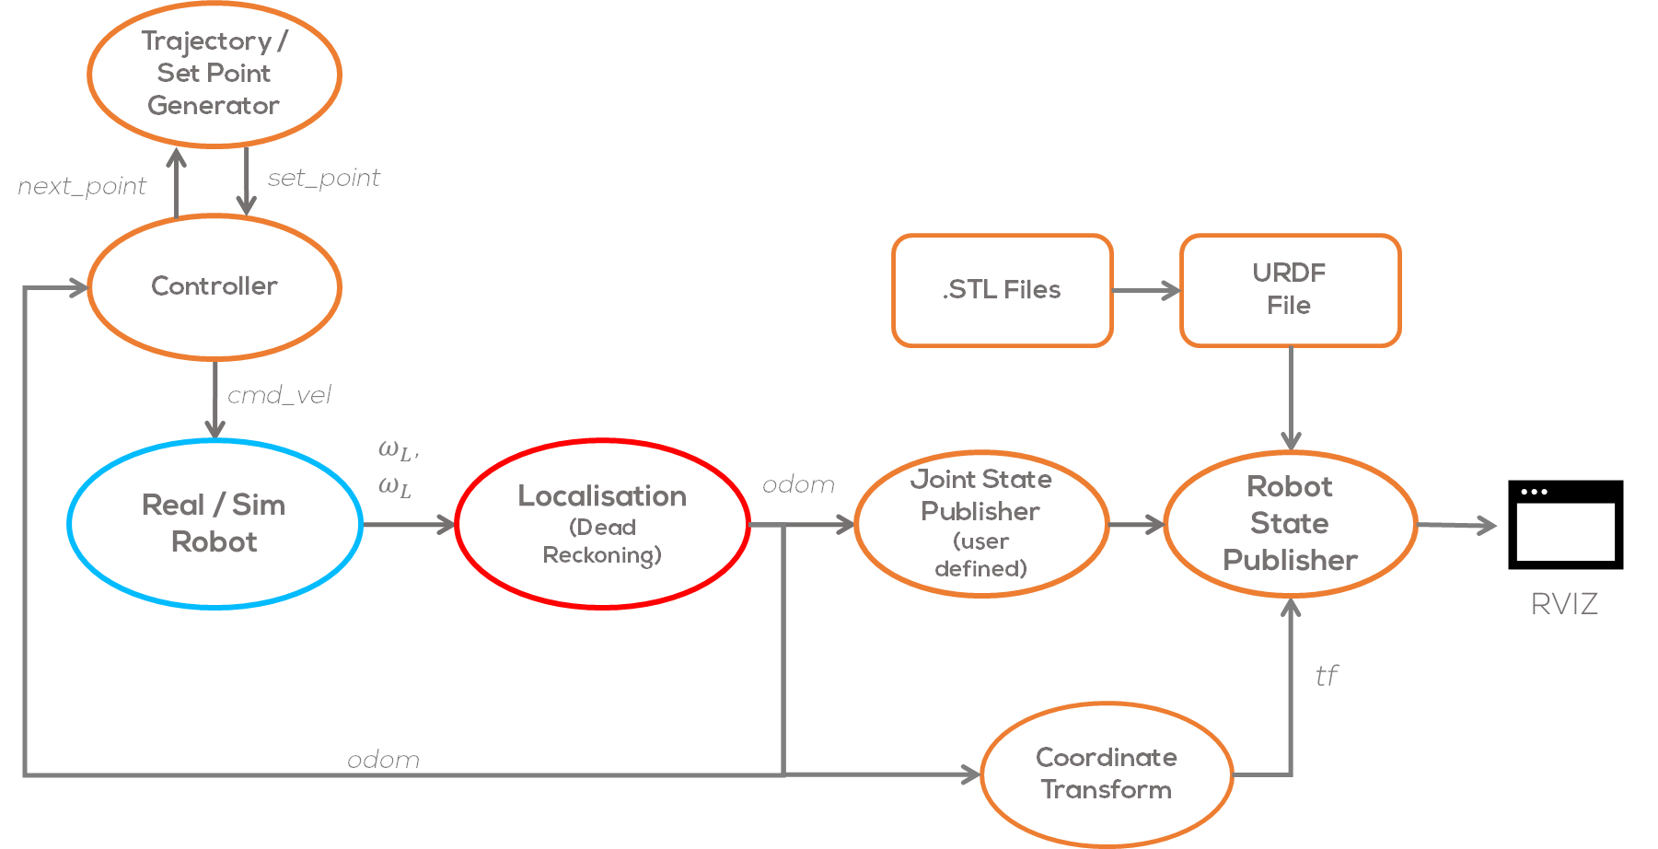
Mini challenge 2: Extra
Set Point Generator:
Make a simple node to pass the different set points to the controller.
Set a flag to be published from the controller node once the robot has reached the goal point.
In this node the user can define different trajectories (square, pentagon, etc.) to test the controller algorithm.

Slide 12
Rules
This is challenge not a class. The students are encouraged to research, improve tune explain their algorithms by themselves.
MCR2(Manchester Robotics) Reserves the right to answer a question if it is determined that the questions contains partially or totally an answer.
The students are welcomed to ask only about the theoretical aspect of the classed.
No remote control or any other form of human interaction with the simulator or ROS is allowed (except at the start when launching the files).
It is forbidden to use any other internet libraires with the exception of standard libraires or NumPy.
If in doubt about libraires please ask any teaching assistant.
Improvements to the algorithms are encouraged and may be used as long as the students provide the reasons and a detailed explanation on the improvements.
All the students must be respectful towards each other and abide by the previously defined rules.
Manchester robotics reserves the right to provide any form of grading. Grading and grading methodology are done by the professor in charge of the unit.

