Slide 1
Challenges
Mini challenge

Slide 2
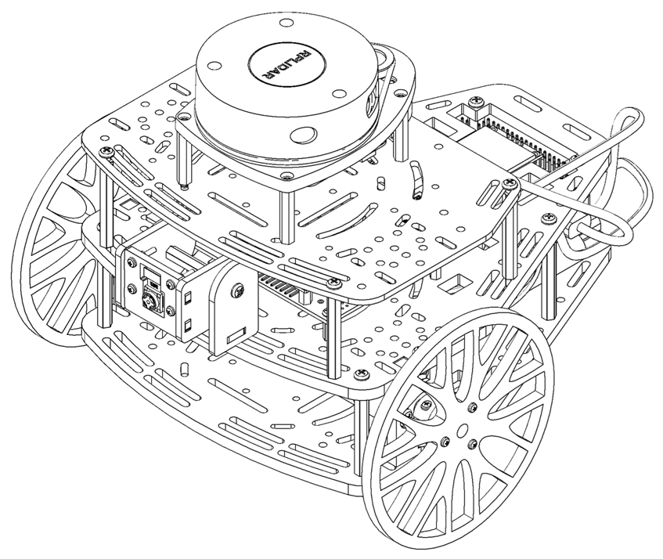
Mini challenge: Reactive Navigation.
This challenge is intended for the student to review the concepts introduced in this week.
This challenge aims to show the students different reactive navigation algorithms for mobile robots.
This challenge will be divided in different sections.

Slide 3
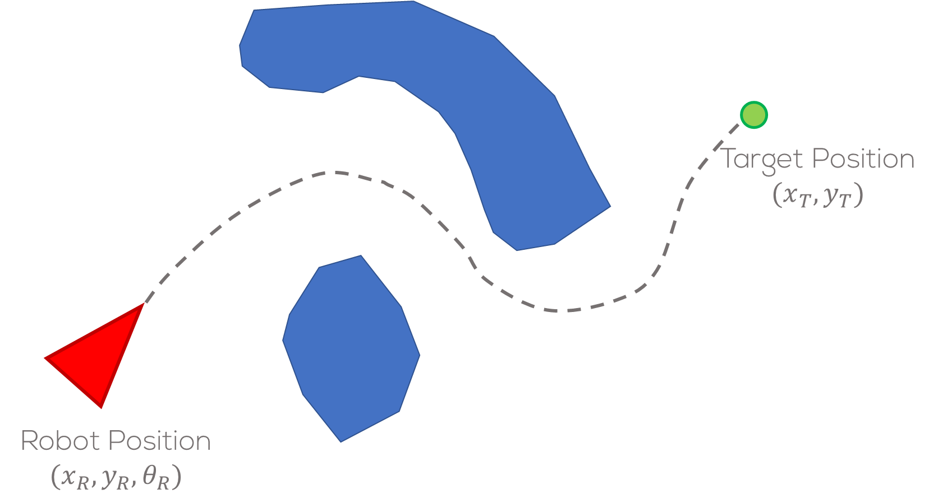
Mini challenge: Reactive Navigation.
This task requires the previously developed multi-point position control strategy for the Puzzlebot.
Using the Gazebo simulator, developed by MCR2, test the behaviour of different reactive navigation algorithms.
Test your algorithms in different scenarios.

Slide 4
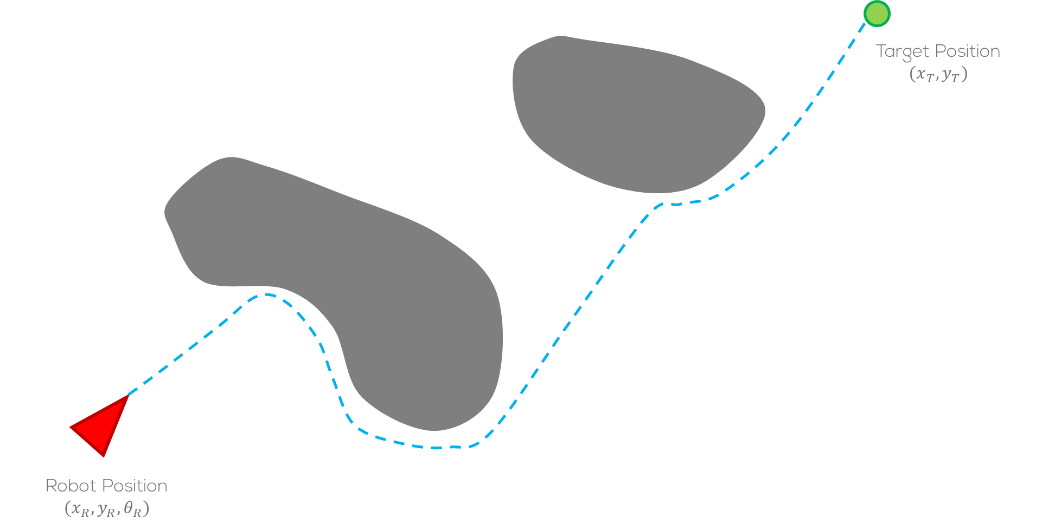
Mini challenge
Task 1:
Using the Gazebo simulator, developed by MCR2, create a reactive navigation algorithm.
The algorithm must be based on the Bug 0 algorithms to avoid obstacles and reach a target position.
The student must create different scenarios, to test their algorithms.
To start, the student can test their own algorithm in the worlds defined by MCR2.

Slide 5
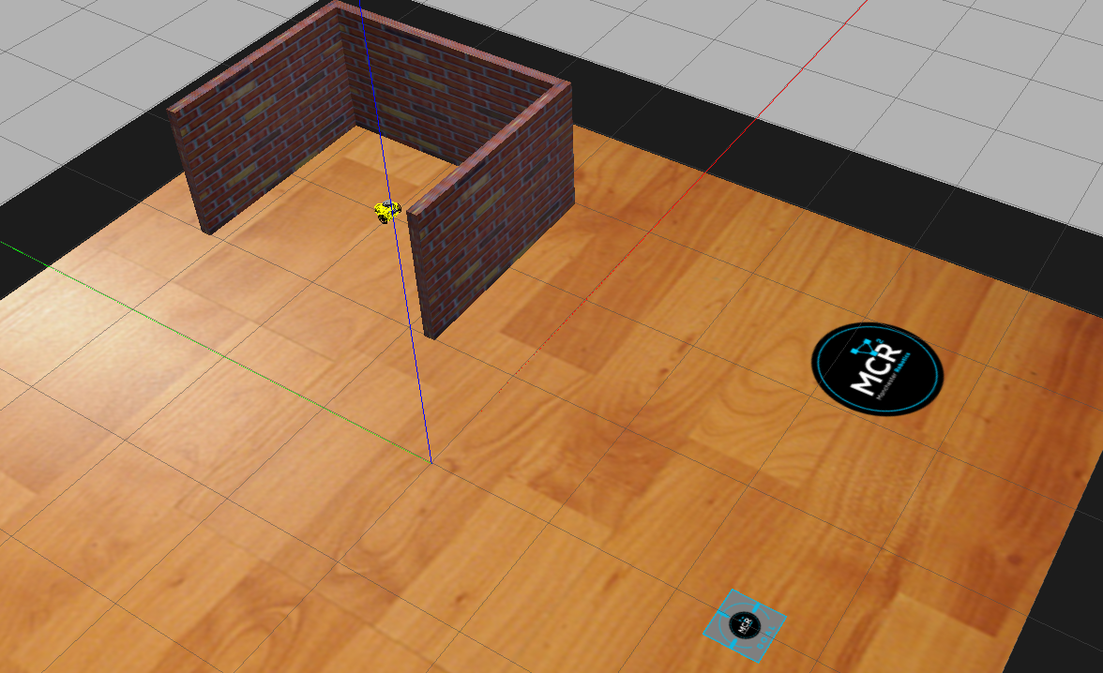
Mini challenge
As per mini challenge 2, the student must define the controller, and the map to be used.
The student must analyse and take into consideration the growing covariance around the pose of the robot.
The students must define the required launch files for this activity.
The simulation must be tested under different scenarios, i.e., different worlds in gazebo.
The students must define a correct sampling time for the simulation .
The usage of any library is strictly forbidden.

Slide 6
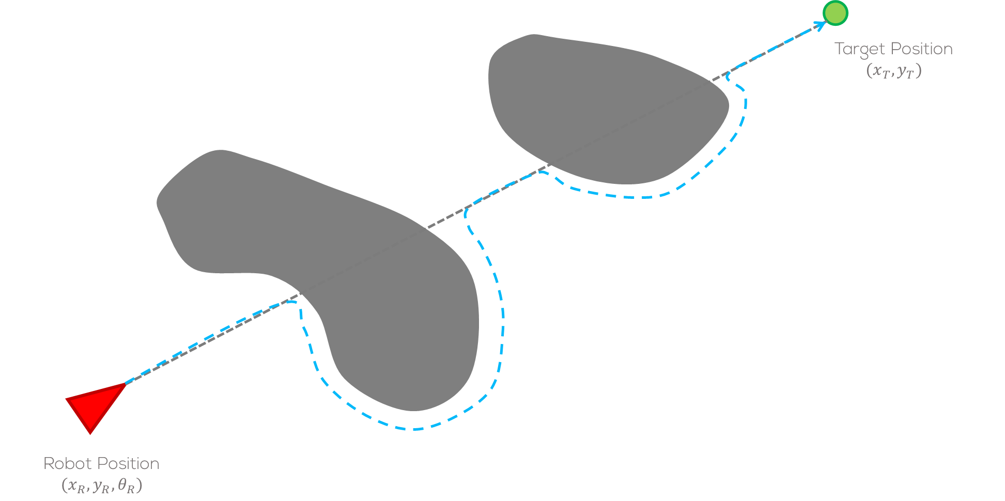
Mini challenge
Task 2:
Using the Gazebo simulator, developed by MCR2, create a reactive navigation algorithm.
The algorithm must be based on the Bug 2 algorithm to avoid obstacles and reach a target position.
The student must create different scenarios, to test their algorithms.
To start, the student can test their own algorithm in the worlds defined by MCR2.

Slide 7
Mini challenge
As per mini challenge 2, the student must define the controller, and the map to be used.
The student must analyse and take into consideration the growing covariance around the pose of the robot.
The students must define the required launch files for this activity.
The simulation must be tested under different scenarios, i.e., different worlds in gazebo.
The students must define a correct sampling time for the simulation .
The usage of any library is strictly forbidden.

Slide 8
Rules
This is challenge not a class. The students are encouraged to research, improve tune explain their algorithms by themselves.
MCR2(Manchester Robotics) Reserves the right to answer a question if it is determined that the questions contains partially or totally an answer.
The students are welcomed to ask only about the theoretical aspect of the classed.
No remote control or any other form of human interaction with the simulator or ROS is allowed (except at the start when launching the files).
It is forbidden to use any other internet libraires with the exception of standard libraires or NumPy.
If in doubt about libraires please ask any teaching assistant.
Improvements to the algorithms are encouraged and may be used as long as the students provide the reasons and a detailed explanation on the improvements.
All the students must be respectful towards each other and abide by the previously defined rules.
Manchester robotics reserves the right to provide any form of grading. Grading and grading methodology are done by the professor in charge of the unit.

