Slide 1
Autonomous Systems - Map-based localisation -
Dr Alexandru Stancu
Dr Mario Martinez

Slide 2
Next two lectures
Map-based localisation
Bayes filter
Kalman filter
Case study: Map-based localisation using Kalman filter
Worked examples

Slide 3
Where we are and where we are going
How much information and support must be provided by human to ensure that the robot is able to achieve its goals.
Mobile Robot
Low Level Control
Reactive Navigation
Mapping
Localisation
Navigation with Path Planning

Slide 4
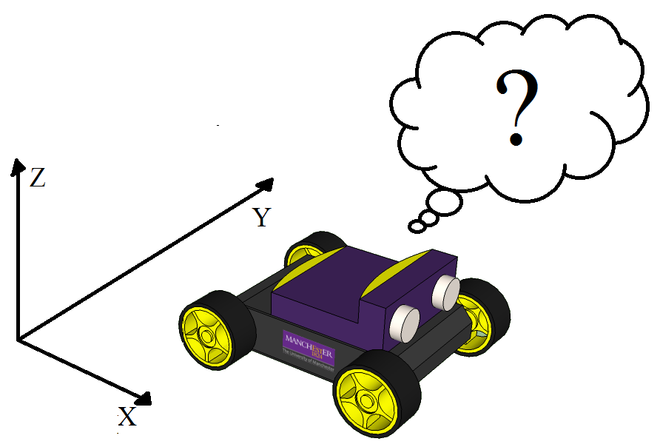
Localisation
The robot needs to know its location in the environment in order to make proper decisions.
Localisation can be achieved using:
Proprioceptive sensors (encoders, IMU). This type of localisation is named dead reckoning localisation.
Exteroceptive sensors (sonar, LiDAR, camera). This type of localisation is named map-based localisation.
External sensors (GPS). Not suitable for indoor applications.

Slide 5
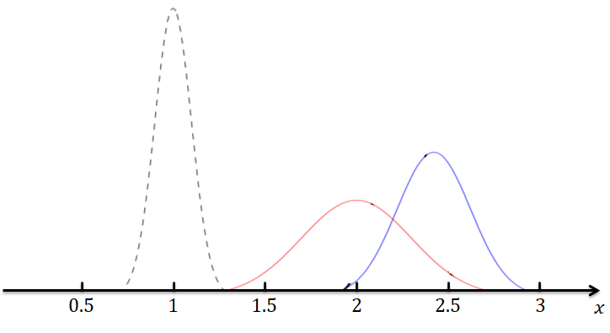


















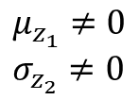






















Kalman filter - example
$$m_{1}$$
$$z_{k}$$
$$0.5$$
$$1$$
$$1.5$$
$$2$$
$$2.5$$
$$3$$
$$x$$
$$μ_{0}=0 \\ σ_{0}=0$$
$$μ_{1}≠0 \\ σ_{1}≠0$$
$$μ_{2}≠0 \\ σ_{2}≠0$$
$$μ_{z_{1}}≠0 \\ σ_{z_{2}}≠0$$
$$0.5$$
$$1$$
$$1.5$$
$$2$$
$$2.5$$
$$3$$
$$0.5$$
$$1$$
$$1.5$$
$$2$$
$$2.5$$
$$3$$
$$0.5$$
$$1$$
$$1.5$$
$$2$$
$$2.5$$
$$3$$
$$0.5$$
$$1$$
$$1.5$$
$$2$$
$$2.5$$
$$3$$
$$x$$
$$x$$
$$x$$
$$x$$

Slide 6




Kalman filter - example
$$Y_{w}$$
$$m_{1}$$
$$z_{k}$$
$$X_{w}$$

Slide 7


Bayes filter – theoretical foundation
Bayes filter is a probabilistic approach to recursively estimates some unknown PDFs as new information, such as measurements, becomes available.
1. State transition, or motion model probability:
$$p\left(x_{k} | x_{k−1},u_{k}\right)$$
2. Measurement, or observation model probability:
$$p\left(z_{k} | x_{k}\right)$$

Slide 8





Bayes filter – theoretical foundation
The belief
$$bel\left(x_{k}\right)$$
is the probability distribution of the system state
$$x_{k}$$
conditioned on all available data; control input:
$$U_{k}=\left\{u_{1},…,u_{k}\right\}$$
and measurement
$$Z_{k}=\left\{z_{1},…,z_{k}\right\}$$
such that:
$bel\left(x_{k}\right)=p\left(x_{k} | U_{k},Z_{k}\right)$
Definition of the belief

Slide 9
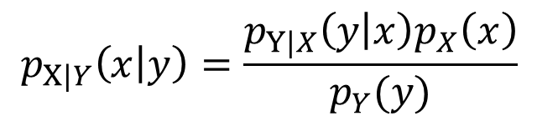
Bayes filter – theoretical foundation
In the following, we will derive a recursive formula for the Bayes filter.
At time instant k, we have k known observations and k control signals have been executed.
$$bel\left(x_{k}\right)=p\left(x_{k} | u_{1},u_{2},…,u_{k},z_{1},z_{2},…,z_{k}\right)$$
Recall the Bayes’ Theorem for continuous random variables:
$$p_{X|Y}\left(x | y\right)=\frac{p_{Y|X}\left(y | x\right)p_{X}\left(x\right)}{p_{Y}(y)}$$

Slide 10


Bayes filter – theoretical foundation
$$x_{k}$$
and
$$z_{k}$$
Let’s apply Bayes’ Theorem to
Therefore, we will swap the two variables and Bayes’ Theorem tells us how to do that:
$$bel\left(x_{k}\right)=p\left(x_{k} | u_{1},u_{2},…,u_{k},z_{1},z_{2},…,z_{k−1},z_{k}\right)=$$
$$=\frac{p\left(z_{k} | x_{k},u_{1},u_{2},…,u_{k},z_{1},z_{2},…,z_{k−1}\right)∙p\left(x_{k} | u_{1},u_{2},…,u_{k},z_{1},z_{2},…,z_{k−1}\right)}{p\left(z_{k} | u_{1},u_{2},…,u_{k},z_{1},z_{2},…,z_{k−1}\right)}$$

Slide 11



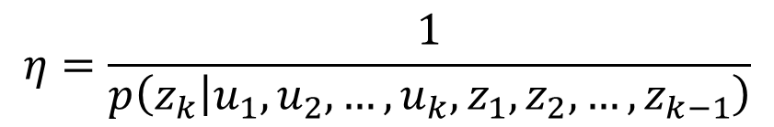
Bayes filter – theoretical foundation
Considering the following notation:
$$η=\frac{1}{p\left(z_{k} | u_{1},u_{2},…,u_{k},z_{1},z_{2},…,z_{k−1}\right)}$$
where
$$η$$
$$x_{k}$$
is a normalisation constant that is independent of .
Therefore
$$bel\left(x_{k}\right)$$
can be expressed as following:
$$bel\left(x_{k}\right)=η∙p\left(z_{k} | x_{k},u_{1},u_{2},…,u_{k},z_{1},z_{2},…,z_{k−1}\right)∙p\left(x_{k} | u_{1},u_{2},…,u_{k},z_{1},z_{2},…,z_{k−1}\right)$$

Slide 12



Bayes filter – theoretical foundation
We consider the Markov assumption for the first term of
$$bel\left(x_{k}\right)$$
$$z_{k}$$
If we know the probability of obtaining the measurement
given that we know the state, then we can ignore the previous measurements and the previous commands executed. Therefore, given the state of the world we can ignore what happened in the past. Consequently, we can get rid of the observations and measurements. Therefore, considering the following assumption:
$$p\left(z_{k} | x_{k},U_{k},Z_{k−1}\right)=p\left(z_{k} | x_{k}\right)$$

Slide 13



Bayes filter – theoretical foundation
Hence:
$$bel\left(x_{k}\right)= η∙p\left(z_{k} | x_{k}\right)∙p\left(x_{k} | u_{1},u_{2},…,u_{k},z_{1},z_{2},…,z_{k−1}\right)$$
$$bel\left(x_{k}\right)= η∙p\left(z_{k} | x_{k}\right)∙p\left(x_{k} | U_{k},Z_{k−1}\right)$$
$$p\left(z_{k} | x_{k}\right)$$
is the observation model. We make the following notation:
$$\overline{bel }\left(x_{k}\right)=p\left(x_{k} | U_{k},Z_{k−1}\right)$$
$$\overline{bel }\left(x_{k}\right)$$
is the estimation of the current state of the system given the past observations up to the time step k-1, so the last observation is missing, but all commands executed. So, having an estimate up to k-1 and executing a motion command.

Slide 14

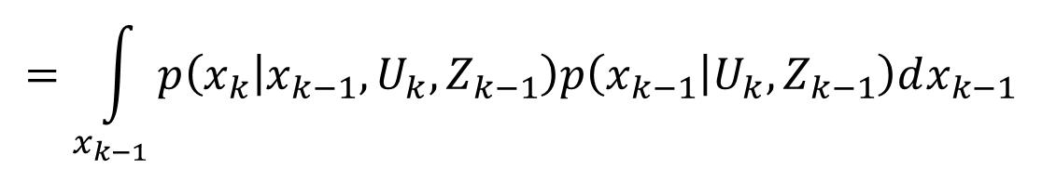


Bayes filter – theoretical foundation
We apply Marginal Distribution for
$$\overline{bel }\left(x_{k}\right)$$
Marginal distribution is applied for continuous random variables and it is equivalent with Law of total probability for discrete random variables.
$$\overline{bel}\left(x_{k}\right)=p\left(x_{k} | U_{k},Z_{k−1}\right)$$
$$=\int_{x_{k−1}}{p\left(x_{k} | x_{k−1},U_{k},Z_{k−1}\right)p\left(x_{k−1} | U_{k},Z_{k−1}\right)dx_{k−1}}$$
$$x_{k−1}$$
is a new variable which represents the state of the system at previous time step.

Slide 15





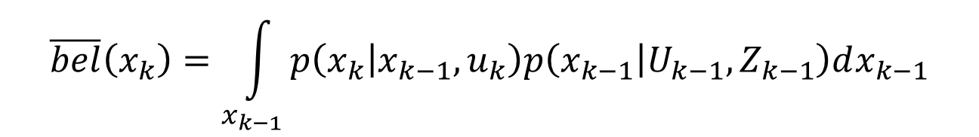

Bayes filter – theoretical foundation
Therefore, a new variable is introduced and we integrate over this new variable, so the expression will stay the same. We apply again Markov assumption and the expression of become:
$$\overline{bel }\left(x_{k}\right)$$
$$\overline{bel}\left(x_{k}\right)=\int_{x_{k−1}}{p\left(x_{k} | x_{k−1},u_{k}\right)p\left(x_{k−1} | U_{k−1},Z_{k−1}\right)dx_{k−1}}$$
$$u_{k}$$
$$x_{k−1}$$
$$x_{k}$$
Therefore, is executed ‘to go’ from to . This tells us how the system should evolve form k-1 to k, i.e., represents the motion model. In other words, given the state and the command GO 2 METERS FORWARD then we can have a probability distribution about the estimation of the position of the robot at current time.
$$\overline{bel }\left(x_{k}\right)$$
$$x_{k−1}$$

Slide 16



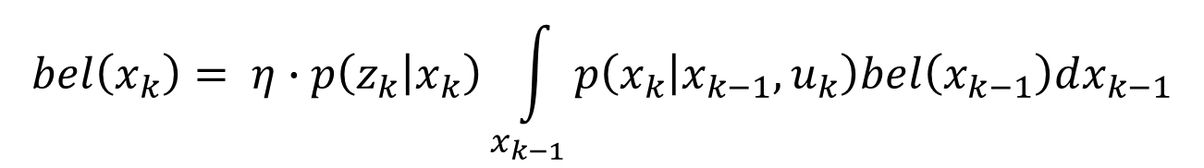



Bayes filter – theoretical foundation
Therefore, we can express as:
$$bel\left(x_{k}\right)$$
$$bel\left(x_{k}\right)= η∙p\left(z_{k} | x_{k}\right)\int_{x_{k−1}}{p\left(x_{k} | x_{k−1},u_{k}\right)bel\left(x_{k−1}\right)dx_{k−1}}$$
$$p\left(z_{k} | x_{k}\right)$$
where is the observation model and is the previous believe, i.e., believe at k-1.
$$bel\left(x_{k−1}\right)$$
We have a recursive update scheme which allows us to estimate the state of the system based on the previous state , the current motion command and the current observation .
$$x_{k−1}$$
$$u_{k}$$
$$z_{k}$$

Slide 17

Bayes filter – theoretical foundation
$$x_{k−1}$$
Therefore, if we have a probability distribution for (the previous state of the system), and if we execute a motion command and we get a new measurement from the exteroceptive sensor (observation), then we can compute the state of the system at the current time instant k.
Recursive Bayes filter
In conclusion, the Bayes filter consists of two main steps: Prediction and Correction.

Slide 18


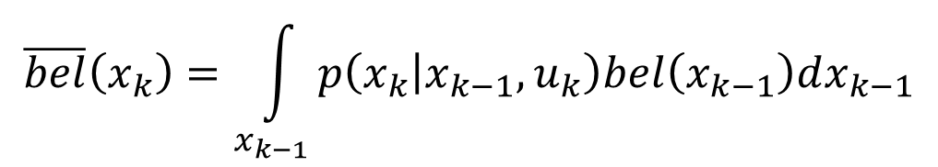
Bayes filter – theoretical foundation
Recursive Bayes filter as a Prediction/Correction algorithm:
Prediction step:
$$\overline{bel}\left(x_{k}\right)=\int_{x_{k−1}}{p\left(x_{k} | x_{k−1},u_{k}\right)bel\left(x_{k−1}\right)dx_{k−1}}$$
Correction step:
$$bel\left(x_{k}\right)= η∙p\left(z_{k} | x_{k}\right)∙\overline{bel }\left(x_{k}\right)$$
Because I don’t know the exact state of the system at time instant k-1, I have to integrate over all possible states.
$$η$$
makes the integral of all possible states to sum up to one.

Slide 19
Bayes filter – theoretical foundation
It is not possible to solve analytically the integral of system states at k-1.
The Bayes filter is a general method for state estimation. It is a theoretical method. However, in robotics, we need an algorithm which can be implemented in a computer.
Kalman filter
Particle filter

Slide 20
Bayes filter – theoretical foundation
If we can represent the Probability Density Function (PDF) as Gaussian (parametric distribution described by mean and variance)
Kalman filter
If the PDF has a non-parametric distribution (has no closed form), there are unlimited numbers of parameters to describe the PDF; hence we need some kind of sampling technique to represent the full distribution.
Particle filter

Slide 21
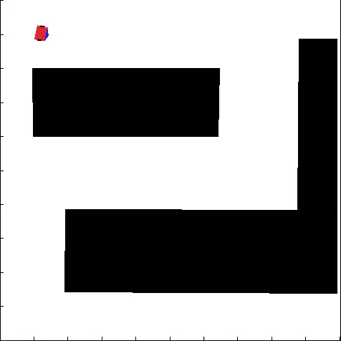

Localisation
Dead Reckoning Localisation
Extended Kalman Filter Localisation
The map is needed!!!

Slide 22
Next topic
Kalman filter

