Slide 1
Recursive Bayes filter Particular case: Kalman filter
Dr Alexandru Stancu
Dr Mario Martinez

Slide 2


Kalman filter
Gaussian PDF
Linear or linearised models for the system and the observation
Consider a linear model for a system:
$$x_{k}=Ax_{k−1}+Bu_{k}+q_{k}$$
$$z_{k}=Cx_{k}+r_{k}$$

Slide 3




Kalman filter
Gaussian PDFs:
$$x_{k}\sim 𝒩\left(μ_{k},Σ_{k}\right)$$
current state
$$x_{k−1}|U_{k−1},Z_{k−1}\sim 𝒩\left(μ_{k−1},Σ_{k−1}\right)$$
previous state
$$x_{k}|x_{k−1},u_{k}\sim 𝒩\left(Aμ_{k−1}+Bu_{k},Q_{k−1}\right)$$
motion model
$$z_{k}|x_{k}\sim 𝒩\left(Cx_{k},R_{k}\right)$$
observation model

Slide 4


Kalman filter
Similar to Bayes filter, Kalman filter follows prediction step and correction step to estimate the belief by incorporating the control signal and the measurement .
$$u_{k}$$
$$z_{k}$$

Slide 5


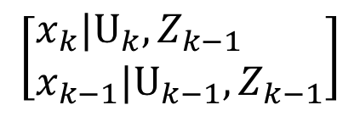



Kalman filter – prediction step
Prediction step:
$$\left[\begin{aligned}&x_{k}|U_{k},Z_{k−1} \\ &x_{k−1}|U_{k−1},Z_{k−1}\end{aligned}\right]$$
We use Marginalisation and Conditioning properties for Gaussian distributions:
General considerations for Marginalisation and Conditioning:
1. Given
$$X=\left[\begin{aligned}&U \\ &V\end{aligned}\right]$$
and
$$X\sim 𝒩\left(μ_{X},Σ_{X}\right)$$
$$Σ_{X}$$
is a multi-variable Gaussian distribution
then, the marginals are also Gaussian:
$$U\sim 𝒩\left(μ_{U},Σ_{U}\right)$$
$$V\sim 𝒩\left(μ_{V},Σ_{V}\right)$$

Slide 6
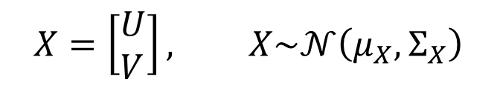

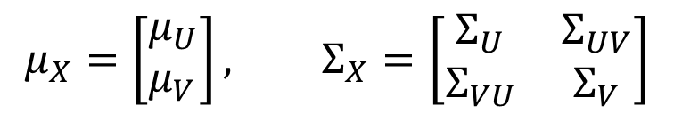
Kalman filter – prediction step
2. The conditionals are also Gaussians:
$$U|V\sim 𝒩\left(μ_{U|V},Σ_{U|V}\right)$$
The Marginalisation and the Conditioning are the most important properties for Kalman filter.
For Gaussian case, Marginalisation is very easy:
$$X=\left[\begin{aligned}&U \\ &V\end{aligned}\right], X\sim 𝒩\left(μ_{X},Σ_{X}\right)$$
$$μ_{X}=\left[\begin{aligned}&μ_{U} \\ &μ_{V}\end{aligned}\right], Σ_{X}=\left[\begin{matrix}Σ_{U} & Σ_{UV} \\ Σ_{VU} & Σ_{V}\end{matrix}\right]$$

Slide 7

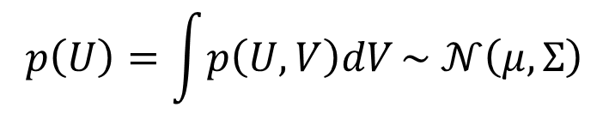

Kalman filter – prediction step
The marginal distribution is:
$$p\left(U\right)=\int{p\left(U,V\right)dV}\sim 𝒩\left(μ,Σ\right)$$
where:
$$μ=μ_{U}$$
$$Σ=Σ_{U}$$
Therefore, If I have a high dimensional Gaussian distribution and I want to compute the marginal for a small number of elements, then I just need to cut out a part of the mean vector and cut out a part of the covariance matrix.

Slide 8
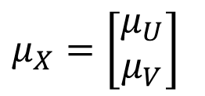

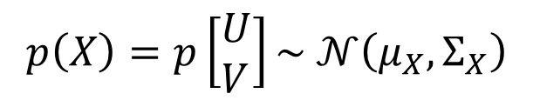

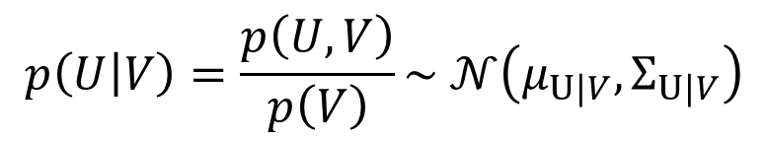
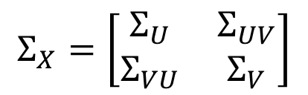
Kalman filter – prediction step
Conditioning is not easy. The proof is out of the scope of this unit. So, the conditional property will be provided without proof.
Given
$$p\left(X\right)=p\left[\begin{aligned}&U \\ &V\end{aligned}\right]\sim 𝒩\left(μ_{X},Σ_{X}\right)$$
$μ_{X}=\left[\begin{aligned}μ_{U} \\ μ_{V}\end{aligned}\right]$
and
$$Σ_{X}=\left[\begin{matrix}Σ_{U} & Σ_{UV} \\ Σ_{VU} & Σ_{V}\end{matrix}\right]$$
where:
Then the conditional distribution is as follows:
$$p\left(U | V\right)=\frac{p\left(U,V\right)}{p\left(V\right)}\sim 𝒩\left(μ_{U|V},Σ_{U|V}\right)$$
$$μ_{U|V}=μ_{U}+Σ_{UV}Σ_{V}^{−1}\left(V−μ_{V}\right)$$
$$Σ_{U|V}=Σ_{U}−Σ_{UV}Σ_{V}^{−1}Σ_{UV}^{T}$$

Slide 9

Kalman filter – prediction step
Observations:
1. means that if I have a high dimensional Gaussian distribution and I want to estimate just a small part out of that, given I know the rest, is very costly operation because I need to invert a large part of the matrix.
$$Σ_{V}^{−1}$$
Example: I want to estimate the pose of the robot given the landmarks position. Therefore, I need to compute the inverse, which is quite expensive.

Slide 10











Kalman filter – prediction step
Observations:
2. If we don’t know anything (almost) about V, so we have big uncertainty , hence:
$$Σ_{v}≫0$$
$$Σ_{V}^{−1}≅0$$
$$μ_{U|V}=μ_{U}$$
$$Σ_{U|V}=Σ_{U}$$
$$p\left(U | V\right)$$
Note that is the probability of U given V, and if we don’t know anything about V, then is almost the same as .
$$p\left(U | V\right)$$
$$p\left(U\right)$$
If is very small then is very large; hence it has large influence in and .
$$Σ_{V}$$
$$Σ_{V}^{−1}$$
$μ_{U|V}$
$$Σ_{U|V}$$

Slide 11






Kalman filter – prediction step
Analogy with the linear system:
$$V$$
in our case is
$$x_{k−1}|U_{k−1},Z_{k−1}$$
$$U|V$$
in our case is
$$x_{k}|x_{k−1},U_{k}$$
motion model
We want to find:
$$U$$
which in our case is
$$x_{k}|U_{k},Z_{k−1}$$
$$\left[\begin{aligned}&U \\ &V\end{aligned}\right] → \left[\begin{aligned}&x_{k}|U_{k},Z_{k−1} \\ &x_{k−1}|U_{k−1},Z_{k−1}\end{aligned}\right]\sim 𝒩\left(\left[\begin{aligned}&Aμ_{k−1}+Bu_{k} \\ &{ μ}_{k−1}\end{aligned}\right],\left[\begin{matrix}AΣ_{k−1}A^{T}+Q_{k} & AΣ_{k−1} \\ {\left(AΣ_{k−1}\right)}^{T} & Σ_{k−1}\end{matrix}\right]\right)$$

Slide 12
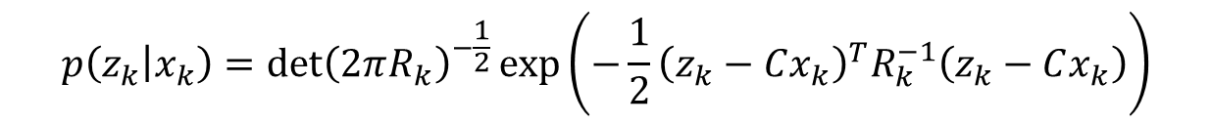
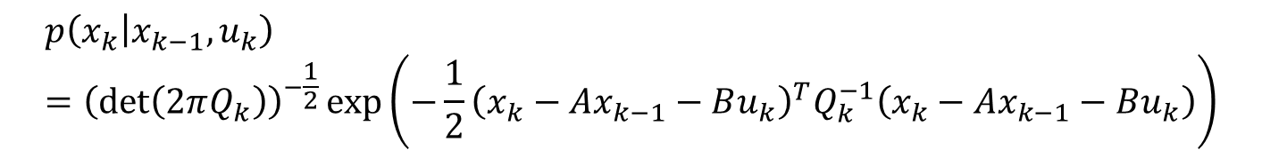


Kalman filter – prediction step
Gaussian distribution for the motion model:
$$p\left(x_{k} | x_{k−1},u_{k}\right)={\left(\det\left(2πQ_{k}\right)\right)}^{−\frac{1}{2}}\exp\left(−\frac{1}{2}{\left(x_{k}−Ax_{k−1}−Bu_{k}\right)}^{T}Q_{k}^{−1}\left(x_{k}−Ax_{k−1}−Bu_{k}\right)\right)$$
Gaussian distribution for observation model:
$$p\left(z_{k} | x_{k}\right)=\det{{\left(2πR_{k}\right)}^{−\frac{1}{2}}\exp\left(−\frac{1}{2}{\left(z_{k}−Cx_{k}\right)}^{T}R_{k}^{−1}\left(z_{k}−Cx_{k}\right)\right)}$$
$$Q_{k}$$
$$R_{k}$$
is the noise of the motion and is the measurement noise.

Slide 13




Kalman filter – prediction step
$$x_{k}|U_{k},Z_{k−1}\sim 𝒩\left(Aμ_{k−1}+Bu_{k},AΣ_{k−1}A^{T}+Q_{k}\right)$$
$${\hat{x}}_{k}=x_{k}|U_{k},Z_{k−1}\sim 𝒩\left({\hat{μ}}_{k},{\hat{Σ}}_{k}\right)$$
$${\hat{μ}}_{k}={Aμ}_{k−1}+Bμ_{k}$$
$${\hat{Σ}}_{k}=AΣ_{k−1}A^{T}+Q_{k}$$
$$\overline{bel}\left(x_{k}\right)=p\left({\hat{x}}_{k}\right)$$

Slide 14
Kalman filter – prediction step
Conditioning is not easy. The proof is out of the scope of this unit. So, the conditional property will be provided without proof.
Given
$$p\left(X\right)=p\left[\begin{aligned}&U \\ &V\end{aligned}\right]\sim 𝒩\left(μ_{X},Σ_{X}\right)$$
$μ_{X}=\left[\begin{aligned}μ_{U} \\ μ_{V}\end{aligned}\right]$
and
$$Σ_{X}=\left[\begin{matrix}Σ_{U} & Σ_{UV} \\ Σ_{VU} & Σ_{V}\end{matrix}\right]$$
where:
Then the conditional distribution is as follows:
$$p\left(U | V\right)=\frac{p\left(U,V\right)}{p\left(V\right)}\sim 𝒩\left(μ_{U|V},Σ_{U|V}\right)$$
$$μ_{U|V}=μ_{U}+Σ_{UV}Σ_{V}^{−1}\left(V−μ_{V}\right)$$
$$Σ_{U|V}=Σ_{U}−Σ_{UV}Σ_{V}^{−1}Σ_{UV}^{T}$$

Slide 15


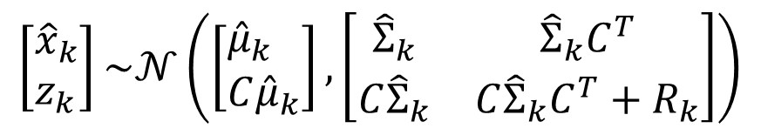
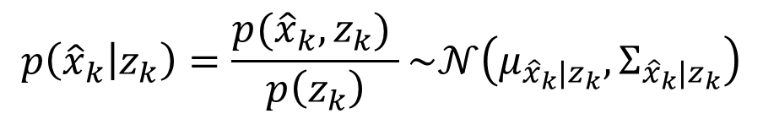

Kalman filter – correction step
Correction step:
We address conditional distribution again. Let’s consider:
$$U≡{\hat{x}}_{k}$$
$$V≡z_{k}$$
$$U\left|V≡{\hat{x}}_{k}\right|z_{k}$$
Chain rule:
$$p\left({\hat{x}}_{k} | z_{k}\right)=\frac{p({\hat{x}}_{k},z_{k}) }{p\left(z_{k}\right)}\sim 𝒩\left(μ_{{\hat{x}}_{k}|z_{k}},Σ_{{\hat{x}}_{k}|z_{k}}\right)$$
$$\left[\begin{aligned}&{\hat{x}}_{k} \\ &z_{k}\end{aligned}\right]\sim 𝒩\left(\left[\begin{aligned}&{\hat{μ}}_{k} \\ &C{\hat{μ}}_{k}\end{aligned}\right],\left[\begin{matrix}{\hat{Σ}}_{k} & {\hat{Σ}}_{k}C^{T} \\ C{\hat{Σ}}_{k} & C{\hat{Σ}}_{k}C^{T}+R_{k}\end{matrix}\right]\right)$$

Slide 16




Kalman filter – correction step
Therefore, by applying equation 2.42 from lecture notes (Conditioning):
$$μ_{U|V}=μ_{{\hat{x}}_{k}|z_{k}}={\hat{μ}}_{k}+{\hat{Σ}}_{k}C^{T}{\left(C{\hat{Σ}}_{k}C^{T}+R_{k}\right)}^{−1}\left[z_{k}−C{\hat{μ}}_{k}\right]$$
where:
$${\hat{Σ}}_{k}C^{T}{\left(C{\hat{Σ}}_{k}C^{T}+R_{k}\right)}^{−1}=K_{k}$$
is the Kalman Gain
$$z_{k}$$
is the real measurement
$$C{\hat{μ}}_{k}$$
is the predicted measurement (given by the observation model)
$$Σ_{{\hat{x}}_{k}|z_{k}}={\hat{Σ}}_{k}−{\hat{Σ}}_{k}C^{T}{\left(C{\hat{Σ}}_{k}C^{T}+R_{k}\right)}^{−1}\left(C{\hat{Σ}}_{k}\right)$$

Slide 17





Kalman filter recursive algorithm
Kalman filter algorithm (inputs: $μ_{k−1}$, $Σ_{k−1}$, $u_{k}$, $z_{k}$, outputs: $μ_{k}$, $Σ_{k}$):
Prediction step:
$${{\hat{μ}}_{k}=Aμ}_{k−1}+Bu_{k}$$
$${\hat{Σ}}_{k}=AΣ_{k−1}A^{T}+Q_{k}$$
Correction step:
$${K_{k}=\hat{Σ}}_{k}C^{T}{\left(C{\hat{Σ}}_{k}C^{T}+R_{k}\right)}^{−1}$$
$${μ_{k}=\hat{μ}}_{k}+K_{k}\left[z_{k}−C{\hat{μ}}_{k}\right]$$
$${Σ_{k}=\hat{Σ}}_{k}−K_{k}C{\hat{Σ}}_{k}$$

Slide 18



Kalman filter
Particular cases:
$$R_{k}≅0$$
1. In the case of a perfect exteroceptive sensor, i.e., :
$$K_{k}={\hat{Σ}}_{k}C^{T}{\left(C{\hat{Σ}}_{k}C^{T}\right)}^{−1}={\hat{Σ}}_{k}C^{T}{\left(C^{T}\right)}^{−1}{\hat{Σ}}_{k}^{−1}C^{−1}=C^{−1}$$
$$μ_{k}={\hat{μ}}_{k}+C^{−1}\left(z_{k}−C{\hat{μ}}_{k}\right)$$
we trust only the exteroceptive sensor,
we don’t trust the prediction model at all.
$$μ_{k}=C^{−1}z_{k}$$

Slide 19




Kalman filter
Particular cases:
$$R_{k}$$
$$R_{k}=∞$$
2. In case of a bad sensor is very big, i.e., :
$$K_{k}={\hat{Σ}}_{k}C^{T}{\left(C{\hat{Σ}}_{k}C^{T}+R_{k}\right)}^{−1}={\hat{Σ}}_{k}C^{T}{\left(C{\hat{Σ}}_{k}C^{T}+∞\right)}^{−1}$$
$$K_{k}={\hat{Σ}}_{k}C^{T}{\left(∞\right)}^{−1}=0$$
we trust only the prediction model,
we don’t trust the exteroceptive sensor at all.
$$μ_{k}={\hat{μ}}_{k}$$

Slide 20
Kalman filter - example

Slide 21
Next topic
Kalman filter applied for map-based localisation

