Slide 1
Autonomous Systems - Kalman filter for map-based localisation -
Dr Alexandru Stancu
Dr Mario Martinez

Slide 2


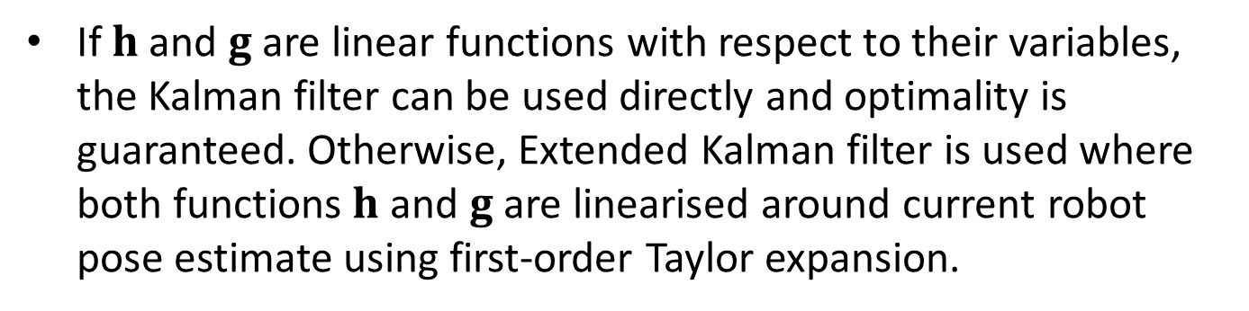


Kalman filter localisation
Motion model for the mobile robot:
$$s_{k}=h\left(s_{k−1},u_{k}\right)+q_{k}$$
$$q_{k}\sim 𝒩\left(0,Q_{k}\right)$$
Robot observation model:
$$z_{i,k}=g\left(m_{i},s_{k}\right)+r_{i,k}$$
$$r_{i,k}\sim 𝒩\left(0,R_{k}\right)$$
If $h$ and $g$ are linear functions with respect to their variables, the Kalman filter can be used directly and optimality is guaranteed. Otherwise, Extended Kalman filter is used where both functions$h$ and $g$ are linearised around current robot pose estimate using first-order Taylor expansion.

Slide 3
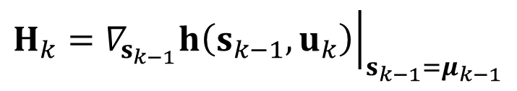


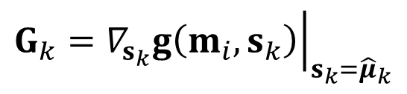


Kalman filter localisation
Linearisation (theoretical aspects):
$${\hat{μ}}_{k}= h\left(μ_{k−1},u_{k}\right)$$
$$H_{k}={\left.∇_{s_{k−1}}h\left(s_{k−1},u_{k}\right)\right|}_{s_{k−1}=μ_{k−1}}$$
$$s_{k}≈{\hat{μ}}_{k}+H_{k}\left(s_{k−1}−μ_{k−1}\right)$$
$${\hat{z}}_{i,k}= g\left(m_{i},{\hat{μ}}_{k}\right)$$
$$G_{k}={\left.∇_{s_{k}}g\left(m_{i},s_{k}\right)\right|}_{s_{k}={\hat{μ}}_{k}}$$
$$z_{i,k}≈{\hat{z}}_{i,k}+G_{k}\left(s_{k}−{\hat{μ}}_{k}\right)$$

Slide 4

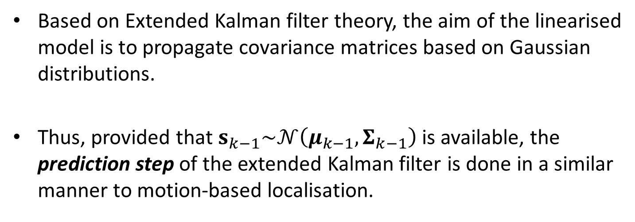

Kalman filter localisation
Based on Extended Kalman filter theory, the aim of the linearised model is to propagate covariance matrices based on Gaussian distributions.
Thus, provided that $s_{k−1}\sim 𝒩\left(μ_{k−1},Σ_{k−1}\right)$ is available, the prediction step of the extended Kalman filter is done in a similar manner to motion-based localisation.
$${\hat{μ}}_{k}= h\left(μ_{k−1},u_{k}\right)$$
$${\hat{Σ}}_{k}=H_{k}Σ_{k−1}H_{k}^{T}+Q_{k}$$

Slide 5





Kalman filter localisation
The correction step of extended Kalman filter is carried out as follows:
$${\hat{z}}_{i,k}=g(m_{i},{\hat{μ}}_{k})$$
$$Z_{k}=G_{k}{\hat{Σ}}_{k}G_{k}^{T}+R_{k}$$
$$K_{k}={\hat{Σ}}_{k}G_{k}^{T}Z_{k}^{−1}$$
$$μ_{k}={\hat{μ}}_{k}+K_{k}(z_{i,k}−{\hat{z}}_{i,k})$$
$$Σ_{k}=\left(I−K_{k}G_{k}\right){\hat{Σ}}_{k}$$

Slide 6
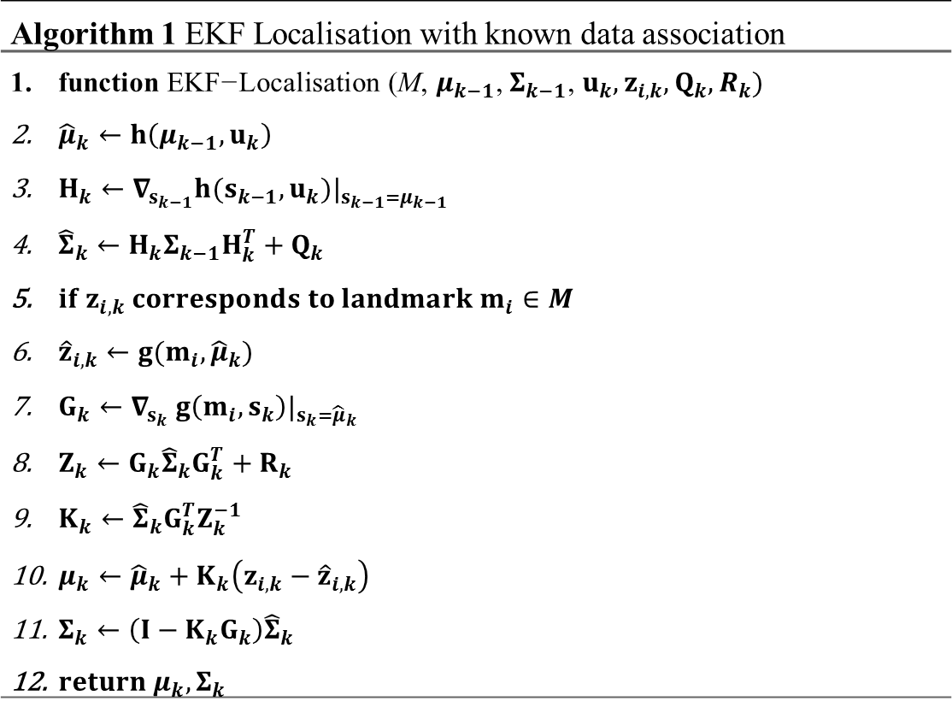
Kalman filter localisation
Algorithm 1 EKF Localisation with known data association
$\text{function} \text{EKF}\text{−}\text{Localisation}\text{ (}\text{M}\text{, }μ_{k−1}\text{, }Σ_{k−1}\text{, }u_{k}, z_{i,k}, Q_{k},R_{k})$ ${\hat{μ}}_{k}←h\left(μ_{k−1},u_{k}\right)$ $H_{k}←∇_{s_{k−1}}h(s_{k−1}, u_{k})|_{s_{k−1}=μ_{k−1}}$ ${\hat{Σ}}_{k}←H_{k}Σ_{k−1}H_{k}^{T}+Q_{k}$ $if z_{i,k} corresponds to landmark m_{i}∈M$ ${\hat{z}}_{i,k}←g(m_{i},{\hat{μ}}_{k})$ $G_{k}←∇_{s_{k}} g\left(m_{i},s_{k}\right)|_{s_{k}={\hat{μ}}_{k}}$ $Z_{k}←G_{k}{\hat{Σ}}_{k}G_{k}^{T}+R_{k}$ $K_{k}←{\hat{Σ}}_{k}G_{k}^{T}Z_{k}^{−1}$ $μ_{k}←{\hat{μ}}_{k}+K_{k}\left(z_{i,k}−{\hat{z}}_{i,k}\right)$ $Σ_{k}←\left(I−K_{k}G_{k}\right){\hat{Σ}}_{k}$ $return μ_{k},Σ_{k}$

Slide 7
Map based localisation
Dead-reckoning localisation: Kinematic/dynamic model Proprioceptive sensors: Encoders Inertial measurement unit (IMU) | Map-based localisation: Kinematic/dynamic model Proprioceptive sensors: Encoders Inertial measurement unit (IMU) Exteroceptive sensors: LiDAR Camera Map of the environment
(a) | (b)
Requirement for: (a) dead-reckoning localisation, (b) map-based localisation.

Slide 8
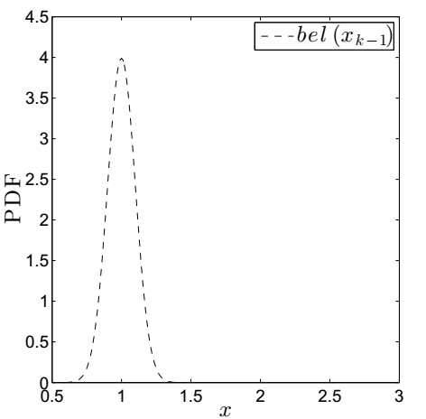
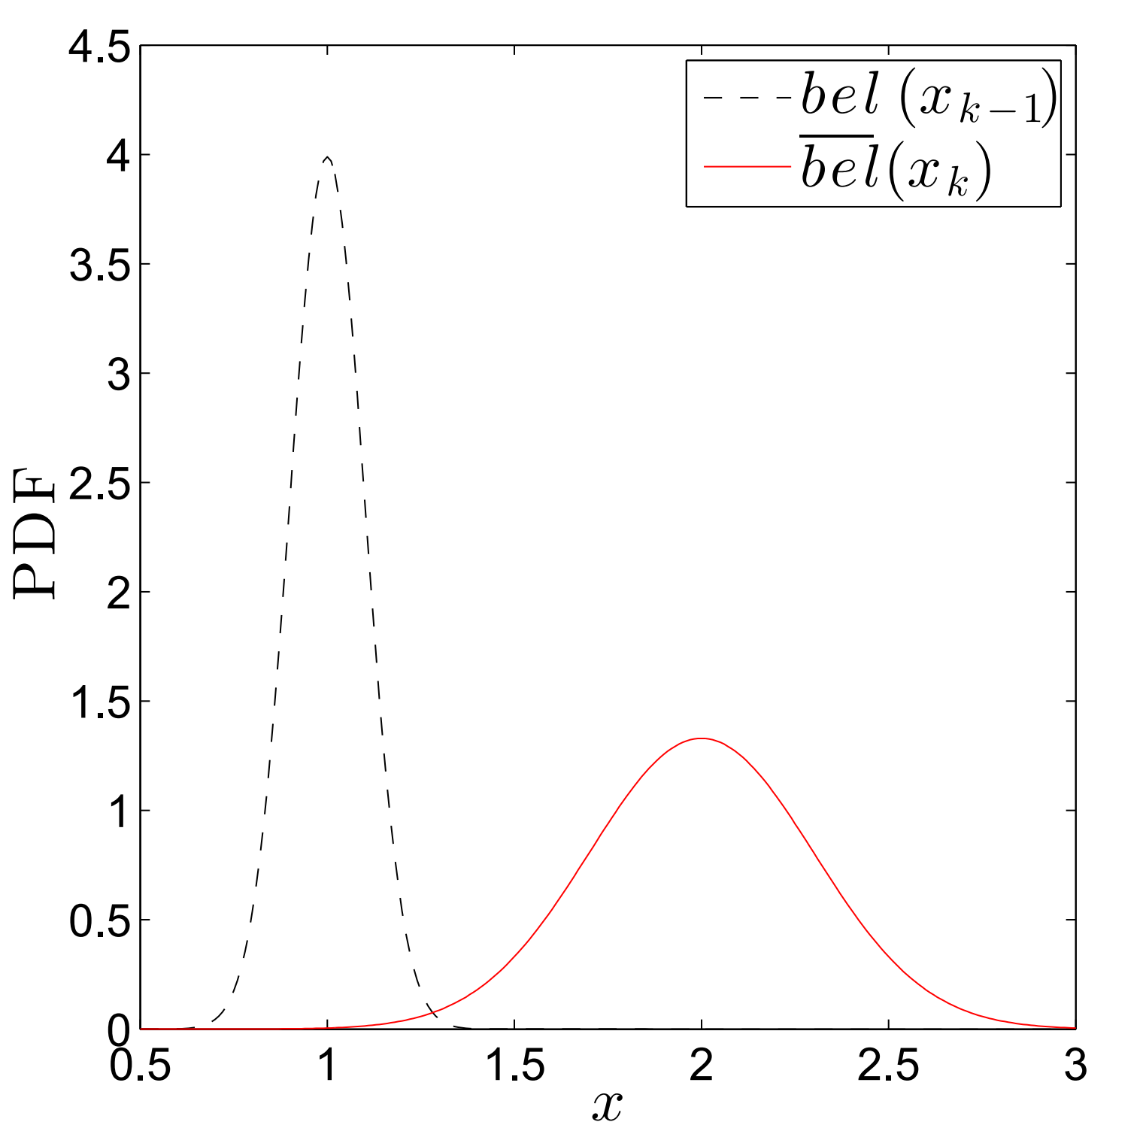
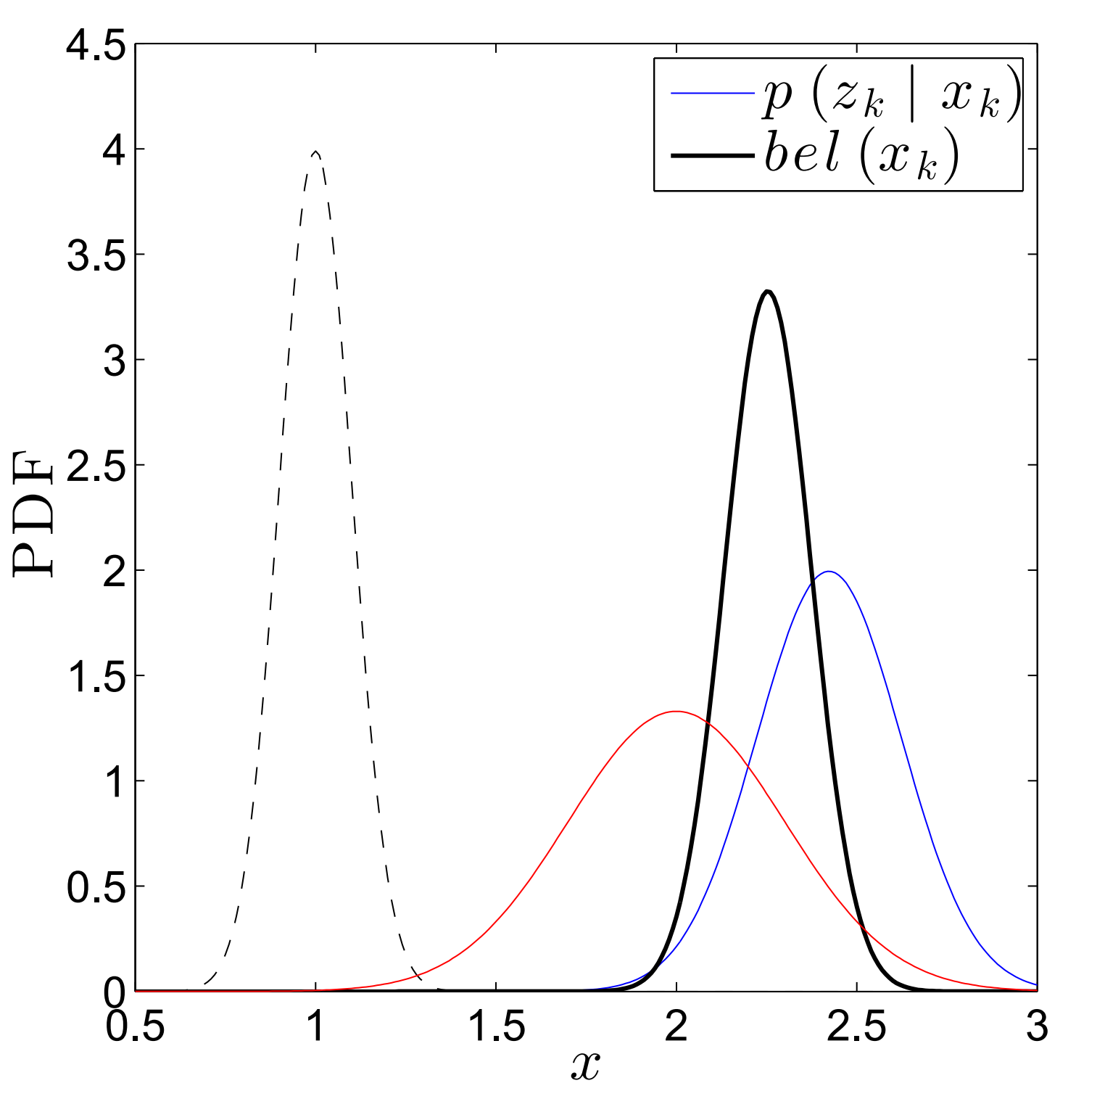
Map based localisation

Slide 9
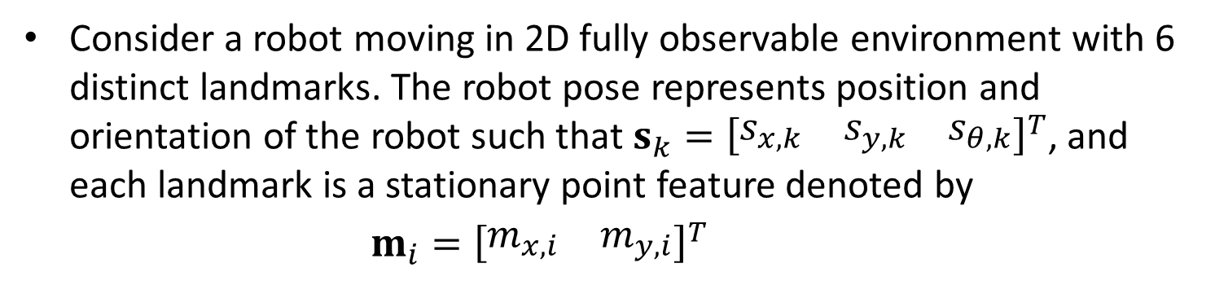
Kalman filter localisation – Case study
Consider a robot moving in 2D fully observable environment with 6 distinct landmarks. The robot pose represents position and orientation of the robot such that$s_{k}={\left[\begin{matrix}s_{x,k} & s_{y,k} & s_{θ,k}\end{matrix}\right]}^{T}$, and each landmark is a stationary point feature denoted by
$m_{i}={\left[\begin{matrix}m_{x,i} & m_{y,i}\end{matrix}\right]}^{T}$

Slide 10
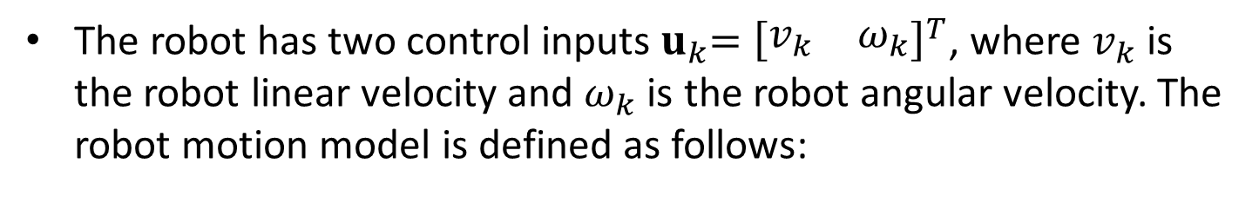
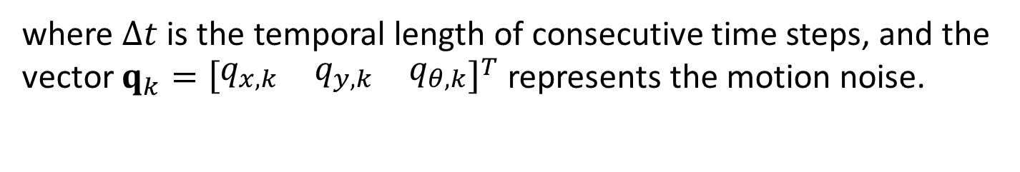

Kalman filter localisation – Case study
The robot has two control inputs${ u}_{k}={\left[\begin{matrix}v_{k} & ω_{k}\end{matrix}\right]}^{T}$, where $v_{k}$ is the robot linear velocity and $ω_{k}$ is the robot angular velocity. The robot motion model is defined as follows:
$$s_{x,k}=s_{x,k−1}+Δt∙v_{k}∙\cos{s_{θ,k−1}} +q_{x,k}$$
$$s_{y,k}=s_{y,k−1}+Δt∙v_{k}∙\sin{s_{θ,k−1}} +q_{y,k}$$
$$s_{θ,k}=s_{θ,k−1}+Δt∙ω_{k}+q_{θ,k}$$
where $Δt$ is the temporal length of consecutive time steps, and the vector $q_{k}={\left[\begin{matrix}q_{x,k} & q_{y,k} & q_{θ,k}\end{matrix}\right]}^{T}$ represents the motion noise.

Slide 11
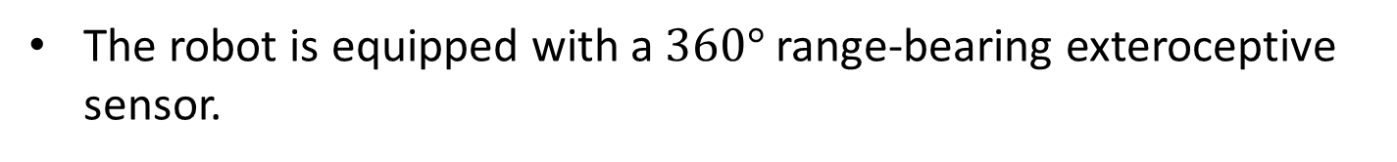
Kalman filter localisation – Case study
The robot is equipped with a $360°$ range-bearing exteroceptive sensor.

Slide 12
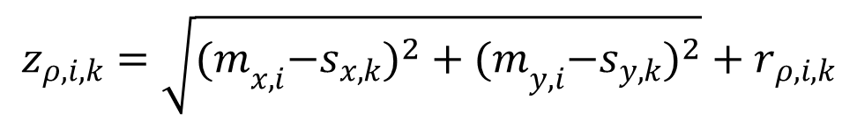
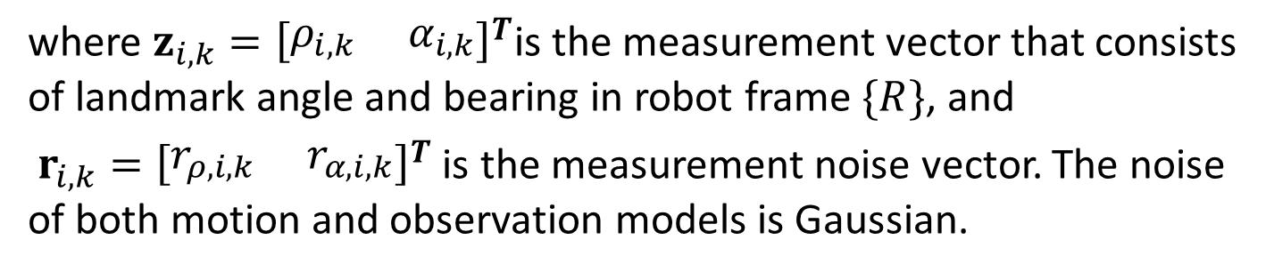
Kalman filter localisation – Case study
The robot observation model is defined as follows:
$$z_{ρ,i,k}=\sqrt{{{(m}_{x,i}−s_{x,k})}^{2}+{{(m}_{y,i}−s_{y,k})}^{2}}+r_{ρ,i,k}$$
$$z_{α,i,k}=atan2{(m_{y,i}−s_{y,k},m_{x,i}−s_{x,k})}−s_{θ,k }+r_{α,i,k}$$
where $z_{i,k}={\left[\begin{matrix}ρ_{i,k } & α_{i,k}\end{matrix}\right]}^{T}$is the measurement vector that consists of landmark angle and bearing in robot frame$\{R\}$, and
$r_{i,k}={\left[\begin{matrix}r_{ρ, i,k } & r_{α, i,k}\end{matrix}\right]}^{T}$ is the measurement noise vector. The noise of both motion and observation models is Gaussian.

Slide 13

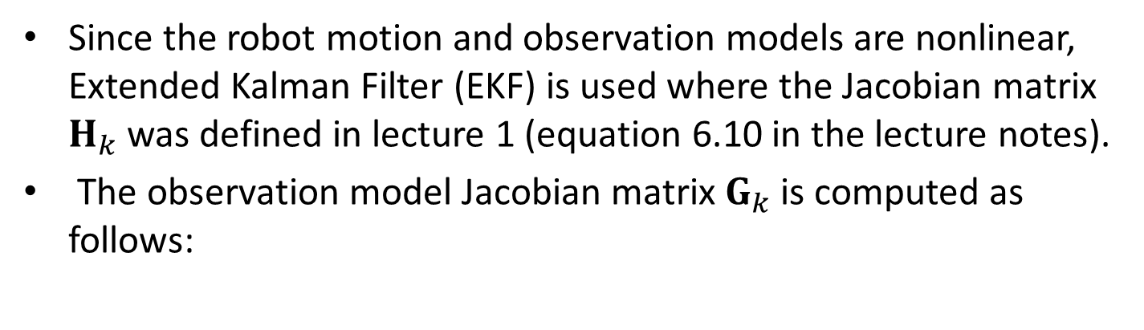
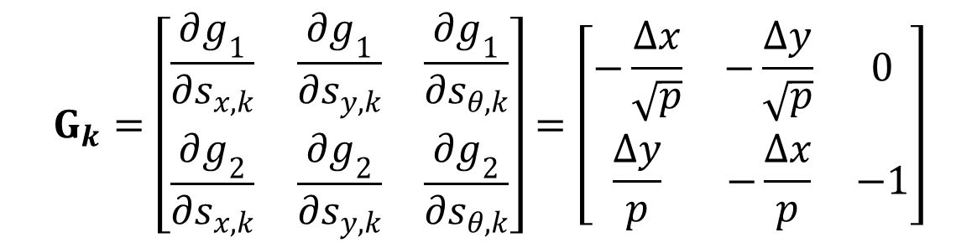


Kalman filter localisation – Case study
Since the robot motion and observation models are nonlinear, Extended Kalman Filter (EKF) is used where the Jacobian matrix $H_{k}$ was defined in lecture 1 (equation 6.10 in the lecture notes).
The observation model Jacobian matrix $G_{k}$is computed as follows:
$$Δx=m_{x,i}−{\hat{s}}_{x,k}$$
$$Δy=m_{y,i}−{\hat{s}}_{y,k}$$
$$p={Δx}^{2}+{Δy}^{2}$$
$$G_{k}=\left[\begin{matrix}\frac{∂g_{1}}{∂s_{x,k}} & \frac{∂g_{1}}{∂s_{y,k}} & \frac{∂g_{1}}{∂s_{θ,k}} \\ \frac{∂g_{2}}{∂s_{x,k}} & \frac{∂g_{2}}{∂s_{y,k}} & \frac{∂g_{2}}{∂s_{θ,k}}\end{matrix}\right]=\left[\begin{matrix}−\frac{Δx}{\sqrt{p}} & −\frac{Δy}{\sqrt{p}} & 0 \\ \frac{Δy}{p} & −\frac{Δx}{p} & −1\end{matrix}\right]$$

