Slide 1
E-Commerce Customer Churn & Behaviour
Big Data Analytics, RFM Segmentation & ML-Based Churn Prediction
Mkhawana T. Hleketani | Burgos Carrera, M. de Los Angeles | Manchidi M. John

Slide 2
Business context & problem statement
E-commerce generates rich behavioural data on loyalty and churn.
Retailers struggle to spot at-risk customers before they leave.
Retention is an important lever (cost advantage is context-dependent).
Goal: turn data into measurable findings and retention guidance.
Notes:
MA: Set up the motivation and state the problem — indicators exist but their link to churn isn't obvious without structured analysis.

Slide 3
Research question & objectives
Main Q: which behaviours relate to churn, and how well can ML predict it?
SQ1: churn proportion; how churned vs retained differ.
SQ2: which RFM segments are most at risk.
SQ3: best model and most important features.
Objectives: document data, clean (PySpark), EDA, RFM, model, recommend, limit.
Notes:
JM: Frame the questions; preview that the ML answer is nuanced due to a data issue we found.

Slide 4
Dataset, provenance & limitations
Kaggle: E-Commerce Customer Churn 2025 - 10K (MIT licence).
Verified 10,000 rows x 15 columns; one row per customer.
No missing values, no duplicates. Churn rate 37.7%.
Real schema differed from the brief's provisional list.
Real vs synthetic: UNVERIFIED (author gives no description).
Notes:
TH: We verified the real schema and are explicit about not confirming provenance.

Slide 5
Data engineering & PySpark pipeline
Reproducible: read -> dedupe -> impute -> normalise -> derive tenure -> persist.
Pandas and PySpark paths agree (10,000 -> 10,000 rows; nothing dropped).
10k rows are NOT 'big data' - PySpark demonstrates a scalable DESIGN.
Same code would run on a cluster for millions of customers.
Notes:
TH: Explain learn-once-run-anywhere design and the Windows winutils/Parquet note.

Slide 6
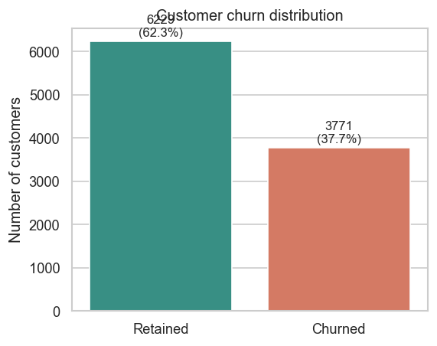
EDA & churn distribution
37.7% churn (3,771 of 10,000).
Churned vs retained differ almost only in recency: ~301 vs ~9 days.
Spend, orders, age, device, category: nearly identical across groups.
Notes:
MA: Recency dominates; demographics and spend do not separate churners.

Slide 7
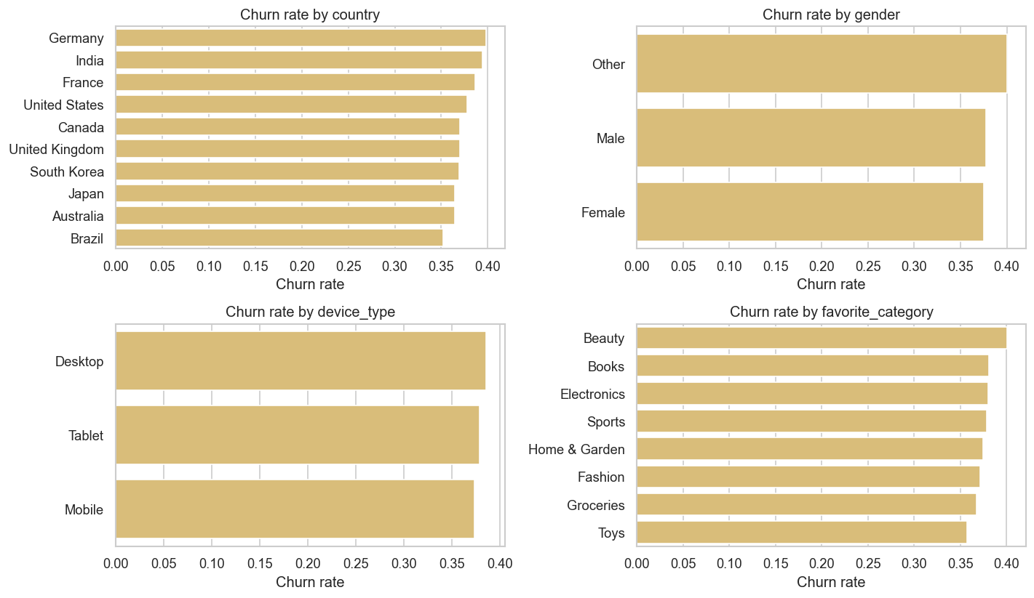
RFM segmentation
True RFM: Recency=days_since, Frequency=orders, Monetary=spend.
'Needs Attention' (31.8%) and 'At Risk' (8.3%): ~94% churn.
Recent segments (Champions, Loyal, ...): ~0% churn.
Notes:
MA: Explain 5-bin scoring with recency reversed; segments split by recency.

Slide 8
Machine-learning approach
Binary classification of 'churned'.
Preprocessing inside sklearn Pipelines (fit on train folds only).
Models: DummyClassifier, Logistic Regression, Random Forest.
Stratified 80/20 split, seed 42, 5-fold CV for selection.
Two experiments: A = all features, B = leakage-resistant (primary).
Notes:
JM: Emphasise no leakage from scaling/encoding and why two experiments.

Slide 9
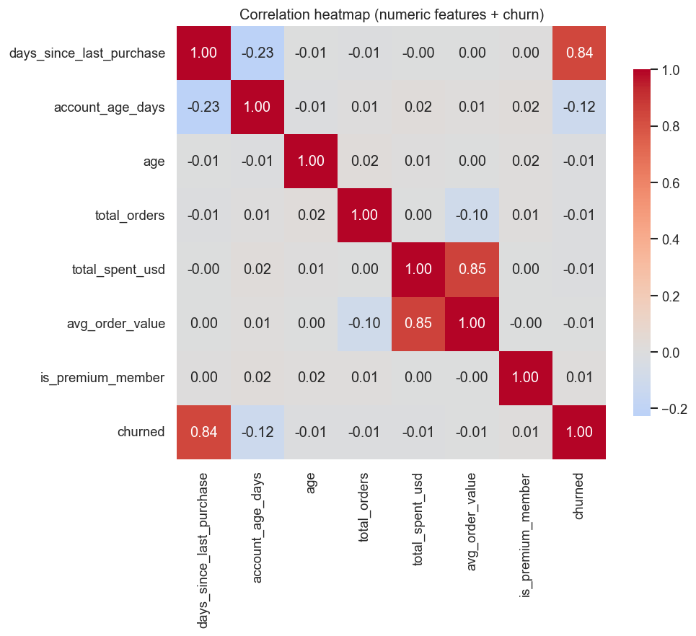
Leakage finding (key result)
churned == (days_since_last_purchase > 90) at 100% accuracy.
This field DEFINES the label -> target-defining leakage.
Dates encode the same recency -> also leakage.
Notes:
JM: This is the most important result; the 'best' naive model is not real prediction.

Slide 10
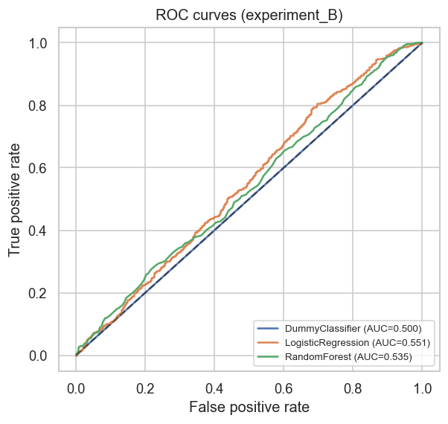
Model evaluation & comparison
Experiment A ~100% (because of leakage) - a sanity check, not a result.
Experiment B: RF ROC-AUC 0.54, F1 0.37; LR F1 0.46.
Barely above majority baseline (Dummy accuracy 0.623).
Low recall + precision -> unfit for targeting.
Notes:
JM: Contrast A vs B; discuss false-negative cost; no honest predictive power.

Slide 11
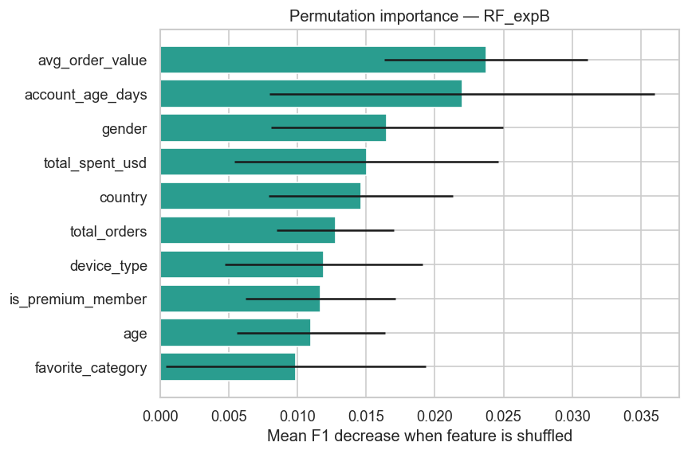
Interpretation & retention recommendations
Exp B importances all tiny; no feature stands out.
R1 Re-engage before day 90. R2 Protect Champions/Loyal.
R3 Prioritise high-value 'At Risk'. R4 Don't deploy a predictive model yet.
Associations, not causation.
Notes:
MA+JM: Keep findings separate from proposed actions; no causal claims.

Slide 12
Conclusion, limitations & future work
Delivered a tested, reproducible, leakage-aware pipeline end-to-end.
Headline: churn is a recency rule; apparent 100% models restate the label.
Dataset describes the base but can't predict FUTURE churn.
Future: event-level forward-labelled data, A/B test, scale-test Spark.
Thank you - questions?
Notes:
All: Summarise the honest story and invite questions.

