Slide 1

BONAM VENKATA CHALAMAYYA
INSTITUTE OF TECHNOLOGY AND SCIENCE
(AUTONOMOUS)
DEPARTMENT OF COMPUTER SCIENCE AND ENGINEERING
project presentation on
AUTOMATIC DETECTION OF GENETIC DISEASES IN PEDIATRIC AGE USING PUPILLOMETRY
Under the guidance of Presented By
Mrs. B. S. R. D. Lakshmi G V V S S S GANESH (21H41A0514)
M. Tech., (Ph.D.,) Y C R DURGA (21H41A0566)
Assistant professor M GAYATHRI (21H41A0534)
DEPARTMENT OF CSE V MEGHANA (21H41A0561)
A G S SAVERI (21H41A0502)

Slide 2
Contents
S.No Description of topic
1. Abstract
2. Introduction
3. Literature Survey
4. Existing System & Disadvantages
5. Proposed System & Advantages
6. Hardware & Software requirements
7. Feasibility study
8. Functional requirements
9. Non-functional requirements
10. Modules
11. UML Diagram
12. Implementation
13. Test Cases
14. Project Execution Screens
15. Conclusion & Future Enhancement
16. Reference

Slide 3
abstract
Inherited retinal diseases cause severe visual defects in children. They are classified in outer and inner retina diseases, and often cause blindness in childhood. The diagnosis for this type of illness is challenging, given the wide range of clinical and genetic causes. It is routinely based on a complex pattern of clinical tests, including invasive ones, not always appropriate for infants or young children.
A different approach is thus needed, the use of pupillometry, a non-invasive technique that measures pupil size and reactions, as a potential tool for detecting genetic diseases in children. Pupil reactions were recorded using an automated pupillometer under controlled lighting conditions. The pupillometry system tested on both synthetic and real-world data, achieving accurate results with lower computational cost than traditional methods.

Slide 4
introduction
Detecting genetic eye diseases early in children is very important for timely treatment and preventing vision loss. However, current diagnostic methods often involve invasive clinical tests, which can be stressful and uncomfortable for young patients. This creates a need for non-invasive, accurate, and child-friendly diagnostic tools.
To address this challenge, our project uses pupillometry and machine learning to automatically detect genetic eye diseases in children. Pupillometry, a technique that measures changes in pupil size in response to light, offers a non-invasive and sensitive method for assessing eye health. The data captured by pupillometry devices provides valuable information about the eye data, which is often affected by genetic eye conditions.
In this project, we use machine learning, specifically Support Vector Machines (SVM), to analyze pupillometry data and identify patterns that indicate specific genetic eye diseases. By training SVM classifiers on datasets of pupillometry recordings from both healthy and affected children, we aim to develop a reliable and accurate diagnostic tool. We also combine the results of multiple SVM classifiers to improve the overall accuracy of our predictions. This approach aims to reduce the need for invasive clinical procedures, making the diagnostic process more comfortable and accessible for children, ultimately leading to earlier detection and better outcomes.

Slide 5
Literature survey
Title | Published by | Year | Observations | Limitations
Pupil abnormalities in 131 cases of genetically defined inherited peripheral neuropathy | H.Houlden, S Smith | 2008 | The study provided key insights into the presence of pupil abnormalities in different types of inherited peripheral neuropathies. | Small and Uneven Sample Distribution
Genes and Genetics in Eye Diseases: A Genomic Medicine Approach | Mahavir Singh, Suresh C Tyagi | 2018 | The research identifies specific genes responsible for various inherited eye disorders | Genetic testing and gene therapies are expensive, making them inaccessible to low-income
Genetic analysis of children with congenital ocular anomalies in three ecological regions of Nepal | Srijana Adhikari, Neelam Thakur | 2020 | identified unique genetic mutations associated with congenital ocular anomalies in the Nepalese population | The study focused only on a few known genes related to congenital ocular anomalies.
Pediatric Eye Disease—Screening, Causes, and Management | Guy L.J. Chen, Jason C.S. Yam | 2021 | The process involves early screening, genetic analysis, advanced imaging techniques, and artificial intelligence-based diagnostics for accurate detection | Screening programs are inaccessible in some regions.
Optical Coherence Tomography in Children with Inherited Retinal Diseases | Jasleen K. Jolly, Brent M. Rodda | 2023 | By providing high-resolution images of retinal microstructures, OCT enables early diagnosis, tracks disease progression, and aids in treatment. | Difficulty in imaging due to child movement.

Slide 6
Existing system
The existing system for diagnosing Inherited Retinal Diseases (IRDs) primarily relies on a series of complex clinical tests, with electrophysiological testing being the most commonly used. These tests, though informative, are often invasive and require a specialized medical setting. The process can be challenging for pediatric patients, especially since these tests often require sedation. This can be problematic, as the procedure is expensive, time-consuming, and not always effective in detecting changes in visual function, particularly in young children.
DISADVANTAGES:
Invasive tests that may require sedation, which is not always suitable for children.
High costs due to specialized equipment and medical staff.
Time-consuming diagnosis process, requiring visits to specialized centers.
Limited ability to monitor disease progression effectively due to poor test reliability.

Slide 7
PROPOSED SYSTEM
The proposed system uses Chromatic Pupillometry combined with Machine Learning to diagnose Inherited Retinal Diseases (IRDs) in children. This system utilizes a pupillometer to collect non-invasive pupillary response data, which is then analyzed using Support Vector Machines (SVMs) to classify the disease. The goal of this system is to provide a faster, easier, and more efficient way to diagnose IRDs, without the need for invasive procedures or sedation, making it particularly suitable for pediatric patients.
ADVANTAGES:
Non-invasive method that eliminates the need for sedation or other invasive tests.
Faster diagnosis with the ability to quickly analyze data using Machine Learning.
Cost-effective, reducing the need for specialized equipment and complex procedures.
Easy monitoring of disease progression and treatment effectiveness through repeated pupillometry tests.

Slide 8
REQUIREMENTS
HARDWARE REQUIREMENTS:
Operating System : Windows
Processor : i3 and above
RAM : 4GB and above
Hard Disk : 20GB and above
Software requirements:
Python IDEL (Python 3.7)

Slide 9
Feasibility Study
1. Technical Feasibility:
Data collection: uses chromatic pupillometry for accurate data acquisition.
Algorithms: applies machine learning (svms, bilstm) for analysis and classification.
System integration: combines hardware (pupillometer) with software for disease detection.
2. Economic Feasibility:
Cost Reduction: Minimizes the need for expensive tests and invasive procedures.
Efficiency: Early diagnosis enables timely interventions, reducing long-term costs.
Improved Diagnosis Speed: The system helps speed up diagnosis, leading to quicker treatment and better patient outcomes.
3. Operational Feasibility:
Non-Invasive: The system is non-invasive, ideal for pediatric patients.
User-Friendly: No need for complex preparations or sedation.
Minimal Training Required: Healthcare providers can easily adopt the system with little additional training.

Slide 10
FUNCTIONAL REQUIREMENTS
Data Collection:
Collect pupillometric data from a pupillometer.
Allow users to upload pupillometric datasets.
Data Processing:
Remove artifacts from raw data.
Extract key features (e.g., pupil diameter, latency).
Reduce unnecessary features.
Classification:
Use SVM classifiers for analysis.
Perform classification on data from both eyes.
Combine SVM results using an ensemble algorithm.
Output:
Show accuracy results for each eye and the ensemble model.
Generate graphs for pupil diameter and classification accuracy.
Predict disease presence or absence based on test data.

Slide 11
NON-FUNCTIONAL REQUIREMENTS
Performance: The system should process and analyze pupillometric data efficiently to provide timely diagnostic support. The classification algorithms (SVMs, ensemble model) should provide results with high accuracy.
Usability: The system includes a user interface for uploading data, running analysis, and viewing results. The system provides visualizations such as pupil diameter graphs and accuracy graphs.
Reliability: The system utilizes an ensemble model to improve the reliability of the classification.
Non-Invasiveness: The system uses chromatic pupillometry, a non-invasive technique.
Maintainability: The system is designed with a modular architecture to allow for updates and modifications to individual components (e.g., the classification algorithms, feature extraction methods) without affecting the entire system.
Scalability: The system's design allows for the incorporation of additional patient data and processing resources. For example, the data processing components can be optimized or distributed to handle larger datasets.

Slide 12
modules
Module 1: Data preprocessing
The initial stage involves data preparation. First, the user uploads the pupillometry dataset, initiating the process. Next, the system cleans and filters the raw data, extracting relevant pupil dilation information while removing noise. Finally, key pupillometric features, such as maximum and minimum pupil size, are extracted and normalized, readying the data for machine learning models.
Module 2: Model training & evaluation
In this module, various machine learning and deep learning models are trained and evaluated. Initially, support vector machines (svms) are trained on right and left eye data to establish baseline accuracy. Subsequently, an ensemble learning approach combines these SVM predictions to enhance overall performance. Lastly, deep learning models, including LSTM and bilstm, are employed for sequence-based analysis, and all model accuracies are visually compared using a bar graph.
Module 3: Disease prediction
The final phase focuses on disease prediction using the trained models. New patient data is input into the system, and the models classify whether a genetic disease is present. The prediction result, either "disease detected" or "no disease detected," is then displayed in the GUI console, providing a clear diagnostic outcome.

Slide 13
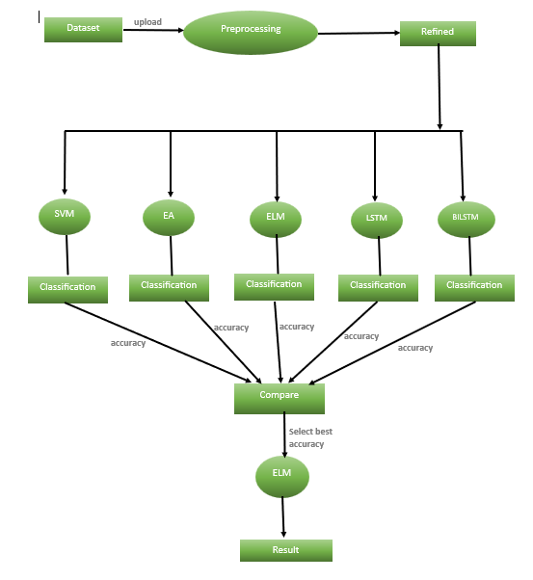
Data flow diagram
fig: Dataflow diagram for Automatic detection of genetic diseases in pediatric age using
pupillometry

Slide 14
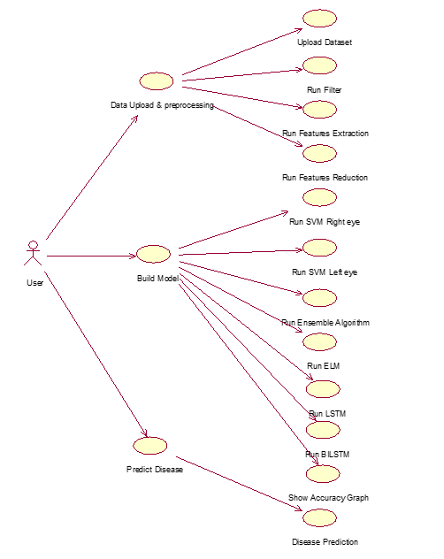
Uml diagrams
fig1: Usecase diagram for Automatic detection of genetic diseases in pediatric age using pupillometry

Slide 15
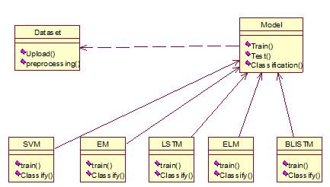
fig2: Class diagram for Automatic detection of genetic diseases in pediatric age using pupillometry

Slide 16
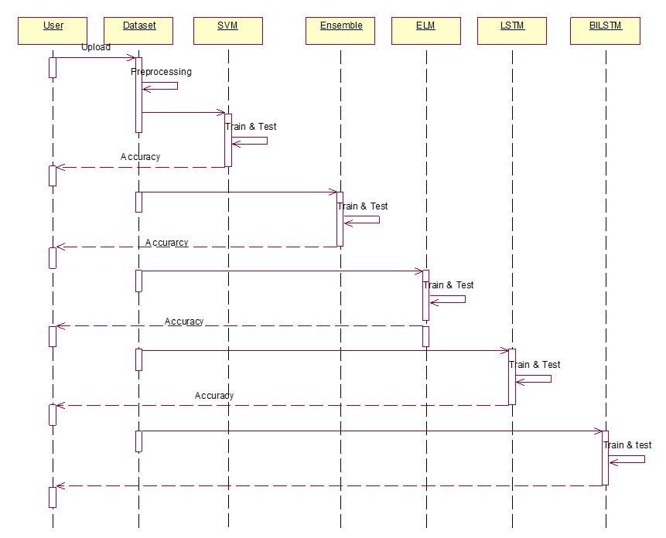
fig3: Sequence diagram for Automatic detection of genetic diseases in pediatric age using pupillometry

Slide 17
fig4: Activity diagram for Automatic detection of genetic diseases in pediatric age using pupillometry

Slide 18
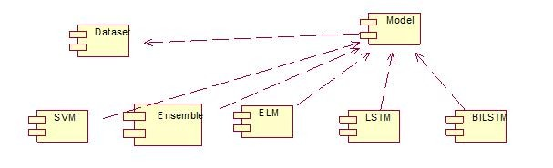
fig5: Component diagram Automatic detection of genetic diseases in pediatric age using pupillometry

Slide 19
implementation
Svm algorithm:
SVM is a powerful classification algorithm that works by finding the optimal boundary (called a hyperplane) that best separates data points into different classes. It is particularly effective for high-dimensional data and is used here to classify left and right pupil features independently.
Pseudocode:
Input: Training data X_train, labels y_train
1. Create SVM classifier
2. Fit SVM model on training data (X_train, y_train)
3. Predict labels for X_test
4. Compute accuracy, sensitivity, specificity

Slide 20
Ensemble Learning algorithm:
Ensemble learning combines multiple models to improve accuracy and robustness. In this project, predictions from two SVM models (left and right eye) are combined using a voting classifier to make a final decision. This approach helps reduce errors that may arise from using a single model.
PSEUDOCODE:
Input: features from left and right eyes
1. Train left SVM classifier
2. Train right SVM classifier
3. Combine both in a voting classifier
4. Fit ensemble on training data
5. Predict using ensemble on test data
6. Compute performance metrics

Slide 21
Extreme Learning Machine algorithm:
ELM is a type of single-layer neural network where the input weights are randomly assigned and not updated during training. It provides faster training compared to traditional networks and is used here to classify combined features from both eyes efficiently.
PSEUDOCODE:
Input: Combined left and right pupil features
1. Create GenELMClassifier with random hidden layer
2. Fit model on training data
3. Predict on test data
4. Compute accuracy, sensitivity, specificity

Slide 22
LSTM ALGORITHM:
LSTM is a deep learning model specialized for handling sequential or time-series data. It uses memory cells to retain long-term dependencies, making it ideal for analyzing patterns in pupil size variations over time. It processes left eye data to detect abnormalities.
PSEUDOCODE:
Input: Left pupil features (X, Y)
1. One-hot encode labels Y
2. Reshape X to (samples, timesteps, features)
3. Create Sequential model
4. Compile and train model
5. Predict and evaluate

Slide 23
BILSTM algorithm:
BILSTM extends LSTM by processing data in both forward and backward directions, capturing past and future context. This improves the model’s understanding of sequential data and helps detect complex patterns in the pupil metrics more effectively.
PSEUDOCODE:
input: left pupil features (x, y)
1. one-hot encode labels y
2. reshape x to (samples, timesteps, features)
3. create sequential model
4. compile and train model
5. predict and evaluate

Slide 24
Test Cases
S.No. | Test Case Description | Expected Output | Actual Output | Result
1. | Upload pupillometric dataset. | Dataset uploaded and displayed. | Dataset uploaded successfully. | Pass
2. | Predict genetic disease based on test data. | "Disease Detected" or "No Disease Detected." | Correct classification displayed. | Pass
3. | Upload invalid dataset | It shows error message | Error message not displayed | Fail
4. | Show accuracy graph | A bar graph of accuracy values displayed | Graph displayed using matplotlib | Pass
5. | Selecting an empty directory | Error message. | It is showing dataset is loaded. | Fail

Slide 25
Project Execution Screens

Slide 26
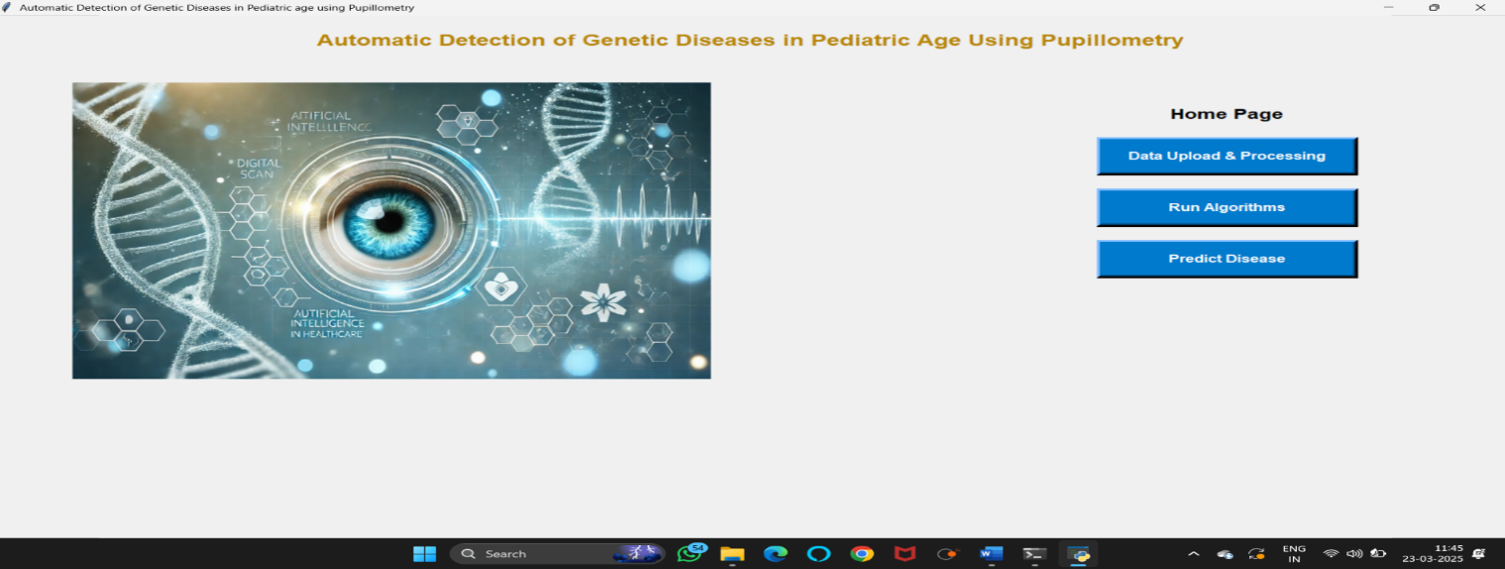
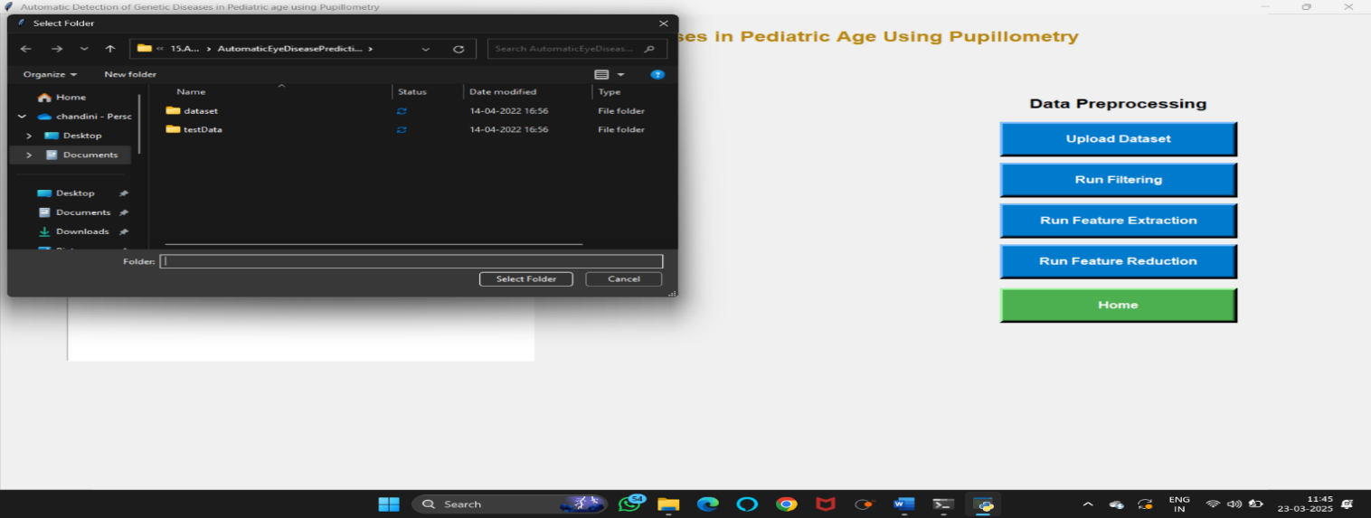
To run project double click on ‘run.bat’ file to get below screen.
In above screen click on ‘upload pupillometric dataset’ button to load dataset.
In above screen uploading ‘dataset’ folder and after upload will get next screen.

Slide 27
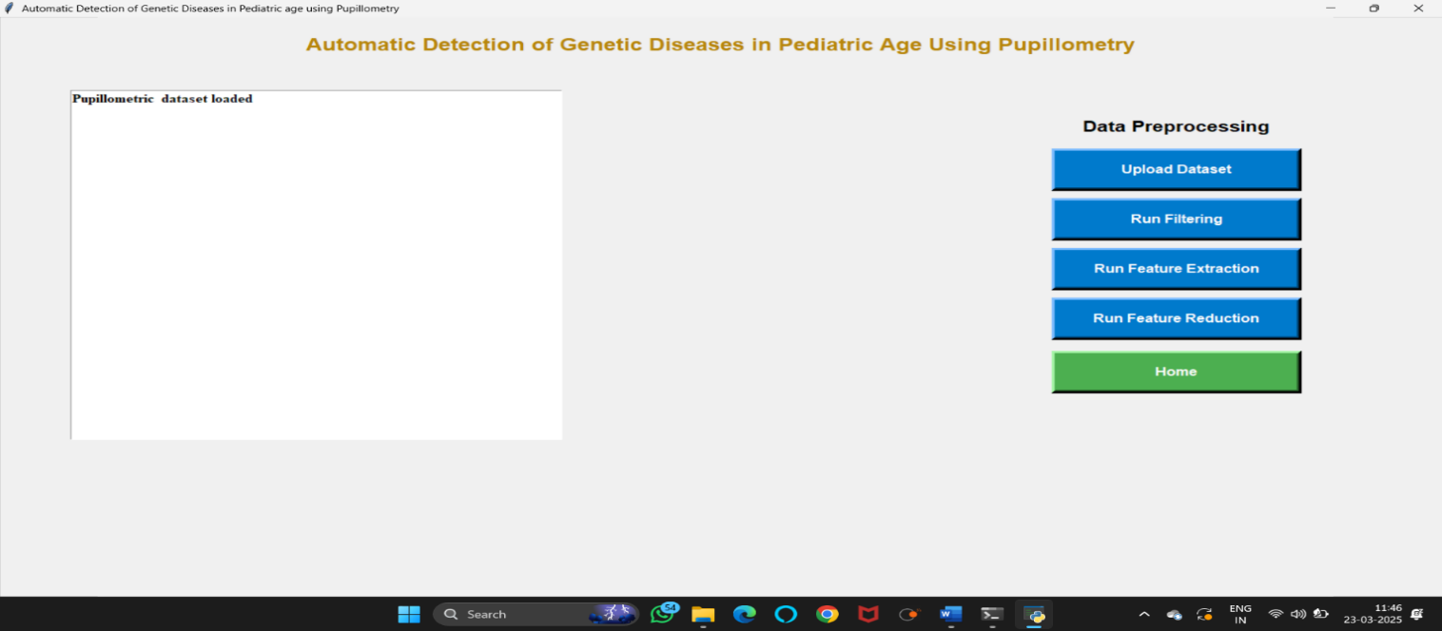
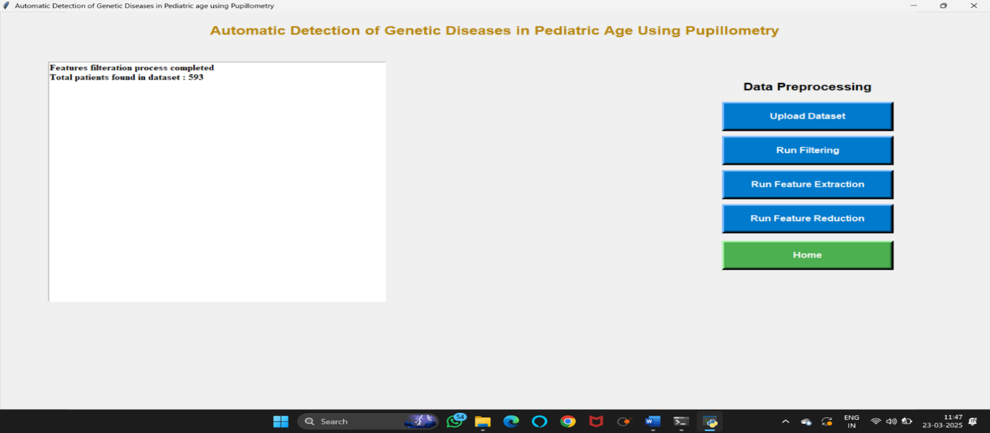
Now click on ‘run filtering’ button to perform filtering on dataset to display the count of data sets.
Now click on ‘run features extraction’ button to read features from raw file.

Slide 28

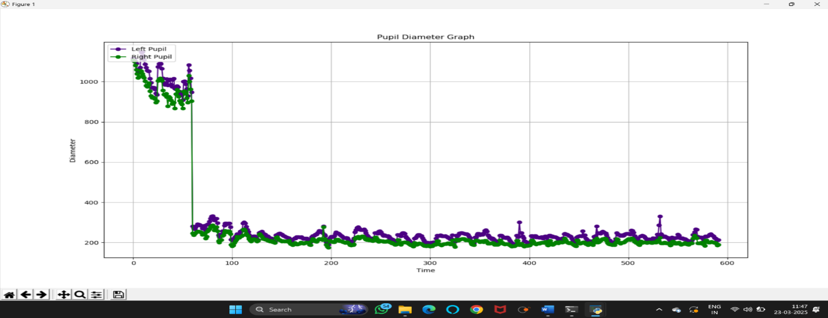
Now click on ‘run features reduction’ button to remove unimportant features and then generate train and test model for classification and to get pupil diameter graph.
Close above graph to get below screen.

Slide 29

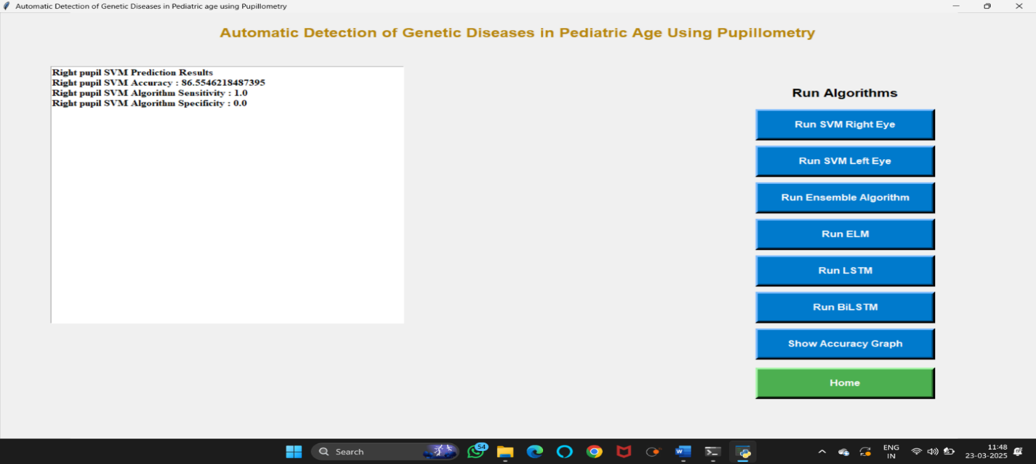
Now click on ‘run svm on right eye features’ to run svm classifier.
Now click on ‘run svm on left eye features’ button to run svm classifier on left eye data.

Slide 30
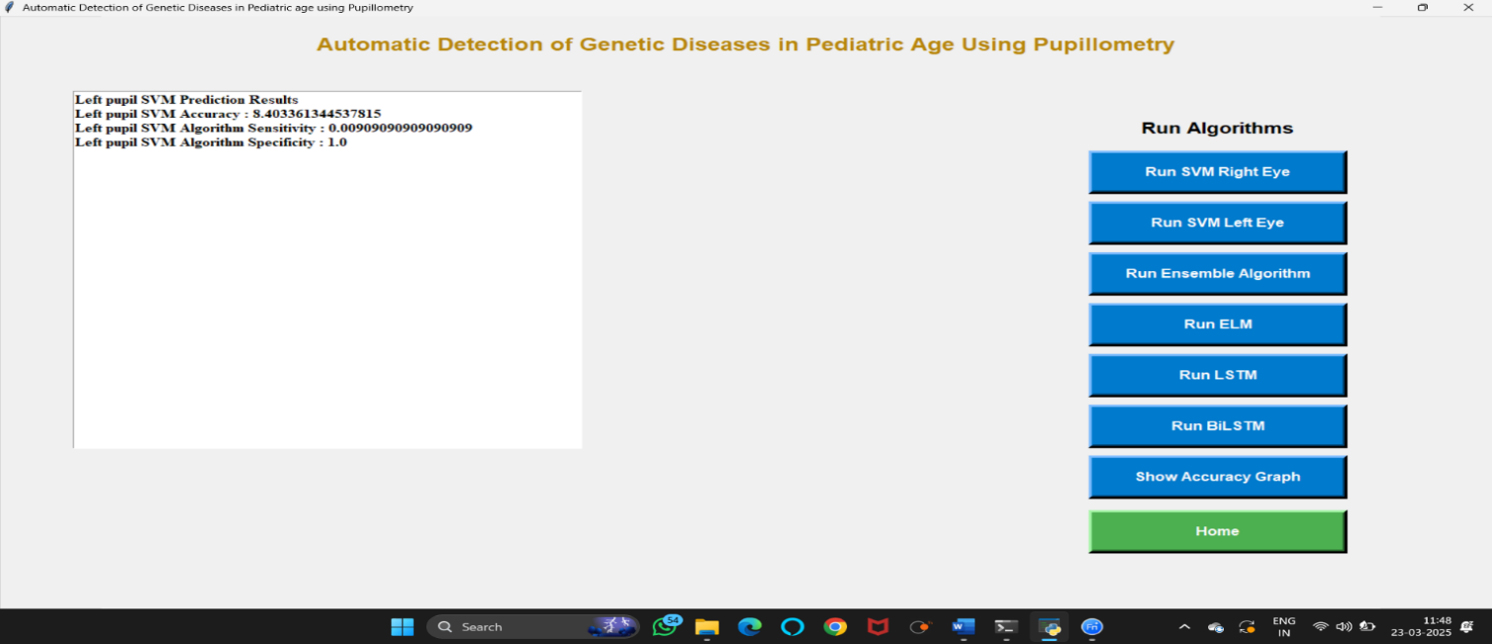
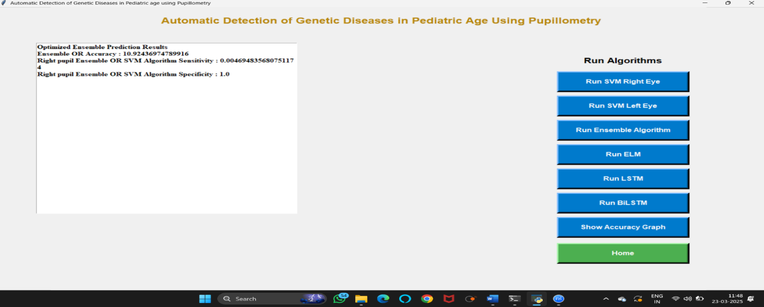
Now click on ‘run or ensemble algorithm (left & right svm)’ button to combine both classifier to choose classifier with better accuracy.
Now click on elm algorithm to get below screen.

Slide 31
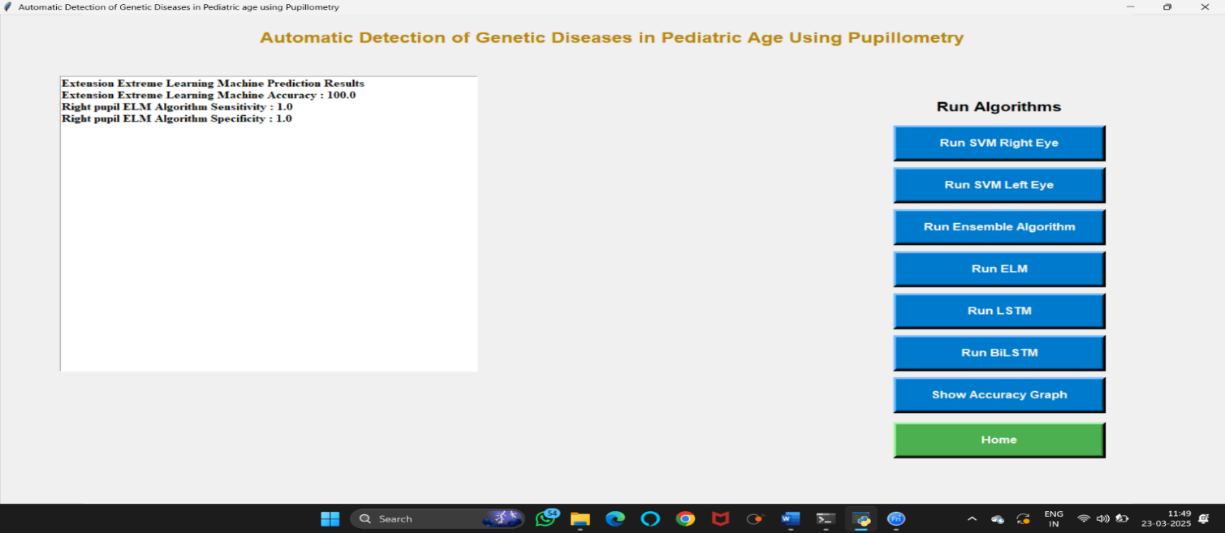
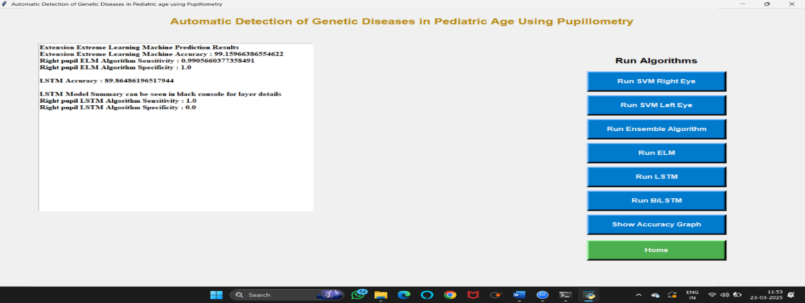
Now click on ‘RUN LSTM’ button to find accuracy.
Now click on ‘RUN BILSTM’ to find the accuracy.

Slide 32
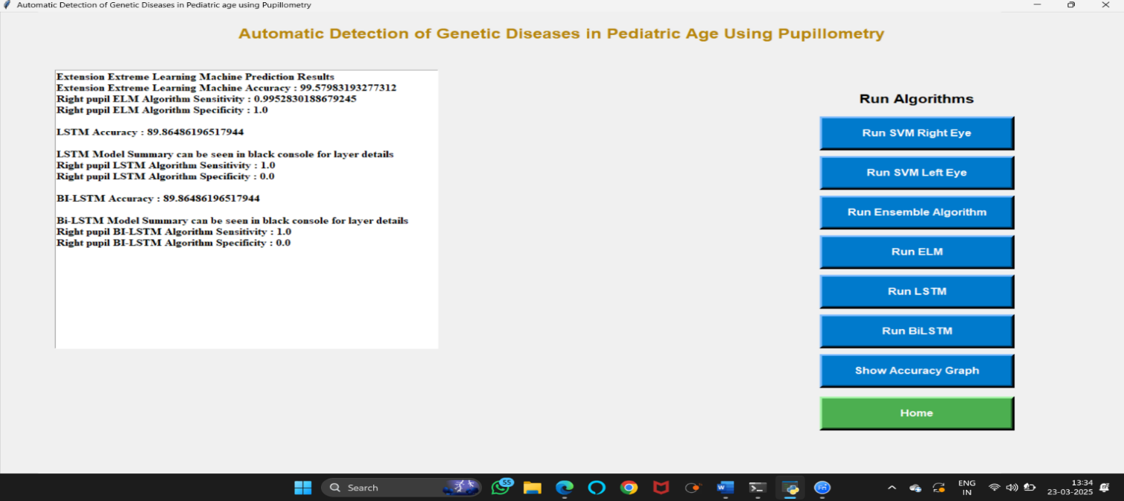
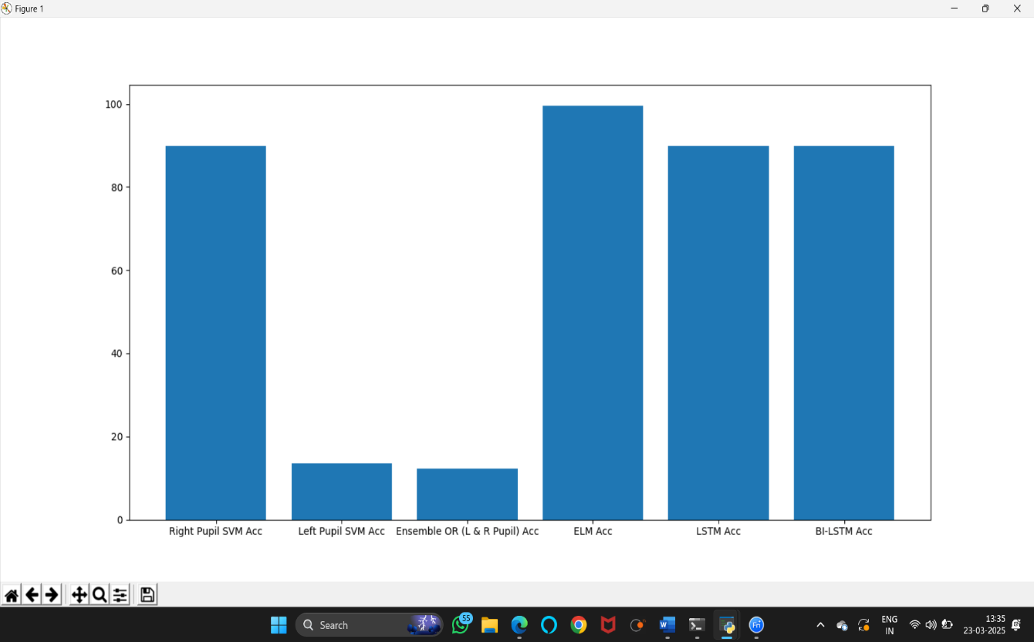
Now click on ‘show accuracy graph to get below accuracy graph.
Now click on ‘predict disease’ button to upload test data and predict disease.

Slide 33
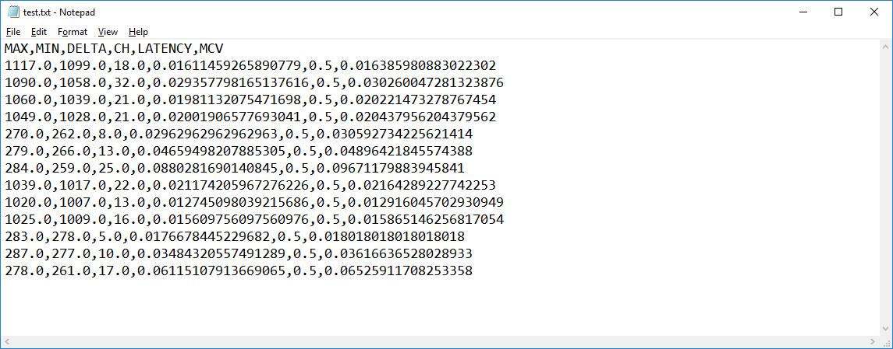
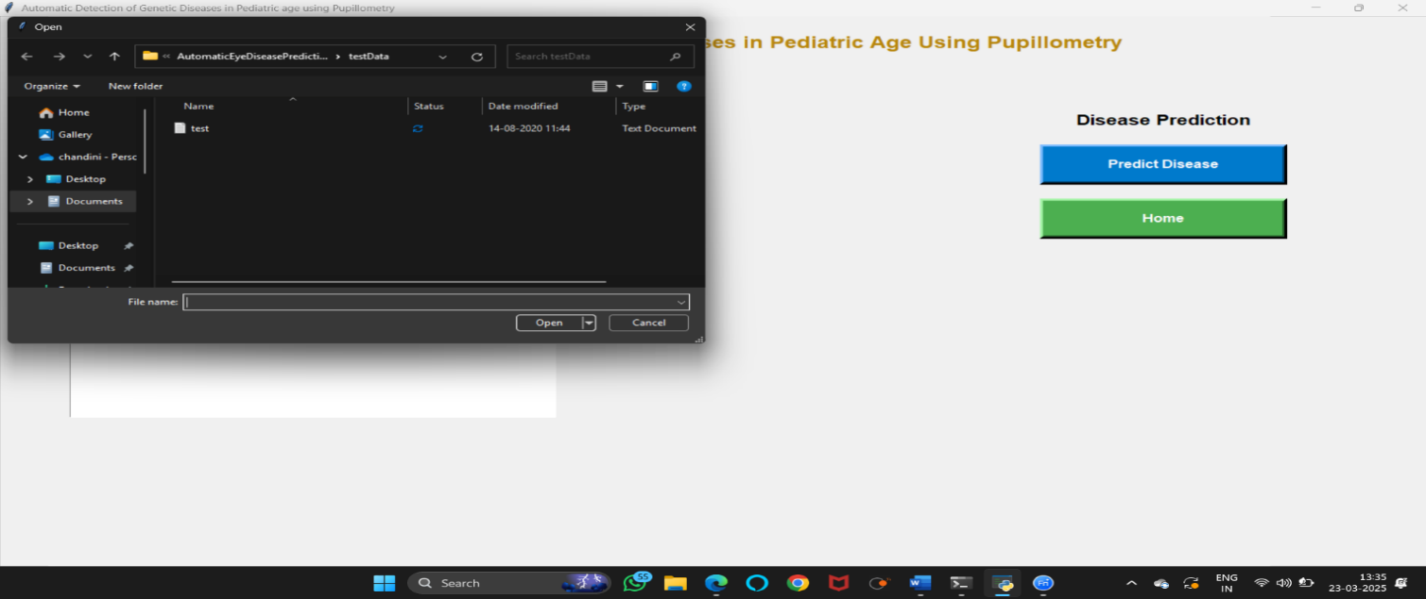
In above test data ‘test.txt’ we have only features values and after uploading classifier will predict disease.
In above screen uploading test data and after upload will get below screen.

Slide 34
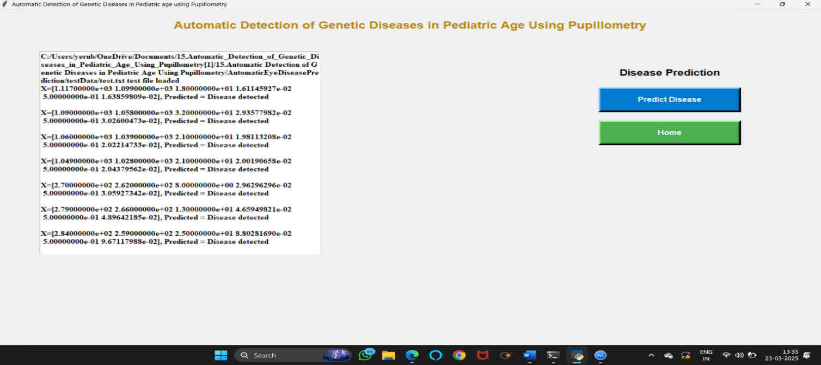
.
In above screen for each test record classifier display result as ‘disease predicted’ or ‘no disease predicted’.

Slide 35
Conclusion and future enhancement
This project demonstrates the feasibility and potential of utilizing pupillometry data and machine learning, specifically Support Vector Machines, for the non-invasive detection of genetic eye diseases in pediatric patients. By automating the analysis of pupil dynamics, we have developed a system that minimizes the need for stressful and invasive clinical procedures, offering a more comfortable and accessible diagnostic approach. The high accuracy achieved through our ensemble SVM classifier highlights the effectiveness of this methodology.
Future enhancements for this project could focus on expanding the system's capabilities by incorporating diverse datasets from various pupillometry devices and patient demographics, thereby improving generalizability. Additionally, integrating the system with electronic health records and developing a user-friendly mobile application could facilitate seamless clinical integration and remote patient monitoring. Furthermore, implementing real-time data analysis and alert systems would enable immediate detection of potential abnormalities, leading to faster interventions and improved patient outcomes.

Slide 36
References
Books & academic sources:
Smith, J. & Lee, R. (2016). Pupillometry in clinical neurology. Oxford university press.
Kaplan, h. (2019). Genetic disorders and visual impairments: A diagnostic approach. Cambridge university press.
Online references:
Automatic detection of genetic diseases in pediatric age using pupillometry by IEEE: https://ieeexplore.Ieee.Org/document/8998205
Pupillometry Wikipedia: https://en.Wikipedia.Org/wiki/pupillometry?Utm_source=chatgpt.Com
Machine learning with python tutorial: https://www.geeksforgeeks.org/machine-learning-with-python/

Slide 37
Thank you

