Slide 1

PROJECT
STOCK ANALYZER
SUBITTED BY: SIDHARTH MANDAL
ASHISH KUMAR
ARMAN DOGRA
SUBMITTED TO: ANCHAL SINGH

Slide 2
Stock Market
What is the Stock Market?
The stock market refers to the collection of markets and exchanges where regular activities of buying, selling, and issuance of shares of publicly-held companies take place. Such financial activities are conducted through institutionalized formal exchanges or over-the-counter (OTC) marketplaces which operate under a defined set of regulations. There can be multiple stock trading venues in a country or a region which allow transactions in stocks and other forms of securities. While both terms - stock market and stock exchange - are used interchangeably, the latter term is generally a subset of the former. If one says that she trades in the stock market, it means that she buys and sells shares/equities on one (or more) of the stock exchange(s) that are part of the overall stock market. The leading stock exchanges in the U.S. include the New York Stock Exchange (NYSE), Nasdaq, and the Chicago Board Options Exchange (CBOE). These leading national exchanges, along with several other exchanges operating in the country, form the stock market of the U.S. Though it is called a stock market or equity market and is primarily known for trading stocks/equities, other financial securities - like exchange traded funds (ETF), corporate bonds and derivatives based on stocks, commodities, currencies, and bonds - are also traded in the stock markets.

Slide 3
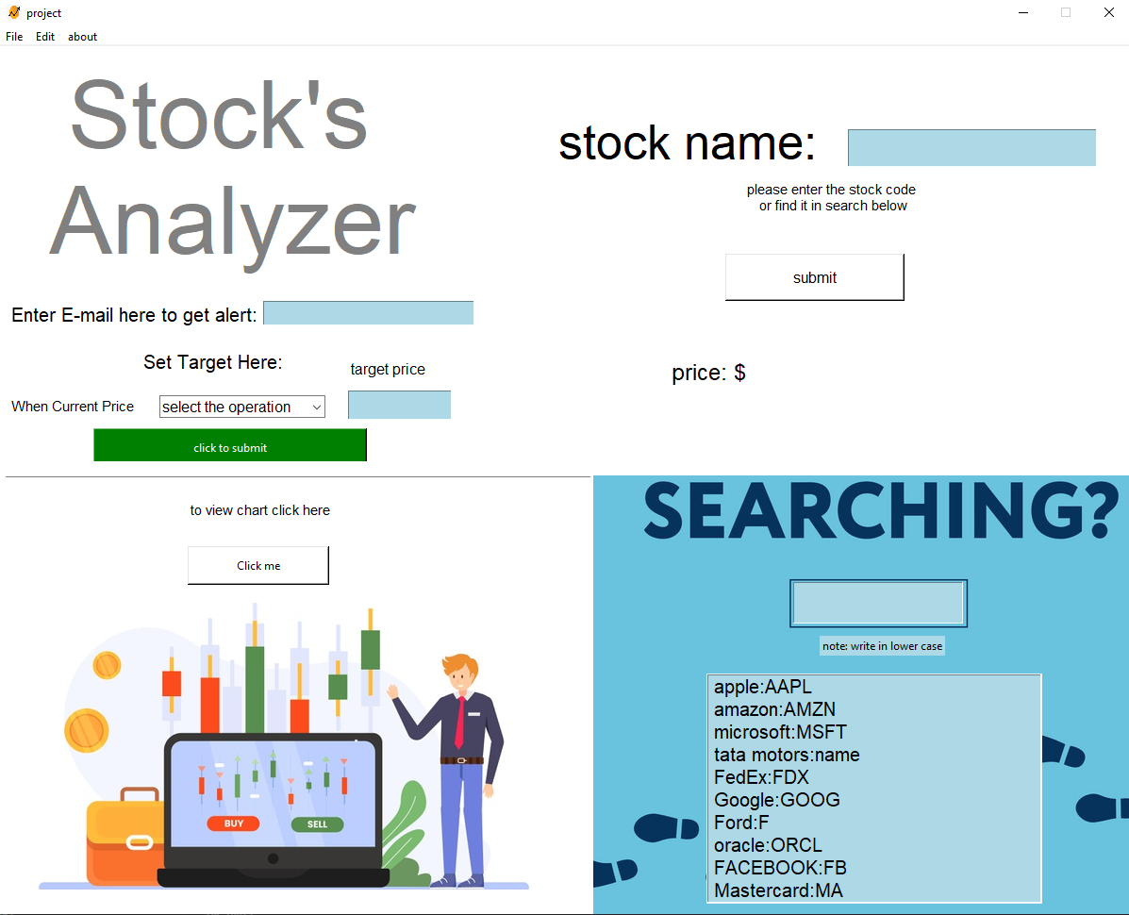
Our project
In our project we used GUI tkinter to make a interface for the user .we have imported these library:-
import tkinter as tk
from tkinter import messagebox
from yahoo_fin import stock_info
import matplotlib.pyplot as plt
from tkinter import *
from tkinter import ttk
from PIL import Image,ImageTk
import smtplib
from email.mime.multipart import MIMEMultipart
from email.mime.text import MIMEText
As you can see on left side this is the project in this project we have divided the layout into four parts so now you can see in the next slide:-

Slide 4
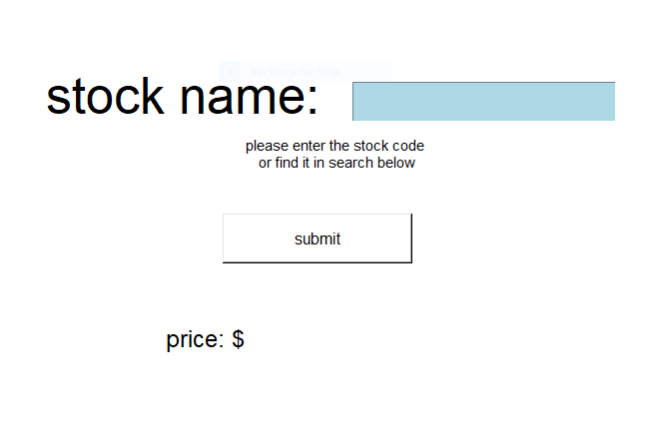
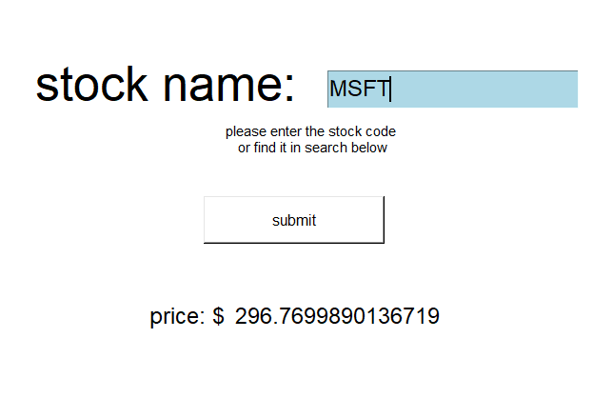
As can you can see on this part of the layout you can write any stock code name or ticker symbol to get the stock price and then click submit button to get the price.
Here we have typed the stock symbol and clicked the submit button and we get price in $ but
Indian stock market is not available and like this you can get any stock price. And to search stock code/ticker symbol move to next slide. We are using yahoo fin library

Slide 5
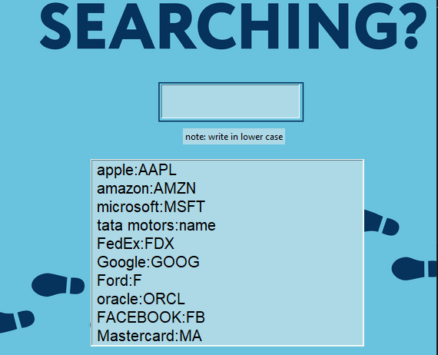
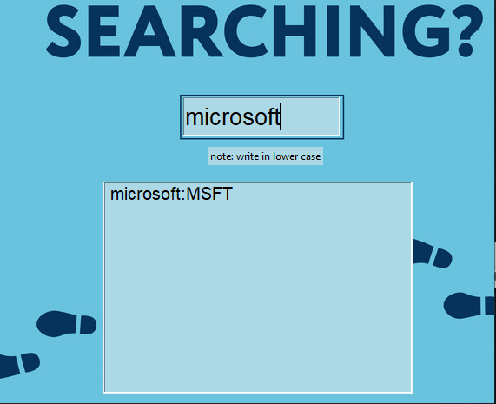
Here you can search the stock code/ticker symbol.
You have type in lower case
Here is the search example:

Slide 6
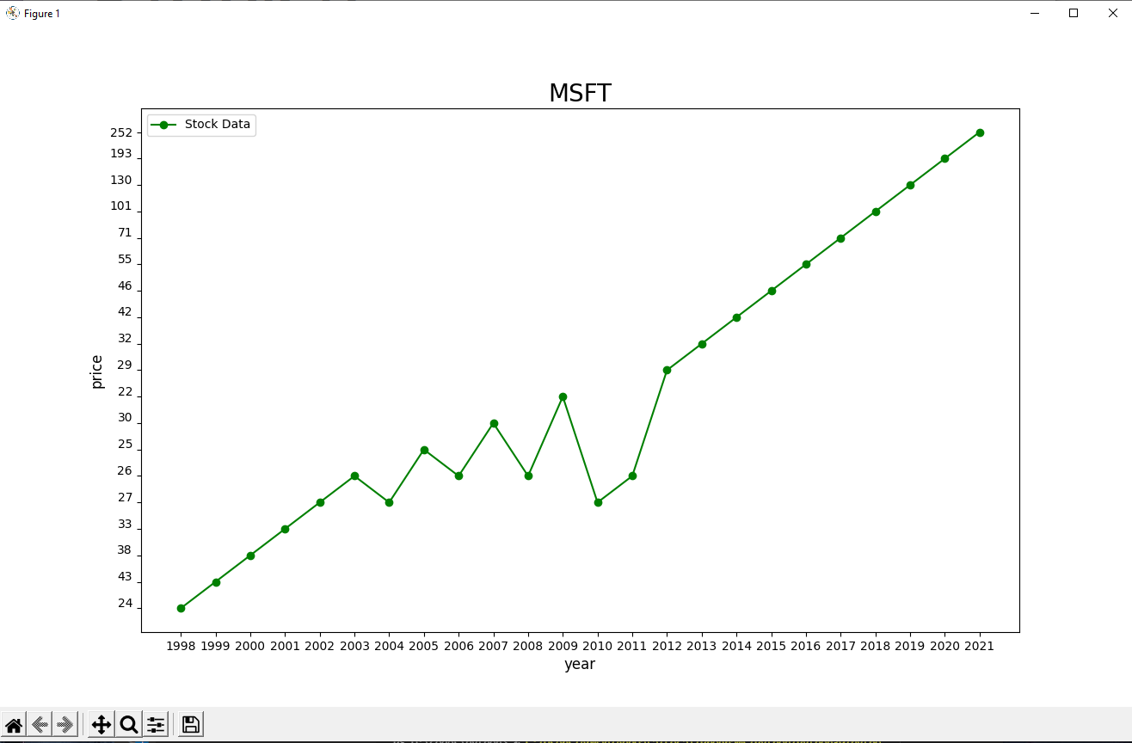
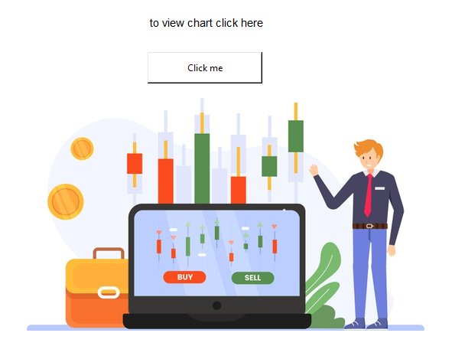
This is the chart layout of Microsoft or MSFT by clicking on the button “click me” and you will get the chart of the stock you entered
It uses the matplotlib to plot the points and create a graph and we are using txt files to create graphs . In the txt file we have entered the previous data of the stock

Slide 7
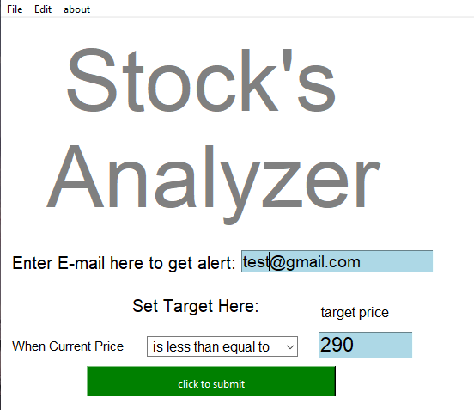
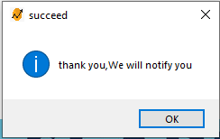
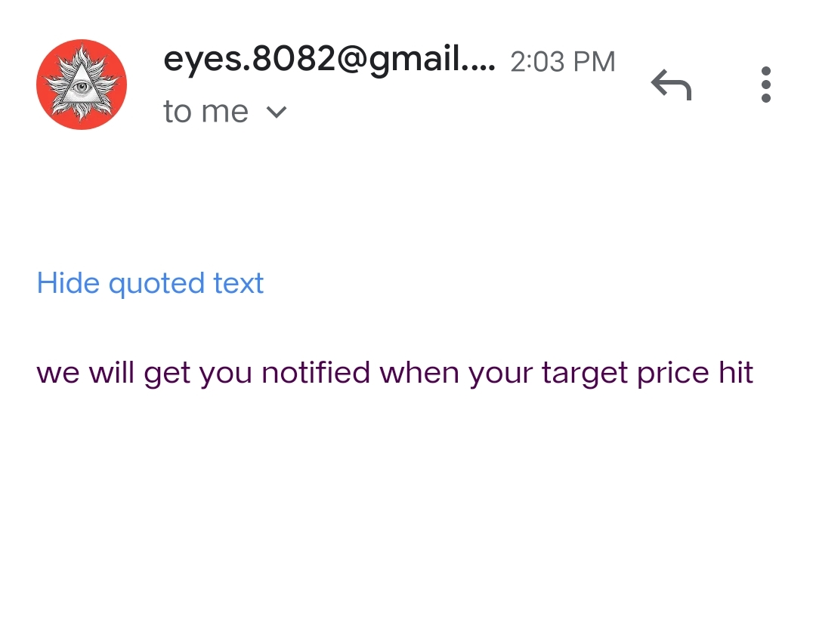
You can enter your email in the text box and set the target price as you wish and click the “click to submit” button this will trigger the smtplib and sent the email to the entered email after the task is finished this dialog box will appear which say “thanks you ,We will notify you”
This is the screenshot of the sent mail via program

Slide 8


