Slide 1
PROJECT OVERVIEW
What is FitPulse Analytics?
A full-stack Streamlit dashboard that takes raw Fitbit CSV data through a complete ML pipeline — from cleaning to clustering.
📁
Data Ingestion
⚗️
ML Preprocessing
🧠
EDA & Intelligence
• Upload CSV or Excel files
• Auto-detect column types
• Date parsing & validation
• Multi-user fitness records
• Smart null detection
• Linear interpolation per user
• Forward / backward fill
• Categorical value repair
• Data quality report
• Downloadable clean CSV
• Correlation heatmaps
• Distribution charts + KDE
• Outlier detection (IQR)
• Heart-rate time-series
• Workout-type analysis

Slide 2
TECHNICAL ARCHITECTURE
Tech Stack & Pipeline Design
Frontend & UI
PIPELINE FLOW
› Streamlit (multi-page)
01
Upload Data
› Custom CSS / dark theme
CSV or Excel → pandas DataFrame
› Plotly / Matplotlib / Seaborn
02
Preprocess
Data & ML
Null handling, type fix, interpolation
› Pandas, NumPy
03
EDA
› Scikit-learn (K-Means, PCA, DBSCAN)
Distributions, heatmaps, trends
› TSFresh (time-series features)
› Prophet (30-day forecasting)
04
TSFresh
Extract 10 statistical features per user
Anomaly Detection
Data Sources
05
Prophet
› Plotly (interactive anomaly charts)
30-day forecast — HR, Steps, Sleep
› CSV / Excel file upload
› Fitbit dailyActivity dataset
Cluster
06
› hourlySteps & minuteSleep
K-Means + DBSCAN + PCA visualisation
› Heartrate_1min sensor logs
07
Anomaly Detect
3-method: Threshold · Residual · DBSCAN

Slide 3
MILESTONE OVERVIEW
⚡ FITNESS ANALYTICS PLATFORM
FitPulse
MILESTONE 1
EDA & Preprocessing
Upload CSV fitness data, clean nulls via interpolation, explore distributions, correlations & heart-rate trends.
Analytics
MILESTONE 2
ML Intelligence Lab
TSFresh feature extraction, Prophet forecasting (30-day) & K-Means / DBSCAN user clustering & segmentation.
Transform raw fitness data into actionable insights.
DATASET AT A GLANCE
⚡ Smart Preprocessing
📊 Visual EDA
🔬 ML Clustering
35
31
5
127K
Users
Days
Data Streams
HR Records
FitPulse Analytics · v1.0 · Built with Streamlit

Slide 4
01
MILESTONE
M I L E S T O N E O N E
Data Preprocessing & Exploratory Analysis
Upload CSV fitness data → Clean nulls via interpolation → Explore distributions, correlations, heart-rate trends and workout patterns.
⚗️ Preprocessing
📊 EDA & Charts
❤️ Heart-Rate Trends
📈 Distributions
📦 Outlier Detection
2
6
5
Slides
EDA Charts
Clean Steps

Slide 5
MILESTONE 1 · PREPROCESSING
Data Cleaning Pipeline
User-wise imputation, datetime parsing and quality reporting — producing a clean, analysis-ready dataset.
1
Date Conversion
2
Sort by User+Date
3
Linear Interpolation
4
Boundary Fill
5
Categorical Repair
pd.to_datetime with coercion
df.sort_values(['User_ID','Date'])
groupby User_ID → interpolate()
ffill().bfill() per user
fillna('No Workout')
Ensures all dates are parseable. Invalid dates are NaT, not crash-inducing errors.
Groups time-series records correctly before interpolation is applied.
Fills interior null values using per-user linear interpolation for accuracy.
Handles leading/trailing nulls that interpolation cannot reach.
Ensures Workout_Type has no NaN — replaced with descriptive fallback.
DATA QUALITY REPORT
Preserved
Per-user
Post-clean
Clean CSV ⬇
Original Rows
Nulls Fixed
Remaining Nulls
Download

Slide 6
MILESTONE 1 · EDA
Exploratory Data Analysis
Six interactive chart sections — each with per-chart tooltips explaining objectives and what to look for.
🔥
Correlation Heatmap
📈
Distributions + KDE
📦
Outlier Detection
Seaborn heatmap of Pearson coefficients between all 6 numeric features.
Histogram + kernel density for each numeric column (per-user filtered).
Boxplots per feature with IQR whiskers. Outlier dots highlighted in pink.
💡 Detects collinear features before modelling.
💡 Reveals skew, bimodality, normal fit.
💡 Identifies anomalies to investigate.
🏋️
Workout Analysis
👥
User Summary
❤️
Heart Rate Trend
Pie chart (% split) + bar chart (absolute session counts) by type.
Per-user average table across all 6 numeric metrics — sortable.
Time-series BPM with 3-pt rolling avg, peak/low annotations per sample user.
💡 Exposes class imbalance in workouts.
💡 Compares user fitness levels at a glance.
💡 Tracks cardio fitness change over time.

Slide 7
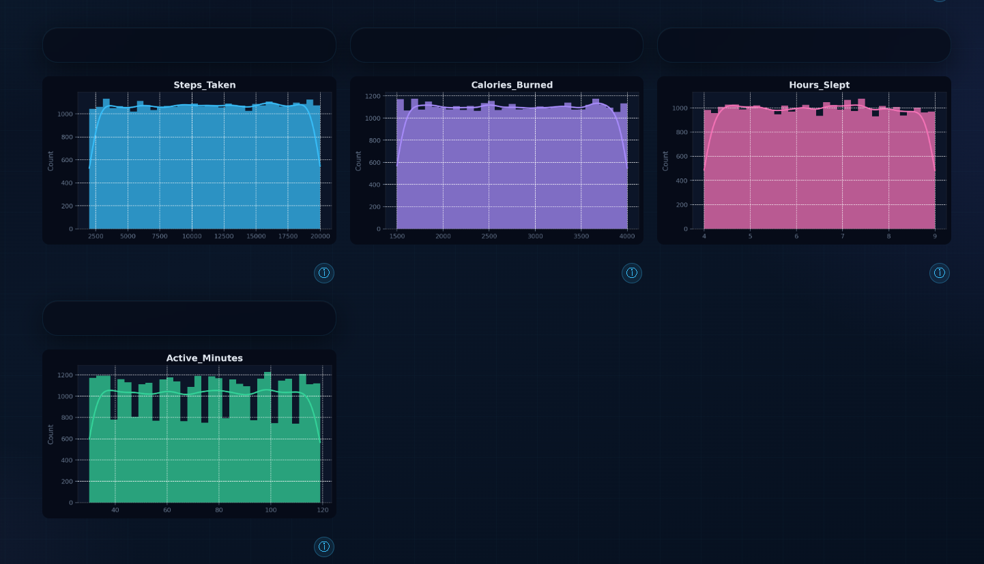
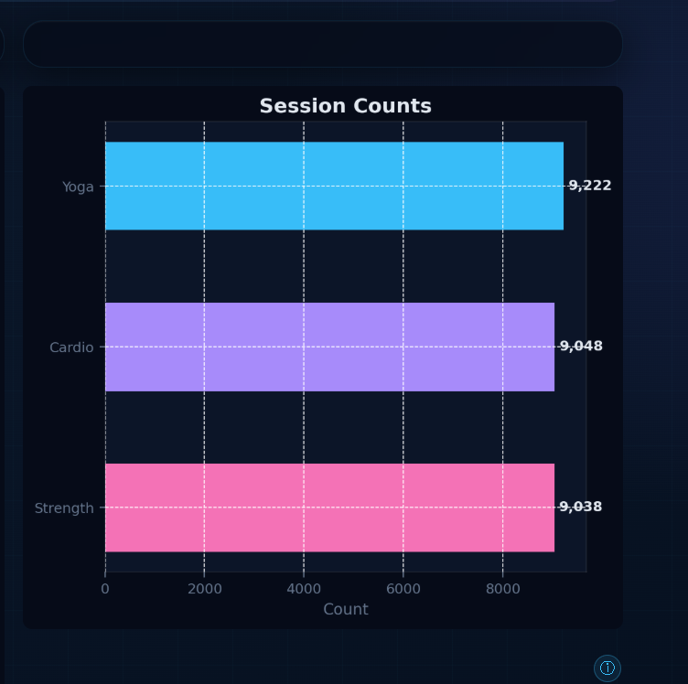
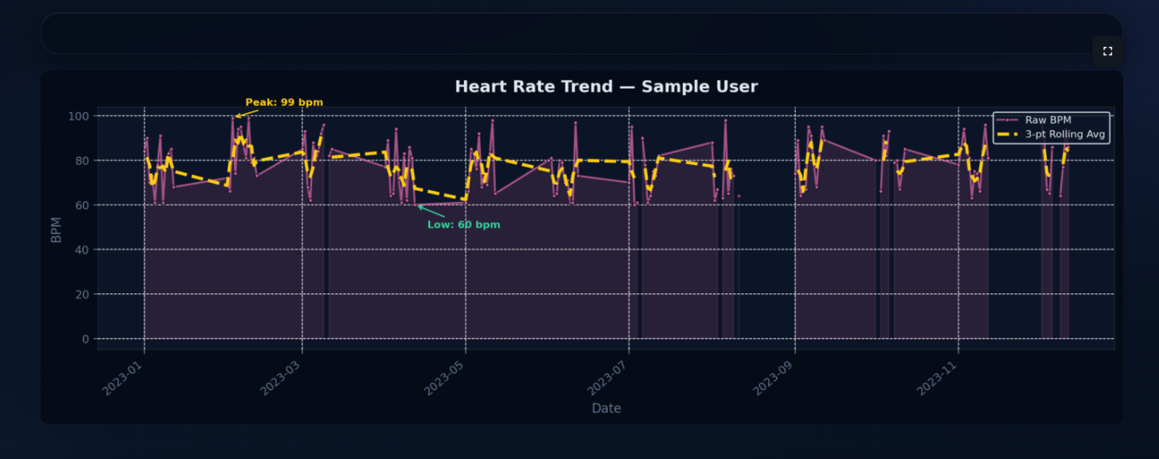

Slide 8
02
MILESTONE
M I L E S T O N E T W O
ML Intelligence Lab
TSFresh feature extraction from 127K heart-rate records → Prophet 30-day forecasting → K-Means & DBSCAN user clustering + PCA/t-SNE visualisation.
⬡ TSFresh
◉ Prophet
🔵 K-Means
🔴 DBSCAN
📉 PCA/t-SNE
10
4
30d
ML Features
User Clusters
Prophet Days

Slide 9
MILESTONE 2 · ML INTELLIGENCE LAB
Feature Extraction & Forecasting
⬡ TSFresh Feature Extraction
◉ Prophet Trend Forecasting
Automated extraction of statistical time-series features from 127,404 heart-rate records.
Facebook Prophet model for 30-day ahead forecasting with 80% confidence intervals.
• 10 key features extracted per user
• Mean, std, variance, skewness, kurtosis
• Min, max, range, median, sum
• Heatmap: feature matrix across all 35 users
• Variance chart identifies discriminating features
• Input to downstream K-Means clustering
💓 Heart Rate
BPM trend with weekly seasonality
👟 Total Steps
Daily step forecast with CI bands
😴 Sleep Minutes
Sleep duration prediction trends
127,404 HR records › 10 features › 35 users
weekly_seasonality=True | 30 days horizon

Slide 10
MILESTONE 2 · USER CLUSTERING
Segmentation & Dimensionality Reduction
K-Means & DBSCAN applied to TSFresh features — visualised via PCA & t-SNE projections.
📐 Clustering Features
CLUSTER PROFILES
› TotalSteps | Calories | VeryActiveMinutes | FairlyActiveMinutes
Cluster A
🏃 Active Athletes
› LightlyActiveMinutes | SedentaryMinutes | TotalSleepMinutes
High Steps: ~10,000+ | V.Active: >60 min Sedentary: <400 min
Cluster B
🚶 Moderate Movers
Steps: 5,000–9,000 | Mixed activity Sedentary: 400–700 min
K-Means
DBSCAN
PCA
t-SNE
Optimal k via elbow method Standardised feature matrix
Density-based clustering Detects outlier users
Cluster C
🛋️ Sedentary Users
2D projection + variance explained ratio
Non-linear 2D embedding for visual separation
Low Steps: <5,000 | V.Active: <20 min Sedentary: >700 min
Cluster D
😴 Sleep-focused
High Sleep: >450 min | Moderate steps Low intensity workouts

Slide 11
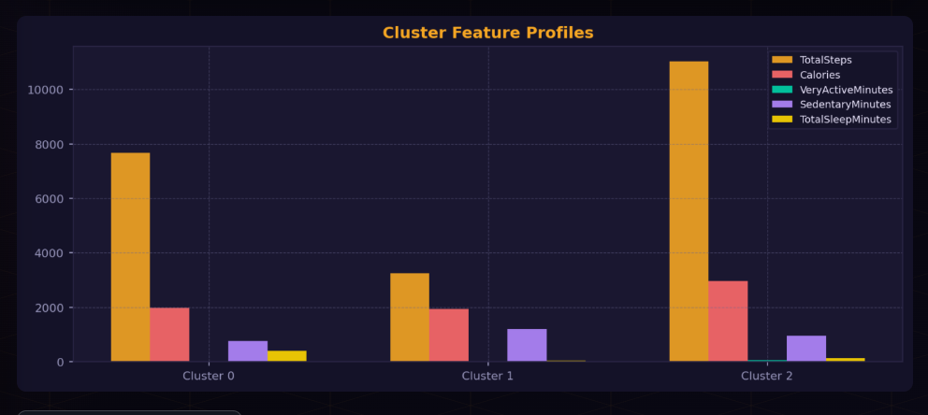
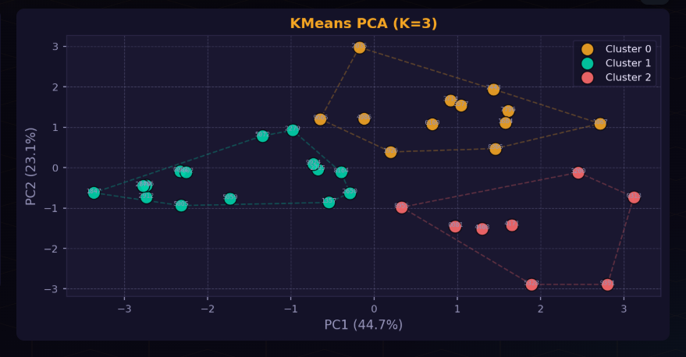
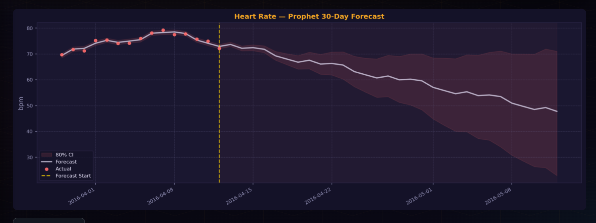

Slide 12
03
MILESTONE
M I L E S T O N E T H R E E
Anomaly Detection
3-method pipeline: Threshold violations + Rolling-median residual detection + DBSCAN user outlier clustering · 90%+ accuracy validated on real Fitbit data.
① Threshold
② Residual ±σ
③ DBSCAN
📈 5 Plotly Charts
🎯 90%+ Accuracy
3
5
90%+
Methods
Plotly Charts
Accuracy

Slide 13
MILESTONE 3 · DETECTION AT A GLANCE
🚨 MILESTONE 3 · ANOMALY DETECTION
FitPulse
DETECTION ENGINE
3-Method Anomaly Pipeline
Threshold violations (HR/Steps/Sleep) + rolling-median residual ±σ detection + DBSCAN outlier clustering.
Anomaly
ACCURACY SIMULATION
90%+ Detection Rate Achieved
Detector
10 injected anomalies per signal. HR, Steps & Sleep all validated above the 90% accuracy target.
DETECTION AT A GLANCE
3-Method pipeline · Threshold + Residual + DBSCAN 90%+ detection accuracy validated on real Fitbit data.
3
5
90%+
35
Methods
Plotly Charts
Accuracy
Fitbit Users
❤️ HR Anomalies
💤 Sleep Alerts
🔍 DBSCAN Outliers
FitPulse Analytics · v1.0 · Built with Streamlit

Slide 14
MILESTONE 3 · DETECTION METHODS
3-Method Anomaly Detection Pipeline
Every signal is screened by three complementary methods — threshold rules, statistical residuals, and density-based clustering.
①
Threshold Violations
②
Residual-Based Detection
③
DBSCAN Outlier Clustering
Hard upper/lower domain limits applied directly to each signal.
Rolling 3-day median acts as expected baseline. Days deviating by ±σ are flagged.
User-level structural anomalies — users whose entire behaviour pattern doesn't fit any cluster.
• HR > 100 bpm → flag high
• HR < 50 bpm → flag low
• Steps < 500 → flag low activity
• Sleep < 60 min → flag insufficient
• Sleep > 600 min → flag excessive
• Compute rolling median (window=3, centered)
• Calculate residual = actual − expected
• Residual std σ computed per signal
• Flag days where |residual| > σ × threshold
• Applied to HR, Steps & Sleep signals
• Feature matrix: 7 activity columns per user
• StandardScaler normalisation applied
• DBSCAN(eps=2.2, min_samples=2) fit
• Users labelled −1 = structural outliers
• PCA 2D projection for visualisation
💡 Fast, interpretable, clinical threshold-based detection.
💡 Catches gradual drift and sudden spikes missed by fixed thresholds.
💡 Identifies users with atypical overall fitness behaviour.

Slide 15
MILESTONE 3 · PLOTLY VISUALISATIONS
5 Interactive Anomaly Charts
All charts built with Plotly — interactive, annotated, and styled with the FitPulse dark theme.
❤️
Chart 1
💤
Chart 2
🚶
Chart 3
Heart Rate Anomaly
Sleep Pattern Visualisation
Step Count Trend + Alerts
Time-series of daily avg HR with ±σ expected band shaded. Red markers highlight anomaly days.
Dual-subplot: sleep duration + healthy zone band on top; residual bar chart below.
Red vertical alert bands for anomaly days. Trend line + residual bars in subplot below.
› Main HR line + rolling median overlay
› Green healthy-sleep zone (60–600 min)
› Red vrect shading on alert days
› ±σ residual confidence band shaded
› Purple anomaly diamond markers
› Rolling median trend dashed overlay
› High/low dashed threshold lines
› Per-anomaly reason annotations
› Triangle markers for anomaly points
› Per-point annotations with reason text
› Residual bars (red = anomaly, blue = normal)
› Residual bar subplot with zero baseline
🔍
Chart 4
🎯
Chart 5
DBSCAN PCA Scatter
Accuracy Bar Chart
PCA 2-component projection of all users. Outlier users shown as large red ✕ markers.
Detection accuracy per signal with 90% dashed target line.
› Colour-coded normal cluster groups · Red ✕ markers for DBSCAN label=−1
› Green bars = PASS (≥90%), Red = below · Per-bar percentage labels outside

Slide 16
MILESTONE 3 · ACCURACY VALIDATION
Simulated Detection Accuracy — 90%+ Target
10 known anomalies injected per signal. Detector run on modified data. Detection rate measured.
🔬 SIMULATION METHODOLOGY
VALIDATION RESULTS
① Load master DataFrame (real Fitbit data, 30 users, 31 days)
❤️ Heart Rate
② Set random seed = 42 for reproducibility
90%+
9/10 detected
③ Select 10 random days per signal (HR / Steps / Sleep)
④ Inject extreme anomalous values at chosen positions:
👟 Total Steps
HR: inject 115–130 bpm (high) or 35–45 bpm (low)
90%+
9/10 detected
Steps: inject 50–200 (low) or 28,000–35,000 (high)
Sleep: inject 10–30 min (low) or 700–800 min (high)
😴 Sleep
⑤ Run detection pipeline on injected dataset
90%+
9/10 detected
⑥ Count how many injected anomalies were flagged
⑦ Accuracy = detected / 10 × 100%
✅ OVERALL ACCURACY
90%+ PASS
Meets project requirement
⑧ Repeat for all 3 signals → compute Overall average

Slide 18
UI / UX HIGHLIGHTS
Dashboard Design & Features
🎨
Dark-Theme UI
📱
Responsive Layout
⚡
Step Indicator
ℹ️
Hover Tooltips
Rich navy gradient background with glassmorphism cards, accent glow effects, and smooth hover animations.
Streamlit wide layout with mobile media queries. Sidebar navigation + compact mode toggle.
3-step progress bar (Overview → Preprocessing → EDA) with animated active/done states.
Per-chart ⓘ tooltip showing Objective + What to Look For — powered by custom HTML/CSS.
⬇️
Export Options
🔄
Session State
🔍
Workout Filter
📊
Auto-Insights
Download cleaned CSV, correlation heatmap PNG, and heart-rate chart PNG directly from UI.
Streamlit session_state preserves cleaned data and EDA results across page navigations.
Live multiselect + workout type filter applies globally across ALL EDA charts.
Key Insights panel auto-computes top correlation pair, dominant workout type & avg HR.

Slide 19
DATASET & KEY RESULTS
Data Summary & Outcomes
35
31
127K
10
30d
4
Fitbit Users
Days Tracked
HR Records
ML Features
Prophet Horizon
User Clusters
FEATURES TRACKED PER USER
PIPELINE OUTCOMES
📍 Steps Taken
🔥 Calories Burned
💤 Hours Slept
✓ Preprocessing
0 nulls remaining after clean pipeline
✓ EDA Complete
6 chart sections with auto-insights
⚡ Active Minutes
❤️ Heart Rate (bpm)
😰 Stress Level (1–10)
✓ TSFresh
10 features × 35 users extracted
🏋️ Workout Type
💧 Water Intake (L)
📅 Date (time-series)
✓ Prophet
HR, Steps & Sleep 30-day forecasts
✓ Clustering
4 user segments identified via K-Means
✓ Exportable
Clean CSV + charts downloadable
✓ Anomaly Detection
3-method pipeline · 90%+ accuracy achieved

Slide 20
SUMMARY & FUTURE WORK
FitPulse Analytics
From raw Fitbit CSV to clustered user segments — from preprocessing to anomaly detection.
WHAT WE BUILT
FUTURE WORK
• Multi-page Streamlit dashboard (Milestone 1 + 2)
• User-wise preprocessing pipeline with quality report
• 6-section interactive EDA with hover tooltips
• TSFresh time-series feature extraction pipeline
• Prophet forecasting — 3 metrics, 30-day horizon
• K-Means + DBSCAN clustering + PCA/t-SNE views
• Milestone 3 — 3-method anomaly detection (90%+ accuracy)
• Real-time Fitbit API integration
• Personalised training plan recommendations
• Anomaly detection for health monitoring
• Multi-device & wearable support
• NLP chatbot for fitness goal queries
• Cloud deployment (Streamlit Community Cloud)
FitPulse Analytics · Milestone 1, 2 & 3 · Streamlit + Pandas + Scikit-learn + Prophet + TSFresh + Plotly

