Slide 1

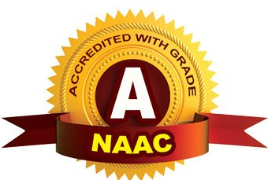
CMR TECHNICAL CAMPUS UGC (Autonomous) Kandlakoya, Medchal Road, Hyd-501 401 Department of Electronics & Communication Engineering Real Time Project Review INTELLIGENT WASTE MANAGEMENT SYSTEM BASED ON IOT
BATCH NO : 11
Project Guide :
Name: Ms.G.Swathi
Designation: Assistant Professor
Project Coordinator :
Name: Mr.G.Pavan Kumar
Designation: Assistant Professor
ROLL NUMBERS :
227R1A05A0-M.Akshitha
227R1A0599-K.Akshitha
227R1A0580-D.Anudeep

Slide 2
CONTENTS
Abstract
Introduction
Literature Survey
Proposed Technology
Implementation and Architecture
Results and Discussion
Conclusion and Future Scope
Reference

Slide 3
ABSTRACT
This project proposes an innovative approach to waste management through the integration of Internet of Things (IoT) technology. Our system employs Infrared (IR) sensors to monitor the fill levels of waste bins in real-time. These sensors are strategically placed in various bins to detect and measure the amount of waste. The data collected by the IR sensors is then transmitted via General Packet Radio Service (GPRS) to a central server. This transmission utilizes a SIM card in the GPRS module to send the information to a mobile application, providing users with immediate updates on the status of waste bins. This system aims to optimize waste collection schedules, reduce unnecessary pickups, and prevent overflow, thereby promoting a cleaner and more efficient urban environment. The use of IoT not only enhances the efficiency of waste management operations but also contributes to the sustainability of smart cities.

Slide 4
INTRODUCTION
The rapid urbanization and population growth in modern cities have led to significant challenges in waste management, necessitating more efficient and sustainable solutions. The Intelligent Waste Management System based on Internet of Things (IoT) technology addresses these challenges by utilizing advanced sensors and communication networks. By incorporating Infrared (IR) sensors to monitor the fill levels of waste bins and General Packet Radio Service (GPRS) modules to transmit data, this system provides real-time insights into waste accumulation. These insights enable optimized waste collection schedules, reducing unnecessary pickups and preventing bin overflow. Through this innovative approach, the project aims to enhance the efficiency and sustainability of urban waste management, contributing to cleaner and smarter cities.

Slide 5
LITERATURE SURVEY
S.No. | Name of Author | Title of the paper | International journal/ conference | Issue | ISBN/ ISSN
1. | A. Bharadwaj, P. Pandey, S. Nayak | A Survey on IoT-based Waste Management Systems | IEEE Conference Publications | 2016 | ISSN 2151-2206
2. | R.R. Lakshmi, S. Dhamodharan | Smart Waste Management System Using IoT | International Journal of Engineering and Technology (IJET) | 2016 | ISSN 2319-8613

Slide 6
EXISTING SYSTEM
Traditionally, waste management systems rely on scheduled waste collection routes without real-time monitoring of bin fill levels.
Waste collection trucks follow predetermined schedules regardless of actual fill levels, leading to inefficiencies such as unnecessary pickups or overflowing bins.
This approach lacks responsiveness to dynamic changes in waste generation and can result in increased operational costs and environmental impact due to inefficient resource allocation.

Slide 7
PROPOSED METHODOLOGY
The proposed Intelligent Waste Management System based on IoT revolutionizes traditional practices by integrating advanced technologies for real-time monitoring and data-driven decision-making.
Using IR sensors embedded in waste bins, the system continuously monitors fill levels. Data collected from these sensors is transmitted via GPRS modules to a central server or cloud platform.
This enables waste management authorities to dynamically optimize collection routes based on real-time data, thereby reducing unnecessary trips and preventing overflow.
It increases efficiency, accuracy and environmental impact.

Slide 8
IMPLEMENTATION
System Design: Identify and integrate IR sensors, GPRS modules, microcontrollers, and power units for the waste bins.
Sensor Installation: Install and calibrate IR sensors in waste bins to measure fill levels accurately.
Data Acquisition: Connect sensors to microcontrollers for data collection and processing.
Data Transmission: Use GPRS modules with SIM cards to transmit data to a central server or cloud platform.
Data Management: Develop a centralized platform for storing and analyzing waste level data to optimize collection schedules.

Slide 9
ARCHITECTURE
MICRO
CONTROLLER
POWER SUPPLY
LCD DISPLAY
IR TX
IR RX
GPRS MODEM
IR TX
IR RX

Slide 10
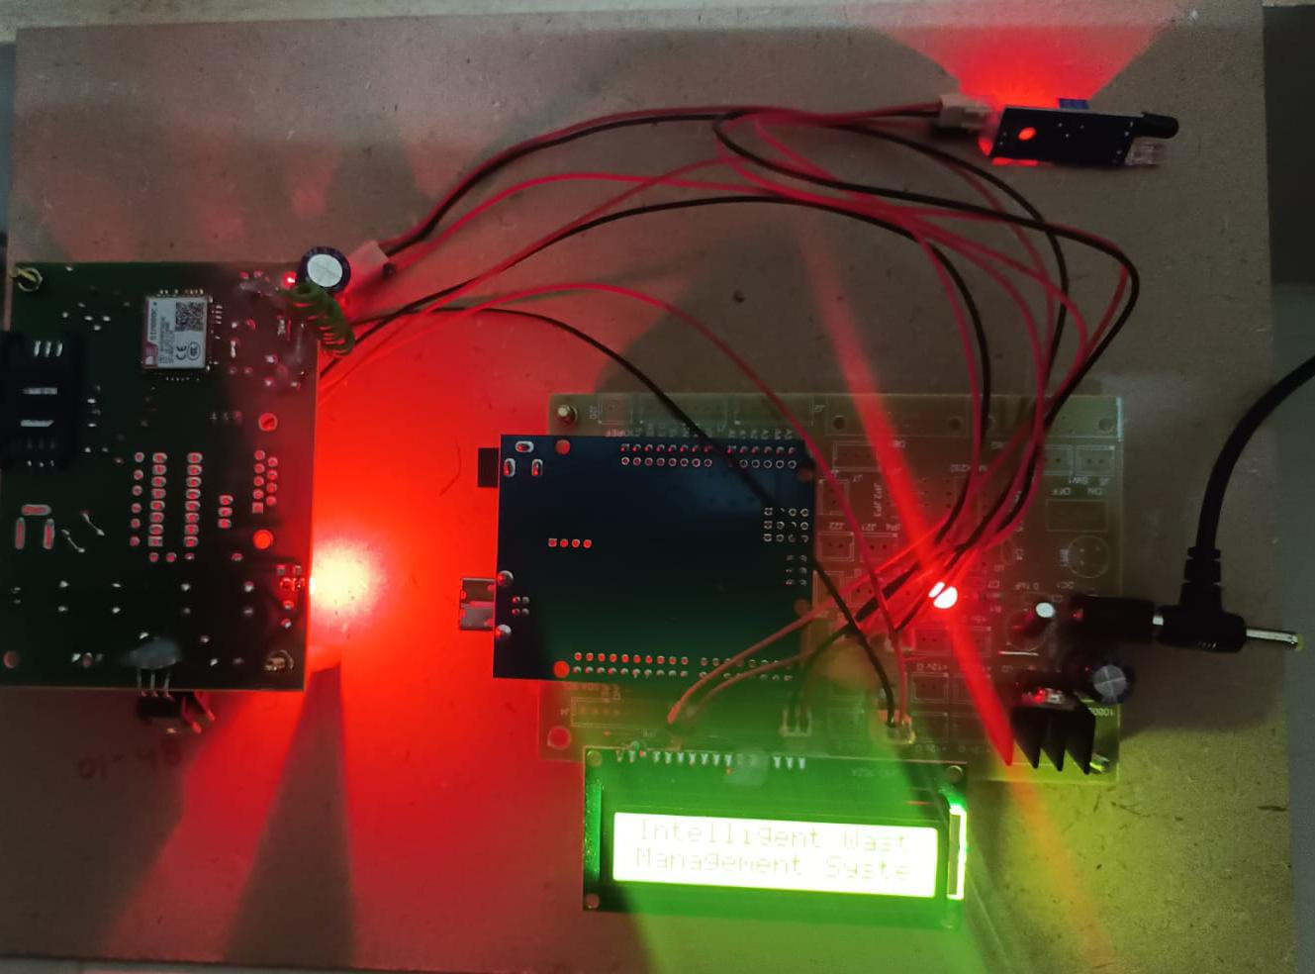
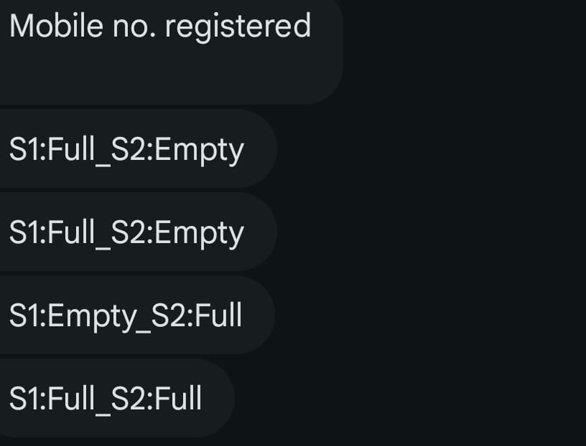
RESULTS & DISCUSSION
The "Intelligent Waste Management System Based on IoT" project successfully developed a system that monitors dustbin fill-levels using IR sensors and transmits data via GPRS. This innovation improves waste collection efficiency by providing real-time fill-level data, enabling optimized collection routes and timely interventions to prevent overflow. The system's integration of IoT technology facilitates cost reduction, enhances operational efficiency, and promotes sustainable urban waste management practices.

Slide 11
CONCLUSION AND FUTURE SCOPE
The Intelligent Waste Management System leveraging IoT technology enhances urban waste management by providing real-time monitoring and optimized collection routes. It improves efficiency, reduces costs, and engages stakeholders through a user-friendly mobile app.
Future Scope:
Expansion: Scale to cover more urban areas.
Smart City Integration: Align with broader smart city initiatives.
Advanced Analytics: Develop predictive analytics for better resource allocation.
Sensor Technology: Explore AI-enabled sensors for enhanced performance.
Waste Sorting Integration: Integrate with automated waste sorting technologies.
Environmental Monitoring: Include sensors for air and water quality monitoring.

Slide 12
REFERENCES
Prashant J. Mahajan; Kalyani V. Pagare, “PIR based automatic fever testing”, International Research Journal of Engineering and Technology(IRJET),vol-07,issue no-04,pp.1345-1347,2020.
Pooja Ajmera, “INFRARED SENSOR” , International Research Journal of Engineering and Technology(IRJET), ISSN: 2278-0181 vol-05,issue no-23,1559-1557.
Hanzhong, “DESIGN OFA NON-CONTACT INFRARED THERMOMETER”, International Research Journal of Engineering and Technology(IRJET),ISSN: 2581-0181 vol-08,issue no-13,1859-183
Rohit Ramagade , Uday Thak, Harshad pidurkar, Lokesh Kathale; ”INNOVATIVE TECHNOLOGIES FOR TEMPERATURE MEASUREMENT OF AERO ENGINE COMPONENT”, International Research Journal of Engineering and Technology(IRJET), ISSN: 2395-0056 vol-05,issue no-23, 2395-0072
Akshay Sharma A S, “ Review on Automatic Sanitizer Dispensing Machine”, International Research Journal of Engineering and Technology(IRJET),vol-09,issue no-07,pp.725-726,2020.

Slide 13
Q&A

Slide 14
THANK YOU

