Slide 1
The Analytics Team
Sprocket Central Pty Ltd
Data Analytics Approach

Slide 2
Agenda
Introduction
Data Exploration
Model Development
Interpretation

Slide 3
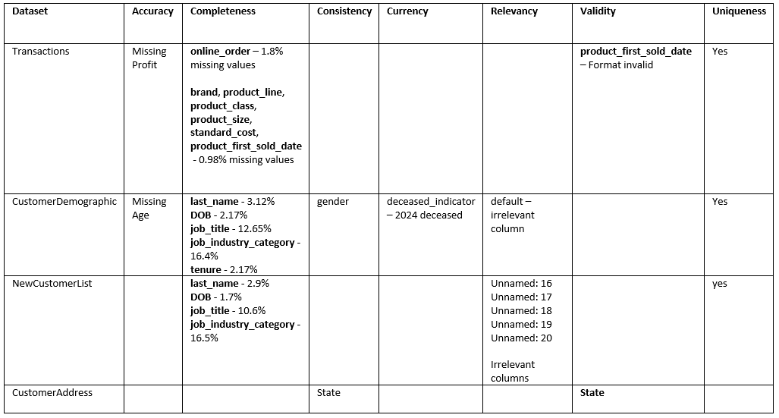
Introduction
Data Quality Assessment :

Slide 4
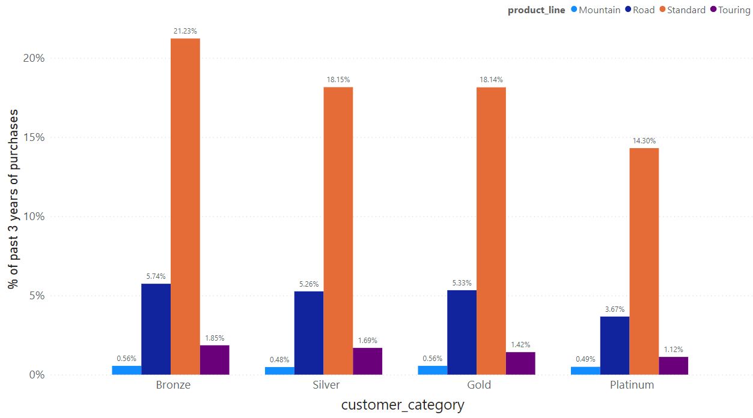
Data Exploration : Customer Category

Slide 5
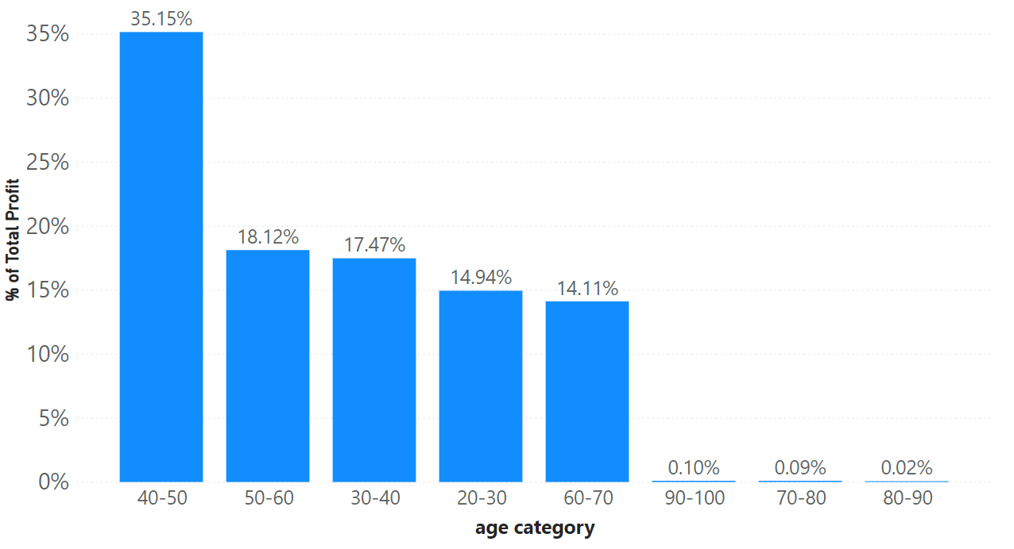
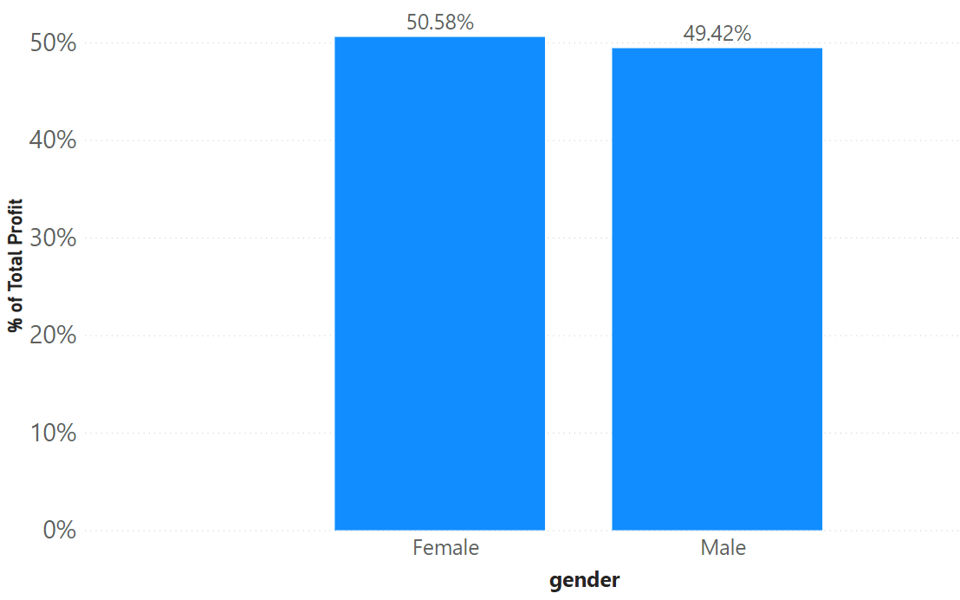
Data Exploration : Age and Gender distribution
The customers aged
between 40-50 contribute to 35.15% of the
total profit
Both the genders contribute almost equally to the % of the total profit

Slide 6
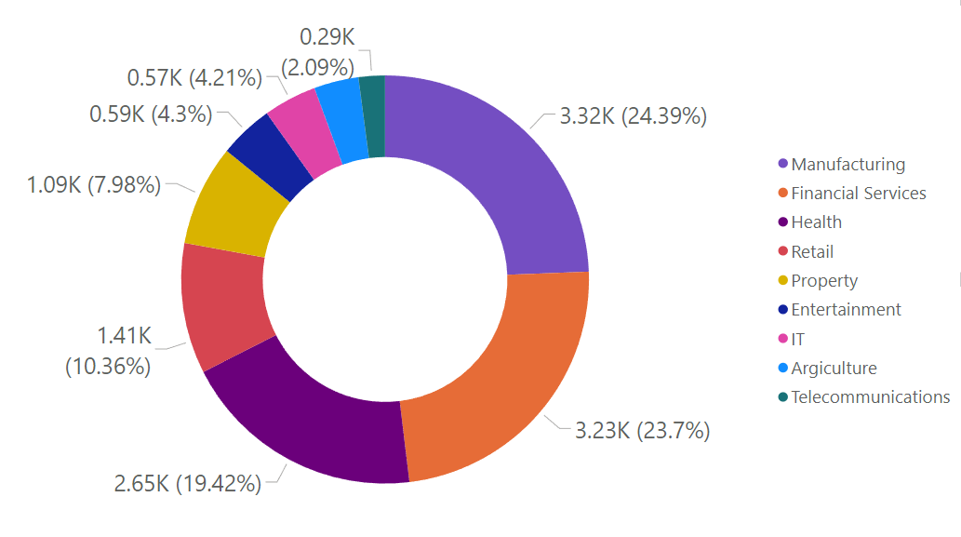
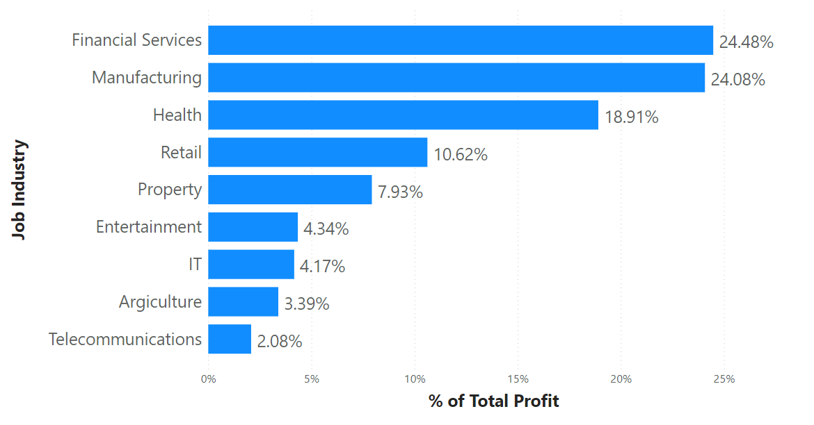
Data Exploration : Job Industry
24.39% of the customers work in Manufacturing industry and 23.7% of the customers work in Property industry
Financial Services contribute to 24.48% of the total profit followed by Manufacturing industry at 24.08%

Slide 7
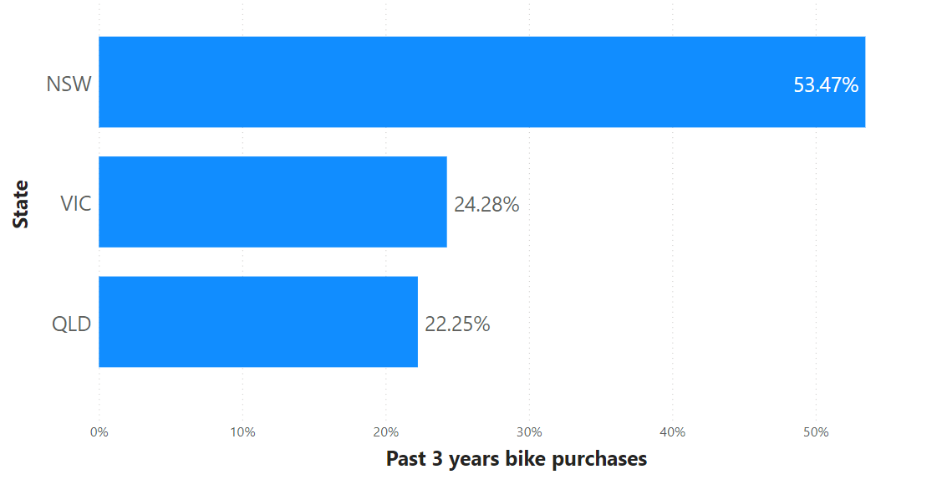
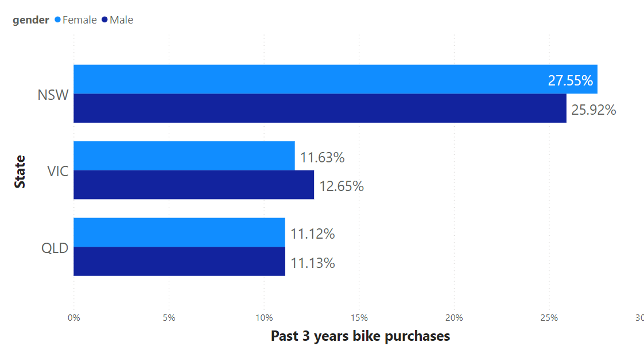
Data Exploration : State
53.47% of the customers from New South Wales have bought bikes multiple times
Females of NSW region have bought bikes more frequently than the males in the same region. Whereas, the males seem to dominate in buying bikes in VIC region.

Slide 8
Model Development
Targeting High Value Customers
Age Category : 40-50
Industry : Manufacturing, Financial Services , Health
State : NSW , VIC
Preferred Product line : Standard

Slide 9
High Value Customer summary table
customer_id | past_3_years_bike_related_purchases | job_industry_category | state | wealth_segment | age
204 | 91 | Health | VIC | Mass Customer | 44
214 | 99 | Financial Services | VIC | Affluent Customer | 44
619 | 98 | Financial Services | VIC | High Net Worth | 41
626 | 91 | Manufacturing | NSW | Affluent Customer | 41
630 | 91 | Financial Services | VIC | Mass Customer | 41
689 | 98 | Manufacturing | NSW | Mass Customer | 41
706 | 98 | Financial Services | VIC | High Net Worth | 41
719 | 95 | Financial Services | NSW | Mass Customer | 46
785 | 97 | Manufacturing | VIC | Affluent Customer | 44
829 | 91 | Financial Services | VIC | Mass Customer | 44
841 | 98 | Manufacturing | NSW | Mass Customer | 44
855 | 97 | Manufacturing | VIC | Affluent Customer | 47
906 | 98 | Manufacturing | NSW | Mass Customer | 47
1267 | 91 | Financial Services | VIC | Mass Customer | 41
1313 | 91 | Manufacturing | NSW | Affluent Customer | 47
1314 | 97 | Manufacturing | VIC | Affluent Customer | 47
1663 | 90 | Financial Services | NSW | Affluent Customer | 48
1692 | 96 | Financial Services | VIC | Mass Customer | 49
1731 | 98 | Manufacturing | VIC | Mass Customer | 49
1747 | 91 | Manufacturing | NSW | Affluent Customer | 49

