Slide 1
Master of Engineering Information Technology · Individual Project
Intelligent Ultrasonic Sensing for Movement Intensity Classification using Hybrid Machine Learning
Mandar Gokul Kale
Matriculation No. 1501517
Guided by Dr. Andreas Pech

Slide 2
sensing question
Ultrasound detects people without a camera, but accuracy can mislead
Camera free sensing: Ultrasonic sensing detects presence and activity from reflected acoustic signals, without a camera.
Two tasks: human presence detection (human vs EmptyRoom/ChairTable) and Standing vs Reading.
Positional cues: Distance and amplitude can act as unwanted positional cues, so position aware and position normalized representations are compared.
Goal: understand how signal representation, model, environment and subject affect performance, including cross environment generalization.

Slide 3




prior work · research gap
Prior work leaves a gap in representation, normalization and environment
Cameras raise privacy issues; PIR, radar and ultrasonic trade off accuracy, cost and privacy.
Aggregate accuracy hides condition specific failures.
Representation effect is rarely separated from model family.
Non-human conditions are treated as one class, though they differ in difficulty.

Slide 4
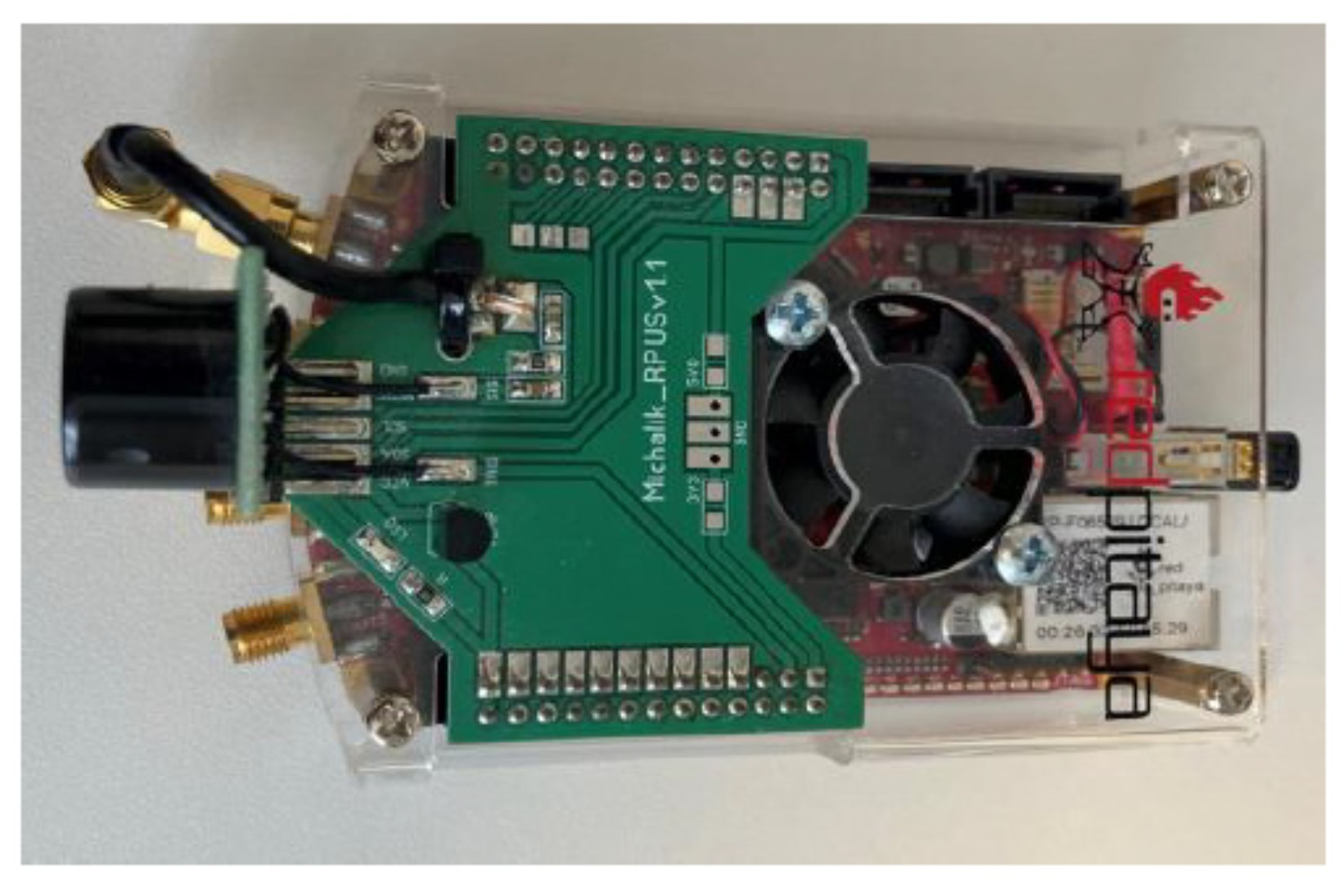
acquisition · fixed geometry
Red Pitaya STEMlab platform used for ultrasonic signal acquisition
Red Pitaya digitizes SRF02 echoes at about 1.95 MS/s
01
SRF02 transducer
About 40 kHz pings, triggered over I2C.
02
Red Pitaya STEMlab
14-bit DMA acquisition; decimation 64 from 125 MS/s.
03
Laptop
25,000 samples per frame, sent by UDP.
sensor on tripod · about 2.1 m · fixed geometry

Slide 5
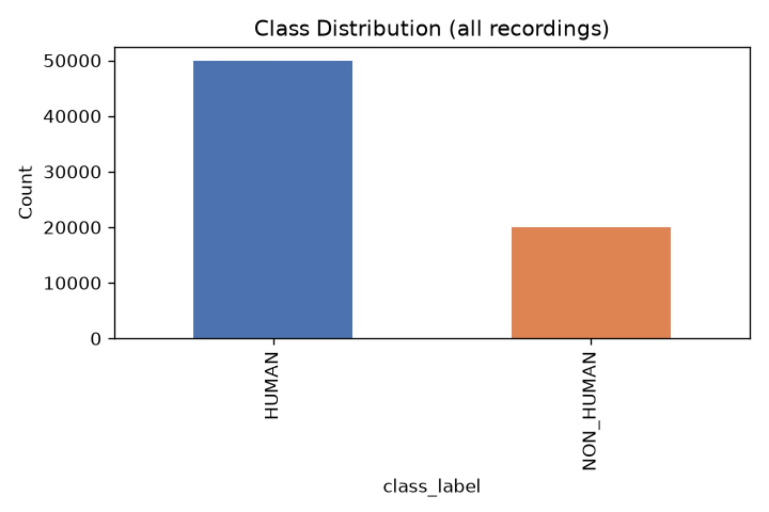
Four conditions, two environments, 70,000 recordings
EmptyRoom: background baseline, no person
ChairTable: static furniture; tests separating objects from humans
HumanReading: seated subject reading
HumanStanding: standing subject
Conditions analyzed separately, not as one non human class
Subject level analysis: Person 3 and Person 4 in Env2 (anonymized)
Class distribution: 50,000 HUMAN vs 20,000 NON_HUMAN
Env1: Laboratory · 30,000 recordings · Train and tune only
Env2: Corridor · 40,000 recordings · Test once
Main binary pipeline · 50,000 HUMAN vs 20,000 NON_HUMAN

Slide 6
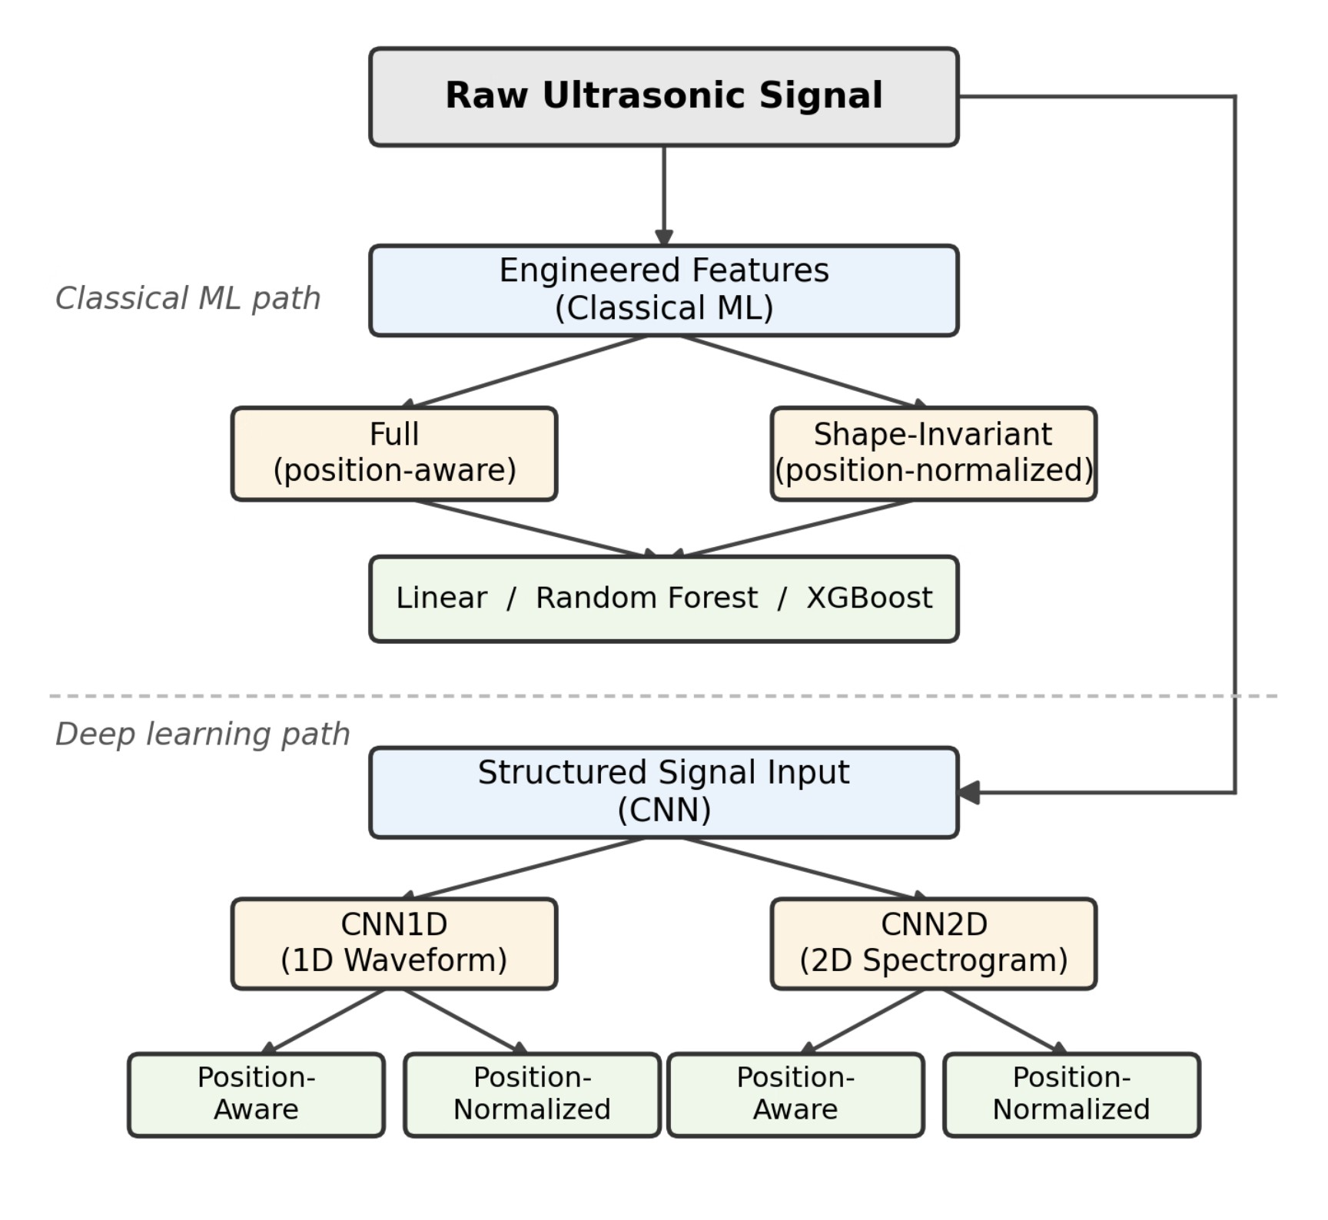
experimental design
Representation–model combinations were systematically compared
Position treatment
Position aware vs position normalized via Hilbert envelope onset alignment.
Representation → model family
Full or shape invariant features, raw waveform, band limited spectrogram.
Representation | Model family
Full or shape invariant features | Classical: Linear, Random Forest, XGBoost
Raw waveform | CNN1D
Band limited spectrogram | CNN2D
Representation taxonomy: each input representation paired with its model family
Adam · binary cross-entropy · early stopping · frozen models

Slide 7
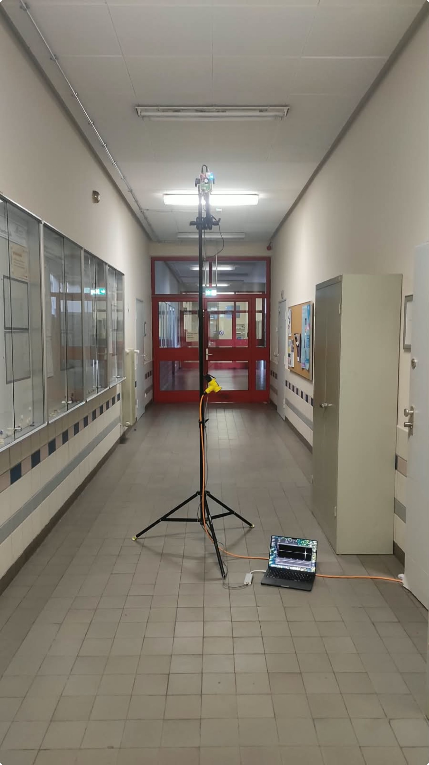
echo characteristics
Non-human echoes are stronger than human echoes
Consistent spectral peak near 40 kHz in every condition.
Energy sits in a short echo burst against near silence.
RMS order
EmptyRoom
ChairTable
HumanReading
HumanStanding
Hard, flat surfaces reflect more coherently than soft human bodies.
Hard, flat reflectors in the echo scene.

Slide 8
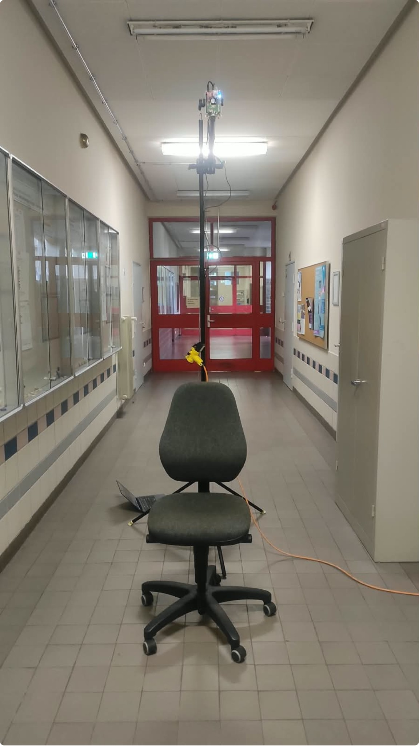
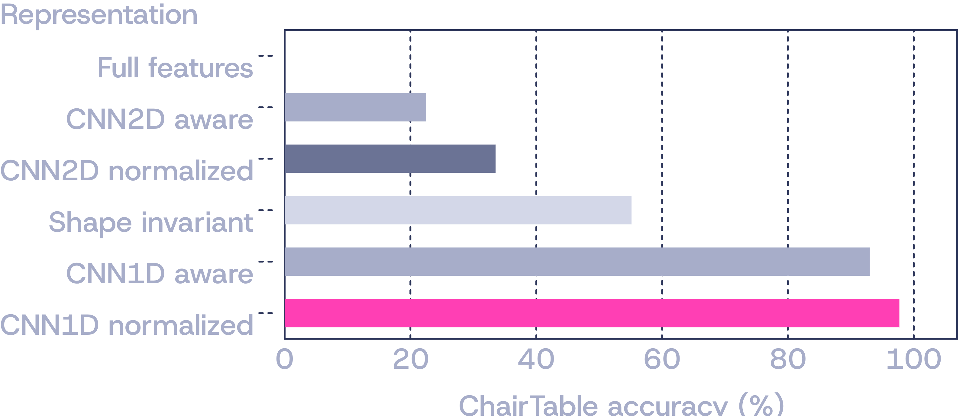
Env2 · ChairTable accuracy
ChairTable breaks generalization: 0% to 97.72% by representation
Full-feature models reached 99.93% validation accuracy on Env1, yet labeled every ChairTable recording HUMAN in Env2.
ChairTable condition: an empty chair beneath the sensor
EmptyRoom stayed at 93 to 98%.

Slide 9
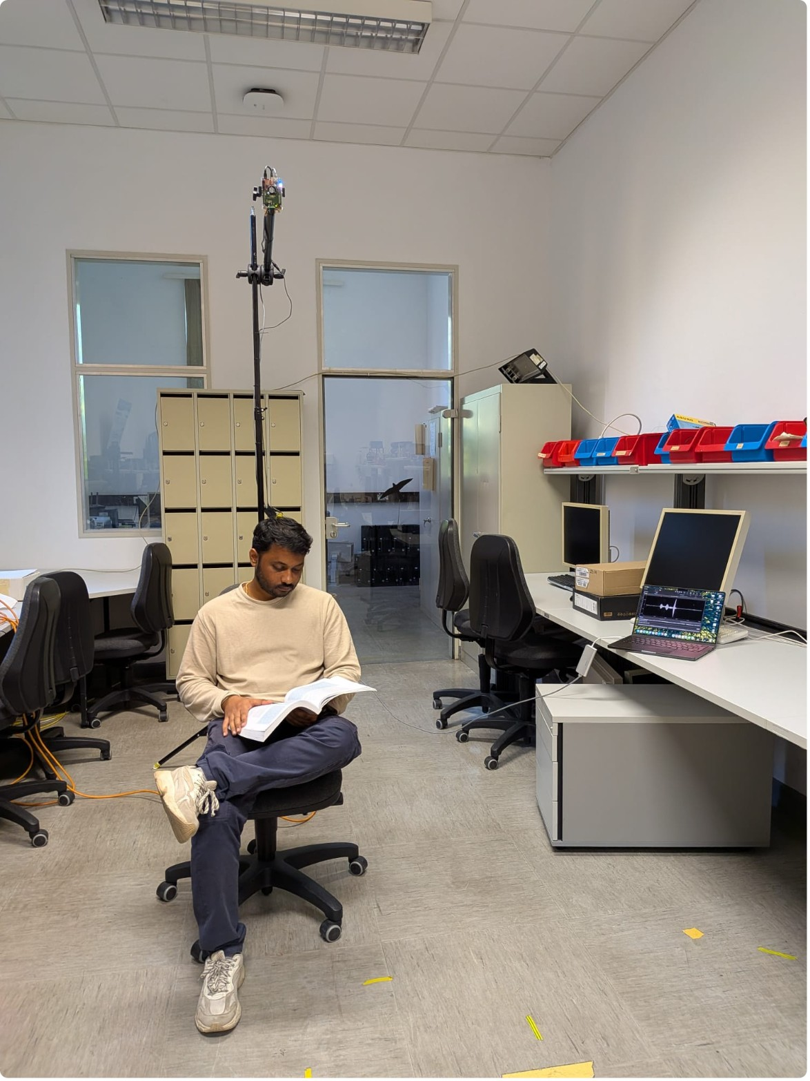
normalization · trade-off
HumanReading condition: a seated subject reading beneath the sensor
Normalization helps ChairTable but costs Reading accuracy
HumanReading falls under every normalized representation
Standing vs Reading
Model | Aware | Normalized
CNN2D | 97.13% | 96.86%
CNN1D | 91.58% | 95.30%
Representation | Position-aware | Position-normalized
Shape | 99.51 | 90.89
CNN1D | 98.59 | 86.06
CNN2D | 99.93 | 96.36
No clear benefit from position-aware input: CNN2D 97.13% vs 96.86%; CNN1D 91.58% vs 95.30%.
Subject effect: Person 3 outperformed Person 4 across all representations.

Slide 10
conclusion
Conclusion
Aggregate accuracy overstates reliability: ChairTable ranges from 0.00% (full hand crafted features) to 97.72% (position normalized CNN1D).
CNN1D with position-normalized raw waveforms was the strongest configuration for cross-environment human-presence generalization, ahead of classical models and band limited CNN2D.
Standing vs Reading: no clear benefit from position-aware input (CNN2D 97.13% aware, 96.86% normalized) normalization cost HumanReading accuracy.
Future work: CNN1D filter visualization, remove only timing or only amplitude, test Person 5 and new environments.

Slide 11
Thank you
Questions?
Mandar Gokul Kale, mandar.kale@stud.fra-uas.de

