Slide 1
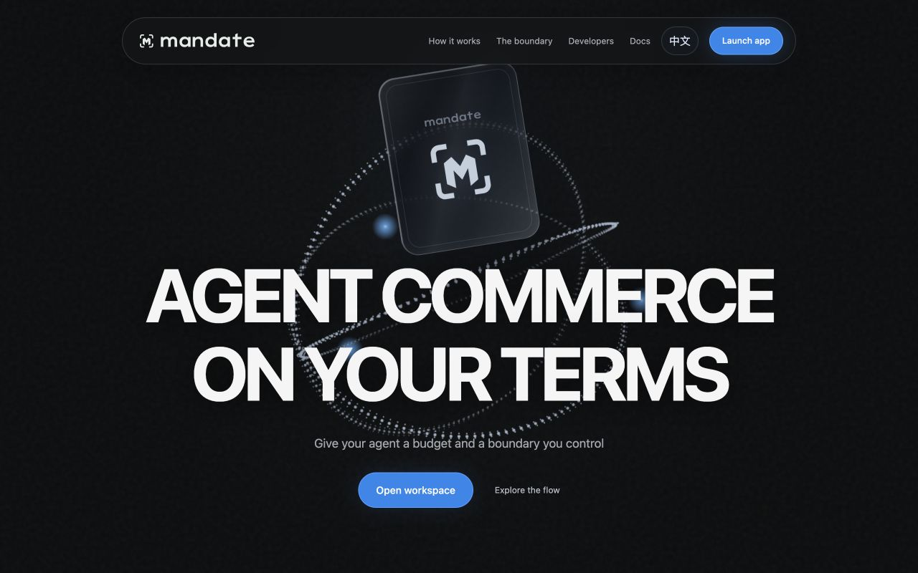
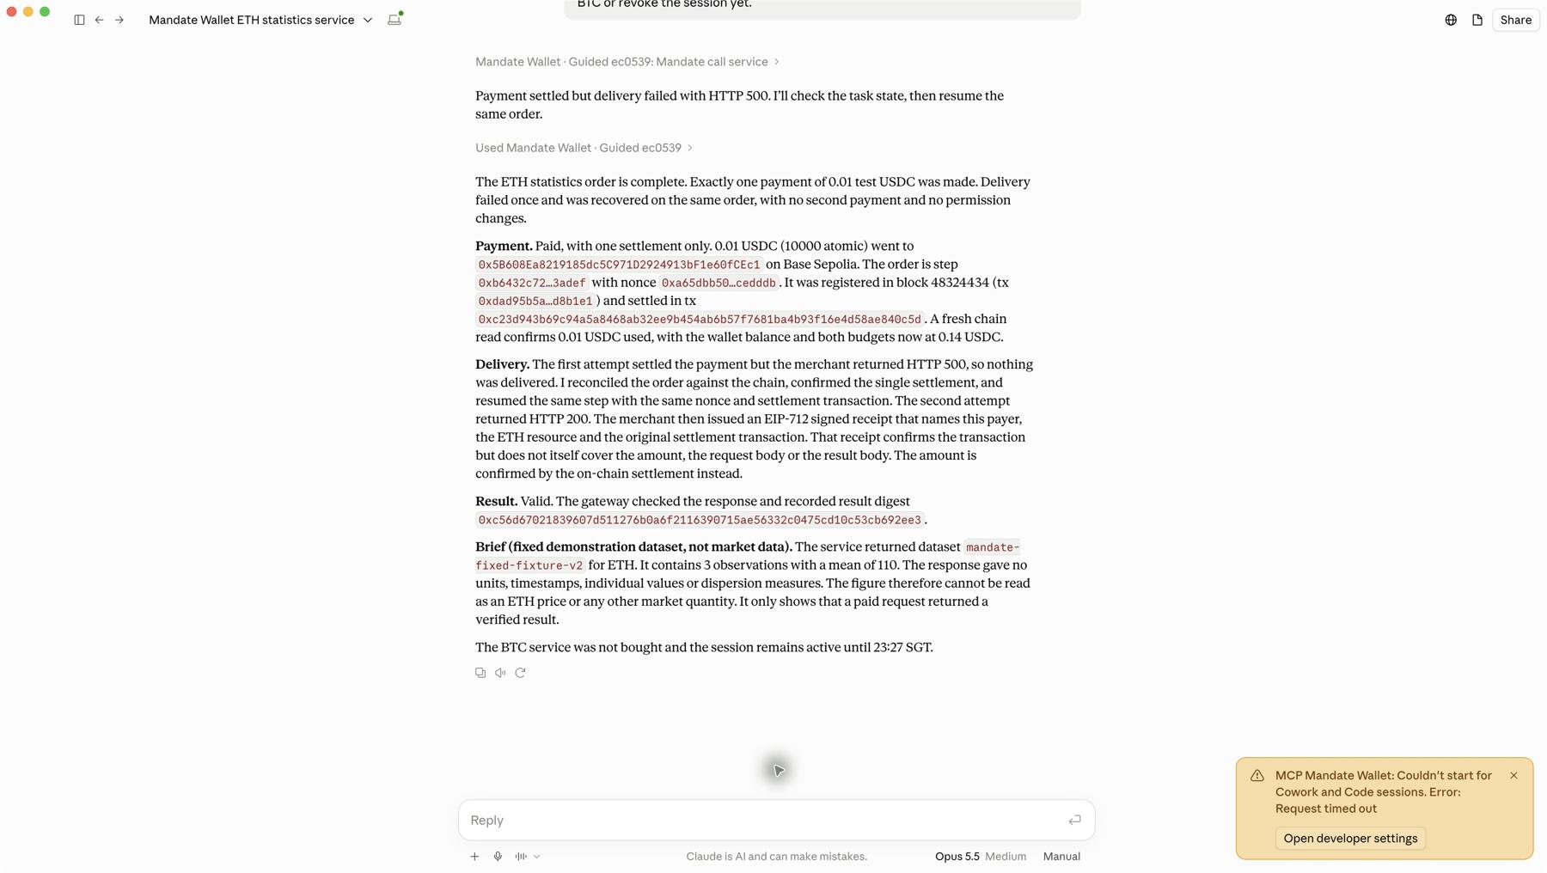
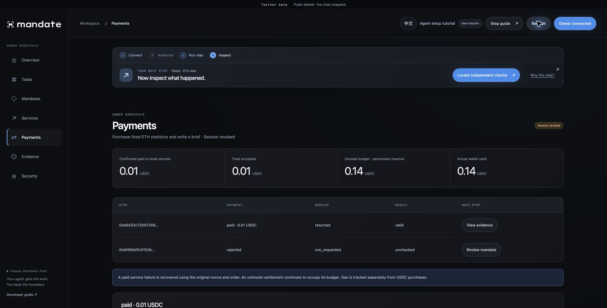
Scoped USDC payments
for AI agents
2026 FinTechathon / Topic F
Mandate Labs
01
Notes:
Mandate Wallet gives AI agents a limited ability to purchase services. The owner controls the approved scope and budget through an external wallet. We demonstrate this with Claude Desktop, Rabby and a USDC payment on Base Sepolia.
Presenter window: 0 to 20 seconds (20 seconds).
Chinese presenter direction (not spoken): 本项目为 Agent 提供有限的采购权限。开场说明所有者保留授权控制权，并介绍演示涉及的软件和网络。
Sources:
competition/submission-2026-10-20/documents/latex/sections/introduction.tex
competition/submission-2026-10-20/documents/latex/sections/public-case.tex

Slide 2
Spending authority for AI agents
The owner defines the scope
The agent executes the task
Approved service, payee, asset, budget and expiry.
A finite session authorizes specific purchases.
Contract checks continue when a host uses its session key directly.
Mandate Labs
02
Notes:
A tool connection tells an agent what it can call. Financial authority also needs an approved purpose, recipient, amount and lifetime. Mandate places those limits in a smart account. The owner approves a finite task, and the agent executes permitted purchases through a session signer. The financial checks continue to apply when a host bypasses the normal client.
Presenter window: 20 to 50 seconds (30 seconds).
Chinese presenter direction (not spoken): 本页区分工具接入与资金授权。说明链上约束针对具体任务，即使宿主绕过客户端，仍需满足合约的财务检查。
Sources:
competition/submission-2026-10-20/documents/latex/sections/introduction.tex
competition/submission-2026-10-20/documents/latex/sections/model.tex

Slide 3
System architecture and trust boundaries
Owner wallet
Rabby
Agent host
Claude Desktop / CLI
API merchant
402 quote and service
review / sign
stdio MCP
HTTP / x402
verify / settle
Mandate workspace
Owner review
status API
MCP gateway
SDK + durable journal
Facilitator
Verify and settle
redacted evidence
Local host
register
settlement
Separate verifier
Independent trust
MandateAccount
Scope and reservations
ERC-1271
USDC token
Authorization and transfer
owner transactions
Public chain
Mandate Labs
03
Notes:
The architecture separates owner administration from agent execution. The workspace prepares unsigned management requests, and Rabby signs them. Claude connects to the local MCP gateway, which runs the purchase client and durable journal. The merchant supplies the service, while the facilitator submits token settlement. On Base Sepolia, the token calls the account to validate the registered payment. A separate verifier checks exported evidence against independently reviewed trust settings. The dashed host region does not protect its keys from the administrator. Token behavior, canonical chain state and the trusted owner remain explicit assumptions.
Presenter window: 50 to 100 seconds (50 seconds).
Chinese presenter direction (not spoken): 沿架构图说明管理权限与执行权限的分工。随后指出本地宿主边界不等于安全隔离，独立验证也需要预先审核的信任配置。
Sources:
competition/submission-2026-10-20/documents/latex/sections/architecture.tex
competition/submission-2026-10-20/documents/latex/sections/model.tex

Slide 4
A bounded ETH data purchase
0.15
0.10
0.01
total test USDC budget
maximum per payment
price of the ETH sample
Claude Desktop + Rabby + Base Sepolia
Fixed ETH dataset. Test USDC payment. Gas uses separate test ETH.
Recorded session: 2 hours. Each payment authorization: at most 5 minutes.
Mandate Labs
04
Notes:
The task is to purchase an ETH statistics sample. The owner approves a total of 0.15 test USDC and a maximum of 0.10 per payment. The service costs 0.01. ETH names the fixed dataset. Payment uses USDC, and native ETH pays gas separately.
Presenter window: 100 to 125 seconds (25 seconds).
Chinese presenter direction (not spoken): 用一个具体任务解释三项金额。ETH 表示固定数据样本，USDC 是实际付款资产，gas 则单独以测试 ETH 支付。
Sources:
competition/submission-2026-10-20/documents/latex/sections/introduction.tex
competition/submission-2026-10-20/documents/latex/sections/public-case.tex

Slide 5
Account preparation and Claude connection
Owner wallet
Rabby
Mandate
workspace
Local
gateway
Agent
Claude Desktop
Blockchain
Base Sepolia
1 Review deployment and funding
2 Sign owner transactions
3 Review task and session scope
4 Create policy and finite session
5 User imports Guided extension
6 Read account context
7 Check current account and grant
8 Return current task context
Mandate Labs
05
Notes:
The workspace first asks the owner to review account deployment and funding. Rabby signs those transactions for Base Sepolia. The owner then approves the task policy and a session with finite scope, budget and expiry. The successful recorded session lasts two hours. The user imports and enables the Guided extension in Claude Desktop. It selects the prepared local connection. Claude reads the account context through the gateway before procurement. Installing the extension alone creates no on-chain spending authority. The owner key stays in Rabby.
Presenter window: 125 to 170 seconds (45 seconds).
Chinese presenter direction (not spoken): 按时序图说明开户、注资、授权和 Claude 接入。强调用户需导入并启用扩展，扩展安装本身不会创建链上资金权限。
Sources:
competition/submission-2026-10-20/documents/latex/sections/architecture.tex
competition/submission-2026-10-20/documents/latex/sections/public-case.tex
https://modelcontextprotocol.io/specification/2025-11-25

Slide 6
x402 payment registration and settlement
Claude
agent
Gateway
session signer
API
merchant
Payment
facilitator
Mandate
account
USDC
token
1 Call approved step
2 Request quote
3 HTTP 402 terms
4 Persist intent and register payment
5 Confirm budget reservation
6 Send payment payload
7 Verify and settle
8 Submit token authorization
9 ERC-1271 check
10 Current authority
11 Data and receipt
12 Separate outcomes
Mandate Labs
06
Notes:
Claude calls an approved step through the gateway. The merchant returns an HTTP 402 quote. The client checks the request, asset, recipient and price, then persists the payment intent. Registration atomically reserves both task and session budgets. The client waits for confirmation before releasing the token payment signature. The facilitator then submits an EIP-3009 authorization to USDC. At settlement, the token invokes the wallet’s ERC-1271 validator and checks current authority. A successful precheck cannot override a later revocation. Canonical transfer events establish payment. Service delivery and result quality receive separate status checks.
Presenter window: 170 to 225 seconds (55 seconds).
Chinese presenter direction (not spoken): 先指出登记确认与付款签名之间的先后关系，再说明 USDC 在实际结算时调用钱包验权。最后将付款、服务返回和结果检查分开叙述。
Sources:
competition/submission-2026-10-20/documents/latex/sections/protocol.tex
competition/submission-2026-10-20/documents/latex/sections/runtime.tex
https://eips.ethereum.org/EIPS/eip-712
https://eips.ethereum.org/EIPS/eip-1271
https://eips.ethereum.org/EIPS/eip-3009

Slide 7
Shared budgets and payment identity
occupied(root) ≤ budget(root) occupied(session) ≤ budget(session)
Constraint | Implemented rule
Registration | EIP-712 binds chain, wallet, policy, session and payment
Shared budget | Atomic root and session reservations
Business retry | Permanent used step and deterministic nonce
Settlement | Registered digest with live version and epoch
Safe release | Strict expiry and unused token nonce
Concurrent 0.10 requests against 0.15: at most one reserves before release.
Mandate Labs
07
Notes:
The first property is bounded authorization. Registration checks the remaining root and session budgets and updates them atomically. Before an eligible release, two competing 0.10 requests cannot both reserve against a 0.15 root budget. A permanent used-step flag and a deterministic business nonce prevent a new session from turning the same step into another purchase. Paid and uncertain commitments remain occupied. Release requires strict expiry and an unused token nonce. Occupancy measures authorization usage and can differ from wallet cash.
Presenter window: 225 to 265 seconds (40 seconds).
Chinese presenter direction (not spoken): 本页给出预算约束及并发反例。说明确定性 nonce 与永久步骤标记共同限制重复采购，并解释预算占用为何不同于余额和已付款金额。
Sources:
competition/submission-2026-10-20/documents/latex/sections/protocol.tex
competition/submission-2026-10-20/documents/latex/sections/analysis.tex
https://eips.ethereum.org/EIPS/eip-712
https://eips.ethereum.org/EIPS/eip-1271
https://eips.ethereum.org/EIPS/eip-3009

Slide 8
Recovery preserves the original payment
Observation | Payment | Delivery | Result
First response: HTTP 500 | paid | failed | unchecked
Original-order recovery | paid | returned | valid
One 0.01 USDC settlement
Same order, business nonce and transaction hash throughout recovery.
Mandate Labs
08
Notes:
In the public case, the first response fails with HTTP 500 after payment. The journal records paid, failed and unchecked as separate outcomes. Claude resumes the same order. The client reconciles its original nonce and transaction hash, then retrieves the paid service without another settlement. The recovered response passes the fixed-data checker. An expired unpaid commitment follows a different path. It cannot receive a refreshed payment window or nonce merely because a service call failed.
Presenter window: 265 to 305 seconds (40 seconds).
Chinese presenter direction (not spoken): 用实际故障展示恢复流程。指出已付款但交付失败与付款到期未结算属于不同情形，不能通过更换 nonce 将后者伪装成重试。
Sources:
competition/submission-2026-10-20/documents/latex/sections/runtime.tex
competition/submission-2026-10-20/documents/latex/sections/public-case.tex

Slide 9
Research questions and implemented mechanisms
01
Policy-bound actions
Typed registration and shared reservations
02
Delegated-session evidence
Signed checkpoints and selective disclosure
03
Host interference
Reference controller and retained-head checks
The release implements a bounded part of the prior proposal.
Mandate Labs
09
Notes:
The earlier proposal asks how approved intent binds to an action, what evidence supports delegated-session accountability, and what remains observable when a host interferes. Mandate answers the first question with typed payment registration and shared reservations. Signed checkpoints, selective disclosures and ActionProof address the second. A reference controller and retained-head comparisons test a bounded part of the third. Echo supplies a separate repaired UserOperation and swap reference. The contribution is this implemented combination and its failure analysis. Scoped wallets already exist, and the current release covers only part of the proposal’s broader research agenda.
Presenter window: 305 to 360 seconds (55 seconds).
Chinese presenter direction (not spoken): 三项研究问题分别对应授权约束、会话证据和宿主干预。说明 Echo 的基础作用与 Mandate 的新增实现，不把整个 proposal 的研究目标表述为既有成果。
Sources:
competition/submission-2026-10-20/documents/latex/sections/introduction.tex
competition/submission-2026-10-20/documents/latex/sections/analysis.tex
competition/submission-2026-10-20/documents/latex/references.bib (proposal, safe, metamask, acharya, baid)

Slide 10
Session evidence and independent verification
Signed headers bind scope, field root μ and the previous checkpoint digest.
Pre-payment
checkpoint ρ0
Registration
checkpoint ρ1
Payment
checkpoint ρ2
Service
checkpoint ρ3
ActionProof
ρ0, R(p), D(p)
Canonical chain evidence
Registration and USDC events
Independent verifier
Merkle disclosures + reviewed trust
Required financial checks: passed. Overall: incomplete.
Mandate Labs
10
Notes:
Each checkpoint signs its scope, field commitment and previous checkpoint digest. Salted Merkle paths let an auditor inspect selected fields. ActionProof associates the pre-payment checkpoint with both the registration digest and token-payment digest. The verifier checks that association, historical authority, occupied budget and canonical token events using separate trust settings. Hidden fields leave their corresponding checks incomplete. In the public run, required financial checks passed while the overall result remained incomplete. The account does not enforce the entire checkpoint chain as an on-chain payment condition.
Presenter window: 360 to 410 seconds (50 seconds).
Chinese presenter direction (not spoken): 说明检查点、字段承诺与 ActionProof 的关系。强调独立验证需要单独的信任配置，选择性披露会限制可验证的结论，完整会话链也并非当前合约的强制付款条件。
Sources:
competition/submission-2026-10-20/documents/latex/sections/evidence.tex
competition/submission-2026-10-20/documents/latex/sections/public-case.tex

Slide 11
Host interference and missing history
World A: history ends at checkpoint 2
h0
h1
h2
Same disclosed prefix
No independent latest head
Completeness remains unknown
World B: checkpoint 3 is withheld
h0
h1
h2
h3
An externally retained head can expose a missing known tail.
A query cap applies at the controller interface. The host can bypass that interface.
Mandate Labs
11
Notes:
Consider two histories. One ends at checkpoint two. The other continues to checkpoint three, but the host withholds that tail. An auditor receiving only the same valid prefix cannot distinguish them without independent latest-head information. A separately retained head can reveal a missing known tail. It cannot establish every unobserved action. Likewise, the reference controller rejects a fourth query through an interface capped at three, but direct host calls can bypass that interface. These experiments identify the enforcement boundary.
Presenter window: 410 to 455 seconds (45 seconds).
Chinese presenter direction (not spoken): 用两段历史解释未锚定前缀的不可区分性。随后说明已保留的最新摘要可以帮助发现已知尾部缺失，但同机控制器无法限制宿主的所有调用。
Sources:
competition/submission-2026-10-20/documents/latex/sections/analysis.tex

Slide 12
Evaluation and measured overhead
120 tasks
Local full-task median (ms)
132 settlements
0 duplicate payments
10,000 invalid calls
20 explicit categories
6 legal controls
Local chain, n=30 per group. Setup excluded. Applicable export and verification included.
Mandate Labs
12
Notes:
Four HTTP configurations each run thirty tasks. B1 uses an EOA with honest local controls. B2 adds Mandate reservations. B3 adds evidence and separate verification. B4 adds the reference controller. Across 120 tasks, the experiment records 132 settlements with no duplicate payment, including explicit recovery. All ten thousand distinct invalid contract calls reject, while six legal controls accept. The chart shows local median full-task time. Reservation adds gas, and evidence and controller work add latency. These timings include applicable export and verification, exclude setup, and do not describe public-network performance.
Presenter window: 455 to 510 seconds (55 seconds).
Chinese presenter direction (not spoken): 介绍四个基线的差异，再解释样本数与统计口径。图中时间来自本地链实验，不代表 Base Sepolia 延迟；额外登记、证据和控制器均有成本。
Sources:
competition/submission-2026-10-20/documents/latex/sections/evaluation.tex
artifacts/m7/benchmarks/audit.json
artifacts/m7/research/dataset-audit.json

Slide 13
Public execution and revocation evidence
0.01
0.14
0
test USDC paid once
final test USDC balance
new transactions after refusal
Settlement on BaseScan
Session revocation on BaseScan
Eight exported key transactions. Required financial checks passed.
Controlled merchant and facilitator. HTTPS source and full history remain unproven.
Mandate Labs
13
Notes:
The execution package links eight key Base Sepolia transactions, including account preparation, registration, settlement and owner revocation. The successful task pays 0.01 USDC once and retains a final balance of 0.14. After revocation, an unused step receives an inactive-grant response before another transaction. The explorer links and exported receipts let reviewers inspect these facts. The merchant and facilitator remain controlled fixtures. Independent HTTPS provenance and complete history are still missing, so the overall verification report stays incomplete.
Presenter window: 510 to 555 seconds (45 seconds).
Chinese presenter direction (not spoken): 通过链上交易、最终余额和撤销后拒绝记录回顾实测结果。说明广播前拒绝不是链上失败交易，并保留受控服务及来源证据方面的限制。
Sources:
competition/submission-2026-10-20/documents/latex/sections/public-case.tex

Slide 14
Next implementation priorities
Supported installation and updates
Broader merchant compatibility
Independent source and history evidence
Financial scope with
reviewable evidence
Beacon commitments and stronger execution proofs remain research extensions.
Mengzhong Ma, Sat Chidananda, Vrushank Ajay Ahire, Wilfried Ariel Mulyawan
Nanyang Technological University, Singapore
Mandate Labs
14
Notes:
The current product combines financial constraints, a graphical workspace, native agent connection and recoverable procurement records. A new user can prepare an account, authorize a finite session and purchase an approved service through Claude. The next priorities are supported installation and updates, broader merchant compatibility, independent source witnessing and separately managed retention. Beacon commitments and stronger execution proofs need further design and evaluation. The present evidence supports a specific testnet implementation. It leaves clear questions for the next engineering and research stages.
Presenter window: 555 to 600 seconds (45 seconds).
Chinese presenter direction (not spoken): 总结当前用户可以完成的流程，并将产品发行、服务兼容、独立来源见证和外部证据保留列为后续工作。随机信标承诺和更强执行证明仍属于研究方向。
Sources:
competition/submission-2026-10-20/documents/latex/sections/conclusion.tex
competition/submission-2026-10-20/documents/latex/sections/analysis.tex
https://docs.drand.love/

