Slide 1
Module1 CSS3

Slide 2
You will learn
1.Introduction to Cascading Style Sheets 3.0
What CSS can do
CSS Syntax
Types of CSS
2. Working with Text and Fonts
Text Formatting
Text Effects
Fonts
3. CSS Selectors
Element Selector
Universal Selector
ID Selector
Class selector
4. Colors and Borders
Background
Multiple Background
Colors RGB and RGBA
HSL and HSLA
Borders
Rounded Corners
Applying Shadows in border

Slide 3
What is CSS ?
CSS stands for “Cascading Style Sheets”
Cascading: refers to the procedure that determines which style will apply to a certain section, if you have more than one style rule.
Style: how you want a certain part of your page to look. You can set things like color, margins, font, etc for things like tables, paragraphs, and headings.
Sheets: the “sheets” are like templates, or a set of rules, for determining how the webpage will look.
CSS is a stylesheet language used to describe the presentation of a document written in HTML or XML.

Slide 4
CSS
History
CSS1 was the first edition introduced in 1996.
CSS2 was published in 1998 and provides enhancement over CSS1.
CSS2.1 was the last 2nd generation edition of CSS.
CSS 3 is the latest edition. Several new functionalities have been provided through CSS3.
Functions like rounded corners, background decoration, box shadows, which are demonstrated in the subsequent sections, are introduced in this version.

Slide 5
CSS
Advantages
A web application will contains hundreds of web pages, which are created using HTML.
Formatting these HTML pages will be a laborious process, as formatting elements need to be applied to each and every page.
CSS saves lots of work as we can change the appearance and layout of all the web pages by editing just one single CSS file.

Slide 6
CSS Syntax Rules
Rule have two parts - Selector and declaration.
Selector: The HTML element you want to add style to.
<p> <h1> <table> etc
Declaration: The statement of style for that element. Made up of property and value.
Refer Note Section-
Rules
Declaration
Selector
p {font-family:Arial;}
Property
Value
Declaration
Notes:
A CSS declaration must always end with semi colon.
There can be multiple declarations represented by multiple property value pairs.
You can also have declarations on separate lines for easy readability like –
P {
font-family:Arial; }
4. CSS is a Case-Senstive.

Slide 7
Inserting a StyleSheet
Multiple Style Sheets – It can be referenced inside an HTML document.
The questions is, what styles will be applicable when there is more than one style specified?
All styles cascade into a new virtual style sheet by applying the following rules, where the higher number has the greater priority:
Browser default – Nothing to do.
External Stylesheet – One or more external style sheet can be referenced.
Internal Stylesheet (styles defined in head section).
Inline Style (styles defined in an HTML element).
Notes:
As you can observe, Inline Style has the highest priority. This means that the inline style defined in an HTML element will override a style defined within the head section, which in turn may override the style defined within an external style sheet.
If the link to the external stylesheet is placed below the internal stylesheet in HTML <head>, the external stylesheet will override the internal stylesheet!

Slide 8
Types of CSS
There are three different way to use CSS
External Style Sheet
Styles are specified in an external CSS file. You can change the looks of entire website by using single external style sheet. CSS has .css extention
Eg.: <head> <link rel="stylesheet" type="text/css" href=“ex1.css” /> </head>
Internal Style Sheet
To Apply specific styles to a single HTML file typically inside the head section of an HTML page.
We can use <style> tag any number of times in any section.
Eg.: <style> p { text-align:left; font-size:24px; } </style>
Inline Styles
Styles are specified inside an HTML tag/element.
Eg.: <p style="font-family:Algerian; font-size:28px;"> Demo of Inline Style </p>

Slide 9
CSS Style Example
Selector - I want the text color of my paragraph to be red and the background color to be black.
<html>
<head>
<style> p {font-family:Arial;
color: red;
background-color:black;}
</style>
</head>
<body>
<p> <b> Welcome to CSS World </b> </p>
</body>
</html>
Welcome to CSS World

Slide 10
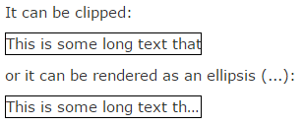
Working with Text and Fonts
CSS3 contains several new text features. Their are following text properties- text-overflow, word-wrap, word-break
text-overflow – This property specifies how overflowed content that is not displayed should be signaled to the user.
Eg.:
p.test1 {
white-space: nowrap;
width: 200px;
border: 1px solid #000000;
overflow: hidden;
text-overflow: clip;
}
p.test2 { On hovering over element – It shows overflowed content
white-space: nowrap; div.test:hover {
width: 200px; text-overflow: inherit;
border: 1px solid #000000; overflow: visible;
overflow: hidden; }
text-overflow: ellipsis;
}

Slide 11
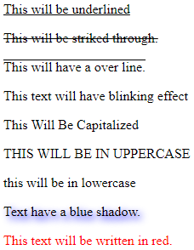
CSS3 Text Example
<html>
<body>
<p style = "text-decoration:underline;"> This will be underlined</p>
<p style = "text-decoration:line-through;"> This will be strike through.</p>
<p style = "text-decoration:overline;"> This will have a over line.</p>
<p style = "text-decoration:blink;"> This text will have blinking effect</p>
<p style = "text-transform:capitalize;"> This will be capitalized</p>
<p style = "text-transform:uppercase;"> This will be in uppercase</p>
<p style = "text-transform:lowercase;"> This will be in lowercase</p>
<p style = "text-shadow:4px 4px 8px blue;">
Text have a blue shadow.</p>
<p style = "color:red;"> This text will be written in red.</p>
</body>
</html>

Slide 12
CSS3 Text
Text Decoration
You can use text-decoration property to set or remove decorations from text.
Example-
p {text-decoration:overline;}
p {text-decoration:line-through;}
p {text-decoration:underline;}
Text Transformation
You can use text-transform property to specify uppercase and lowercase letters of any text.
Example-
h1 {text-transform:uppercase;}
h2 {text-transform:lowercase;}
p {text-transform:capitalize;}

Slide 13
CSS3 Font
CSS Font Family
The font-family property should hold several font names as a "fallback" system. If the browser does not support the first font, it tries the next font.
Example :
p { font-family:”Arial”, Times, “Sans-serif”;}
CSS Font Style
You can use the property font-style to specify mostly italic text. It has three values – Normal, Italic, Oblique (similar to italic).

Slide 14
CSS3 Font Cont…
CSS Font Size
You can use the font-size property to set the size of text. The font-size value can be
absolute or it can be relative.
Example- h1 {
font-size: 30px;
}
p {
font-size: 14px;
}

Slide 15
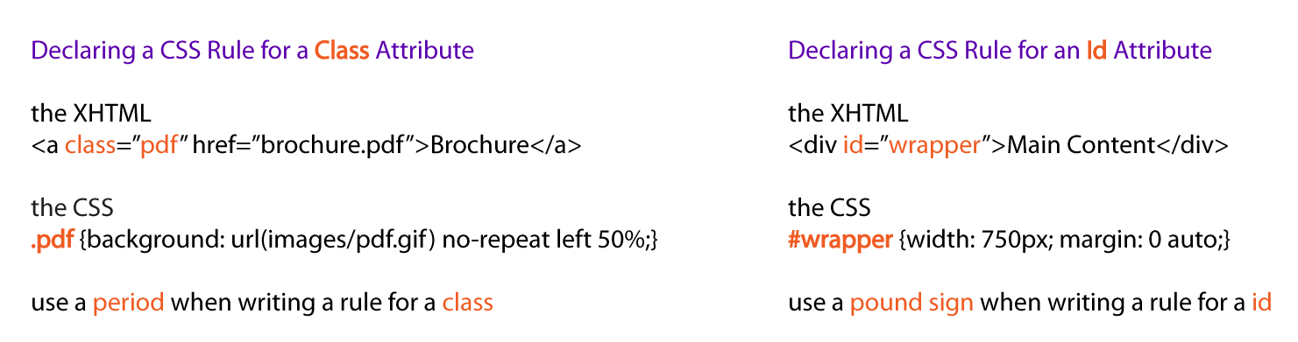
CSS Selectors
CSS selectors allow you to select and manipulate HTML elements based on their class, id, type, attribute, and more.
Examples –

Slide 16
CSS Selectors (Cont.)
Declaring a CSS Rule for HTML Element (Type)
Style will be applicable to content of all particular element. Here all <p> tag will be styled.
Example-
The HTML
<p> Welcome to the CSS World</p>
<p> <b><i> Powered by – Next Level Learning</i></b></p>
The CSS
p {text-align: center; color: blue;}

Slide 17
CSS Selectors (Cont.)
Group Selector
We can group various elements of same style to minimize the code. The selectors should be separated with comma. Here <h2>and <p> elements are styled as one group.
Example-
h2 {text-align: center; color: red; } p {text-align: center; color: red;}
Grouped Selectors-
h2, p {text-align: center; color: red; }

Slide 18
CSS Selectors (Cont.)
Universal Selector
We can Select all elements and nested elements to style their properties.
Example-
All elements which having text became red and central aligned.
Universal Selector
* {text-align: center; color: red; }

Slide 19
Colors and Borders
CSS Background
We can use CSS Background properties to define the background effects of an element.
The following properties can be used for background effects:
background-color
background-image
background-repeat
background-position

Slide 20
Formatting with CSS Properties
CSS Background Position
If the background image disturbs the text, i.e. if the text cannot be read clearly due to
the image in the background, we can set the position of the background image.
Example-
body {
background-image:url(“nll.jpg");
background-repeat:no-repeat;
background-position:right top;
}

Slide 21
Formatting with CSS Properties
CSS Background Shorthand
You can also specify all the properties in a single property. This property is known as shorthand property.
For specifying shorthand property, you just need to use background.
Example-
body {
background:cyan url(‘nll.jpg') no-repeat right top;
}

Slide 22
Background Image
CSS Background Image
You can use an image as the background for an element using background-image property.
Example-
body{ background-image:url(‘java.png’); }
By default, the image is repeated, both horizontally and vertically, so as to cover the entire
body (or the element on which it is applied).

Slide 23
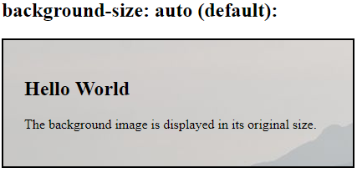
Background in CSS3
<!DOCTYPE html>
<html><head><style>
#example1 {
border: 2px solid black;
padding: 25px;
background: url(mountain.jpg);
/* Image mountain.jpg is in present directory */
background-repeat: no-repeat;
background-size: auto;}
</style></head><body>
<h2>background-size: auto (default):</h2>
<div id="example1">
<h2>Hello World</h2>
<p>The background image is displayed in its original size.</p>
</div></body>
</html>
Output

Slide 24
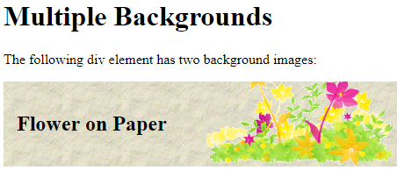
Multiple Background
<!DOCTYPE html>
<html><head><style>
#example1 {
background-image: url(img_flwr.gif), url(paper.gif);
/*Images are in current directory */
background-position: right bottom, left top;
background-repeat: no-repeat, repeat;
padding: 15px;
}
</style></head>
<body><h1>Multiple Backgrounds</h1>
<p>The following div element has two background images:</p>
<div id="example1">
<h2>Flower on Paper</h2>
</div></body>
</html>
Output

Slide 25
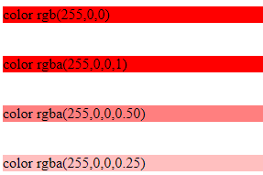
RGB and RGBA
RGB stand for Red Green Blue declared in 0 -255 range(255,0,0) or Hexadecimal (#FF0000) format .
RGBA colors are same like RGB colors, but it has an extra forth value: Alpha. Alpha is opacity level of color. Value of Alpha is between 0.0 to 1.00. 0.50 means 50 percent transparent observe third output
<html><body>
<div style="background:rgb(255,0,0)">
color rgb(255,0,0)</div><br><br>
<div style="background:rgba(255,0,0,1)">
color rgba(255,0,0,1)</div><br><br>
<div style="background:rgba(255,0,0,0.50)">
color rgba(255,0,0,0.50)</div><br><br>
<div style="background:rgba(255,0,0,0.25)">
color rgba(255,0,0,0.25)</div>
</body></html>
Output

Slide 26
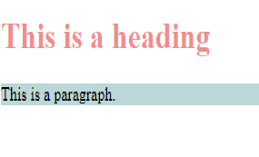
HSL and HSLA
HSL stands for hue saturation and lightness. In RGB colors, we cannot change saturation and lightness of color, but in HSL, we can change.
HSLA stands for Hue Saturation Lightness and Alpha. HSLA and HSL are same , except alpha value. Both are supported in HTML5 based browsers only.
Hue is a degree on the color wheel from 0 to 360. 0 is red, 120 is green, 240 is blue.
Saturation is a percentage value; 0% means a shade of gray and 100% is the full color.
Lightness is also a percentage; 0% is black, 100% is white.
<!DOCTYPE html>
<html><head>
<title>CSS HSLA Color Values</title>
<style type="text/css">
h1 { color: hsla(360,80%,50%,0.5); }
p { background-color: hsla(180,60%,30%,0.3);
}
</style></head><body>
<h1>This is a heading</h1>
<p>This is a paragraph.</p>
</body></html>
Output

Slide 27
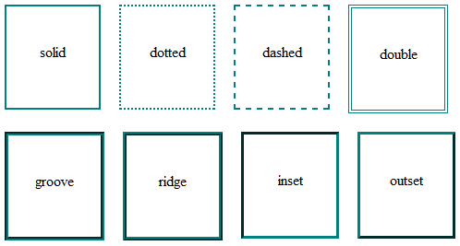
Understanding Border
We can use these 9 way to decorate border
none: no border (default);
solid: a single solid line;
dotted: a dotted line;
dashed: a dashed line;
double: a double border;
groove: a grooved line;
ridge: a ridged line;
inset: global inset 3D effect;
outset: global outset 3D effect;
<html> <body>
<p style = "border:4px solid red;">
This example is showing solid red 4 pixel thick border. </p> </body></html>
Output

Slide 28
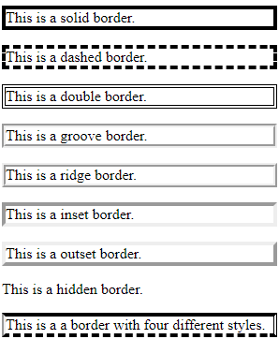
Border Example
<html> <body>
<p style = "border-width:4px; border-style:solid;">
This is a solid border.</p>
<p style = "border-width:4px; border-style:dashed;">
This is a dashed border.</p>
<p style = "border-width:4px; border-style:double;">
This is a double border.</p>
<p style = "border-width:4px; border-style:groove;">
This is a groove border.</p>
<p style = "border-width:4px; border-style:ridge">
This is a ridge border.</p>
<p style = "border-width:4px; border-style:inset;">
This is a inset border.</p>
<p style = "border-width:4px; border-style:outset;">
This is a outset border.</p>
<p style = "border-width:4px; border-style:hidden;">
This is a hidden border. </p>
<p style = "border-width:4px; border-top-style:solid;
border-bottom-style:dashed; border-left-style:groove;
border-right-style:double;">
This is a a border with four different styles. </p>
</body></html>
Output

Slide 29
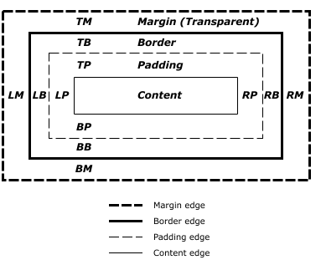
Box Model –To understand the border
All HTML elements can be considered as boxes. In CSS, the term "box model" is used when talking about design and layout. The CSS box model is essentially a box that wraps around every HTML element. It consists of: margins, borders, padding, and the actual content. We create border using box model. The margin, border, and padding can be broken down into top, right, bottom, and left segments in the right diagram, "LM" for left margin, "RP" for right padding, "TB" for top border.
The perimeter of each of the four areas (content, padding, border, and margin) is called an "edge". So each box has four edges:
content edge or inner edge
The content edge surrounds the rectangle given by the width and height of the box, which often depend on the element's rendered content. The four content edges define the box's content box.
padding edge
The padding edge surrounds the box padding. If the padding has 0 width, the padding edge is the same as the content edge. The four padding edges define the box's padding box.
border edge
The border edge surrounds the box's border. If the border has 0 width, the border edge is the same as the padding edge. The four border edges define the box's border box.
margin edge or outer edge
The margin edge surrounds the box margin. If the margin has 0 width, the margin edge is the same as the border edge. The four margin edges define the box's margin box.

Slide 30
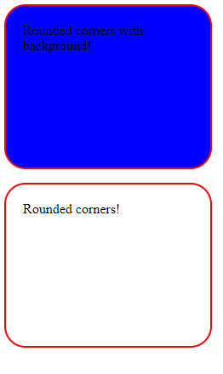
Rounded Corners
<html><head>
<style>
#rndcrn1 {
border-radius: 25px;
background: #0000FF;
border: 2px solid #FF0000;
padding: 20px; width: 200px; height: 150px; }
#rndcrn2 {
border-radius: 25px;
border: 2px solid #FF0000;
padding: 20px; width: 200px;height: 150px; }
</style></head><body>
<p id = "rndcrn1">Rounded corners with background!</p>
<p id = "rndcrn2">Rounded corners!</p>
</body></html>
Outputs

Slide 31
Formatting with CSS Properties
CSS Background Color
The background-color property is used to specify the background color of an element.
Example-
body {
background-color:darkblue;
}
Similarly, we can specify the background for any element (wherever applicable).
p { background-color:orange; }

Slide 32
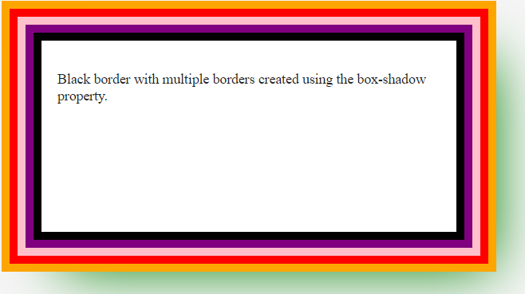
Applying Shadows in border Example
<html>
<head><Style>
<body> {
background-color: #F5F5F5;
color: #555; font-size: 1.1em;}
.container {
margin: 40px auto; width: 40%;
box-shadow: 2em 2em 4em green;}
.element {
padding: 20px;background-color: white;
color: #222;margin-top: 70px;
height: 200px;border: 10px solid black;
box-shadow: 0 0 0 10px purple, 0 0 0 20px pink,
0 0 0 30px red, 0 0 0 40px orange;}
</style></head>
<body>
<div class="container">
<div class="element">
<p> Black border with multiple borders
created using the box-shadow property.</p>
</div>
</div>
</body></html>

Slide 33


Assignments
Task 1 : Below Web page has 5 images in background . Create background by using id selector . Width must be twice of height . Use any 5 image .
Task 2: By using class selector and <div> tag create below page . Hint use relative positioning and must not use <TABLE> tag

