Slide 1
Module 1 Web Technologies
HTML5
CSS3
JavaScript

Slide 2
Introduction to HTML5

Slide 3
We will learn
HTML Basics
Tables
List
Working With Links
Image Handling
Frames
HTML Forms for User Input
New Form Elements

Slide 4
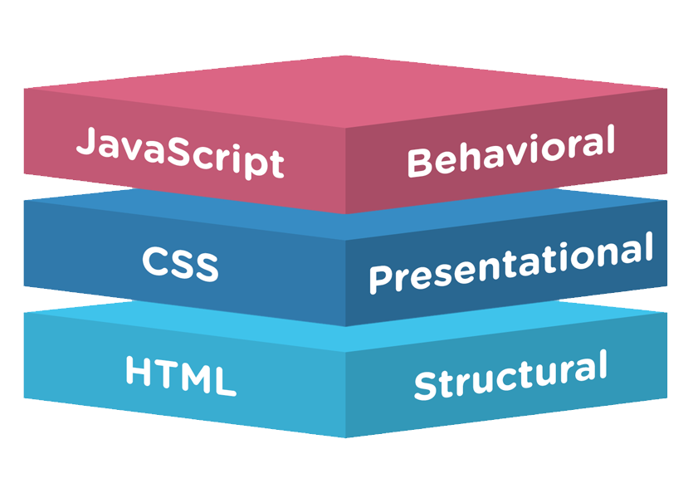
HTML , CSS , JAVASCRIPT Relationship

Slide 5
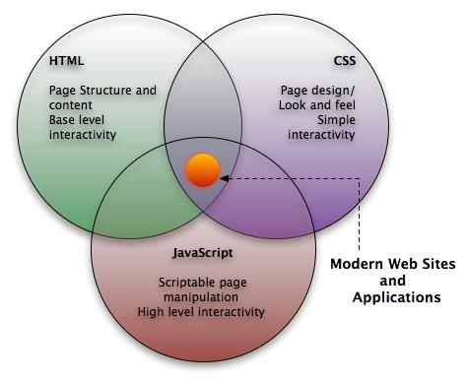
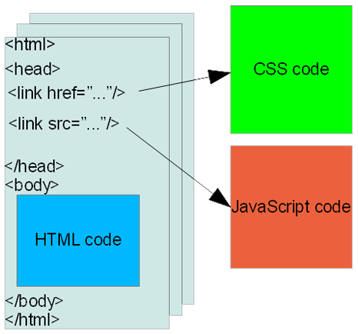
HTML vs CSS vs JAVASCRIPT
Overview

Slide 6
HTML is a markup language describes how your content looks in web browser
Overview
Tim Berners-Lee was the author of html, with his team at CERN.
The HTML that Tim invented was strongly based on SGML (Standard Generalized Mark-up Language).
Hypertext Markup Language (First Version of HTML) was formally published on June 1993.
Platform independent.
Current version of is HTML5.
Markup languages are designed for the processing, definition, and presentation of text by a set of markup tags.
Allow to embed other scripting languages.

Slide 7
You can write your HTML code in almost any available text editor, including notepad.
Open source text editor
Brackets http://brackets.io/ Notepad++ https://notepad-plus-plus.org/
or
We’ll use Eclipse which has built-in HTML Editor.
HTML Document will always be saved in .html extension or an .htm extension.

Slide 8
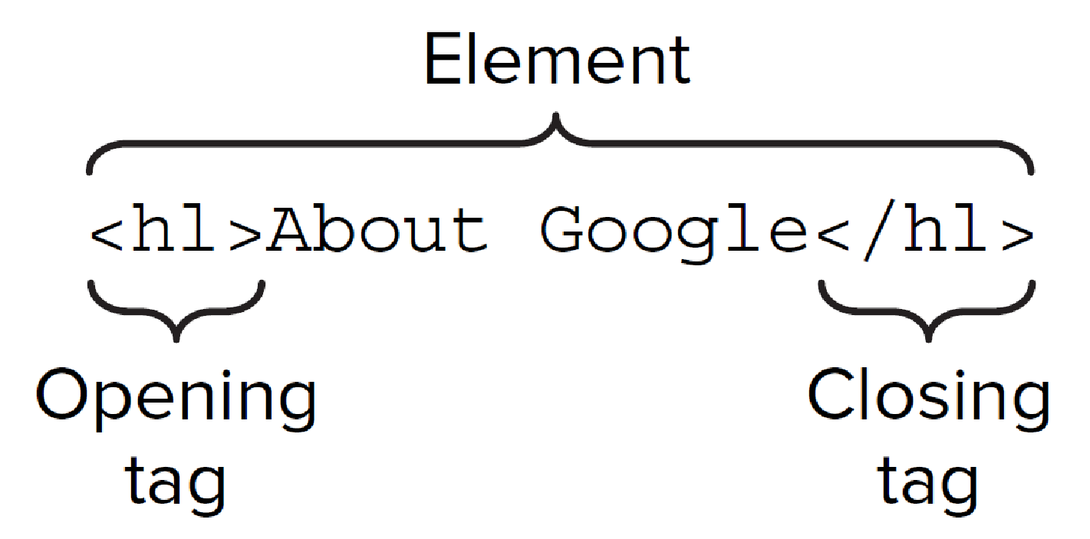
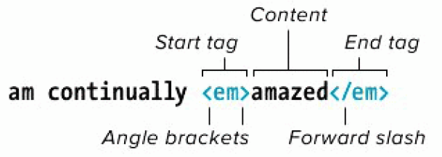
HTML Tags and Elements
Tags are enclosed in angle brackets < >
For Eg.: <html> Opening Tag, </html> Closing Tag.
Element is the combination of (opening & closing Tags and the content between them).
For Eg.:
<p>Part of this text is <b>bold</b>. </p> is a PARAGRAPH element that contains a BOLD element
An HTML document is a collection of elements (text/media with context).

Slide 9
Empty tags vs Container tags
Some elements which do not requires closing tags are known as Empty Tags or Elements.
For Eg.:
<img src=“peoplestrategists_logo.jpg” alt=“People Strategists Logo” />
<br /> begining of new line. BR stands for BReak.
<hr /> puts a line across the page. HR stands for Horizontal Rule.
The elements which requires opening and closing tags, are known as Container Tags or Elements.
For Eg.:
<h1> This is a heading </h1>
<p> This is a paragraph </p>

Slide 10
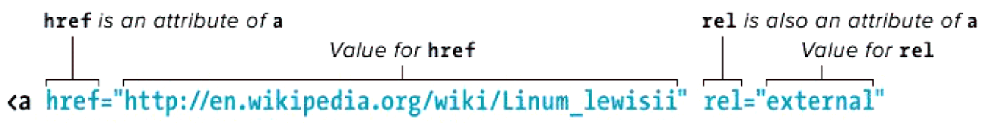

HTML Attributes and Values
HTML elements can have attributes which provide additional information about an element.
Always specified in the opening tag and should contained value.
For Eg.:
<!DOCTYPE html>
<html>
<head>
<title>Align Attribute Example</title>
</head>
<body>
<p align="left">This is left aligned</p>
<p align="center">This is center aligned</p>
<p align="right">This is right aligned</p>
</body>
</html>
This is left aligned This is center aligned This is right aligned

Slide 11
Structural Elements
A standard HTML document has two main structural elements
head contains setup information for the browser & the Web page
For E.g., the title for the browser window, style definitions, JavaScript code, …
body contains the actual content to be displayed in the Web page
<html lang=“en”>
<head>
<meta charset=“UTF-8” />
<title>My first HTML document</title>
</head>
<body>
<p> Hello world! </p>
</body>
</html>

Slide 12
Comments and doctype
HTML has a mechanism for embedding comments that are not displayed when the page is rendered in a browser.
Eg.: <!-- This is comment text -->
Besides tags, text content, and entities, an HTML document must contain a doctype declaration as the first line. For
Eg.:
<!DOCTYPE html>
<html lang=“en”>
<head>
<meta charset=“UTF-8” />
<title>My first HTML document</title>
</head>
<body>
<p> Hello world! </p>
</body>
</html>
Current version of HTML is 5 and it makes use
of the following declaration: <!DOCTYPE html>
Notes:
Note : The doctype declaration is not an HTML tag but tells the browser which version of HTML the page is written in.

Slide 13
<head> and <body> Elements
The <head> element is where you include a <title> element (that appears in the title bar of the browser).
You can also include lots of other type of information in the <head> element.
Cascading Style sheet information, or a link to an external style sheet (or several).
“Meta” data, such as who authored the page, the type of content, and clues that search engines may (or may not) use to help categorize your page.
JavaScript code.
The <body> element contains the main bulk of the material to be displayed on the webpage.
Paragraphs.
Tables and lists.
Images.
JavaScript code.
PHP code can be included here too (if passed through a PHP parser before being served to the client’s browser).
Other embedded objects (videos, etc).

Slide 14
<head> Elements
Meta tags
The <meta> tag provides metadata about the HTML document.
Meta elements are typically used to specify page description, keywords, author of the document, last modified, and other metadata.
Some examples –
Example 1 - Define keywords for search engines:
<meta name="keywords, description " content="HTML, CSS, XML, XHTML, JavaScript">
Example 3 - Define the author of a page:
<meta name="author" content="Hege Refsnes">
Example 4 - Refresh document every 30 seconds:
<meta http-equiv="refresh" content="30">

Slide 15
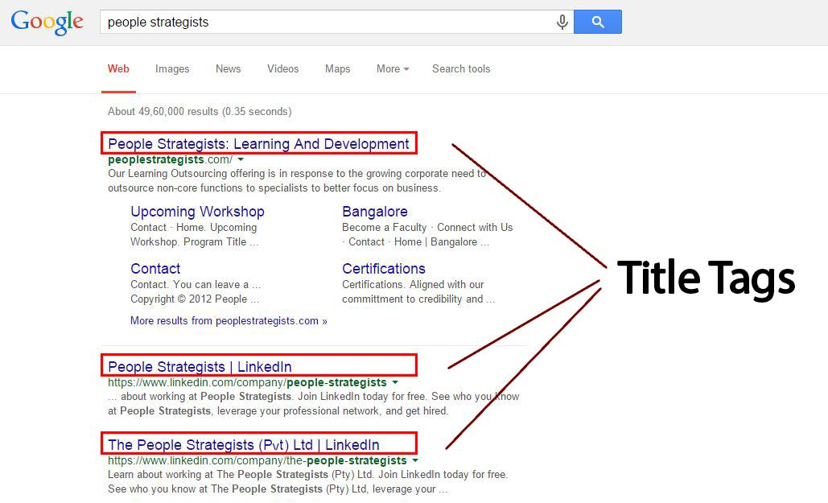

<head> Elements (Cont.)
Title Tag
The <title> tag is required in all HTML documents and it defines the title of the document.
The <title> element: Defines a title in the browser toolbar.
Provides a title for the page when it is added to favorites.
Displays a title for the page in search-engine results.
Eg.:

Slide 16
<head> Elements (Cont.)
Link Tag
The <link> tag defines a link between a document and an external resource.
In HTML the <link> tag has no end tag.
Some Imp. Attributes – charset, - To know browser, which character encoding is used. href, - hyperlink. rel, - Relation between linked document. target. – It specifies where to open the linked document.
Example –
<head>
<link rel="stylesheet" type="text/css" href="theme.css">
</head>
Notes:
Note : The <link> tag is used to link to external style sheets.
The <link> element is an empty element. It contains attributes only.

Slide 17
<head> Elements (Cont.)
Script Tags
The <script> tag is used to define a client-side script, such as a JavaScript.
The <script> element either contains scripting statements, or it points to an external script file through the src attribute.
Example -
<html>
<head>
<title>Align Attribute Example</title>
</head>
<body>
<p id="demo"></p>
<script>document.getElementById("demo").innerHTML = "Hello JavaScript!"; </script>
</body>
</html>
Hello JavaScript!
Notes:
Note: Script can be used in both head and body section. In accordance with logic of script, it can be used in either of the section.
Mostly it is used in the head section.

Slide 18
<head> Elements (Cont.)
Style Tag
The <style> tag is used to define style information for an HTML document.
Inside the <style> element you specify how HTML elements should render in a browser.
Example-
<html>
<head>
h1 {color:red;} p {color:blue;}
</head>
<body>
<h1>A heading</h1> <p>A paragraph.</p>
</body>
</html>
This is a heading This is a paragraph.
Notes:
Note: Each HTML document can contain multiple <style> tags.
Style can also be used externally using link tag. We’ll discuss this more deeply in CSS.

Slide 19
Elements for the BODY section
Block-level elements
The BODY of a document consists of multiple block elements. If plain text is found inside the body, it is assumed to be inside a paragraph P. See the syntax rules for an explanation of the syntax used in the overview.
Headings
H1 - Level 1 header
H2 - Level 2 header
H3 - Level 3 header
H4 - Level 4 header
H5 - Level 5 header
H6 - Level 6 header
Text containers
P - Paragraph
PRE - Preformatted text
BLOCKQUOTE - Large quotation
ADDRESS - Address information
Text Level Elements
Logical Markups
Physical Markups
Special Markups
Lists
UL - Unordered list
OL - Ordered list
DIR - Directory list
MENU - Menu item list
LI - List item
DL - Definition list
DT - Definition term
DD- Definition
Others
DIV - Logical division
CENTER - Centered division
FORM - Input form
HR - Horizontal rule
TABLE - Tables

Slide 20
Semantic Elements
A semantic element clearly describes its meaning to both the browser and the developer.
Eg. of non-semantic elements: <div> and <span> - Tells nothing about its content.
Eg. of semantic elements: <form>, <table>, and <img> - Clearly defines its content.
Many web sites contain HTML code like: <div id="nav"> <div class="header"> <div id="footer"> to indicate navigation, header, and footer.
HTML5 offers new semantic elements to define different parts of a web page:
<article>
<aside>
<details>
<figcaption>
<figure>
<footer>
<header>
<main>
<mark>
<nav>
<section>
<summary>
<time>

Slide 21
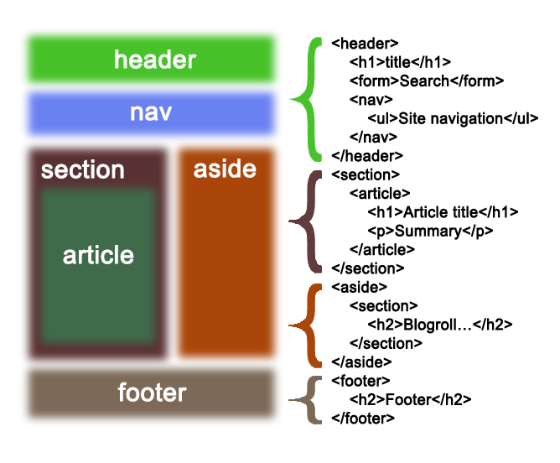
Semantic Elements

Slide 22
Learn To Manage Document Spacing
Browser displays only single space, we can use below facilities for space
&nbsp; or
&#160;
We can insert a longer space by using any one of the following options
Two spaces - &ensp;
Four spaces - &emsp;
Tab [4 Spaces]- &nbsp;&nbsp;&nbsp;&nbsp;
We can use pre-formatted <pre></pre>tag to read spaces and any formatting.
<br> tag to force subsequent text in new line.
<p> tag to start new paragraph .

Slide 23
HTML Table
Table Tag : <tr> Table Row - Defines a new row, <td> Table Data - Defines a single cell, <th> Table Headings - Defines header cell.
Table Attributes : border - creates boundary around cells and table , cellspacing – creates space between cells , cellpadding – create space inside cell ,colspan – merges columns, rowspan – merges rows
<html> <body> <table border =“2”> <tr> <th>Month</th> <th>No of Days</th> </tr> <tr> <td>January</td> <td>HTML</td> </tr> <tr> <td>April</td> <td>CSS</td> </tr> </table> </body> </html>
Month | No of Days
January | 31
April | 30
Notes:
Tables can be used not only to display tabular data but also to position the contents of the page in a
more structured manner. The page layout can be controlled very effectively with tables. Tables are
defined with the <table> tag.
Note: Tables are used on websites for two major purposes.
1) The primary purpose of arranging information in a table
2) The more widely used purpose of creating a page layout with the use of hidden tables. (border attribute values set to “0”).
The Attributes and it values
ALIGN - Align the table in a web page. (LEFT | RIGHT | CENTER).
BORDER - Specifies the thickness of the border
BGCOLOR - The background color for the table.
CELLPADDING - Specifies the space between the cell wall and contents .
CELLSPACING - Specifies the space between cell.
WIDTH - Specifies the width of the table
The WIDTH attribute value can be in percent (or) pixels. Pixels can be thought of as the smallest
logical unit for display. Pixel resolution can vary from PC to PC. Tables built with percents will
occupy that percentage of the browser’s visible area or the container area.

Slide 24
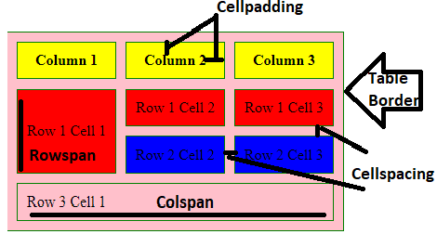
Table Tag and Attributes
<html>
<body>
<table border=“2" cellpadding="10" cellspacing="10" bordercolor="green" bgcolor="pink">
<tr bgcolor="yellow"><th>Column 1</th><th>Column 2</th><th>Column 3</th></tr>
<tr bgcolor="red"><td rowspan="2">Row 1 Cell 1</td>
<td>Row 1 Cell 2</td><td>Row 1 Cell 3</td></tr>
<tr bgcolor="blue"><td>Row 2 Cell 2</td><td>Row 2 Cell 3</td></tr>
<tr bgcolor=“grey"><td colspan="3">Row 3 Cell 1</td></tr>
</table>
</body>
</html>
Output

Slide 25
List Tag
Numbered | Ordered List and Bulleted | Unordered List
Unordered Lists - <ul> tag. Item lists in <li> tag. The list items will be marked with bullets.
Attribute :<ul type="disc|circle|square"> { Default Disc} Nested <li> tag to list the item inside <ul> tag
Ordered Lists - <ol> tag. Item lists in <li> tag. . The list items will be marked with numbers. Attribute :type =<ol “I|i|A|a|1” > { default 1} Nested <li> tag to list the item inside <ol> tag
<html>
<body>
<h2>Unordered List </h2>
<ul>
<li>Java</li>
<li>Python</li>
<li>Ruby</li>
</ul>
<h2>Ordered List </h2>
<ol>
<li>Java</li>
<li>Python</li>
<li>Ruby</li>
</ol>
</body>
</html>
Unordered List Java Python Ruby Ordered List Java Python Ruby

Slide 26
Working With Hyperlinks
Links and Navigation
Anchor Element-
An anchor can be used to create a link to another document (with the href attribute).
Types –
External : <a href=“https://www.google.com”>Google</a>
Internal : <a name="top"></a>
<a href="#top">link to top</a> within same page
Adding Hyperlinks to List Item
<ul> <h2>My Favourite Sports</h2>
<li><a href="http://en.wikipedia.org/wiki/Football">Football</a></li>
<li><a href="http://en.wikipedia.org/wiki/Tennis">Tennis</a></li>
<li><a href="http://en.wikipedia.org/wiki/Rugby_football">Rugby</a></li>
<li><a href="https://en.wikipedia.org/wiki/Cricket">Cricket</a></li>
</ul>
Notes:
Linking the pages
A link is a unidirectional pointer from a source document that contains the link to the some destination. Links help the user to navigate across pages as well as within a page. The text or an image that provides such link(s) is called hypertext or hyperlink.
Hyperlinks can be created by using a <A> tag, which stands for anchor and has the following attributes.
HREF - Hypertext Reference: This attribute points the link to a bookmark, another file, either within the same webs site or elsewhere on the internet.
NAME - Name: The name of the bookmark. This attribute lets you “bookmark” a location on the web page. An HREF anchor can point a link to that area on the page.
TITLE - Displays balloon help in IE
TARGET - With the target attribute, you can define where the linked document will be opened.
You can use HREF to point to a URL and allow the reader to view the page from the beginning. Or, you can use HREF to point to a specific area of that page, indicated by a NAME bookmark, so that the user goes straight to that section of the document.
Formatting the Link
The following attributes of <BODY> tag is used to provide color for the link.
LINK - Specifies the link color.
VLINK - Specifies the visited link color
ALINK - Specifies the active link color.
Inseting Image
“SRC” Attribute: used to mention the path where the image file is stored and the image file name.
“ALT” Attribute: used to display an alternate text in case the image file could not be loaded.

Slide 27
Working With Hyperlinks
Anchor Element-
An anchor can be used to create a link to another document (with the href attribute).
Types –
External : <a href=“https://www.google.com”>Google</a>
Internal : <a name="top"></a>
<a href="#top">link to top</a> within same page
Adding Hyperlinks to List Item
<ul> <h2>My Favourite Sports</h2>
<li><a href="http://en.wikipedia.org/wiki/Football">Football</a></li>
<li><a href="http://en.wikipedia.org/wiki/Tennis">Tennis</a></li>
<li><a href="http://en.wikipedia.org/wiki/Rugby_football">Rugby</a></li>
<li><a href="https://en.wikipedia.org/wiki/Cricket">Cricket</a></li>
</ul>
Notes:
Linking the pages
A link is a unidirectional pointer from a source document that contains the link to the some destination. Links help the user to navigate across pages as well as within a page. The text or an image that provides such link(s) is called hypertext or hyperlink.
Hyperlinks can be created by using a <A> tag, which stands for anchor and has the following attributes.
HREF - Hypertext Reference: This attribute points the link to a bookmark, another file, either within the same webs site or elsewhere on the internet.
NAME - Name: The name of the bookmark. This attribute lets you “bookmark” a location on the web page. An HREF anchor can point a link to that area on the page.
TITLE - Displays balloon help in IE
TARGET - With the target attribute, you can define where the linked document will be opened.
You can use HREF to point to a URL and allow the reader to view the page from the beginning. Or, you can use HREF to point to a specific area of that page, indicated by a NAME bookmark, so that the user goes straight to that section of the document.
Formatting the Link
The following attributes of <BODY> tag is used to provide color for the link.
LINK - Specifies the link color.
VLINK - Specifies the visited link color
ALINK - Specifies the active link color.
Inseting Image
“SRC” Attribute: used to mention the path where the image file is stored and the image file name.
“ALT” Attribute: used to display an alternate text in case the image file could not be loaded.

Slide 28
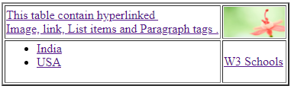
Working With Hyperlinks Cont…
Adding hyperlinks to table contents
<html><body><table border="2">
<tr><td><p> <a href="https://www.google.com">This table
contain hyperlinked <br>Image, link, Output
List items and Paragraph tags .</a></p></td>
<td><a href="https://www.google.com">
<img src="C:/Windows/Web/Wallpaper/Theme2/img11.jpg"
width="80" height="40" title="Example Image Link" /></a></td>
</tr><tr><td><ul>
<li><a href="https://en.wikipedia.org/wiki/India">India</a></li>
<li><a href="https://en.wikipedia.org/wiki/United_States">USA</a></li>
</ul></td><td><a href="https://www.w3schools.com/">W3 Schools</a>
</td></tr></table></body></html>
Notes:
Linking the pages
A link is a unidirectional pointer from a source document that contains the link to the some destination. Links help the user to navigate across pages as well as within a page. The text or an image that provides such link(s) is called hypertext or hyperlink.
Hyperlinks can be created by using a <A> tag, which stands for anchor and has the following attributes.
HREF - Hypertext Reference: This attribute points the link to a bookmark, another file, either within the same webs site or elsewhere on the internet.
NAME - Name: The name of the bookmark. This attribute lets you “bookmark” a location on the web page. An HREF anchor can point a link to that area on the page.
TITLE - Displays balloon help in IE
TARGET - With the target attribute, you can define where the linked document will be opened.
You can use HREF to point to a URL and allow the reader to view the page from the beginning. Or, you can use HREF to point to a specific area of that page, indicated by a NAME bookmark, so that the user goes straight to that section of the document.
Formatting the Link
The following attributes of <BODY> tag is used to provide color for the link.
LINK - Specifies the link color.
VLINK - Specifies the visited link color
ALINK - Specifies the active link color.
Inseting Image
“SRC” Attribute: used to mention the path where the image file is stored and the image file name.
“ALT” Attribute: used to display an alternate text in case the image file could not be loaded.

Slide 29
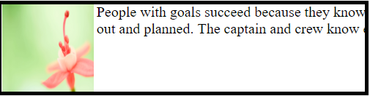
Image Handling
A well constructed image showing the product at its best. Images could be more powerful than any cleaver description.
The <img> tag defines an image in an HTML page.The <img> tag has two required attributes: src and alt. If Images are not inserted into an HTML page, it creates a holding space for the referenced image.
Attributes : Align {bottom ,middle ,left, right} ,Alt ,Height , Width
<img src="C:/Windows/Web/Wallpaper/Theme2/img11.jpg"alt="Flower" height="100" width="100" align="right"><p>People with goals succeed because they know where they're going. Now think of a ship leaving a harbor and think of it with a complete voyage mapped out and planned. The captain and crew know exactly where it's going and how long it will take. </p> OUTPUT

Slide 30

HTML Forms
Form Elements | Description
Text Field | Can create a Text Field by using Input Element with Type=‘text’ Attribute.
Password Field | When text is entered in Password Field it shows **** Symbol
Combo Box | It can have multiple values and it allows user to select one value at a time
Drop down List | It can have multiple values and allows user to select more than one value at a time
Radio Button | Can create a Radio Button by using Input Element with Value and Name Attribute
Check Box | Can create Check box by Using Input Element
Command Button | This is useful for submitting any data that is helpful in transferring data across different interfaces
Textarea | It is multiple line text field with row and column attribute
Submit Button | It is auto programmed submit button to send data
Reset Button | Reset button will clear input

Slide 31
HTML5 New Form Elements
Tag | Description
date | Selector for calendar date
number | A field containing a numeric value only
range | Numeric selector within a range of values
email | Input type should be an email.
search | Term to supply to a search engine
url | Input type should be URL type.
datetime-local | Date and time display, with no setting or indication for time zones
tel | Input type should be telephone number.
color | Color selector
datetime | Full date and time display, including a time zone.

Slide 32
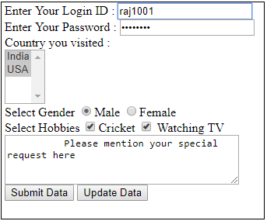
HTML Form Tags
Form Elements
<html><body><form name=“frm”>
Enter Your Login ID : <input type=text size=20><br>
Enter Your Password : <input type=password maxlength=8 size=20>
Country you visited : <br>
<select name='combo1' multiple>
<option>India</option>
<option>USA</option>
</select><br>
Select Gender
<input type=Radio value=Male name='gender' checked>Male
<input type=Radio value=Female name='gender'>Female <br>
Select Hobbies
<input type= checkbox >Cricket
<input type= checkbox > Watching TV<br>
<textarea rows="4" cols="40">
Please mention your special request here
</textarea><br>
<input type=submit value="Submit Data">
<input type=button value="Update Data">
</form></body></html>
Output
Notes:
Note: Form data can be manipulated by client side scripts like Javascript and VBScript.
GET method.
The GET method is the default method for browsers to submit information.
GET is easy to deal and fast.
All the information form the form is appended onto the end of the URL.
It is not secure because the data input appears in the URL.
Most browsers limit a URL to several thousand characters.
POST method.
Used to pass large amount of information to the server.
Contents are sent with HTTP request body, not with URL.

Slide 33
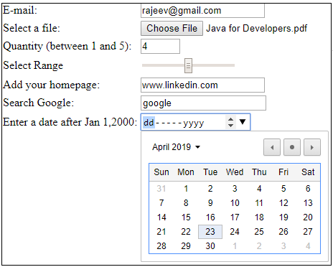
HTML 5 Form Tags (Cont.)
Form Elements
<!DOCTYPE html>
<html>
<body>
<form name=“frm1”>
E-mail: <input type="email" name="email"><br>
Select a file: <input type="file" name="myFile"><br>
Quantity (between 1 and 5):
<input type="number" name="quantity" min="1" max="5"><br>
Select Range
<input type="range" name="points" min="0" max="10"><br>
Add your homepage:
<input type="url" name="homepage"><br>
Search Google:
<input type="search" name="googlesearch">
Enter a date after Jan 1,2000:</td><td>
<input type="date" name="bday" min="2000-01-02">
</form></form>
</body>
</html>
Output
Notes:
Note: Form data can be manipulated by client side scripts like Javascript and VBScript.
GET method.
The GET method is the default method for browsers to submit information.
GET is easy to deal and fast.
All the information form the form is appended onto the end of the URL.
It is not secure because the data input appears in the URL.
Most browsers limit a URL to several thousand characters.
POST method.
Used to pass large amount of information to the server.
Contents are sent with HTTP request body, not with URL.

Slide 34
HTML 5 Audio and Video Tag
Attributes Supported by Audio \ Video Tag
autoplay Media will be played once loaded
controls Controls like pause , play will appeared
loop Audio\Video will keep on running
muted Audio\Video will
src Audio\Video source URL
Type Type of media either Audio or Video
Video format supported
MP4 video/mp4
WebM video/webm
Ogg video/ogg
Audio Format Supported
MP4 audio/mp4
WebM audio/webm
Ogg audio/ogg
HTML 5 added audio and video tag .
<video width="320" height="240" controls>
<source src="movie1.mp4" type="video/mp4">
<source src="movie1.ogg" type="video/ogg">
Your browser does not support the video tag.
</video>
<audio controls>
<source src="horse.ogg" type="audio/ogg">
<source src="horse.mp3" type="audio/mpeg">
Your browser does not support the audio tag.
</audio>

Slide 35
Elements for the BODY section
Headings
There are 6 types of heading tags.
Eg.: –
<html>
<body>
<h1>This is heading 1</h1>
<h2>This is heading 2</h2>
<h3>This is heading 3</h3>
<h4>This is heading 4</h4>
<h5>This is heading 5</h5>
<h6>This is heading 6</h6>
<p><b>Tip:</b> Use h1 to h6 elements only for headings. Do not use them just to make text bold or big. Use other tags for that.</p>
</body>
</html>
This is heading 1 This is heading 2 This is heading 3 This is heading 4 This is heading 5 This is heading 6 Tip: Use h1 to h6 elements only for headings. Do not use them just to make text bold or big. Use other tags for that.

Slide 36
Elements for the BODY section (Cont.)
<p> - Paragraph Tag and <pre> - Preformatted Tag
<p> Tag - Another way to structure your text in paragraph forms.
<Pre> Tag - is used to apply structural exactness.
Eg.:
<html>
<body>
<p>This is a paragraph of text.</p>
<p>This is a second paragraph of text.</p>
<pre>This is preformatted text with exact space,
line and breaks.</pre>
</body>
</html>
This is a paragraph of text. This is a second paragraph of text. This is preformatted text with exact space, line and breaks.

Slide 37
Elements for the BODY section (Cont.)
Text Formatting Elements
Physical markup
TT - Teletype
I - Italics
B - Bold
U - Underline
STRIKE - Strikeout
BIG - Larger text
SMALL - Smaller text
SUB - Subscript
SUP - Superscript
Logical markup
EM - Emphasized text
STRONG - Strongly emphasized
DFN - Definition of a term
CODE - Code fragment
SAMP - Sample text
KBD - Keyboard input
VAR - Variable
CITE - Short citation
Special markup
A - Anchor
IMG - Image
BASEFONT - Default font size
APPLET - Java applet
PARAM - Parameters for Java applet
FONT - Font modification
BR - Line break
MAP - Client-side imagemap
AREA - Hotzone in imagemap

Slide 38
Elements for the BODY section (Cont.)
Text Formatting Elements (Physical Markup)
Tag Description
<b>….</b> - bold.
<i>……</i> - italic.
<u>….</u> - underline.
<strike>…</strike> - strikethrough.
<sub>….</sub> - subscript.
<sup>….</sup> - superscript.
<big>….</big> - bigger font (one font size bigger).
<small>….</small> - small font (one font size smaller).
<tt>….</tt> - typewriter (monospaced).

Slide 39
Elements for the BODY section (Cont.)
Character Entities
Some characters like the < character, have a special meaning in HTML, and therefore cannot be used in the text. The most common character entities:
Result | Description | Entity Name
< > & “ ‘ | non-breaking space less than greater than ampersand quotation mark apostrophe | &nbsp; &lt; &gt; &amp; &quot; &apos;
Some Other Commonly Used Character Entities
© ® £ ¥ | copyright registered trademark pound yen | &copy; &reg; &pound; &yen;

Slide 40
HTML 5 Advancement
Advance version of HTML.
In 2008, the first HTML5 public draft was released
HTML5 W3C Final Recommendation was released 28. October 2014.
New elements, attributes, and behaviors were introduced.
It helps to create more powerful website and interactive web applications.
HTML5 comes with XML syntax.
HTML5 is to compete with Flash and Silverlight.
Empowering Mobile devices.

Slide 41
Technical Advantages Over Previous Version.
Audio and Videos are integral part of HTML5 specifications e.g. <audio> and<video> tags.
Vector graphics is integral part of HTML5 e.g. SVG and canvas.
JS GeoLocation API in HTML5 helps identify location of user browsing any website (provided user allows it).
Full duplex communication channels can be established with Server using Web Sockets.
Allows JavaScript to run in background. This is possible due to JS Web worker API in HTML5.
Application Cache, Web SQL database and Web storage is available as client side storage.
Retain Backward Compatibility with previous versions of HTML5.

Slide 42
HTML5 Technology Functions
Semantics: allowing you to describe more precisely what your content is.
Connectivity: allowing you to communicate with the server in new and innovative ways.
Offline & Storage: allowing web pages to store data on the client-side locally and operate offline more efficiently.
Multimedia: making video and audio first-class citizens in the Open Web.
2D/3D Graphics & Effects: allowing a much more diverse range of presentation options.
Performance & Integration: providing greater speed optimization and better usage of computer hardware.
Device Access: allowing for the usage of various input and output devices.
Styling: letting authors write more sophisticated themes.

Slide 43
HTML5 New Tags and Elements
HTML5 Indroduces 28 New Elements, Some of them are mentioned here.
Navigation:
<article>
<aside>
<header>
<hgroup>
<footer>
<figure>
<figcaption>
<nav>
<section>
Multimedia/Interactivity:
<audio>
<canvas>
<embed>
<source>
<track>
<video>
New <input> types:
color
date
datetime
datetime-local
email
month
number
range
search
tel
time
url
week
Miscellaneous:
<bdi>
<command>
<datalist>
<details>
<keygen>
<mark>
<meter>
<output>
<progress>
<summary>
<rp>
<rt>
<ruby>
<time>
<wbr>

Slide 44
Elements removed in HTML5
Element | Use instead
<acronym> | <abbr>
<applet> | <object>
<basefont> | CSS
<big> | CSS
<center> | CSS
<dir> | <ul>
<font> | CSS
<frame>
<frameset>
<noframes>
<strike> | CSS
<tt> | CSS

Slide 45
Migration from HTML4 to HTML5
HTML4 | HTML5
<div id="header"> | <header>
<div id="menu"> | <nav>
<div id="content"> | <section>
<div id="post"> | <article>
<div id="footer"> | <footer>

Slide 46
Defining HTML5 Documents
Remember the DOCTYPE declaration-
<!DOCTYPE html>
Again, HTML5 simplifies this line:
<html lang="en">
The default character encoding (charset) declaration
<meta charset="UTF-8">
Notes:
Program –
<!doctype html>
<html lang="en">
<head>
<meta charset="utf-8">
<title>Welcome to Snapdeal Academy</title>
</head>
<body>
</body>
</html>

Slide 47
Graphics API
(Canvas and SVG)
Previously possible with Flash, VML, Silverlight.
Very complex to do in JavaScript without plugins (for example, rounded corners or diagonal lines).
Provide native drawing functionality on the Web.
Completely integrated into HTML5 documents (Part of DOM).
Can be styled with CSS.
Can be controlled with JavaScript.

Slide 48
(Canvas and SVG)
Both have their own unique features and can be used combined.
Canvas | SVG
Low level | High Level
Immediate mode | Retained mode
Fixed size | Scalable
Best for keyboard-based apps | Best for mouse-based apps
Animation (no object storage) | Medium animation
Pixels | XML object model
No interaction | User interaction (hit detection, events on the tree)

Slide 49
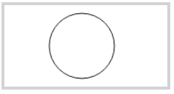
Canvas
<canvas> element as “a resolution-dependent bitmap canvas which can be used for rendering graphs, game graphics, or other visual images on the fly.” Canvas is a rectangle in your page where you can use JavaScript to draw anything you want and CSS for styling. In 2D context and 3D context (Web GL).
Eg.:
<canvas id="myCanvas" width="200" height="100" style="border:4px solid #d3d3d3;"> Your browser does not support the HTML5 canvas tag.</canvas> <script> var c = document.getElementById("myCanvas"); var ctx = c.getContext("2d"); ctx.beginPath(); ctx.arc(95,50,40,0,2*Math.PI); ctx.stroke(); </script>

Slide 50


SVG – Scalable Vector Graphics
<svg> element Modularized, XML-based language for describing 2D vector and mixed vector/raster graphics. You can zoom SVG graphics to any level.
Eg.:
<svg width="100" height="100"> <circle cx="50" cy="50" r="40" stroke="blue" stroke-width="4" fill="orange" /> Sorry, your browser does not support inline SVG. </svg> <br> <svg width="300" height="200"> <polygon points="100,10 40,198 190,78 10,78 160,198" style="fill:red;stroke:black;stroke-width:5;fill-rule:evenodd;" /> Sorry, your browser does not support inline SVG. </svg>

Slide 51
HTML5 Media Elements - Audio and Video
<audio> and <video>- are two new HTML5 media elements can be controlled using Audio/Video API, have native support in the browser (Embedded Codecs).
AV Containers and Codecs
Audio and Video containers H264 and Ogg.
Audio and Video codecs (algorithm used to encode and decode an audio or video stream) Audio – AAC, MP3, Vorbis. Video – H264, MP4, Theora.
You can add multiple formats per (Audio/Video).
Refer note section for code example-
Notes:
HTML <video> Element
<video width="320" height="240" controls>
<source src="movie.mp4" type="video/mp4">
<source src="movie.ogg" type="video/ogg">
Your browser does not support the video tag.
</video>
HTML <audio> Element
<audio controls> <source src="horse.ogg" type="audio/ogg"> <source src="horse.mp3" type="audio/mpeg"> Your browser does not support the audio element. </audio>

Slide 52
HTML5 Plug-ins
To extend the functionality of the HTML browser. Plug-ins are also known as Helper Applications. Popular example of plug-ins are Java applets. Plug-ins can be added to web pages with the <object> tag or the <embed> tag.
<object> Element – It is used to embed plug-ins (like Java applets, PDF readers, Flash Players) in web pages.
Eg.: <object width=“200" height=“60" data=“SnapdealAcademy.swf"></object>
<embed> Element – Used to embed object within an HTML document. It does not have closing tag.
Eg.: <embed width=“200" height=“60" src="SnapdealAcademy.swf">

Slide 53
HTML5 Geolocation
It
It allows users to share their location for location-aware services.
Show user’s position on map.
Tag content (Photos/Sound/Video).
Turn-by-Turn Navigation.
Alert users of nearby points of interest.
Social Networking.
Notes:
Location Data
Location information consists of a pair of latitude and longitude coordinated and accuracy information- Latitude is the numerical value indicating distance north or south of the equator. Longitude is the numerical value indicating distance East or West of Greenwich. For Eg.: Taj Mahal, Latitude : 27.1750, Longitude : 78.0419
Coordinates are always returned in decimal format.
Depending on the device, additional meta data can be provided:
Altitude, Altitude Accuracy, Heading, Speed.
In this additional metadata is not available it will be returned as a null value.
Location Source
A Device can use any of the following sources:
IP Address.
Coordinate Triangulation.
GPS.
Wi-fi with MAC addresses.
GSM or CDMA cell phone IDs.
User Defined.
Geolocation Code (Ref. w3c)-
<script> var x = document.getElementById("demo"); function getLocation() { if (navigator.geolocation) { navigator.geolocation.getCurrentPosition(showPosition); } else { x.innerHTML = "Geolocation is not supported by this browser."; } } function showPosition(position) { x.innerHTML = "Latitude: " + position.coords.latitude + "<br>Longitude: " + position.coords.longitude; } </script>

Slide 54
HTML Drag and Drop
It
In HTML5, drag, and drop is part of the standard, and any element can be draggable. In order to make another HTML element draggable, three things must be done:
Set the draggable attribute to true on the element that you wish to make draggable.
Add a listener for the dragstart event
Set the drag data within the listener defined above.
Notes:
Drag and Drop Code (Ref. w3c)-
<!DOCTYPE HTML> <html> <head> <script> function allowDrop(ev) { ev.preventDefault(); } function drag(ev) { ev.dataTransfer.setData("text", ev.target.id); } function drop(ev) { ev.preventDefault(); var data = ev.dataTransfer.getData("text"); ev.target.appendChild(document.getElementById(data)); } </script> </head> <body> <div id="div1" ondrop="drop(event)" ondragover="allowDrop(event)"></div> <img id="drag1" src="img_logo.gif" draggable="true" ondragstart="drag(event)" width="336" height="69"> </body> </html>

Slide 55
HTML5 Local Storage
With local storage, web applications can store data locally within the user's browser. Local storage don’t use cookies unlike previous versions, it is more secure and can store large amounts of data locally, without any performance issue.
It provides two objects for storing data on the client:
window.localStorage - stores data with no expiration date.
window.sessionStorage - stores data for one session (data is lost when the tab is closed).

Slide 56
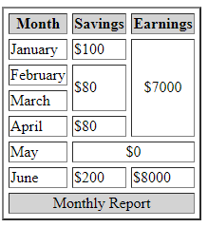
Lab Exercises
Lab1 : Create a HTML List below description . [ Suggested file name : Mylist.Html ]’
India
Delhi
Mumbai
Kolkata
Chennai
USA
New York
Los Angeles
Houston
Phoenix
Lab2 : Create a HTML page with 3 columns having 5 countries name , their capital and national flag image . [Suggested file name : country_capital.html ]
Lab3 : Create following table structure and contents , Hint : Use only HTML tags and attributes.

Slide 57
Lab Exercises
Lab4 : Create 3 webpage with one paragraph about yourself , your hobbies and education . Link these pages to navigate from one to another . [Suggested page names : Myself.html,Myhobbies.html and Myeducation.html]
Lab5 : Create a HTML registration page with label Name , Password , Email , DOB [Calendar] , Gender [select from radio button] , Hobbies , Country [choose from drop down] and submit button . Label and form component must be aligned horizontally and vertically .

