Slide 1

Java Script

Slide 2
Objectives
In this session, you will learn to:
Identify the structure of a JavaScript program
Validate form using JavaScript
Control program flow
Identify object in JavaScript

Slide 3


Overview of JavaScript
Let us first understand how the data gets validated in a simple HTML form.

Slide 4
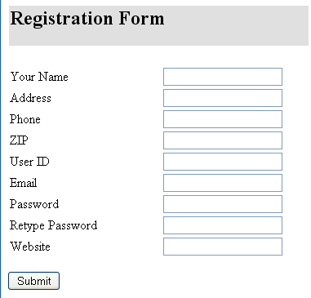

Overview of JavaScript (Contd.)
The following figure depicts steps of the form validation.
Data entered by the user is sent to the server for validation.
Web Server
This Web page requires the users to enter all the details asked on the page.
The server, after verifying the data, returns the data to the client computer.
Client

Slide 5
Scripting with JavaScript
This process of sending data repeatedly to the server results in extensive traffic over the network. To avoid this, you can use a scripting language.

Slide 6

Scripting with JavaScript (Contd.)
What is scripting Language?

Slide 7
Scripting with JavaScript (Contd.)
Scripting language:
Is a programming language that can be used for Web-based programming.
Is interpreted at run time.
Is generally embedded in a Web page.

Slide 8
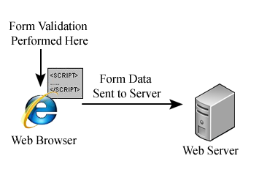
Identify JavaScript
JavaScript:
is a lightweight and object-based interpreted programming language.
Is designed for creating network-centric applications.
Is a complementary to and integrated with Java.
Is a complementary to and integrated with HTML.
Is open and cross-platform.
The following figure depicts how the client-side form validation is performed on client PC with JavaScript embedded in the Web page.

Slide 9
Advantages of JavaScript
JavaScript comprises the following advantages:
Less server interaction: It help users to validate their inputs before sending the page off to the server. This saves server traffic therefore servers get less load.
Immediate response to the users: They don't have to wait for a page reload to see if they have forgotten to enter something.
Increased interactivity: You can create interfaces that react when the user hovers over them with a mouse or activates them via the keyboard.
Richer interfaces: You can use JavaScript to include such items as drag-and-drop components and sliders to give a Rich Interface to your site visitors.

Slide 10
Limitation of JavaScript
Though JavaScript is a powerful scripting language however it has the following limitations:
Client-side JavaScript does not allow its user to read or write of files. This has been kept for security reason.
JavaScript cannot be used for networking applications because there is no such support available.
JavaScript doesn't have the multithreading or multiprocessor capabilities.

Slide 11

Java vs JavaScript
Is JavaScript a part of Java?

Slide 12

Java vs JavaScript (Contd.)
The following figure depicts the difference between Java and JavaScript
Java
JavaScript
Java is an Object Oriented Programming (OOP) language.
Java can stand on its own.
Java creates applications that run in a virtual machine or browser.
Java is a much larger and more complicated language that creates "standalone" applications.
Java file is saved with .java extension.
JavaScript is a object- based scripting language.
JavaScript must (primarily) be placed inside an HTML document to function.
JavaScript code is run on a browser only.
JavaScript is text that is fed into a browser that can interpret it and then it is enacted by the browser.
JavaScript file is saved with .js extension.

Slide 13
Client-Side Script vs Server-Side Script
How client-side script is different from server-side script?

Slide 14
Client-Side Script vs Server-Side Script (Contd.)
The following figure depicts the difference between client-side and server-side script
Client-side Script
Server-side script
Client-side scripts provide a front-end to websites for validating and processing client requests.
Client-side script is embedded into an HTML page and is executed by a Web browser.
Client-side scripts are mostly used to validate the data entered by the users.
The client-side scripts are visible to the users.
Statements are embedded within <SCRIPT> </SCRIPT> tags.
Server-side scripts provide a back-end to websites for processing client requests on the Web server.
Server-side script is embedded into an HTML page and is executed on a Web server.
Server-side scripts are mostly used to handle database-related requests and manipulate data.
The server-side scripts are not visible to the users.
Statements are embedded within <SERVER></SERVER> tags.

Slide 15
Structure of JavaScript Program
The JavaScript code integrated into an HTML file is interpreted and executed by the Web browser.
The <SCRIPT> and </SCRIPT> tags are used to mark the beginning and end of the JavaScript code.
The <SCRIPT> tag may contain the LANGUAGE attribute, which indicates the scripting language to be used for writing the scripting code.
JavaScript code can be embedded in:
The header of the page
The body of the page
An external file

Slide 16
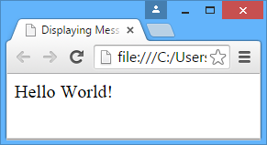
Structure of JavaScript Program (Contd.)
The following code displays the inclusion of the JavaScript code within the header of a Web page:
First.html
<HTML>
<HEAD>
<TITLE>Displaying Message</TITLE>
<SCRIPT LANGUAGE="JavaScript">
/* Prints Hello World! on the screen.*/
document.write("Hello World!");
</SCRIPT>
</HEAD>
<BODY></BODY>
</HTML>
Output

Slide 17
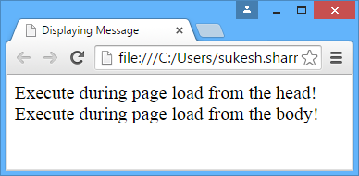
Structure of JavaScript Program (Contd.)
The following code displays the inclusion of the JavaScript code within the header and body part of a Web page:
First.html
<HTML>
<HEAD>
<TITLE>Displaying Message</TITLE>
<SCRIPT LANGUAGE="JavaScript">
/*JavaScript code in header section*/
document.write("Execute during page load from the head! <br>");
</SCRIPT>
</HEAD>
<BODY>
<SCRIPT LANGUAGE="JavaScript">
/*JavaScript code in body section*/
document.write("Execute during page load from the body! <br>");
</SCRIPT>
</BODY>
</HTML>
Output

Slide 18
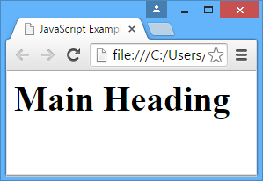
Structure of JavaScript Program (Contd.)
The following code displays the inclusion of the JavaScript code within the header and body part of a Web page:
First.html
Functions.js
function getHeader() {
return "<h1>Main Heading</h1>";
}
<html>
<head>
<title>JavaScript Example</title>
<script type="text/javascript" src="functions.js">
</script>
</head>
<body>
<script type="text/javascript">
document.write(getHeader());
</script>
</body>
</html>
Output

Slide 19

Rules and and Conventions Used in JavaScript
What are the rules and conventions used in JavaScript?

Slide 20
Rules and Conventions Used in JavaScript (Contd.)
Basic rules and conventions used in JavaScript are:
Semicolon:
When two or more statements are written on a single line, they must be separated by a semicolon.
Comments:
Are ignored by the interpreter.
Are added to enhance the readability and understandability of the code.
Quotes:
You can use either double quotation marks (" ") or single quotation marks (' ') to enclose a string of characters.
Case sensitivity:
JavaScript is a case-sensitive scripting language.

Slide 21
Common JavaScript Concepts
The following list provides the building blocks of a JavaScript program:
Variables: are used to store values in computer memory.
Operators: are used to perform computations on variables and constants.
Expressions: are a combination of values, variables, and operators and are used to perform computations.
Functions: are a block of statements that perform a particular task.

Slide 22
Working With Variables and Data
Variables, data types, operators, and expressions form the core of any programming language, including JavaScript.
Keywords:
Are predefined identifiers.
Perform unique pre-defined functions, such as declaring variables (var) and defining functions (function).
Cannot be used as names for variables, functions, objects, or methods.
For example:
Break, continue, do, else, for, int, boolean, return, abstract, final, catch, class, byte, and function.

Slide 23
Variables
Variables can hold different types of data.
Datatypes:
Can be classified into the following categories:
Numeric
String
Boolean
The variable naming rules and conventions for JavaScript are:
The first character of the variable must begin with an alphabet or the underscore (_) character.
In a combination of two or more words, the first character of each word except that of the first word should be capitalized.
JavaScript is case sensitive.
Variable declaration is implicit.

Slide 24
Variables (Contd.)
A variable can be declared using the var keyword. For example:
var firstName;
Literals:
Are actual data values and are fixed values that are assigned to variables.
Can be classified into the following categories:
String literal i.e. var name = "David";
Integer literal. i.e. var age = 10;
Floating-point literal i.e. var salary = 6000.50;
Scope of a variable:
A variable can be accessed either in the function in which it is declared or in any other function.
Depending upon the accessibility of the variable, it can be categorized into the following variables:
Local Variables: are declared with in a function.
Global Variables: are declared outside the function definition.

Slide 25
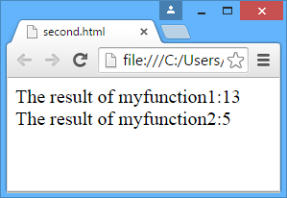
Variables (Contd.)
The following code shows the use of the local and global variables:
second.html
<HTML>
<HEAD>
<SCRIPT language="JavaScript">
var a;//Global variable
var b=2; //Global variable
var result=0; //Global variable
function myfunction1()
{
var b=10; //Local variable
result=a+b;
document.write("The result of myfunction1:"+ result + "<BR>");
}
function myfunction2(){
result=a+b;
document.write("The result of myfunction2:"+result+ "<BR>");
}
function Calculate()
{a=parseInt(form1.txtNum.value);
myfunction1();
myfunction2();
}
</SCRIPT>
</HEAD>
<BODY>
<FORM NAME="form1">
Enter Value: <INPUT TYPE="text" NAME="txtNum">
<INPUT TYPE="button" Value="Calculate" onClick='Calculate()'>
</FORM>
</BODY>
</HTML>
Output

Slide 26
Operator
Operators:
Are used to perform computations, such as addition, subtraction, comparison, and concatenation on operands. Operator are of the following types:
Arithmetic (+, -, %, /)
Logical (&&, !, ||)
Comparison (==,===, !, =, >)
String (+)
Assignment (=, +=, -=)
Conditional (?:)
The following table lists some other operators included in JavaScript.
Operator | Description | Example | Return Value
delete | Deletes a property of an object or an element in the array index. | delete Arr[5] | Deletes the sixth element of the array, Arr.
new | Creates an instance of an object type. | Arr=new Array() | Assigns memory for the array, Arr.
typeof | Returns a string value that identifies the data type of an operand. | A= typeof 17 | The value assigned to A is number.

Slide 27
Operator
Operator precedence determines the order in which the operators in an expression are evaluated.
The following table lists the precedence of the JavaScript operators.
Precedence | Operator
1 | Parentheses, function calls, or array subscripts
2 | ! , ~, -, ++, --, typeof, new, delete
3 | *, /, %
4 | +, -
5 | <<, >>, >>>
6 | <, <=, >, >=
7 | ==, !=, ===, !==
8 | &
9 | ^
10 | &&
11 | ||
12 | ?:
13 | =, +=, -=, *=, /=, %=, <<=, >>=, >>>=, &=, ^=, |=
14 | The comma(,) operator

Slide 28
Expression
Expression:
Is a part of a statement that is evaluated as a value.
Can use any combination of variables, literals, and operators.
Is of the following types:
Assignment expression
Arithmetic expression
String expression
Logical expression

Slide 29
Introducing Functions and Events
Events are used to add dynamism to Web pages by making the Web pages respond to user actions, such as mouse clicks, mouse movements, or key presses.
Functions:
Perform specific tasks and can be used repetitively throughout the program.
Consist of the following features:
Reusability
Modularity
Overall programming simplicity
Are of the following types:
Built-in functions
User-defined functions

Slide 30
Built-In Functions
Built-in functions:
Are already coded to ease the programmer's task.
Supported by JavaScript are:
isNaN()
parseInt()
parseFloat()
eval()
The isNAN()function Helps to determine if an argument is not a number.
The parseInt()function parses the string argument and returns an integer.
The parseFloat()function accepts a string argument and returns a floating point number.
The eval()function evaluates any JavaScript statement or expression stored as a string, which also includes string equivalents of arithmetic expressions.

Slide 31
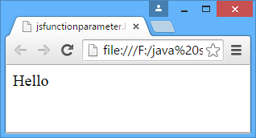
User-Defined Functions
User-defined functions:
You can also create customized functions in your program to enhance readability and efficiency.
To use functions effectively, you need to know:
How to declare a user-defined function.
How to pass arguments.
How to return a value.
How to call a user-defined function from the main program.
For example:
<html>
<head>
<script type="text/javascript">
function myfunction(txt){
Document.write(txt);
}
</script>
</head>
<body onload="myfunction('Hello')">
</body>
</html>
Output

Slide 32
Identifying Different Types of Dialog Box
Commonly used built-in methods:
JavaScript follows an object model where each object has its own methods.
Methods are actions that an object can be made to perform.
The following methods are commonly used in JavaScript:
alert()
prompt()
Confirm()

Slide 33
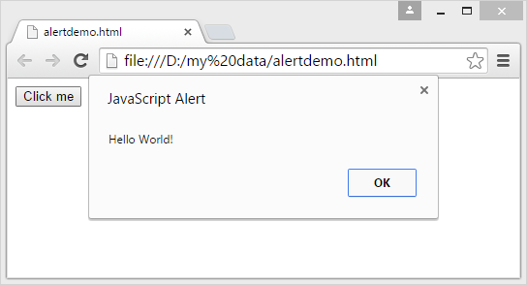
Identifying Different Types of Dialog Box (Contd.)
The alert()method:
Is used to display messages to the user.
Syntax:
alert("Message to the user");
For example:
function alertMethod()
{
alert("Hello World!");
}
Output

Slide 34
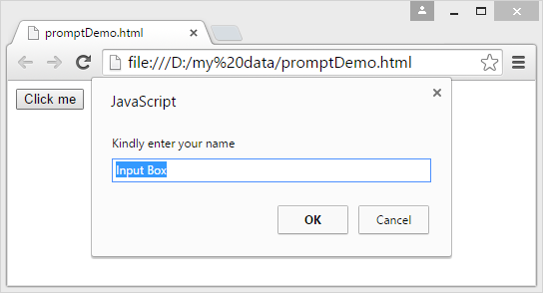
Identifying Different Types of Dialog Box (Contd.)
The prompt()method:
Is used to display a dialog box with an appropriate message.
Syntax:
prompt("Message to the user");
For example:
function promptMethod()
{
prompt("Kindly enter your name", "Input Box");
}
Output

Slide 35
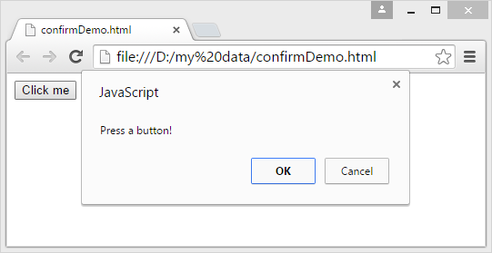
Identifying Different Types of Dialog Box (Contd.)
The confirm()method:
Is used to display a dialog box with a message and an OK and a Cancel button.
Syntax:
confirm("Press a button!");
For example:
function confirmMethod()
{
confirm("Press a button!");
}
Output

Slide 36
Defining Program Behavior
Program behavior refers to the output of a program when the user interacts with the program.
In JavaScript, events are actions that occur as a result of the user interaction with the Web pages or other browser-related activities.
The function, which is executed in response to some event, is called an event handler.
The following figure displays the event handling process.
Performs an action
Generates an event
USER
BROWSER
EVENT HANDLER
Browser displays output
Processes the event and sends output

Slide 37
Defining Program Behavior (Contd.)
The following table lists the different events supported by JavaScript and their description.
Event | Description
click | Is generated when a user clicks on a form element or on a link.
change | Is generated when a user changes the value of a form field.
focus | Is generated when a form object receives control.
load | Is generated when a page is loaded into the browser.
mouseOver | Is generated when a user moves the mouse pointer over a link, area, or object.
mouseOut | Is generated when the mouse pointer leaves the link, area, or object.
select | Is generated when a user selects a form field.
blur | Is generated when the control is removed from a form object.

Slide 38
Defining Program Behavior (Contd.)
The following table lists the different form fields and the event handlers associated with them.
Object | Event Handlers
Button | onClick
Reset | onClick
Submit | onClick
Radio | onClick
Checkbox | onClick
Link | onClick, onMouseOver, and onMouseOut
Form | onSubmit and onReset
Text | onChange, onFocus, onBlur, and onSelect

Slide 39
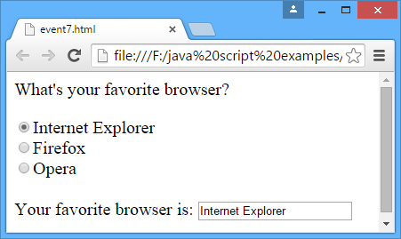
Defining Program Behavior (Contd.)
The following code illustrates onclick event:
<html>
<head>
<script type="text/javascript">
function check(browser){
document.getElementById("answer").value=browser;
}
</script>
</head>
<body>
<p>What's your favorite browser?</p>
<form>
<input type="radio" name="browser" onclick="check(this.value)" value="Internet Explorer">Internet Explorer<br />
<input type="radio" name="browser" onclick="check(this.value)" value="Firefox">Firefox<br />
<input type="radio" name="browser" onclick="check(this.value)" value="Opera">Opera<br />
<br />
Your favorite browser is: <input type="text" id="answer" size="20">
</form>
</body>
</html>
Output

Slide 40
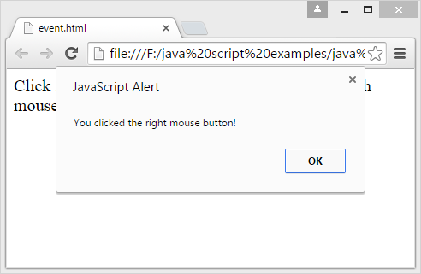
Defining Program Behavior (Contd.)
The following code illustrates onmousedown event:
<html>
<head>
<script type="text/javascript">
function whichButton(event)
{
if (event.button==2)
{
alert("You clicked the right mouse button!");
}
else
{
alert("You clicked the left mouse button!");
}
}
</script>
</head>
<body onmousedown="whichButton(event)">
<p>Click in the document. An alert box will alert which mouse button you clicked.</p>
</body>
</html>
Output

Slide 41
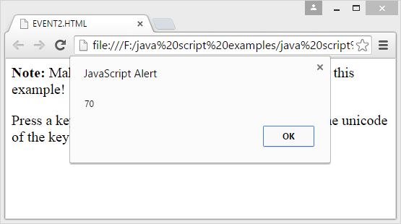
Defining Program Behavior (Contd.)
The following code illustrates onkeyup event:
<html>
<head>
<script type="text/javascript">
function whichButton(event)
{
alert(event.keyCode);
}
</script>
</head>
<body onkeyup="whichButton(event)">
<p>Press a key on your keyboard. An alert box will alert the unicode of the key pressed.</p>
</body>
</html>
Output

Slide 42
Controlling Program Flow
All programming languages offer programming constructs for constructing a program.
There are the following types of programming constructs:
Decision-making or conditional constructs
Iterative constructs or looping constructs

Slide 43
Using Decision-Making Constructs
Decision-making constructs:
Provide the facility to execute a portion of a program only once.
Are of the following types:
if…else construct
switch…case construct
The if…else construct:
Is the primary decision-making construct of any programming language.
Allows for the conditional branching of code.
Syntax:
if (boolean expression) {
Statements to be executed if expression is true
}
else {
Statements to be executed if expression is false
}

Slide 44
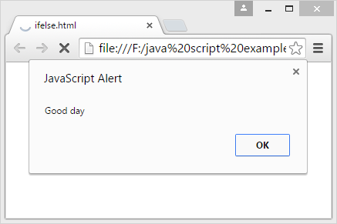
Using Decision-Making Constructs (Contd.)
The following code illustrates the if else constructs:
<html>
<body>
<script type="text/javascript">
var d = new Date();
var time = d.getHours();
if (time < 10) {
alert("Good morning");
}
else {
alert("Good day");
}
</script>
<p>
If the time on your browser is less than 10,
you will get a "Good morning" greeting.
Otherwise you will get a "Good day" greeting.
</p>
</body>
</html>
Output

Slide 45
Using Decision-Making Constructs (Contd.)
The switch case construct:
Compares the value of a variable against multiple constant values that the variable can contain.
Syntax:
switch(variableName)
{
case "str1":
//Statements to be executed if variableName is equal to str1
break;
case "str2":
//Statements to be executed if variableName is equal to str2
break;
default:
//Statements to be executed if variableName is not equal to str1 and str2
}

Slide 46
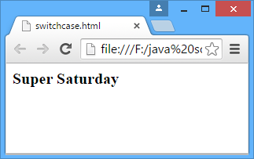
Using Decision-Making Constructs (Contd.)
The following code illustrates the switch case constructs:
<html>
<body>
<script type="text/javascript">
var d = new Date();
theDay=d.getDay();
switch (theDay) {
case 5:
document.write("<b>Finally Friday</b>");
break;
case 6:
document.write("<b>Super Saturday</b>");
break;
case 0:
document.write("<b>Sleepy Sunday</b>");
break;
default:
document.write("<b>I'm really looking forward to this weekend!</b>");
}
</script>
</body>
</html>
Output

Slide 47
Using Iterative Constructs
The Iterative constructs are of the following types:
while construct
do-while construct
for construct
The while construct:
Is used to execute a code till the time the given condition continues to hold true.
Syntax:
while (Boolean expression)
{
//Execute one or more statements
}

Slide 48
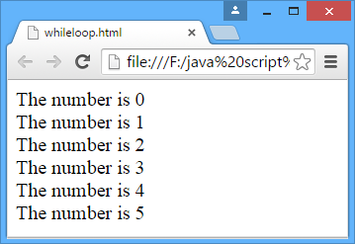
Using Iterative Constructs(Contd.)
The following code illustrates the while constructs:
<html>
<body>
<script type="text/javascript">
i=0;
while (i<=5)
{
document.write("The number is " + i);
document.write("<br />");
i++;
}
</script>
</body>
</html>
Output

Slide 49
Using Iterative Constructs (Contd.)
The do-while construct:
Does not check the condition for the first time.
Is used to execute a code at least once, and then the boolean condition is evaluated.
Syntax:
do
{
//Statements to be executed
}while(condition a);

Slide 50
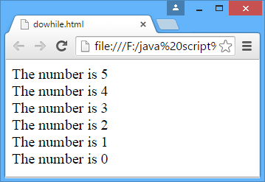
Using Iterative Constructs(Contd.)
The following code illustrates the do-while constructs:
<html>
<body>
<script type="text/javascript">
i = 5;
do
{
document.write("The number is " + i);
document.write("<br />");
i--;
}
while (i >= 0);
</script>
</body>
</html>
Output

Slide 51
Using Iterative Constructs (Contd.)
The for construct:
Is used to execute a group of statements repeatedly, based on some condition.
Syntax:
for(x=initial_Value; condition; x increment/decrement)
{
Statements to be executed
}

Slide 52
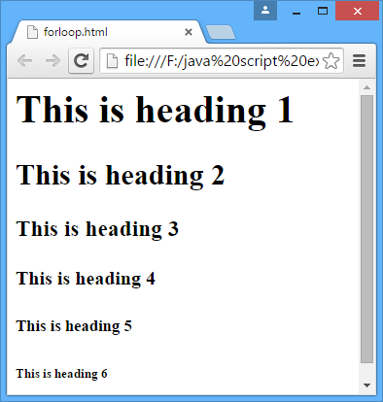
Using Iterative Constructs(Contd.)
The following code illustrates the for constructs:
<html>
<body>
<script type="text/javascript">
for (i = 1; i <= 6; i++)
{
document.write("<h" + i + ">This is heading " + i);
document.write("</h" + i + ">");
}
</script>
</body>
</html>
Output

Slide 53
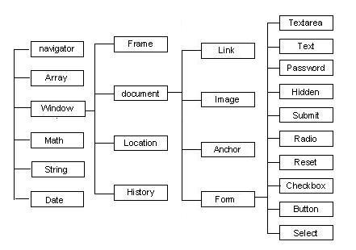
Introducing the JavaScript Object Model
JavaScript objects are used to manipulate the components of a Web page.
The window object is the default object in the document object model of an HTML document. It contains many objects and does not need to be referenced by name.
The JavaScript objects are arranged in a hierarchical order, as shown in the following figure.
Java Script Object Hierarchy

Slide 54
Types of Objects
The window object:
Is one of the highest-level objects in the JavaScript object hierarchy.
Represents the content area of the browser window that can be divided into multiple frames or sub-regions.
Syntax:
<windowobject>.property=<value>;
For example:
<windowobject>.status="Text";

Slide 55
Types of Objects (Contd.)
The following table lists some properties of the window object.
Properties | Description
defaultStatus | Is a string value containing the default status bar text. The status bar text is a string assigned by the user that is displayed when the mouse pointer is moved over the window. By default, the status bar text is an empty string.
frames[] | Is a collection of frames in a window. You can refer to a particular frame in a window by specifying its frame number within the [ ] of the frames [ ] property.
length | Is an integer value representing the number of frames in the parent window.
name | Is a string value containing the name of the window or the frame.
parent | Is a string value containing the name of the parent window.
self | Is a string value containing the name of the current window.
status | Is a string value and is used to set the text on the status bar of the window.

Slide 56
Types of Objects (Contd.)
Some of the widely used methods of the window object are:
open()
close()
alert()
prompt()
Confirm()
The open()method:
Opens a Web page in the current window or in a new browser window.
Syntax:
open("URL","Window Name","Attributes");
For example:
sWindowName=open("http://www.hotmail.com","Hotmail" ,"scrollbars=1,status=1");

Slide 57
Types of Objects (Contd.)
The following table lists the properties that can be specified in the Attributes argument of the open()method.
Properties | Description
toolbar | Creates the Standard toolbar with buttons such as Back and Forward.
location | Creates the location entry field displaying the current URL.
directories | Creates the standard directory buttons, such as What's New and What's Cool that provides related information. Directory buttons in a Web browser access Web pages that contain information on how to browse the World Wide Web.
status | Creates the status bar at the bottom of the browser window.
menubar | Creates the menu bar at the top of the window.
scrollbars | Creates scroll bars, which can be used when the Web page grows beyond the size of the current window.

Slide 58
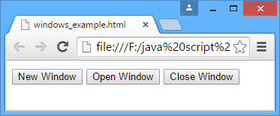
Types of Objects (Contd.)
The following code illustrate the use of the window object.
<HTML>
<HEAD>
<SCRIPT> //Declaration of Global variable
var sWindowName;
function fnNewWindow()
{
alert("New Window ahead....");
sWindowName=open("","Window","scrollbars=1,status=1");
status="Clicked the New Window Option";
}
function fnOpenWindow()
{
alert("Opening..patience required");
sWindowName=open("http://www.hotmail.com","Hotmail","scrollbars=1,status=1");
status="Clicked the Open Window Option";
}
function fnCloseWindow()
{
alert("Thank you...");
sWindowName.close();
status="Clicked the Close Window Option";
}
</SCRIPT>
</HEAD>
<BODY>
<INPUT type="Button" name="btNewWindow" value="New Window" onClick="fnNewWindow()">
<INPUT type="Button" name="btOpenWindow" value="Open Window" onClick="fnOpenWindow()">
<INPUT type="Button" name="btCloseWindow" value="Close Window" onClick="fnCloseWindow()">
</BODY>
</HTML>
Output

Slide 59
Types of Objects (Contd.)
The two event handlers used to handle all the events generated by the window object are:
onLoad: Executed when a Web page is loaded in a frame or a window.
onUnload: Executed when a frame or a window in a Web page is exited or closed
The document object:
Is subordinate to the window object in the document object model hierarchy.
Provides the properties and methods to work with many aspects of the current document, including information about anchors, forms, links, title, current location and URL, and the current colors.
Two of the widely used methods of the document object are:
write()
writeln()

Slide 60
Types of Objects (Contd.)
The following table lists some of the properties of the document object.
Properties | Description
alinkColor | Is a string value representing the color for active links.
anchors[] | Is an array object containing references to all the elements in an <A> tag.
bgColor | Is a string value representing the background color of the document.
cookie | Is a string value containing name=value pairs of data that will persist in the memory of the client computer until the Web browser is cleared, if no expiration date is present. The data will also persist in the memory until the expiration date is reached.
fgColor | Is a string value representing the text color of the document.
linkColor | Is a string value representing the color of the unvisited links.
lastModified | Is a string value representing the date and time when the document was last modified.
links[] | Is an array object containing references of all elements in the <A> tag and the elements that use the <AREA> tag.
location | Is a string value representing the current URL.

Slide 61
Types of Objects (Contd.)
The history object:
Contains a list of all the pages that have been visited in the browser window.
Has the following methods:
back(): is used to move to the previous page.
forward(): is used to move to the next page.
go(x): is used to move back x pages.
For example:
<html>
<body>
<input type="button" value=" go forward " onclick="history.forward()">
<input type="button" value="go back" onclick="history.back()">
<input type="button" value="go back" onclick="history.go(-2)">
</body>
</html>

Slide 62
Types of Objects (Contd.)
The location object:
Is used to enable navigation to different URLs on the Internet through JavaScript.
Properties consist of various pieces of information that make up a complete URL. The syntax of a complete URL is:
protocol://hostname/pathname/search#hash
For example:
<html>
<head>
</head>
<body>
<input type="button" value="open“ onclick = "location.href = 'http://www.google.com'">
</body>
</html>

Slide 63
Types of Objects (Contd.)
The navigator object:
Is an independent object that has its own set of properties and methods.
Is used to determine the latest features supported by a particular Web browser, such as browser version, user platform, and plug-ins.
Does not have any events associated with it.
For example:
<html>
<head>
</head>
<body>
<SCRIPT LANGUAGE = JavaScript>
function callme(){
alert("Your Browser is: " + navigator.appName+"\n web browser version "+navigator.appVersion);
}
</SCRIPT>
<input type="button" value="open " onclick= "callme()">
</body>
</html>

Slide 64
Introducing JavaScript Language Objects
JavaScript supports the following built-in language objects:
String object
Array object
Date object
Math object
String object:
Is one of the highest-level language objects in the JavaScript object hierarchy.
Can be created by using the assignment operator.
Syntax: var create_string= new String ([“stringExpression”])

Slide 65
Introducing JavaScript Language Objects (Contd.)
The following table lists some of the String object methods.
The following code snippet shows the use of the slice() method:
var strval="Hello World!";
document.write(strval.slice(6));
Methods | Description
charCodeAt() | Returns integer character code from a character.
concat() | Returns a concatenated string.
replace() | Matches a specified regular expression with a string and replaces the match with a specified substring.
slice() | Slices a section of a specified string and returns a new string containing the sliced section.
substring() | Returns the characters in a string as a substring between two specified indices.
toLowerCase() | Converts a string to lowercase.
toUpperCase() | Converts a string to uppercase.
World!
Output

Slide 66
Introducing JavaScript Language Objects (Contd.)
Some of the widely used properties of the String object are:
length property
prototype property
length property:
Is used to determine the length of a string in JavaScript.
Syntax:
<string-object>.length
For example:
"Hello".length
The following code snippet shows the use of the slice() method:
var strval="Hello World!";
document.write(strval.slice(6));
5
Output

Slide 67
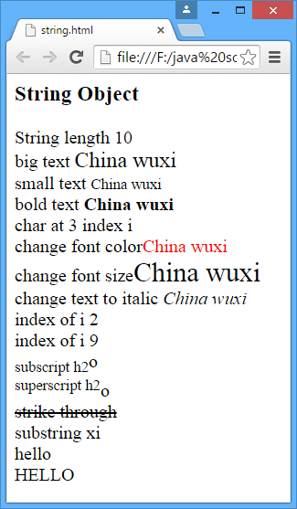
Types of Objects (Contd.)
The following code illustrates the use of various methods and properties of the String object:
<html>
<body>
<h3>String Object</h3>
<script type="text/JavaScript" language ="JavaScript">
var txt = new String("China wuxi");
document.write("String length "+txt.length );
document.write("<br>big text " + txt.big());
document.write("<br>small text " + txt.small())
document.write("<br>bold text " + txt.bold());
document.write("<br>char at 3 index "+txt.charAt(2));
document.write("<br> change font color"+txt.fontcolor("red"));
document.write("<br> change font size"+txt.fontsize(5));
document.write("<br> change text to italic "+txt.italics())
document.write("<br> index of i "+txt.indexOf("i"));
document.write("<br> index of i "+txt.lastIndexOf("i"));
document.write("<br>superscript h2".sub()+"o");
document.write("<br>subscript h2".sup()+"o");
document.write("<br>strike through".strike());
document.write("<br>substring "+txt.substring(8,10));
document.write("<br> HELLO".toLowerCase() );
document.write("<br> hello".toUpperCase() );
</script>
</body>
<html>
Output

Slide 68
Array Object
Arrays are variables used to store a sequence of values.
These values are stored in indexed locations within the array.
For example:
Names = new Array(5);
Five names can be stored in the preceding array by using the following code snippet:
Names[0] = "David";
Names[1] = "Lee";
Names[2] = "Jon";
Names[3] = "Peter";
Names[4] = "Sam";

Slide 69
Array Object (Contd.)
Dense array:
Is an array that is initially declared with each element being assigned a specific value.
For example:
day = new Array('Sunday', 'Monday', 'Tuesday','Wednesday', 'Thursday', 'Friday', 'Saturday')
You can include different types of values in the array.
The following code snippet shows how you can use different values in the same array:
mixedArray=new Array("str1", "str2", 1, 2, 4.5, true, false, new Array(7, 8, 9 ))

Slide 70
Array Object (Contd.)
The following table lists some methods associated with the Array object.
Some widely used properties of the Array object are:
length property
prototype property
Methods | Description
concat() | Returns an array object as a combination of two array objects.
join(separator_string) | Returns an array of string from an array that is separated by a specified string separator, such as comma or period.
pop() | Returns the last element of the array.
push() | Pushes a value to the end of an array.
reverse() | Reverses the order of the elements in an array.
shift() | Selects the first element of the array and removes it from the array.
sort() | Sorts the elements of an array.

Slide 71
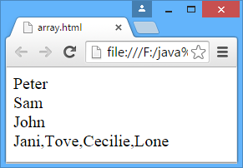
Array Object (Contd.)
The following code illustrates the use of Array object:
<html>
<body>
<script type="text/javascript">
var name1 = new Array(3);
name1[0]="Peter";
name1[1]="Sam";
name1[2]="John";
document.write(name1[0]);
document.write("<br>"+name1[1]);
document.write("<br>"+name1[2]);
var parents = ["Jani", "Tove"];
var children = ["Cecilie", "Lone"];
var family = parents.concat(children);
document.write("<br>"+family);
</script>
</body>
</html>
Output

Slide 72
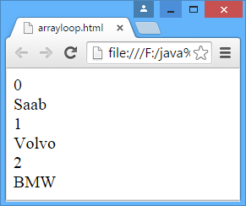
Array Object (Contd.)
The following code illustrates the use of Array object that retrieves elements using for loop:
<html>
<body>
<script type="text/javascript">
var x;
var mycars = new Array();
mycars[0] = "Saab";
mycars[1] = "Volvo";
mycars[2] = "BMW";
for (x in mycars)
{
document.write(x + "<br />");
document.write(mycars[x] + "<br />");
}
</script>
</body>
</html>
Output

Slide 73
Date Object
The Date object is used to extract parts of date and time.
Syntax:
var date_object=new Date([parameters])
The Date object supports a number of methods to handle date and time:
get(): It allows you to retrieve the date and time values stored in the Date object.
set(): It allows you to set date and time values in the Date object.
UTC(): It Returns the number of milliseconds from the date in a Date object since January 1, 1970 00:00:00 according to universal time.
parse(): It returns a date string and returns the number of milliseconds since January 01 1970 00:00:00.
to(): It returns string values from Date objects.

Slide 74
Date Object (Contd.)
The following table lists some methods associated with the Date object.
Methods | Description
getTime() | Returns the number of milliseconds since January 1, 1970 00:00:00.
getYear() | Returns the current year.
getMonth() | Returns the current month.
getDate() | Returns the current date between 1 and 31.
getHours() | Returns the current hours in the range 0 to 23.
setTime() | Sets the number of milliseconds since January 1, 1970 00:00:00.
toGMTString() | TReturns the date string in the universal format. For example, it can be Wed, 21 2004 02:03:44.
parse(“dateString”) | Converts a string date to milliseconds.

Slide 75
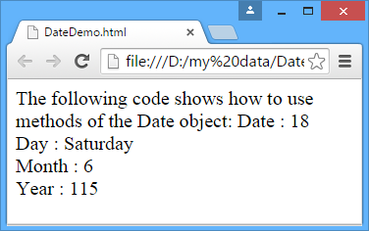
Date Object (Contd.)
The following code shows how to use methods of the Date object:
<HTML>
<BODY>
<SCRIPT language="JavaScript">
var d = new Date();
var weekday=new Array(7);
weekday[0]="Sunday";
weekday[1]="Monday";
weekday[2]="Tuesday";
weekday[3]="Wednesday";
weekday[4]="Thursday";
weekday[5]="Friday";
weekday[6]="Saturday";
document.write("Date : " + d.getDate());
document.write("</br>");
document.write("Day : " + weekday[d.getDay()]);
document.write("</br>");
document.write("Month : " + d.getMonth());
document.write("</br>");
document.write("Year : " + d.getYear());
document.write("</br>");
</SCRIPT>
</BODY>
</HTML>
Output

Slide 76
Math Object
JavaScript allows you to perform complex mathematical calculations by using the Math object.
The Math object is static by nature because its properties and methods do not change.
The following table lists some methods associated with the Math object.
Methods | Description
Math.abs(value) | Returns the absolute value of the value.
Math.acos(value) | Returns the arc cosine of the value in radians.
Math.ceil(value) | Returns an integer greater than or equal to the value.
Math.cos(value) | Returns the cosine of the value.
Math.exp(value) | Returns the Euler’s constant to the power of the value.
Math.floor(value) | Returns the integer less than or equal to the value.
Math.log(value) | Returns the natural logarithm of the value.
Math.max(value1, value2) | Returns the maximum among value1 and value2.
Math.pow(value1, value2) | Returns value1 raised to value2.

Slide 77
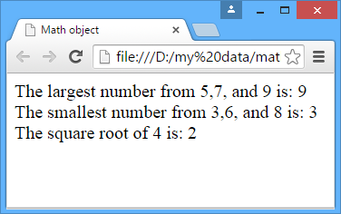
Math Object (Contd.)
The following code shows how to use some of the methods of the Math object:
<HTML>
<TITLE>Math object</TITLE>
<BODY>
<SCRIPT language="JavaScript">
document.write("The largest number from 5,7, and 9 is: " + Math.max(5,7,9) + "<br />");
document.write("The smallest number from 3,6, and 8 is: " + Math.min(3,6,8) + "<br />");
document.write("The square root of 4 is: "+ Math.sqrt(4));
</SCRIPT>
</BODY>
</HTML>
Output

Slide 78
Validating Form
A website may require users to enter data through forms.
This data needs to be validated to ensure that the user inputs are verified before being sent to the server for processing.
The following objects of JavaScript are commonly used while working with Web forms:
form object
button object
checkbox object
text object
textarea object
radio object
select object

Slide 79
Validating Form (Contd.)
form object:
Acts as a container for several other objects that collect information from the user.
Has the following properties:
Name: It describes the name of the form.
Action: It specifies the URL of the page, which processes the information submitted by the form.
Method: It describes the format in which the data will be sent to the server and takes either GET or POST as its value.
Elements: Contains all the elements, such as text boxes, check boxes, and radio buttons in a form.
Has the following methods:
submit(): It allows the user to submit a form to the server for processing.
reset(): It resets the fields of a given form.
Is associated with the following events:
onSubmit
onReset

Slide 80
Validating Form (Contd.)
button object:
Allows you to perform various tasks based on user actions.
Has the following properties:
Name
Value
Has the following methods:
click()
focus()
blur()
Is associated with the following events:
onClick
onMouseDown
onMouseUp

Slide 81
Validating Form (Contd.)
checkbox object:
Is used to accept multiple values at the same time.
Has the following properties:
Name
Value
Checked
Has the following methods:
click()
focus()
blur()

Slide 82
Validating Form (Contd.)
Text object:
Is used for accepting/displaying single line text entry.
Has the following properties:
Name
Value
Has the following methods:
blur()
focus()
Select()
textarea object:
Allows the user to create a field that can accept multiple lines of text.
Has the following properties:
Name
Value

Slide 83
Validating Form (Contd.)
radio object:
Allows the user to accept a single value from a set of alternatives.
Has the following properties:
Name
Value
Checked
Index
Length
Select object:
Allows the user to select an option available in a drop-down menu.
Has the following properties:
Name
Text
Selectedindex
Selected
Value

Slide 84
Applying Validation
JavaScript allows client-side validation logic to be applied to a Web form.
Client-side validation reduces the processing time of a script.
The following properties and method of the form object are used to validate the data entered in the form:
element
action
submit()
element:
Is an array of all the elements of a form, such as text box or a radio button.
For example:
document.forms[0].element[0].value;
document.forms[0].element[1].value;

Slide 85
Applying Validation (Contd.)
action:
Is assigned a value that specifies the URL of the page where the form inputs are to be submitted for processing.
For example:
document.Form_name.action=”URL_address”;
submit():
Is similar to the submit button, which when invoked submits the form to the server for processing.
For example:
myForm.submit();

Slide 86
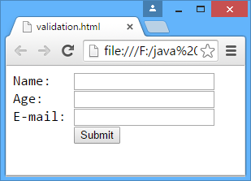
Applying Validation (Contd.)
The following code shows how to use validation on form:
<html>
<head>
<script type="text/javascript">
function validate(){
var at=document.getElementById("email").value.indexOf("@");
var dot=document.getElementById("email").value.indexOf(".");
var age=document.getElementById("age").value;
var fname=document.getElementById("fname").value;
submitOK="true";
if (!isNaN(fname)||fname.length>10){
alert("The name must be characters and less than 10 characters");
submitOK="false";
}
if (isNaN(age)||age<1||age>100){
alert("The age must be a number between 1 and 100");
submitOK="false";
}
if (at==-1 || dot==-1) {
alert("Not a valid e-mail!");
submitOK="false";
}
if (submitOK=="false") {
return false;
}
}
</script>
</head>
<body>
<form action="ok.html" onsubmit="return validate()">
Name (max 10 chararcters): <input type="text" id="fname" size="20"><br />
Age (from 1 to 100): <input type="text" id="age" size="20"><br />
E-mail: <input type="text" id="email" size="20"><br />
<br />
<input type="submit" value="Submit">
</form>
</body>
</html>
Output

Slide 87
Using Regular Expressions in JavaScript
What are regular expressions?

Slide 88
Using Regular Expressions in JavaScript (Contd.)
Regular expressions are the expressions that enable you to match patterns in JavaScript.
You can define a regular expression in two ways. These are:
Assigning a regular expression to a variable
Using the RegExp object
Assigning a regular expression to a variable:
Syntax:
var <var_name> = /<pattern>/
For example:
var reg = /JavaScript/
Modifiers are the characters that can be used with a pattern to make the pattern more specific, such as whether the regular expression is global or case sensitive.
For example:
var exjava = /java/gi;

Slide 89
Using Regular Expressions in JavaScript (Contd.)
Using the RegExp object:
RegExp is a global object and is used to create an instance of an object with the help of the new keyword.
For example:
var reg = new RegExp("java");
To make this regular expression global, the g modifier can be used, as shown in the following code snippet:
var reg = new RegExp("java", "g");

Slide 90
Using Regular Expressions in JavaScript (Contd.)
The Following code illustrates how to use the RegExp object:
<SCRIPT LANGUAGE="JavaScript">
function checkZipCode(){
var reg5digit=/^\d{5}$/ //regular expression defining a 5 digit number
if (document.zipform.zip.value.search(reg5digit)==
-1) //if match failed
alert("Please enter a valid 5 digit number inside form")
}
</SCRIPT>
<FORM NAME="zipform">
Enter Zip Code:
<INPUT TYPE="text" NAME="zip" SIZE=15>
<INPUT TYPE="button" onClick="checkZipCode()" VALUE="Validate“></FORM>

Slide 91
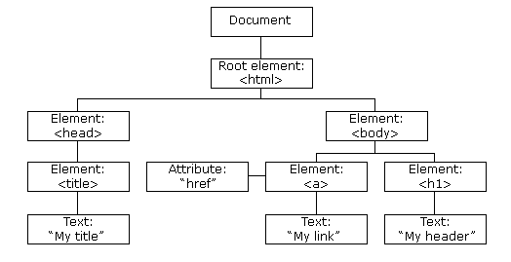
Working with HTML Document Object Model (DOM)
The HTML DOM is a standard object model and programming interface for HTML.
Using HTML DOM, JavaScript can retrieve and modify all the elements of an HTML document.
When a web page is loaded, the browser creates a Document Object Model of the page.
The HTML DOM model is constructed as a tree of Objects:

Slide 92
Working HTML Document Object Model (DOM) (Contd.)
Using the object model, JavaScript can create dynamic HTML, such as:
can change all the HTML elements in the page
can change all the HTML attributes in the page
can change all the CSS styles in the page
can remove existing HTML elements and attributes
can add new HTML elements and attributes
can react to all existing HTML events in the page
can create new HTML events in the page

Slide 93
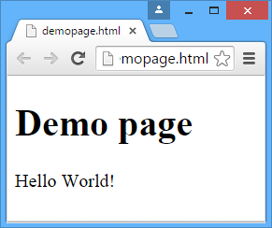
Identifying DOM Programming Interface
HTML DOM can be accessed with JavaScript.
In the DOM, all HTML elements are defined as objects.
The programming interface is the properties and methods of each object.
A property is a value that you can get or set, such as changing the content of an HTML element.
The following code illustrates how to changes the content (the innerHTML) of the <p> element with id="d1":
<!DOCTYPE html>
<html>
<body>
<h1>Demo page</h1>
<p id="d1"></p>
<script>
document.getElementById("d1").innerHTML = "Hello World!";
</script>
</body>
</html>
Output

Slide 94
Identifying DOM Programming Interface (Contd.)
The following methods can be use to find HTML elements:
The following code illustrates how to find HTML elements using HTML DOM:
Methods | Description
document.getElementById() | Finds an element by element id.
document.getElementsByTagName() | Finds elements by tag name.
document.getElementsByClassName() | Finds elements by class name.
<!DOCTYPE html>
<html>
<body>
<h1>Demo page</h1>
<p id="d1"></p>
<script>
document.getElementById("d1").innerHTML = "Hello World!";
</script>
</body>
</html>
<!DOCTYPE html>
<html>
<body>
<p id="intro">Hello World!</p>
<p>This example demonstrates the <b>getElementById</b> method!</p>
<p id="demo"></p>
<script>
myElement = document.getElementById("intro");
document.getElementById("demo").innerHTML =
"The text from the intro paragraph is " + myElement.innerHTML;
</script>
</body>
</html>

Slide 95
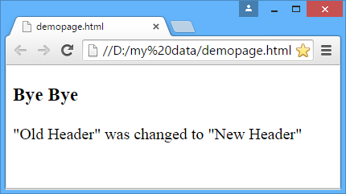
Identifying DOM Programming Interface (Contd.)
The following methods or properties can be use to change HTML elements:
The following code illustrates how to change the content of HTML element using HTML DOM:
Methods | Description
element.innerHTML= | Changes the inner HTML of an element
element.attribute= | Changes the attribute of an HTML element
element.setAttribute(attribute, value) | Change the attribute of an HTML element.
element.style.property | Change the style of an HTML element
<!DOCTYPE html>
<html>
<body>
<h3 id="header">Hello There.</h3>
<script>
var element = document.getElementById("header");
element.innerHTML = "Bye Bye";
</script>
<p>"Old Header" was changed to "New Header"</p>
</body>
</html>
Output

Slide 96
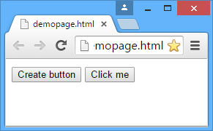
Identifying DOM Programming Interface (Contd.)
The following methods can be use to add or delete HTML elements:
The following code illustrates how to add element in a Web page using HTML DOM:
Methods | Description
document.createElement() | Creates an HTML element.
document.removeChild() | Remove an HTML element.
document.appendChild() | Add an HTML element.
document.replaceChild() | Replace an HTML element.
<!DOCTYPE html>
<html>
<body>
<button onclick="myFunction()">Create button</button>
<script>
function myFunction() {
var btn = document.createElement("BUTTON");
var t = document.createTextNode("Click me");
btn.appendChild(t);
document.body.appendChild(btn);
}
</script>
</body>
</html>
Output

Slide 97
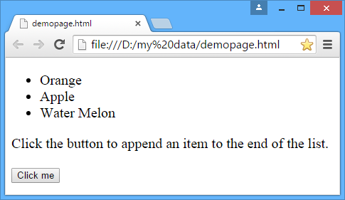
Identifying DOM Programming Interface (Contd.)
The following code illustrates how to append element in a Web page using HTML DOM:
<!DOCTYPE html>
<html>
<body>
<ul id="myList">
<li>Orange</li>
<li>Apple</li>
</ul>
<p>Click the button to append an item to the end of the list.</p>
<button onclick="myFunction()">Click me</button>
<script>
function myFunction() {
var node = document.createElement("LI");
var textnode = document.createTextNode("Water Melon");
node.appendChild(textnode);
document.getElementById("myList").appendChild(node);
}
</script>
</body>
</html>
Output

Slide 98
Summary
Scripting language is a programming language that can be used for Web-based programming.
JavaScript is a lightweight and object-based interpreted programming language.
JavaScript is open and cross-platform.
The JavaScript code integrated into an HTML file is interpreted and executed by the Web browser.
The <SCRIPT> and </SCRIPT> tags are used to mark the beginning and end of the JavaScript code.
Operator precedence determines the order in which the operators in an expression are evaluated.
Events are used to add dynamism to Web pages by making the Web pages respond to user actions, such as mouse clicks, mouse movements, or key presses.

Slide 99
Summary (Contd.)
The alert() method is used to display messages to the user.
The prompt() method is used to display a dialog box with an appropriate message.
The confirm() method is used to display a dialog box with a message and an OK and a Cancel button.
In JavaScript, events are actions that occur as a result of the user interaction with the Web pages or other browser-related activities.
The window object is one of the highest-level objects in the JavaScript object hierarchy.
The history object contains a list of all the pages that have been visited in the browser window.
The location object is used to enable navigation to different URLs on the Internet through JavaScript.
The navigator object is an independent object that has its own set of properties and methods.

Slide 100
Summary (Contd.)
The form object acts as a container for several other objects that collect information from the user.
The button object allows you to perform various tasks based on user actions.
The checkbox object is used for accepting/displaying single line text entry.
The text object is used for accepting/displaying single line text entry.
The radio object allows the user to accept a single value from a set of alternatives.
The Select object allows the user to select an option available in a drop-down menu.
Regular expressions are the expressions that enable you to match patterns in JavaScript.
The HTML DOM is a standard object model and programming interface for HTML.

