Slide 1
Module 2 Database and SQL
Mysql

Slide 2
Introduction to Database
A database is a collection of related data which represents some aspect of the real world. A database system is designed to be built and populated with data for a certain task.
DBMS: Database Management System is a software for storing and retrieving users' data by considering appropriate security measures. It allows users to create their own databases as per their requirement.
It consists of a group of programs which manipulate the database and provide an interface between the database. It includes the user of the database and other application programs.
RDBMS: RDBMS stands for Relational Database Management System. RDBMS is a type of DBMS that uses a relational model for its databases. An RDBMS therefore enables you to create relational databases. A relational database is a database that allows related data to be stored across multiple tables, and linked by establishing a relationship between the tables. It provides an efficient way to store data, as you can enter data once, then reference it from elsewhere in the database. Popular RDBMS are Mysql, Oracle, MS Access, SQL Server, FileMaker, PostgreSQL.

Slide 3
Characteristics of DBMS
Real-world entity − A modern DBMS is more realistic and uses real-world entities to design its architecture.
Relation-based tables − DBMS allows entities and relations among them to form tables.
Isolation of data and application − A database system is entirely different than its data. A database is an active entity, whereas data is said to be passive, on which the database works and organizes.
Less redundancy − DBMS follows the rules of normalization, which splits a relation when any of its attributes is having redundancy in values.
Consistency − Consistency is a state where every relation in a database remains consistent.
Query Language - DBMS is equipped with query language, which makes it more efficient to retrieve and manipulate data.
ACID Properties − DBMS follows the concepts of Atomicity, Consistency, Isolation, and Durability (normally referred as ACID).
Multiuser and Concurrent Access -DBMS supports multi-user environment and allows them to access and manipulate data in parallel.
Multiple views - DBMS offers multiple views for different users.
Security -DBMS offers many different levels of security features, which enables multiple users to have different views with different features.

Slide 4
Overview of Database Models
Basic Definitions:
Data: Known facts that can be recorded and have an implicit meaning.
Table: A collection of data elements organized in terms of rows and columns.
Record/Tuple: A single entry in a table is called a record or a tuple.
Field: A table consists of several records(row), each record can be broken into several smaller entities known as fields.
Database: A collection of related data.
Database Management System (DBMS): A software package/ system to facilitate the creation and maintenance of a computerized database.
Database System: The DBMS software together with the data itself. Sometimes, the applications are also included.

Slide 5
Database Models
Database Models:
Define how the logical structure of a database is modeled.
Are fundamental entities to introduce abstraction in a DBMS.
Define how different parts of data are connected to each other and how these are processed and stored inside the system.

Slide 6
Overview of Database Models
Types of Database Models:
Hierarchical model
Network model
Relational model
Object-oriented model

Slide 7
Database Models (Contd.)
Hierarchical Model:
The data is organized in a tree structure.
There is a hierarchy of parent and child data segments.
A parent can have many children, but a child can have a single parent.
This structure allows one-to-many relationship between two types of data.

Slide 8
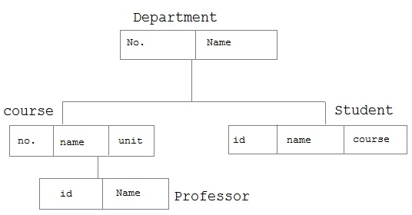
Overview of Database Models (Contd.)
Example of Hierarchical Model:

Slide 9
Database Models (Contd.)
Network Model:
Entities are organized in a graph, in which some entities can be accessed through several path.
A parent can have multiple children and a child can also have multiple parents.
This structure allows many-to-many relationship between two types of data.

Slide 10
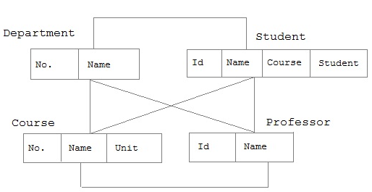
Database Models (Contd.)
Example of Network Model:

Slide 11
Database Models (Contd.)
Relational Model:
All data is represented in terms of tuples, grouped into relations.
The tables or relations are related to each other.
A database organized in terms of the relational model is a relational database.
The purpose of the relational model is to provide a declarative method for specifying data and queries.

Slide 12
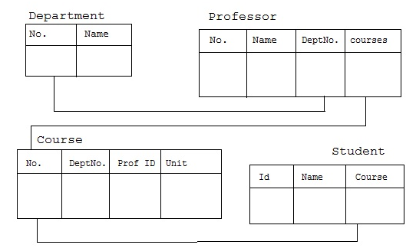
Database Models (Contd.)
Example of Relational Model:

Slide 13
Database Models (Contd.)
Object-Oriented Model:
Both data and their relationship are contained in a single structure known as an object.
An object includes information about relationship between the facts within the object, as well as information about its relationship with other objects.
An object is the abstraction of the real-word entity. An object represents only one occurrence of entity.
Attributes describe the property of an object.
Objects that are similar in characteristics are grouped in class.

Slide 14
Database Models (Contd.)
Example of Object-Oriented Model :
Employee
Name
ID
Salary

Slide 15
Relational DBMS
A Relational Database Management System (RDBMS):
Is a database management system based on relational model introduced by E.F Codd.
Represents data in terms of tuples(rows).
Is used to manage Relational database.
Relational Database:
Is a collection of organized set of tables from which data can be accessed easily.
Consists of number of tables and each table has its own primary key.

Slide 16
Database Keys
Super Key is defined as a set of attributes within a table that uniquely identifies each record within a table. Super Key is a superset of Candidate key.
A Candidate Key:
Is a subset of a super key.
Is a single field or the least combination of fields that uniquely identifies each record in the table. The least combination of fields distinguishes a candidate key from a super key.
Must contain unique values.
Must not contain null values.
Contains the minimum number of fields to ensure uniqueness.
Must uniquely identify each record in the table.

Slide 17
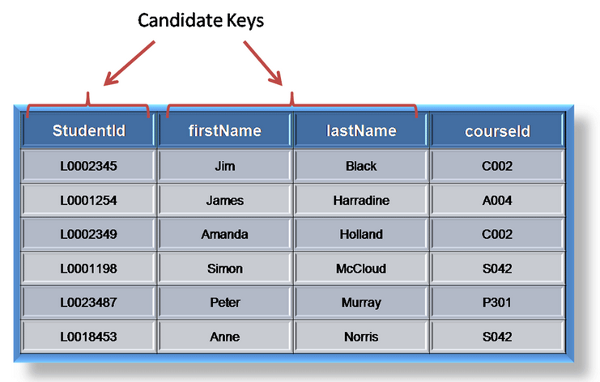
Database Keys
Example of Candidate Key:

Slide 18
Database Keys (Contd.)
Primary Key:
Is a candidate key that is most appropriate to be the main reference key for the table.
Is used throughout the database to help establish relationships with other tables.
Must contain unique values. Must never be null and should uniquely identify each record in the table.

Slide 19
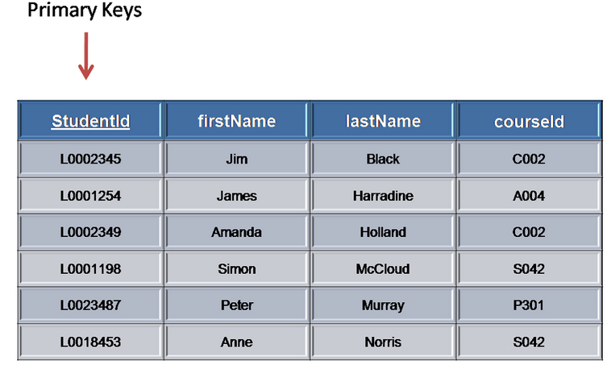
Database Keys (Contd.)
Example of Primary Key:

Slide 20
Database Keys (Contd.)
A foreign Key is generally a primary key from one table that appears as a field in another table, where the first table has a relationship to the second.
For example, if we had a table A with a primary key X that linked to a table B where X was a field in B, then X would be a foreign key in B.

Slide 21
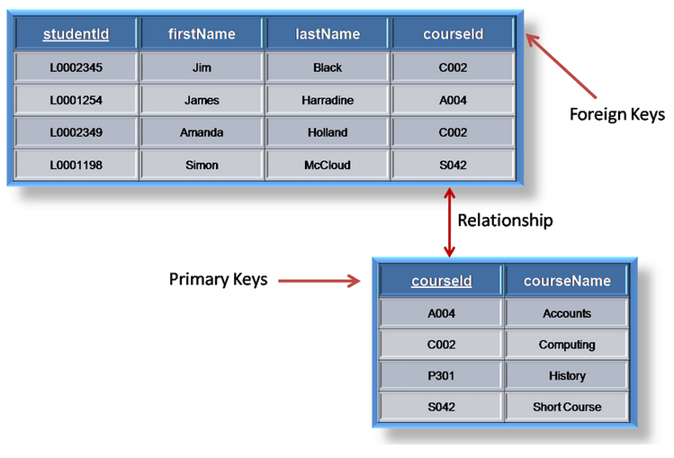
Database Keys (Contd.)
Example of Foreign Key:

Slide 22
Database Keys (Contd.)
Alternate key is any candidate key which is not selected to be the primary key.
Compound key (also called a composite key or concatenated key) is a key that consists of 2 or more attributes.

Slide 23
Basic of SQL
The SQL Language :
SQL (We pronounced "ess-que-el") stands for Structured Query Language. SQL is used to communicate with a database. According to ANSI (American National Standards Institute), it is the standard language for relational database management systems. SQL statements are used to perform tasks such as update data on a database or retrieve data from a database. Some common relational database management systems.

Slide 24
Rules for SQL Statements
SQL commands can be written on multiple line.
Clauses are generally used to separate lines to build accuracy through it is not necessary.
Tabulation (Index) can be used.
Command words cannot divide over the lines.
SQL commands are not case sensitive.
SQL commands is enrolled with SQL prompt. The SQL prompt, perform as a command line buffer.
Execution takes place when the statements specified by a semi-colon(;).
Only one statement can be present at any time within the buffer and it can be run in multiple ways.
Place a semicolon (;) at the end of the last clause.
Place a semicolon (;) forward slash / on the last line in the buffer.
Place a forward slash at the SQL prompt.
Point a RUN command at the SQL prompt.

Slide 25
Standard SQL Statement Group
Data Definition Language (DDL) It is subset of SQL statements that change the structure of the database schema in some way, typically by creating, deleting, or modifying schema objects such as databases, tables, and views. In this category we have CREATE, ALTER, DROP and TRUNCATE commands.
Data Manipulation Language (DML) These SQL commands are used to store, modify, and delete data from database tables. In this category, we have INSERT, UPDATE, and DELETE commands.
Transaction Control Language (TCL) These SQL commands are used to handle changes which affect the data in database. Basically, we use these commands with in the transaction or to make a stable point during changes in database at which we can rollback the database state if required. In this category, we have SAVEPOINT, ROLLBACK and COMMIT commands.
Data Control Language (DCL) These SQL commands are used to implement security on database objects like table, view, stored procedure, etc. In this category, we have GRANT and REVOKE commands.
Data Query Language (DQL)This SQL command is used to fetch/retrieve data from database tables. In this category we have only SEELCT command

Slide 26
Data Query Language
SELECT [DQL] is the most frequently used SQL command. General syntax is
SELECT [DISTINCT|ALL ] { * | [fieldExpression [AS newName]} FROM tableName [alias] [WHERE condition][GROUP BY fieldName(s)] [HAVING condition] ORDER BY fieldName(s)
WHERE
SELECT is the SQL keyword that allows database to retrieve data.
[DISTINCT | ALL] are optional keywords that can be used to fine tune the results returned from the SQL SELECT statement. If nothing is specified then ALL is assumed as the default.
{*| [fieldExpression [AS newName]} at least one part must be specified, "*" selected all the fields from the specified table name, fieldExpression performs some computations on the specified fields such as adding numbers or putting together two string fields into one.
FROM tableName is mandatory and must contain at least one table, multiple tables must be separated using commas or joined using the JOIN keyword.
WHERE condition is optional, it can be used to specify criteria in the result set returned from the query.
GROUP BY is used to put together records that have the same field values.
HAVING condition is used to specify criteria when working using the GROUP BY keyword.
ORDER BY is used to specify the sort order of the result set.

Slide 27
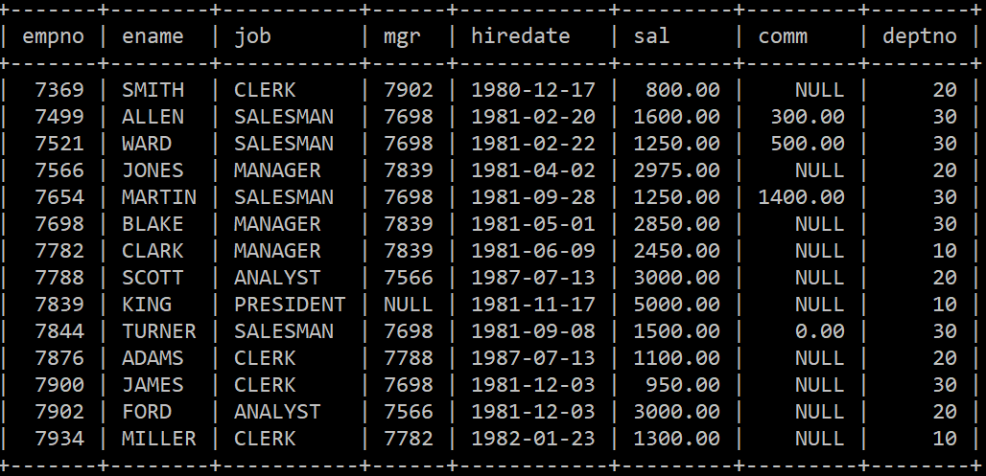
Data Query Language cont..
We will do DQL operation on ‘EMP’ Table.

Slide 28
Data Query Language cont..
We will do DQL operation on ‘EMP’ Table.
SELECT * FROM EMP; -- All information will be displayed. All rows and all columns.
SELECT empno , ename FROM EMP; -- Only employee number and name will be displayed for all rows .
SELECT * FROM EMP WHERE deptno = 20; -- Only department no 20 information will be displayed.
SELECT * FROM EMP WHERE sal >= 1500; -- Those employees whose salary is more than 1500 will be displayed .
SELECT DISTINCT(job) FROM EMP; -- Only unique job from emp table will be displayed . [Avoid duplicate]
SELECT * FROM EMP ORDER BY sal ; -- Salary wise ascending order, information will be displayed.
SELECT empno, sal * 12 'Annual Salary' from EMP; -- empno and 'Annual Salary‘ column heading
will be displayed for all employee after calculating yearly salary, DQL allows calculation.

Slide 29
Aggregate (Group) Functions
Aggregate (Group) functions are built-in SQL functions that operate on groups of rows and return just one value for the entire group. These are aggregate functions available in Mysql:
COUNT, MAX, MIN, AVG, SUM.
SELECT COUNT(*) FROM emp; -- Row count of table will be displayed. Output 14 will be displayed.
SELECT COUNT(comm) FROM emp; -- Count of comm field will be displayed. Null value will be ignored
Output 4 will be displayed.
SELECT MAX(sal) FROM emp; -- Maximum salary will be displayed. Output 5000.00
SELECT MIN(sal) FROM emp; -- Minimum salary will be displayed. Output 800.00
SELECT AVG(sal) FROM emp; -- Average salary will be displayed. Output 2073.214286
SELECT SUM(sal) FROM emp; -- Total salary of emp table will be displayed. Output 29025.00
We can use multiple group function in single SQL statement.

Slide 30
GROUP BY & HAVING clause
GROUP BY Clause is used to collect data from multiple records and group the result by one or more column. It is generally used in a SELECT statement With aggregate functions like COUNT, SUM, MIN, MAX, AVG on the grouped column. HAVING clause is filter for GROUP BY clause.
SELECT deptno, COUNT(*) FROM emp GROUP BY deptno;
deptno | COUNT(*)
10 3
20 5
30 6
Problem: 14 employees are in ‘EMP’ table. We want to know department wise employee count.
Analysis: We have to use GROUP BY clause to make department groups and in SELECT clause will use group function COUNT(*) to know the count.
SELECT job as Jobs , COUNT(*) as Number FROM emp GROUP BY job Having Number >5;
Jobs Number
CLERK 4
MANAGER 3
SALESMAN 4
Problem: There are 5 type of jobs in ‘EMP’ table. We want we know those jobs who having more than two associates.
Analysis: We have to use GROUP BY clause to make job groups HAVING clause filter the count more than 2. Here we have use column alias ‘Number’ and ‘Jobs’ for COUNT(*) and job respectively

Slide 31
SQL Single-row functions
Single row functions are the one which work on single row and return one output per row. There are five category of single row function in Mysql.
Number Functions
Character Functions
Date functions
Conversion functions
Miscellaneous functions

Slide 32
Number Functions
MySQL Number functions are used primarily for numeric manipulation and/or mathematical calculations.
ABS(X) : The ABS() function returns the absolute value of X .
SELECT ABS(-29); -- Output 29
CEIL(X)
CEILING(X) These functions return the smallest integer value that is not smaller than X.
select ceiling(7.4); -- Output 8.0 . Both functions are equivalent .
POW(X, Y)
POWER(X, Y) These two functions return the value of X raised to the power of Y.
SELECT POWER(2,4); -- Output 16 . Both functions are equivalent .
ROUND(X)
ROUND(X,D) This function returns X rounded to the nearest integer. If a second argument, D, is supplied, then the function returns X rounded to D decimal places. If D is negative it will effect whole number.
SELECT ROUND(8758.63); -- Output 8759
SELECT ROUND(8758.63,1); -- Output 8758.6
SELECT ROUND(8758.63,-2);--Output 8800 . Second left digit (5) from decimal place will be rounded off and 758 became 800 .
GREATEST(n1,n2,n3,..........) The GREATEST() function returns the biggest value in the set of input parameters.
SELECT GREATEST(1,0,100,111,170,11); -- Output 170
LEAST(N1,N2,N3,N4,......) It returns the least-valued item from the value list (N1, N2, N3, and so on).
SELECT LEAST(1,0,100,-66,111,170,11); -- Output -66

Slide 33
Character Functions
Character functions are used to perform an operation on input string.
LENGTH(str) Returns the length of the string str, measured in bytes
SELECT LENGTH('Learning Mysql'); -- Output 14
INSTR(): This function is used to find the occurrence of an alphabet.
select INSTR('Learning Mysql', 'q');-- Output 13
LCASE() , LOWER() These function convert input string to lower case.
select Lcase("Learning Mysql"); --Output learning mysql
UCASE() , UPPER() These function convert input string to upper case .
select UPPER('Learning Mysql'); --Output LEARNING MYSQL
TRIM(): Returns the string str with all remstr prefixes or suffixes removed. If none of the specifies BOTH, LEADING, or TRAILING is given, BOTH is assumed.
SELECT TRIM(" Mysql "); -- output Mysql
SELECT TRIM(TRAILING '?' From "???Mysql???");--Output ???Mysql It is equivalent to RTRIM() . RTRIM ONLY REMOVES SPACES
SELECT TRIM(LEADING '?' From "???Mysql???"); -- Output Mysql??? It is equivalent to LTRIM() . LTRIM ONLY REMOVES SPACES
SUBSTRING(str FROM pos FOR len) len argument return a substring from string str starting at position pos
SELECT SUBSTRING('LEARNING MYSQL IS FUN',6); -- Output ING MYSQL IS FUN 6th character onwards will be returned .
SELECT SUBSTRING('LEARNING MYSQL IS FUN',16 ,6); -- Output IS FUN 6 characters returned from 16th character .
REVERSE(): As name suggests it reverses the string.
select REVERSE('A *** Z');--Output Z *** A
RPAD(str,len,padstr) Returns the string str, right-padded with the string padstr to a length of len characters.
SELECT RPAD('Mysql',10,'*'); -- Output Mysql*****

Slide 34
Date Functions
MySQL Date Functions that allow us to manipulate date and time data . Frequently used Date functions are
ADDDATE(date,INTERVAL expr unit)
DATE_ADD(date,INTERVAL expr unit)
SELECT DATE_ADD('2019-05-09', INTERVAL 31 DAY); -- Output 2019-06-09
SELECT ADDDATE('1998-01-02', INTERVAL 31 DAY); -- Output 2019-06-09 SELECT ADDDATE(‘2019-05-09', 31); It is also fine.
DAYNAME(date) Returns the name of the weekday for date. SELECT DAYNAME('2019-05-09'); Output : Thursday
DAYOFYEAR(date) Returns the day of the year for date, in the range 1 to 366. SELECT DAYOFYEAR('2019-05-09'); -- Output 129
NOW() Returns the current date and time as a value in 'YYYY-MM-DD HH:MM: SS' or YYYYMMDDHHMMSS format . SELECT NOW(); O/P 2019-05-09 16:17:01
SYSDATE() Returns the current date and time value in 'YYYY-MM-DD HH:MM:SS' or YYYYMMDDHHMMSS format . SELECT SYSDATE(); O/P2019-05-09 16:17:01
DATE_FORMAT(date, format) Formats the date value according to the format string.
SELECT DATE_FORMAT('2019-05-09 22:23:00', '%W %M %Y'); -- Output : Thursday May 2019 ( Week Month and Year
WEEKDAY(date) Returns the weekday index for date (0 = Monday, 1 = Tuesday, 6 = Sunday) SELECT WEEKDAY('2019-05-09 22:23:00'); -- Output : 3
CURTIME() Returns the current time as a value in 'HH:MM:SS' or HHMMSS format . SELECT CURTIME(); O/P : 17:42:47
MAKEDATE(year,dayofyear) Returns a date, given year and day-of-year values. dayofyear must be greater than 0 or the result is NULL.
SELECT MAKEDATE(2019,25), MAKEDATE(2019,32); O / P 2019-01-25 2019-02-01
WEEKOFYEAR(date) Returns the calendar week of the date as a number in the range from 1 to 53. SELECT WEEKOFYEAR('2019-05-09'); O / P 19
FROM_DAYS(N) Given a day number N, returns a DATE value. SELECT FROM_DAYS(737915); O / P : 2020-05-05

Slide 35
Conversion functions
MySQL Conversion Functions convert a value from one data type to another. Conversions can be conducted between string, date, and numeric type of data.
There are three Conversion Functions in MySQL: CONVERT, CAST, BINARY.
The CONVERT() function converts a value into the specified data type or character set.
CONVERT(value, type) Second Parameter ‘type’ could be 1 out of 7 values.
SELECT CONVERT("2019-05-19", DATE); O / P : 2019-05-19 DATE Converts value to DATE. Format: "YYYY-MM-DD"
SELECT CONVERT('2019-05-10', DATETIME); O/P : 2019-05-10 00:00:00 DATETIME Converts value to DATETIME. Format: "YYYY-MM-DD HH:MM:SS"
SELECT CONVERT("15:08:18", TIME); O / P : 15:08:18 TIME Converts value to TIME. Format: "HH:MM:SS"
SELECT CONVERT('181', CHAR); O / P: 181 CHAR Converts value to CHAR (a fixed length string)
SELECT CONVERT(0-35, SIGNED); O /P : -35 SIGNED Converts value to SIGNED (a signed 64-bit integer)
SELECT CONVERT(0-35, UNSIGNED); O/ P: 18446744073709551581 UNSIGNED Converts value to UNSIGNED (an unsigned 64-bit integer)
SELECT CONVERT('181', BINARY); O /P : 181 BINARY Converts value to BINARY (a binary string)
SELECT CAST('2019-05-10' AS DATETIME); O / P : 2019-05-10 00:00:00
SELECT ENAME , CAST(SAL AS CHAR) AS SALARY_IN_CHAR FROM EMP; 0 / P : SMITH | 800.00 | ALLEN | 1600.00 …..
SELECT BINARY('NLL') = 'nll' AS BINARY_TEST; O / P : 0 -- Binary function checks value bit by bit if any bit differs 0 will be output else result will 1

Slide 36
Miscellaneous functions
Mysql miscellaneous functions are used for different purpose.
SELECT INET_ATON('204.15.23.255');O / P : 3423541247 INET_ATON() Return the numeric value of an IP address
SELECT INET_NTOA(3423541247); O /P : 204.15.23.255 INET_NTOA() Return the IP address from a numeric value
SELECT RAND(); O/P: 0.57041182701514 RAND() Return a random floating-point value range between 0 and 1
SELECT UUID; O / P:29491e12-c446-1037-a349-6b3be6d05f6a UUID() Return a Universal Unique Identifier (UUID)
UUID_SHORT() Return an integer-valued universal identifier
VALUES() Define the values to be used during an INSERT
DEFAULT() Return the default value for a table column
MASTER_POS_WAIT() Block until the slave has read and applied all updates up to the specified position
NAME_CONST() Cause the column to have the given name
SLEEP() Sleep for a number of seconds

Slide 37
Joins in MySQL
Joins are used to combine the data from two tables, with the result being a new, temporary table.
Joins are performed based on something called a predicate, which specifies the condition to use in order to perform a join.

Slide 38
Joins in MySQL (Contd.)
Join types:
Outer Join:
Left Outer Join
Right Outer Join
Inner Join
Self Join

Slide 39
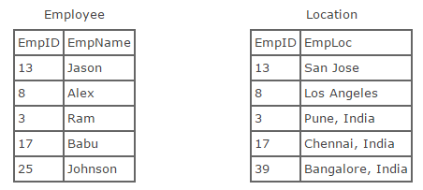
Joins in MySQL (Contd.)
Lets take two tables to understand joins:

Slide 40
Joins in MySQL (Contd.)
Left Outer Join:
Retains all of the rows of the left table, regardless of whether there is a row that matches on the right table.
Example:
SELECT * FROM employee LEFT OUTER JOIN location
ON employee.empID = location.empID

Slide 41
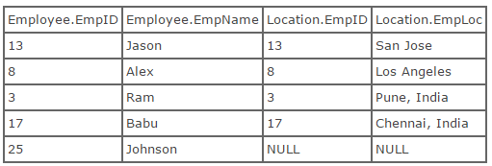
Joins in MySQL (Contd.)
Result:

Slide 42
Joins in MySQL (Contd.)
Right Outer Join:
Retains all of the rows of the right table, regardless of whether there is a row that matches on the left table.
Example:
SELECT * FROM employee RIGHT OUTER JOIN location
ON employee.empID = location.empID

Slide 43
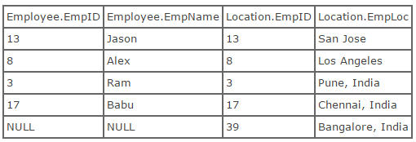
Joins in MySQL (Contd.)
Result:

Slide 44
Joins in MySQL (Contd.)
Inner Join:
Returns only the rows that actually match based on the join predicate.
Example:
SELECT * FROM employee INNER JOIN location ON
employee.empID = location.empID

Slide 45
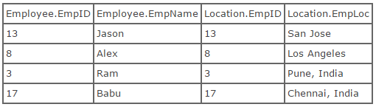
Joins in MySQL (Contd.)
Result:

Slide 46
Joins in MySQL (Contd.)
Self Join:
Uses a different alias for same table.
Used to compare records within one table.
Treats one table as two separate tables by using alias.

Slide 47
Joins in MySQL (Contd.)
Example:
SELECT e1.employee_name
FROM employee e1, employee e2
WHERE e1.employee_location = e2.employee_location
AND e2.employee_name="Joe";

Slide 48
Nested Queries
A MySQL subquery is a query that is nested inside another query, such as SELECT, INSERT, UPDATE or DELETE.
A MySQL subquery is also can be nested inside another subquery.
A MySQL subquery is also called an inner query, while the query that contains the subquery is called an outer query.

Slide 49
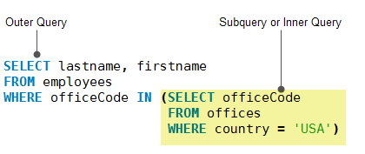
Nested Queries
Example:

Slide 50
Database Objects
MySQL uses many different data types broken into three categories:
Numeric
Date and time
String
Numeric Data Types:
INT (4 bytes): A normal-sized integer that can be signed or unsigned. You can specify a width of up to 11 digits
TINYINT (1 byte): A very small integer that can be signed or unsigned. You can specify a width of up to 4 digits.

Slide 51
MySQL Data Types (Contd.)
Numeric Data Types:
SMALLINT (2 bytes): A small integer that can be signed or unsigned. You can specify a width of up to 5 digits.
MEDIUMINT (3 bytes): A medium-sized integer that can be signed or unsigned. You can specify a width of up to 9 digits.
BIGINT (8 bytes): A large integer that can be signed or unsigned. You can specify a width of up to 20 digits.
FLOAT(M, D): A floating-point number that cannot be unsigned. You can define the display length (M) and the number of decimals (D).
DOUBLE(M, D): A double precision floating-point number that cannot be unsigned. You can define the display length (M) and the number of decimals (D).

Slide 52
MySQL Data Types (Contd.)
Date and Time Types:
DATE: A date in YYYY-MM-DD format, between 1000-01-01 and 9999-12-31.
DATETIME: A date and time combination in YYYY-MM-DD HH:MM:SS format, between 1000-01-01 00:00:00 and 9999-12-31 23:59:59.
TIMESTAMP: A timestamp between midnight, January 1, 1970, and sometime in 2037.
TIME: Stores the time in HH:MM:SS format.
YEAR(M): Stores a year in 2-digit or 4-digit format.

Slide 53
MySQL Data Types (Contd.)
String Types:
CHAR(M): A fixed-length string between 1 and 255 characters in length. Defining a length is not required, default is 1.
VARCHAR(M): A variable-length string between 1 and 255 characters in length. You must define a length when creating a VARCHAR field.
BLOB or TEXT: A field with a maximum length of 65535 characters. Binary Large Objects used to store large amounts of binary data, such as images or other types of files.
TINYBLOB or TINYTEXT: A BLOB or TEXT column with a maximum length of 255 characters.

Slide 54
MySQL Data Types (Contd.)
String Types:
MEDIUMBLOB or MEDIUMTEXT: A BLOB or TEXT column with a maximum length of 16777215 characters.
LONGBLOB or LONGTEXT: A BLOB or TEXT column with a maximum length of 4294967295 characters.
ENUM: Creates a list of items from which the value must be selected.
Introduction to DQL, DDL, DML, DCL

Slide 55
Data Integrity
The term data integrity refers to the accuracy and consistency of data. While creating databases, attention needs to be given to data integrity and how to maintain it. A good database will enforce data integrity whenever possible.
For example, a user could accidentally try to enter a phone number into a date field. If the system enforces data integrity, it will prevent the user from making these mistakes.
In database data integrity is of 4 types:
Entity integrity: Two row must not be identical. It is achieved by PRIMARY KEY.
Referential integrity: When two or more tables have a relationship, we have to ensure that the foreign key value matches the primary key value at all times. It is achieved through FOREIGN KEY - PRIMARY KEY relationship.
Domain integrity: It concerns about validity of entries for a given column. It is achieved by selecting appropriate DATA TYPE for a column and applying CONSTRAINT on it.
User-defined integrity: It allows the user to apply business rules to the database that aren’t covered by any of the other three data integrity types. It is achieved through DOMAIN and BUSINESS RULE.

Slide 56
Working with Keys
PRIMARY Key Constraint:
Can be added to a table using CREATE TABLE statement or ALTER TABLE statement.
Using CREATE TABLE statement:
Example 1:
CREATE TABLE users(
user_id INT AUTO_INCREMENT PRIMARY KEY,
username VARCHAR(40),
password VARCHAR(255),
email VARCHAR(255)
);

Slide 57
Working with Keys (Contd.)
Example 2:
CREATE TABLE roles(
role_id INT AUTO_INCREMENT,
role_name VARCHAR(50),
PRIMARY KEY(role_id)
);

Slide 58
DDL Alter
Using ALTER TABLE statement:
Syntax:
ALTER TABLE <table_name>
ADD PRIMARY KEY(primary_key_column);
Example:
ALTER TABLE roles
ADD PRIMARY KEY (role_id);

Slide 59
Composite Primary Key
Example of PRIMARY Key Constraint on Multiple Columns (Composite key):
CREATE TABLE Persons
(
P_Id int NOT NULL,
LastName varchar(255) NOT NULL,
FirstName varchar(255),
Address varchar(255),
City varchar(255),
CONSTRAINT pk_PersonID PRIMARY KEY (P_Id,LastName)
);

Slide 60
DDL Alter drop
Example for dropping a PRIMARY Key Constraint:
ALTER TABLE Persons
DROP PRIMARY KEY;

Slide 61
FOREIGN Key
FOREIGN Key Constraint:
Can be added to a table using CREATE TABLE statement or ALTER TABLE statement.
Example using CREATE TABLE statement:
CREATE TABLE Persons(
P_Id INT AUTO_INCREMENT PRIMARY KEY,
LastName VARCHAR(40),
FirstName VARCHAR(255),
Address VARCHAR(255)
);

Slide 62
Working with Keys (Contd.)
CREATE TABLE Orders
(
O_Id int NOT NULL,
OrderNo int NOT NULL,
P_Id int,
PRIMARY KEY (O_Id),
FOREIGN KEY (P_Id) REFERENCES Persons(P_Id)
);

Slide 63
DDL Alter
Example using ALTER TABLE statement when Persons and Orders tables are already created:
ALTER TABLE Orders
ADD CONSTRAINT fk_PerOrders
FOREIGN KEY (P_Id)
REFERENCES Persons(P_Id);

Slide 64
Alter Foreign Key
Example for dropping a FOREIGN Key Constraint:
ALTER TABLE Orders
DROP FOREIGN KEY fk_PerOrders;

Slide 65
DDL Create Table
CREATE TABLE Statement:
Is used to create tables.
Syntax:
CREATE TABLE [IF NOT EXISTS] <table_name>
(
col1_name datatype [NOT NULL|NULL] [DEFAULT value] [AUTO_INCREMENT] [UNIQUE] [PRIMARY KEY],
col2_name datatype [NOT NULL|NULL] [DEFAULT value] [AUTO_INCREMENT] [UNIQUE] [PRIMARY KEY]
);
Gather information about Rest Constraints Unique , Default , Not Null .

Slide 66
Example of CREATE TABLE Statement:
CREATE TABLE tutorials_tbl
(
tutorial_id INT NOT NULL AUTO_INCREMENT,
tutorial_title VARCHAR(30) NOT NULL,
tutorial_author VARCHAR(40) NOT NULL,
submission_date DATE,
PRIMARY KEY ( tutorial_id )
);

Slide 67
ALTER TABLE Statement:
Changes the structure of an existing table.
Can add a column, a constraint, delete a column, rename a column and a table or change the type of the table.
Renaming a Table:
Use of RENAME TO clause.
Example:
ALTER TABLE Testing RENAME TO TestTable;

Slide 68
Adding a Column to Table:
Use of ADD clause.
Example:
ALTER TABLE TestTable ADD iValues INT;
Example for Adding a PRIMARY KEY Constraint to Table:
ALTER TABLE TestTable ADD PRIMARY KEY (Id);
Changing Column Name:
Use of CHANGE COLUMN clause.
Example:
ALTER TABLE TestTable CHANGE COLUMN iValues iValues1 INT;

Slide 69
Changing Column Data Type:
Use of MODIFY COLUMN clause.
Example:
ALTER TABLE TestTable MODIFY COLUMN iValues1 MEDIUMINT;
Dropping a Column:
Use of DROP COLUMN clause.
Example:
ALTER TABLE TestTable DROP COLUMN iValues1;

Slide 70
Data Manipulation Language (DML)
Data Manipulation Language which deals with data manipulation and includes most common SQL statements such
INSERT
UPDATE
DELETE
It is used to store, modify, retrieve, delete and update data in a table.

Slide 71
DML INSERT Statement
Inserts records into a table.
Syntax:
INSERT INTO <table_name> ( col1, col2,...colN )
VALUES( value1, value2,...valueN );
Example:
INSERT INTO tutorials_tbl(tutorial_title, tutorial_author, submission_date)
VALUES("Learn PHP", "John Poul", NOW());

Slide 72
DML UPDATE Statement
Can update one or more field altogether.
Can specify any condition using WHERE clause.
Can update values in a single table at a time.
Syntax:
UPDATE <table_name> SET col1=new_value1, col2=new_value2
[WHERE Clause]

Slide 73
DML Update Example
Example 1:
UPDATE tutorials_tbl
SET tutorial_title='Learning SQL'
WHERE tutorial_id=3;
Example 2:
UPDATE tutorials_tbl
SET tutorial_title='Learning SQL‘;

Slide 74
DML DELETE Statement
Deletes records from a table.
Can specify any condition using WHERE clause.
Can delete records from a single table at a time.
If no, WHERE condition is specified, all rows will be removed. After performing a DELETE operation you need to COMMIT or ROLLBACK the transaction to make the change permanent or to undo it.
Syntax:
DELETE FROM <table_name>
[WHERE Clause]

Slide 75
DML Delete Example
Example 1:
DELETE FROM tutorials_tbl WHERE tutorial_id=3;
Example 2:
DELETE FROM tutorials_tbl

Slide 76
Transaction Control Language (TCL)
Transaction:
Is a logical unit of work requested by a user to be applied to the database objects.
Groups one or more SQL statements into a single logical unit.
Works on tables that use transaction-safe storage engines, like InnoDB and BDB.
Syntax for creating a transaction:
START TRANSACTION;
Statements
COMMIT|ROLLBACK;

Slide 77
TCL
Running the COMMIT command will explicitly end the current transaction. Changes will be committed.
Running the ROLLBACK command will explicitly end the current transaction. Changes will be rolled back.
Example:
START TRANSACTION;
INSERT INTO tutorials_tbl(tutorial_title, tutorial_author, submission_date)
VALUES("Learn PHP", "John Poul", NOW());
COMMIT;

Slide 78
TCL Savepoint
SAVEPOINT Statement:
Sets a named transaction savepoint with a name of identifier. If the current transaction has a savepoint with the same name, the old savepoint is deleted and a new one is set.
Syntax:
SAVEPOINT identifier

Slide 79
Database Security and Privileges)
ROLLBACK TO SAVEPOINT Statement:
Rolls back a transaction to the named savepoint without terminating the transaction.
Syntax:
ROLLBACK TO [SAVEPOINT] identifier

Slide 80
PL/SQL Basics
Introduction
The PL/SQL programming language was developed by Oracle Corporation in the late 1980s as procedural extension language for SQL.
PL/SQL is a completely portable, high-performance transaction-processing language.
PL/SQL provides a built-in, interpreted and OS independent programming environment.
PL/SQL can also directly be called from the command-line SQL*Plus interface.
Direct call can also be made from external programming language calls to database.
PL/SQL's general syntax is based on that of ADA and Pascal programming language.
PL/SQL is tightly integrated with SQL.
It offers extensive error checking.
It offers numerous data types.
It offers a variety of programming structures.
It supports structured programming through functions and procedures.
It supports object-oriented programming.
It supports the development of web applications and server pages.

Slide 81
PL/SQL Block Structure
PL/SQL program units organize the code into blocks. A block without a name is known as an anonymous block. The anonymous block is the simplest unit in PL/SQL. It is called anonymous block because it is not saved in the database.
An anonymous block is an only one-time use. Useful in creating test units. Declare and Exception are optional. Begin and End are mandatory block.
The following illustrates anonymous block syntax
[DECLARE]
Declaration statements;
BEGIN
Execution statements;
[EXCEPTION]
Exception handling statements;
END;
/

Slide 82
Named block
Named blocks: That’s PL/SQL blocks which having header or labels are known as Named blocks. These blocks can either be subprograms like functions, procedures, packages or Triggers.
Example: Here a code example of printing number 1 to 5 using procedure (Named block ).
Delimiter //
CREATE procedure while_example()
BEGIN
declare str VARCHAR(50) default '';
declare x INT default 0;
SET x = 1;
WHILE x <= 5 DO
SET str = CONCAT(str,x,',');
SET x = x + 1;
END WHILE;
select str;
END //

Slide 83
Named block
MySQL has three different kinds of variables:
Local variables
Local variables are set in the scope of a statement or block of statement. Once that statement or block of statements has completed, the variable goes out of scope.
Session variables
Session variables are set in the scope of your session with the MySQL server. A session starts with a connection to the server and ends when the connection is closed. Variables go out of scope once the connection is terminated.
Variables created during your connection cannot be referenced from other sessions. To declare or reference a session variable, prefix the variable name with an @ symbol: SET @count = 100;.
Global variables
Global variables exist across connections.
They are set using the GLOBAL keyword:
SET GLOBAL max_connections = 300;.
Using the DECLARE statement with a DEFAULT will set the value of a local variable.
Values can be assigned to local, session, and global variables using the SET statement

Slide 84
SQL in PL/SQL
SQL in PL/SQL block not working directly . We required to transfer column value to PL/SQL variable . INTO keywod help us to transfer sql column value to PL/SQL variable
DELIMITER $$
CREATE PROCEDURE GetCustomerLevel( p_customerNumber INT(11),
OUT p_customerLevel varchar(10)
)
BEGIN
DECLARE creditlim DOUBLE;
SELECT creditlimit INTO creditlim FROM customers
WHERE customerNumber = p_customerNumber;
SELECT CUSTOMERLEVEL(creditlim)
INTO p_customerLevel;
END $$

Slide 85
Exception Handling
When an error occurs inside a stored procedure, it is important to handle it appropriately, such as continuing or exiting the current code block’s execution, and issuing a meaningful error message.
MySQL provides an easy way to define exceptions to specific conditions e.g., specific error codes. (User define exception)
The following stored procedure adds an order line item into an existing sales order. It issues an error message if the order number does not exist.
DELIMITER $$
CREATE PROCEDURE AddOrderItem(in orderNo int, in productCode varchar(45), in qty int, in price double, in lineNo int )
BEGIN
DECLARE C INT;
SELECT COUNT(orderNumber) INTO C FROM orders
WHERE orderNumber = orderNo;
-- check if orderNumber exists
IF(C != 1) THEN
SIGNAL SQLSTATE '45000'
SET MESSAGE_TEXT = 'Order No not found in orders table';
END IF;
END

Slide 86
Procedure , Function
Basic procedure creation and calling : Creating a procedure to find factorial and call it. Procedure does not return any value.
DELIMITER // -- Start Creating procedure with delimiter
CREATE PROCEDURE fact(IN x INT) -- Name of procedure with parameter
BEGIN -- Mandatory Block
DECLARE result INT; -- Variable Declaration
DECLARE i INT; -- Variable Declaration
SET result = 1; -- Initialing variable
SET i = 1; -- Initialing variable
WHILE i <= x DO – main Logic
SET result = result * i;
SET i = i + 1;
END WHILE;
SELECT x AS Number, result as Factorial; -- putting the result
END; // -- End of procedure
CALL fact(5) // -- Calling procedure with input
CALL fact(4) // -- Calling procedure

Slide 87
Trigger Introduction
A SQL trigger is a set of SQL statements stored in the database catalog. A SQL trigger is executed or fired whenever an event associated with a table occurs e.g., insert, update or delete. A SQL trigger is a special type of stored procedure. It is special because it is not called directly like a stored procedure. The main difference between a trigger and a stored procedure is that a trigger is called automatically when a data modification event is made against a table whereas a stored procedure must be called explicitly.
It is important to understand the SQL trigger’s advantages and disadvantages so that you can use it appropriately. In the following sections, we will discuss the advantages and disadvantages of using SQL triggers.
Advantages of using SQL triggers
SQL triggers provide an alternative way to check the integrity of data.
SQL triggers can catch errors in business logic in the database layer.
SQL triggers provide an alternative way to run scheduled tasks. By using SQL triggers, you don’t have to wait to run the scheduled tasks because the triggers are invoked automatically before or after a change is made to the data in the tables.
SQL triggers are very useful to audit the changes of data in tables.
Disadvantages of using SQL triggers
SQL triggers only can provide an extended validation and they cannot replace all the validations. Some simple validations have to be done in the application layer. For example, you can validate user’s inputs in the client side by using JavaScript or on the server side using server-side scripting languages such as JSP, PHP, ASP.NET, Perl.
SQL triggers are invoked and executed invisible from the client applications, therefore, it is difficult to figure out what happens in the database layer.
SQL triggers may increase the overhead of the database server.

Slide 88
Lab Exercise 1 Creation of tables
Create Table ‘dept' with following column and data type.
deptno int(2)
dname varchar(14)
loc varchar(13)
deptno column must be Primary Key .
Now Create Table ‘emp' with following column and data type.
empno int(4)
ename varchar(10)
job varchar(9)
mgr int(4)
hiredate date
sal decimal(7,2)
comm decimal(7,2)
deptno int(2) empno column must be Primary Key and deptno must be Foreign Key .
insert into emp values( 7839, 'KING', 'PRESIDENT', null,'1981-11-17', 5000, null, 10);
insert into emp values( 7698, 'BLAKE', 'MANAGER', 7839,'1981-05-01',2850, null, 30);
insert into emp values(7782, 'CLARK', 'MANAGER', 7839,'1981-06-09',2450, null, 10);
insert into emp values( 7566, 'JONES', 'MANAGER', 7839,'1981-04-02',2975, null, 20);
insert into emp values( 7788, 'SCOTT', 'ANALYST', 7566,'1987-07-13',3000, null, 20);
insert into emp values(7902, 'FORD', 'ANALYST', 7566,'1981-12-03',3000, null, 20);
insert into emp values(7369, 'SMITH', 'CLERK', 7902,'1980-12-17',800, null, 20);
insert into emp values(7499, 'ALLEN', 'SALESMAN', 7698,'1981-02-20', 1600, 300, 30);
insert into emp values(7521, 'WARD', 'SALESMAN', 7698,'1981-02-22',1250, 500,30);
insert into emp values(7654, 'MARTIN', 'SALESMAN', 7698,'1981-09-28',1250, 1400, 30);
insert into emp values(7844, 'TURNER', 'SALESMAN', 7698,'1981-09-08',1500, 0, 30);
insert into emp values(7876, 'ADAMS', 'CLERK', 7788,'1987-07-13', 1100, null, 20 );
insert into emp values(7900, 'JAMES', 'CLERK', 7698, '1981-12-03', 950, null, 30 );
insert into emp values(7934, 'MILLER', 'CLERK', 7782,'1982-01-23', 1300, null, 10);
1.List the employees details who are joined in the year 1981.
2.List the employees details whose name consist of characters
and salry more than 2500.
3.List the employees name and hire date who does not belong
to department 30.
4. Display the location and hiredate of SMITH.
5.List the employees details who are senior to King.
6.List the employees details of department 20 whose Jobs are similar to
department 10.
7.List the employees details whose jobs are similar to either SMITH or ALLEN.
8.Find the highest paid employee details from accounting department.
9.List the manager Id and number of employees working under same manager in ascending order. [Manager Id 7566 should came first]
10.List the employees name who are getting dept wise highest salary.
11. List all employees who are not eligible for earning commission .
12.List those employees whose Salary is odd value.
13.Increase salary by 15% to all employees who are sales person.
14.Assign commission 250 to all who are earning no commission.
15. Insert one employee JOHN with ID 9999 who join today as Manager , John salary , commission is not decided yet.
16. Delete Turner from emp table.
Execute these insert commands to populate dept table.
insert into dept values(10, 'ACCOUNTING', 'NEW YORK');
insert into dept values(20, 'RESEARCH', 'DALLAS');
insert into dept values(30, 'SALES', 'CHICAGO');
insert into dept values(40, 'OPERATIONS', 'BOSTON');

Slide 89
Lab Exercise
Execute these insert command on SQL prompt to populate emp table.
insert into emp values( 7839, 'KING', 'PRESIDENT', null,'1981-11-17', 5000, null, 10);
insert into emp values( 7698, 'BLAKE', 'MANAGER', 7839,'1981-05-01',2850, null, 30);
insert into emp values(7782, 'CLARK', 'MANAGER', 7839,'1981-06-09',2450, null, 10);
insert into emp values( 7566, 'JONES', 'MANAGER', 7839,'1981-04-02',2975, null, 20);
insert into emp values( 7788, 'SCOTT', 'ANALYST', 7566,'1987-07-13',3000, null, 20);
insert into emp values(7902, 'FORD', 'ANALYST', 7566,'1981-12-03',3000, null, 20);
insert into emp values(7369, 'SMITH', 'CLERK', 7902,'1980-12-17',800, null, 20);
insert into emp values(7499, 'ALLEN', 'SALESMAN', 7698,'1981-02-20', 1600, 300, 30);
insert into emp values(7521, 'WARD', 'SALESMAN', 7698,'1981-02-22',1250, 500,30);
insert into emp values(7654, 'MARTIN', 'SALESMAN', 7698,'1981-09-28',1250, 1400, 30);
insert into emp values(7844, 'TURNER', 'SALESMAN', 7698,'1981-09-08',1500, 0, 30);
insert into emp values(7876, 'ADAMS', 'CLERK', 7788,'1987-07-13', 1100, null, 20 );
insert into emp values(7900, 'JAMES', 'CLERK', 7698, '1981-12-03', 950, null, 30 );
insert into emp values(7934, 'MILLER', 'CLERK', 7782,'1982-01-23', 1300, null, 10);
');

Slide 90
Lab Exercise 2 SQL Queries
Solve these SQL queries.
List the employees details who are joined in the year 1981.
List the employees details whose name consist of A and salary more than 2500.
List the employees name and hire date who does not belong to department 30.
Display the work hire date of SMITH.
List the employees details who are senior to King.
List the employees details of department 20 whose Jobs are similar to department 10.
List the employees details whose jobs are similar to either SMITH or ALLEN.
Find the highest paid employee details from accounting department.
List the manager Id and number of employees working under same manager in ascending order. [Manager Id 7566 should came first]
List the employees name who are getting department wise highest salary.
List all employees who are not eligible for earning commission .
List those employees whose Salary is odd value.
Increase salary by 15% to all sales person.
Assign commission 250 to all who are earning no commission.
Add new employee JOHN with ID 9999 who join today as Manager , John’s salary , commission is not decided yet.
Remove Turner from emp table.

