Slide 1
Rescuing Leftover Cuisine
Data-driven impact for food rescue
JPMorgan Chase Hackathon · NYC · Boston · Chicago · Los Angeles

Slide 2
The problem we addressed
Surplus food from businesses often becomes waste instead of meals.
RLC rescues food and delivers it to shelters, pantries, and community partners.
Our goal: turn a decade of rescue logs into actionable strategy — and a prototype coordination platform.

Slide 3
Data & scope
Rescue tracking dataset: donor, recipient, pounds, ZIP, dates, completion status.
~155K rows across four metros; we analyze completed rescues for impact metrics.
Maps use ZIP centroids; scheduling demo stores posts locally (JSON) for the hackathon.

Slide 4
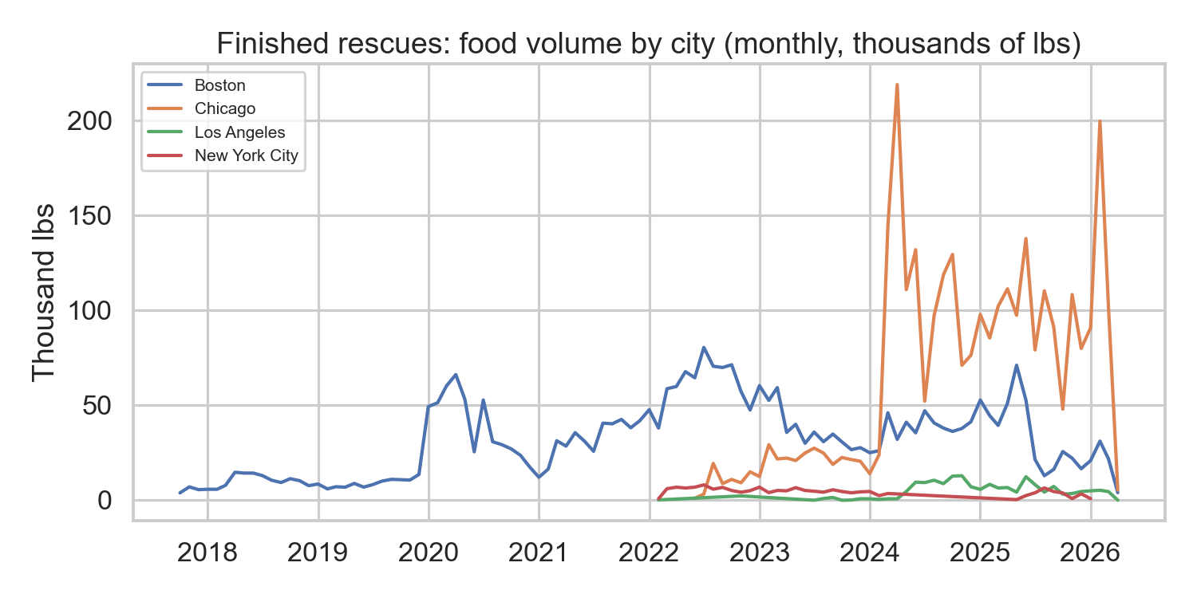
Where volume is growing — by city (monthly lbs)
Finished rescues — use for growth narrative and city mix.

Slide 5
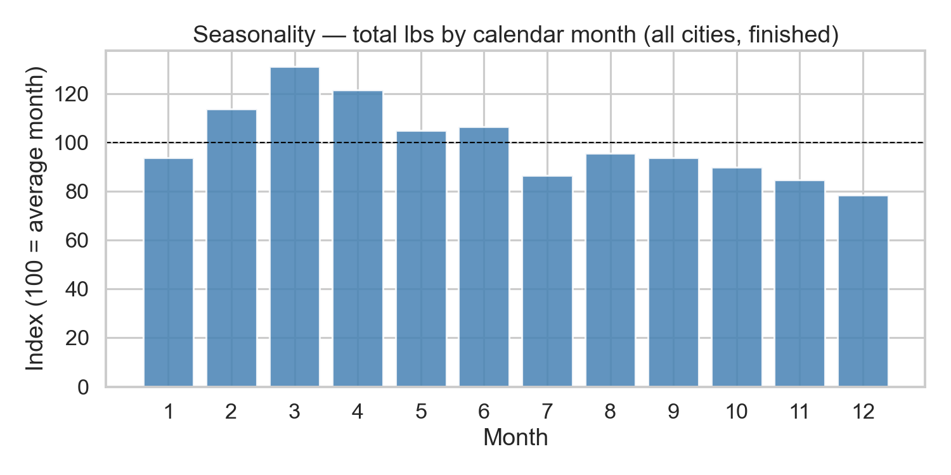
Seasonality — when to staff drivers
Index vs average month — align volunteer shifts and donor reminders.

Slide 6
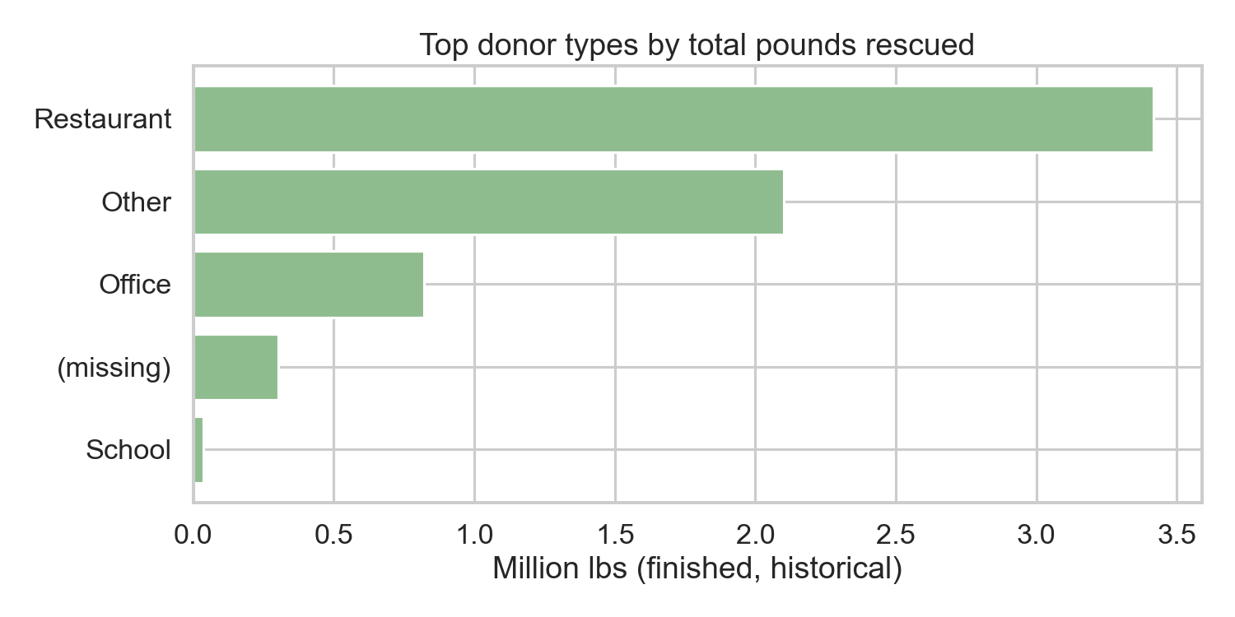
Donor types — who supplies the pounds
Prioritize outreach by high-volume donor categories.

Slide 7
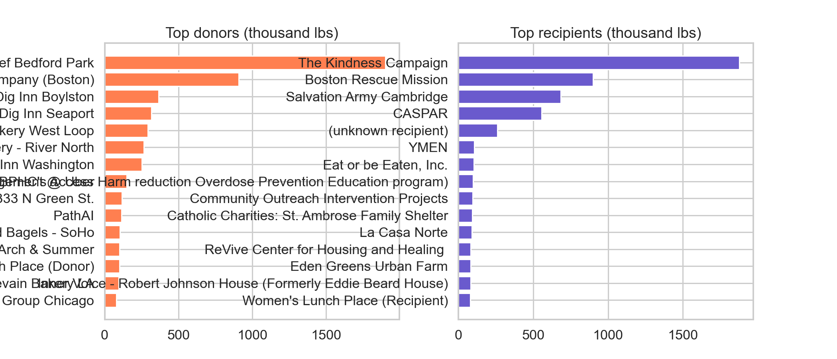
Top donors & recipients
Deepen anchor partnerships; watch recipient load.

Slide 8
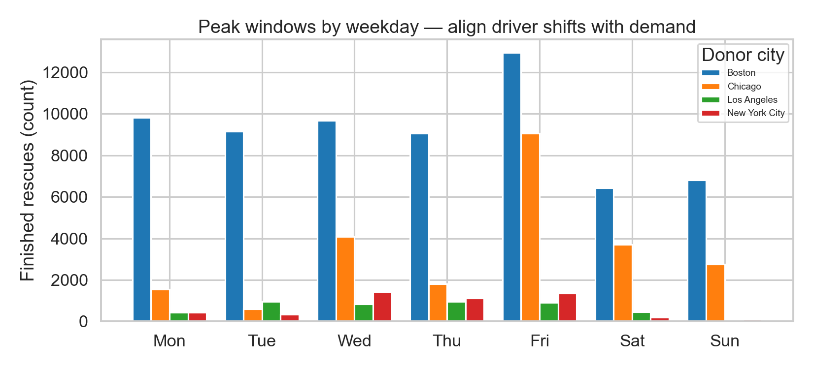
Operations — weekday peaks
Schedule capacity where weekday demand spikes.

Slide 9
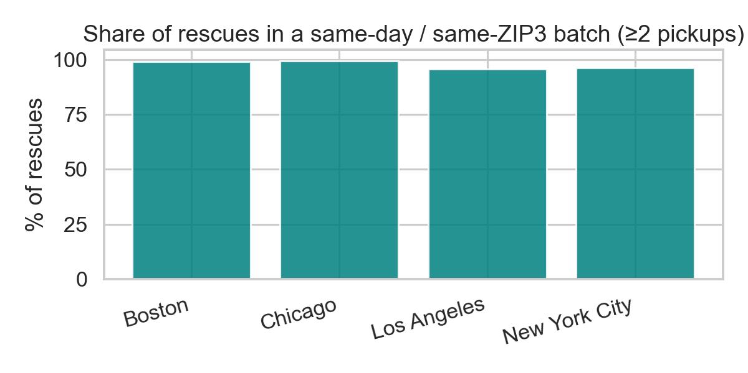
Cost focus — same-area batching (ZIP3 proxy)
Multi-stop routes in dense ZIP3s reduce duplicate trip starts.

Slide 10
Maps & hot spots (live demo)
Route map: donor ZIP → recipient ZIP flows, weighted by pounds.
Heat map: surplus concentration by donor ZIP for targeting and batching.
Run locally: streamlit run app.py → Map & Waste pages.

Slide 11
Scheduling & marketplace prototype
Donors post pounds + pickup window; see estimated landfill savings vs trip cost.
Drivers/riders post capacity and availability — live board with masked contacts.
Shows how RLC could coordinate like a platform while staying nonprofit-led.

Slide 12
Economics story (for businesses)
Landfill/hauling is not free — donation + batched rescue can beat throw-away cost under realistic assumptions.
RLC coordination spreads logistics learning; grants/partners can subsidize trips so donors are not “priced out.”
Full calculator in app: Strategy & economics page.

Slide 13
Recommendations
Staff and route-batch around weekday + seasonal peaks.
Prioritize corridors (ZIP3) with repeated multi-pickup days.
Pilot scheduling board with RLC ops; add auth, DB, and SMS/email next.

Slide 14
Thank you
Questions?
Demo: http://127.0.0.1:8501 (local Streamlit)

