Slide 1

Comp-6321 Project Presentation Analyzing Suspicious URLs using Machine Learning Algorithms
Mandeep Kaur
Std. ID- 40059801
k_ndeep@encs.concordia.ca

Slide 2
Project Outline
Reference Paper
Introduction
Goal of Project
Project Architecture
Software Requirements
Results
Learning Outcomes
Summary

Slide 3
Research Paper
Justin Ma, Lawrence K. Saul, Stefan Savage, and Geoffrey M. Voelker, Identifying suspicious URLs: an application of large-scale online learning, in Proceedings of the 26th Annual International Conference on Machine Learning, New York, NY, USA, 2009, ICML 09, pp. 681688, ACM.

Slide 4

Suspicious/Malicious URLS
Malicious URLs are serious threat to cyber security.
They host unsolicited content and attack unsuspected users, making them victims of various types of scams:
Theft of money
Identity theft
Malware Identification

Slide 5
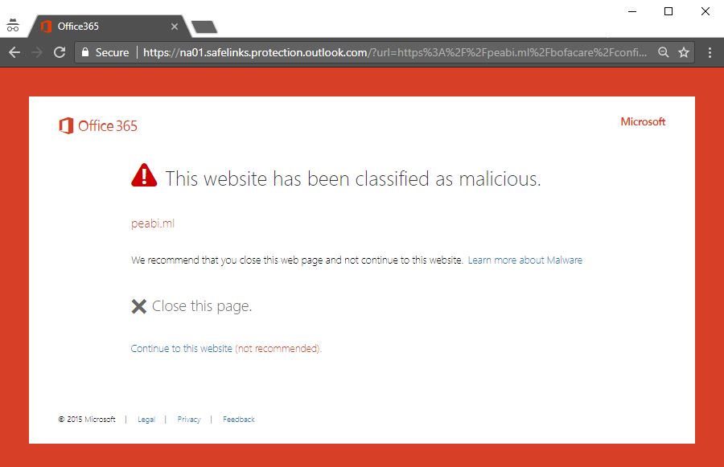


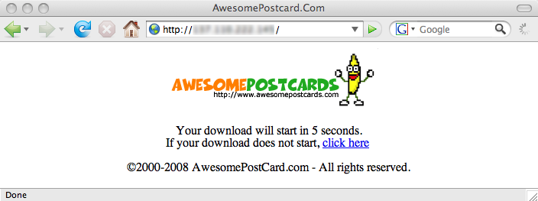

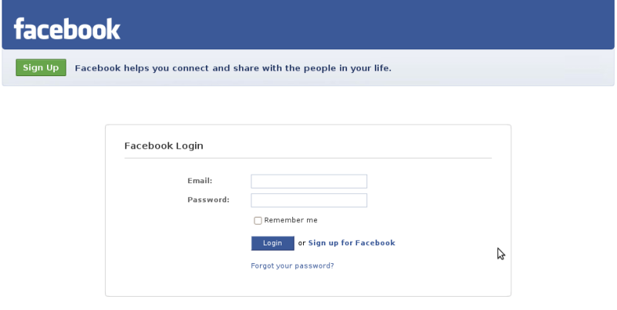
Few Examples
Trojan downloads
Phished Websites: Which one is real ?

Slide 6

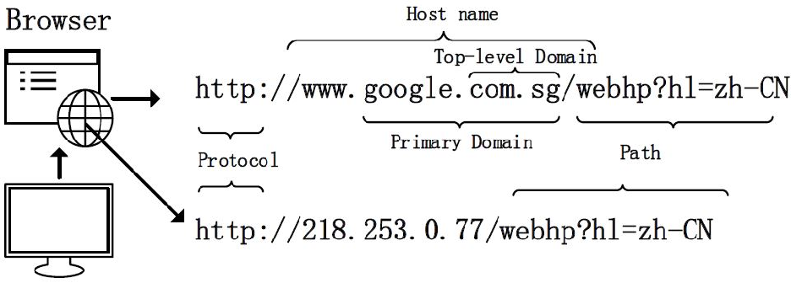
Example of a URL: Uniform Resource Locator

Slide 7
Objective
The aim of this project is to detect malicious websites by doing analysis of existing datasets containing suspicious
and benign URLs using well known Machine learning
algorithms.
Focus is on achieving better accuracy to improve the model.

Slide 8
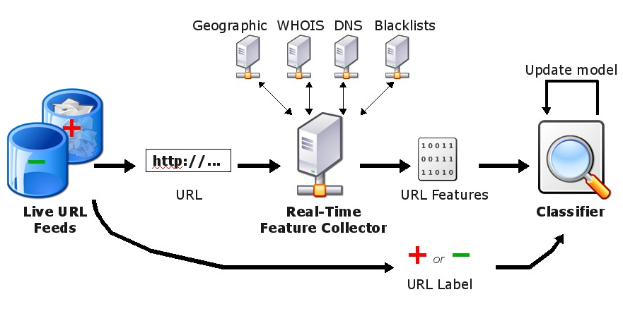
Live URL Classification System (Research Paper)

Slide 9
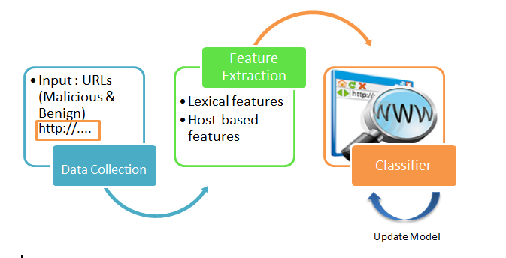
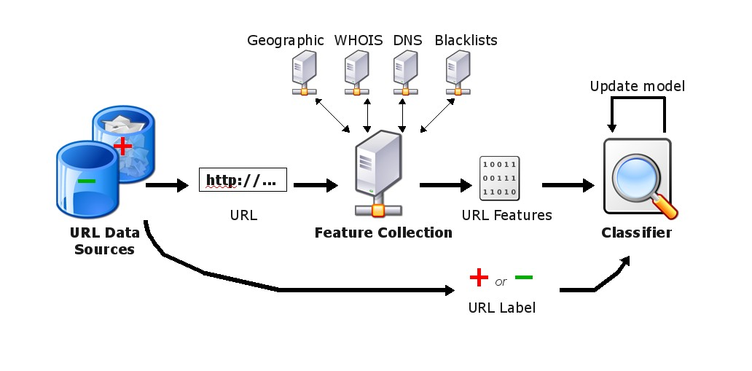



URL Classification Model (Implemented Project Model)
Label
Hypothesis
$${ y}_{t}∈\left\{1,0\right\}$$
Example

Slide 10
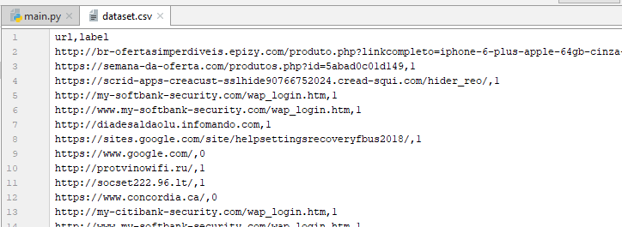
Dataset
Dataset contains URLs with labels 0 and 1
Label 1 – malicious URL (from Phish Tank and Spam)
Label 0 – Benign URL (from Yahoo Web Directory)

Slide 11
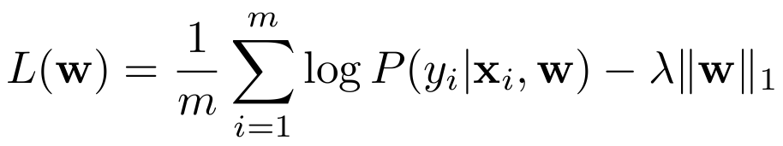
Algorithms used:
Logistic Regression
Easy to understand
Implicit feature selection
Support Vector Machine (Linear SVM)
Well suited for high dimensional data
Fast computation
High accuracy

Slide 12
Features
Example

Slide 13
Lexical Features
The property that malicious URLs tend to look different from benign URLs, such as,
Length of URL
Domain length
Number of dots
Tokens in URL host name
and path
Average token count and
many more.

Slide 14
Host Based Features
They describe properties of website host and allows us to approximate ‘where’ malicious sited are hosted, ‘who’ own them and ‘how’ they are managed.
WHOIS – Registration date, Registrar, Registrant
IP Prefix, Autonomous System Number (ASN)
Connection speed

Slide 15
Software Specifications
Operating System – Windows 10
Python 3.6
IntelliJ IDEA 2018.1
Libraries used – skLearn , pandas, numpy
Testing
Code tested on:
Python Shell 3.6
IntelliJ IDEA 2018.1
Windows Command Prompt (version 10.0.1)

Slide 16

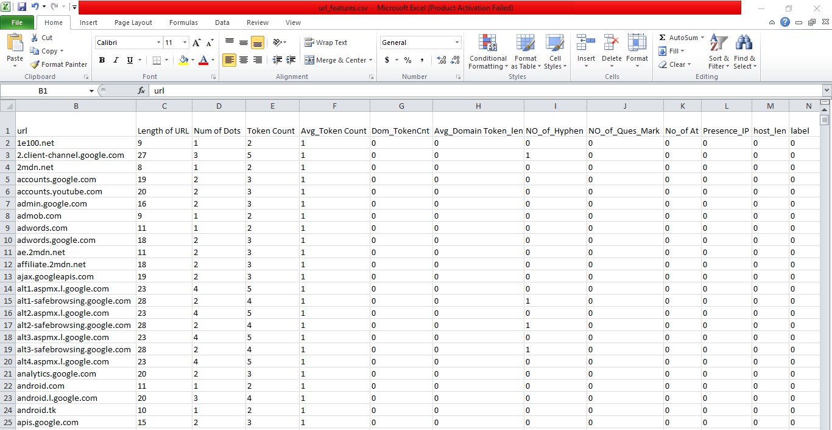
Experiment Results
Representation of the features set data collected
from URLs.

Slide 17
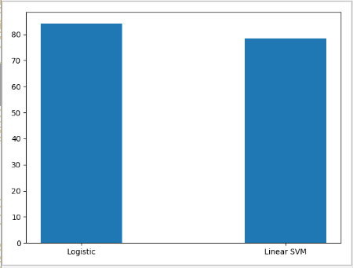
Experiment Results
Graph representation showing performance
comparison of both the classifiers.
Logistic = 84.16 and Linear SVM = 78.46

Slide 18
Learning Outcomes
Difference between Supervised and unsupervised learning.
Importance of feature vectors for a classifier to perform well.
Importance of machine learning for real world problems.

Slide 19
Conclusion
Logistic regression performed better than Linear SVM
with accuracy i.e., 96% with test size = 25%.
More features = Better accuracy
From cross validation, it is analyzed that accuracy depends on test size of the dataset i.e., accuracy varies with the increase or decrease in the test size.
Test Size (%) | Accuracy(%)
 | Logistic Regression | SVM | Perceptron
10 | 79 | 85 | 58
20 | 97 | 81 | 61
25 | 96 | 74 | 65

Slide 20
Future Work
Getting high accuracy by adding more feature vectors other than lexical and host.
Implement online algorithm to compare present results and achieving better learning model.

Slide 21
Thank you

