Slide 1

Technology Usage: Current, Future & Demographics
Developer Survey Dashboard Summary (Cognos)
Prepared by: Mandeep Kour
Date: 13-Sep-2025

Slide 2


OUTLINE
Executive Summary
Introduction
Methodology
Results — Programming Language Trends: Current, Next Year, Findings & Implications
Results — Database Trends: Current, Next Year, Findings & Implications
Job Postings Visualization
Web Frameworks- Current & Future
Dashboard: Current Technology Usage
Dashboard: Future Technology Trend
Dashboard: Demographics
Dashboard Insights
Overall Findings & Implications
Conclusion
Appendix

Slide 3

EXECUTIVE SUMMARY
Stacks: JS/TS and C#/.NET lead current and future language interest; Python remains highly attractive.
Databases: PostgreSQL dominates future demand; SQL Server/MySQL remain significant today; polyglot pairs (Postgres+Redis/SQLite) appear.
Platforms: AWS is most used and most desired; Azure and GCP follow.
Frameworks: Strong signals for React, Spring Boot, ASP.NET Core, Node.js, FastAPI.
Demographics: Largest cohorts 25–34 and 35–44; education led by Bachelor’s, then Master’s.
Implication: Invest training and hiring in AWS + PostgreSQL + JS/TS + C# + Python; maintain SQL as a baseline skill

Slide 4

INTRODUCTION
Purpose: Summarize current usage and future interest in languages, databases, platforms, and frameworks; profile respondent demographics.
Audience: Hiring managers, practice leads, and L&D teams planning skills, staffing, and training.
Value: Aligns talent strategy with market interest; informs stack choices for upcoming projects and upskilling.

Slide 5

METHODOLOGY
Data Sources:
Developer survey (survey_data_updated.csv) analyzed in IBM Cognos Analytics.
Job postings (job-postings.xlsx) via API/web queries; popular languages salaries (popular-languages.csv/HTML).
Collection/Wrangling:
Split multi-select tech fields on ‘;’, trim, drop blanks; compute Top-10 counts.
Parsed salary strings ($, commas, k, ranges) to numeric; validated outliers (e.g., “R” false positives) with strict matching.
Built 3 dashboards (2×2 panels) with value labels and clear titles.
Tools:
Cognos (dashboards), Python/pandas & Matplotlib (cleaning + plots).

Slide 6
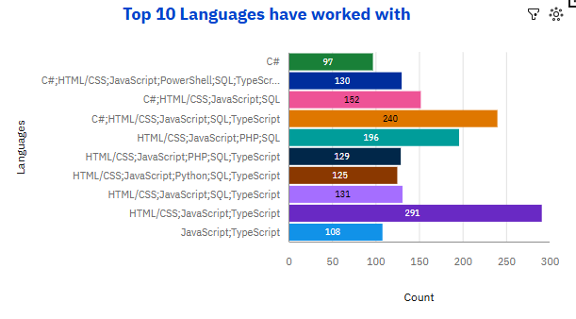
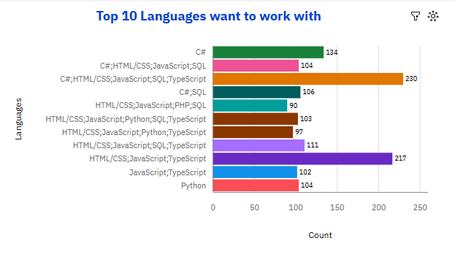
PROGRAMMING LANGUAGE TRENDS
Current Year (worked with)
Next Year (want to work with)

Slide 7
Top 10 PROGRAMMING LANGUAGES Worked with TRENDS - FINDINGS & IMPLICATIONS
Finding | Implication
JS/TS web stack dominates (e.g., HTML/CSS; JavaScript; TypeScript). | Keep JS/TS as core; prioritize hiring/training and standards around TS-based front-ends.
Enterprise .NET full-stack combos are very strong (C#; HTML/CSS; JavaScript; SQL; TypeScript). | Continue investing in C#/.NET APIs paired with TS front-ends; staff cross-functional squads.
PHP appears in popular current combos (…JavaScript; PHP; SQL). | Plan maintenance for PHP apps; begin modernization/migration paths.
Python shows in mixed stacks (…JavaScript; Python; SQL; TypeScript) rather than standalone. | Support Python for data/automation/back-end services, but expect it mainly alongside JS/TS.
SQL present across many combos. | Keep SQL/data-modeling as a baseline competency for all devs.
PowerShell appears in a long current combo only. | Likely legacy/ops usage; shift automation to more portable tools where possible.
Multi-tech combos > single languages. | Hire and train for T-shaped, polyglot developers comfortable across front-end, back-end, and DB.

Slide 8
Top 10 PROGRAMMING LANGUAGES want to work with TRENDS - FINDINGS & IMPLICATIONS
Finding | Implication
JS/TS web stack remains a top desire (HTML/CSS; JavaScript; TypeScript). | Continue deepening TS/JS capability (frameworks, testing, performance).
.NET remains highly desired (C#; HTML/CSS; JavaScript; SQL; TypeScript) and standalone C# interest rises. | Expand .NET hiring/training; create back-end C# growth paths.
Python appears as a clear standalone interest. | Add/scale Python learning tracks (APIs, data, automation); seed Python projects.
PHP combos drop in desirability compared to current. | De-emphasize new PHP builds; offer reskilling from PHP to JS/TS, C#, or Python.
SQL still pervasive in desired combos. | Reinforce SQL fundamentals and query optimization training.
Desire continues to favor polyglot stacks (combos common). | Structure roadmaps and curricula for cross-stack fluency; encourage full-stack rotations.

Slide 9
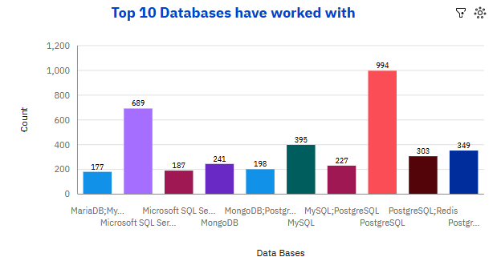
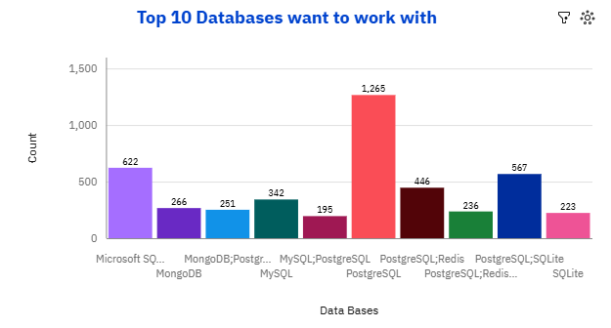
DATABASE TRENDS
Current Year
Next Year
< Bar chart of top 10 databases for the current year goes here >
< Bar chart of top 10 databases for the next year goes here.>

Slide 10
Top 10 DATABASES have worked with - FINDINGS & IMPLICATIONS
Finding | Implication
PostgreSQL is the top current DB (~994). | Keep Postgres as a primary platform; invest in tuning, extensions, and managed Postgres.
Microsoft SQL Server is widely used (~689). | Maintain strong MS SQL support; plan integration/migration paths where desired.
MySQL has broad current usage (~395). | Continue MySQL ops/readiness; not the main growth engine but still core.
MongoDB appears but behind the top RDBMS. | Use MongoDB selectively for document use-cases; avoid defaulting to it.
PostgreSQL+Redis / PostgreSQL+SQLite combos are present (303 / 349). | Encourage polyglot patterns (Postgres core + Redis cache/queues; SQLite for edge/offline).
MariaDB shows up mainly in combos, not leading. | Limit new MariaDB starts; standardize on Postgres/MySQL for relational.

Slide 11
Top 10 DATABASES want to work with - FINDINGS & IMPLICATIONS
Finding | Implication
PostgreSQL dominates future interest (~1,265). | Prioritize Postgres training, migrations, and new builds on Postgres.
PostgreSQL+SQLite (~567) and PostgreSQL+Redis (~446) are popular future combos. | Plan architectures with Postgres core plus SQLite (edge) and Redis (cache/streaming).
Microsoft SQL Server still has strong interest (~622). | Continue MS SQL capability for enterprise workloads; support hybrid landscapes.
MySQL interest remains (solo ~342; combo ~195). | Keep MySQL competency; use where it fits legacy or specific ecosystems.
MongoDB interest is moderate (~251). | Apply for document-heavy schemas; avoid one-size-fits-all adoption.
SQLite also appears standalone (~223). | Enable local/embedded/offline apps; add tooling/pipelines for sync patterns.

Slide 12
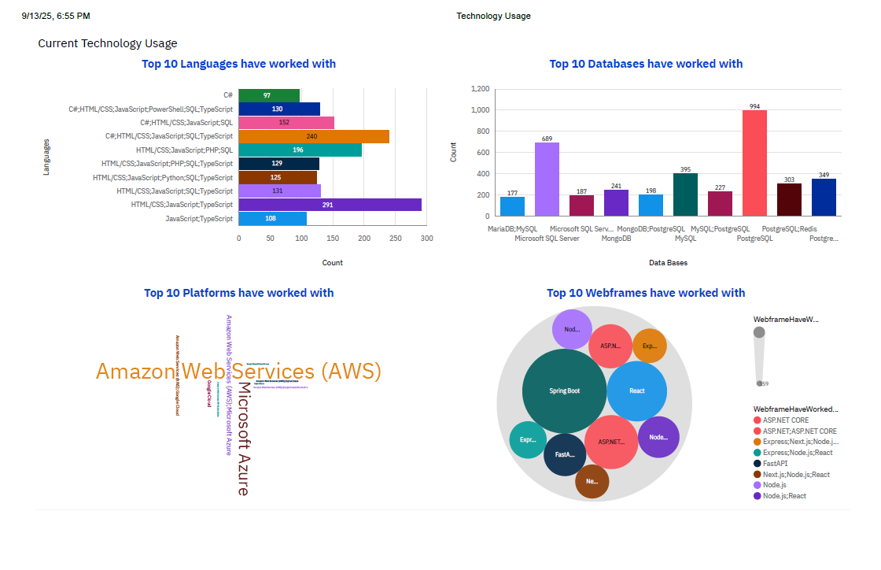
DASHBOARD TAB 1

Slide 13
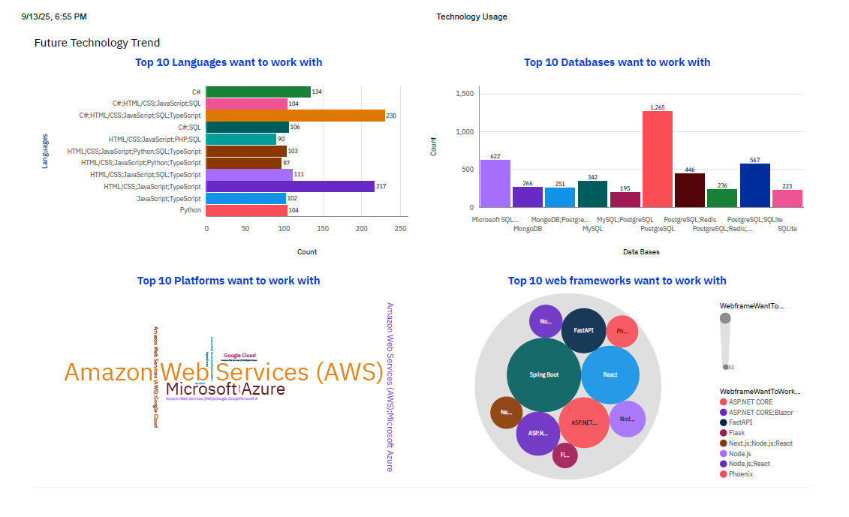
DASHBOARD TAB 2

Slide 14
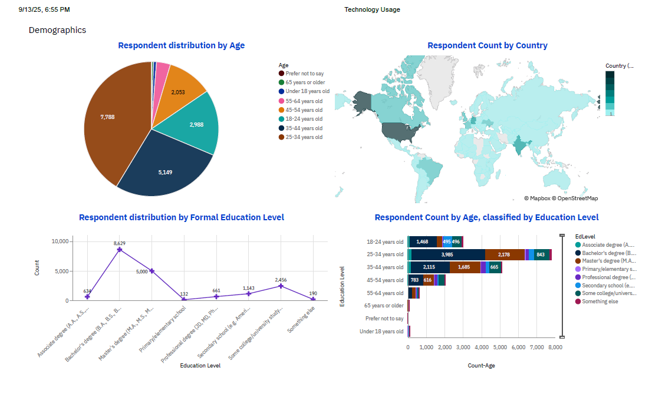
DASHBOARD TAB 3

Slide 15

DISCUSSION
Current Technology Usage
Languages: JS/TS web stack leads (e.g., HTML/CSS; JavaScript; TypeScript). Strong .NET full-stack combos (C#; TypeScript) also rank high; PHP appears but behind leaders.
Databases: PostgreSQL is the top RDBMS; SQL Server and MySQL remain widely used; polyglot mixes (Postgres+Redis/SQLite) are present.
Platforms: AWS is most prominent, followed by Microsoft Azure (and Google Cloud).
Web frameworks: Big bubbles for Spring Boot and React, with ASP.NET Core, Node.js, FastAPI, and Express in the pack.
Future Technology Trend
Languages (desire): Momentum continues for JS/TS and C#; Python interest rises.
Databases (desire): Clear tilt to PostgreSQL (dominant), with Postgres+SQLite and Postgres+Redis popular combos.
Platforms (desire): AWS still the #1 target; Azure and Google Cloud follow.
Web frameworks (desire): Interest clusters around React, Spring Boot, ASP.NET Core, FastAPI.
Demographics
Age: Largest cohorts are 25–34 and 35–44, then 18–24; seniors and minors are small shares.
Country: Broad global distribution with strong concentrations in North America, Europe, and South Asia.
Education: Bachelor’s is the largest group, followed by Master’s; other levels are smaller.
Age × Education: Bachelor’s-level respondents dominate the 25–34 and 35–44 groups.

Slide 16
Current Technology Usage - Findings & Implications
Area | Key Finding | Implication
Languages | JS/TS web stack leads; C#/.NET full-stack very strong; PHP appears but lower. | Keep JS/TS and C#/.NET as primary stacks; put PHP in maintenance & plan modernization.
Databases | PostgreSQL tops usage; SQL Server and MySQL widely used; polyglot mixes (Postgres+Redis/SQLite) present. | Invest in PostgreSQL excellence; maintain SQL Server/MySQL; use Redis/SQLite tactically.
Platforms | AWS dominates with Azure next; GCP visible. | Keep AWS-first standards; ensure Azure/GCP depth for partner/customer needs.
Web Frameworks | Big bubbles for Spring Boot and React; ASP.NET Core, Node.js, FastAPI, Express active. | Resource squads across Java/Spring, React/Node, ASP.NET Core; enable FastAPI/Express for services.
Skills Pattern | SQL appears across stacks; multi-tech combos > single languages. | Make SQL baseline; hire/train T-shaped polyglot developers.

Slide 17
Future Technology Trend - Findings & Implications
Area | Key Finding | Implication
Languages (Desire) | JS/TS and C# remain top; Python interest rises; standalone C# demand increases. | Expand learning paths & roles in TS/React/Node, C#/.NET, and Python (APIs/data/automation).
Databases (Desire) | PostgreSQL is the clear target; combos Postgres+SQLite and Postgres+Redis popular; MS SQL still strong; MySQL/Mongo moderate. | Default new builds to Postgres; architect SQLite (edge/offline) and Redis (cache/streams); keep MS SQL/MySQL competency.
Platforms (Desire) | AWS remains #1; Azure and GCP follow. | Prioritize AWS certifications/patterns; curate Azure/GCP upskilling as secondary.
Web Frameworks (Desire) | Interest clusters around React, Spring Boot, ASP.NET Core, FastAPI. | Focus enablement/hiring on these frameworks; standardize toolchains.
Overall Direction | Continuity from current → future with a decisive tilt to PostgreSQL and steady AWS / JS/TS / C#. | Concentrate investments on PostgreSQL, AWS, JS/TS + C#; grow Python; support polyglot stacks.

Slide 18
Demographics - Findings & Implications
Metric | Key Finding | Implication
Age | Largest cohorts: 25–34, then 35–44, then 18–24. | Aim upskilling and career paths at early–mid career talent.
Country | Broad global spread with strong NA, Europe, South Asia presence. | Schedule programs across time zones; localize examples where useful.
Education | Bachelor’s is the largest group, followed by Master’s. | Tailor curriculum depth and prerequisites to Bachelor’s/Master’s audiences.
Age × Education | Bachelor’s dominates within 25–34 and 35–44 groups. | Target certifications/advanced tracks to these cohorts for maximum impact.
Workforce Planning | Demographic base supports scalable training and cross-stack growth. | Build pipeline programs, mentorship, and rotations to develop full-stack capability.

Slide 19

CONCLUSION
Where we are now (Current Usage): JS/TS web stack and C#/.NET dominate; PostgreSQL is the leading DB with SQL Server/MySQL still significant; AWS is the most-used platform; frameworks cluster around Spring Boot, React, ASP.NET Core, Node.js, FastAPI
Where we’re heading (Future Trend): Continued preference for JS/TS and C#, with rising Python interest. PostgreSQL is the clear target DB (often paired with Redis or SQLite). AWS remains the top aspiration; Azure/GCP follow. Framework interest centers on React, Spring Boot, ASP.NET Core, FastAPI
Who we’re building for (Demographics): Largest cohorts are 25–34 and 35–44 with Bachelor’s then Master’s degrees; respondents span North America, Europe, and South Asia
Implications:
Standardize new builds on PostgreSQL; keep SQL Server/MySQL well supported.
Keep AWS-first patterns; maintain depth in Azure/GCP.
Prioritize skills and hiring in TypeScript/React/Node, C#/.NET, and Python; make SQL a baseline skill.
Encourage polyglot designs (Postgres core + Redis cache/streams; SQLite for edge/offline)
Next 60–90 days (actions): • Launch focused upskilling: AWS + Postgres + TS/React + C# + SQL. • Identify 2–3 services to migrate/pilot on Postgres (with Redis/SQLite where useful). • Align hiring reqs to target stacks; add a Python track for data/APIs. • Define success metrics: time-to-first-commit on new stack, defect rate, perf gains, migration milestones

Slide 20

APPENDIX
Data & Prep
Source: survey_data_updated.csv (18,845 rows, 114 columns).
Multi-select tech fields are semicolon-delimited (;); split to rows, trim, then count values.
Removed null/blank tokens before ranking Top 10
Columns used
Current usage: LanguageHaveWorkedWith, DatabaseHaveWorkedWith, PlatformHaveWorkedWith, WebframeHaveWorkedWith.
Future trend: LanguageWantToWorkWith, DatabaseWantToWorkWith, PlatformWantToWorkWith, WebframeWantToWorkWith.
Demographics: Age, Country, EdLevel
Dashboard structure (Cognos, 3 tabs, 2×2 each)
Current Technology Usage: Bar (Languages), Column (Databases), Word Cloud (Platforms), Hierarchy Bubble (Webframes).
Future Technology Trend: Bar (Languages Want), Column (Databases Want), Treemap (Platforms Want), Hierarchy Bubble (Webframes Want).
Demographics: Pie (Age), Map (Country), Line (Education distribution), Stacked Bar (Age × Education).

Slide 21
APPENDIX
Export (for grading/linking)
Dashboard → Share → Export (Landscape) → Save as PDF → (Next steps optional) upload to GitHub → share read-only link
Limitations / Notes
Self-reported survey; frequency ≠ proficiency.
“Combos” (e.g., HTML/CSS; JavaScript; TypeScript) reflect multi-select responses, not strict stacks.
Top-10 truncation hides long-tail technologies.
Country names must match Cognos map expectations
Glossary
HaveWorkedWith = current usage; WantToWorkWith = future intent.
Hierarchy Bubble = bubble size by count; Treemap = area by count with hierarchical grouping.

Slide 22
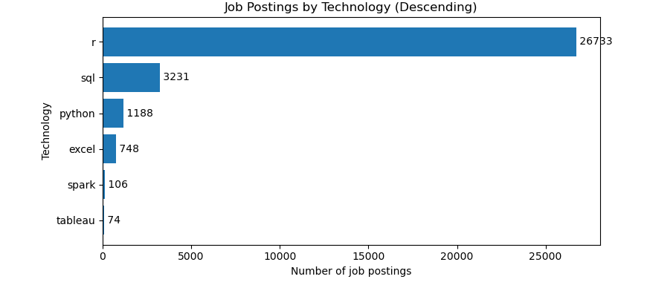
JOB POSTINGS
In Module 1, you have collected the job postings data using web scraping in a file named “popular-languages.csv”. Present that data using a bar chart here. Order the bar chart in descending order of salary
Total postings analyzed: 32,080
Share by tech:
R: 26,733 (83.3%) → suspiciously high
SQL: 3,231 (10.1%)
Python: 1,188 (3.7%)
Excel: 748 (2.3%)
Spark: 106 (0.3%)
Tableau: 74 (0.2%)
Key findings
The bar for R dwarfs everything else; this is very likely a query artifact (single-letter term “r” matching unrelated text).
Ignoring the R anomaly, the demand picture is: SQL > Python > Excel > Spark > Tableau.
Even without R, SQL clearly leads—consistent with data roles where SQL is foundational.
Python shows solid demand; Excel remains relevant; Spark and Tableau are comparatively niche in this snapshot.

Slide 23
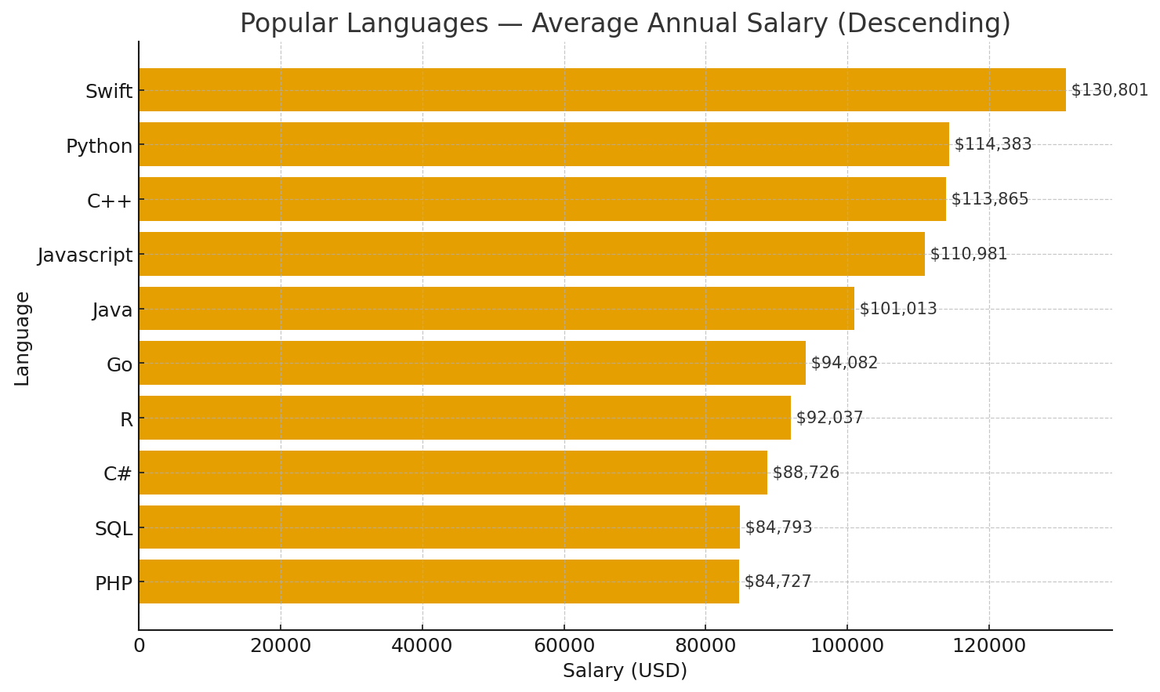
POPULAR LANGUAGES
In Module 1, you have collected the job postings data using web scraping in a file named “popular-languages.csv”. Present that data using a bar chart here. Order the bar chart in descending order of salary.
Top pay: Swift ($130.8k) leads—Apple/iOS specialization commands a premium.
High tier (~$111–114k): Python, C++, and JavaScript cluster just below Swift → strong demand across data/ML (Python), systems/fintech (C++), and web (JS).
Mid tier (~$94–101k): Java ($101k) then Go ($94k) → solid enterprise/server-side roles; Go is strong but below Python/JS in this sample.
Data science niche: R ($92k) trails Python, reflecting broader industry use of Python for DS/ML.
Enterprise stack: C# ($88.7k) sits mid-low versus Java in this set.
Entry/commodity web & core skill: PHP ($84.7k) and SQL ($84.8k) are lowest—valuable, but typically not the main driver of comp when listed alone.
Spread: gap between top and bottom ≈ $46k (~54% over the lowest), so language choice can materially affect salary bands

