Slide 1
C and C++ learnings
https://www.geeksforgeeks.org/c-programming-language/
https://www.programiz.com/c-programming/c-keywords-identifier
https://www.tutorialspoint.com/cprogramming/index.htm

Slide 2
C Data types
Data types in c refer to an extensive system used for declaring variables or functions of different types.
The type of a variable determines how much space it occupies in storage and how the bit pattern stored is interpreted.

Slide 3
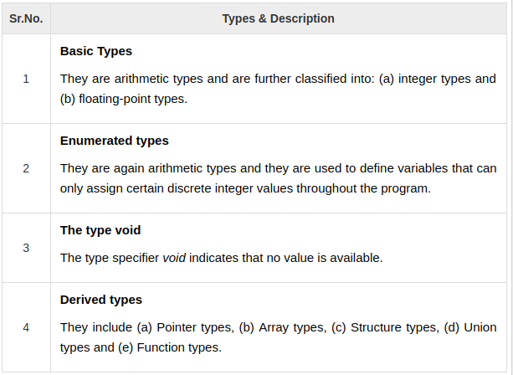
C Data types

Slide 4
C Enum
Enumeration is a user defined datatype in C language. It is used to assign names to the integral constants which makes a program easy to read and maintain. The keyword “enum” is used to declare an enumeration.

