Slide 1
C and C++ learnings
https://www.geeksforgeeks.org/c-programming-language/
https://www.programiz.com/c-programming/c-keywords-identifier
https://www.tutorialspoint.com/cprogramming/index.htm
https://www.cs.utah.edu/~germain/PPS/Topics/C_Language/enumerated_types.html

Slide 2
C Data types
Data types in c refer to an extensive system used for declaring variables or functions of different types.
The type of a variable determines how much space it occupies in storage and how the bit pattern stored is interpreted.

Slide 3
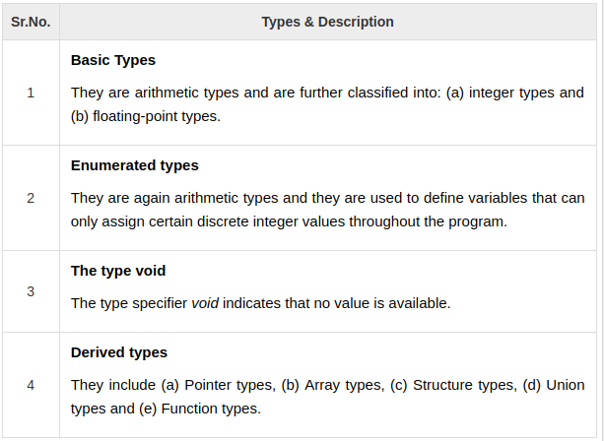
C Data types

Slide 4
C Enum
Enumeration is a user defined datatype in C language. It is used to assign names to the integral constants which makes a program easy to read and maintain. The keyword “enum” is used to declare an enumeration.

Slide 5
Enum types
Enumerated Types are a special way of creating your own Type in C.
Enum type is a "list of key words".
Enumerated types are used to make a program clearer to the reader/maintainer of the program.
For example, say we want to write a program that checks for keyboard presses to find if the down arrow or up arrow has been pressed.
We could say: if ( press_value == 32 ).
32 is the computers representation of the down arrow.
Or, we could create our own enumerated type with the key words: down_arrow and up_arrow.
Then we could say: if ( press_value == down_arrow ).
This second version is much more readable and understandable to the programmer.

Slide 6
Enumeration type declaration
When you create an enumerated type, only blueprint for the variable is created. Here's how you can create variables of enum type.
enum boolean {
false,
true
};
enum boolean check;

Slide 7
Enumeration type declaration
Here is another way to declare same check variable using different syntax.
enum boolean {
false,
true
} check;

Slide 8
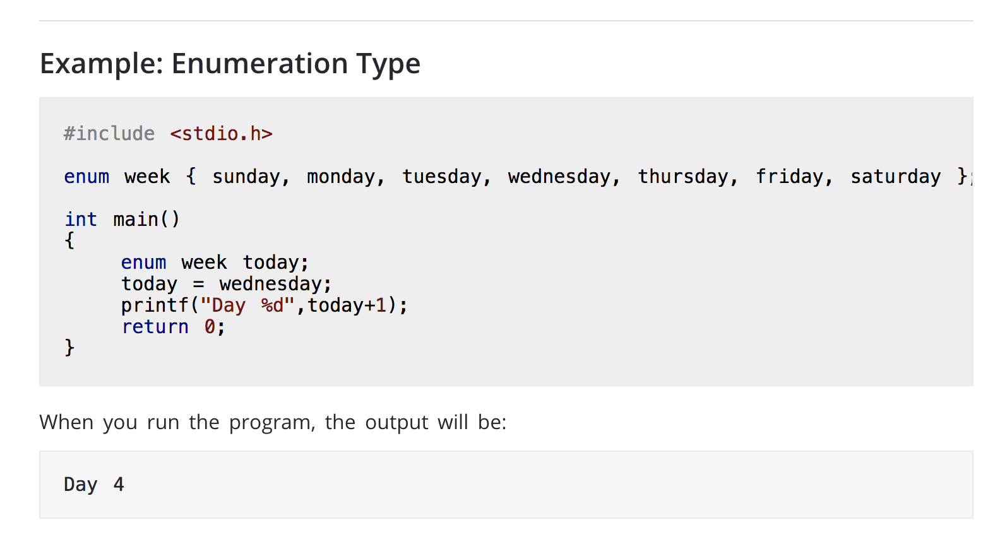
Enumeration type

Slide 9
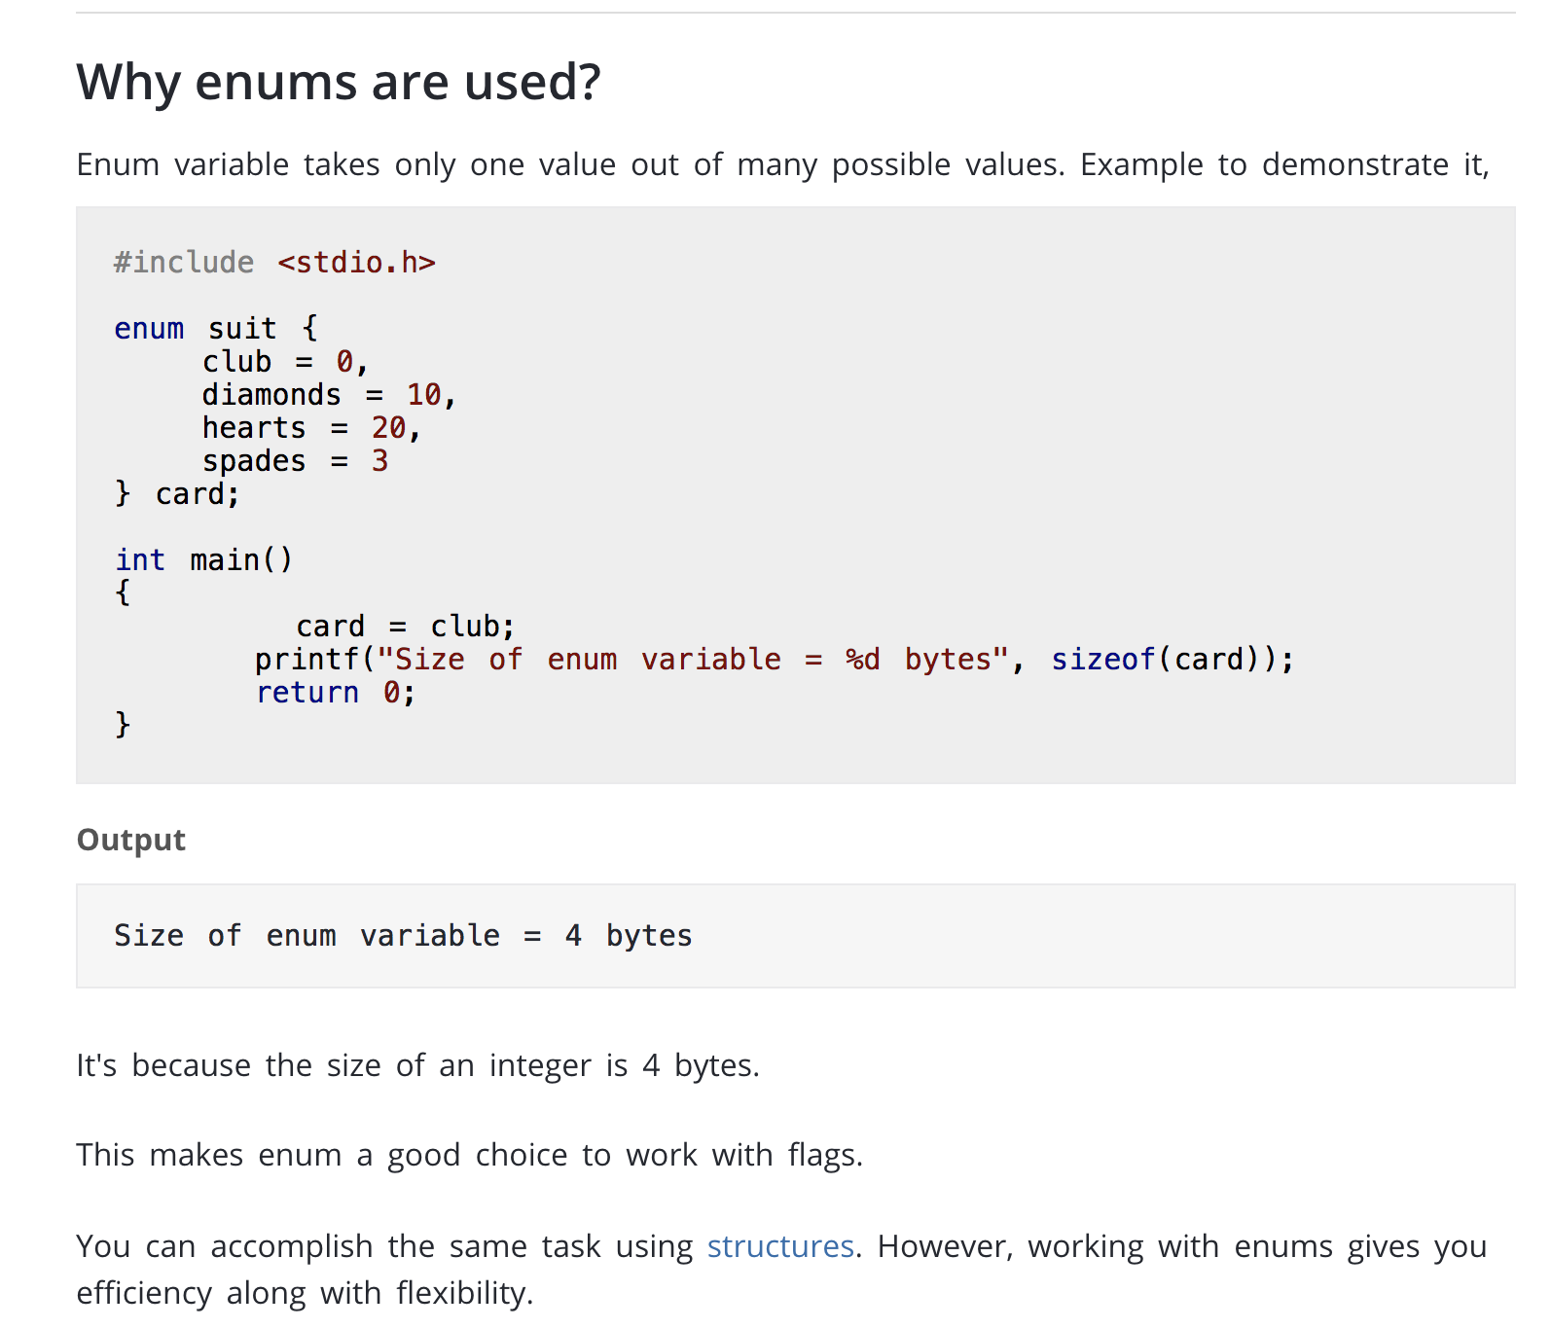
Why enums are used
You can accomplish almost anything in C programming without using enumerations. However, they can be pretty handy in certain situations. That's what differentiates good programmers from great programmers.

Slide 10
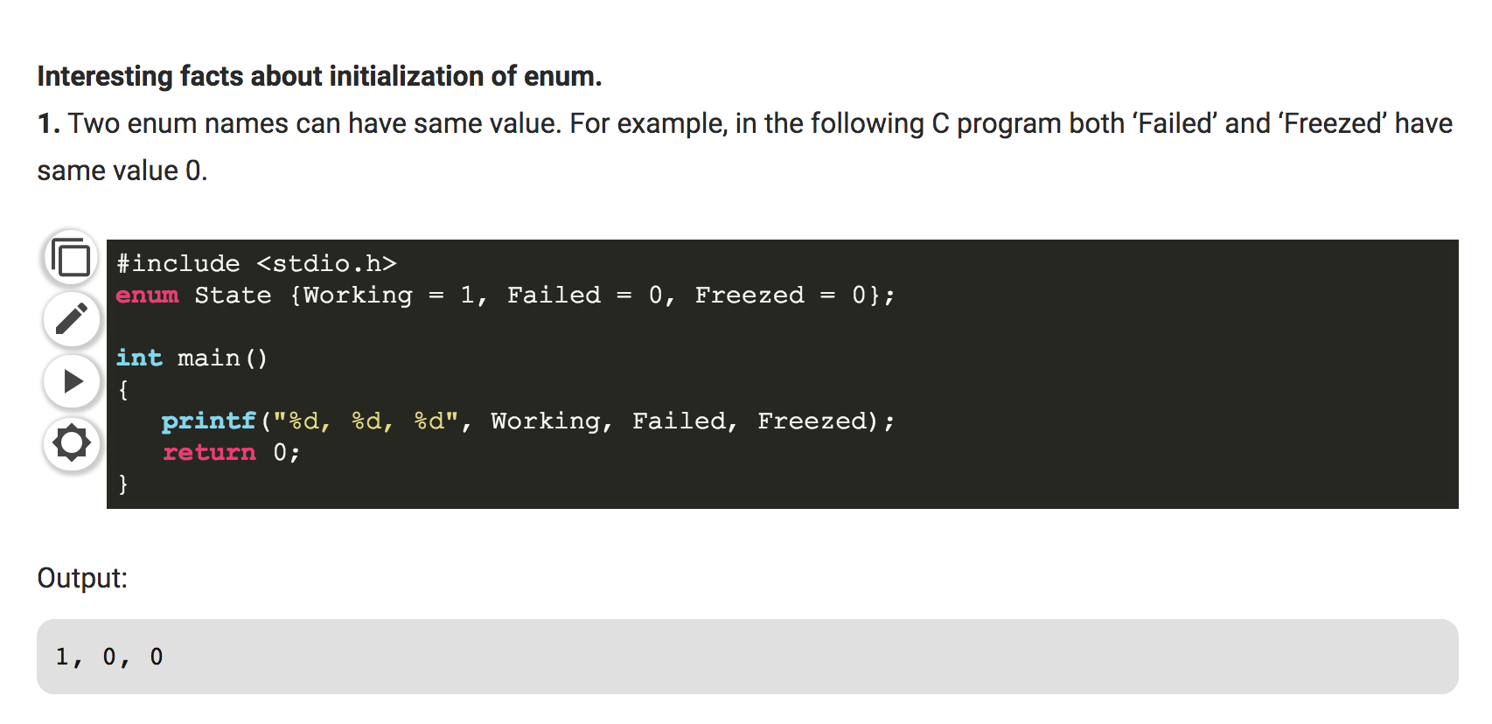
enum fact 1

Slide 11
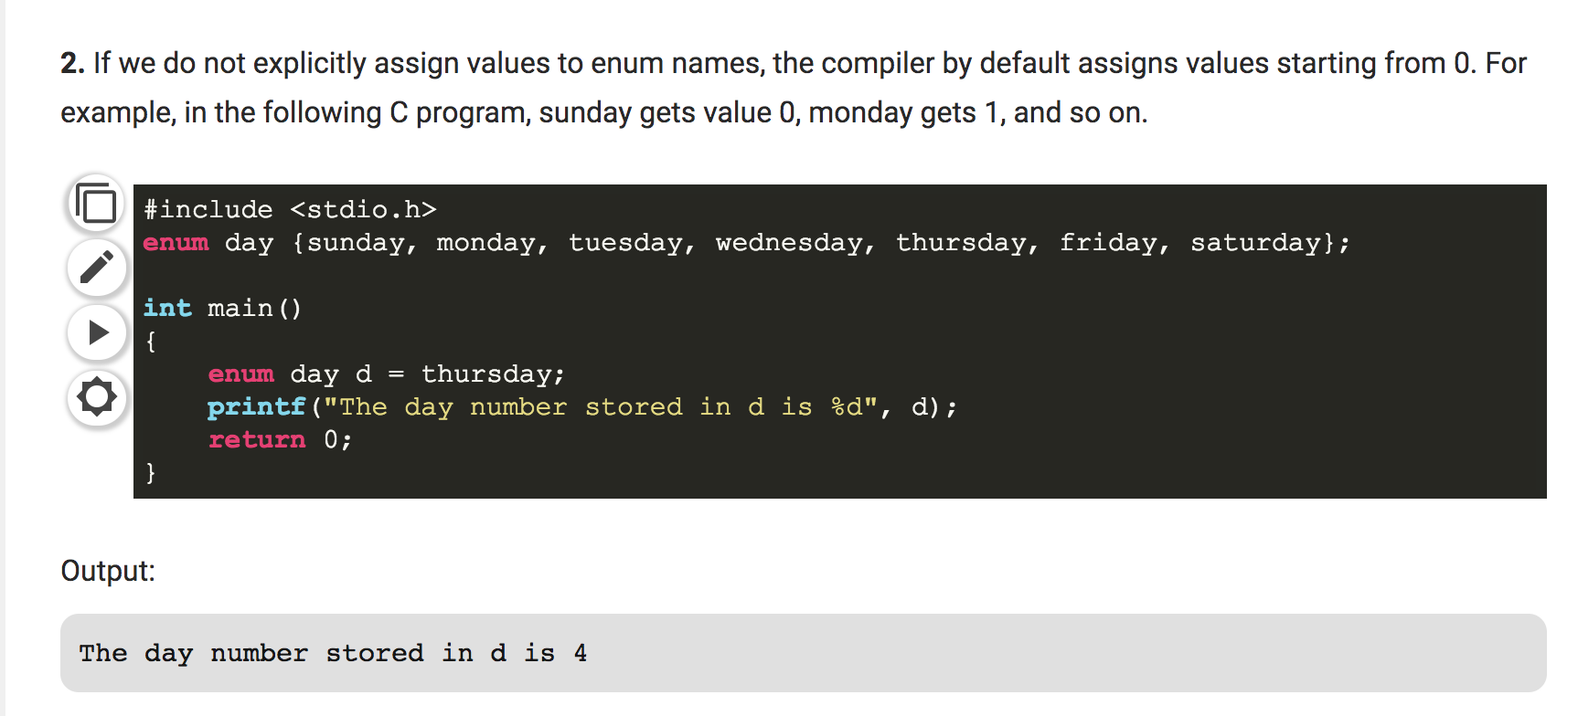
enum fact 2

Slide 12
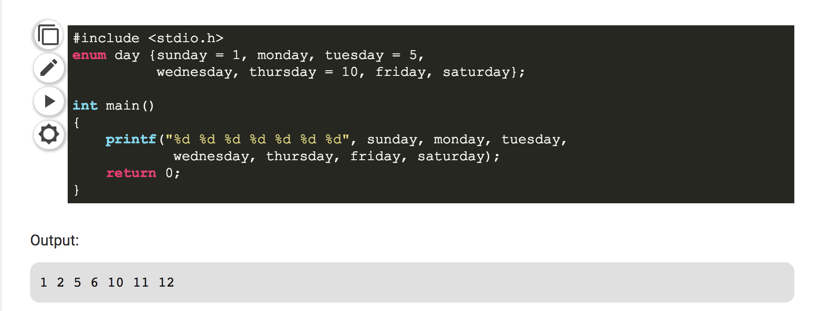
enum fact 3
We can assign values to some name in any order. All unassigned names get value as value of previous name plus one.

Slide 13
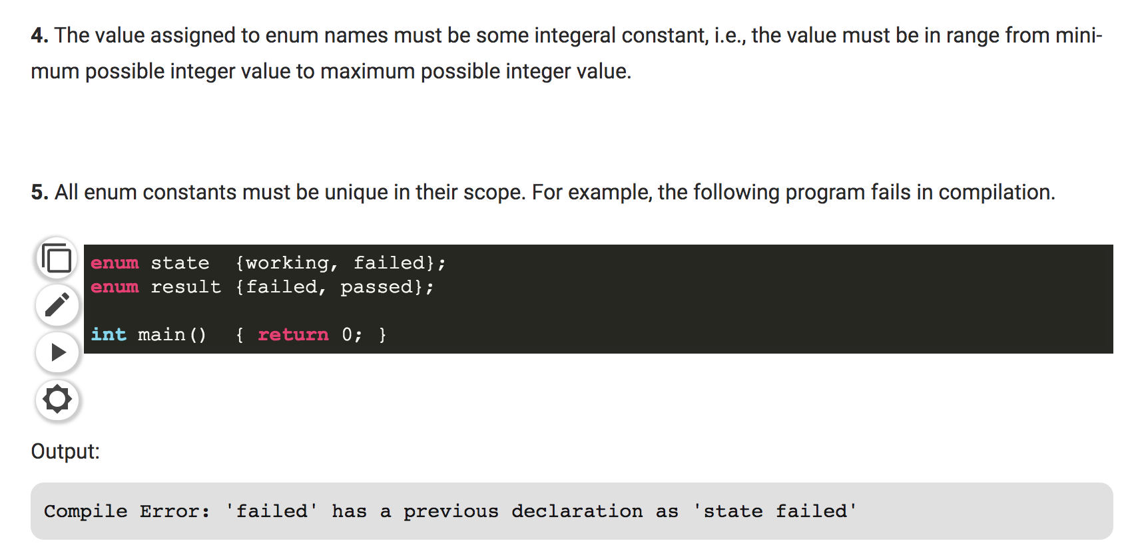
enum fact 4

Slide 14
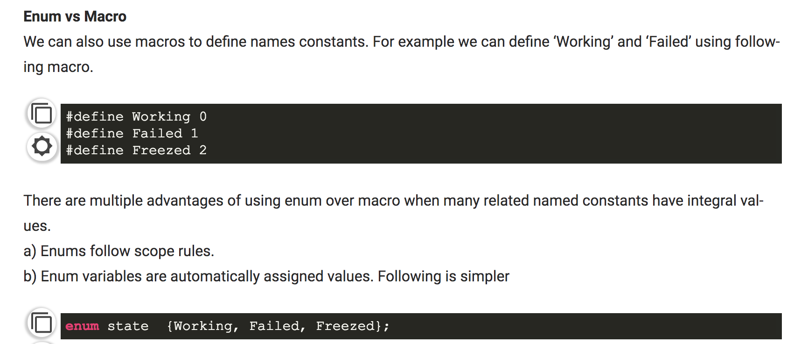
Enum vs Macro

