Slide 1
ZYRON-ML
ABTalks
60 Days. 60 Projects. One Consistent Developer.
DAY 01
BUILD
SHIP
SHARE
GROW
DAY 60
A mobile-first 60-day coding challenge platform for Indian college students — built to turn daily effort into visible proof of work.

Slide 2
01 — THE PROBLEM
Learning to code isn't the hard part. Staying consistent is.
📚
🔄
🚧
📉
Learn
→
Repeat
→
Stall
→
Lose Momentum
Students follow tutorials and courses
But rarely build independently
Projects start but don't finish
No structure, no visibility, no proof
💡 What students actually need: A simple daily structure that keeps them building, shipping, and sharing — with visible proof of their progress.

Slide 3
02 — THE ABTALKS SOLUTION
Turn 60 Days Into 60 Proofs of Work.
Every day, a student receives a challenge, builds a real project, pushes it to GitHub, shares it on LinkedIn, and grows their public portfolio — one day at a time.
🎯
💻
📤
📣
🚀
Challenge
Build
Ship
Share
Grow
Get a new project every day
Code a real project with clear instructions
Push to GitHub — public track record
Post on LinkedIn — visible proof
Earn XP, build streak, create portfolio
The daily loop: Challenge → Build → GitHub commit → LinkedIn post → Streak +1 → XP earned

Slide 4
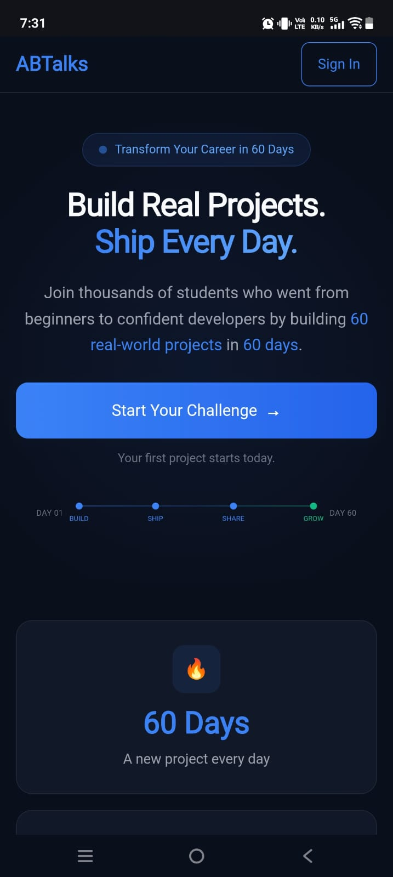
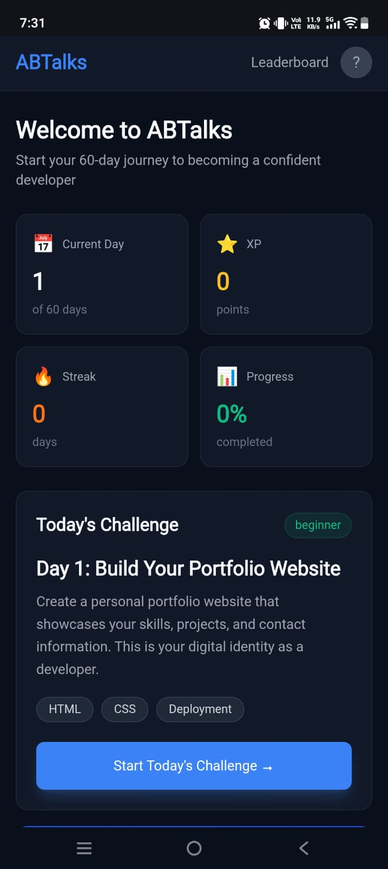
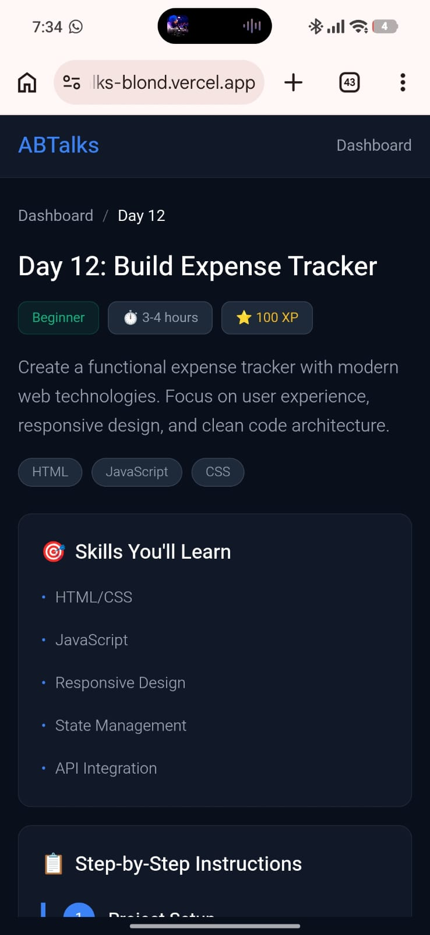
03 — THE PRODUCT
One journey. Three core experiences.
Landing Page
Dashboard
Challenge Day
Discover the challenge → /
Track streak, XP, progress → /dashboard
Build + submit proof → /day/12
1 Landing
→
2 Dashboard
→
3 Challenge Day
→
✓ Proof Submitted

Slide 5
04 — A DAY INSIDE ABTALKS
What does one day actually look like?
DAY 12
Build Expense Tracker
✓
Understand the task — clear instructions and requirements
✓
Build the project — follow step-by-step guide with code samples
✓
Submit GitHub proof — link your repository as proof of work
✓
Share on LinkedIn — post proof publicly for visibility
✓
Submit Live Demo — optional deployment link
✓
Earn +100 XP — streak continues, progress saved
+100 XP earned
🔥 12 day streak

Slide 6
05 — MOTIVATION SYSTEM
Progress you can see.
A deliberate design choice: every element is built to make consistency feel rewarding — not punitive.
➖
🕯️
🔥
🔥
🔥
0 Days
1–6 Days
7–13 Days
14–29 Days
30+ Days
No streak yet
Small flame
Growing flame
Strong flame
Blazing streak
🔥
+100
60
60
Daily Streak
XP per Challenge
Days of Progress
Portfolio Projects

Slide 7
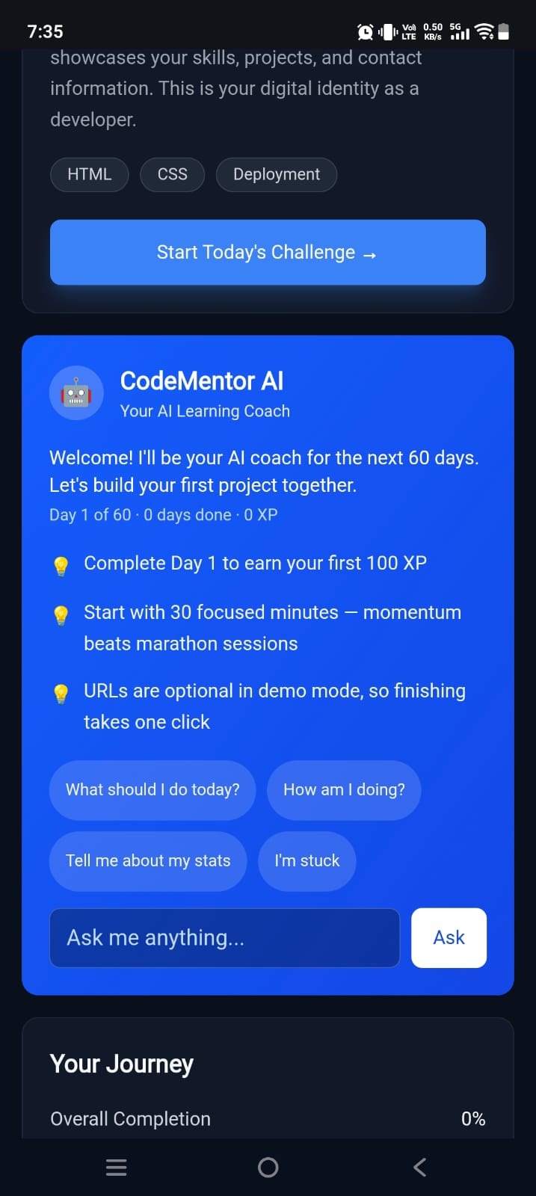
06 — AI LEARNING COACH
When you get stuck, you don't have to stop.
A context-aware support layer built into the dashboard — not a replacement for the challenge, but a guide that helps students keep going.
Progress-aware greetings
Responds to current streak and XP
Contextual Q&A
Answers questions about challenges, milestones, streaks
Quick-question chips
One-tap prompts for fast help
Free-text interaction
Ask anything, get a contextual response
Encouragement engine
Supportive responses for stuck moments

Slide 8
07 — THOUGHTFUL STUDENT EXPERIENCE
Designed for real students — not perfect users.
🌱
First Day
🔄
Missed Day
👤
Empty Profile
0 XP, 0 streak, clean onboarding state. The student sees exactly what to do next — no confusion, no overwhelming history.
Streak resets but progress continues. Supportive messaging — not punitive. The student can pick up right where they left off.
Fresh start with Day 1 unlocked. Clear CTA to begin. No fake data, no misleading progress bars.
Mobile-first at 390px
✓ No horizontal scroll
✓ 44px+ touch targets
✓ Clear hierarchy

Slide 9
08 — DESIGN & TECHNOLOGY
Built as a real product experience.
PRODUCT DESIGN
TECHNOLOGY
Premium dark UI with Deep Navy + Electric Blue
Next.js 16.3
App Router, server components
Mobile-first responsive design optimized for 390px
React 19
Client components, hooks
Streak / XP / milestone visualization system
TypeScript 5
Strict mode, type safety
GitHub + LinkedIn proof-of-work submission flow
AI Learning Coach with contextual guidance
Tailwind CSS v4
Utility-first styling
Edge-case handling: first day, missed day, empty profile
Vercel
Deployment, edge network
localStorage
Client-side persistence
📦 No backend required — all state persisted via browser localStorage. 60 challenge days with progressive difficulty (Days 1–20 beginner, 21–45 intermediate, 46–60 advanced).

Slide 10
Your next 60 days start here.
📅
⚡
💻
📣
60 Days
60 Projects
GitHub Proof
LinkedIn Proof
ABTalks turns daily coding into a habit → a portfolio → public proof of work
Build. Ship. Share. Grow.

