Slide 1
FUNCTIONS
TYPES OF FUNCTIONS

Slide 2
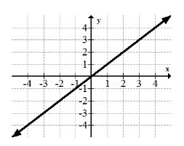
IDENTITY FUNCTION
Algebraic expression:f(x)=x
Domain: all Real Numbers
Range: all Real Numbers

Slide 3
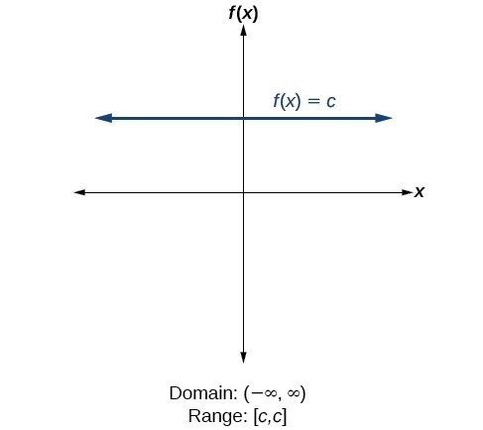
CONSTANT FUNCTION
Algebraic expression: f(x)=C
Domain: all Real Numbers
Range: constant

Slide 4
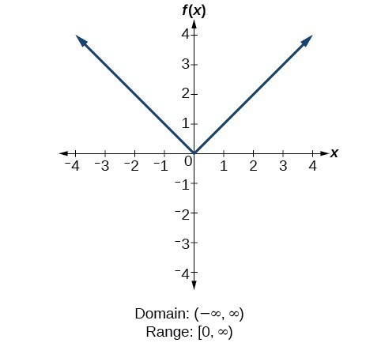
MODULUS FUNCTION
Algebraic expression: f(x)= |x|
Domain: all Real Numbers
Range: all non-negative Real Numbers

Slide 5
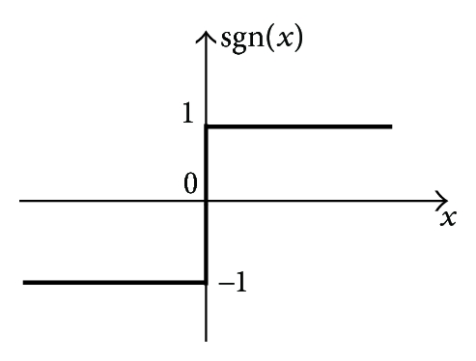
SIGNUM FUNCTION
Algebraic expressions: f(x)= 1 if x>0
Domain: all Real Numbers 0 if x=0
Range: -1,0,1 -1 if x<0

Slide 6
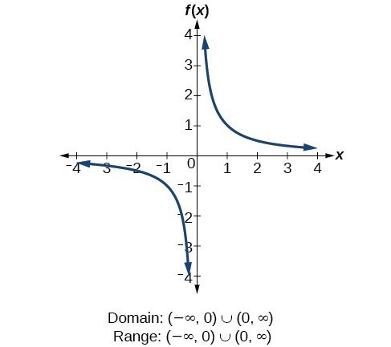
RECIPROCAL FUNCTION
Algebraic expressions: f(x)= 1/x
Domain: all Real Numbers except zero
Range: : all Real Numbers except zero

Slide 7
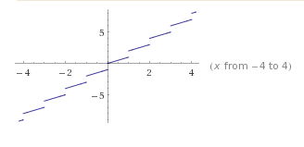
GREATEST INTEGER FUNCTION
Algebraic expressions: f(x)= [x]
Domain: all Real Numbers
Range: set of Integers

Slide 8
Name: Ashmeet kaur Class: XI A(Commerce)
THANK YOU….

