Slide 1
REHMAT CREATIONS – Traditional Clothing Store

Slide 2
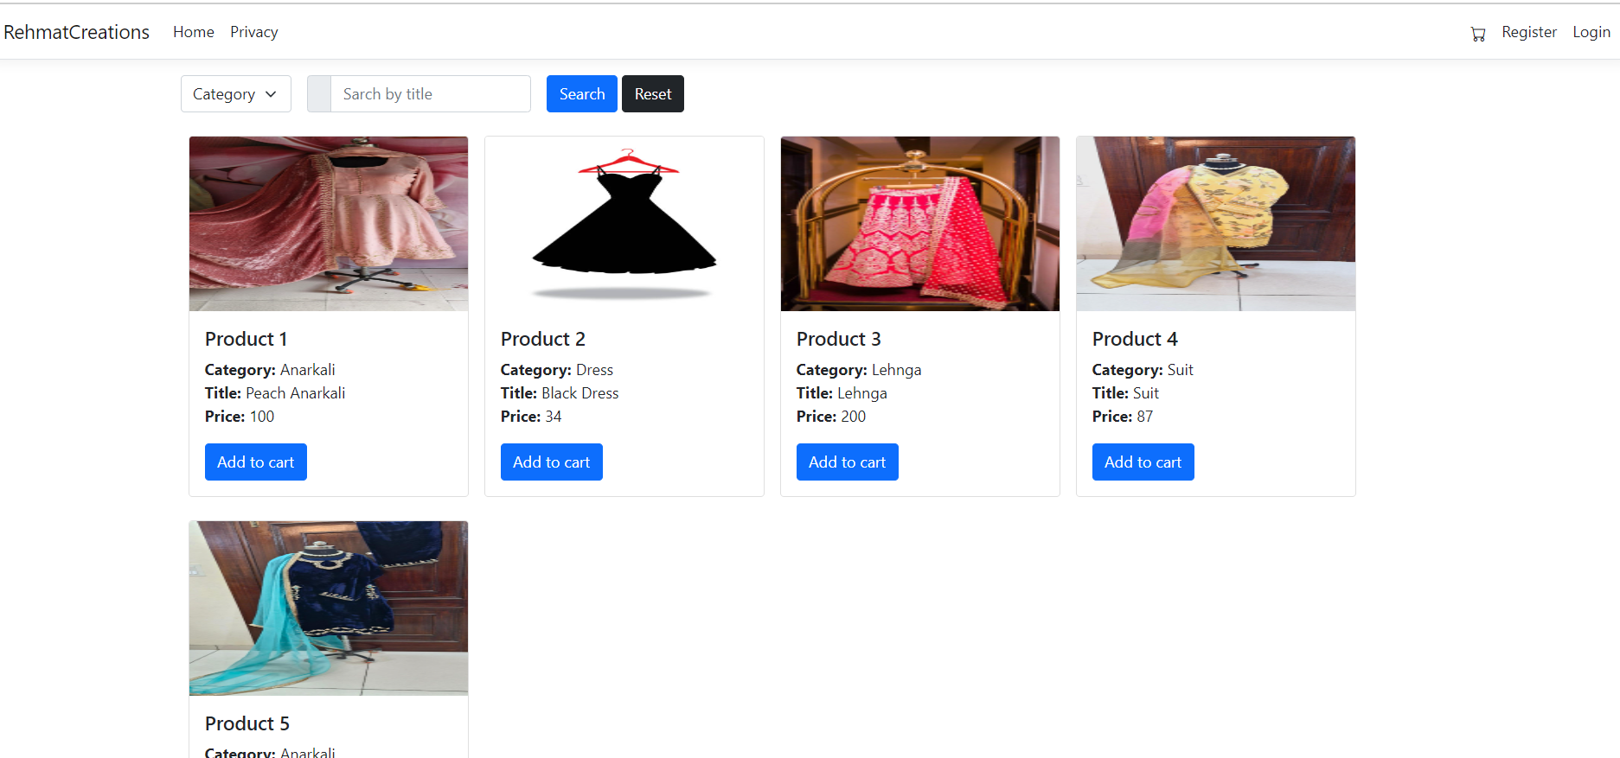
HOME PAGE

Slide 3
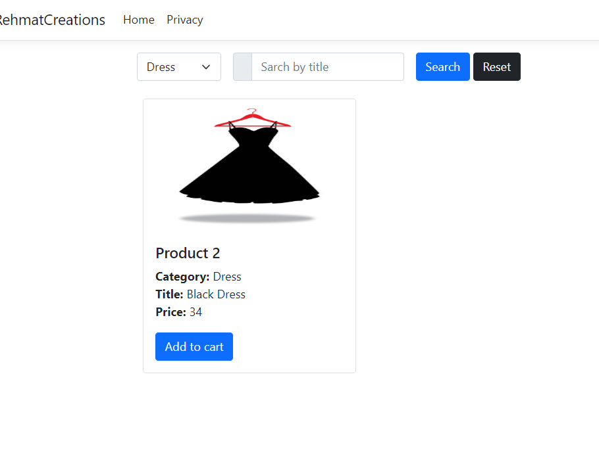
CATEGORY PAGE - Dress

Slide 4
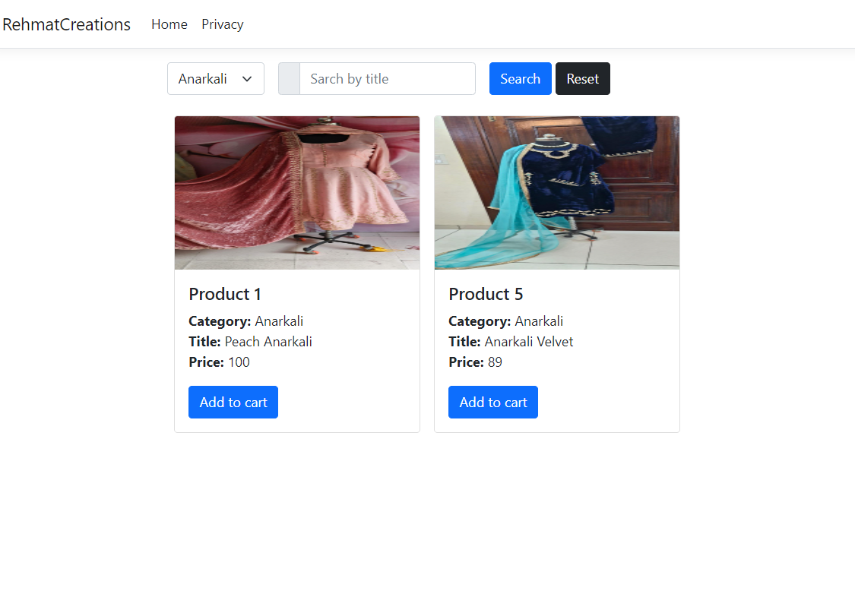
CATEGORY PAGE - ANARKALI

Slide 5
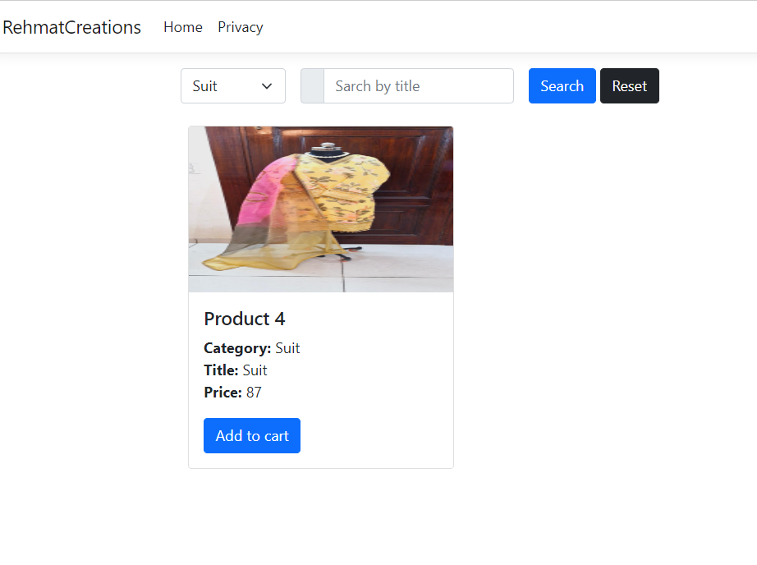
CATEGORY PAGE - SUIT

Slide 6
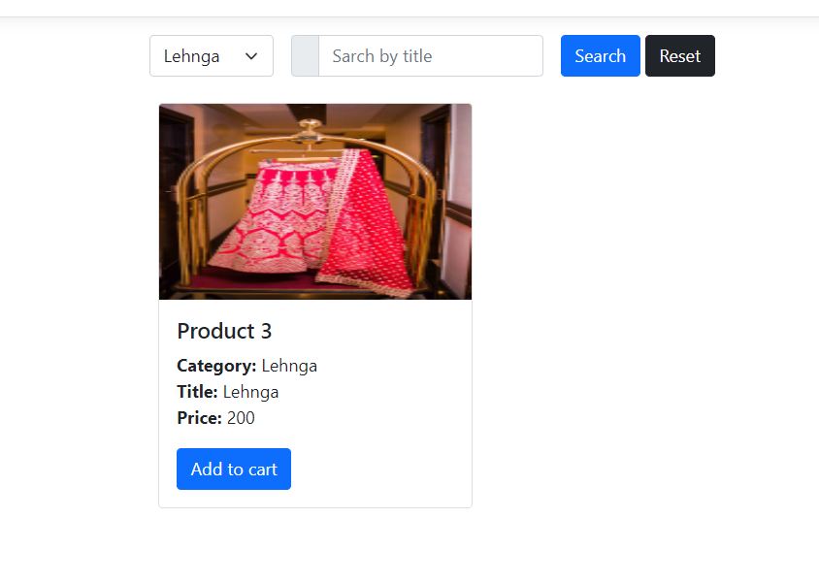
CATEGORY - LEHNGA

Slide 7
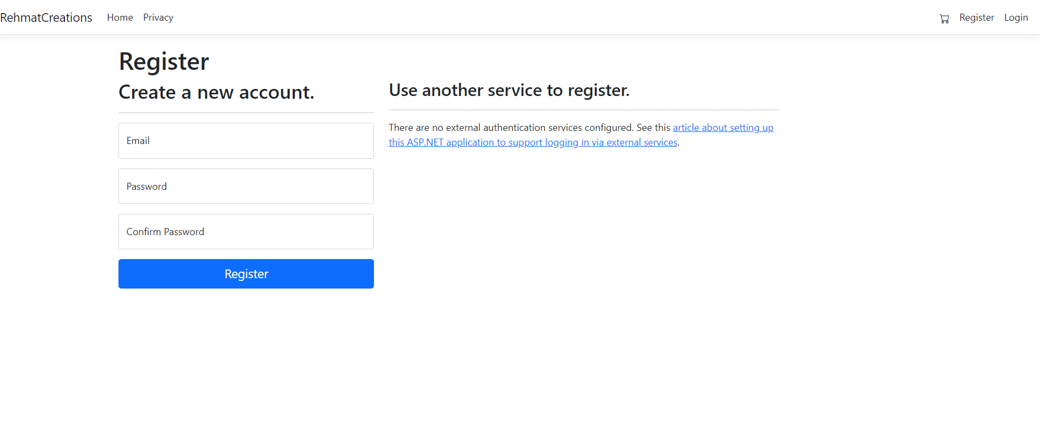
REGISTER PAGE

Slide 8
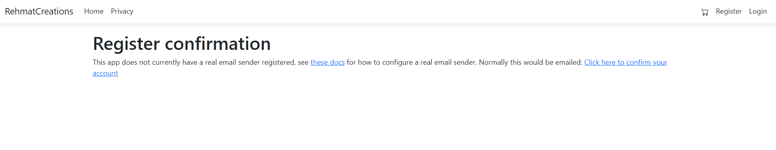
CONFIRMING EMAIL

Slide 9
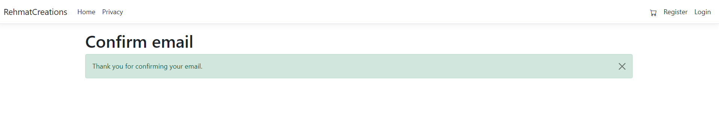
CONFIRMED EMAIL

Slide 10
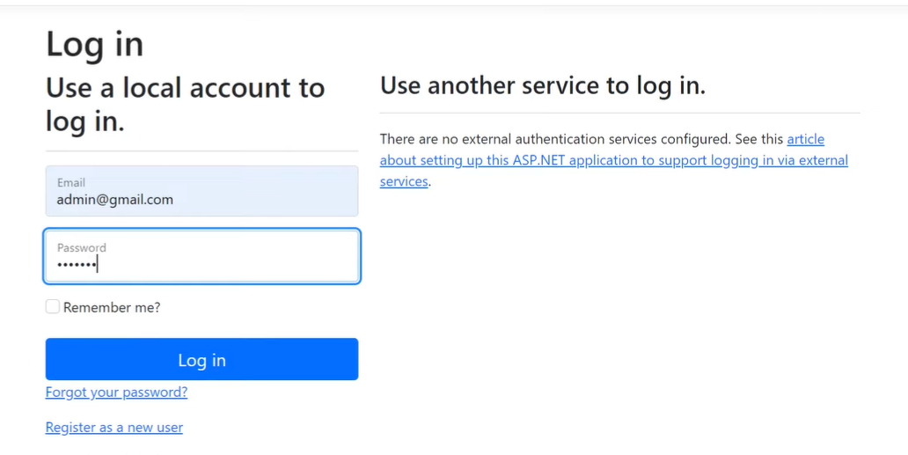
ADMIN Page

Slide 11
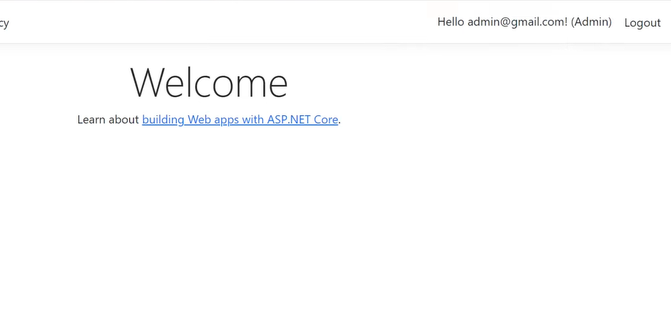
ADMIN

Slide 12
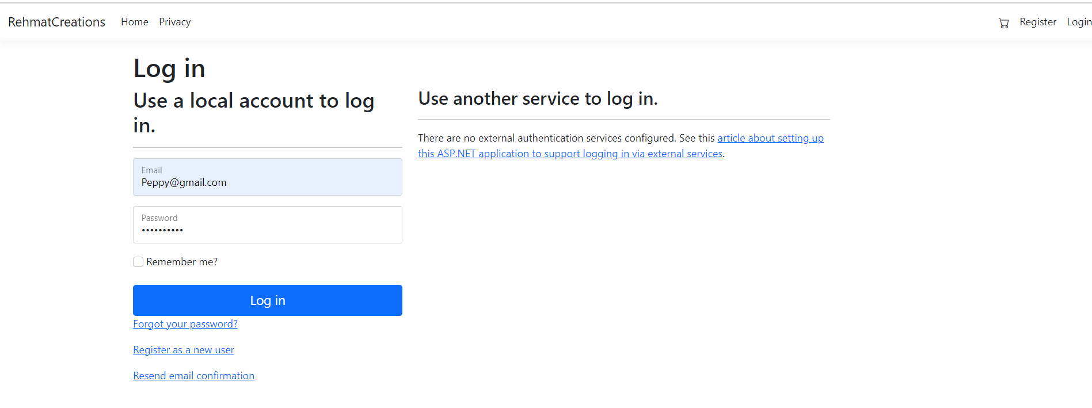
LOGIN PAGE

Slide 13
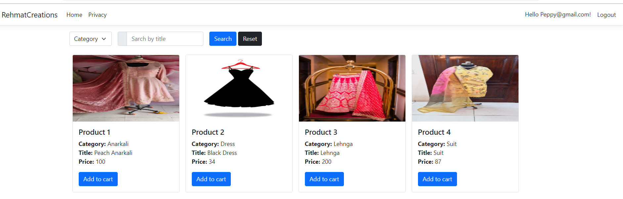
LOG in as USER

Slide 14
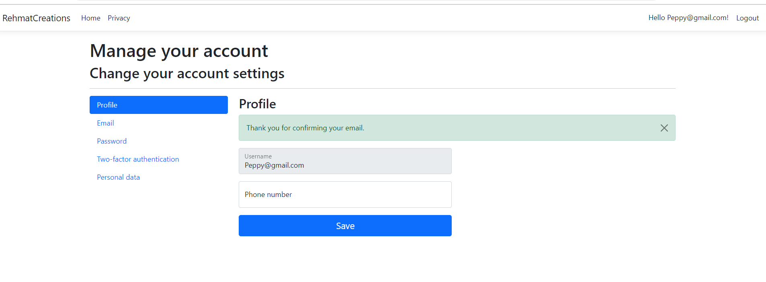
USER- MANAGE YOUR ACCOUNT

