Slide 1
Functional Testing OSPOS
Mandie Livingston

Slide 2
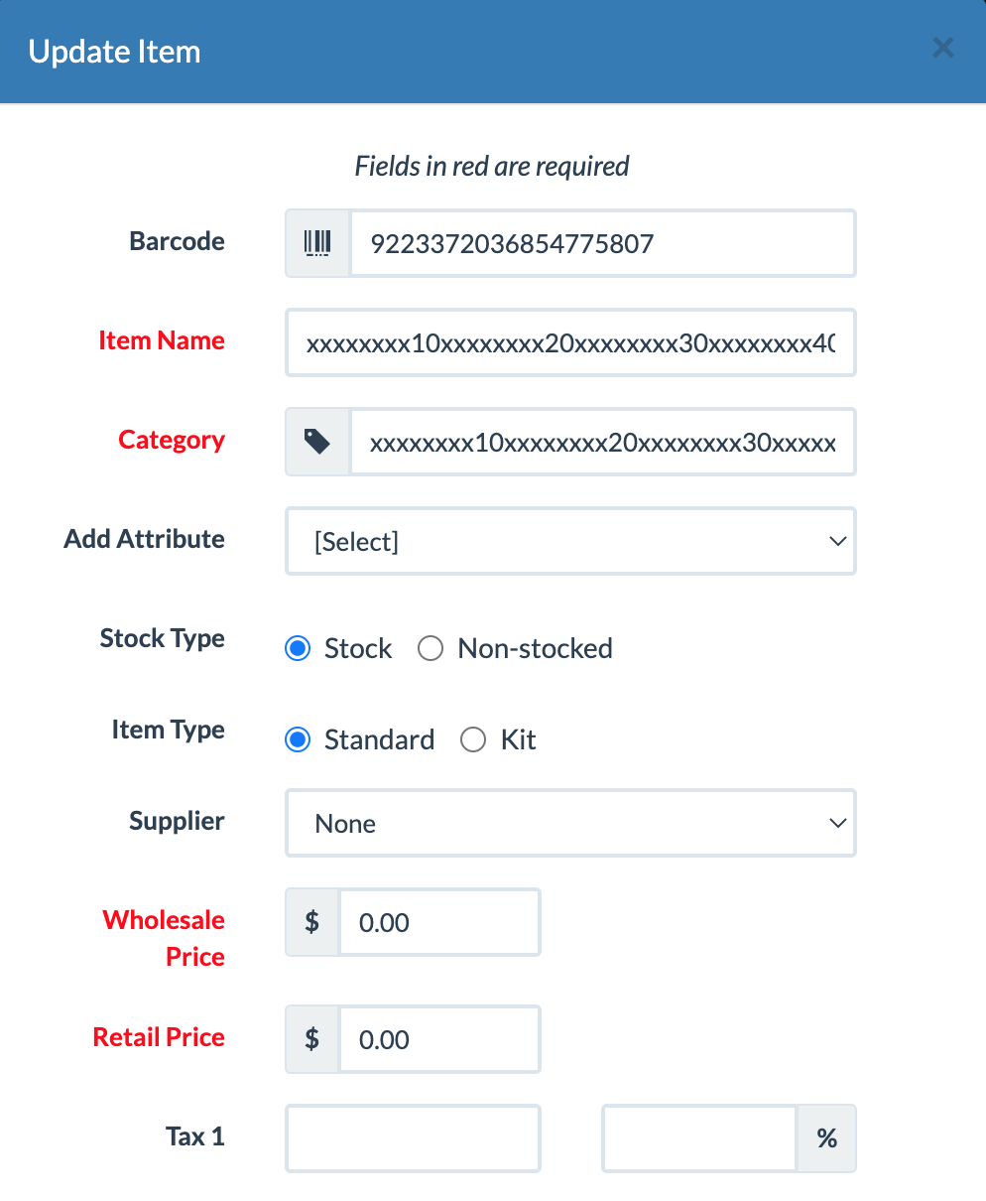
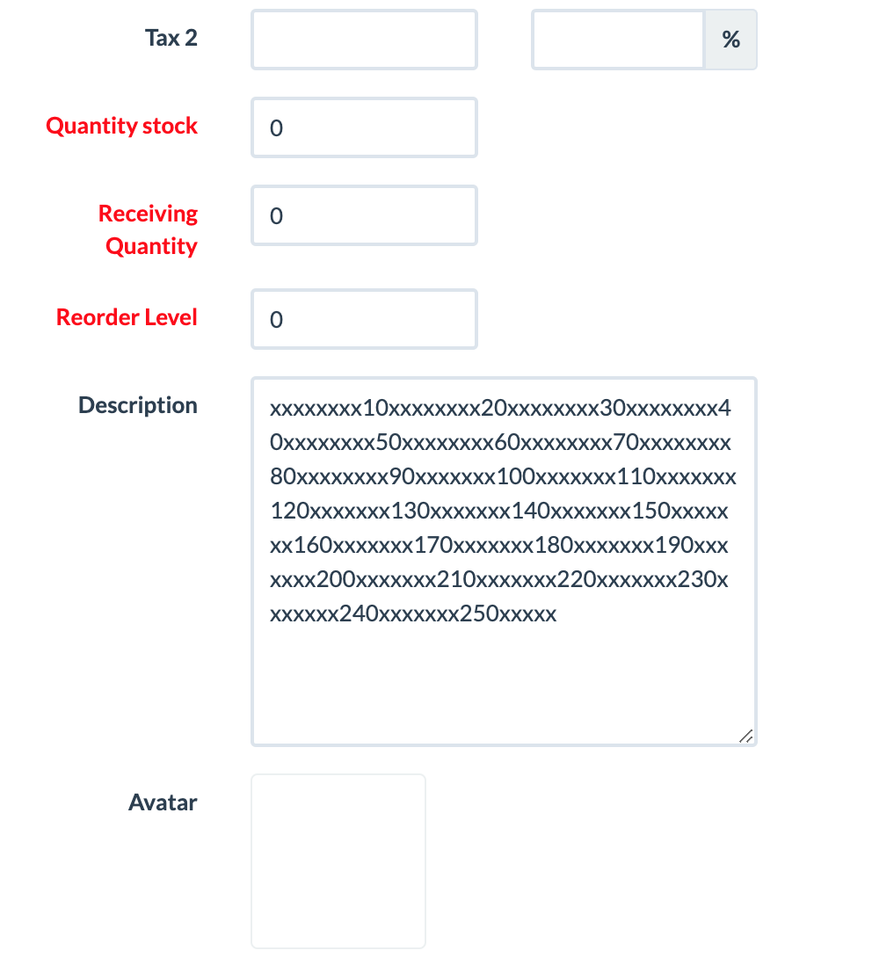
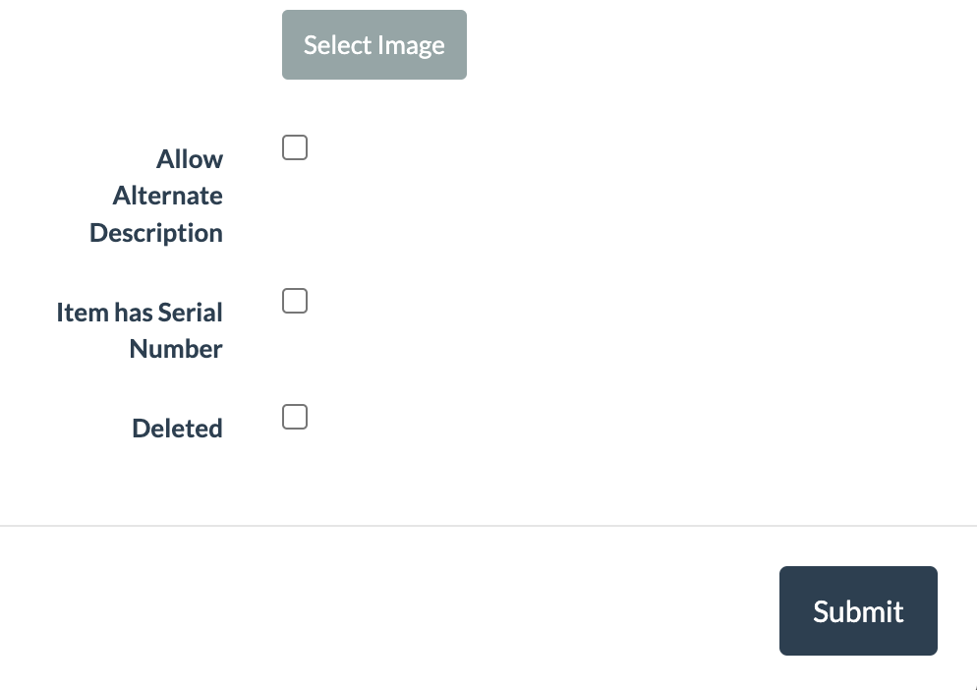
Adding new Items
Adding text longer than 258 characters truncated the text
Adding extreme numeric values resulted in a value of 0
Bulk uploads behave differently than manual uploads

Slide 3
Managing Suppliers
Similar text length issues as items
No error message for invalid phone number
Exporting suppliers returns inconsistent data across filetypes

Slide 4
Managing Inventory through Receivables
Usability issues stimy productivity with clumsy workflows

