Slide 1

Smart Car Parking With Monitoring System
Presented By:
Mandip Thapa
London Met ID:
19031343
Faculty:
Computer Networking and IT Security
Year:
2021/2022

Slide 2
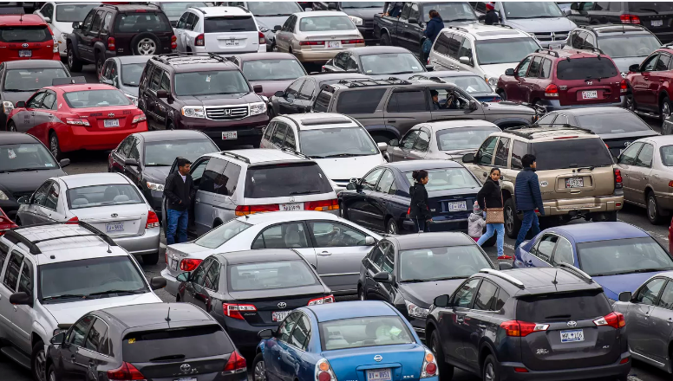
Current Scenario
Parking slots are unmanaged.
Parking slots are not secured.
Parking slots are not monitored.
Stress while searching for a parking space.

Slide 3
About The Solution
Only let authorized personnel to park.
Live parking slot monitoring.
Senses spot/vehicle occupancy in real-time.
Developed to reduce stress while searching for a parking space.

Slide 4
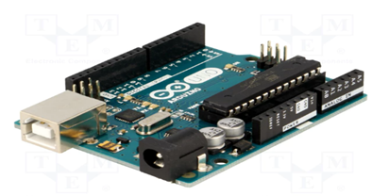
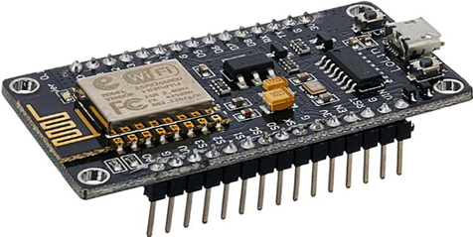
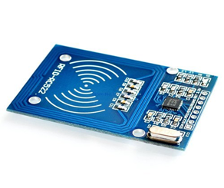
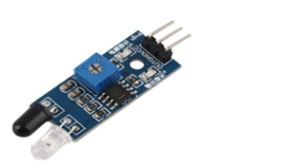
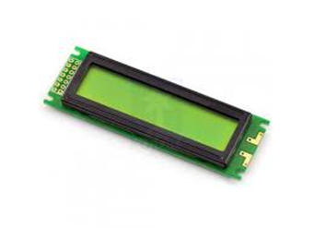
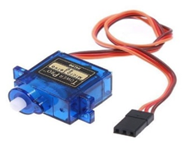
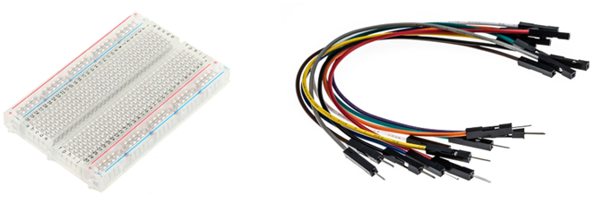
Material Used (Hardware)
Arduino UNO
Node MCU ESP8226
RFID reader
IR sensor
LCD display
Servo motor
Buzzer
Jumper wires
Breadboard

Slide 5



Software Used
Arduino IDE
Circuito.io
HTML/CSS

Slide 6
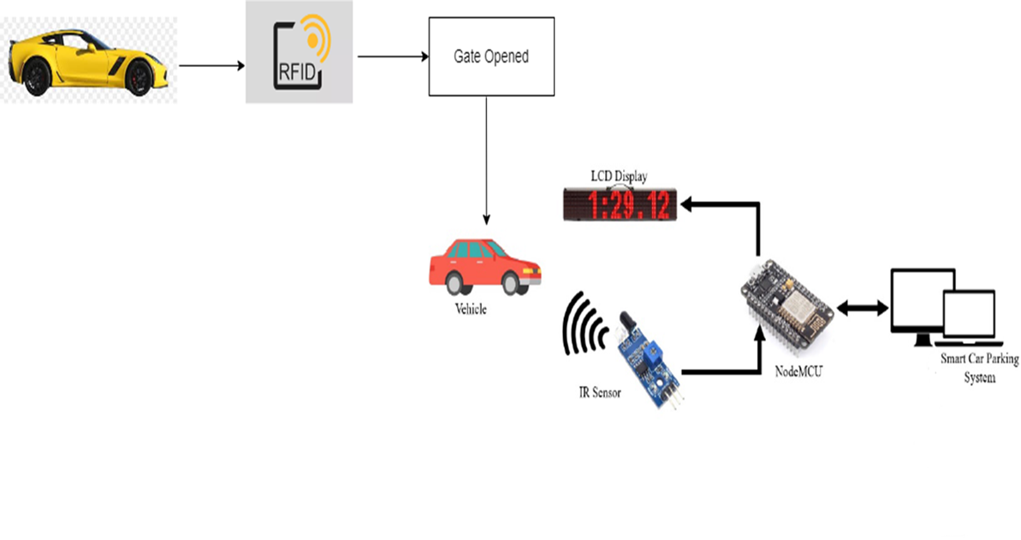
System Design

Slide 7
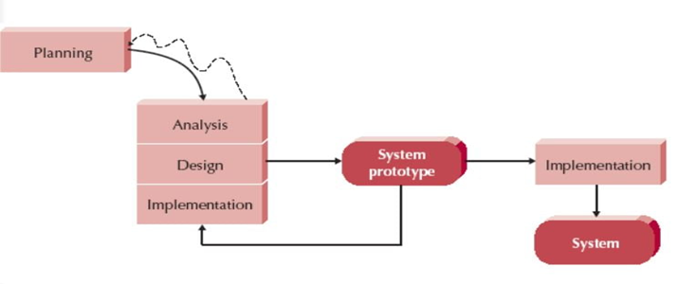
Selected Methodology: Evolutionary Prototyping Model
Phases of this Methodology:
Planning
Analysis
Design
Implementation

Slide 8
Thank You!

