Slide 1
DATAJAM 2026 · NS HEALTHCARE · TEAM :ALC
ALC Mismatch Dashboard
Alternate Level of Care · Nova Scotia Healthcare
OUR TEAM
MR
JM
YE
Mandipa Raut
Jiaqi Mao
Jia‘en Yu
Data Analysis and Developer
Data Analysis
Data Analysis & Research
Mandipa.Raut@smu.ca
Jiaqi.Mao@smu.ca
yujiaen1029@gmail.com
Sobey School of Business · Saint Mary's University · Halifax, Nova Scotia · March 7, 2026

Slide 2
Pain 1: Transparency
The Auditor General ask for “Health Zone Level” data
Aggregate data cover’s the real situation among different zone
Why can’t provided: Hard to calculate cause Data Blind
Solution: bypass the government data, provide transparency to public
Pain 2: Access and Flow
Karen Oldfield: Need to use data for target resources (based on Health zone)
Why can’t do it: 700 ALC patient blocking bed on 3000 bed, on
Dr. Aaron Smith’s access flow: “coming in, moving through, and getting out”
Solution: Find out blind spot for Karen Oldfield to target, from now to mid 2027)Alayacare.
Pain 3: ROI

Slide 3
DATAJAM 2026 · HEALTHCARE TRACK
The Beds Are Full.
545
But Nobody's Sick.
BEDS BLOCKED DAILY
545 Nova Scotia hospital beds are occupied every single day
by patients who are medically ready to leave — but have nowhere to go.
192,000
ALC DAYS IN 2023–24
21.3%
OF ALL HOSPITAL DAYS
(NS vs 16.9% Canada)
🏨 Think of it like a hotel where checkout never happens —
new guests pile up at the door while old guests sit in their rooms.
1 / 7

Slide 4
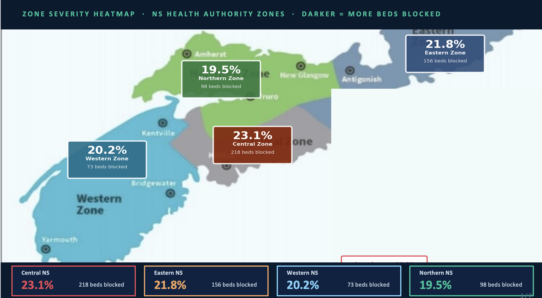
THE DATA STORY
The Cost Gap Is Shocking
National average cost fo Acute bed
$1,200 / day
NS average for Acute bed cost
$975 / day
ALC care operation(West Bedford) $600 /day
💡 NS spends $873.8M on long-term care annually — yet ALC days keep rising.
2 / 7

Slide 5
WHY THIS PROBLEM AFFECTS EVERYONE
👤 PATIENTS
🏥 HOSPITALS
🏛️ GOVERNMENT
Getting Worse, Not Better
ER Gridlock Starts Here
Spending Without Direction
ALC patients lose muscle, develop infections, and decline mentally in hospital
Halifax Infirmary at 102% capacity, Dartmouth General at 121%
$873.8M spent on long-term care — yet ALC days are rising, not falling
They need a home-like environment — hospital actively harms them
54,285 Nova Scotians left ER without treatment in 2024 (9.8% of visits)
Auditor General (Jan 2026): government not tracking the right performance data
SOCIAL VULNERABILITY (lack of home support) — not medical need — predicts ALC status
NS Health launched ALC Designation Project — government already knows this is a crisis
Money is going to capacity — not to fixing the mismatch between patients and resources
Patient suffers → ER overflows → Ambulances stuck → Lives at risk → $873M misspent
4 / 7

Slide 6
OUR SOLUTION — THE MISMATCH DASHBOARD
Don't build more beds. Fix where the resources go.
1
2
3
Map the Mismatch
Target Top 3 Zones
Pilot & Measure
Merge LTC waitlist + ALC days + home care data by NS zone. Reveal which zones have the worst gap between demand and available care.
Identify the 3 zones where redirecting existing home care resources would free the most hospital beds. No new hiring. No new building.
3-month pilot in Zone 1 (Central NS). Track beds freed, ER wait-time changes, ambulance offload delays, and cost savings in real time.
📊 DATA SOURCES:
NS Open Data: LTC Waitlist · Home Support Waitlist · LTC Facilities | CIHI: ALC Days | NS Health: Nursing Home Wait Times
Impact: 100+ beds freed → ER wait times drop → Ambulances respond faster → $5M+ saved in top 3 zones alone
5 / 7

Slide 7
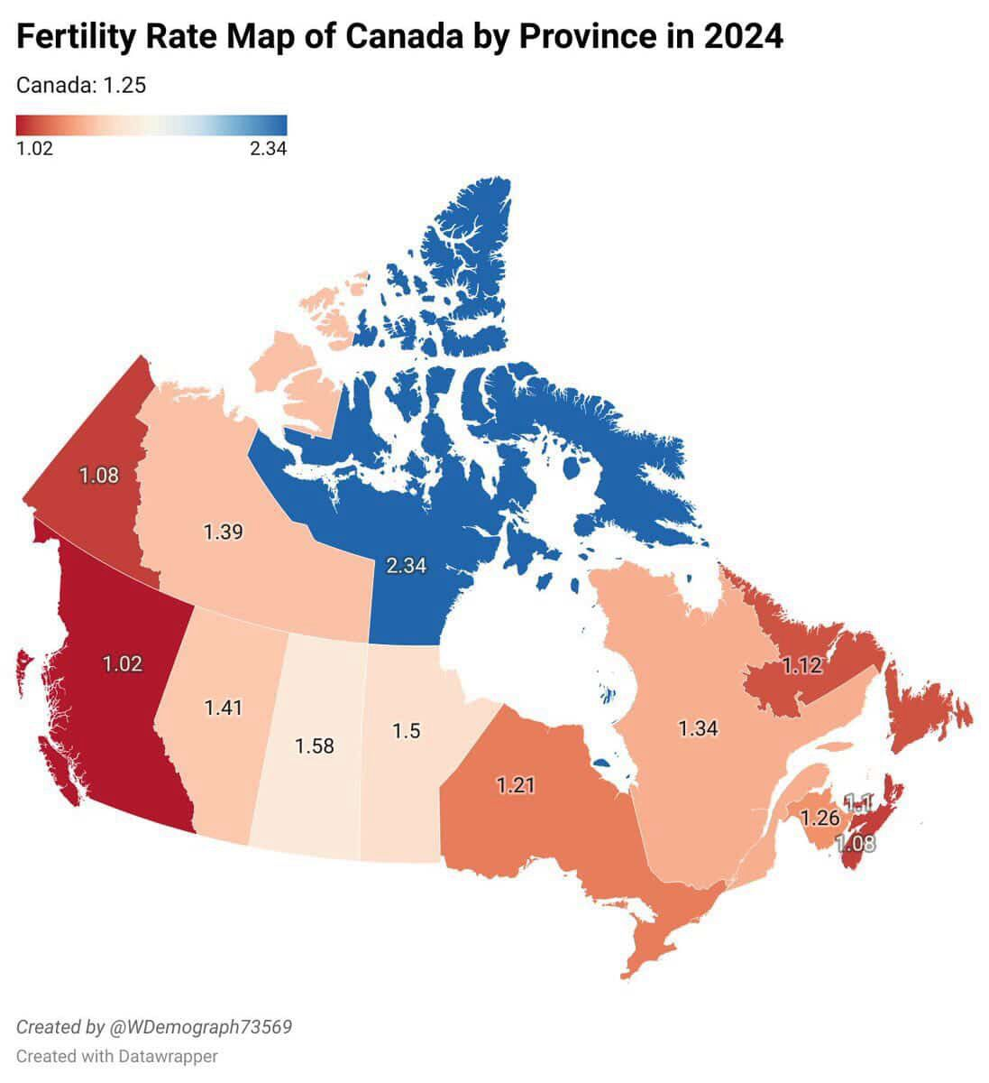
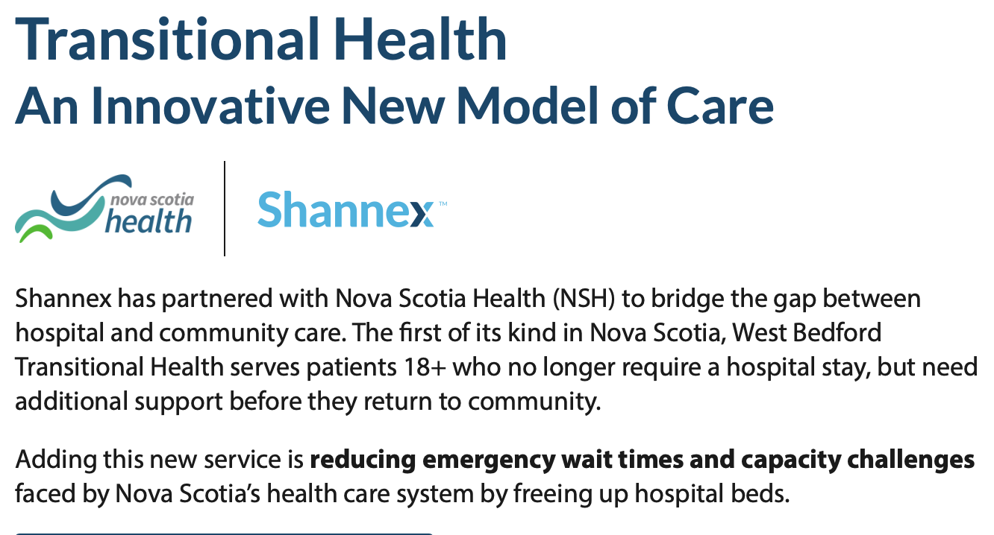
Nova Scotians
Monitoring
AlayaCare
40,000 Nova Scotian

Slide 8
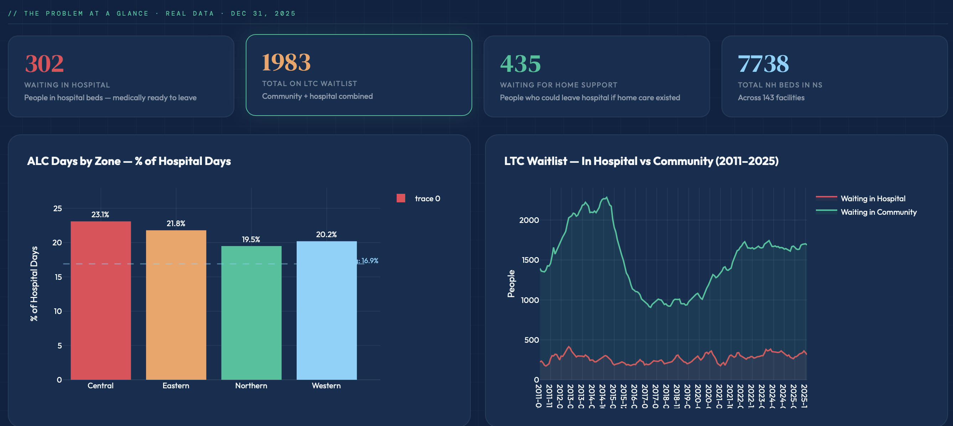

Slide 9
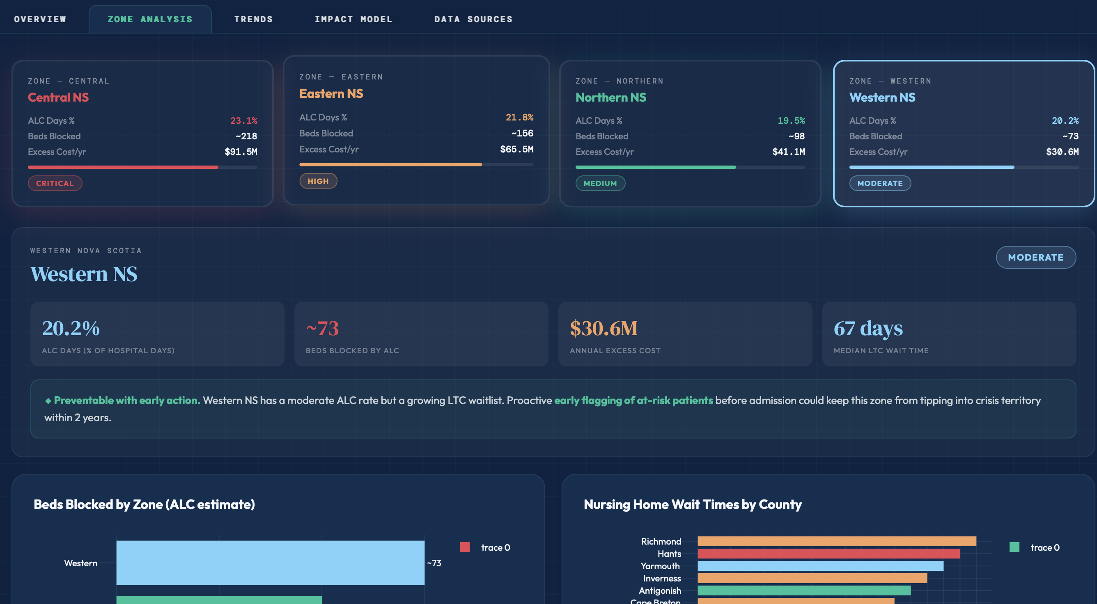

Slide 10
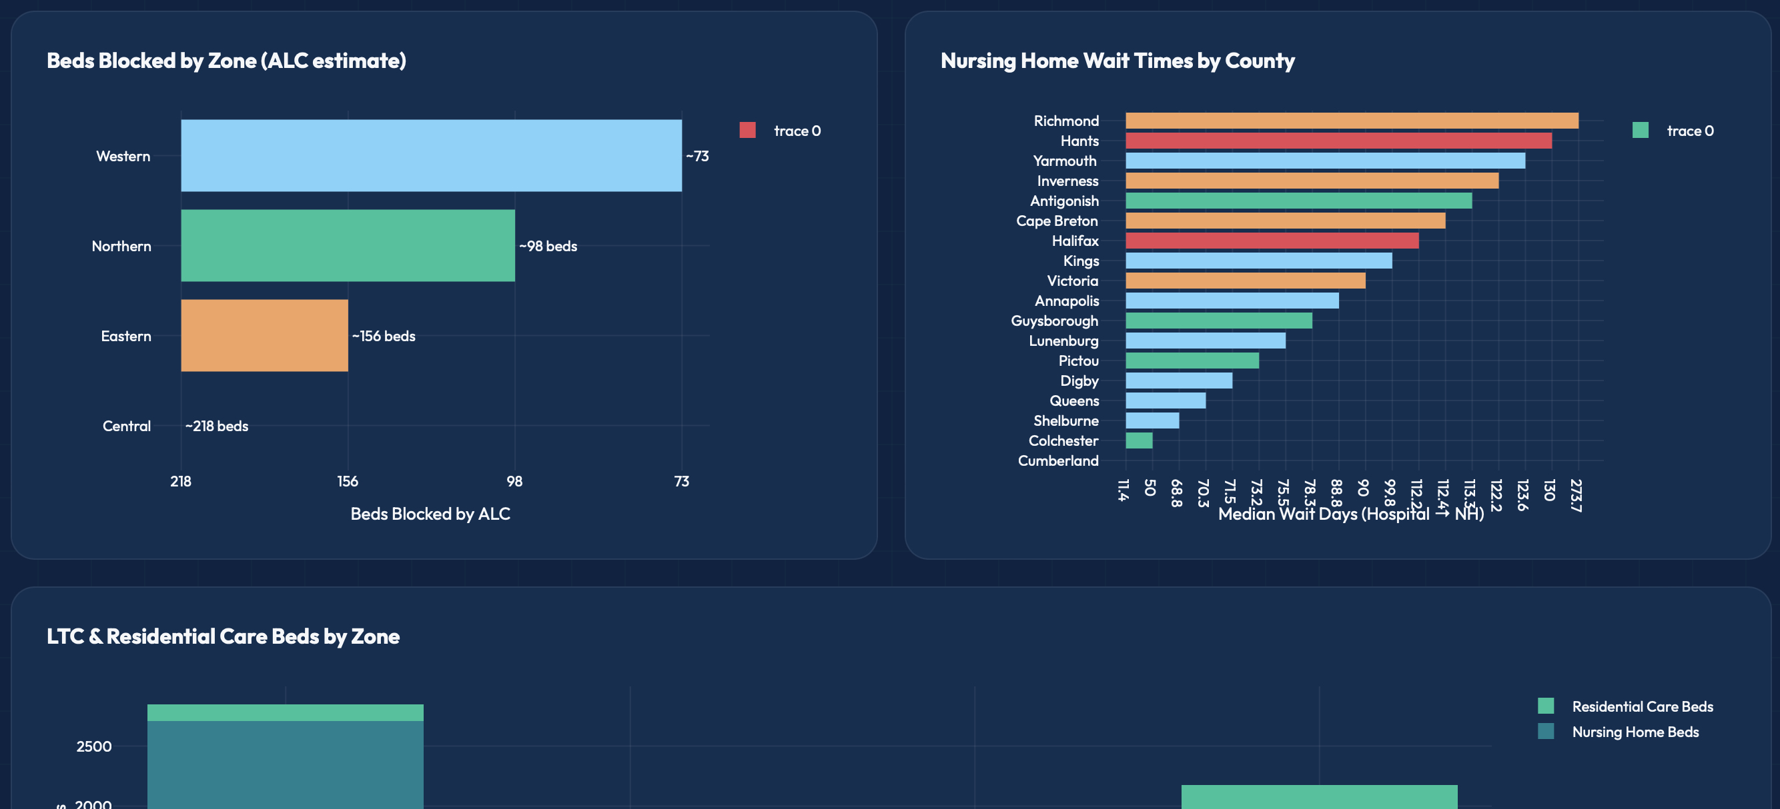

Slide 11
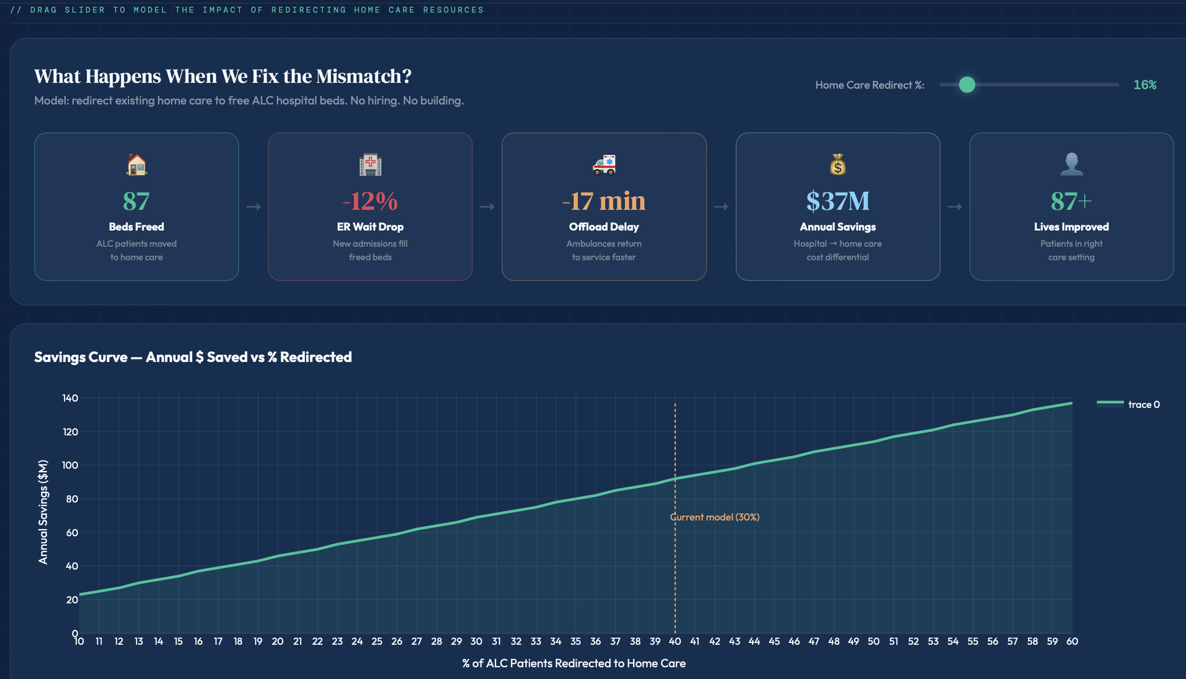

Slide 12
