Slide 1
DATAQUEST · THEME: EDUCATION
The Missing List
More than 40% of South African learners who start Grade 1 never finish matric. Nobody publishes which schools.
7,681
842
212,893
0.694
secondary schools scored for 2025
on the priority tier
learners inside those schools
test AUC, on years never seen
A school-level dropout risk register for South Africa, built entirely from open government data.
github.com/Mandla78/lp-dev-dataquest

Slide 2
THE PROBLEM
The number is known. The list is not.
40 of every 100 children who walk into a Grade 1 classroom will not walk out of a Grade 12 one. That figure is published, widely quoted and not in dispute.
The problem is not that the number is unknown. It is that it cannot be pointed at anything.
Nobody can deploy a teacher to a percentage. An organisation with one retention programme and funding for twelve schools cannot use a national average to choose the twelve.
Learners are counted after they are gone, in aggregate, once a year.
Every year that list does not exist,
help goes somewhere —
just not necessarily where the loss is worst.
The Missing List · DataQuest · Education
2

Slide 3
WHAT HAS TO BE ANSWERED FIRST
Four questions stand in the way. We answer three.
None of them currently has an answer anywhere in the public record.
Which provinces are losing the most?
ANSWERED
8 of 9, ranked by measured risk
Which districts inside those provinces?
ANSWERED
72, ranked within their province
Which schools inside those districts?
ANSWERED
7,681, scored individually
Which grades inside those schools?
NOT YET
Needs per-grade enrolment — held under permission
On the fourth we are deliberate. We can say a school is losing its Grade 8–12 pipeline. We cannot yet say whether the loss sits in Grade 10 or Grade 11. That is a form, not a rebuild — the same pipeline answers it the day the permission arrives.
The Missing List · DataQuest · Education
3

Slide 4
THE CHALLENGE QUESTION
The data is broken, and nothing says so
Seven detectors over 572,607 records across two datasets.
572,607
19
13
0
records scanned
discrepancies found
severe enough to change a model
raise an error anywhere
2017 loses 1.44 million learners nationally; 2018 gains 1.31 million back.
Province codes are unstable — KZ/KZN, GT/GP — turning a country of nine provinces into a dataset of eleven.
Gauteng's 2023 file has its key column headed "G". Three thousand schools vanish.
724 schools sit at latitude zero — a point in the Atlantic Ocean.
Phase appears in 21 spellings, quintile in 17, the fee flag in 11.
8,792 schools change their recorded phase between years.
Not one of them raises an error. The files open, the row counts look reasonable, the totals look plausible. A crash gets noticed within the hour; a province that quietly becomes two survives into a published finding.
The Missing List · DataQuest · Education
4

Slide 5
THE SAME STANDARD, APPLIED TO US
We audited our own work, and it failed too
Our first PDF parser trusted each report's header as the layout for the whole file. The reports do not work that way.
It produced 14,005 records claiming more learners were advanced into matric than sat the exam, and silently destroyed the pass-rate column.
So we removed pass rate from the model and wrote a comment explaining why. The comment was wrong. The evidence behind it was our own bug.
After the fix
pass rate 0% → 88.4%
coverage of the matric column
And the model
AUC 0.654 → 0.694
pass rate is now its strongest variable
The fix is verified by arithmetic the source itself prints: where a report gives both the achieved count and the pass rate, the rate must equal achieved ÷ wrote. It holds on 82,979 of 82,979 checkable records.
The Missing List · DataQuest · Education
5

Slide 6
DATA INCLUSION
Two public datasets, joined on one key
Published openly by the Department of Basic Education. No login, no licence, no NDA, no purchase.
EMIS School Masterlists
478,761 records · 29,655 schools · 2007–2025 · all 9 provinces
Enrolment, educators, quintile, fee status, phase, district, coordinates. Built from 140 provincial spreadsheets.
education.gov.za › Programmes › EMIS Downloads
NSC School Performance Reports
93,846 records · 8,093 schools · 2008–2024
Candidates who wrote, achieved, the pass rate, and learners progressed without meeting requirements. Extracted by us from 13 PDFs — the department publishes no machine-readable version.
education.gov.za › Resources › Reports
Joined on the EMIS number, normalised to bare digits first — it is published both with and without a leading zero, and getting it wrong fails the join silently rather than loudly.
Matric evidence is carried forward only, never backward, with an age marker so a stale figure can be discounted. Carrying it backward would be reading the future.
Raw source files are committed alongside the code, so the extraction can be checked rather than taken on trust.
The Missing List · DataQuest · Education
6

Slide 7
THE SOLUTION
What the machine learning actually does
Two supervised models were trained. The choice between them is the most consequential decision in the project.
Supervised learning
Learns from 61,485 historical school-years where the outcome is already known. Nothing is rule-based — the weights are fitted from data, not chosen by us.
Feature engineering
Raw registers become 31 candidate variables: enrolment trajectory, volatility, share of own peak, learners per educator, what neighbouring schools do, matric throughput. 15 survive into the model.
Weight of Evidence
Each variable is binned and re-expressed as the log-odds of loss it carries — letting a linear model capture non-linear risk and treat missing data as its own informative category.
Calibrated probabilities
Isotonic regression maps scores onto real observed rates, so a school at 0.30 loses learners about 30% of the time. Ranking gives order; calibration tells a planner how far their budget reaches.
Split by year, never at random. Trained on 61,485 school-years (2008–2016), tuned on 15,357 (2018–2019), measured once on 23,043 (2021–2023). A school recurs across years, so a random split would train and test on the same school.
The Missing List · DataQuest · Education
7

Slide 8
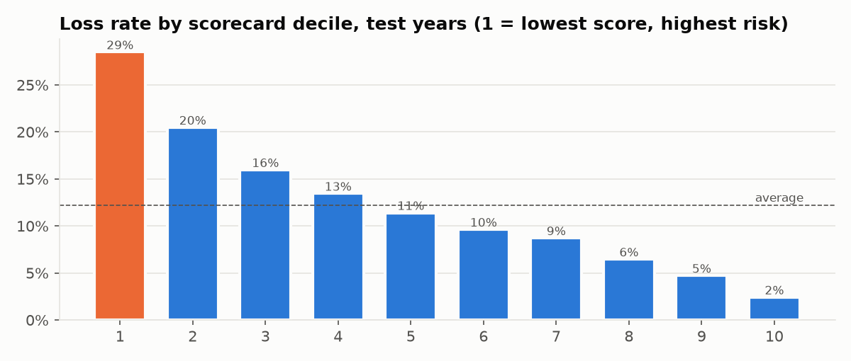
RESULTS
Measured once, on years the model never saw
2021–2023. No refitting, no threshold tuning after the fact.
0.694
0.388
0.281
2.34×
AUC on unseen years
Gini
KS statistic
lift in the worst tenth
Worst tenth loses at 28.5% against 2.43% in the best tenth — the schools it ranks worst really are the ones losing learners.
Recall 53% at the threshold. A missed school gets nothing; a false alarm gets a visit. Those costs are not symmetric.
Accuracy is our weakest number and we say so. At 71% it is below the 88% you score by predicting nobody ever loses learners — a model that identifies no one. That is why we lead with lift.
The Missing List · DataQuest · Education
8

Slide 9
THE DECISION WE HAD TO DEFEND
A better-ranking model exists. It is not what we ship.
SHIPPED
Logistic Regression Scorecard
AUC 0.6939 · lift 2.34×
Every score breaks into visible points. A school can be told it lost 37 points for its matric pass rate.
BENCHMARK, NOT SHIPPED
Calibrated Random Forest
AUC 0.7161 · lift 2.46×
Ranks better and cannot tell a school why it was flagged. Trained on the identical frame and split.
The gap is 0.022 AUC, and we publish it. This output directs public money. Whoever must justify the spend has to explain it line by line — to a treasury, a community, or a school that disagrees with its ranking. That is worth more than two hundredths of a ranking statistic, and stating the price makes the choice defensible rather than merely asserted.
We also measured the mistakes that inflate a model silently. A random split lifts the tree from 0.692 to 0.731 — it has learned to recognise schools, not predict them.
The Missing List · DataQuest · Education
9

Slide 10
THE PRODUCT
A ranked list, and a reason beside every school
A planner filters to their province and sees what to work first — a morning's decision instead of a year's guesswork.
WHY THIS SCHOOL
RANK 1 OF 7,681 · Vhembe East, Limpopo
Ntevhedzeni
111 learners 48% risk of losing learners faster than its province by 2027
Against a national base rate of 12.2%.
matric pass rate: below 42.8 (-37 pts)
enrolment volatility: 0.21 or more (-17 pts)
school size (learners): below 225 (-13 pts)
That is the whole score. A school flagged for a pass-rate reason needs different help from one flagged for a staffing reason.
Coverage, stated plainly: 8 provinces, not 9. The Northern Cape published a Word template where its 2025 masterlist should be — a fault our own audit found, not one we introduced. The model covers all nine; the register covers the eight that published.
The Missing List · DataQuest · Education
10

Slide 11
SYSTEM SECURITY
It holds nothing worth stealing — by design
Confidentiality is the easy half. The half that needs controls is integrity.
0
School
0
Public
personal records held
smallest unit of analysis
executable model artefacts
every source — nothing to steal
No personal information
Learner records are protected under POPIA and a hackathon team has no lawful basis to process them. A tool that names children creates a register of vulnerable minors.
Input validation at the boundary
Every download is checked against its format's magic bytes before it is written. A portal returning an HTML error page under a spreadsheet's filename is routine, and is rejected.
Nothing executable ships
The model is model.json — inert data. No pickle, no joblib, no eval. Loading a pickled model executes what is inside it.
The audit is an integrity control
Seven detectors already catch corrupted, truncated or altered source files. They caught our own parser producing 14,005 impossible records.
The gap we have not closed: dependencies are minimum-pinned but not hash-locked. A departmental deployment needs a lockfile and an internal mirror. A security section with no gap in it has not been written honestly.
The Missing List · DataQuest · Education
11

Slide 12
BUSINESS MODEL
R612,000 a year, against what it prevents
A tool for the people who allocate support — never sold to the schools that need it.
R612k
R49
R0
4 provinces
to run for a year
per school scored
data acquisition — all sources public
break-even, at R150k each
WHAT THE PROBLEM COSTS
212,893 learners sit in the 842 schools the register flags as priority.
90 learners is the median two-year drop at a flagged school that does lose them — measured across 2,807 such cases, not assumed.
~21,600 learners is what that comes to across the 28.5% of the priority tier that loses.
WHO PAYS
Year 1 grant-funded pilot, two provinces
Year 2 four provinces at R150k, NGO tier at R25k
Year 3 nine provinces, national rollout
Adding a province is a filter, not a project.
The state has already spent about R200,000 educating one learner by Grade 10. This costs less than three of them.
The argument is not that the tool is cheap. It is that it is negligible against what is already being spent on the learners it exists to keep in school.
The Missing List · DataQuest · Education
12

Slide 13
LIMITATIONS
What we are honest about
Every one of these is on the live application, not held back for the questions.
It measures enrolment decline, not dropout. A learner who transfers to a better school and one who leaves education entirely look identical in a headcount.
It is a triage list, not a verdict. At 0.694 AUC the ranking is worth working from the top of, and not good enough to be believed about any single school without a visit.
Population stability is a real caveat. PSI is 0.44 from training to the 2025 register, above the level at which a scorecard is normally rebuilt. Seventeen years separate them. It is the strongest argument for annual retraining.
The raw masterlists are incomplete in the repository. Four of the 140 spreadsheets remain; the built tables were produced from the full set and are committed in full. The README says so rather than implying otherwise.
A better model exists and is not shipped. The forest reaches 0.7161. We report the gap rather than hide it.
A model that directs public money should be re-validated annually and withdrawn if it stops performing. A model nobody re-checks is a governance risk long before it is a technical one.
The Missing List · DataQuest · Education
13

Slide 14
THE MISSING LIST
Open government data, a list a province
can act on this week, and a reason
next to every school.
7,681
842
19
0.694
schools scored
priority tier
data discrepancies found
AUC on unseen years
github.com/Mandla78/lp-dev-dataquest

