Slide 1


Chemistry of Inclusions in steel
Presented By:-
Name: Monika Mandloi
Roll No. : 193110034
Mtech : 1st year(MM1)
Guided By:-
Prof. Asim Tewari
Prof. Deepoo Kumar

Slide 2
content
Introduction
Classification of Inclusions
Formation fInclusions
Morphology of inclusions
Kinetics of inclusions
Calcium Treatment
Effects on Mechanical properties
3D characterization of inclusions
Image Analysis
Measurement of inclusions
Future Scope
References
3
4
5-6
7
8-9
10
11
12-13
14
15
16
17

Slide 3
Steelmaking is high temperature process. At higher temperature there is high amount of dissolved oxygen is present.
We have to reduce the content of oxygen and sulfur in solution to produce quality steel.
We use some deoxidiser such as aluminium , silicon, manganese etc. Which have high affinity for oxygen and form non metallic oxides in liquid steel.
Introduction

Slide 4
Endogenous inclusions are the products of chemical reactions in melted steel such as oxides and sulfides.
There are two types of deoxidation processes.
One is called primary deoxidation, which is a process that occurs when elements, such as calcium, carbon and aluminium are introduced to the smelt.
The deoxidation elements create inclusions with a lower density than the liquid steel. The density difference makes the inclusions rise in the smelt towards the metal-slag interface.
Secondary deoxidation happens when the oxygen solvability decreases during solidification
Exogenous inclusions are those appearing from external sources such as fragments of refractories , entrapped slag, reoxidation by external air etc. They vary in size and are often found in clusters.
Inclusions are classified mainly in two groups:
Classification of Inclusions

Slide 5
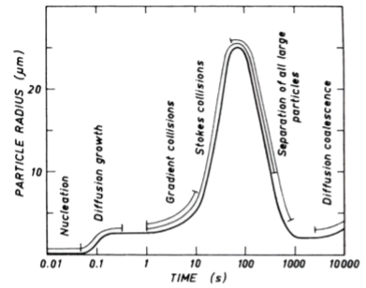
Formation of Inclusions
2 [𝐴𝑙] + 3[𝑂] = (𝐴𝑙2𝑂3)
[𝑆𝑖] + 2[𝑂] = (𝑆𝑖𝑂2)
[𝑀𝑛]+ [𝑂] = (𝑀𝑛𝑂)

Slide 6
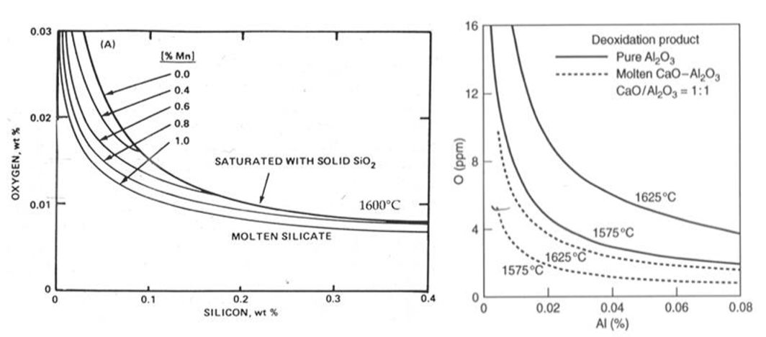
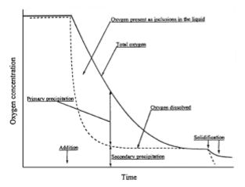
Formation of Inclusions
Deoxidation equilibria for silicon, manganese, aluminum and calcium
Dissolved and total oxygen content during ladle processing

Slide 7
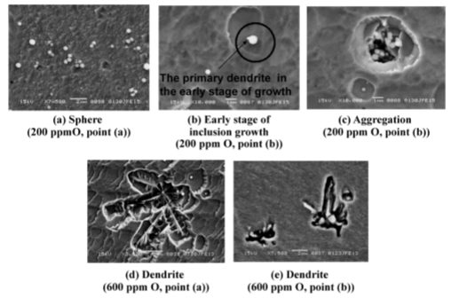
Morphology of inclusions
Alumina inclusion morphologies at various starting oxygen levels in liquid iron just after aluminum deoxidation

Slide 8
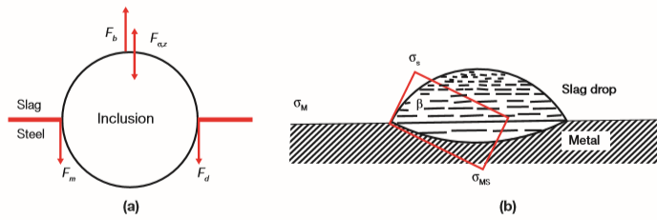

Kinetics of inclusions
Forces acting on a separating particle (where Fσ,z is the interfacial capillary force, Fm is damping of acceleration due to the fluid, Fd is the drag force and Fb is the buoyancy force) (a), and interfacial tensions acting on a slag drop in contract with a metal surface (b)
where
Vt is the sphere velocity, ∆ ρ is the differential density between the particle and the liquid, μ is the liquid dynamic viscosity, g is the acceleration due to gravity and r is the particle diameter.

Slide 9
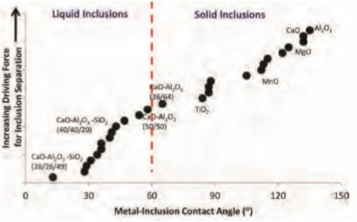
Kinetics of inclusions

Slide 10
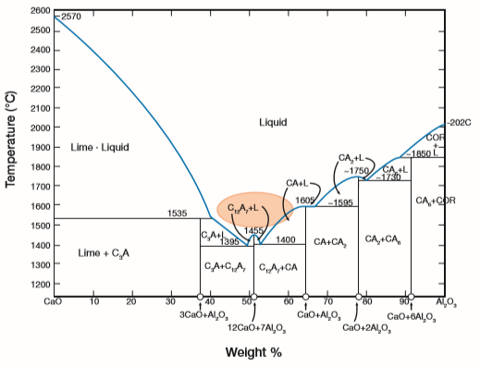
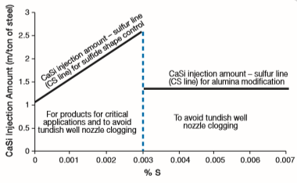
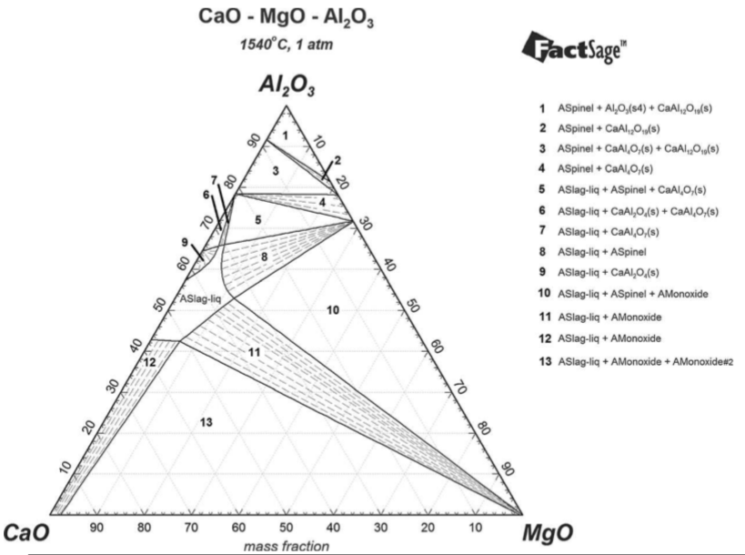
Calcium Treatment
CaO-Al2O3 phase diagram. Desirable range for the inclusions is highlighted.
Isothermal projection of ternary system CaO-MgO-Al2O3 at T ¼ 1813K (15408C). Calculated using FactSage.
Recommended CaSi injection amount for inclusion shape control and avoiding tundish well nozzle clogging during casting of a completely killed (Al-killed) steel.

Slide 11
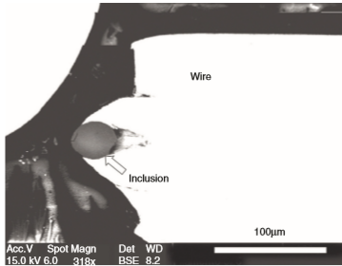
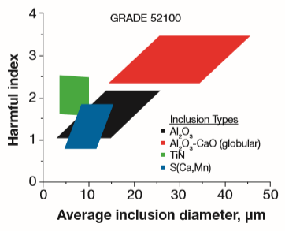
Due to the incompatibilities with the steel matrix, inclusions create stress fields around itself that are potential crack initiation sites.
Two examples that shows effects of inclusions on its serviceability
1. Tire cords and springs:
They are made up of silicon manganese steel wires.
Presence of hard NMIs such as alumina is
detrimental for wire drawing operations. We have
to adjust steel composition , so it prevents formation
of Aluminium-rich NMIs and favor low melting ,
plastic silicates.
2. Bearing steel:
The size and quantity of the NMIs present in steel
is adversely affect the fatigue life of bearing.
Some NMIs such as calcium aluminates and spinel
are detrimental for bearing life.
Effects on Mechanical properties

Slide 12
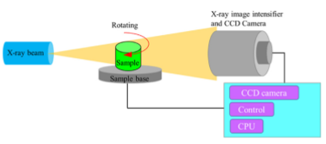
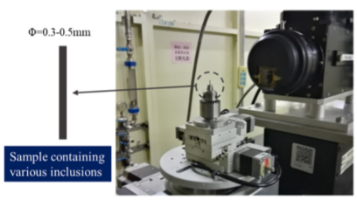
3D characterization of inclusions
Principle of X-ray Micro-CT
Micro-CT in BL13W1 at SSRF

Slide 13
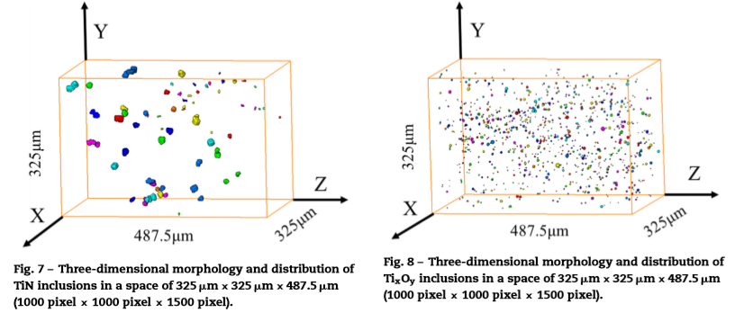
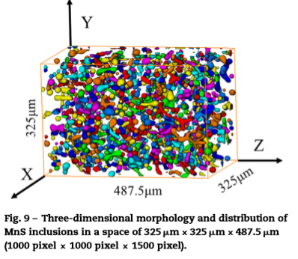
3D characterization of inclusions

Slide 14
SEM Image of sample
Image Analysis
Labelling of image particles using Image J software

Slide 15
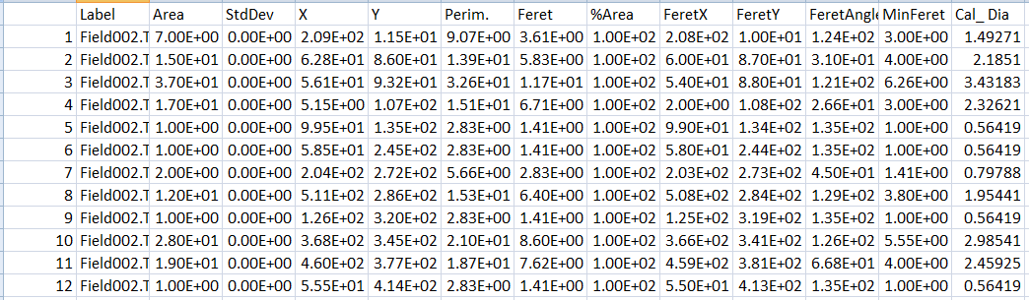
Measurement of inclusions

Slide 16
Future Scope
We will use Convolutional Neural Networks (CNNs) which is a powerful tool for classification of steel samples by image recognition.
Using images of different types of inclusions with regards to morphology and quantity. To facilitate the possibility to classify specific inclusions based on images instead of conventional chemical analysis.
We do image analysis of SEM and OM images with the goal to attain higher prediction accuracy.

Slide 17
References
Wagner Viana Bielefeldt and Antônio Cezar Faria Vilela, Study of Inclusions in High Sulfur, Al‐Killed Ca‐Treated Steel via Experiments and Thermodynamic Calculations.
R. J. O’Malley Iverson, Inclusion Evolution and Removal in Ladle Refining, PSMRC Materials Science & Engineering Missouri University of Science & Technology 1400 N. Bishop Ave.
Andre Luiz Vasconcellos da Costa e Silva, Non-metallic inclusion in steels-origin and control, EEIMVR-UFF,Volta Redonda,RJ,Brazil,2018.
Zhiqiang shang, Tao Li, Shufeng Yang, Jianchuan Yan, Han Guo, Three-dimensional characterization of typical inclusions in steel by X-ray Micro-CT,2020.
H. Gaye, Inclusion Formation in Steels. The Making Shaping and Treating of Steel, Vol. 3, Casting (Eds: A. W. Cramb, M. Byrne), AISE 2003, chap. 3, 1.
Björklund, J., A study of slag-steel-inclusion interaction during Ladle treatment. 2006.
Verma, N., et al., Calcium Modification of Spinel Inclusions in Aluminum-Killed Steel: Reaction Steps. Metallurgical and Materials Transactions B-Process Metallurgy and Materials Processing Science, 2012. 43(4): p. 830-840.
P.H. Lindon and J.C. Billington, “Oxide Formation and Separation During De-Oxidation of Molten Iron With Mn-Si-Al Alloys,” Transactions of the Metallurgical Society of AIME, Vol. 245, 1969, pp. 1775–1784.

Slide 18

Thank You

