Slide 1
RoboReviews
🤖
Turning review chaos
into clear decisions
Sentiment · Clustering · Recommendation Articles
NLP Capstone Project

Slide 2
The Problem
34K+
3
4–6
Amazon Reviews
analyzed
AI Models
end-to-end
Business-friendly
meta-categories
The Challenge
Amazon products accumulate thousands of reviews — far too many for any team to read manually. RoboReviews solves this with a three-stage NLP pipeline: sentiment labels are derived automatically from star ratings (no manual labeling), recurring themes are surfaced via clustering, and GenAI generates actionable recommendation articles for non-technical stakeholders.

Slide 3
What We Built — One Pipeline, Three Models
01
02
03
Sentiment Classifier
Theme Clustering
GenAI Summarization
Baseline + DistilBERT fine-tuning
MiniLM + UMAP + HDBSCAN
Recommendation Articles
Labels each review as positive, neutral, or negative using TF-IDF logistic regression as a benchmark, then improves with DistilBERT transformer fine-tuning.
Embeds reviews with sentence transformers, reduces dimensions with UMAP, then clusters with HDBSCAN to discover recurring product themes automatically.
Transforms cluster insights into readable markdown and JSON recommendation articles — ready for a business team to act on immediately.
Result: Raw reviews → structured insight → actionable deliverable

Slide 4
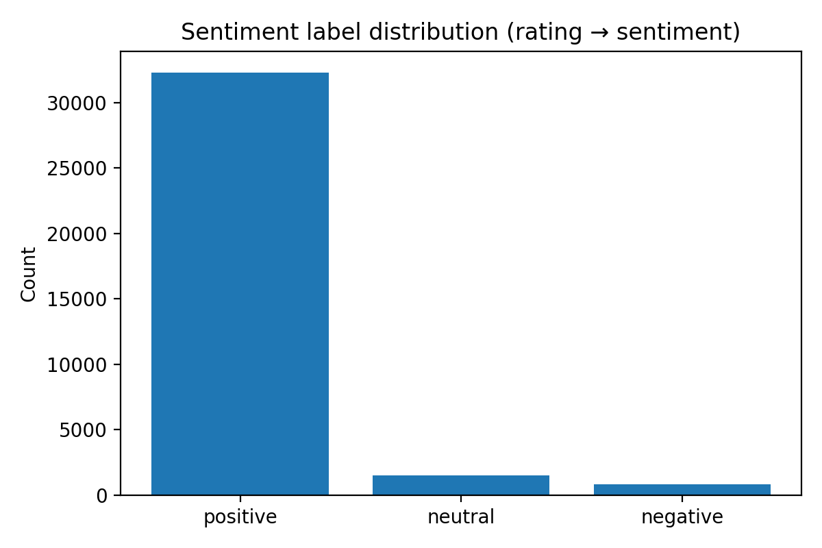
Data & Preprocessing
Dataset
Amazon Product Reviews
Class Distribution
Raw rows
34,660
After cleaning
34,626 rows
Train split
27,700 reviews
Test split
6,926 reviews
Label mapping
1–2★ → Negative · 3★ → Neutral · 4–5★ → Positive
⚠ Class imbalance: Positive class dominates — minority classes (neutral/negative) are harder to classify

Slide 5
Model 1 — Sentiment Classification: Approach
Baseline: TF-IDF + Logistic Regression
Transformer: DistilBERT Fine-Tuning
Converts text to term-frequency matrix
Pre-trained on vast text corpora with attention mechanism
Logistic regression for multi-class classification
Captures context and semantic relationships
Fast training — establishes a performance benchmark
VS
Fine-tuned on our Amazon review dataset
Accuracy: 87.96% | Weighted F1: 0.897
Better minority class handling (neutral/negative)
Key constraint: class imbalance means minority classes (neutral, negative) are underrepresented in training

Slide 6
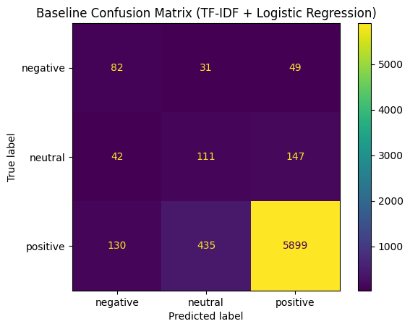
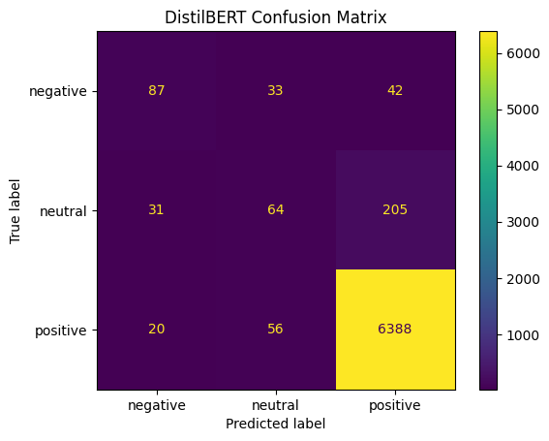
Model 1 — Sentiment Classification: Results
87.96%
0.897
↑ Better
↑ Improved
Baseline Accuracy
Baseline F1
DistilBERT Accuracy
Minority Classes
TF-IDF + Logistic Regression
Weighted F1 Score
Reduced over-prediction
Less false positives
Baseline Confusion Matrix
DistilBERT Confusion Matrix

Slide 7
Model 2 — Clustering: Approach
📄
🔢
📉
🔵
🏷️
Review Text
MiniLM Embeddings
UMAP Reduction
HDBSCAN Clusters
Meta-Categories
→
→
→
→
Raw Amazon review text input
384-dim sentence vector representations
High-dim → 2D for visualization
Noise-tolerant density clustering
4–6 interpretable product themes
Discovered Meta-Categories
Build Quality
Setup / Usability
Customer Service
Compatibility
Delivery / Packaging

Slide 8
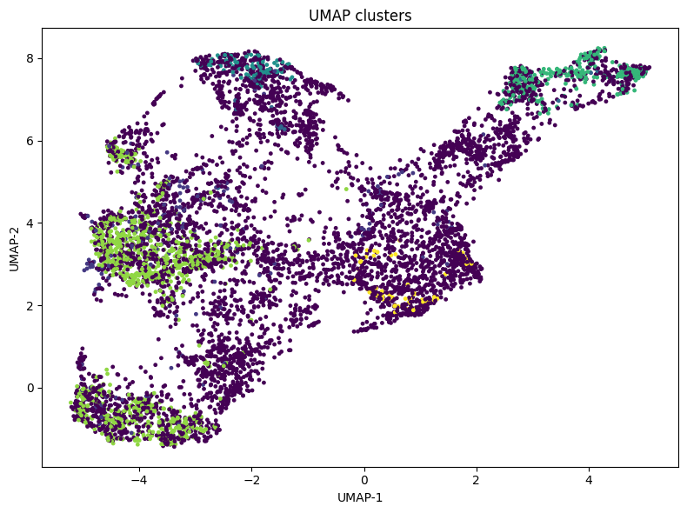
Model 2 — Clustering: UMAP Visualization
Key Insights
🏝️
UMAP reveals distinct 'islands' of meaning in review space
🔍
HDBSCAN identifies noise points — reviews that don't belong to any clear theme
🏷️
Each cluster mapped to a business-meaningful category
📝
Keywords extracted per cluster to validate theme interpretation
✅
Results verified with 1–2 example reviews per meta-category

Slide 9
Model 3 — GenAI Summarization → Recommendation Articles
What It Produces
recommendation_articles.md
Top Products
# Build Quality
What people like
(988 reviews)
tablet, great, kindle, price, love, easy
Setup / Usability
Top complaints (80 reviews)
tablet, amazon, kindle, use, apps
Example review
"This is a really great tablet me and my kids love it."
Compatibility
What people like (113 reviews)
tv, amazon, stick, love, great, streaming device
🏆
Best-rated items with key differentiators
⚠️
Top Complaints
Most common issues per product
🚫
Worst Product
What to avoid and why
📄
Deliverables
recommendation_articles.md + .json

Slide 10
Key Takeaways
1
Built an end-to-end NLP pipeline on 34.6K cleaned Amazon reviews — from raw text to actionable report.
2
Baseline TF-IDF + Logistic Regression achieves 87.96% accuracy — a strong benchmark for the majority class.
3
DistilBERT fine-tuning improves minority class handling (neutral/negative) and reduces false positives.
4
UMAP + HDBSCAN clustering surfaces recurring themes — no manual sentiment labeling; clusters interpreted into business-friendly meta-categories.
5
GenAI summarization converts those themes into a deliverable any business team can act on immediately.

Slide 11
Demo Plan — Live Walkthrough (2 Minutes)
📋
🔍
📄
Step 1
Step 2
Step 3
Input a Review
Explore Clusters
Generate Article
Paste any Amazon review text into the web interface and trigger sentiment analysis with confidence score.
Select a meta-category to view theme keywords and representative example reviews from that cluster.
Click 'Generate Article' to produce the final recommendation article — showing the full end-to-end pipeline live.
Minimum bar: a working webpage/app where sentiment, clusters, and articles are visible or interactive

Slide 12
🤖 RoboReviews
Thank You
Sentiment · Clustering · Recommendation Articles
Questions?

