Slide 1
RogueQD
McMaster Engineering Competition 2016
Ian Prins
Mikhail Andrenkov
Ori Almog
(Team 8)

Slide 2
What is RogueQD
RogueQD is a communications system for boats and buoys in the deep sea.
Employees the 3 - 3,000 Khz VLF/LF/MF radio band as a medium of communication.
Allows for distress signals to be sent by boats and propagated al about the system.
Simulates transmission error.
RogueQD – Rogue Query & Distress

Slide 3
Basics
Boats can talk to one another (Similar to how walkie-talkies work). Boats can listen on a frequency and broadcast to a frequency. This kind of communicatin is called jargon.
Boats can also send distress signals to buoys. This is done on the 500 Khz channel. See: Distress.
Buoys report weather statuses. Nearby boats that can hear the buoy make note of its calls.

Slide 4
Messaging
Messages are sent by boats and buoys.
Buoys have really good receivers, with high reception strengths. They’re built with purpose!
Boats have poor receivers – receivers are big and heavy, and boats tend to be very light.
Boats and buoys have similar transmitters. Transmitters are fairly lightweight, so boats can carry trasmitters that can send a distant signal.

Slide 5
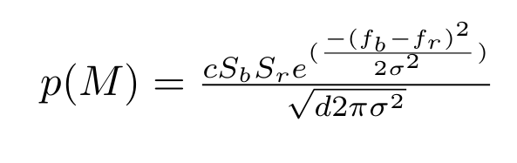
Message reception
Whether or not a message is successfully transmitted depends on:
- Sender transmission strength
- Receiver reception strength
- Distance between the two
- Frequency difference between the two

Slide 6
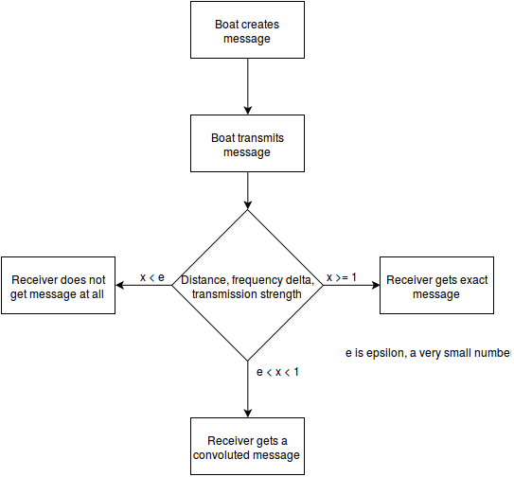
Message reception

Slide 7
GUI
The technology that was used for the GUI is Java Swing.
- Updates at 60 FPS (Frames per second)
- Vibrant colors
- Green squares: Buoys
- Blue circles: Boats
- Each has a visible ID
- Messages appear at the bottom

Slide 8
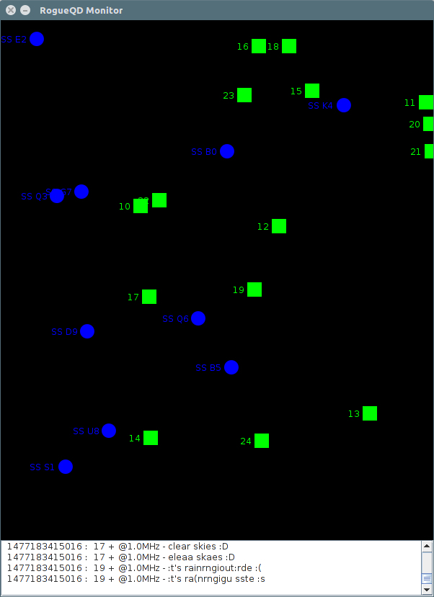

Slide 9
About us
Ian “GOTO >>” Prins
Mikhail “Heuristic” Andrenkov
Ori “XOR” Almog
FSP enthusiasts and third year Software Engineering students

Slide 10


