Slide 1

THERMAL ENGINEERING LAB
NAME:TARUN VERMA
REG NO:20183112
ME-B

Slide 2
Experiment 9 Heat transfer in lagged pipe apparatus
AIM:
To plot the radial temperature distribution and to determine the thermal conductivity of pipe insulation
THEORY:
Equations for the steady state radial heat conduction team inside to outside of a hollow
cylinder can be written as
Where
r= Inner radius hollow cylinder
r2= Outer radius of hollow cylinder
T1= Temperature of the inner surface (℃)
T2= Temperature of the outer surface (℃)
L = Length of the cylinder
k= Thermal conductivity of the cylinder material in W/m K.
Q=Heat flow rate in W
Q=2πkL(T1−T2)/ln(r2/r)

Slide 3
Apparatus
The apparatus consists of a metal cylinder inside which an electric heater coil wound uniformly on a silica cylinder is placed. The metal cylinder is insulated with pipe with thicker insulation so that the end losses will be negligible and heat flow is only radial. The radial temperature distributions within the insulation are measured by a number of Iron-constantan thermocouples placed at equal angular intervals at different ratio.

Slide 4
Experimental Setup
The apparatus consists of two concentric pipes inside a casing. The space between the inner and outer pipes is filled up with an insulating material whose thermal conductivity is to be determined. The heating coil is provided in the inner sphere. The power supply to the heating coil is adjusted by using dimmer stat, chromel-alumel thermocouples are used to measure the temperatures at various locations. Thermocouples 1-3 measure the temperature of the outer surface of the inner pipe, thermocouples 4-6 which are placed equidistant from the center measure the temperature of inner insulating material layer, thermocouples 7 -9 on the outer surface of outer pipe and thermocouple 10 - 12 which are placed equidistant from the center in the outer insulating material layer.

Slide 5
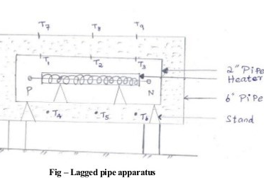
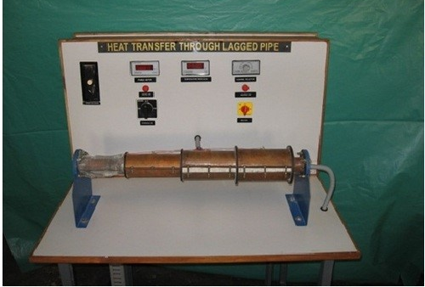
Diagram

Slide 6
Specifications
1. Inner radius of inner pipe:25 mm
2. Outer radius of inner pipe, R1: 28 mm
3. Inner radius of outer pipe : 50 mm
4. Outer radius of outer pipe, R3 : 53 mm
5. Radius at which thermocouples 4 - 6 are placed, R2: 37.5 mm
6. Radius at which thermocouples 10 - 12 are placed, R: 62.5 mm
7. Length of the specimen. L: 50 cm

Slide 7
Procedure
1.The heater is put on and the wattage is maintained at some desired value.
2. Readings of the thermocouples are taken at regular intervals until steady state is reached.
3. The steady state temperatures are then recorded.
The procedure is then repeated for different wattages to the input heater.

Slide 8
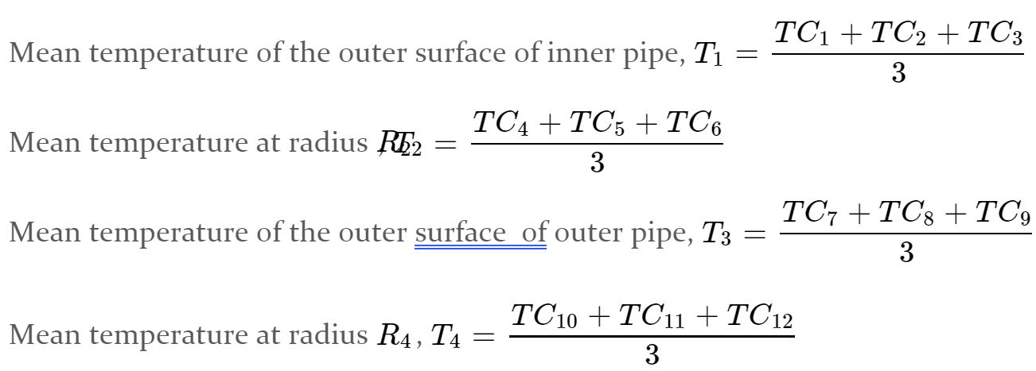
Formulae
Assuming the heater input to be equal to the heat flow rate through the lagging material , the local temperature ‘T’ is plotted against the local radius ‘R’. Choosing any two points preferably those well within the insulation ,the value of ‘k’ can be calculated using equation (1) and (2).

Slide 9
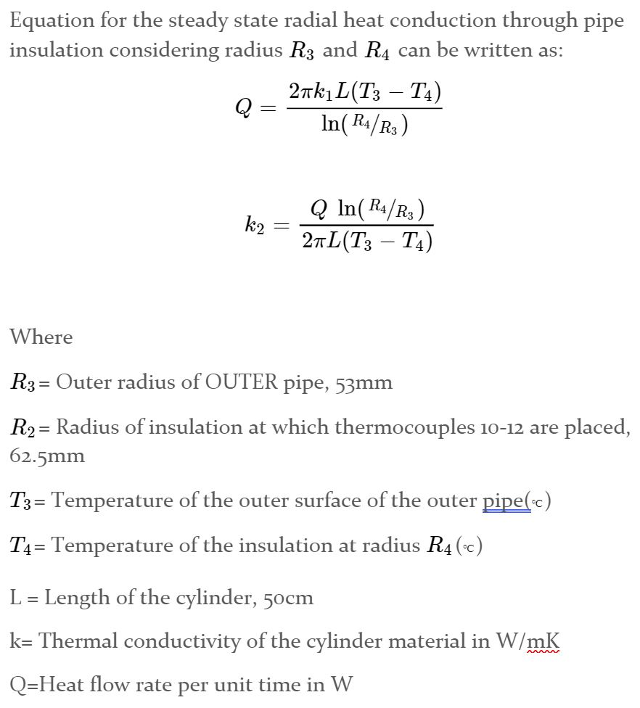
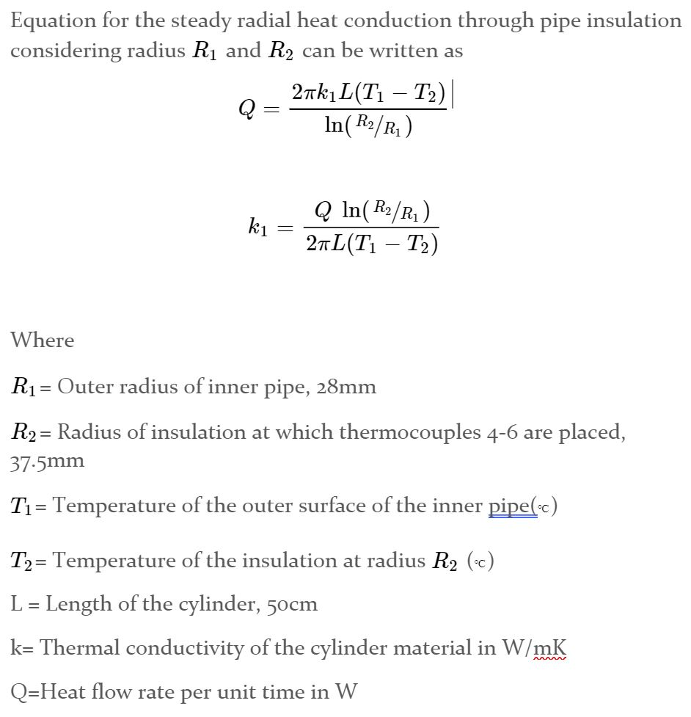

Slide 10
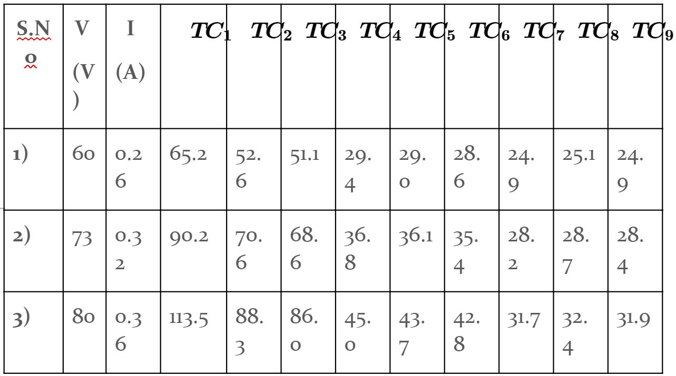
Observation Table
Here,
TCn is in ℃.
R1= 25mm
R2= 50mm
R3= 75mm

Slide 11
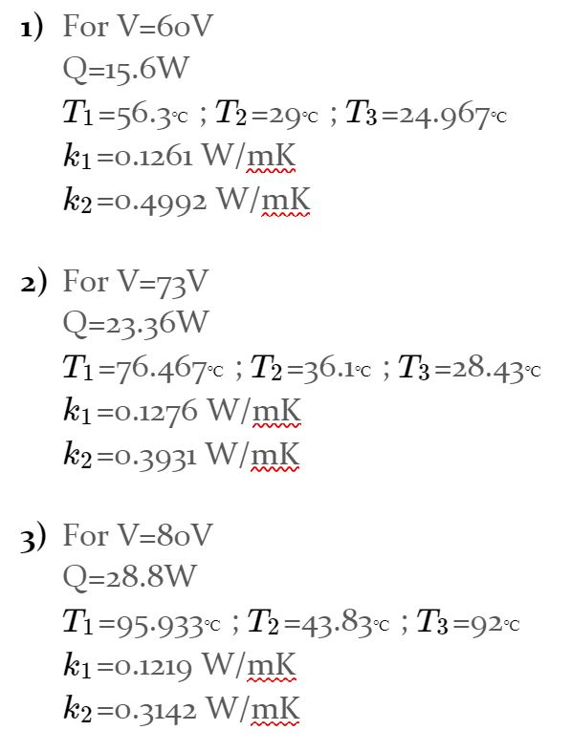
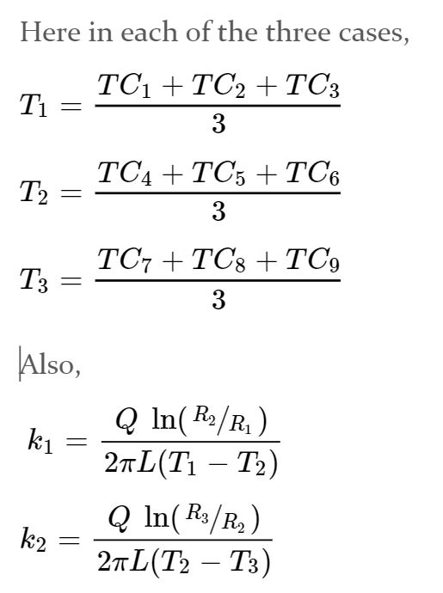
Calculations

Slide 12
Result
Thermal conductivity,
k1=0.1252W/mK and
k2=0.4021W/Mk

Slide 13

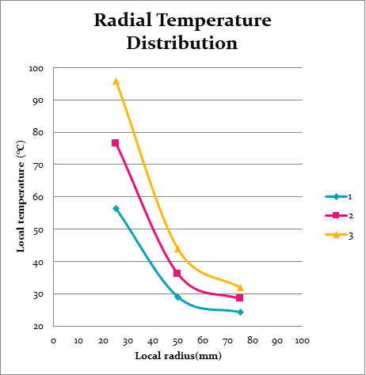
Graph

Slide 14
Precautions
Give adequate time to the apparatus to reach the steady state.
Take the readings only when temperature values become constant i.e, when steady state is reached.

