Slide 1
Presenter name | Date

Slide 2

Click the icon to add a picture, browse to select your file, note it will fit to shape height or width.
To reposition or resize within the frame, select image, go to Drawing Tools > Format, select Crop to position or enlarge.
Note: only one image should be used, do not overlap the title text.
[delete instructions before use]
Presenter name | Date

Slide 3
Globe images cannot be edited, more options will be provided.
[delete instructions before use]
Presenter name | Date

Slide 4
Your national science agency
5,500 dedicated people
Across the world including Australia,
Singapore, Vietnam, US and Chile
$4.5B+ a year
Value delivered to the Australian economy through our science and technology
57 sites
One of the world’s largest multidisciplinary
science and technology organisations
State-of-the-art national research infrastructure

Slide 5
Australia’s innovation catalyst
697
Patent families
$1B+
Total market capitalisation of portfolio companies
2,400 partners
Turning science into solutions with industry, government and research collaborators
497
Active licenses
170+
Start-up companies
from CSIRO science
and technology
150k school students
Delivering STEM education programs to equip Australia’s future workforce
Nurturing and enabling the
national innovation and commercialisation ecosystem

Slide 6
Solving the greatest challenges
Future industries
Health and wellbeing
A secure Australia and region
Food security and quality
Sustainable energy
and resources
Resilient and valuable environments
We are focusing on the issues that matter the most, for our quality of life, for the economy and for the environment.

Slide 7
Our research and development
Key areas of research
Animals and plants
Astronomy and space
Climate
Environment
Farming and food production
Health
Information technology
Mining and manufacturing
Renewables and energy
We are one of the largest and most diverse scientific research organisations in the world.
Our research focuses on providing solutions in nine core areas.

Slide 8
Template Information
Slides 1-3: title slide layout options (vertical theme)
Slides 4-7: facts about CSIRO slides you can use within your presentation
Slide 8-9: one column layout plus various bullet levels
Slide 10: two column layout plus 2 heading levels
Slide 11: approved colour palette
Slides 12-14: other layout options (there are more in each theme)
Slides 15-16: section divider slides
Slides 17-18: end slide that must be included in all presentations providing contact details
Slides 19-24: alternative layout (horizontal theme), includes partner logo title slide
Slides 25-35: accessibility information

Slide 9
One column layout
Second level
Text level one (24pt)
  Text level two (20pt)
    Text level three (20pt)
      Text level four (20pt)
        Text level five (18pt)
These font sizes are recommended, font must be Calibri
You can increase font sizes providing the hierarchy of information is maintained (ie. slide heading is largest, followed by Level 1, then Level 2 and so on)
Font size must be consistent across all slides
Do not use font sizes smaller than 16pt; if you do not have enough room to fit your text, spread your content over multiple slides

Slide 10
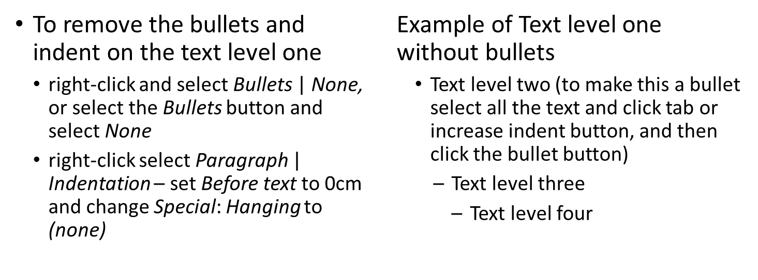
Two column layout

Slide 11
Approved colour palette
CORE
PRIMARY
Blueberry
R30 G34 B170
Plum
R109 G32 B119
Ocean Blue
R0 G75 B135
Teal
R0 G115 B119
Mint
R0 G122 B83
Midday Blue
R0 G169 B206
Midnight Blue
R0 G29 B52
SECONDARY
Steel
R117 G117 B121
Mist
R218 G219 B220
Fuschia
Orange
Gold
Lavender
Light
Teal
Forest
Light
Mint

Slide 12
Dark background option
To apply a different layout to slides
  right-click on the slide thumbnail, go to Layout and select the slide template you require, or
  under Home > Layout and select the slide template you require

Slide 13
Text and half image

Slide 14
Text and quarter image

Slide 15
Section 1:
  Level 2
    Level 3
    Section divider slide with 3 text levels

Slide 16
Section 1:
  Level 2
    Level 3
    Section divider slide with 3 text levels

Slide 17
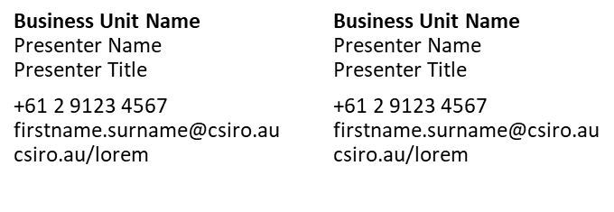
Thank you

Slide 18
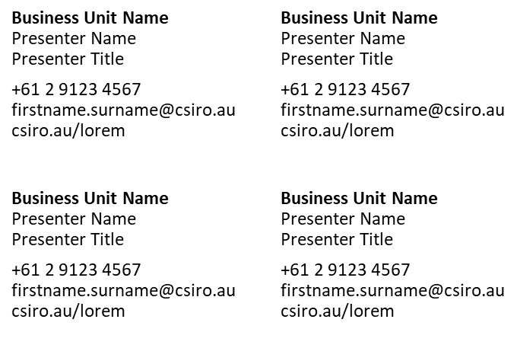
Thank you

Slide 19
Presenter name | Date

Slide 20
Click the icon to add a picture, browse to select your file, note it will fit to shape height or width.
To reposition or resize within the frame, select image, go to Drawing Tools > Format, select Crop to position or enlarge.
Note: only one image should be used, do not overlap the title text.
[delete instructions before use]
Presenter name | Date

Slide 21
Presenter name | Date
Space for collaborator logos
[delete instructions before use]

Slide 23
Section 1:
  Level 2
    Level 3
    Section divider slide with 3 text levels

Slide 24

Thank you

Slide 25
Accessible presentations
Follow theses techniques to meet WCAG 2.0 document accessibility guidelines:
  use built-in slide layouts and styling features
  set a logical tab order for ‘floating objects’
  avoid text boxes
  avoid blank lines (line spacing is included)
  use slide notes
  provide alternative text for images and graphical objects
  provide captions and text transcript for multimedia content
  use built-in structuring features (tables, lists, columns, document title)
  create accessible charts
  make content easier to see (e.g. text size, colours, transitions)
  make content easy to understand.

Slide 26
Accessible layout
use built-in slide layouts and styling features
Home > Slides > Layout and select slide
    set a logical tab order for ‘floating objects’. To display tab order click on Home > Drawing > Arrange > Selection Pane and reorder as required using the arrow buttons at the bottom
  tab order is usually from ‘lowest’ to ‘highest’ (e.g. title first in tab order)
  for simple layouts, insert objects in a logical tab order
  for complex layouts, create the slide and then set the tab order
    Home > Arrange > Selection Pane
    reorder as required
    example with the three boxes on this page’s arrange settings
1: High
2: Middle
3: Low

Slide 27
Accessible layout
avoid text boxes for main content
  do not insert text boxes on blank slides, use the text boxes contained in the built-in slide layouts
avoid blank lines
  to insert space between lines, use the Line Spacing Options and not blank lines (right-click select Paragraph > Spacing)
use slide notes to explain and expand on the slide content in text format

Slide 28
Accessible images and multimedia
add alternative text to images/graphical objects
  alternative text should include what information the image is trying to convey
  to add alt text:
    PPT 2013: right-click on your image, select Size and Position > Alt Text, enter a short description
    Office 365: select image, go to Drawing Tools > Format and select Alt Text, enter a short description or mark as decorative
provide captions and text transcript for multimedia content

Slide 29
Use built-in structuring features
tables should be clear and appropriately structured
  Use tables and not spaces or tabs (Insert > Tables)
  identify the column headers of tables
    PPT 2013/Office 365: select the table, select Design > Table Style Options, tick the ‘Header Row’ option
  avoid complex tables
    simple data tables (containing one row of headers and one column of headers) are preferred
    merged cells and nested tables should be avoided
    when possible separate complex tables into multiple simple tables

Slide 30
Use built-in structuring features
use lists: Home > Paragraph and select the Bullets or Numbering icon
only use the column feature if necessary, not recommended
add a Document Title, note this is different to the file name
  PPT 2013/Office 365: click File > Properties then enter the Title in the Title text box

Slide 31
Create accessible charts
Insert > Illustrations > Chart
use shape and colour to convey information
add titles and labels
apply a predefined chart layout and then alter if required
use different line types (dotted, dashed) for line charts and not just colour
use fill patterns for bar charts as well as colour

Slide 32
Make content easier to see
text should be no smaller than 16 pt for content and 12 pt for graphical objects
avoid use of slide transitions and text animations
  as these can be problematic for many users, best practice is to avoid slide transitions and text animations unless necessary to communicate information
use the approved colour palette (see slide 11) as these colours have sufficient contrast
do not use images of text

Slide 33
Make the content easy to understand
when possible write clear and short sentences
avoid making your presentation too cluttered
  use lots of white space
  stick to the slide template fonts and colours
provide context for hyperlinks
give each slide a title

Slide 34
Troubleshooting
The background image disappears when I print
  Make sure your presentation has not turned off the background
    Go to the Office button or File select PowerPoint options
    Under the Advanced tab ensure Print in background is checked
    If the background still disappears select all slides, go to Design menu – uncheck Hide Background Graphics

Slide 35
Troubleshooting
The file size of my presentation is very large
  If your presentation has multiple images the file size will be large. You can compress your images to help the final size
  Compress images by using the Picture toolbar
  Either change the resolution of your images (which can affect image quality so make sure to check your images if you select this option) or compress pictures which works with colour without affecting the quality of your image
  Deleting cropped areas of images will also reduce the file size

