Slide 1
Web App Project: JobHub
Aolei Zhou(aoleizho), Haoge Huang(haogeh), Mandi Liu(mandil)

Slide 2
Background
Purpose: Simplify the job search for IT professionals.
Current Landscape:
Applicants struggle to track and manage their numerous job applications.
Recruiters face challenges in timely and clear processing of a large pool of applicants.
Our Edge:
Unique Feature: Advanced Job Application Management.
Addressing gaps overlooked by competitors.
Vision: Become the go-to platform for genuine feedback on interview experiences across top IT companies.

Slide 3
Original Goal of Sprint1
Design Phase:
Craft the User Interface (UI).
Define functionalities and features.
Establish page layouts and logical transitions between pages.
Functionality Breakdown:
Categorize features for Applicants and Employers.
Determine visibility and edit permissions based on user roles.
Data Management:
Design the data model.
Illustrate SQL relationship diagrams.
Implementation:
Explore the template: pure.css (https://purecss.io/buttons/ )
Complete HTML and CSS files.

Slide 4
Preliminary Result
User Profile Page & Company Profile Page: Aolei Zhou
Account Type:
Applicant Account:
Create and edit User Profile
Apply for a position
Add reviews for company interview process
Company Account:
Create and edit Company Profile
Post/delete a job
Change application status for each applicant

Slide 5
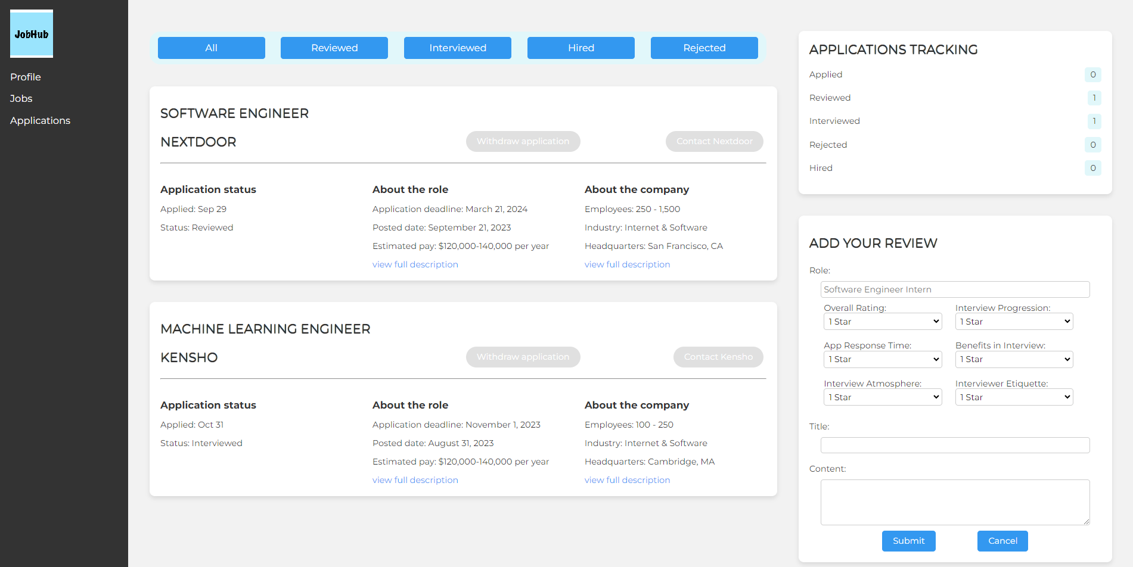
Preliminary Result — Application Management

Slide 6
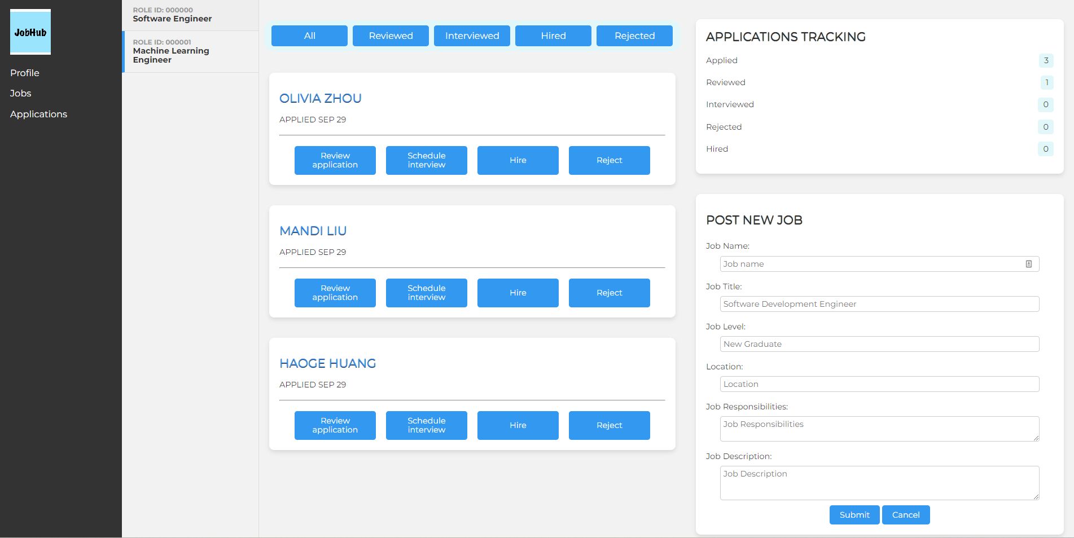
Preliminary Result — Application Management

Slide 7
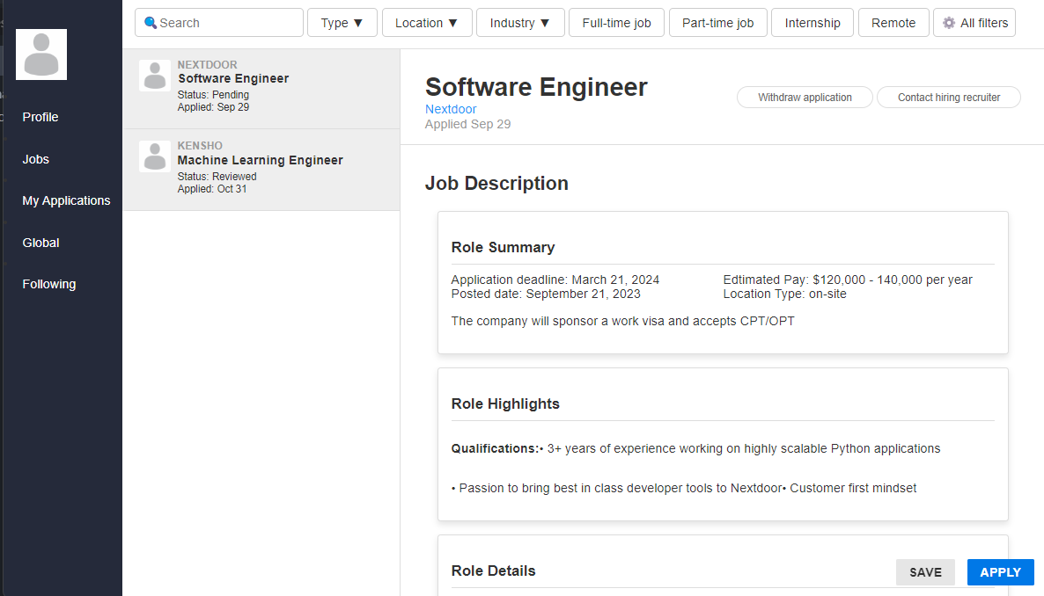
Preliminary Result - Job List

Slide 8
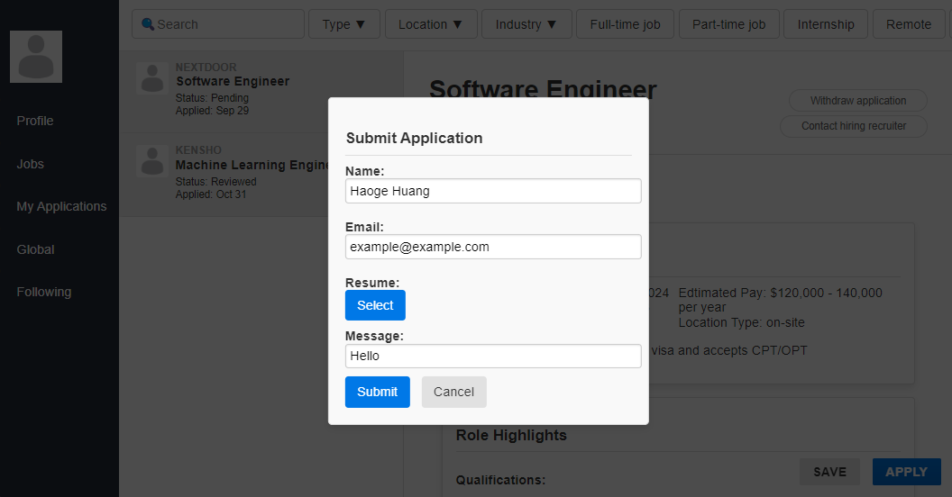
Preliminary Result - Job List

Slide 9
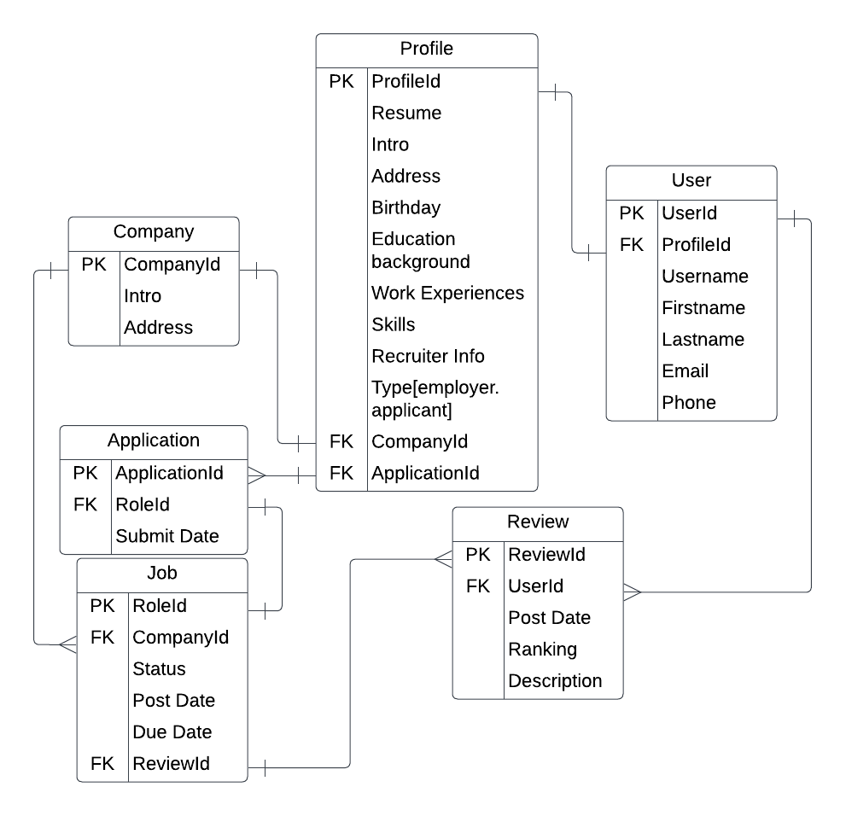
Preliminary Result - Database

Slide 10
Progress & Problems
Progress:
Database ERD
UI Framework - Pure CSS Template
Basic page interaction features
Problems
Schedule interview/Hire/Reject/Contact company: connect to the applicant’s email
Unify UI Template
Responsive CSS

Slide 11
Next Sprint Plan
Backend Development:
Implement models to handle user data and interactions.
Develop intuitive and user-friendly forms to facilitate user inputs and interactions.
Make sure all navigation links are functional, directing users to the correct pages.
Database Implementation:
Utilize sqlite.db to create a functional version of the application.
User Interface:
Optimize the user interface to bring a more coherent design across all pages.

