Slide 1



wu_enrollment_2020
View in Power BI
Last data refresh:
2/25/2022 8:04:10 PM UTC
Downloaded at:
2/25/2022 8:09:39 PM UTC

Slide 2
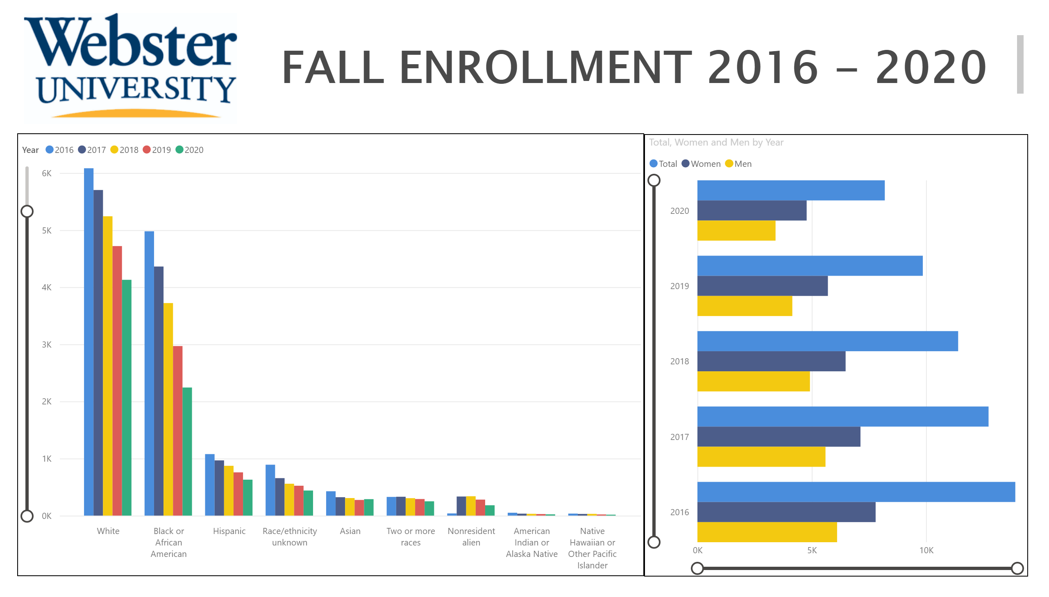
Itv1
Notes:
image
No alt text provided
textbox
No alt text provided
clusteredColumnChart
No alt text provided
clusteredBarChart
No alt text provided

Slide 3
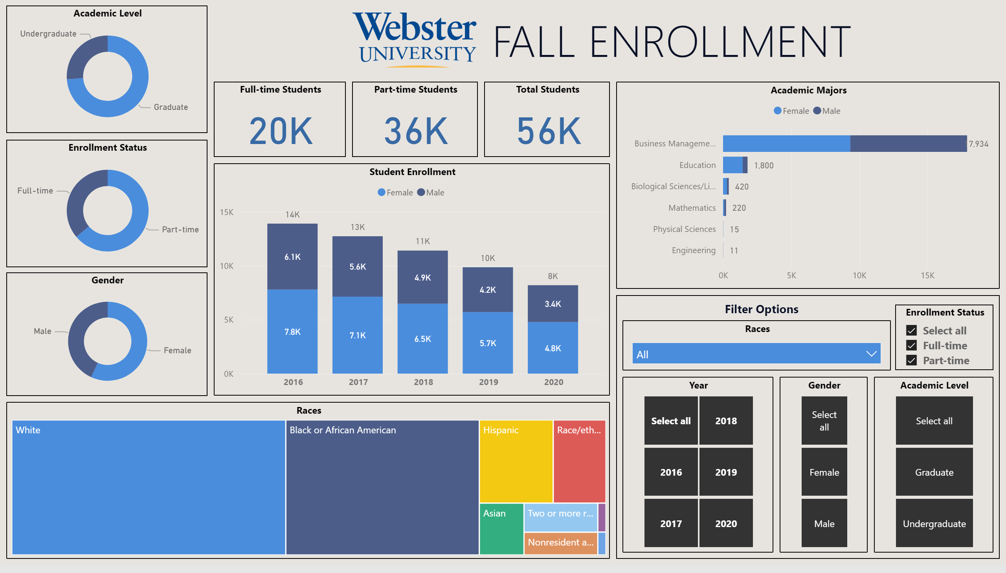
Overview
Notes:
image
No alt text provided
Races
No alt text provided
Races
No alt text provided
textbox
No alt text provided
shape
No alt text provided
textbox
No alt text provided
Year
No alt text provided
Gender
No alt text provided
Student Enrollment
No alt text provided
Full-time Students
No alt text provided
Gender
No alt text provided
Total Students
No alt text provided
Enrollment Status
No alt text provided
Academic Level
No alt text provided
Academic Level
No alt text provided
Academic Majors
No alt text provided
Part-time Students
No alt text provided
Enrollment Status
No alt text provided

Slide 4
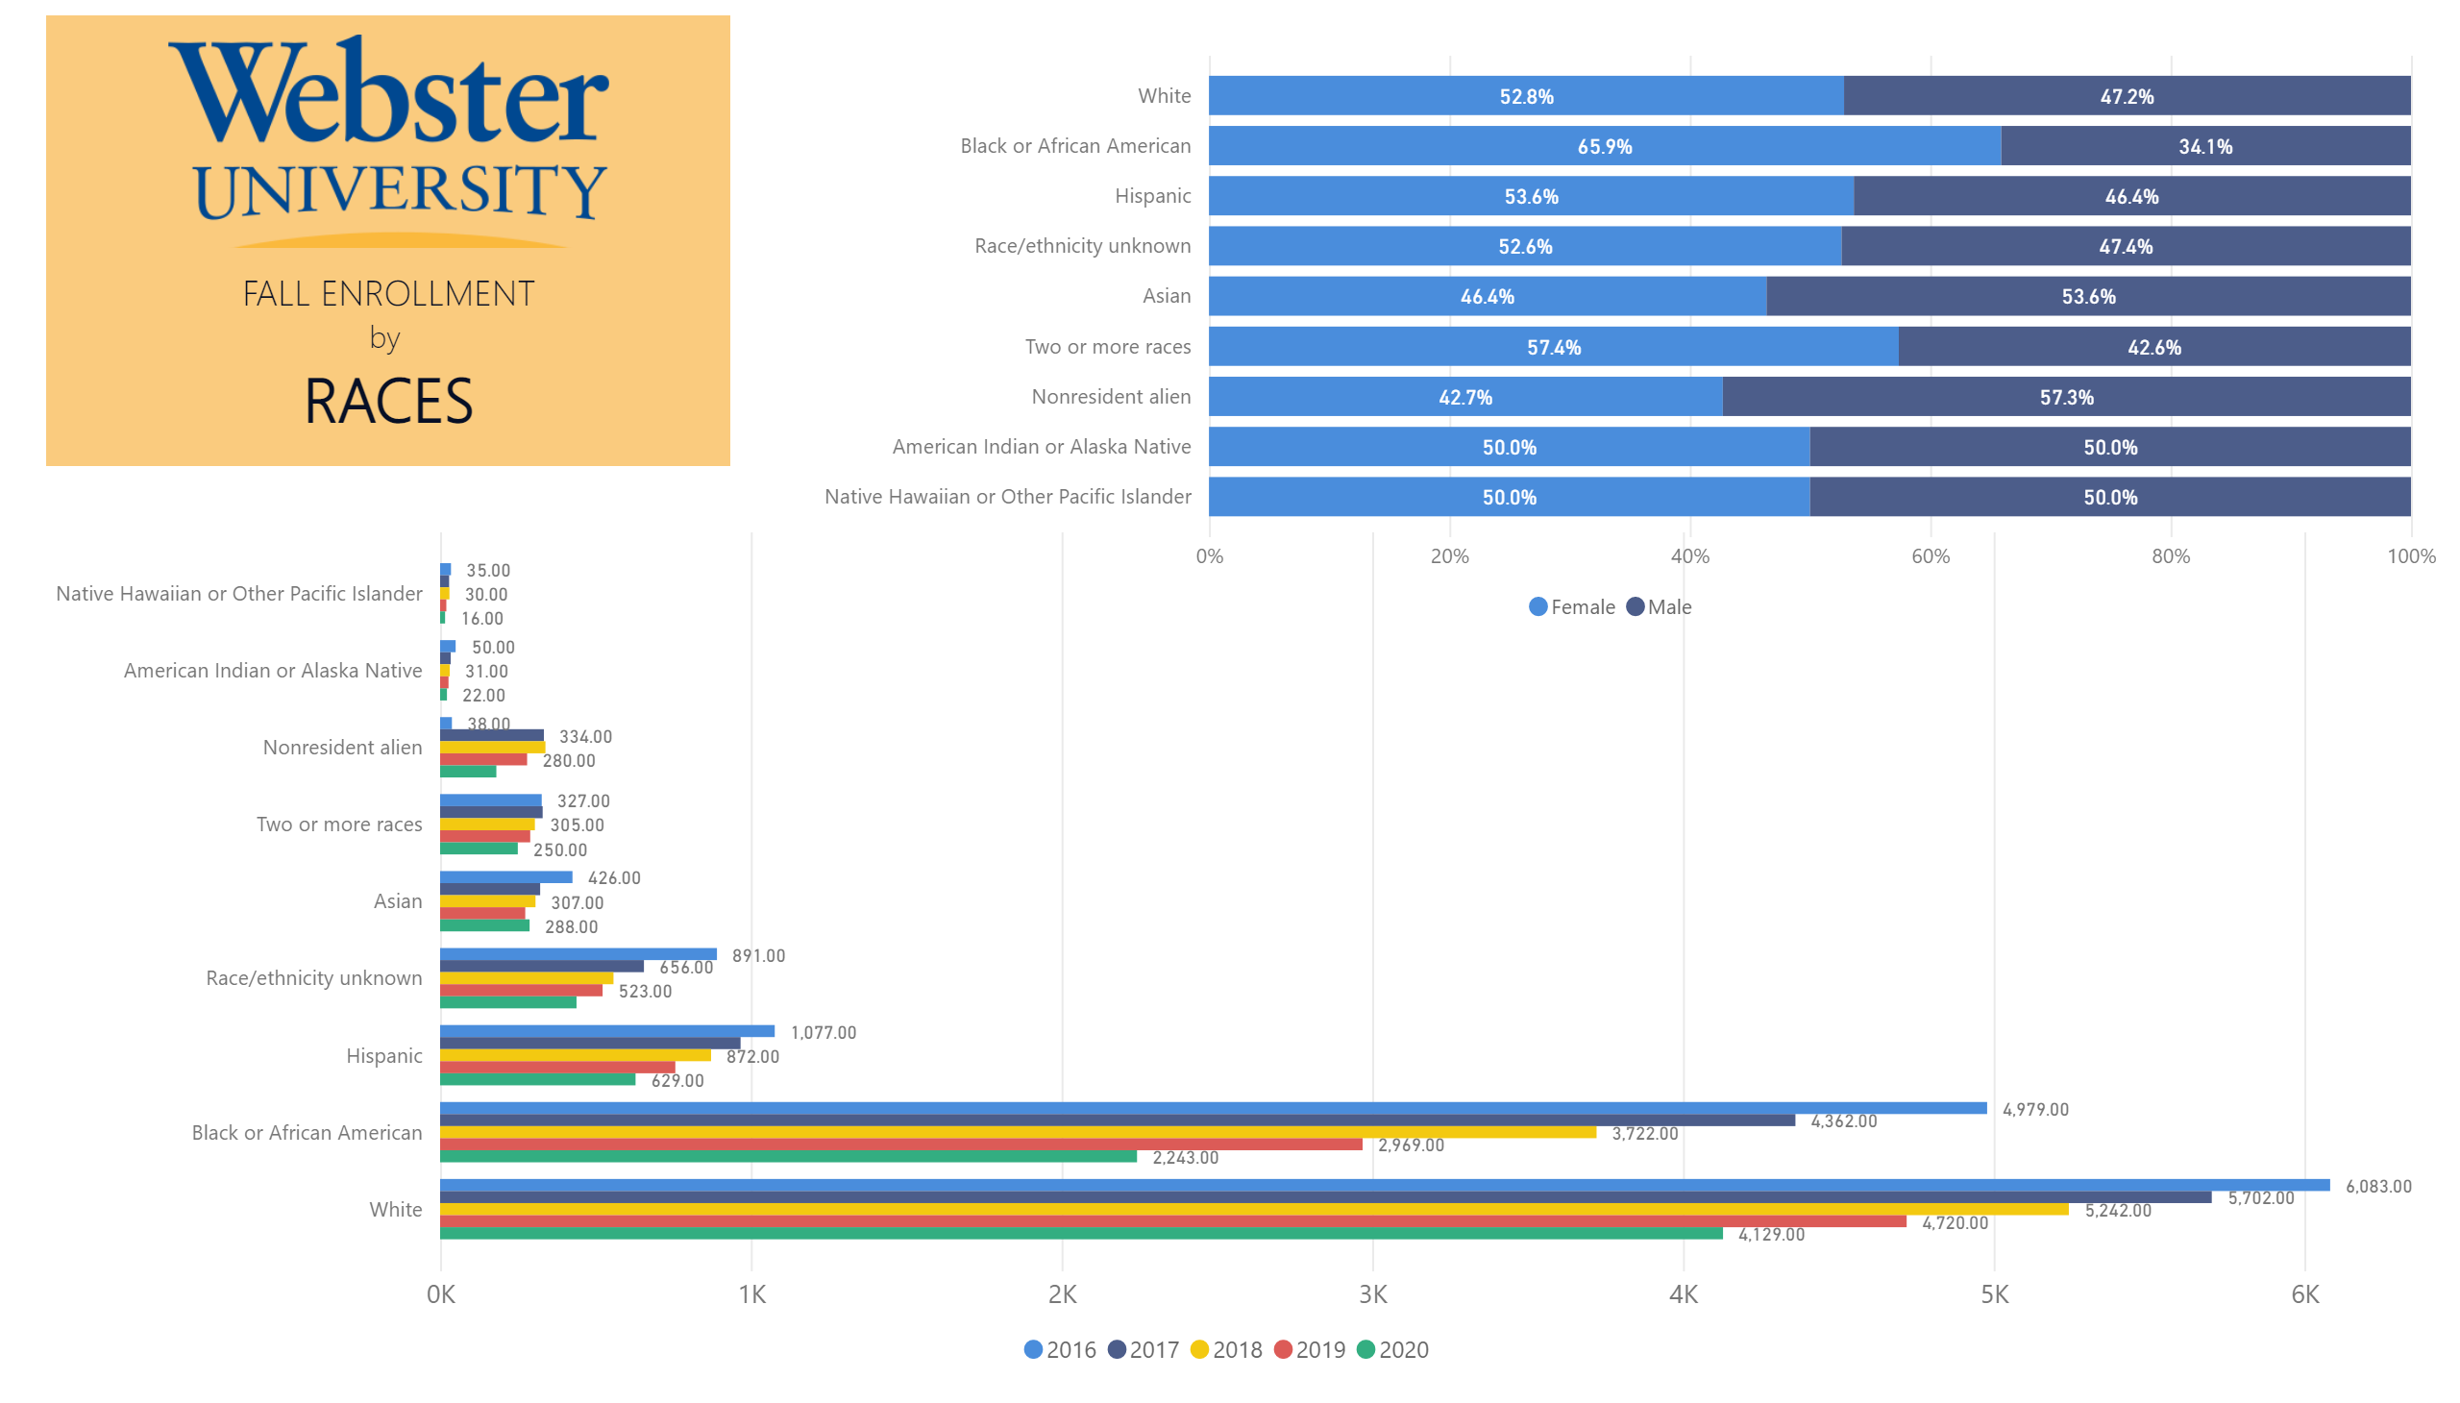
Race
Notes:
clusteredBarChart
No alt text provided
hundredPercentStackedBarChart
No alt text provided
image
No alt text provided
textbox
No alt text provided
shape
No alt text provided

Slide 5
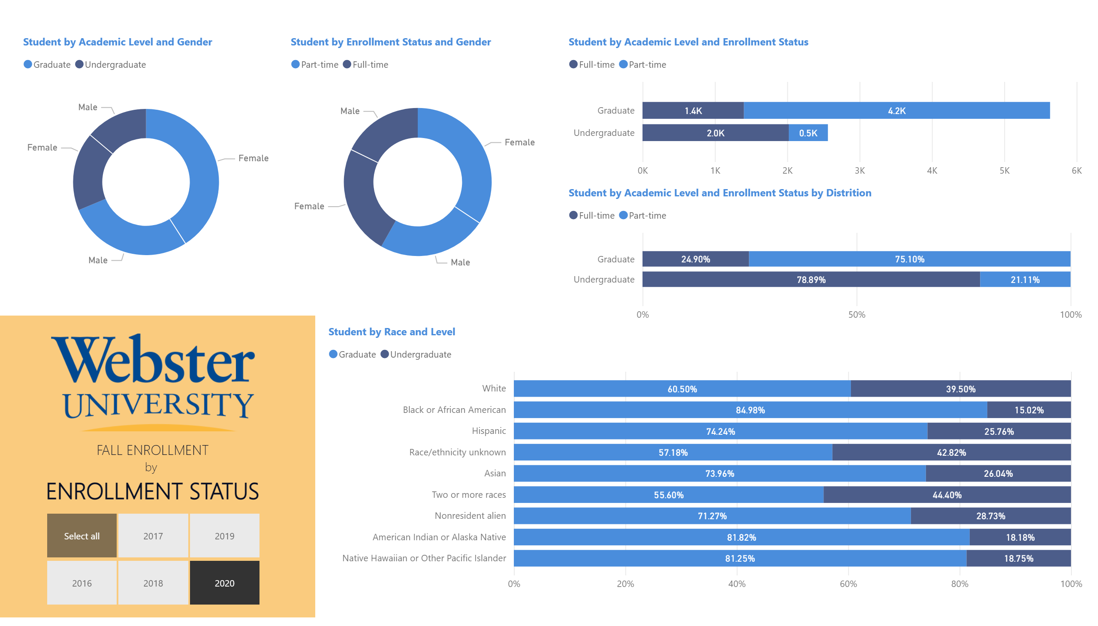
Status
Notes:
slicer
No alt text provided
Student by Academic Level and Enrollment Status
No alt text provided
Student by Academic Level and Enrollment Status by Distrition
No alt text provided
image
No alt text provided
textbox
No alt text provided
shape
No alt text provided
hundredPercentStackedBarChart
No alt text provided
Student by Enrollment Status and Gender
No alt text provided
Student by Academic Level and Gender
No alt text provided

Slide 6
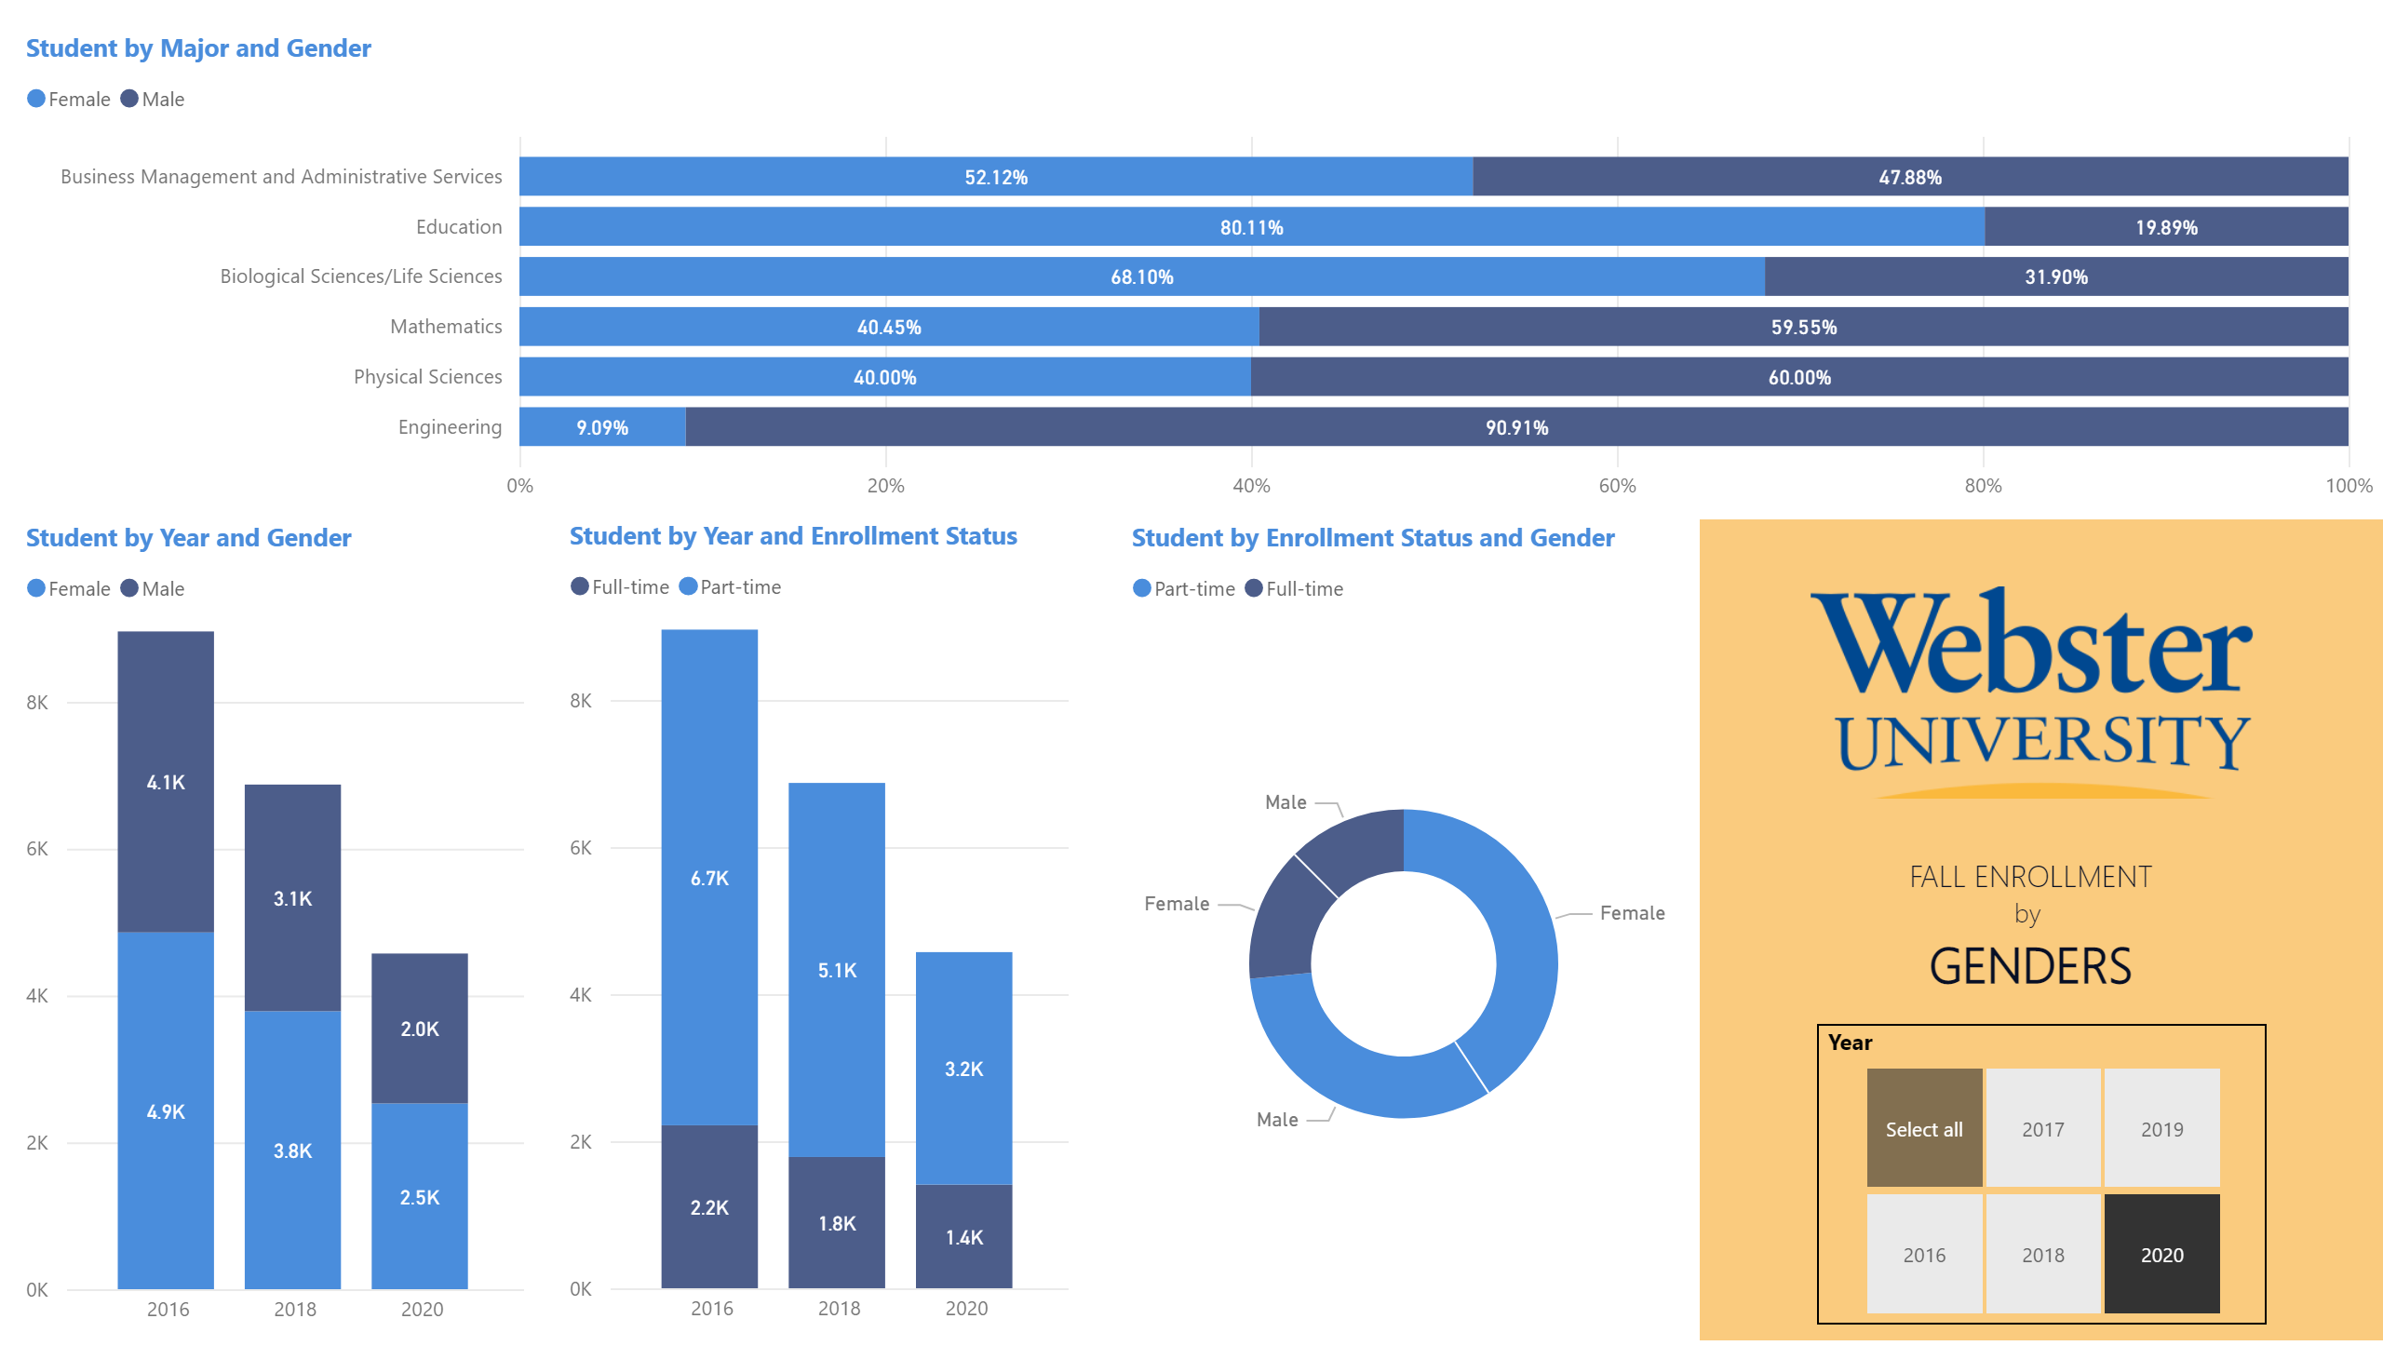
Major
Notes:
columnChart
No alt text provided
hundredPercentStackedBarChart
No alt text provided
Student by Enrollment Status and Gender
No alt text provided
Year
No alt text provided
image
No alt text provided
textbox
No alt text provided
shape
No alt text provided
Student by Year and Enrollment Status
No alt text provided

