Slide 1
TastyFake

Slide 2
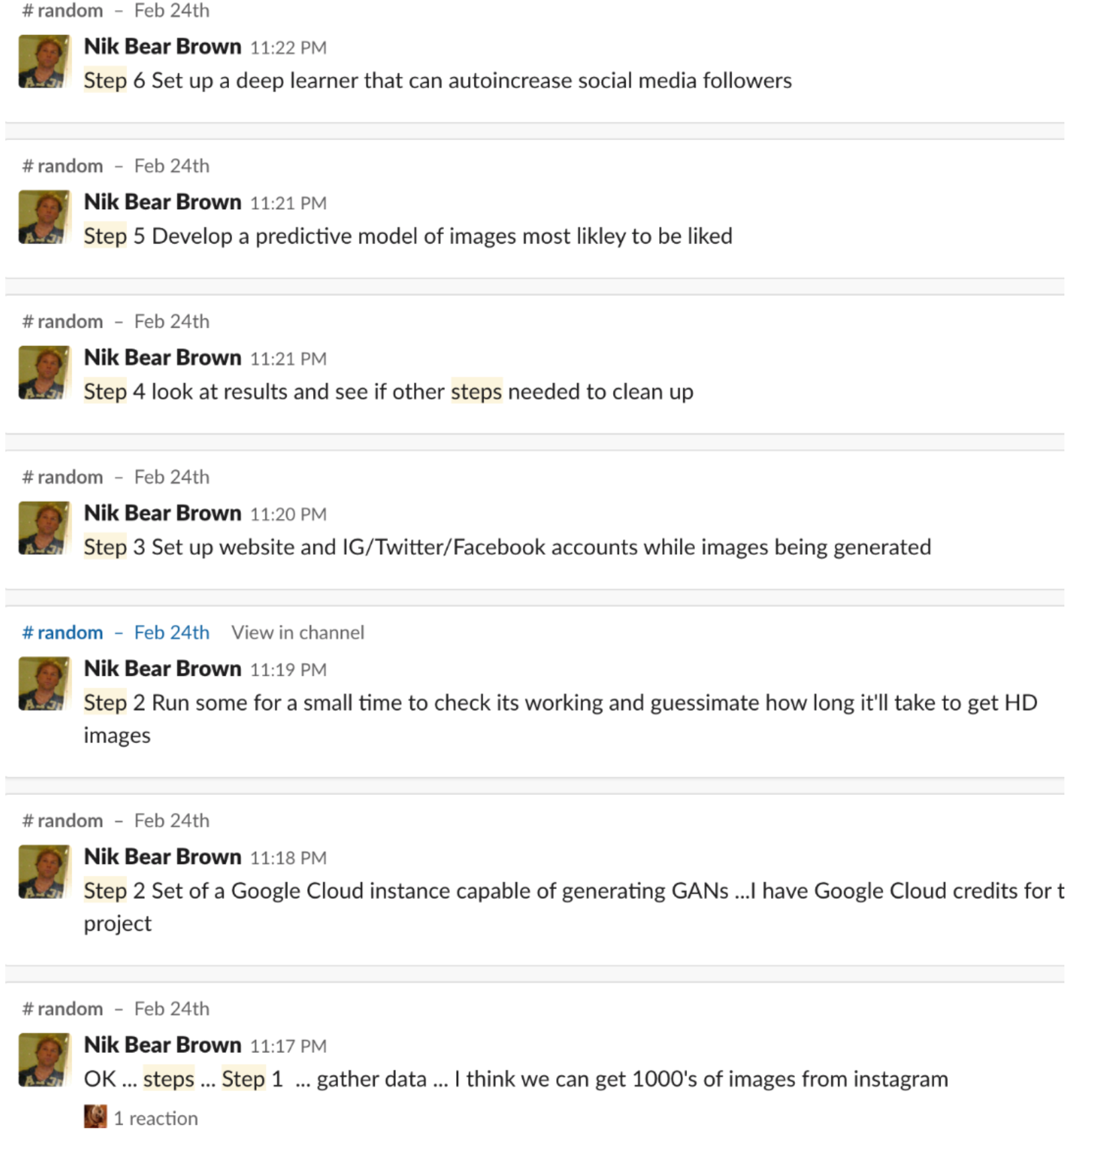
Steps

Slide 3
Plan/Idea
Step | Owner | Description
1.0 Collect data manually | Grace | Collect 200 images from IG: 30% American, 30%China Dish 20% France 10% India 10% Mexico
 | Ziwei
1.1 Try to collect images automatically

Slide 4
Question
Automatically collect images from IG
Collect image from IG dynamically?

