Slide 1

Predicting Flight Delays
and Cancellations
Group 11 - Mengying Wang

Slide 2
Background
When planning a trip, passengers should keep in mind that airlines do not guarantee their schedules, delayed and cancellation of flights always break our plans. Especially, airlines are cutting 20% to 50% of their domestic flight schedules by April 1, 2020, due to the coronavirus outbreak. So predicting the flight status before traveling is very necessary for passengers to plan a trip and prepare for the worst situation.

Slide 3
Data Preprocessing
01
02
03
Data Source
Data Cleaning
Data Format
From U.S. Department of Transportation's (DOT) Bureau of Transportation Statistics
3 .csv files
(airlines, airports and flights)
5819079 * 31
Drop columns with too much missing data
Drop useless columns
Date and Time
Add classify variables （Delayed）
Get dummy variables

Slide 4
Exploratory Data Analysis
Canceled Flights:
Total flights: 5819079,
Cancelled flights 89884,
% of cancelled flights: 1.54 %;
Delayed Flights:
On time: 72.82%,
Small delay: 19.48%,
Large delay: 7.70%.

Slide 5
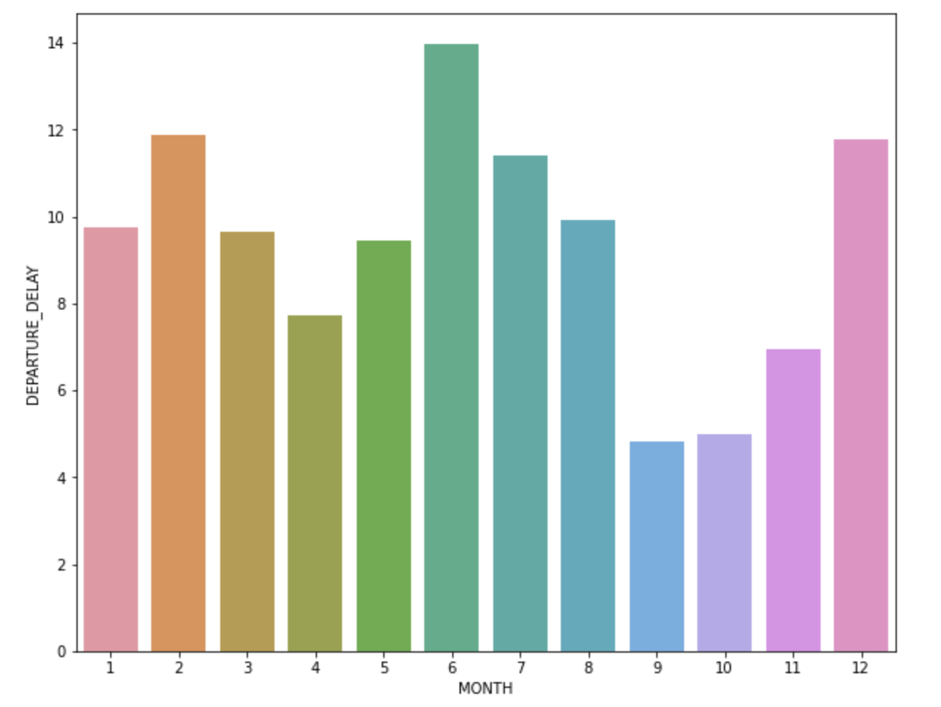
Exploratory Data Analysis
Delayed flights each month

Slide 6
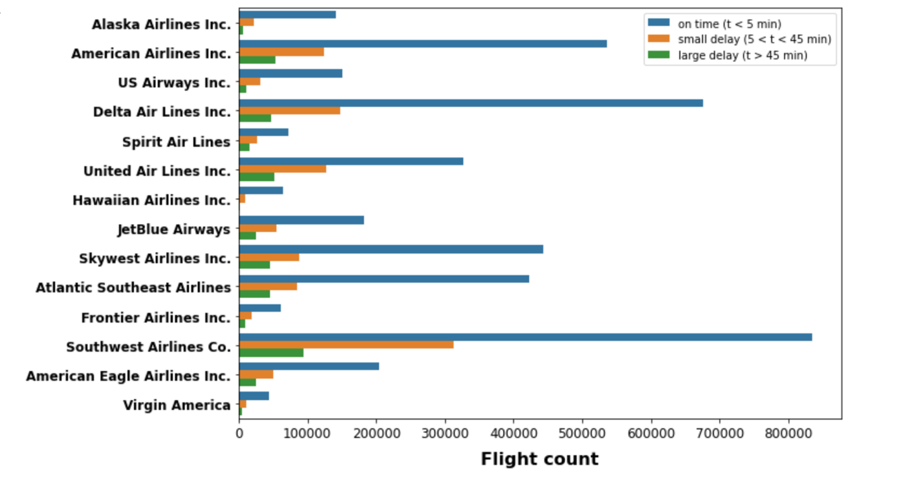
Exploratory Data Analysis
Relationship between delayed flights and airlines

Slide 7
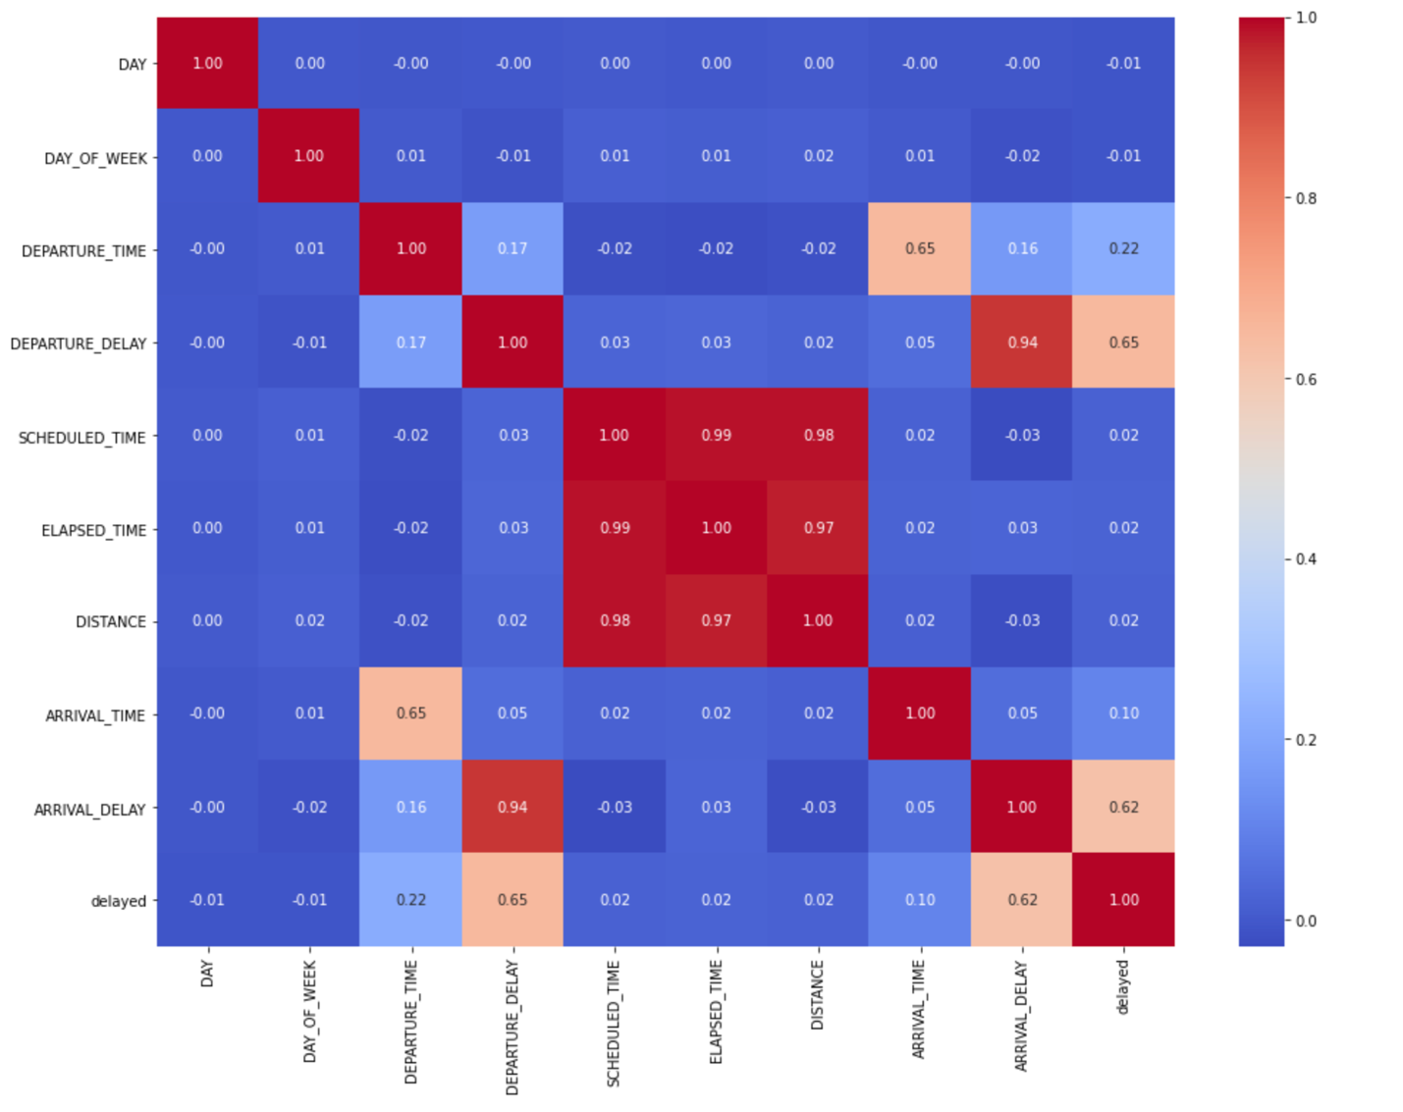
Exploratory Data Analysis
Heatmap for all columns

Slide 8
Exploratory Data Analysis
Training Dataset
Independent Variables: 'MONTH', 'DAY', 'DAY_OF_WEEK’,
'DEPARTURE_TIME’, 'AIRLINE', 'ORIGIN_AIRPORT’,
'DESTINATION_AIRPORT', 'DISTANCE’;
Dependent Variable: ‘delayed’;
All categories variables are transferred to dummy variables;
Output as train.csv.

Slide 9
Prediction & Conclusion
Logistic Regression
Random Forest
CatBoost
LightGBM

Slide 10
Prediction & Conclusion
 | Run Time | AUC
Logistic Regression | 5.612s | 0.658
Random Forest (1 CPU) | 12m24s | 0.7026835834131947
Random Forest (12 CPU) | 3m30s | 0.7014089947897176
CatBoost (no GPU) | 9m 13s | 0.7669619882652702
CatBoost (with GPU) | 22s | 0.7660014629988159
LightGBM (with GPU) | 21m 45s | 0.8585378889100973
Logistic Regression: H2O Frame, low performance
LightgGBM: Good performance, too much RAM used

Slide 11
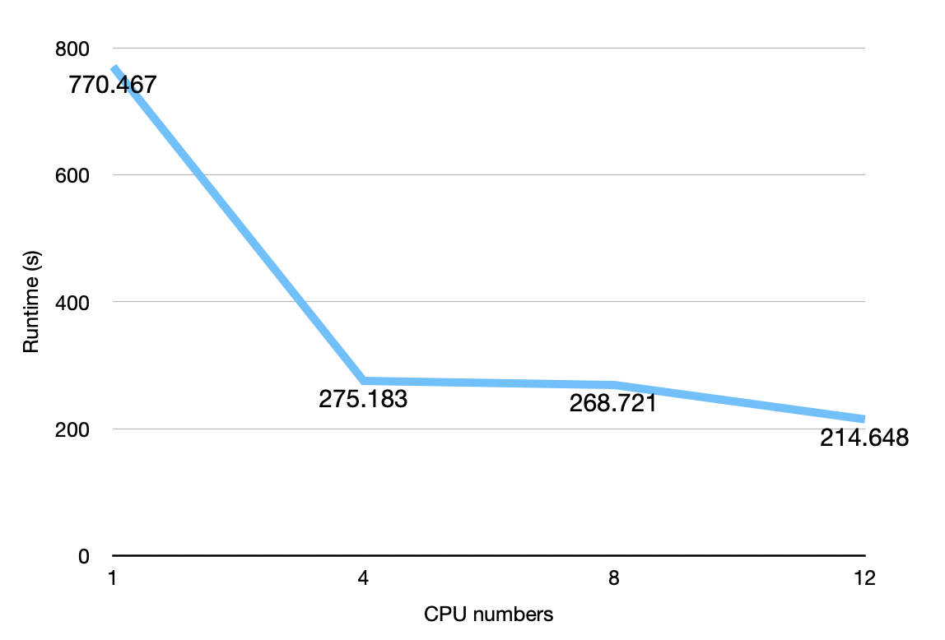
Prediction & Conclusion
Random Forest
n_estimators=100,
max_depth=10,
n_jobs = 1, 4, 8,12
Ran on Local Jupyter notebook
AUC: 0.701~0.704

Slide 12
Prediction & Conclusion
CatBoost:
random_state=17,
learning_rate=0.1,
max_depth=5
01
9m13s
Without
GPU
02
22s
With
GPU
Ran on Google CoLab Pro
GPU: Tesla P100
AUC: 0.7660~0.7669

Slide 13
Prediction & Conclusion
LightGBM:
Install LightGBM (GPU Version) on Google Colab,
Change and recompile cmake files,
Use GridSearch to find best parameters,
Built LightGBM classifier,
Training and get model performance.
Ran on Google CoLab Pro
GPU: Tesla P100
AUC: 0.86

Slide 14
Prediction & Conclusion
 | Run Time | AUC
Logistic Regression | 5.612s | 0.658
Random Forest (1 CPU) | 12m24s | 0.7026835834131947
Random Forest (12 CPU) | 3m30s | 0.7014089947897176
CatBoost (no GPU) | 9m 13s | 0.7669619882652702
CatBoost (with GPU) | 22s | 0.7660014629988159
LightGBM (with GPU) | 21m 45s | 0.8585378889100973
AUC: LightGBM > CatBoost > Random Forest > Logistic Regression,
According to the performance of Random Forest and CatBoost models, there is a very minor slight decrease on AUC after acceleration, it needs follow-up experiment to research on it,
These models will be more accurate if we have the data of weather or other events such as air traffic control.

Slide 15
Thank you!

