Slide 1
Road Accidents and Safety Analysis & Prediction
Qifeng Zhou, Mengying Wang
(team 11)

Slide 2
In this project, we use the dataset for Road Safety Data, analysis the relationship between different variables, train the data using Linear Regression and Decision Tree by Spark, and then get some useful information from the results.
Notes:
Our project use the dataset Road Safety Data, analysis the relationship between different variables, train the data using Linear Regression and Decision Tree by Spark, and then get some useful information from the results.

Slide 3
Data Processing & Code Optimization
1. Clean data
2. Create Dataset of each files
3. Union/Join tables to connect the data
4. Transform the Streaming data from other host
5. Update the previous dataset for the upcoming ML
6. Optimization
A."spark.storage.memoryFraction","0.6"
B. "spark.shuffle.file.buffer","64"
C. "spark.serializer", "org.apache.spark.serializer.KryoSerializer“
D. "spark.shuffle.sort.bypassMergeThreshold","300“
E. data persistence level

Slide 4
Data training
Package –
org.apache.spark.ml
Regression –
Linear Regression & Decision Tree
Improve –
Cross-Validation & Parametric Grid
Notes:
For the training part, I use spark.ml to do machine learning, I generate 3 models in our project, linear regression and decision tree, and an optimal linear regression improved by cross validation and perameter grid.

Slide 5
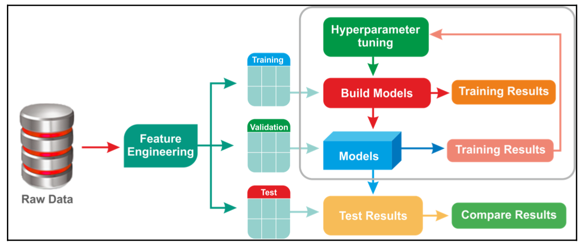
Data training
Notes:
This is the data processing for training, I divided the whole dateset to training and test for 9:1, and divide the training date in to training and cross validation，And then just as u see, the test one is using for test and compare results, the training data it is used for Building model, this one is used for crosss validated and Hyperparameter tuning

Slide 6
Conclusion
Complete import and analysis the data.
User can insert new data by streaming.
Training data using machine learning and make the lable feature Predictable.
Generate some plots by Python and reflect relationships between different variables.

Slide 7
Thank you!

