Slide 1
Road Accidents and Safety Analysis & Prediction
Qifeng Zhou, Mengying Wang
(team 11)

Slide 2
Data Processing & Code Optimization
1. Clean data
2. Create Dataset of each files
3. Union/Join tables to connect the data
4. Transform the Streaming data from other host
5. Update the previous dataset for the upcoming ML
6. Optimization
A."spark.storage.memoryFraction","0.6"
B. "spark.shuffle.file.buffer","64"
C. "spark.serializer", "org.apache.spark.serializer.KryoSerializer“
D. "spark.shuffle.sort.bypassMergeThreshold","300“
E. data persistence level

Slide 3
Data training
Package –
org.apache.spark.ml
Regression –
Linear Regression & Decision Tree
Improve –
Cross-Validation & Parametric Grid

Slide 4
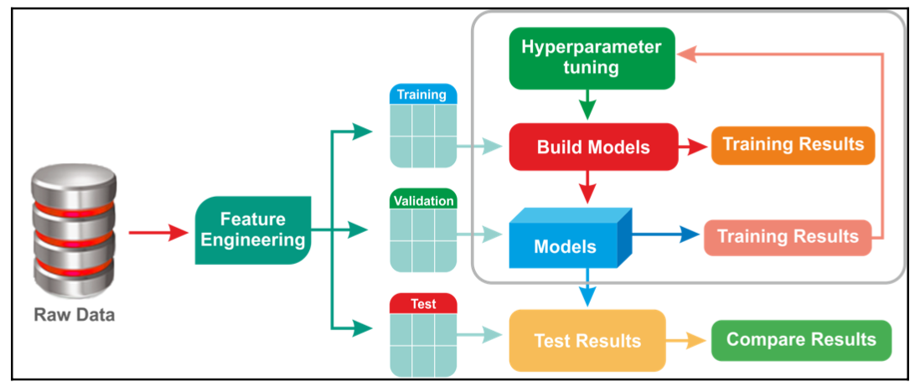
Data training

Slide 5
Conclusion
Complete import and analysis the data.
User can insert new data by streaming.
Training data using machine learning and make the lable feature Predictable.
Generate some plots by Python and reflect relationships between different variables.

Slide 6
Thank you!

