Slide 1
Dining Philosophers
By Dominic Cifrese, Patrick Courchene, and Mandy Redford

Slide 2
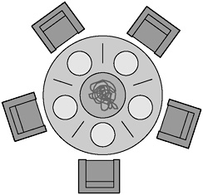
Problem Description
5 Philosophers are sitting around a table with a chopstick to their left and right.
A philosopher needs two chopsticks to eat.
A philosopher can either eat or think, and no one should starve.

Slide 3
Running The Code

Slide 4
How are program meets The requirements
This solves the Dining Philosophers problem by giving each Philosopher as fair a chance to eat and think as any other Philosopher.

Slide 5
Graph Of the number of times a philosopher eats

Slide 6
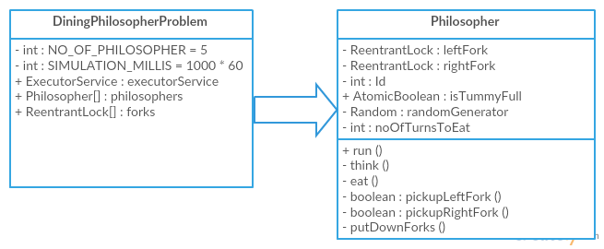
UML Diagram

Slide 7
Challenges Faced
Scheduling time together
GUI
Coming up with 1 cohesive idea

