Slide 1

Unix and IBM i
AIX and Linux run natively on Power Systems
IBM i can do Unix type things in two ways:
Posix/QShell
Ordinary *PGM code, but called via symbolic link from IFS
Unix (Posix) artefacts in /bin, etc.
QSH command from IBM i environment
Portable Application Solutions Environment, or PASE
AIX code running exactly as it would on AIX, though with limitations to maintain the integrity of IBM i and of its stored objects
Unix (AIX) artefacts in /QOpenSys/bin, etc.
CALL QP2TERM or CALL QP2SHELL
Can also be called direct from an ILE program, although interfacing is complex; PASE memory is not accessible from ILE except via specific IBM APIs, and relevant documentation is sparse
Used extensively by IBM i and its licensed programs
From V6R1 onwards, Java uses PASE
Used by third party products, e.g. Essbase, QAS
Free-of-charge IBM i Developer Tools, 5799-PTL, deliver several important PASE-based tools, specifically PERL, plus some Posix-based tools
IBM i database via CLI or JDBC – no special treatment
Creation of PASE programs on IBM i requires AIX C compiler installed
Open source gcc, or IBM supplied (chargeable). 5799-PTL requires the latter
N.B. All PASE and QShell processing, as always in Unix, is case sensitive

Slide 2
Interfacing ILE and PASE
IBM i job
Custom, Standardised Interface Mechanism written in ILE C
IBM-supplied ILE/PASE API (‘QP2’)
PASE in this Job (32-bit or 64-bit)
ASCII
ILE Program Code
EBCDIC
1. Start PASE in job
PASE Library
PASE variables
Exported function
2. Load required PASE library
IBM i variables
3. Find and 4. Call req’d library function
ILE-PASE data exchange (parameter passing, ASCII<->EBCDIC)
Argument list array and signature
Input integer values
Output parameters, via special QP2 PASE memory allocation that can also be accessed via ILE pointer
Data exchange buffer: input strings and output function result
5. Unload library, close PASE

Slide 3
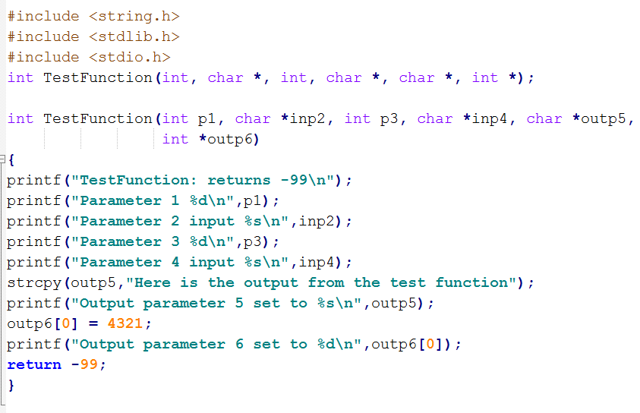
Simple (?) example – AIX C code, compiled on AIX & run in PASE
Example C source code: test.c
inp1 integer
inp2 string
inp3 integer
inp4 string
outp5 string
outp6 integer
function result is -99
Compile and bind to create C library: test.a
Now FTP test.a to IBM i IFS (use binary mode)
test.a is our PASE library, TestFunction is our exported function

Slide 4

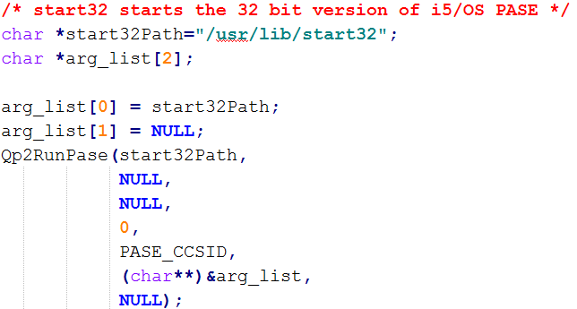
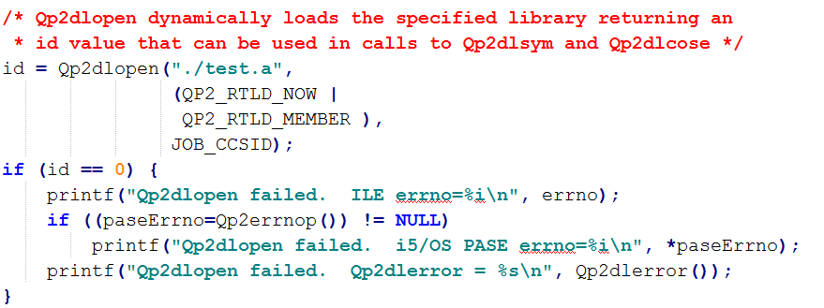
ILE C code to call TestFunction: Steps 1 and 2
1. Start PASE in job
2. Load required PASE library
example assumes test.a is in the current IFS directory (CHGCURDIR)
note (basic) exception handling: ‘QP2’ exceptions, PASE exceptions

Slide 5

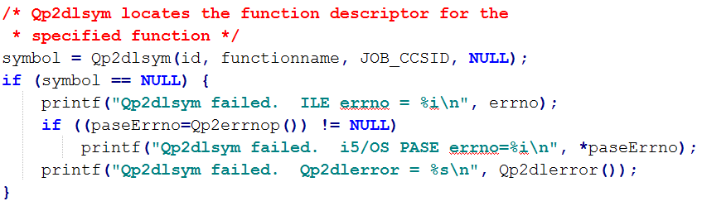
ILE C code to call TestFunction: Step 3, and notes on Step 4
3. Find required PASE function
Note exception handling as step 2
Now the fun starts: Step 4. We need to:
A. Set up our QP2 argument list and signature, and our QP2 data buffer
B. Translate input strings (inp2, inp4) to ASCII
C. Get all our input parameters into the QP2 argument list and QP2 data buffer
D. Allocate PASE memory for output parameters
E. Get all our output parameter pointers into the QP2 argument list
F. Call TestFunction (at last!)
G. Get function result
H. Get output parameters (outp5, outp6)
I. Translate output strings (outp5) to EBCDIC

Slide 6
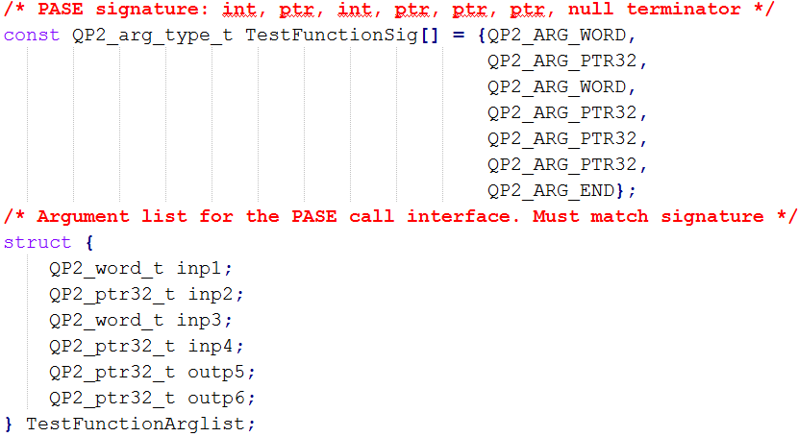
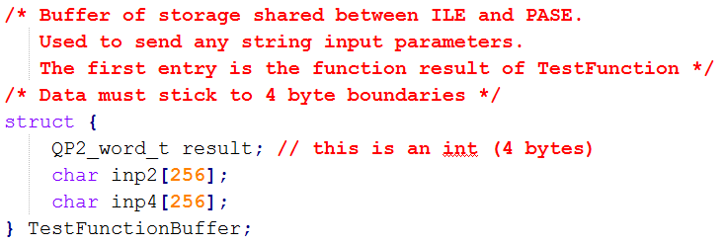
ILE C code to call TestFunction: Step 4: Call function: A
4.A. Set up our QP2 argument list and signature, and our QP2 data buffer
inp1 integer (QP2 ‘word’, 32 bits = 4 bytes long)
inp2 string (pointer will be set to location of string in data buffer)
inp3 integer (QP2 word)
inp4 string (pointer will be set to location of string in data buffer)
outp5 string (pointer, see later)
outp6 integer (pointer, see later)
Note the null terminator (QP2_ARG_END) on the signature

Slide 7

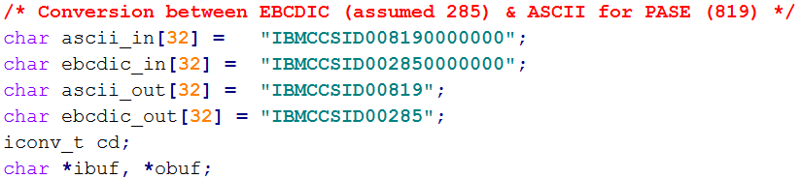
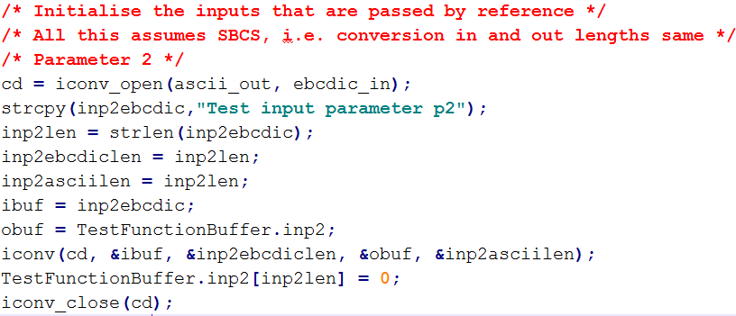
ILE C code to call TestFunction: Step 4: Call function: B
4.B. Translate input strings (inp2, inp4) to ASCII
Only inp2 shown, to save space; inp4 handled identically
Note that we are assuming iconv is successful – could reasonably add relevant exception handling here
Puts ASCII version straight into QP2 data buffer, adding the necessary C string null terminator

Slide 8

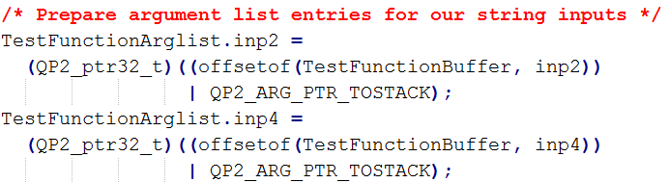
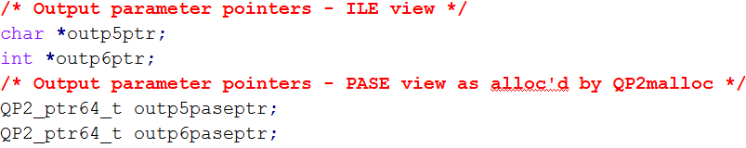
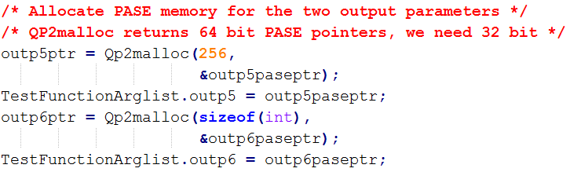
ILE C code to call TestFunction: Step 4: Call function: C, D, E
C. Get all our input parameters into the QP2 argument list and QP2 data buffer
Put inp1 and inp3 into QP2 argument list. We’ve already put inp2 & inp4 in the data buffer, just need to set their correct pointer values in the QP2 argument list
D. Allocate PASE memory for output parameters
TestFunction needs to see PASE 32 bit pointers for the two output parameters;
ILE C needs to see the same memory locations via ordinary IBM i pointers;
Qp2malloc does this magic
E. Get all our output parameter pointers into the QP2 argument list
Note that Qp2malloc returns a 64-bit PASE pointer; the ones in the QP2 argument list are 32-bit
Have not tried 64-bit PASE
This lot is what made me decide I wanted to do this in ILE C (where there was a decent, if 64-bit PASE, example in the IBM documentation) not in ILE RPG

Slide 9
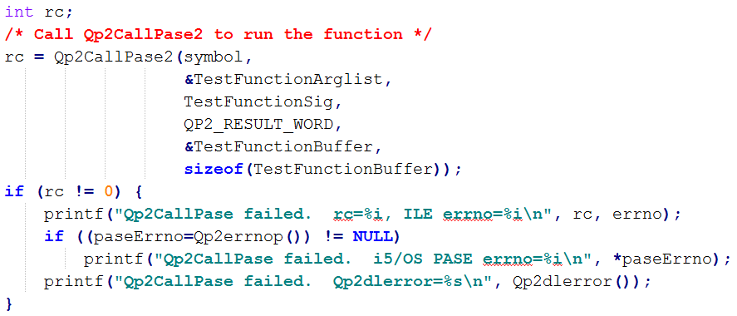
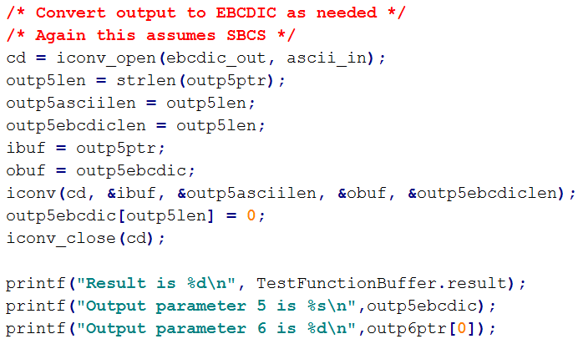
ILE C code to call TestFunction: Step 4: Call function: F, G, H, I
F. Call TestFunction (at last!)
QP2/PASE exception handling as step 2
The QP2_RESULT_WORD indicates that there will be a 32-bit integer function result from TestFunction
G. Get function result
Returned in the QP2 data buffer as mentioned previously
H. Get output parameters (outp5, outp6)
Note the use of the ILE versions of the Qp2malloc-generated pointers
I. Translate output strings (actually only one, outp5) to EBCDIC

Slide 10
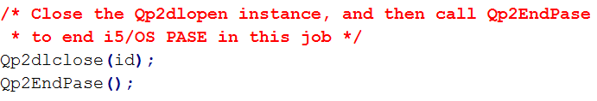
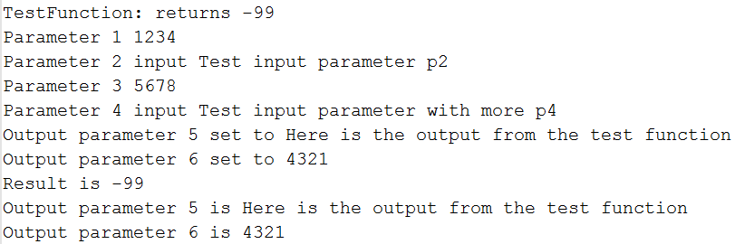
ILE C code to call TestFunction: Step 5, Output, Notes
5. Unload library, close PASE
Output (to job standard output, stdout):
First 7 lines come from PASE
Last 3 lines come from ILE
Notes:
Code embedded: test.c (PASE) and QCLESRC. CALLPASE (ILE). Note that the ILE code differs slightly from the examples above, which have been tidied up for clarity.
Compilation option needed for ILE C code: CRTBNDC TERASPACE(*YES *TSIFC)

