Slide 1
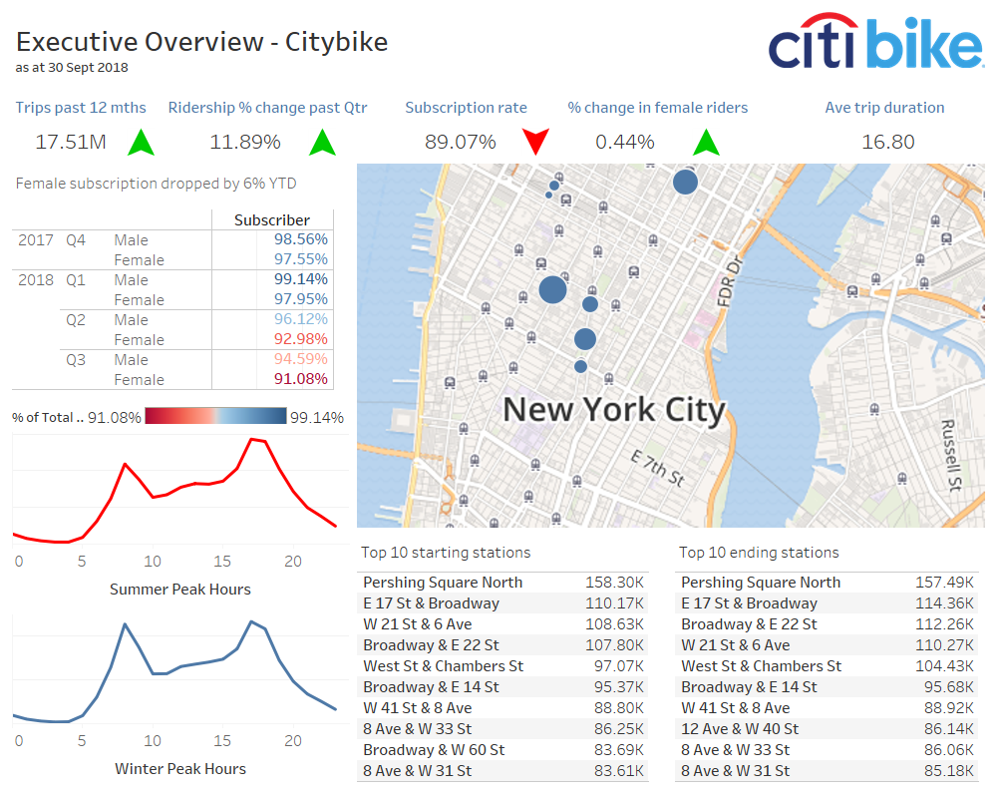
Report Notes:
Female riders increased by 0.44% the past year however annual subscription dropped 6%
Total ridership increased by 11.89% the past quarter however the ridership decreased by 0.01% from a year ago.
Quarterly increase in ridership is seasonal

Slide 2
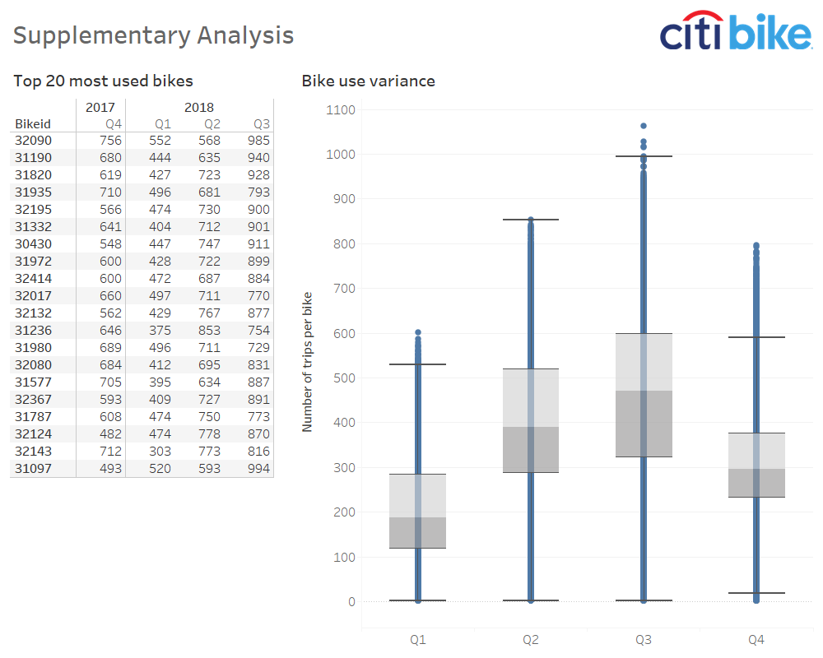
Report Notes:
Bike usage is seasonal
Median bike use per quarter is 188 (Q1), 390 (Q2), 471 (Q3) and 296 (Q4)

Slide 3
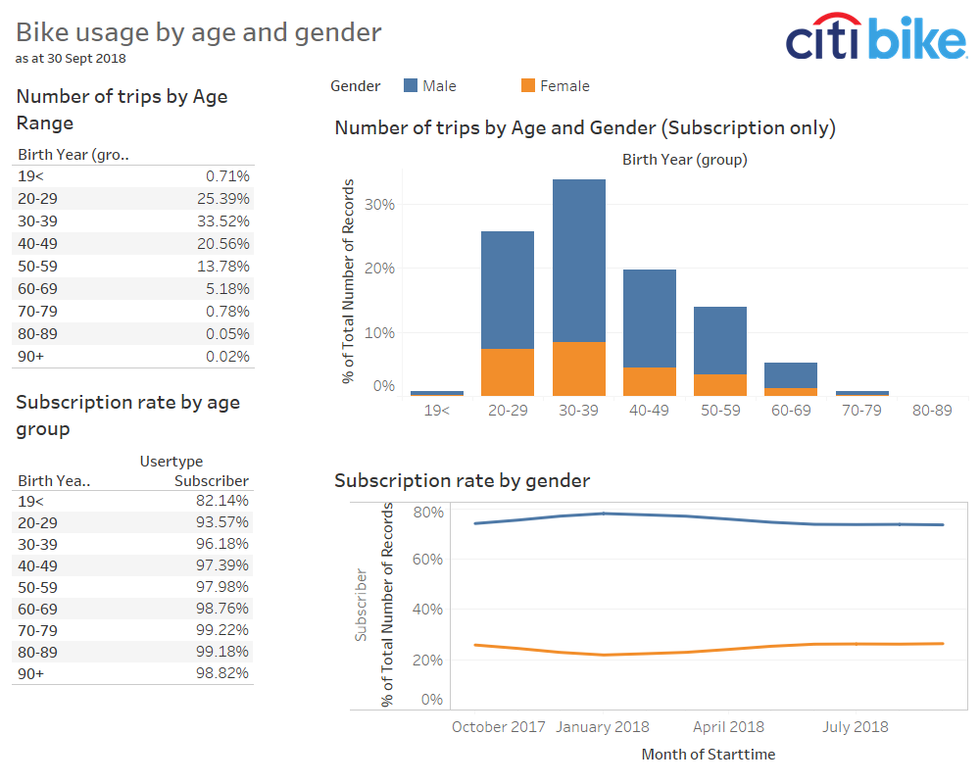

Slide 4
